Slide 1
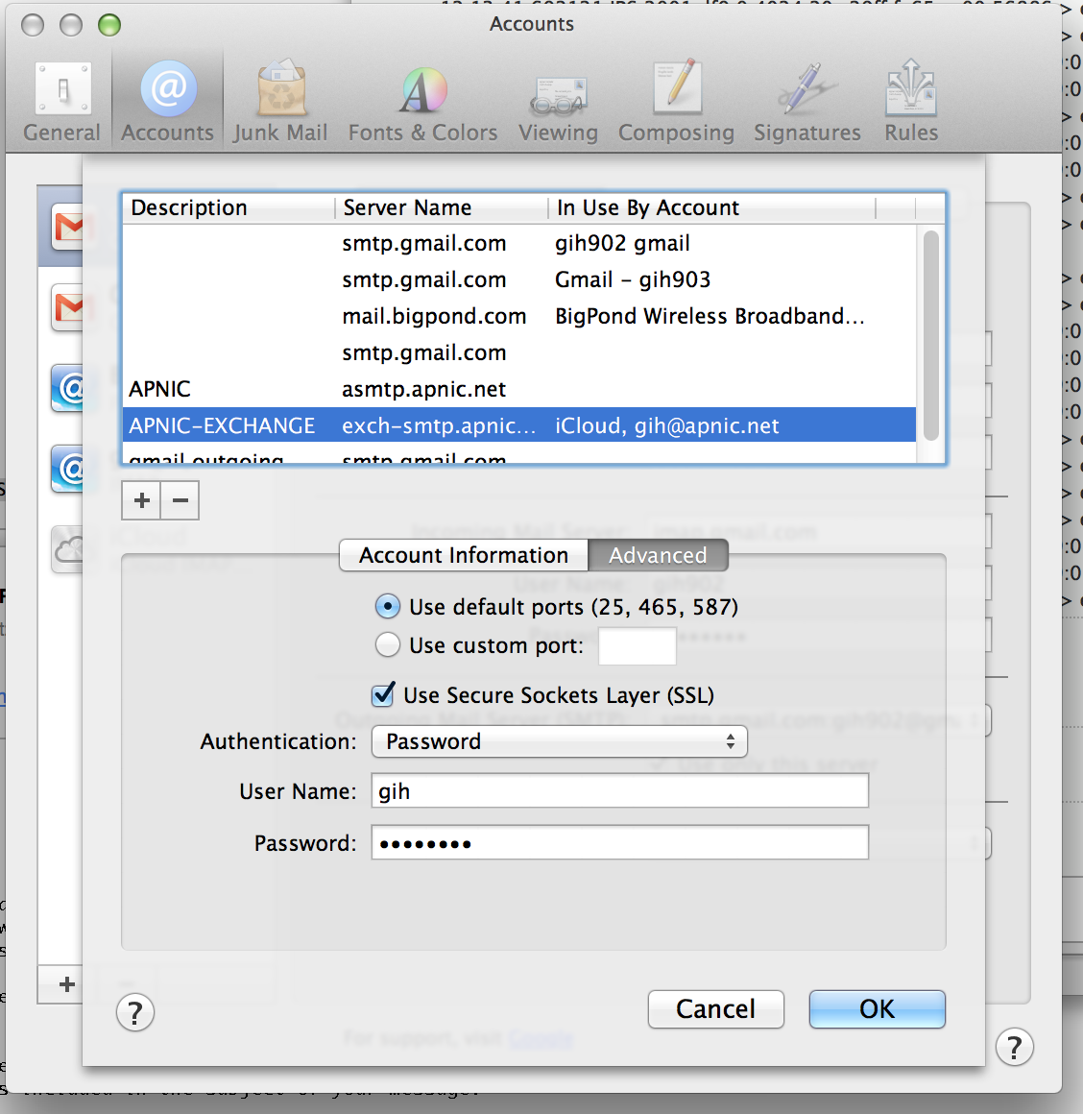

Slide 2
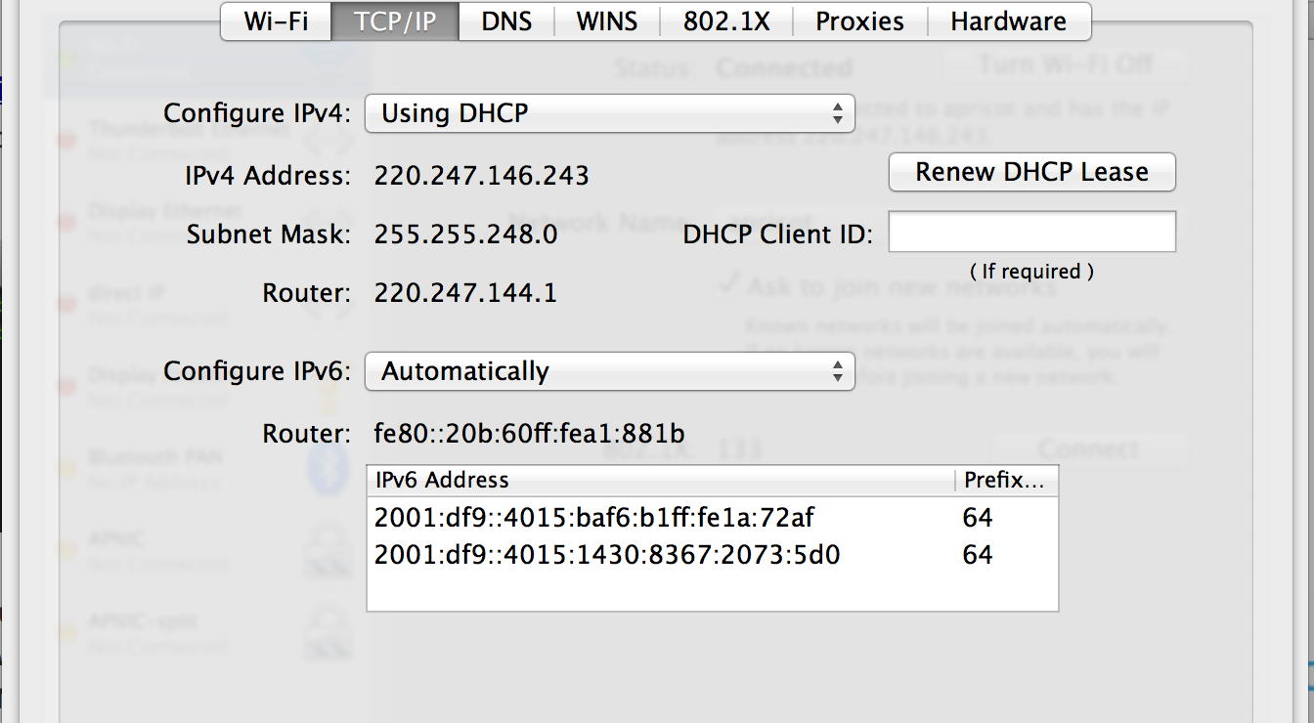

Slide 3
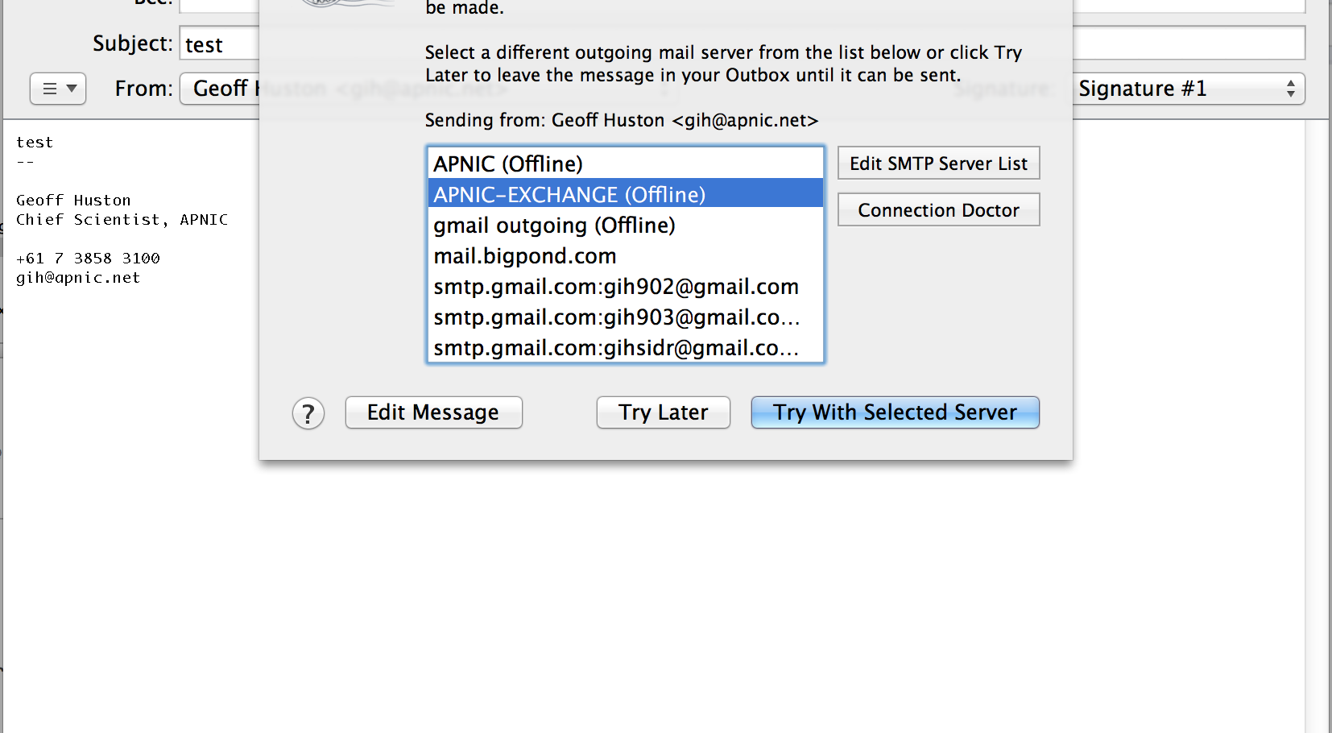

Slide 4
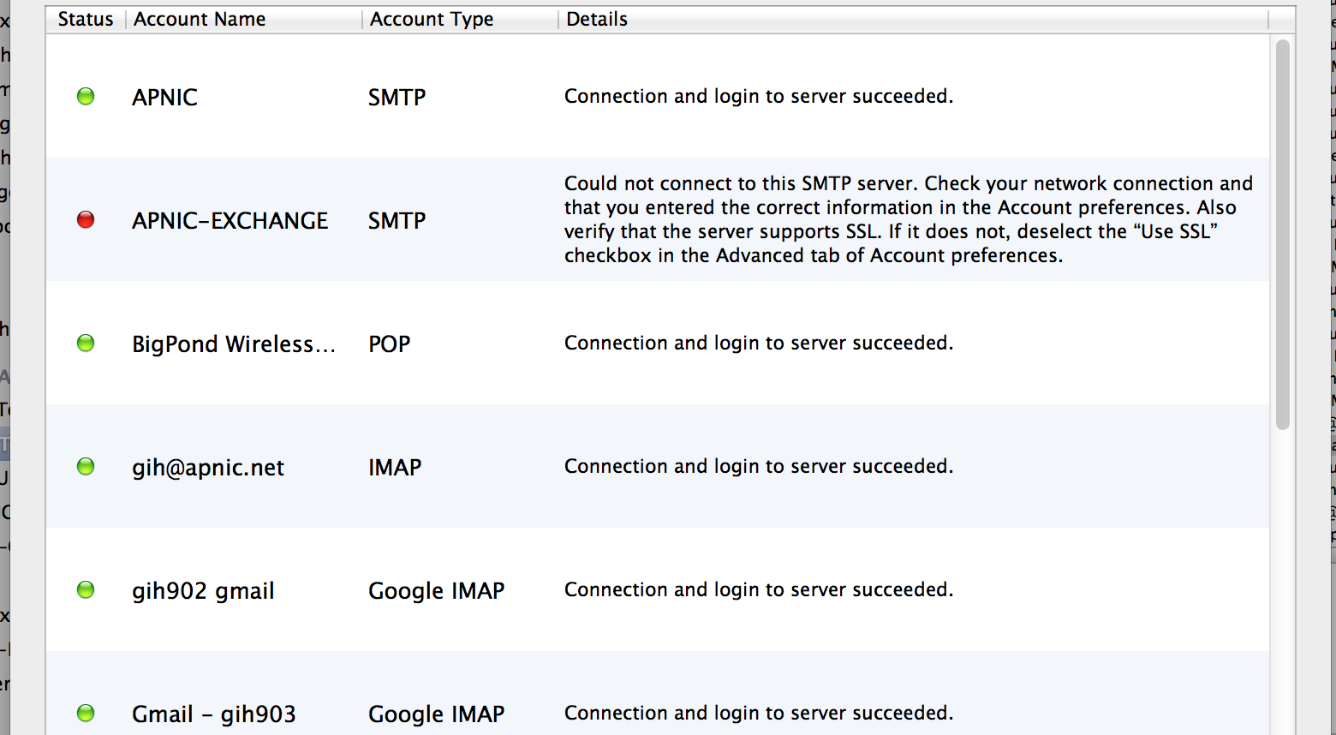

Slide 5
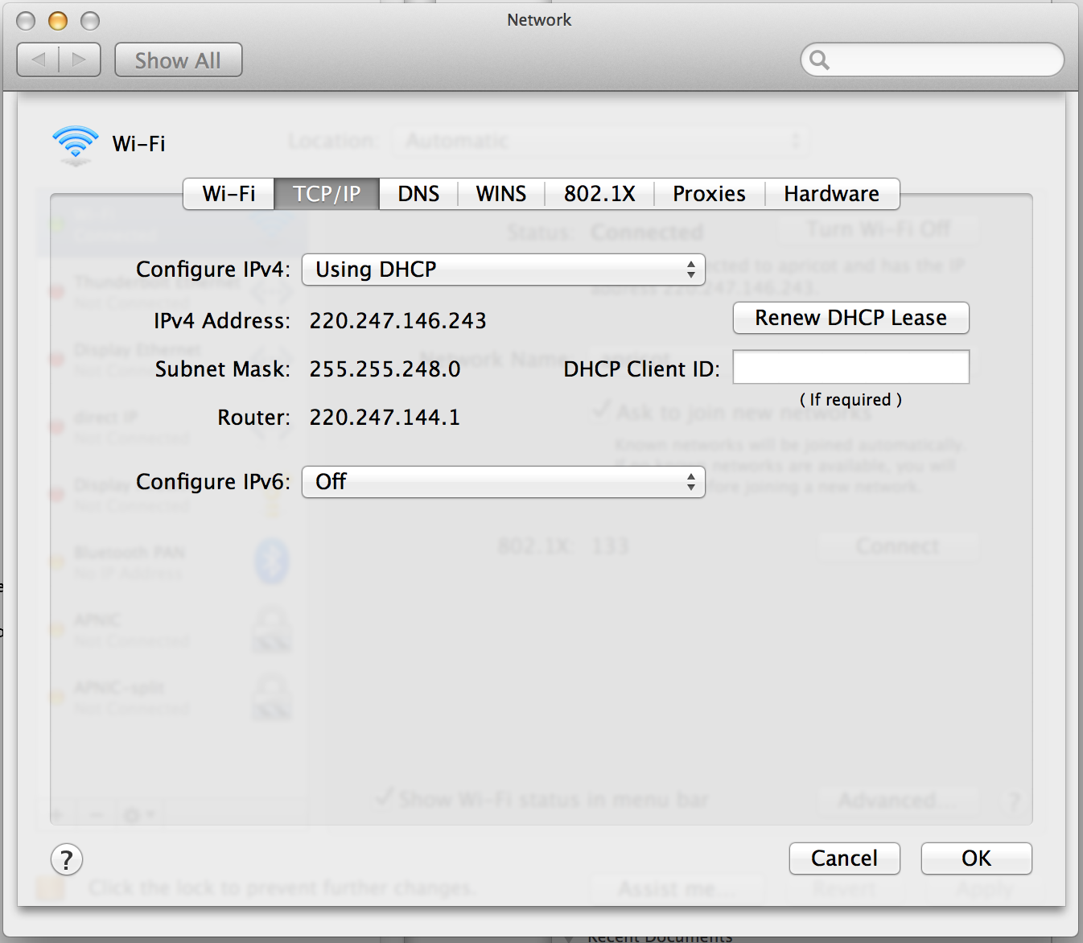

Slide 6
1362012788.007246 IP6 2001:dd8:9:2::101:16.587 > 2001:df9::4015:1430:8367:2073:5d0.57100: Flags [P.], seq 1:97, ack 1, win 4320, options [nop,nop,TS val 508156037 ecr 889805948], length 96
0x0000: b8f6 b11a 72af 000b 60a1 881b 86dd 6000 ....r...`.....`.
0x0010: 0000 0080 0632 2001 0dd8 0009 0002 0000 .....2..........
0x0020: 0000 0101 0016 2001 0df9 0000 4015 1430 ............@..0
0x0030: 8367 2073 05d0 024b df0c 6af0 c68b 23fc .g.s...K..j...#.
0x0040: 7ec3 8018 10e0 799a 0000 0101 080a 1e49 ~.....y........I
0x0050: d885 3509 5c7c 3232 3020 4941 4d44 4132 ..5.\|220.IAMDA2
0x0060: 2e6f 7267 2e61 706e 6963 2e6e 6574 204d .org.apnic.net.M
0x0070: 6963 726f 736f 6674 2045 534d 5450 204d icrosoft.ESMTP.M
0x0080: 4149 4c20 5365 7276 6963 6520 7265 6164 AIL.Service.read
0x0090: 7920 6174 2054 6875 2c20 3238 2046 6562 y.at.Thu,.28.Feb
0x00a0: 2032 3031 3320 3130 3a35 333a 3039 202b .2013.10:53:09.+
0x00b0: 3130 3030 0d0a 1000..
1362012788.007437 IP6 2001:df9::4015:1430:8367:2073:5d0.57100 > 2001:dd8:9:2::101:16.587: Flags [.], ack 97, win 8205, options [nop,nop,TS val 889806133 ecr 508156037], length 0
0x0000: 000b 60a1 881b b8f6 b11a 72af 86dd 6000 ..`.......r...`.
0x0010: 0000 0020 0640 2001 0df9 0000 4015 1430 .....@......@..0
0x0020: 8367 2073 05d0 2001 0dd8 0009 0002 0000 .g.s............
0x0030: 0000 0101 0016 df0c 024b 23fc 7ec3 6af0 .........K#.~.j.
0x0040: c6eb 8010 200d bcca 0000 0101 080a 3509 ..............5.
0x0050: 5d35 1e49 d885 ]5.I..
1362012788.019769 IP6 2001:df9::4015:1430:8367:2073:5d0.57100 > 2001:dd8:9:2::101:16.587: Flags [P.], seq 1:48, ack 97, win 8205, options [nop,nop,TS val 889806145 ecr 508156037], length 47
0x0000: 000b 60a1 881b b8f6 b11a 72af 86dd 6000 ..`.......r...`.
0x0010: 0000 004f 0640 2001 0df9 0000 4015 1430 ...O.@......@..0
0x0020: 8367 2073 05d0 2001 0dd8 0009 0002 0000 .g.s............
0x0030: 0000 0101 0016 df0c 024b 23fc 7ec3 6af0 .........K#.~.j.
0x0040: c6eb 8018 200d fa4d 0000 0101 080a 3509 .......M......5.
0x0050: 5d41 1e49 d885 4548 4c4f 205b 4950 7636 ]A.I..EHLO.[IPv6
0x0060: 3a32 3030 313a 6466 393a 3a34 3031 353a :2001:df9::4015:
0x0070: 3134 3330 3a38 3336 373a 3230 3733 3a35 1430:8367:2073:5
0x0080: 6430 5d0d 0a d0]..
1362012788.203943 IP6 2001:dd8:9:2::101:16.587 > 2001:df9::4015:1430:8367:2073:5d0.57100: Flags [.], ack 48, win 4367, options [nop,nop,TS val 508156234 ecr 889806145], length 0
0x0000: b8f6 b11a 72af 000b 60a1 881b 86dd 6000 ....r...`.....`.
0x0010: 0000 0020 0632 2001 0dd8 0009 0002 0000 .....2..........
0x0020: 0000 0101 0016 2001 0df9 0000 4015 1430 ............@..0
0x0030: 8367 2073 05d0 024b df0c 6af0 c6eb 23fc .g.s...K..j...#.
0x0040: 7ef2 8010 110f cac8 0000 0101 080a 1e49 ~..............I
0x0050: d94a 3509 5d41 .J5.]A
1362012788.204423 IP6 2001:dd8:9:2::101:16.587 > 2001:df9::4015:1430:8367:2073:5d0.57100: Flags [P.], seq 97:128, ack 48, win 4367, options [nop,nop,TS val 508156235 ecr 889806145], length 31
0x0000: b8f6 b11a 72af 000b 60a1 881b 86dd 6000 ....r...`.....`.
0x0010: 0000 003f 0632 2001 0dd8 0009 0002 0000 ...?.2..........
0x0020: 0000 0101 0016 2001 0df9 0000 4015 1430 ............@..0
0x0030: 8367 2073 05d0 024b df0c 6af0 c6eb 23fc .g.s...K..j...#.
0x0040: 7ef2 8018 110f 0952 0000 0101 080a 1e49 ~......R.......I
0x0050: d94b 3509 5d41 3530 3120 352e 352e 3420 .K5.]A501.5.5.4.
0x0060: 496e 7661 6c69 6420 646f 6d61 696e 206e Invalid.domain.n
0x0070: 616d 650d 0a ame..
1362012788.204652 IP6 2001:df9::4015:1430:8367:2073:5d0.57100 > 2001:dd8:9:2::101:16.587: Flags [.], ack 128, win 8203, options [nop,nop,TS val 889806328 ecr 508156235], length 0
0x0000: 000b 60a1 881b b8f6 b11a 72af 86dd 6000 ..`.......r...`.
0x0010: 0000 0020 0640 2001 0df9 0000 4015 1430 .....@......@..0
0x0020: 8367 2073 05d0 2001 0dd8 0009 0002 0000 .g.s............
0x0030: 0000 0101 0016 df0c 024b 23fc 7ef2 6af0 .........K#.~.j.
0x0040: c70a 8010 200b baf5 0000 0101 080a 3509 ..............5.
0x0050: 5df8 1e49 d94b ]..I.K
1362012788.205844 IP6 2001:df9::4015:1430:8367:2073:5d0.57100 > 2001:dd8:9:2::101:16.587: Flags [F.], seq 48, ack 128, win 8203, options [nop,nop,TS val 889806329 ecr 508156235], length 0
0x0000: 000b 60a1 881b b8f6 b11a 72af 86dd 6000 ..`.......r...`.
0x0010: 0000 0020 0640 2001 0df9 0000 4015 1430 .....@......@..0
0x0020: 8367 2073 05d0 2001 0dd8 0009 0002 0000 .g.s............
0x0030: 0000 0101 0016 df0c 024b 23fc 7ef2 6af0 .........K#.~.j.
0x0040: c70a 8011 200b baf3 0000 0101 080a 3509 ..............5.
0x0050: 5df9 1e49 d94b ]..I.K

Slide 7
1362012788.007246 IP6 2001:dd8:9:2::101:16.587 > 2001:df9::4015:1430:8367:2073:5d0.57100: Flags [P.], seq 1:97, ack 1, win 4320, options [nop,nop,TS val 508156037 ecr 889805948], length 96
0x0000: b8f6 b11a 72af 000b 60a1 881b 86dd 6000 ....r...`.....`.
0x0010: 0000 0080 0632 2001 0dd8 0009 0002 0000 .....2..........
0x0020: 0000 0101 0016 2001 0df9 0000 4015 1430 ............@..0
0x0030: 8367 2073 05d0 024b df0c 6af0 c68b 23fc .g.s...K..j...#.
0x0040: 7ec3 8018 10e0 799a 0000 0101 080a 1e49 ~.....y........I
0x0050: d885 3509 5c7c 3232 3020 4941 4d44 4132 ..5.\|220.IAMDA2
0x0060: 2e6f 7267 2e61 706e 6963 2e6e 6574 204d .org.apnic.net.M
0x0070: 6963 726f 736f 6674 2045 534d 5450 204d icrosoft.ESMTP.M
0x0080: 4149 4c20 5365 7276 6963 6520 7265 6164 AIL.Service.read
0x0090: 7920 6174 2054 6875 2c20 3238 2046 6562 y.at.Thu,.28.Feb
0x00a0: 2032 3031 3320 3130 3a35 333a 3039 202b .2013.10:53:09.+
0x00b0: 3130 3030 0d0a 1000..
1362012788.007437 IP6 2001:df9::4015:1430:8367:2073:5d0.57100 > 2001:dd8:9:2::101:16.587: Flags [.], ack 97, win 8205, options [nop,nop,TS val 889806133 ecr 508156037], length 0
0x0000: 000b 60a1 881b b8f6 b11a 72af 86dd 6000 ..`.......r...`.
0x0010: 0000 0020 0640 2001 0df9 0000 4015 1430 .....@......@..0
0x0020: 8367 2073 05d0 2001 0dd8 0009 0002 0000 .g.s............
0x0030: 0000 0101 0016 df0c 024b 23fc 7ec3 6af0 .........K#.~.j.
0x0040: c6eb 8010 200d bcca 0000 0101 080a 3509 ..............5.
0x0050: 5d35 1e49 d885 ]5.I..
1362012788.019769 IP6 2001:df9::4015:1430:8367:2073:5d0.57100 > 2001:dd8:9:2::101:16.587: Flags [P.], seq 1:48, ack 97, win 8205, options [nop,nop,TS val 889806145 ecr 508156037], length 47
0x0000: 000b 60a1 881b b8f6 b11a 72af 86dd 6000 ..`.......r...`.
0x0010: 0000 004f 0640 2001 0df9 0000 4015 1430 ...O.@......@..0
0x0020: 8367 2073 05d0 2001 0dd8 0009 0002 0000 .g.s............
0x0030: 0000 0101 0016 df0c 024b 23fc 7ec3 6af0 .........K#.~.j.
0x0040: c6eb 8018 200d fa4d 0000 0101 080a 3509 .......M......5.
0x0050: 5d41 1e49 d885 4548 4c4f 205b 4950 7636 ]A.I..EHLO.[IPv6
0x0060: 3a32 3030 313a 6466 393a 3a34 3031 353a :2001:df9::4015:
0x0070: 3134 3330 3a38 3336 373a 3230 3733 3a35 1430:8367:2073:5
0x0080: 6430 5d0d 0a d0]..
1362012788.203943 IP6 2001:dd8:9:2::101:16.587 > 2001:df9::4015:1430:8367:2073:5d0.57100: Flags [.], ack 48, win 4367, options [nop,nop,TS val 508156234 ecr 889806145], length 0
0x0000: b8f6 b11a 72af 000b 60a1 881b 86dd 6000 ....r...`.....`.
0x0010: 0000 0020 0632 2001 0dd8 0009 0002 0000 .....2..........
0x0020: 0000 0101 0016 2001 0df9 0000 4015 1430 ............@..0
0x0030: 8367 2073 05d0 024b df0c 6af0 c6eb 23fc .g.s...K..j...#.
0x0040: 7ef2 8010 110f cac8 0000 0101 080a 1e49 ~..............I
0x0050: d94a 3509 5d41 .J5.]A
1362012788.204423 IP6 2001:dd8:9:2::101:16.587 > 2001:df9::4015:1430:8367:2073:5d0.57100: Flags [P.], seq 97:128, ack 48, win 4367, options [nop,nop,TS val 508156235 ecr 889806145], length 31
0x0000: b8f6 b11a 72af 000b 60a1 881b 86dd 6000 ....r...`.....`.
0x0010: 0000 003f 0632 2001 0dd8 0009 0002 0000 ...?.2..........
0x0020: 0000 0101 0016 2001 0df9 0000 4015 1430 ............@..0
0x0030: 8367 2073 05d0 024b df0c 6af0 c6eb 23fc .g.s...K..j...#.
0x0040: 7ef2 8018 110f 0952 0000 0101 080a 1e49 ~......R.......I
0x0050: d94b 3509 5d41 3530 3120 352e 352e 3420 .K5.]A501.5.5.4.
0x0060: 496e 7661 6c69 6420 646f 6d61 696e 206e Invalid.domain.n
0x0070: 616d 650d 0a ame..
1362012788.204652 IP6 2001:df9::4015:1430:8367:2073:5d0.57100 > 2001:dd8:9:2::101:16.587: Flags [.], ack 128, win 8203, options [nop,nop,TS val 889806328 ecr 508156235], length 0
0x0000: 000b 60a1 881b b8f6 b11a 72af 86dd 6000 ..`.......r...`.
0x0010: 0000 0020 0640 2001 0df9 0000 4015 1430 .....@......@..0
0x0020: 8367 2073 05d0 2001 0dd8 0009 0002 0000 .g.s............
0x0030: 0000 0101 0016 df0c 024b 23fc 7ef2 6af0 .........K#.~.j.
0x0040: c70a 8010 200b baf5 0000 0101 080a 3509 ..............5.
0x0050: 5df8 1e49 d94b ]..I.K
1362012788.205844 IP6 2001:df9::4015:1430:8367:2073:5d0.57100 > 2001:dd8:9:2::101:16.587: Flags [F.], seq 48, ack 128, win 8203, options [nop,nop,TS val 889806329 ecr 508156235], length 0
0x0000: 000b 60a1 881b b8f6 b11a 72af 86dd 6000 ..`.......r...`.
0x0010: 0000 0020 0640 2001 0df9 0000 4015 1430 .....@......@..0
0x0020: 8367 2073 05d0 2001 0dd8 0009 0002 0000 .g.s............
0x0030: 0000 0101 0016 df0c 024b 23fc 7ef2 6af0 .........K#.~.j.
0x0040: c70a 8011 200b baf3 0000 0101 080a 3509 ..............5.
0x0050: 5df9 1e49 d94b ]..I.K

Slide 8
telnet exch-v6only.rand.apnic.net 587
Trying 2001:dd8:9:2::101:16...
Connected to exch-v6only.rand.apnic.net.
Escape character is '^]'.
220 IAMDA1.org.apnic.net Microsoft ESMTP MAIL Service ready at Thu, 28 Feb 2013 10:55:11 +1000
EHLO [IPv6:2001:df9::4015:1430:8367:2073:5d0]
501 5.5.4 Invalid domain name

Slide 9
telnet exch-v6only.rand.apnic.net 587
Trying 2001:dd8:9:2::101:16...
Connected to exch-v6only.rand.apnic.net.
Escape character is '^]'.
EHLO [IPv6:2001:df9:0:4015:baf6:b1ff:fe1a:72af]
250-IAMDA1.org.apnic.net Hello [2001:dd8:9:2::101:249]
250-SIZE 30965760
250-PIPELINING
250-DSN
250-ENHANCEDSTATUSCODES
250-STARTTLS
250-X-ANONYMOUSTLS
250-AUTH GSSAPI NTLM
250-X-EXPS GSSAPI NTLM
250-8BITMIME
250-BINARYMIME
250-CHUNKING
250-XEXCH50
250-XRDST
250 XSHADOW

Slide 11
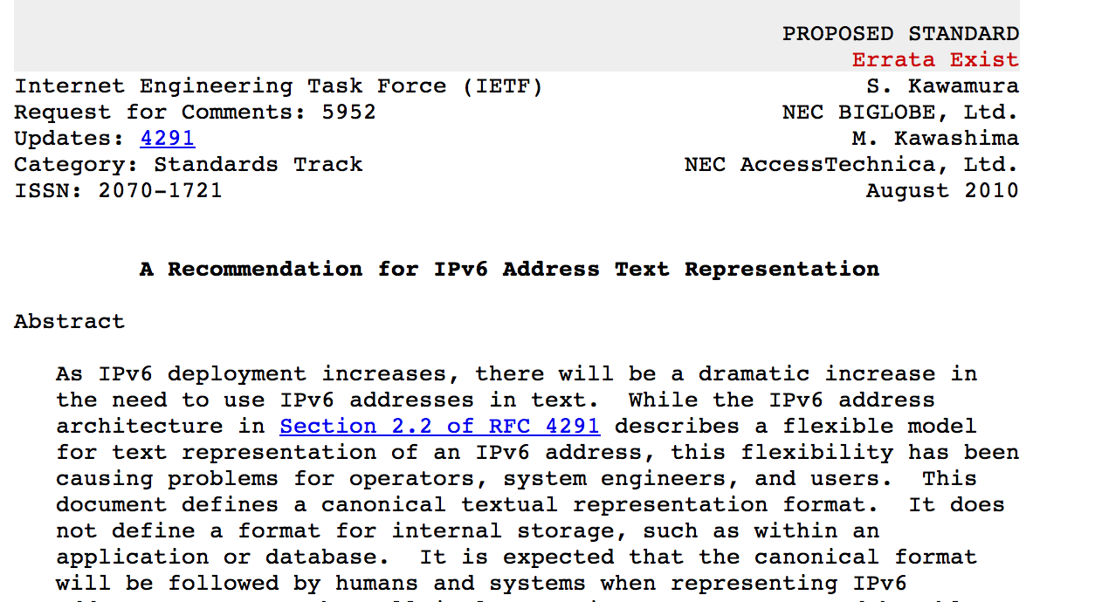

Slide 12
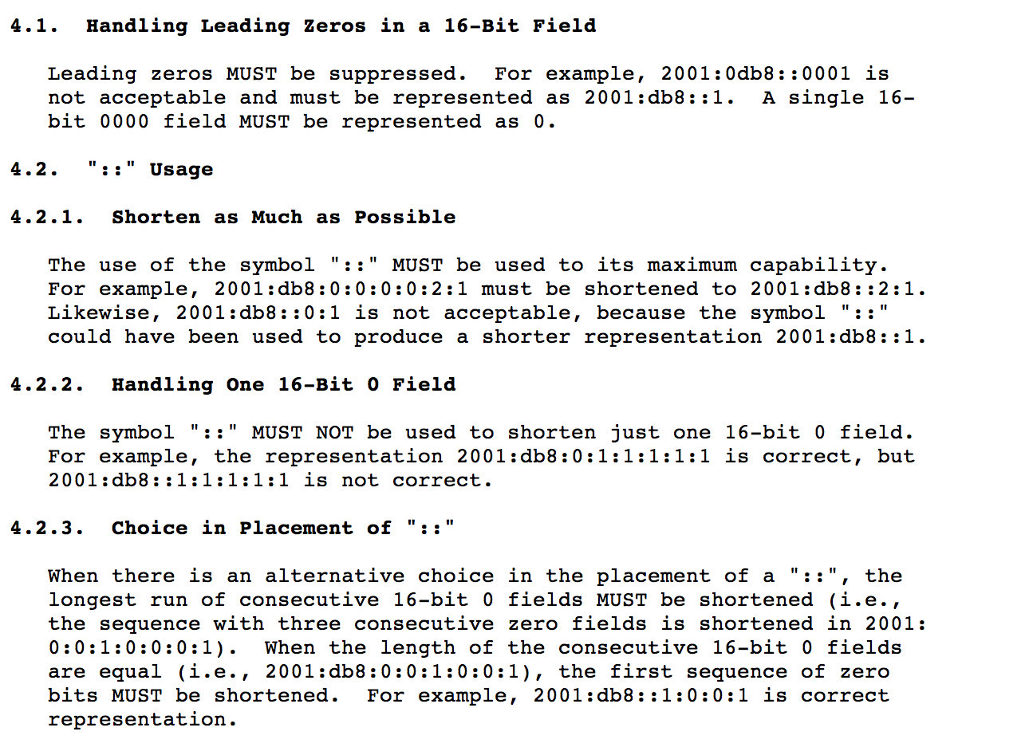

Slide 13
