Slide 1
The Death of Transit and Beyond
Geoff Huston
Chief Scientist, APNIC
Dave Crosby, https://www.flickr.com/photos/wikidave/4044498586/

Slide 2
This presentation is not about any specific network details
Or specific plans
Or particular services
Or any particular technology
Or anything like that

Slide 3
It’s about architecture
And, in particular, about the evolution of network architecture in the Internet

Slide 4
It’s about architecture
And some thoughts about the implications of these changes in terms of public policies for the Internet

Slide 5
Our Heritage
The Telephone Network

Slide 7
Our Heritage
The Telephone Network
  The major technology achievement of the twentieth century
  Connected handsets to handsets
  The network was intentionally transparent
  Real time virtual circuit support between connected edge devices
  Network-centric architecture with minimal functionality in the edge devices

Slide 8
Computer Networks
Computer Networks

Slide 9
Computer Networks
The original concept for computer networks was the telephone network
  The network was there to enable connected computers to exchange data
    All connected computers were able to initiate or receive “calls”
    A connected computer could not call ”the network” – the network was an invisible common substrate
    It made no difference if the network had active or passive internal elements

Slide 10
Internet Architecture (c1980’s)
“End-to-End” design:
  Connected computer to computer
  The network switching function was stateless
    No virtual circuits, no dynamic state for packets to follow
  Single network-wide addressing model
  Single network-wide routing model
  Simple datagram unreliable datagram delivery in each packet switching element
  hop-by-hop destination-address-based packet forwarding paradigm

Slide 11
Internet Architecture (c1980’s)
IP Network
TCP/IP Engine
TCP/IP Engine
TCP hosts

Slide 12
The Result was Revolutionary!
  By stripping out network-centric virtual circuit states and removing time synchronicity the resultant packet carriage network was minimal in design and cost and maximized flexibility
  More complex functions, such as flow control, jitter stability, loss mitigation and reliability, were pushed out to the attached devices on the edge

Slide 13
Role Specialization
In the regulated world of national telephone operators every telephone network was “equal”
Markets do not normally support such outcomes, and we see role specialization as a way of sustaining efficient distribution chains to support public services
We rapidly started differentiating between Internet networks differentiating on roles and services and differentiating on the flow of revenues between networks

Slide 14
Network Role Segmentation

Slide 15
Enter Content
Breaking the edge into clients and servers
  Access networks service the needs “clients”
  Clients are not directly reachable by other clients
  Clients connect to services
The role of the network here is to carry clients to the service access point
  The assumption here is that there are many more clients than service points

Slide 16
Content vs Carriage
Who pays whom?
  The only reason why access networks have clients is because there are content services that clients want to access
    Therefore carriage providers should pay for content
  There is no “end-to-end” financial settlement model in the Internet – both “ends” pay for access and network providers settle between themselves. To a carriage network, content is just another client
    Content should pay for carriage, just like any other client

Slide 17
Content vs Carriage
Who pays whom?
  The only reason why access networks have clients is because there are content services that clients want to access
    Therefore carriage should pay for content
  There is no “end-to-end” financial settlement model in the Internet – both “ends” pay for access and network providers settle between themselves. To a carriage network, content is just another client
    Content should pay for carriage, just like any other client
The content folk resolved this fight by going “over the top” and created relationships directly with end users

Slide 18
Content Server
Content Server

Slide 19
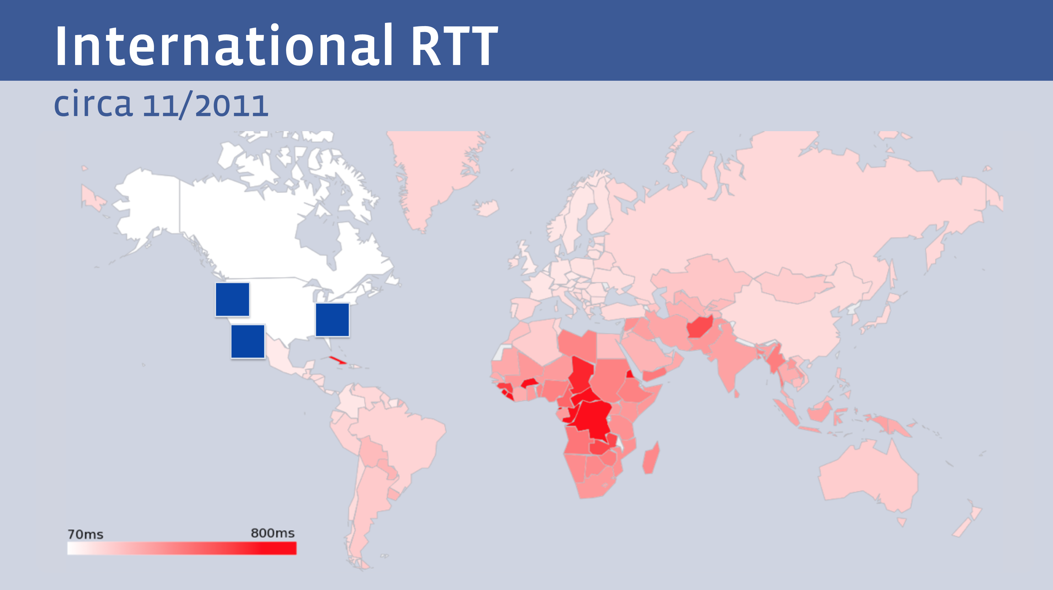
The Tyranny of Distance
  But not all clients enjoy the same experience from a single service
Facebook presentation at NANOG 68

Slide 20
Content Distribution
Content Distribution Network

Slide 21
Let them eat data!
The rise of the Content Distribution Network
  Replicate content caches close to large user populations
  The challenge of delivering many replicant service requests over high delay network paths is replaced by the task of updating a set of local caches by the content distribution system and then serving user service requests over the access network
  Reduced service latency, increased service resilience, happy customers!

Slide 22
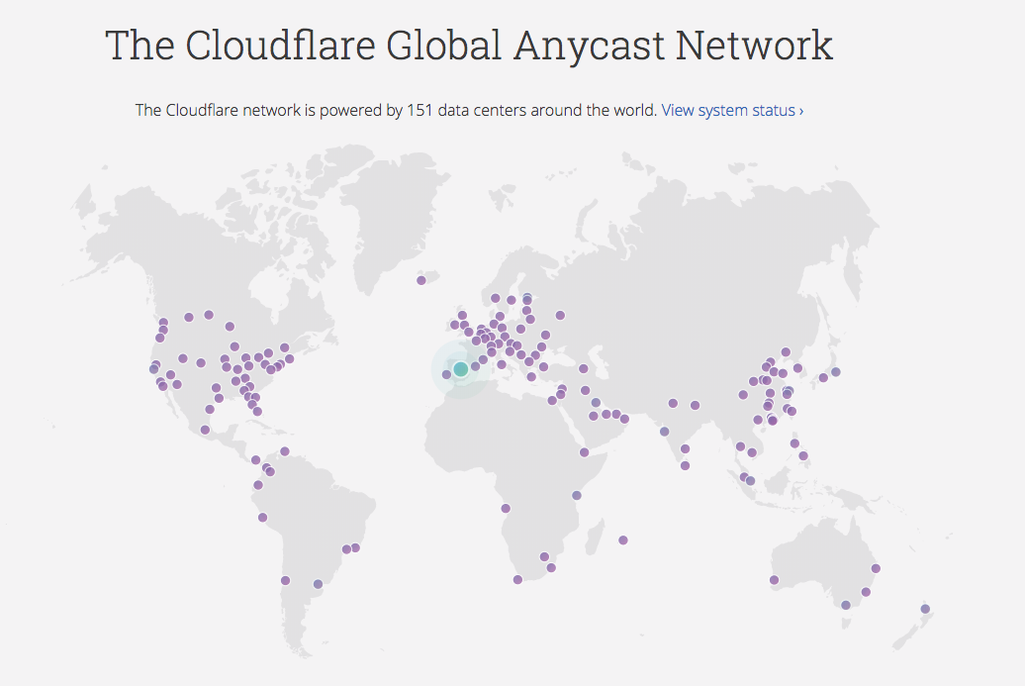
CDN Reach – some examples

Slide 23
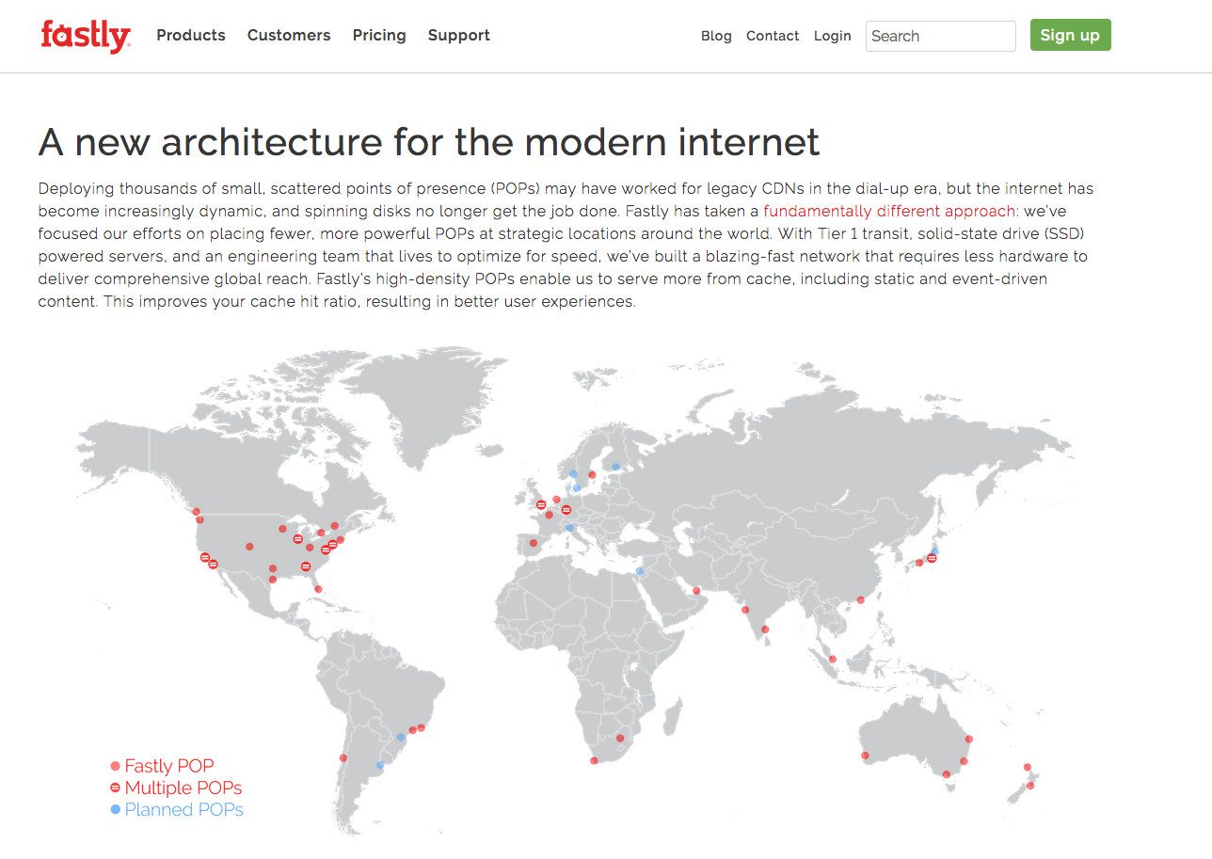
CDN Reach – some examples

Slide 24
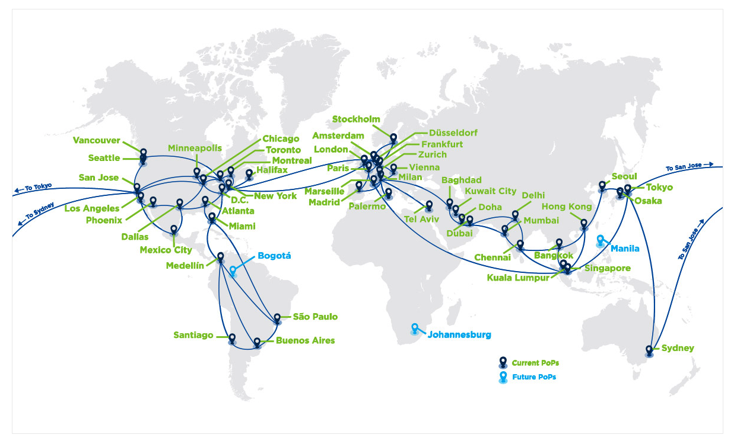

CDN Reach – some examples

Slide 25
Role Reversal
Service portals are increasingly located adjacent to users
And that means changes to the network:
  Public Networks no longer carry users’ traffic to/from service portals via ISP carriage services
  Instead, Private Networks carry content to service portals via CDN services
This shift has some profound implications for the Internet

Slide 26
Who’s building now?
Almost all new submarine international cable projects are heavily underwritten by content providers, not carriers
Large content providers have huge and often unpredictable traffic requirements, especially among their own data centers. Their capacity needs are at such a scale that it makes sense for them, on their biggest routes, to build rather than to buy. Owning subsea fibre pairs also gives them the flexibility to upgrade when they see fit, rather than being beholden to a third-party submarine cable operator.”
Tim Stronge of Telegeography, January 2017

Slide 27
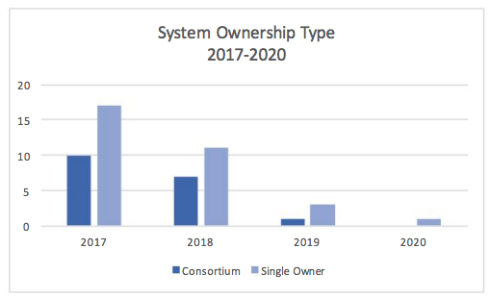
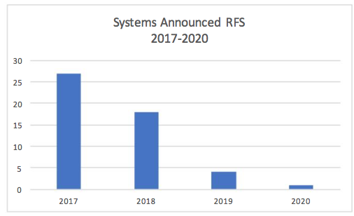
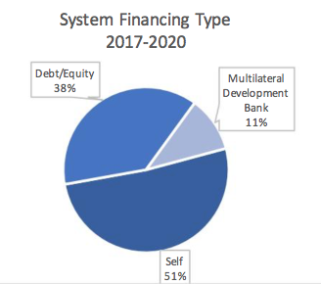
Submarine Cables
And those that are being built are now single owner cables
Fewer cables being built
And the majority are now self-funded
Tim Stronge, Telegeography, Jan 2017

Slide 28
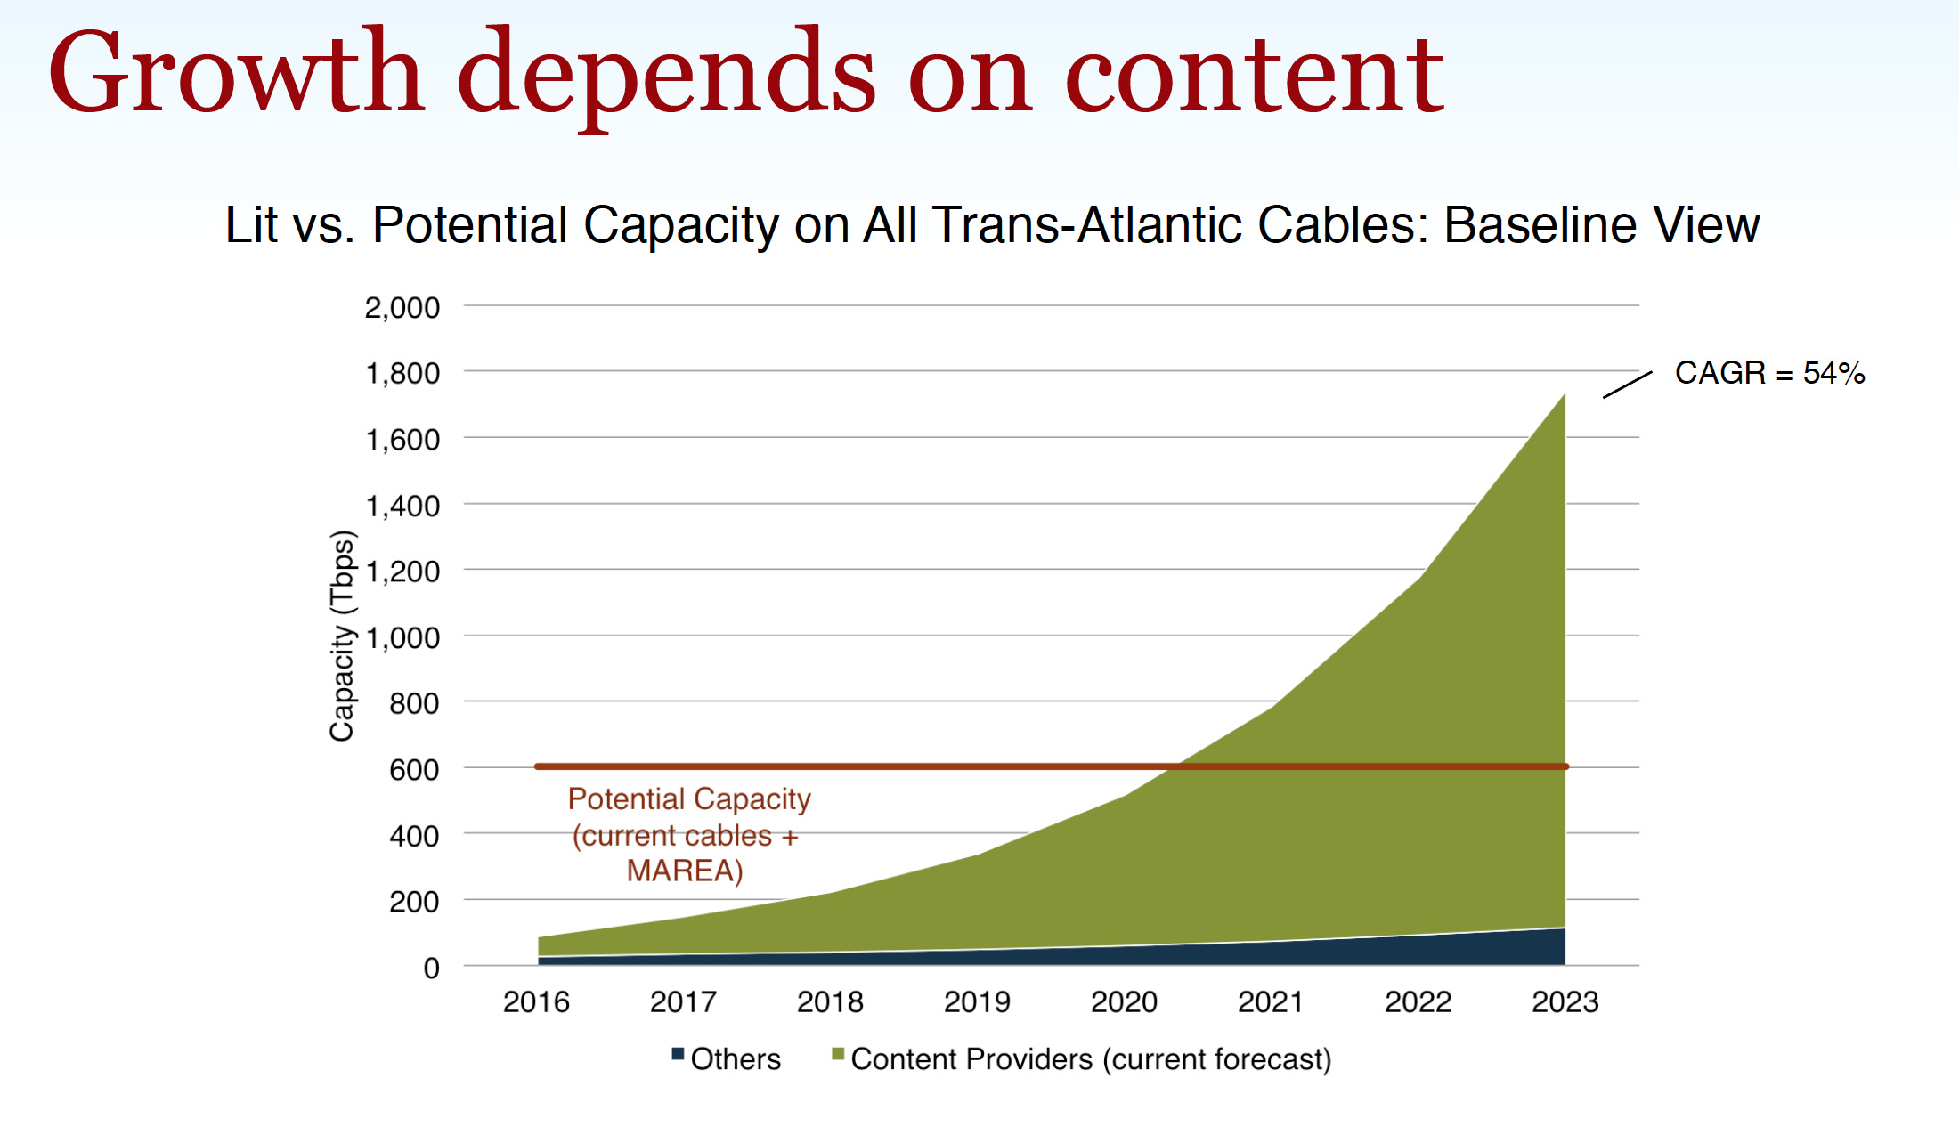
Submarine Cables
And those that are being built are now single owner cables
Fewer cables being built
And the majority are now self-funded
Tim Stronge, Telegeography, Sept 2017

Slide 29
Today’s Internet Architecture
We’ve split the network into clients and servers
  Web servers
  Streaming servers
  Mail servers
  DNS servers
Servers and services now sit in CDN bunkers with global replication and DDOS hardening
Users don’t reach out to content any more - the CDNs bring content to users

Slide 30
Today’s Internet Architecture

Slide 31
Who needs Transit?
If users don’t send packets to users any more…
If content is now delivered via CDNs to users via discrete service cones…
If there is no universal service obligation…
Then why do we still need Transit Service providers?

Slide 32
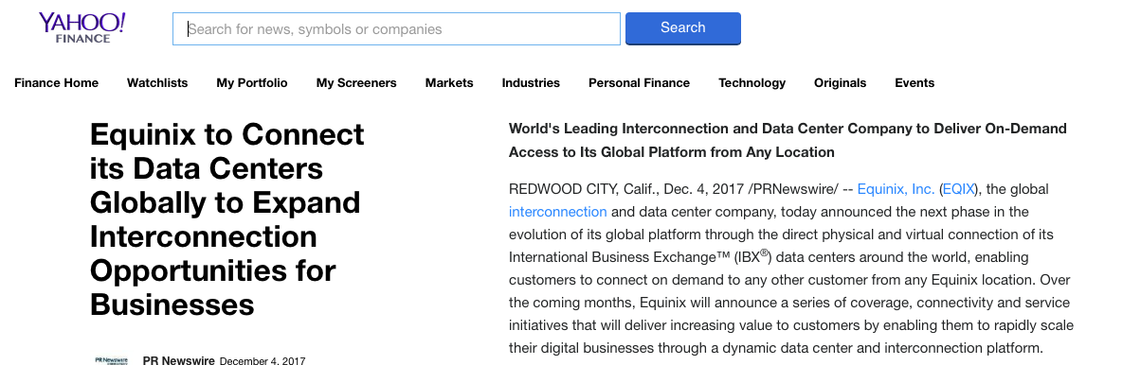
Closed Transit?
We see the CDN systems reserve a carriage resource through dedicated bandwidth / wavelength / cable purchase and effectively bypass the open IP carriage infrastructure

Slide 33
Transit?
Once the CDN caches sit “inside” the Edge NAT of the Access ISP then the entire wide area network becomes a marginal activity compared to the value of the content feeds!

Slide 34
Internet Names and Addresses?
If the Internet is (or maybe soon will be) a collection of discrete CDN service ‘cones’ then why do we expect end users to pay for the maintenance of:
  A global address plan?
  A global name system?
  A single global network?

Slide 35
It’s not just the Death of Transit
It’s the re-purposing of the entire network
  Service provisioning sits within cloud providers and distributed data centres
  Edge computers are now acting as televisions into the clouded world of data
  The distinction between personal and public data realms is disappearing into the realm of corporately owned private data empires

Slide 36
Exactly where are we?
We started this journey building a telephone network for computers to communicate between each other
But now one-way content distribution lies at the core of today’s Internet
This content distribution role is an enterprise service framework rather than a public carriage service
The internal parts of the carriage network are now being privatized and removed from public regulatory oversight

Slide 37
Policy?
If CDN feeder networks are private networks, and there is little residual public carriage other than last mile access networks, then what do we really mean by “public communications policy”?
In the regulatory world ‘content’ is commerce, not carriage!

Slide 38
Policy?
In today’s Internet what do we mean in a policy sense by concepts such as:
“universal service obligation”
“network neutrality”
“rights of access” or even
“market dominance”
when we are talking about diverse CDNs as the dominant actors in the Internet?

Slide 39







The Large and the Largest
Company | Market Cap (B)
Apple | 910
Amazon | 825
Alphabet | 775
Microsoft | 756
Facebook | 562
Tencent | 479
Alibaba | 476
Berkshire Hathaway | 464
JPMorgan Chase | 356
ExxonMobil | 350
The world’s 10 largest publicly traded companies, as ranked by their market capitalization, Q2, 2018

Slide 40
Content really is King
None of these seven technology companies are a telephone company, or even a transit ISP, or even an ISP at all!
All of them have pushed aside carriage networks in order to maintain direct relationships with billions of consumers
These valuable consumer relationships are based on content services, not carriage

Slide 41
Content Consolidation
There are not thousands of content service platforms
  There are just a few left
And the space is dominated by a small number of dominant actors who set the rules of engagement for all others

Slide 42
Content Consolidation
“The size and scale of the attacks that can now easily be launched online make it such that if you don't have a network like Cloudflare in front of your content, and you upset anyone, you will be knocked offline.
…
In a not-so-distant future, if we're not there already, it may be that if you're going to put content on the Internet you'll need to use a company with a giant network like Cloudflare, Google, Microsoft, Facebook, Amazon, or Alibaba.
…
Without a clear framework as a guide for content regulation, a small number of companies will largely determine what can and cannot be online.
https://blog.cloudflare.com/why-we-terminated-daily-stormer/
August 2017

Slide 43
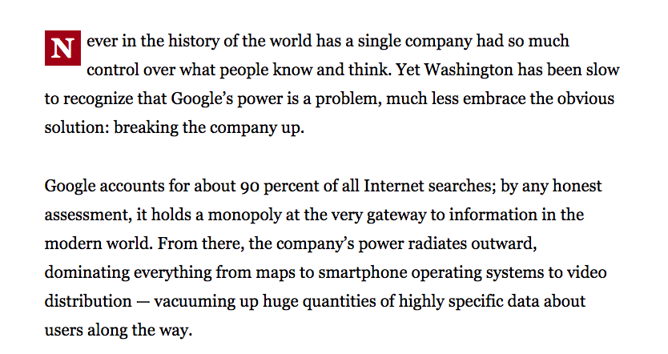
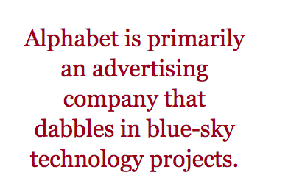
Consolidation?
Boston Globe , June 14 2018

Slide 44
Competition or Cartel?
With a small number of truly massive enterprises at the heart of the area of digital content and service is this still a space that is shaped by competitive pressures?
Or do these dominant incumbents get to set their own terms of engagement with each other, with users, and even with the public sector?

Slide 45
Competition or Cartel?
With a small number of truly massive enterprises at the heart of the area of digital content and service is this still a space that is shaped by competitive pressures?
Or do these dominant incumbents get to set their own terms of engagement with each other, with users, and even with the public sector?
As concerning as this might sound, it’s not a novel situation!

Slide 46

We’ve been here before…
High Museum of Art, Atlanta

Slide 47
The Gilded Age
A term applied to America in the 1870 – 1890’s about the building of industrial and commercial corporate giants on platforms that were a mix of industrial innovation and enterprise with elements of greed, corruption and labor exploitation
Andrew Carnegie - US Steel
John Rockfeller - Standard Oil
Theodore Vail - AT&T
George Westinghouse – Rail Brakes
Thomas Edison – General Electric
J P Morgan - Banking

Slide 48
The Gilded Age
During this period in the United States the dominant position within industry and commerce was occupied by a very small number of players who were moving far faster than the regulatory measures of the day.
The resulting monopolies took the US decades to dismember, and even today many of these gilded age companies remain dominant in their field

Slide 49
The Internet’s Gilded Age
At some point in the past decade or so the dominant position across the entire Internet has been occupied by a very small number of players who are moving far faster than the regulatory measures that were intended to curb the worst excesses of market dominance by a small clique of actors.

Slide 50
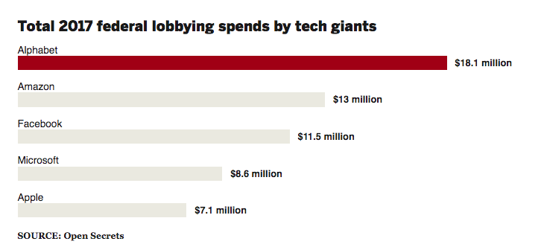
The Internet’s Gilded Age
At some point in the past decade or so the dominant position across the entire Internet has been occupied by a very small number of players who are moving far faster than the regulatory measures that were intended to curb the worst excesses of market dominance by a small clique of actors.

Slide 51
The Internet’s Gilded Age
These actors have enough market influence to set their own rules of engagement with:
  Users,
  Each other,
  Third party suppliers,
  Regulators and Governments
By taking a leading position with these emergent technologies, these players are able to amass vast fortunes, with little in the way of accountability to a broader common public good

Slide 52
The Internet’s Gilded Age
These actors have enough market influence to set their own rules of engagement with:
  Users,
  Each other,
  Third party suppliers,
  Regulators and Governments
By taking a leading position with these emergent technologies, these players are able to amass vast fortunes, with little in the way of accountability to a broader common public good
Is this the Internet we were dreaming of?

Slide 53

The Internet’s Future
Gittes: How much are you worth?
Cross: I've no idea. How much do you want?
Gittes: I just want to know what you're worth. Over
ten million?
Cross: Oh my, yes!
Gittes: Why are you doing it? How much better can you
eat? What can you buy that you can't already
afford?
Cross: The future, Mr. Gittes - the future!
Chinatown (1974)

Slide 54
What is this all about?
This is no longer just a conversation about incremental changes in carriage and communications within the Internet.
For me, the essential topic of this conversation is how we can strike a sustainable balance between an energetic private sector that has rapidly amassed overarching control of the digital service and content space, and the needs of the larger society in which we all would like some equity of opportunity to thrive and benefit from the outcomes of this new digital age.

Slide 56
What’s the problem?
Is it that these enterprises are:
  so big?
  exploitative of their workers?
  distorting markets?
  extracting monopoly rentals from consumers?
  not providing consumers what they want?

Slide 57
What we want
It seems that these enterprises have focussed very sharply on giving users precisely what they want
The ability to customise a solution to a market of 1 and still bring economies of scale to that market underlies their success
So we all use these services – because they work for us!

Slide 58
There are side-effects
In order to understand what each consumer wants, the service provider needs to understand the consumer
Which brings us to…

Slide 59
Surveillance Capitalism
Much of the wealth and impact of these activities is built upon a foundation of aggregation of individual user behaviour and construction of personal profiles
It also has benefitted from a cavalier attitude towards data security and privacy concerns and the absence of regulatory imposts that attempt to safeguard some basic common aspects of personal privacy

Slide 60
Surveillance Capitalism
Much of the wealth and impact of these activities is built upon a foundation of aggregation of individual user behaviour and construction of personal profiles
It also has benefitted from a cavalier attitude towards data security and privacy concerns and the absence of regulatory imposts that attempt to safeguard some basic common aspects of personal privacy
Are there more microphones than people in this room today?

Slide 61

Is this what we want?

Slide 62
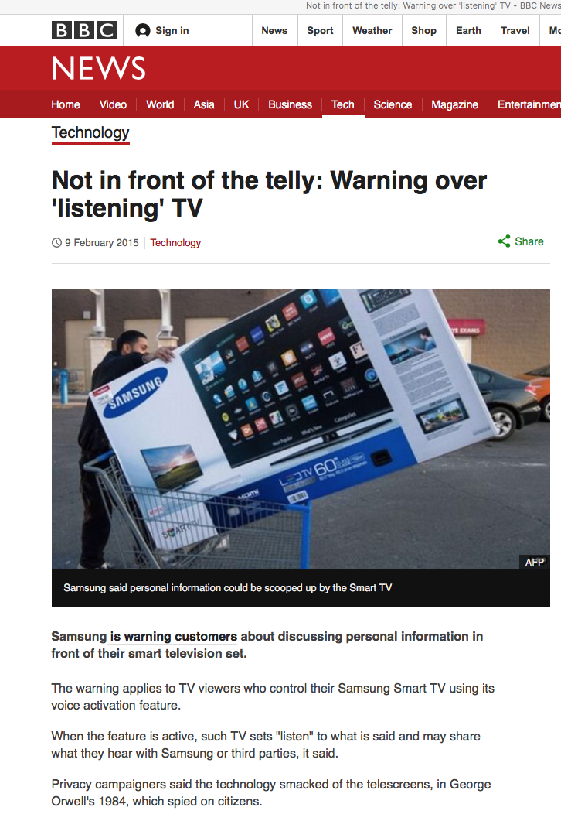
Is this what we want?

Slide 63
What we might want
If this situation calls for some public sector response then perhaps the thrust of any such response should focus on the consumer rather than the dynamics of the market

Slide 64
Some questions
An effective regulatory regime should be able to provide clear answers to these questions:
  Who owns my personal profile data?
  Where is it stored?
  What regulatory regime protects it?
  Should I be informed when my profile is sold?
  Do I have an informed valuation of my personal profile?
  Who is at fault if my personal data is leaked?

Slide 65
Where are we?
Its clear we’re not in Kansas any more
And whatever the Internet may be, it’s not a telephone network for computers

Slide 66
Where are we?
We are now communicating with a computer-mediated environment rather than with each other
The network itself is largely incidental to this evolving story, and this is not really about the Internet any more
It’s about a set of revolutionary social changes on a par with the industrial revolution that have been triggered by abundant computing, storage and comms

Slide 67
Where are we?
We are now communicating with a computer-mediated environment rather than with each other
The network itself is largely incidental to this evolving story, and this is not really about the Internet any more
It’s about a set of revolutionary social changes on a par with the industrial revolution that have been triggered by abundant computing, storage and comms
How many mips and gigs are in this room today?

Slide 68
Maybe its more than this
In a world of abundant content what do we choose to view?
What do we choose to believe?
Search becomes the arbiter of content selection and assumes a level of ultimate importance in this world
What’s the outcome of search being dominated by a single entity?

Slide 69
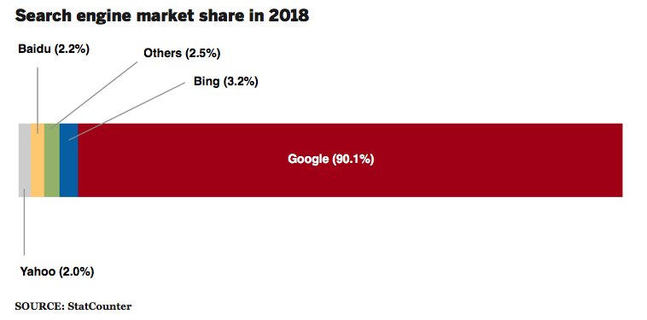
Is it about what we buy or is this more about what we think?
Share of search in US market

Slide 70
Where does all this head?
For our society this market-driven digitisation of our world has the potential to be incredibly empowering or incredibly threatening
Or both at the same time!

Slide 71
Thanks!

