Slide 1
The Death of Transit and the Future Internet
Geoff Huston
Chief Scientist, APNIC
Dave Crosby, https://www.flickr.com/photos/wikidave/4044498586/

Slide 2
This presentation is not about any specific network details:
Or specific network plans
Or particular services
Or any particular technology
Or anything like that

Slide 3
It’s about architecture
And, in particular, about the evolution of network architecture in the Internet

Slide 4
Our Heritage
The Telephone Network

Slide 6
The Telephone Network
The major technology achievement of the twentieth century
  Connected handsets to handsets
  The network was intentionally transparent
  Real time virtual circuit support between connected edge devices
  Network-centric architecture with minimal functionality in the edge devices

Slide 7
Computer Networks
Computer Networks

Slide 8
Computer Networks
The original concept for computer networks was based on the telephone network
  The network was there to enable connected computers to exchange data
    All connected computers were able to initiate or receive “calls”
    A connected computer could not call ”the network” – the network was an invisible common substrate
    It made no difference if the network had active or passive internal elements

Slide 9
Internet Architecture (c1980’s)
“End-to-End” packet design:
  Connected computer to computer
  All data is segmented into independent packets
  The network switching function was stateless
    No virtual circuits, no dynamic state for packets to follow
  Single network-wide addressing model
  Single network-wide routing model
  Simple datagram unreliable datagram delivery in each packet switching element
  hop-by-hop destination-address-based packet forwarding paradigm

Slide 10
Internet Architecture (c1980’s)
IP Network
TCP/IP Engine
TCP/IP Engine
TCP hosts

Slide 11
The Result was Revolutionary!
  By stripping out network-centric virtual circuit states and removing time synchronicity the resultant packet carriage network was minimal in design and cost and maximized flexibility and efficiency
  More complex functions, such as flow control, jitter stability, loss mitigation and reliability, were pushed out to the attached devices on the edge

Slide 12
Role Specialization
In the regulated world of national telephone operators every telephone network was “equal”
Markets do not normally support such outcomes, and we see role specialization as a way of sustaining efficient distribution chains to support public services
We rapidly started differentiating between Internet networks differentiating on roles and services and differentiating on the flow of revenues between networks

Slide 13
The 1990’s Internet

Slide 14
Transit Networks were “special”
These were the so-called “Tier One” networks
These networks collectively managed the “default-free zone” and arbitrated reachability on the network
These networks were at the apex of the money flow within the Internet ecosystem
They effectively formed a cartel that defined the Internet as we knew it at the time

Slide 15
Enter Content
Breaking the edge into clients and servers
  Access networks service the needs of “clients”
  Clients are not directly reachable by other clients
  Clients only connect to services
The role of the network here is to carry clients to the service access point
  The assumption here is that there are many more clients than service points

Slide 16
Content vs Carriage
Who pays whom?
  The only reason why access networks have clients is because there are content services that clients want to access
    Carriage access providers should directly pay for content for their users
  There is no “end-to-end” financial settlement model in the Internet – both “ends” pay for access and network providers settle between themselves. To a carriage network, content is just another client
    Content providers should pay for carriage, just like any other client

Slide 17
Content vs Carriage
Who pays whom?
  The only reason why access networks have clients is because there are content services that clients want to access
    Carriage access providers should directly pay for content for their users
  There is no “end-to-end” financial settlement model in the Internet – both “ends” pay for access and network providers settle between themselves. To a carriage network, content is just another client
    Content providers should pay for carriage, just like any other client
The content folk resolved this fight by going “over the top” and created relationships directly with end users

Slide 18
The Evolution of Content Service
Content Server

Slide 19
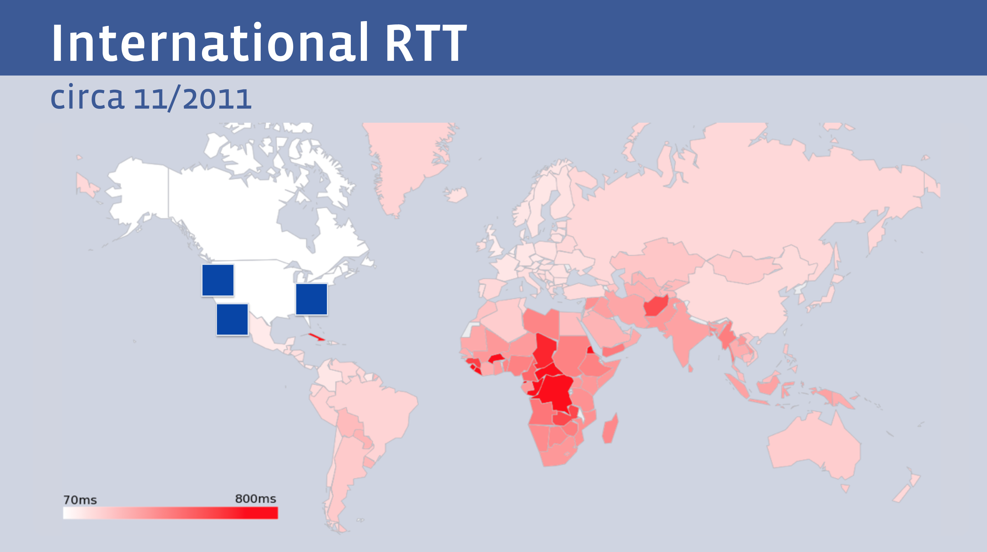
The Tyranny of Distance
  But not all clients enjoy the same experience from a single service
Facebook presentation at NANOG 68

Slide 20
Enter Content Distribution
Content Distribution Network

Slide 21
Let them eat data!
The rise of the Content Distribution Network
  Replicate content caches close to large user populations
  The challenge of delivering many replicant service requests over high delay network paths is replaced by the task of updating a set of local caches by the content distribution system and then serving user service requests over the access network
  Reduced service latency, increased service resilience, happy customers!

Slide 22
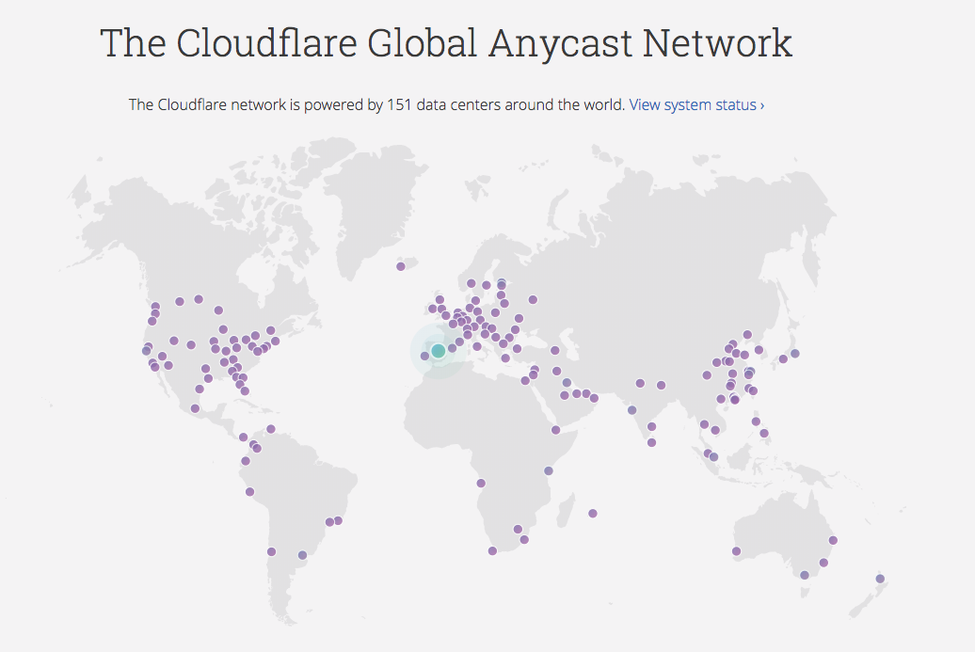
CDN Reach – some examples

Slide 23
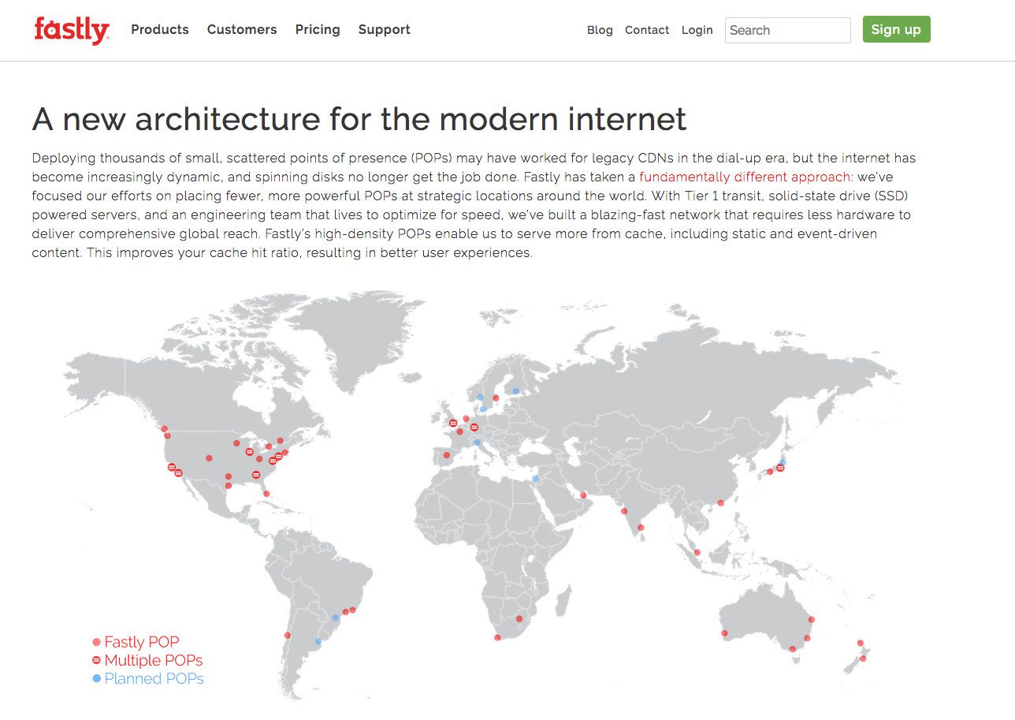
CDN Reach – some examples

Slide 24
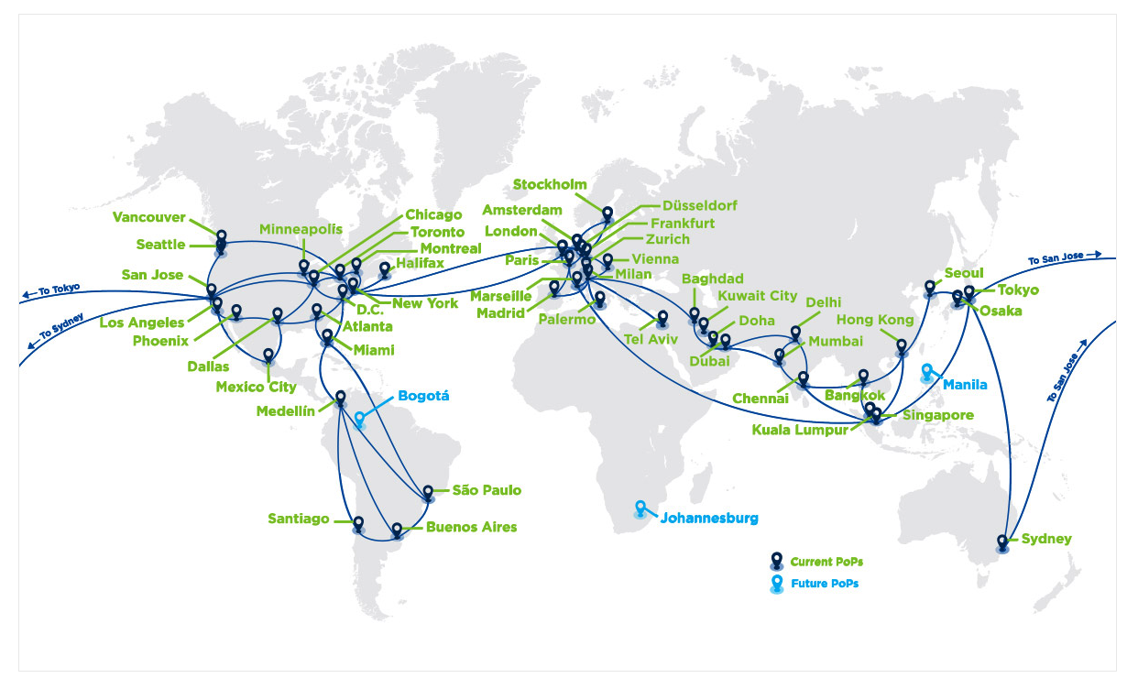

CDN Reach – some examples

Slide 25
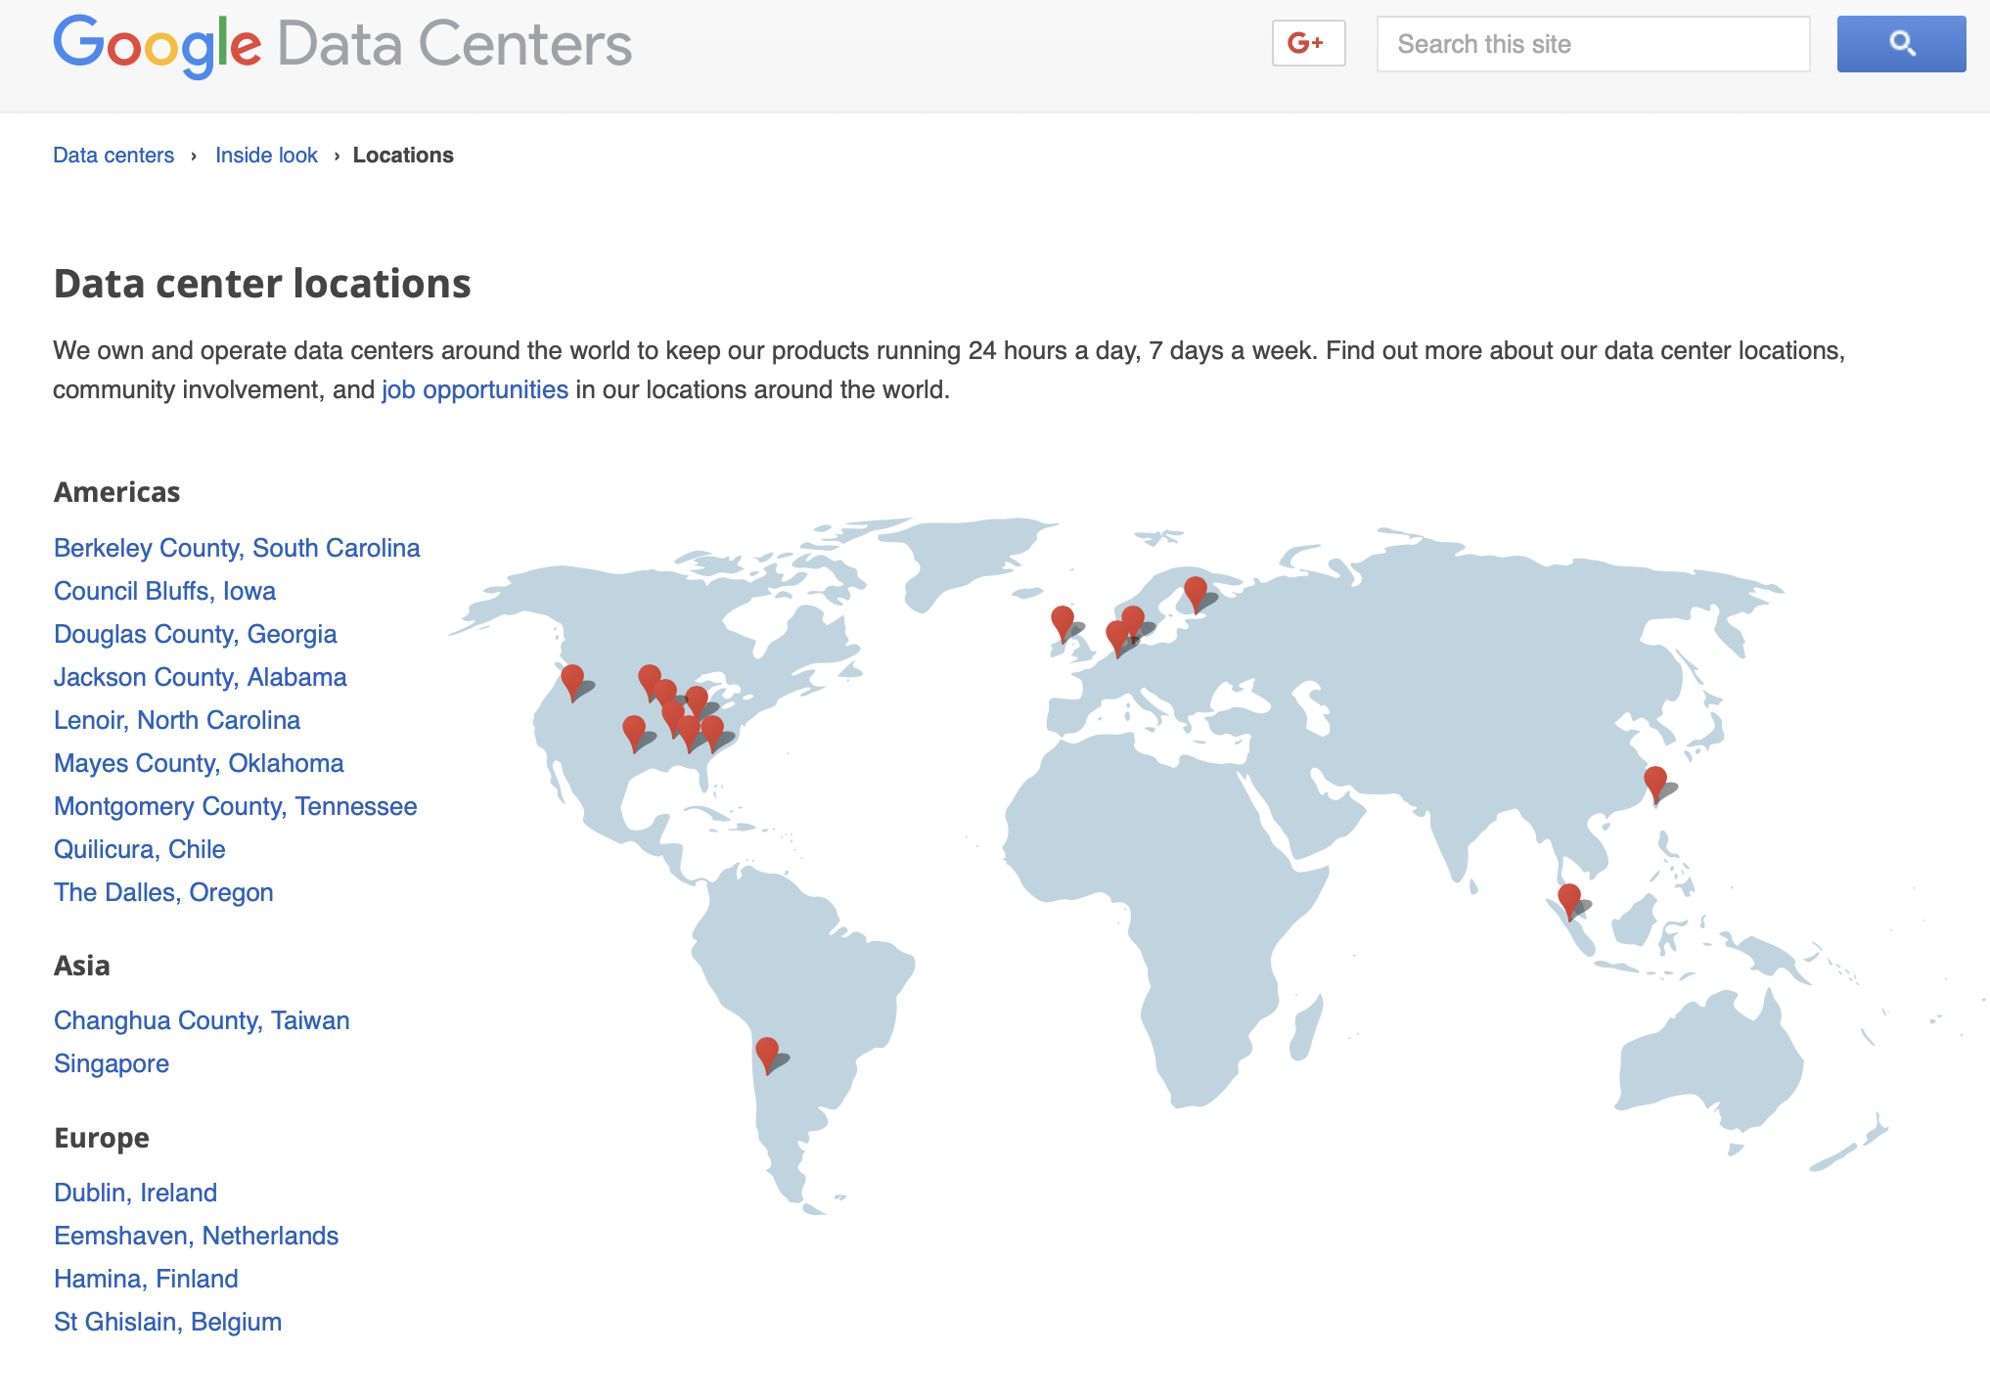
CDN Reach – some examples

Slide 26
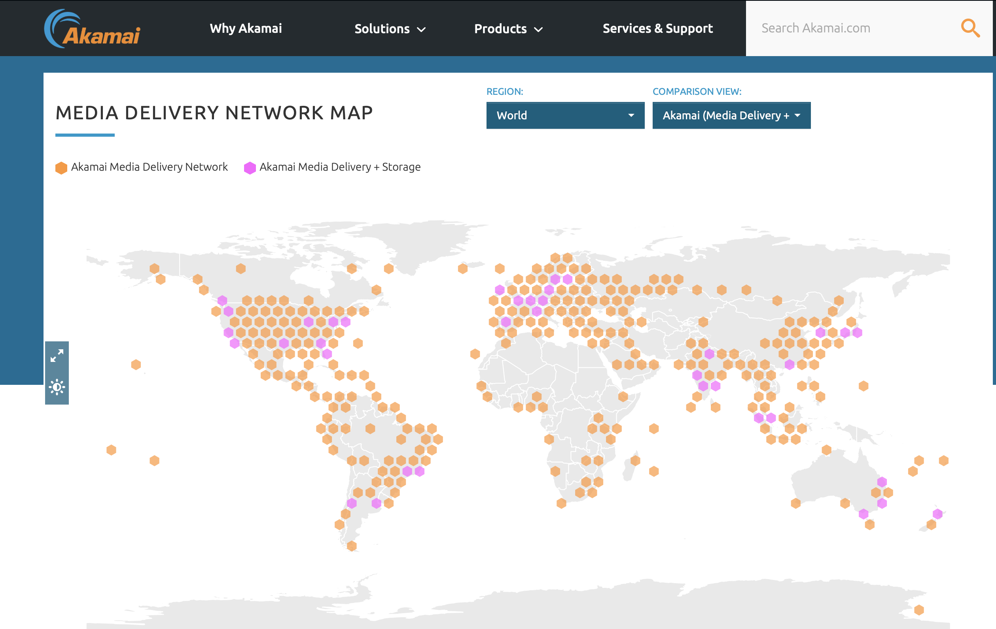
CDN Reach – some examples

Slide 27
Today’s Internet Architecture
We’ve split the network into clients and servers
  Web servers
  Streaming servers
  Mail servers
  DNS servers
Servers and services now sit in CDN bunkers with global replication and DDOS hardening
Users don’t reach out to content any more - the CDNs bring content to users

Slide 28
Role Reversal
Service portals are increasingly located adjacent to users
And that means changes to the network:
  Public Networks no longer carry users’ traffic to/from service portals via ISP carriage services
  Instead, Private Networks carry content to service portals via CDN services

Slide 29
Role Reversal
Service portals are increasingly located adjacent to users
And that means changes to the network:
  Public Networks no longer carry users’ traffic to/from service portals via ISP carriage services
  Instead, Private Networks carry content to service portals via CDN services
This shift has some profound implications for the Internet

Slide 30
Who’s building now?
Almost all new submarine international cable projects are heavily underwritten by content providers, not carriers
Large content providers have huge and often unpredictable traffic requirements, especially among their own data centers. Their capacity needs are at such a scale that it makes sense for them, on their biggest routes, to build rather than to buy. Owning subsea fibre pairs also gives them the flexibility to upgrade when they see fit, rather than being beholden to a third-party submarine cable operator.”
Tim Stronge of Telegeography, January 2017

Slide 31
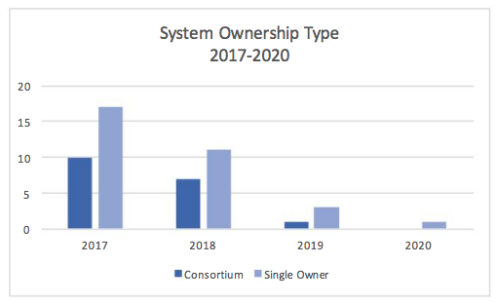
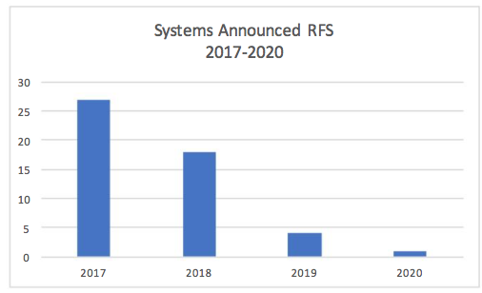
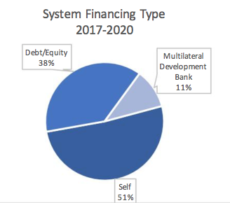
Submarine Cables
And those that are being built are now single owner cables
Fewer cables being built
And the majority are now self-funded
Tim Stronge, Telegeography, Jan 2017

Slide 32
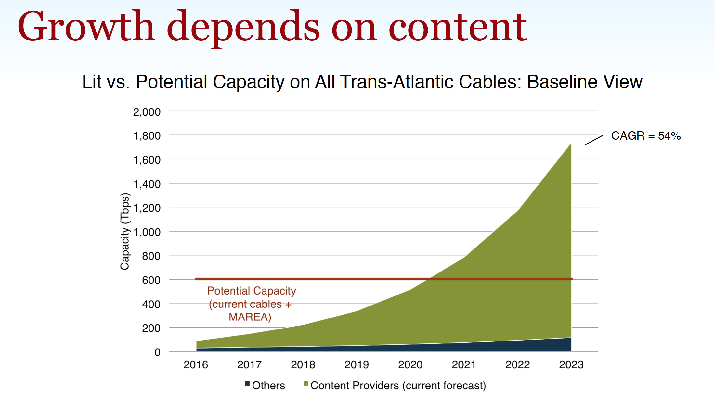
Submarine Cables
And those that are being built are now single owner cables
Fewer cables being built
And the majority are now self-funded
Tim Stronge, Telegeography, Sept 2017

Slide 33

Submarine Cables
And those that are being built are now single owner cables
Submarine cables now interconnect content data centers
Fewer cables being built
And the majority are now self-funded
Submarine Telecoms Magazine, November 2018

Slide 34
Today’s Internet Architecture

Slide 35
Who needs Transit?
If users don’t send packets to users any more…
If content is now delivered via CDNs to users via discrete service cones…
If there is no universal service obligation…
Then why do we still need Transit Service providers?

Slide 36
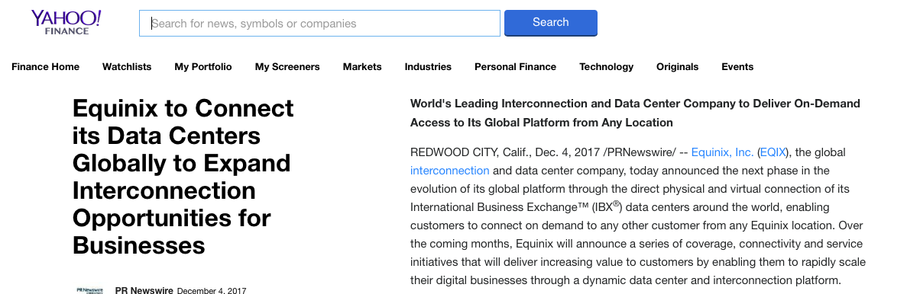
Closed Transit?
We see the CDN systems reserve a carriage resource through dedicated bandwidth / wavelength / cable purchase and effectively bypass the open IP carriage infrastructure

Slide 37
Transit?
Once the CDN caches sit “inside” the Edge NAT of the Access ISP then the entire wide area network becomes a marginal activity compared to the value of the content feeds!

Slide 38
Internet Names and Addresses?
If the Internet is (or maybe soon will be) a collection of discrete CDN service ‘cones’ then why do we expect end users to pay for the maintenance of:
  A global address plan?
  A global name system?
  A single global network?

Slide 39
It’s not just Death of Transit
It’s the re-purposing of the entire network
  Service provisioning sits within cloud providers and distributed data centres
  Edge computers are now acting as televisions into the clouded world of data
  The distinction between personal and public data realms is disappearing into the realm of corporately owned private data empires

Slide 40
Exactly where are we?
We started this journey building a telephone network for computers to communicate between each other
But now one-way content distribution lies at the core of today’s Internet
This content distribution role is an enterprise service framework rather than a public carriage service
The internal parts of the carriage network are now being privatized and removed from public regulatory oversight

Slide 41
Policy?
If CDN feeder networks are private networks, and there is little residual public carriage other than last mile access networks, then what do we really mean by “public communications policy”?
In the regulatory world ‘content’ is commerce, not carriage!

Slide 42
Policy?
In today’s Internet what do we mean in a policy sense by concepts such as:
“universal service obligation”
“network neutrality”
“rights of access” or even
“market dominance”
when we are talking about diverse CDNs as the dominant actors in the Internet?

Slide 43







The Large and the Largest
Company | Market Cap (B)
Apple | 1,091
Amazon | 976
Microsoft | 877
Alphabet | 839
Berkshire Hathaway | 523
Facebook | 473
Alibaba | 423
Tencent | 388
JPMorgan Chase | 379
Johnson & Johnson | 370
The world’s 10 largest publicly traded companies, as ranked by their market capitalization, Q3, 2018

Slide 44
Content Really is King!
None of these seven technology companies are a telephone company, or even a transit ISP, or even an ISP at all!
All of them have pushed aside carriage networks in order to maintain direct relationships with billions of consumers
These valuable consumer relationships are based on content services, not carriage

Slide 45
Content Consolidation
There are not thousands of content service platforms any more
  There are just a few left
And the space is dominated by a small number of dominant actors who set the rules of engagement for all others

Slide 46
Content Consolidation
“The size and scale of the attacks that can now easily be launched online make it such that if you don't have a network like Cloudflare in front of your content, and you upset anyone, you will be knocked offline.
…
In a not-so-distant future, if we're not there already, it may be that if you're going to put content on the Internet you'll need to use a company with a giant network like Cloudflare, Google, Microsoft, Facebook, Amazon, or Alibaba.
…
Without a clear framework as a guide for content regulation, a small number of companies will largely determine what can and cannot be online.
https://blog.cloudflare.com/why-we-terminated-daily-stormer/
August 2017

Slide 47
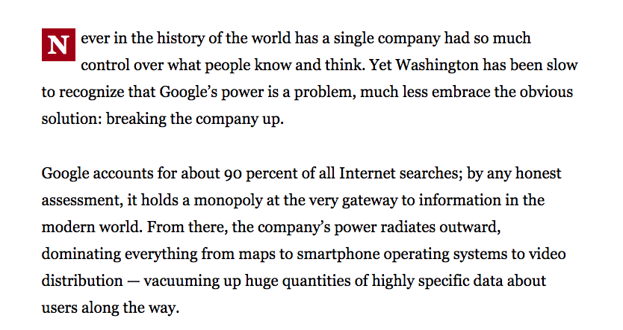
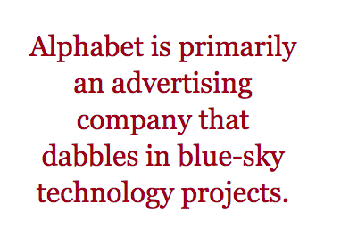
Consolidation?
Boston Globe , June 14 2018

Slide 48
Competition or Cartel?
With a small number of truly massive enterprises at the heart of the area of digital content and service is this still a space that is shaped by competitive pressures?
Or do these dominant incumbents get to set their own terms of engagement with each other, with users, and even with the public sector?

Slide 49
Competition or Cartel?
With a small number of truly massive enterprises at the heart of the area of digital content and service is this still a space that is shaped by competitive pressures?
Or do these dominant incumbents get to set their own terms of engagement with each other, with users, and even with the public sector?
As concerning as this might sound, it’s not a novel situation!

Slide 50

We’ve been here before…
High Museum of Art, Atlanta

Slide 51
The Gilded Age
A term applied to America in the 1870 – 1890’s about the building of industrial and commercial corporate giants on platforms that were a mix of industrial innovation and enterprise with elements of greed, corruption and labor exploitation
Andrew Carnegie - US Steel
John Rockfeller - Standard Oil
Theodore Vail - AT&T
George Westinghouse – Rail Brakes
Thomas Edison – General Electric
J P Morgan - Banking

Slide 52
The Gilded Age
During this period in the United States the dominant position within industry and commerce was occupied by a very small number of players who were moving far faster than the regulatory measures of the day.
The resulting monopolies took the US decades to dismember, and even today many of these gilded age companies remain dominant in their field

Slide 53
The Internet’s Gilded Age
At some point in the past decade or so the dominant position across the entire Internet has been occupied by a very small number of players who are moving far faster than the regulatory measures that were intended to curb the worst excesses of market dominance by a small clique of actors.

Slide 54
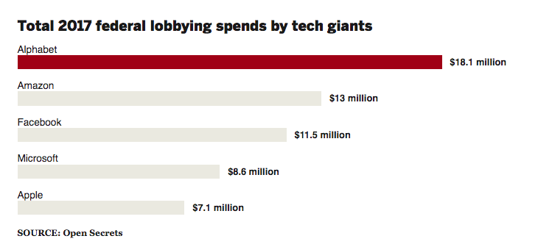
The Internet’s Gilded Age
At some point in the past decade or so the dominant position across the entire Internet has been occupied by a very small number of players who are moving far faster than the regulatory measures that were intended to curb the worst excesses of market dominance by a small clique of actors.

Slide 55
The Internet’s Gilded Age
These actors have enough market influence to set their own rules of engagement with:
  Users,
  Each other,
  Third party suppliers,
  Regulators and Governments
By taking a leading position with these emergent technologies, these players are able to amass vast fortunes, with little in the way of accountability to a broader common public good

Slide 56
The Internet’s Gilded Age
These actors have enough market influence to set their own rules of engagement with:
  Users,
  Each other,
  Third party suppliers,
  Regulators and Governments
By taking a leading position with these emergent technologies, these players are able to amass vast fortunes, with little in the way of accountability to a broader common public good
Is this the Internet we were dreaming of?

Slide 57

The Internet’s Future
Gittes: How much are you worth?
Cross: I've no idea. How much do you want?
Gittes: I just want to know what you're worth. Over
ten million?
Cross: Oh my, yes!
Gittes: Why are you doing it? How much better can you
eat? What can you buy that you can't already
afford?
Cross: The future, Mr. Gittes - the future!
Chinatown (1974)

Slide 58
What is this all about?
This is no longer just a conversation about incremental changes in carriage and communications within the Internet.
For me, the essential topic of this conversation is how we can strike a sustainable balance between an energetic private sector that has rapidly amassed overarching control of the digital service and content space, and the needs of the larger society in which we all would like some equity of opportunity to thrive and benefit from the outcomes of this new digital age.

Slide 60
What’s the problem?
Is it that these enterprises are:
  so big?
  exploitative of their workers?
  distorting markets?
  extracting monopoly rentals from consumers?
  not providing consumers what they want?

Slide 61
What’s the problem?
In the quest for ever-faster service delivery we are seeing the return of proprietary solutions in applications and service delivery platforms that expose as little as possible to the underlying network platform

Slide 62
What’s the problem?
Perhaps the problem is the looming demise of open technologies and open technology standards
  Akamai uses Fast to improve content delivery
  Google uses QUIC and BBR
  Facebook and WhatsApp use strong encryption to hide the application from the network and the platform
  Applications are no longer constructed on a platform of common libraries provided by the platform
  Applications are now paranoid and avoid exposing their behaviour wherever and whenever possible
  Applications are increasingly reluctant to use standard open technologies in standard and open ways

Slide 63
What’s the problem?
In its place we are seeing a resurgence of various closed technologies that create a set of datacentre-to-application bindings that are impervious to all third parties
These closed architectures make minimal assumptions about a common network protocol, a common name space or even a common name space
What happens to the efforts that support open technologies, open standards and open networking in such a world?

Slide 64
Where does all this head?

Slide 65
Where does all this head?
I just don’t know!
But I’m not sure that it’s all good!

Slide 66
Thanks!

