Slide 1
The Future Internet
A highly personal view by
Geoff Huston
November 2019

Slide 2
The past is a foreign land – we did things differently then

Slide 3
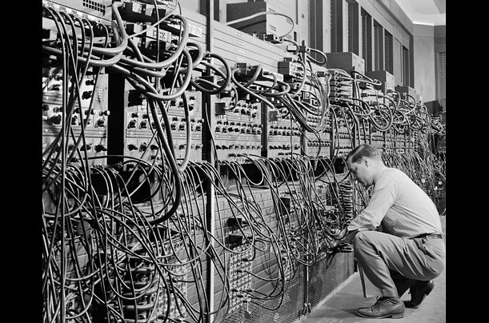
The Computing and Comms Evolutionary Path
1946 – Eniac – a numeric calculator

Slide 4
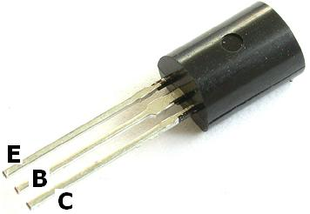
The Computing and Comms Evolutionary Path
1947– The Transistor

Slide 5
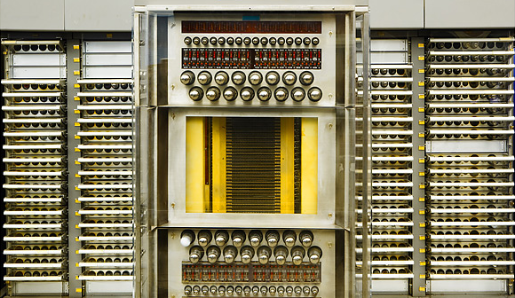
The Computing and Comms Evolutionary Path
1946 – Eniac – a numeric calculator
1954 SAGE – a programmable computer

Slide 6
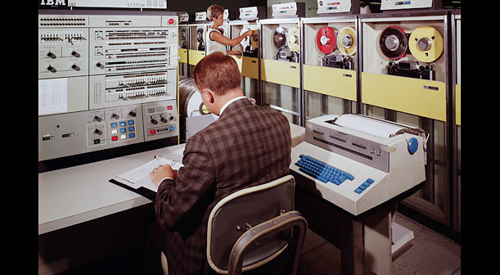
The Computing and Comms Evolutionary Path
1964 IBM 360 – commercial computing
1964: IBM 360

Slide 7
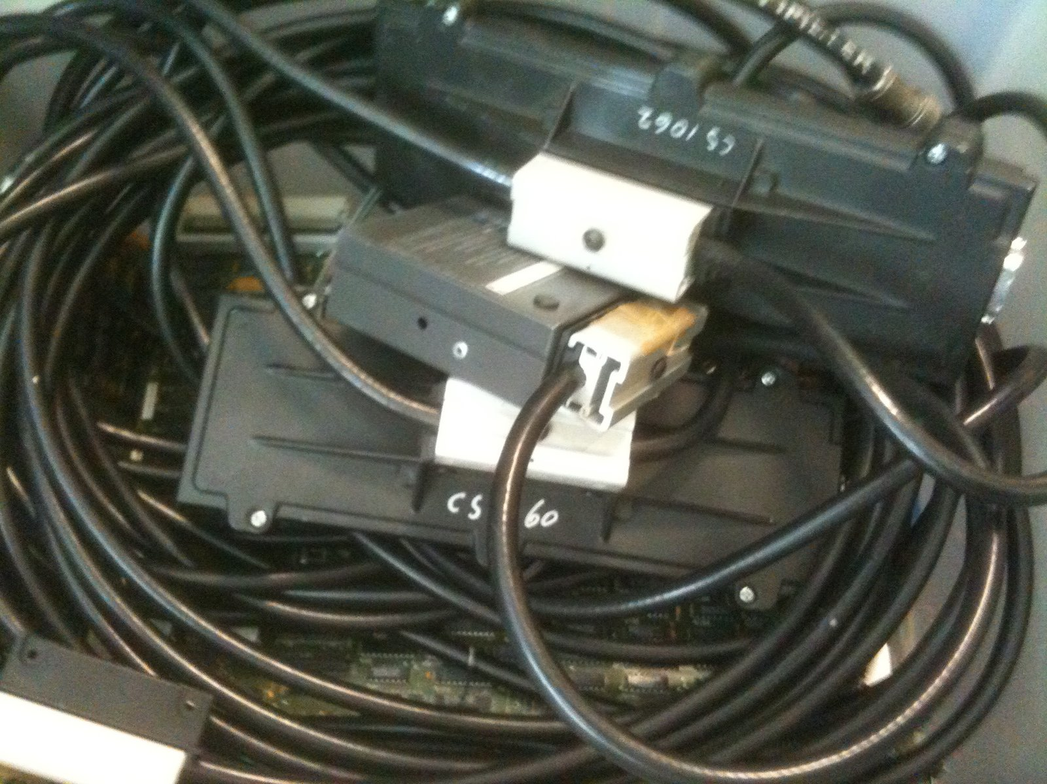
The Computing and Comms Evolutionary Path
1976 Ethernet

Slide 8
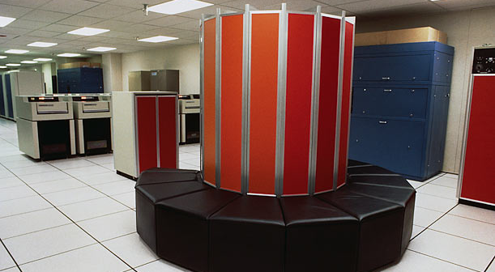
The Computing Evolutionary Path
The Computing and Comms Evolutionary Path
1976 CRAY-1 – “super” computing

Slide 9
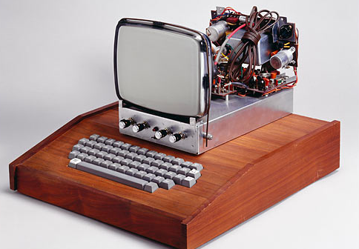
The Computing Evolutionary Path
The Computing and Comms Evolutionary Path
1976 – Apple-1
1976: Apple I

Slide 10
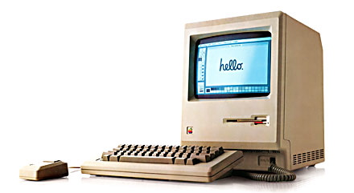
The Computing and Comms Evolutionary Path
1984 – Apple Mac

Slide 11
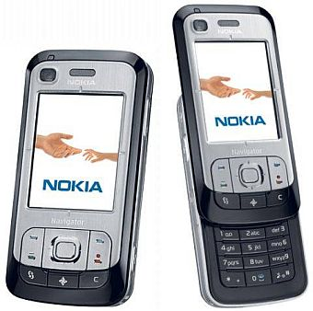
The Computing and Comms Evolutionary Path
1993 – GSM

Slide 12
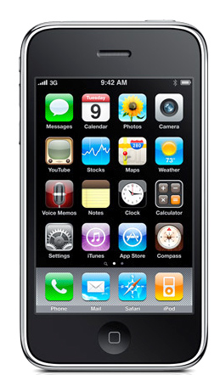
The Computing and Comms Evolutionary Path
2007 – Apple’s iPhone

Slide 13
Today!

Slide 14
The metrics of success

Slide 15
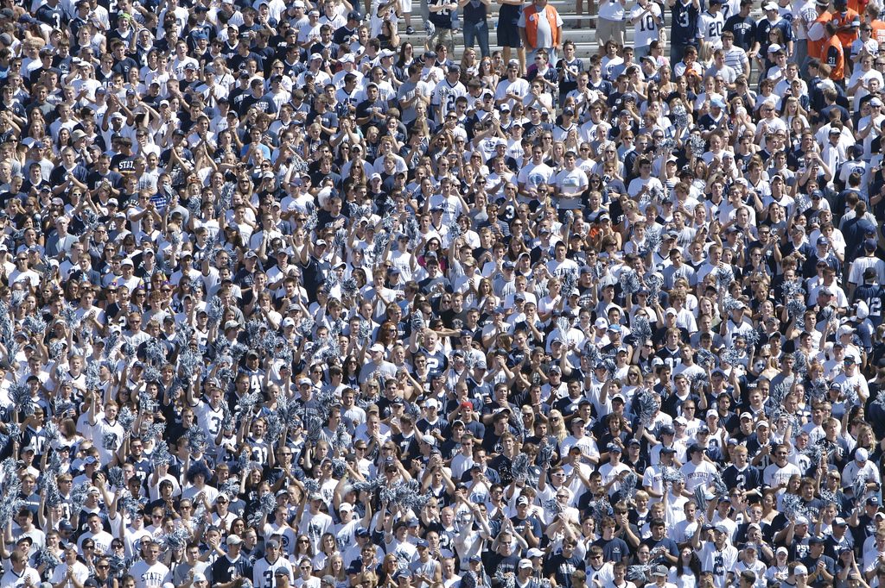
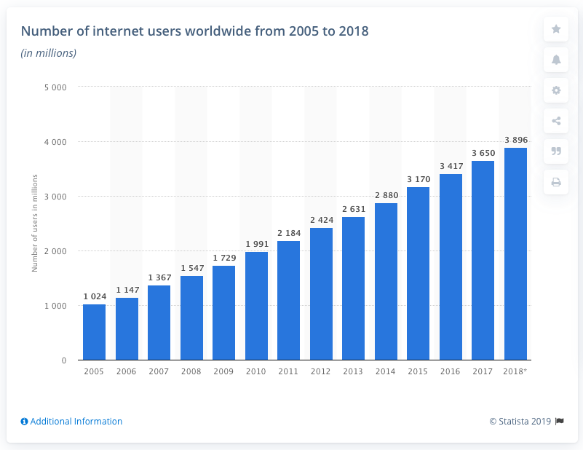
Counting Users...
There are 3.9 billion Internet users today
Source: Generator Research

Slide 16
Counting Things...
And 26 billion
Connected Things!

Slide 17
IP: Occam’s Razor applied to Networking
Why has IP been so effective?

Slide 18
IP: Occam’s Razor applied to Networking
Why has IP been so effective?
Because it’s cheap!

Slide 19
IP: Occam’s Razor applied to Networking
Why has IP been so effective?
Because it’s cheap!
Why is IP cheap?

Slide 20
IP: Occam’s Razor applied to Networking
Why has IP been so effective?
Because it’s cheap!
Why is IP cheap?
Because its minimal
in what it does!
Hop-by-Hop stateless forwarding
Datagram transmission
End-To-End data integrity
Decoupled resource management, topology management
Version
IHL
Type of Service
Total Length
Identification
Flags
Fragment Offset
Time To Live
Protocol
Header Checksum
Source Address
Destination Address
Options
Padding

Slide 21
IP: Occam’s Razor applied to Networking
Why has IP been so effective?
Because it’s cheap!
Why is IP cheap?
Because its minimal
in what it does!
Hop-by-Hop stateless forwarding
Datagram transmission
End-To-End data integrity
Decoupled resource management, topology management
Version
IHL
Type of Service
Total Length
Identification
Flags
Fragment Offset
Time To Live
Protocol
Header Checksum
Source Address
Destination Address
Options
Padding
What about all the other “network” functions?

Slide 22
We added stuff to the network

Slide 23
We added:
Identity and location overloading
Multicast
Packet quantization and fragmentation
(in)security
Delay
IPv6
Jitter control
IPv6 Transition
Buffering and Queues
Tunnels
Ultra High Speed
MPLS
Routing
High Speed
Congestion Control
Consistent Speed
QoS
Load Management

Slide 24
What’s not working…
Identity and location overloading
Multicast
(in)security
Packet quantization and fragmentation
Delay
IPv6
Jitter control
IPv6 Transition
Buffering and Queues
Tunnels
Ultra High Speed
MPLS
Routing
High Speed
Congestion Control
Consistent Speed
QoS
Load Management

Slide 25
What really needs to work…
Scaling

Slide 26
What might happen?

Slide 27
What might happen?
We can keep on scaling – right?

Slide 28
People: It’s a mobile world!
2017: 1.5 billion mobile units shipped
Factors:
Production volumes bring down component unit cost
Common platform (Android) is bringing down software unit cost
No need for new content - leverage off the the existing web universe of content
Assumes an abundant minimal common network substrate

Slide 29
People: It’s a mobile world!
saturated

Slide 30
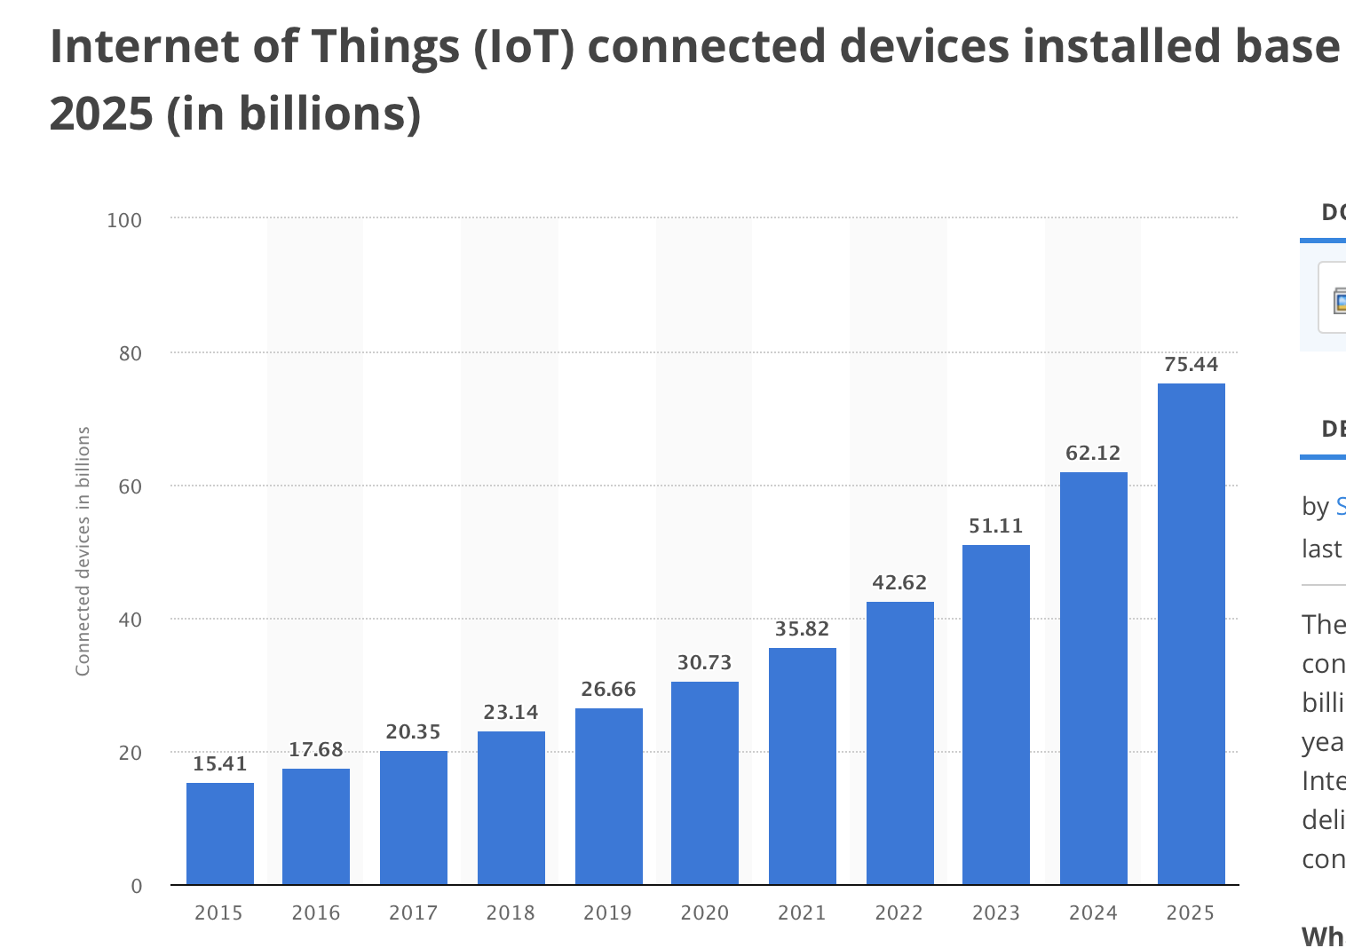
Things

Slide 31
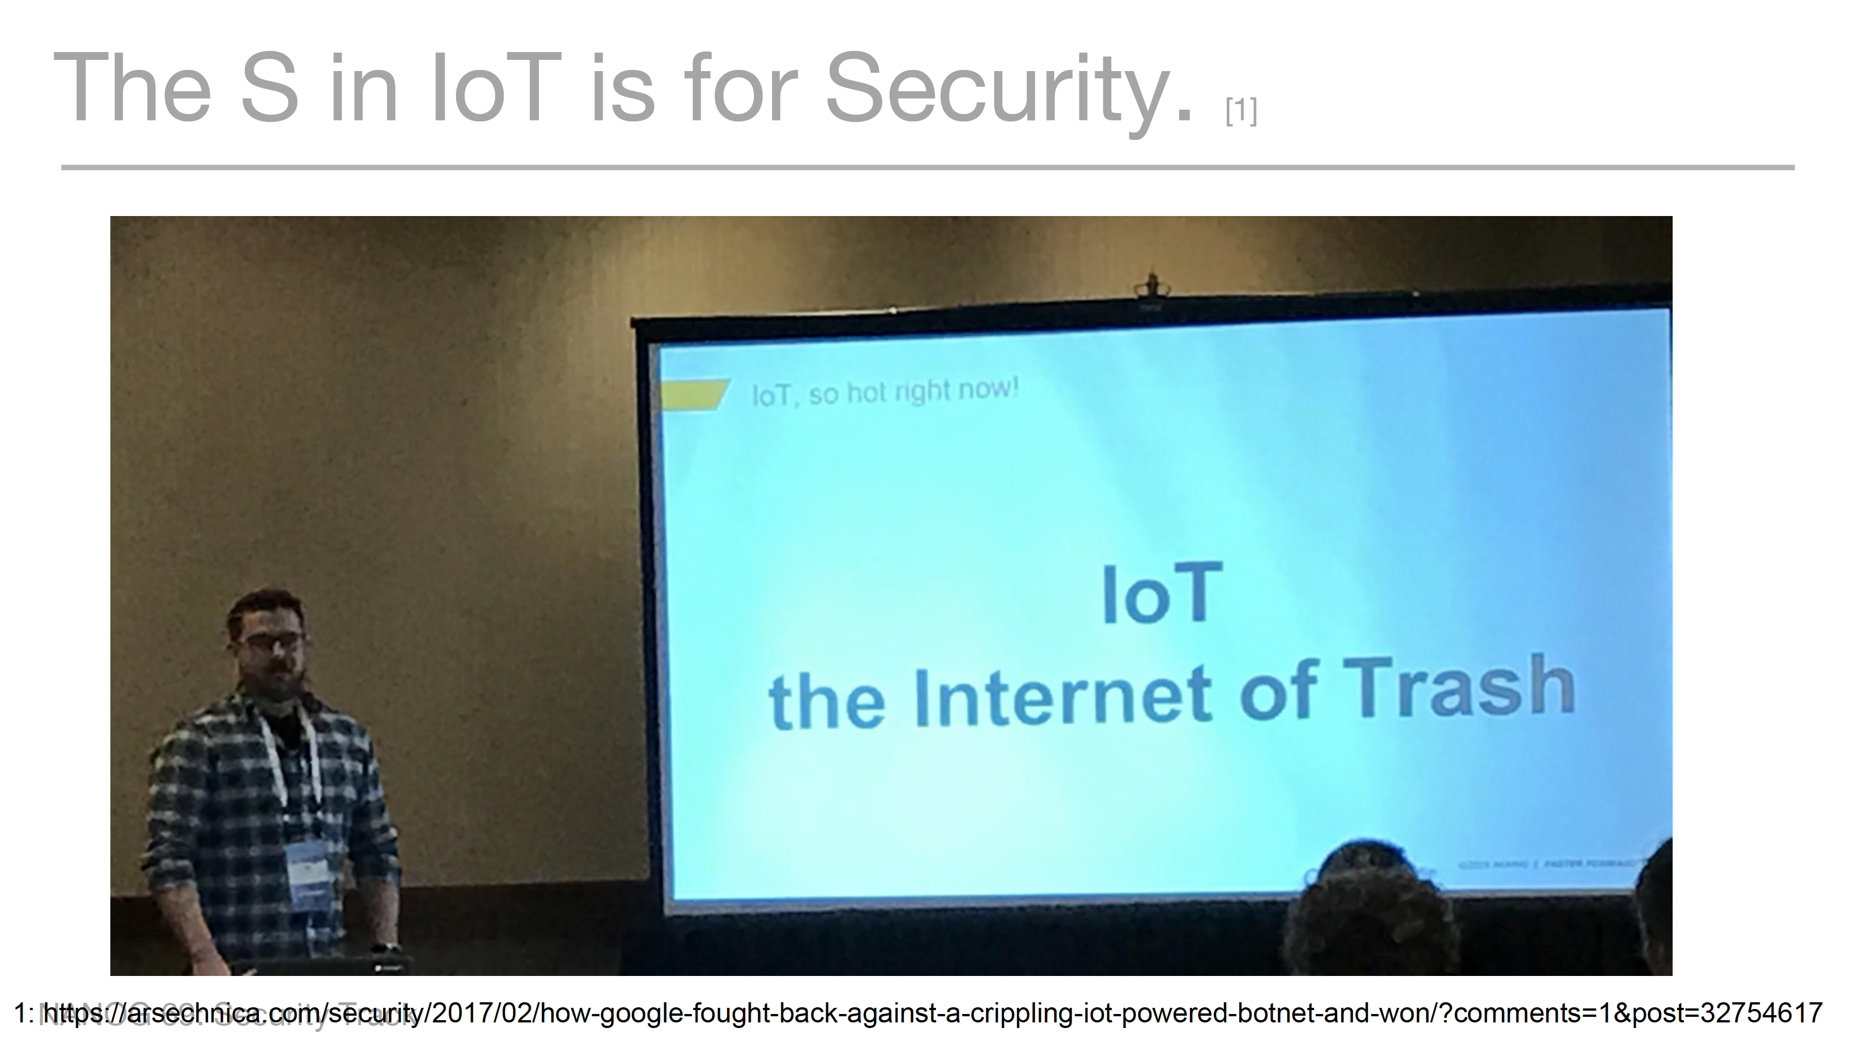
Cheap, Plentiful, Toxic, Demented Things

Slide 32
Physics

Slide 33
Physics
1T
100G
composite (PPAM)optics
10G
Peak Circuit Speed (log scale)
1G
100M
10M
shutter (on/off)optics
1990
1995
2000
2005
2010
2015
2020

Slide 34
What might happen?
We can keep on scaling – right?
Wrong!

Slide 35
If the Internet can’t keep scaling, then let’s change it!

Slide 36
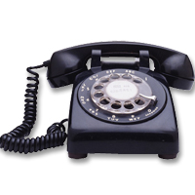
Telephony Networking

Slide 37
Telephony Networking
Microphone
Speaker
Network Magic *
Bell
Pulse Generator
The Network defines the Service

Slide 38
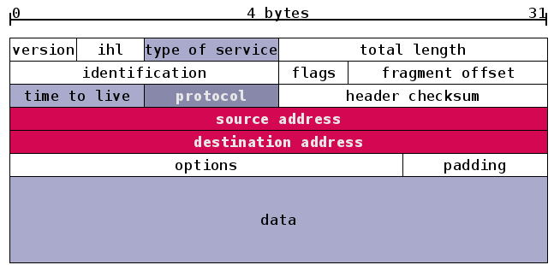
Computer Networking
Packet Switch
network
Platform Functions
Packets
The Platform defines
the Services

Slide 39
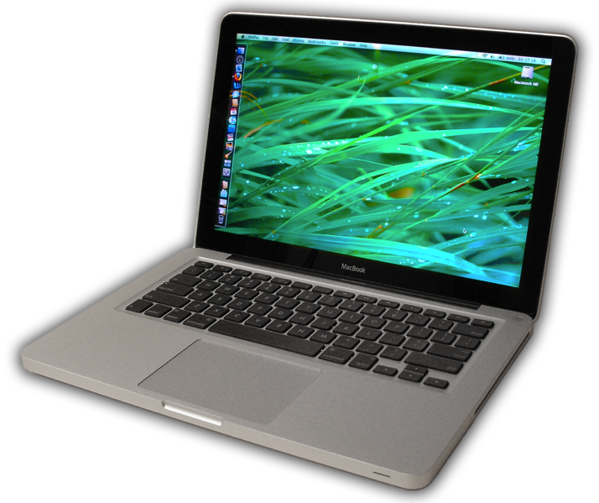
Computer Networking
Application Servers
network
Application Clients
The Applications define
the Services

Slide 40
Computer Networking
network
Content Clouds
The Cloud defines
the Services

Slide 41
Computer Networking
The Internet is no longer a network – its just a last mile aggregator for content and service distribution platforms!
network
Content Clouds
The Cloud defines
the Services

Slide 42
IP: Occam’s Razor applied to Networking
Why has IP been so effective?
Because it’s cheap!
Why is IP cheap?
Because its minimal
in what it does!
Hop-by-Hop stateless forwarding
Datagram transmission
End-To-End data integrity
Decoupled resource management, topology management
Version
IHL
Type of Service
Total Length
Identification
Flags
Fragment Offset
Time To Live
Protocol
Header Checksum
Source Address
Destination Address
Options
Padding
What about all the other “network” functions?
They are now part of the upper levels in applications, not part of the network!

Slide 43
Application-centric networking
Pushing functionality into user space within the application and bypassing common infrastructure
QUIC – a user level transport and security solution
DoH - a user level DNS name resolution approach

Slide 44
Where to from here?

Slide 45
The Internet is not planned, not organised, not orchestrated

Slide 46
The Internet is not planned, not organised, not orchestrated
Users propel the Internet!

Slide 47
What’s shaping our future?
We need to think about world where computation, storage and communications are all abundant commodities. It’s innovative services and applications that will shape much of the Internet’s future. And the most effective innovative force in such an environment is open technologies, and open software in particular. This allows innovators to assume the entirety of the current state of the art and build from there. This is truly a powerful model!

Slide 48
In thinking about a future Internet

Slide 49
There’s no need to clean the slate

Slide 50
There’s no need to clean the slate
Nor to forget everything we’ve learned about packet networks so far

Slide 51
There’s no need to clean the slate
Nor to forget everything we’ve learned about packet networks so far
But we need to think about a future that is way beyond today’s Internet

Slide 52
And as we look at the evolution of this digital platform there are probably two important design principles to bear in mind

Slide 53
Focus

Slide 54
Simplicity

Slide 55
Thank You!

