Slide 1
Another year of BGP!
Geoff Huston
Chief Scientist, APNIC

Slide 2

Through the Routing Lens …
There are very few ways to assemble a single view of the entire Internet
The lens of routing is one of the ways in which information relating to the entire reachable Internet is bought together
Even so, its not a perfect lens, but it can provide some useful insights about the entire scope of the Internet

Slide 3
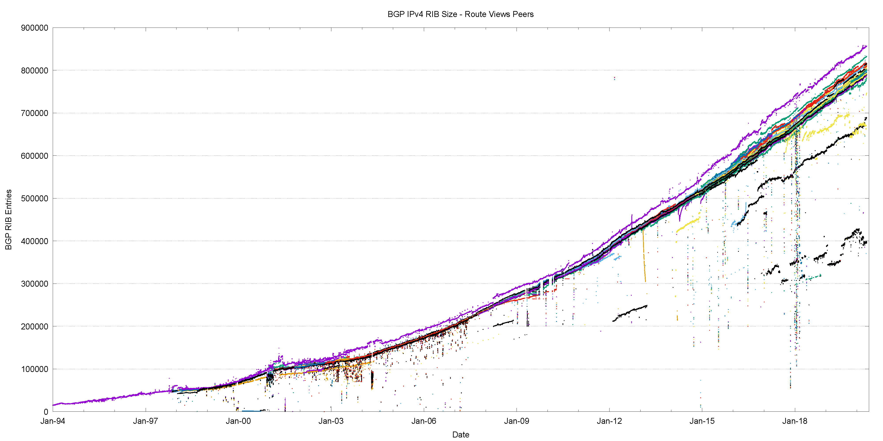
25 Years of Routing the Internet
This is a view pulled together from each of the routing peers of Route-Views
2011: Address Exhaustion
2005: Consumer Market
2001: The Great Internet
Boom and Bust
1994: Introduction of CIDR

Slide 4
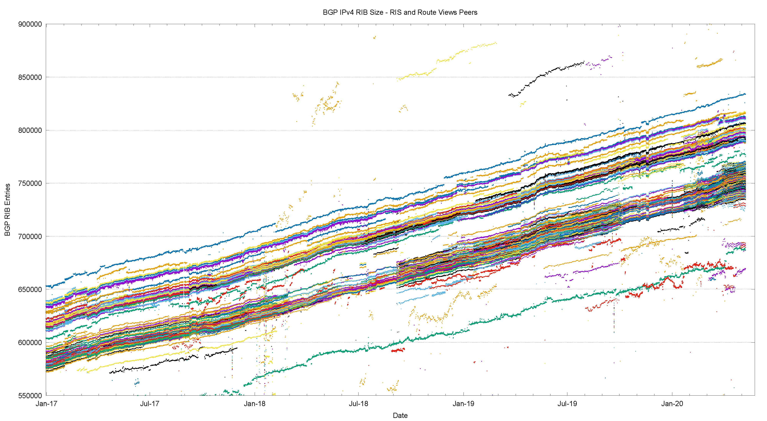
2017-2020 in detail

Slide 5
2017-2020 in detail
Route Views Peers
average growth trend
RIS Peers

Slide 6
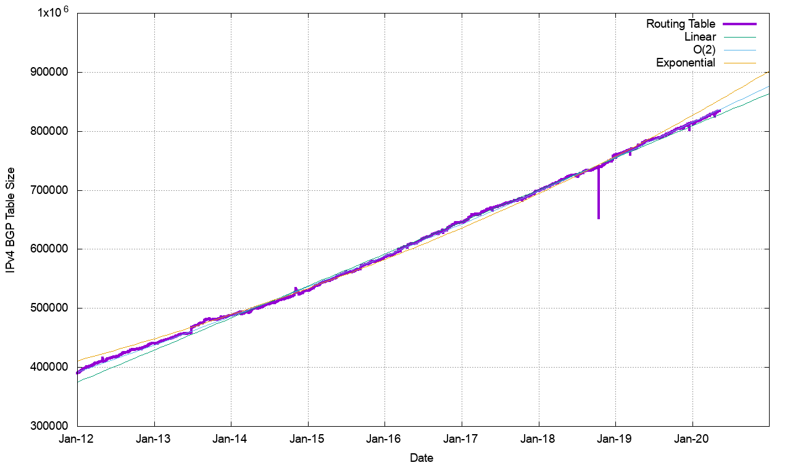
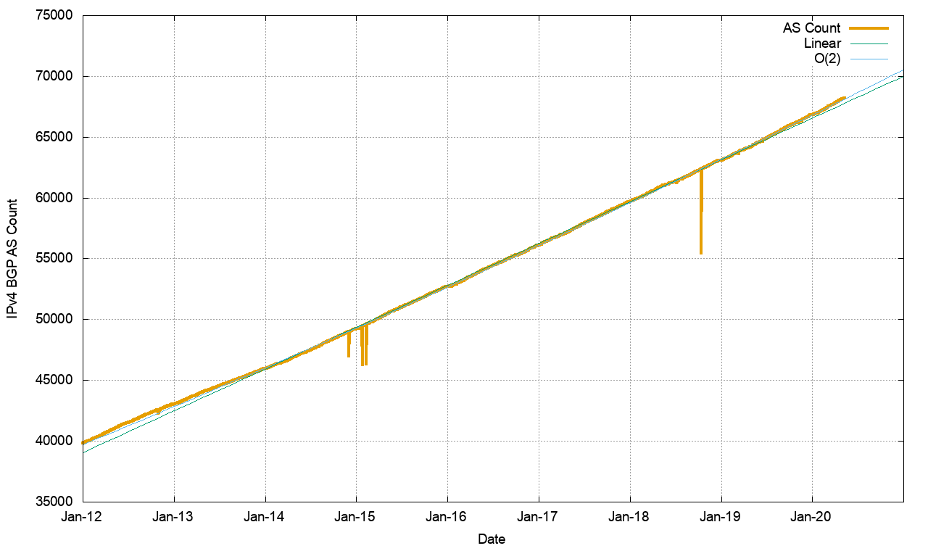
Routing Indicators for IPv4
Routing prefixes – growing by some 55,000 prefixes per year
AS Numbers– growing by some 3,400 prefixes per year

Slide 7
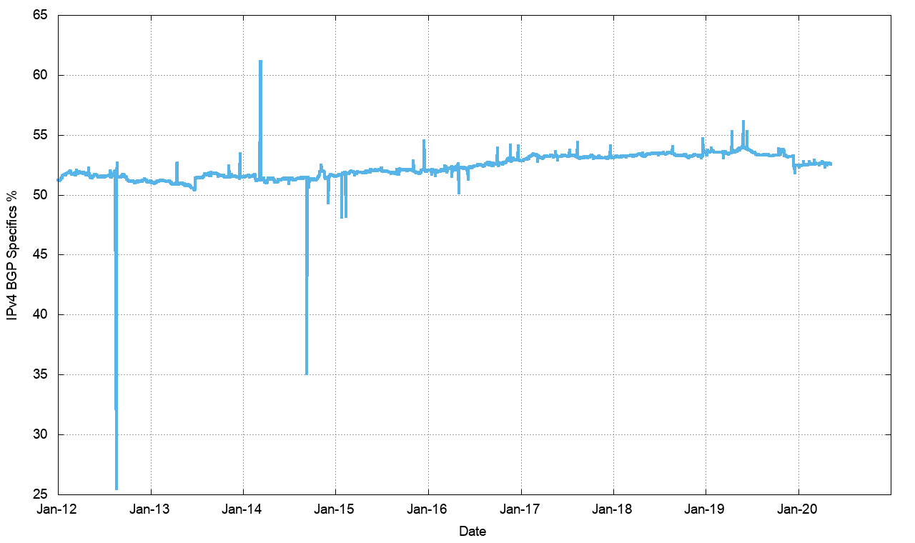
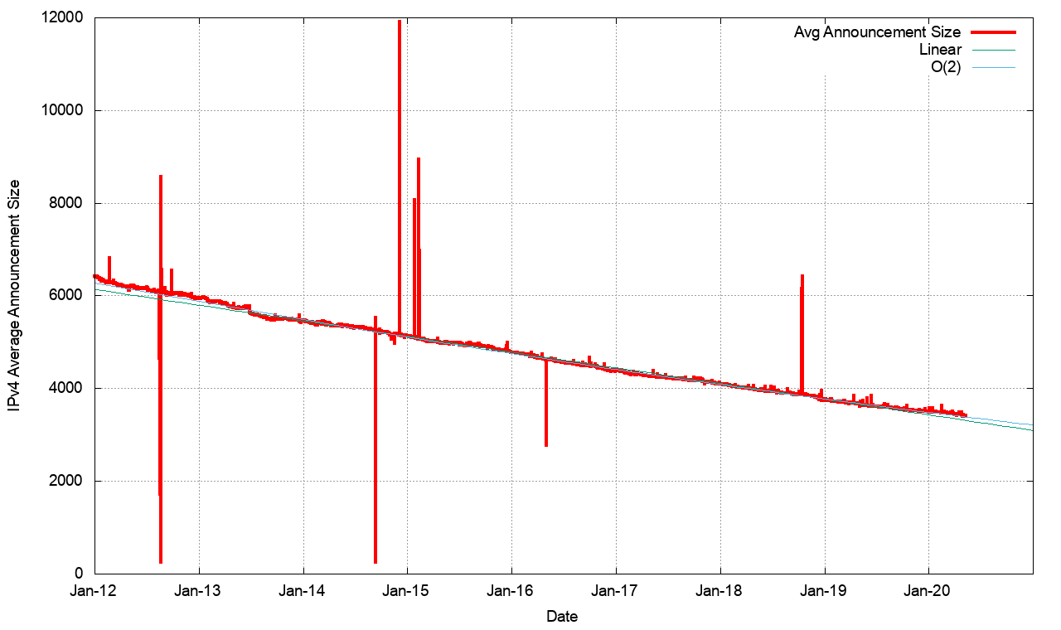
Routing Indicators for IPv4
More Specifics are still taking up slightly more than one half of the routing table
But the average size of a routing advertisement continues to shrink

Slide 8
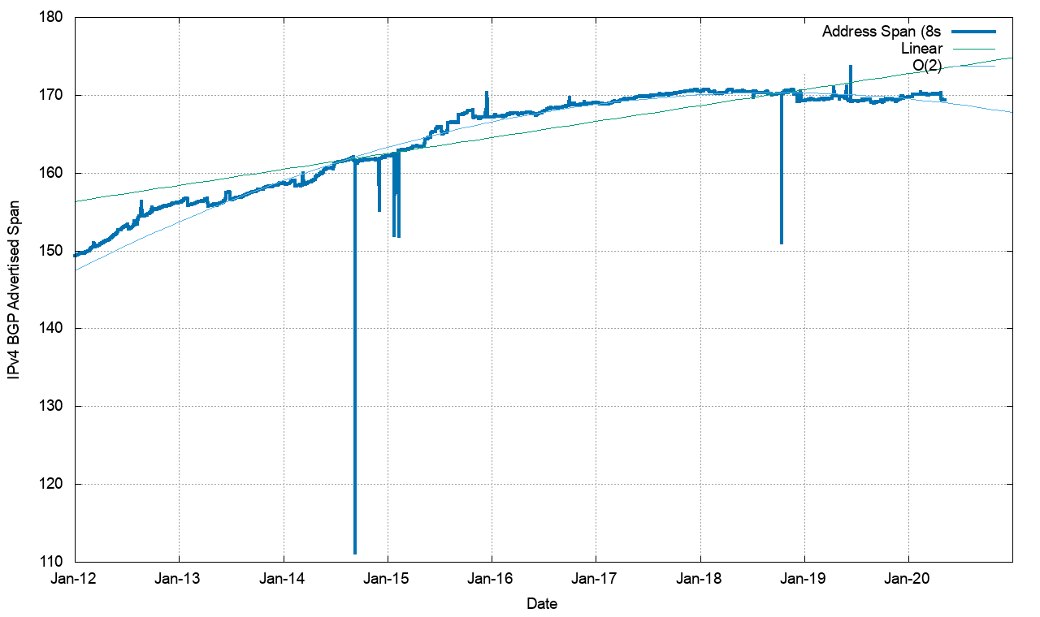
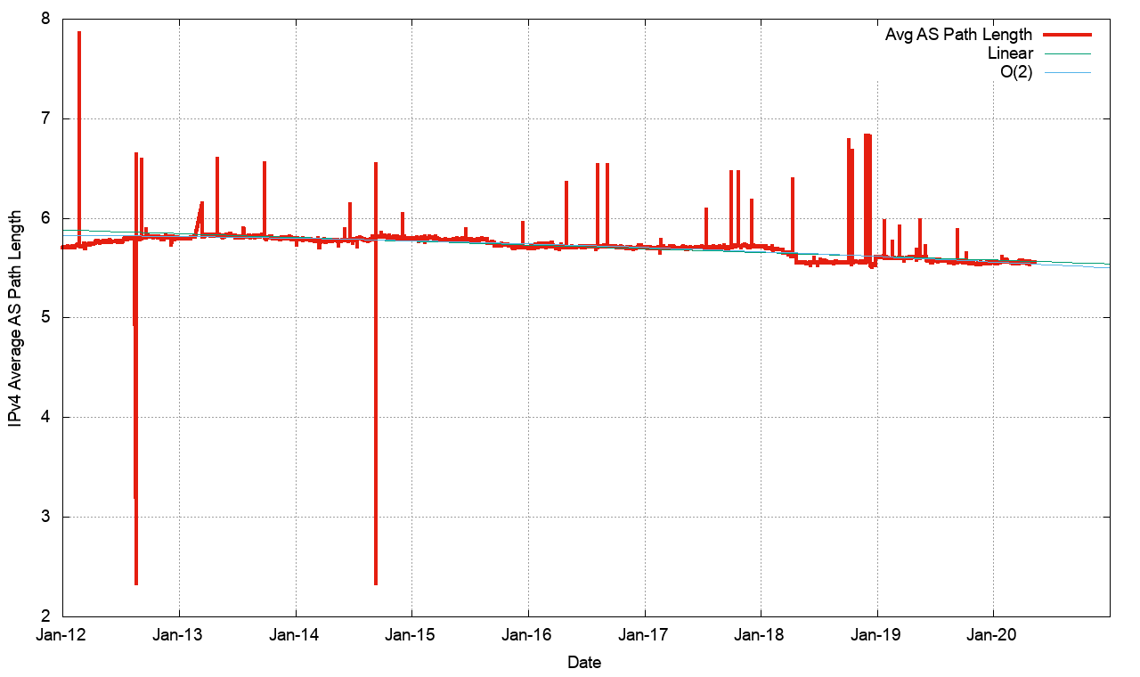
Routing Indicators for IPv4
Address Exhaustion is now visible in the extent of advertised address space
The “shape” of inter-AS interconnection appears to be relatively steady

Slide 9
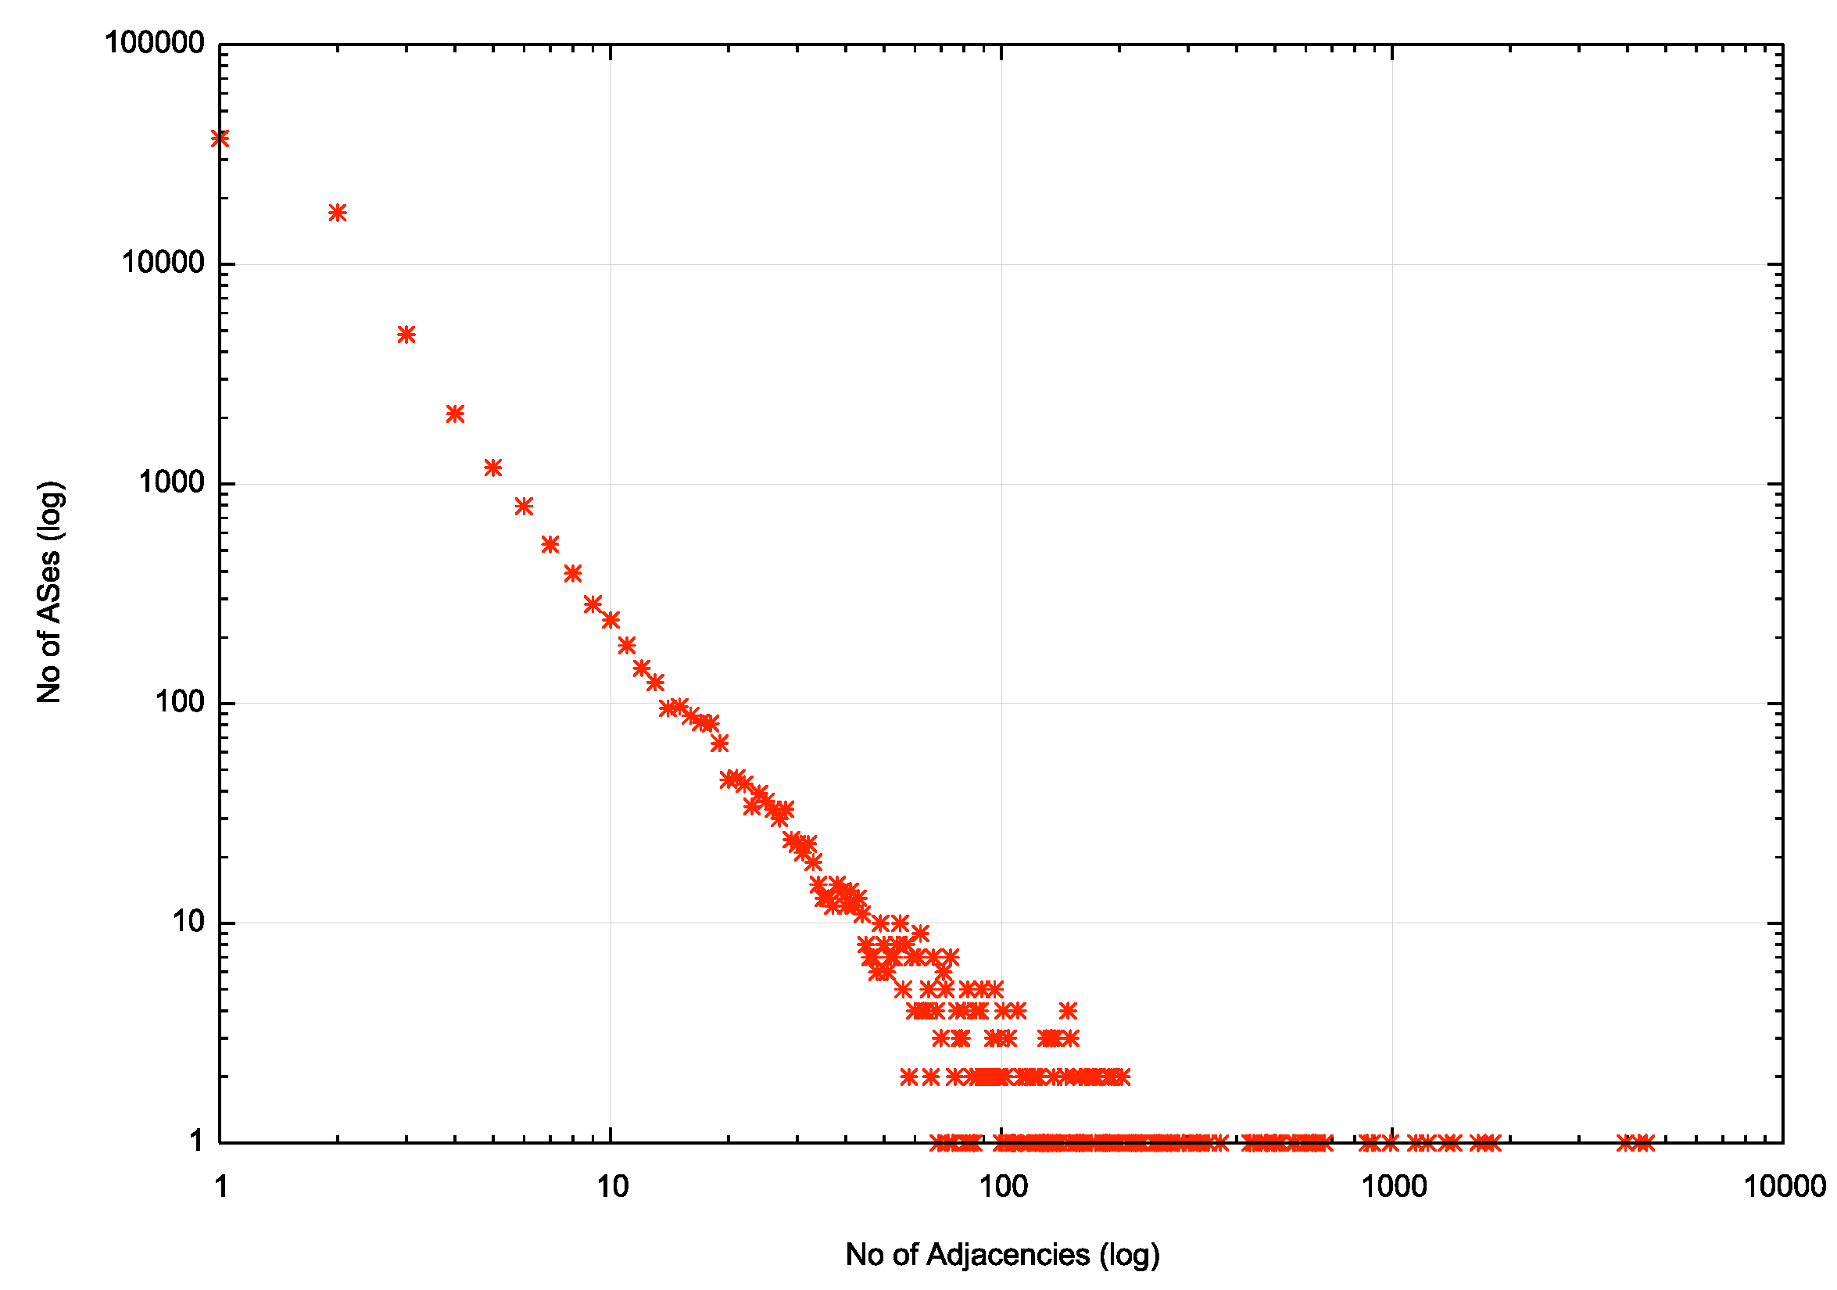
AS Adjacencies (AS131072)
54,697 out of 66,928 ASNs have 1 or 2 AS Adjacencies (82%)
2,195 ASNs have 10 or more adjacencies
10 ASNs have >1,000 adjacencies
4,788 AS6939 HURRICANE, US
4,378 AS3356 LEVEL3, US
3,870 AS174 COGENT-174, US
1,877 AS6461 ZAYO-6461, US
1,735 AS7018 ATT-INTERNET4, US
1,675 AS3257 GTT-BACKBONE GTT, DE
1,413 AS2914 NTT-COMMUNICATIONS-2914, US
1,306 AS1299 TELIANET Telia Carrier, EU
1,304 AS3549 LVLT-3549, US
1,161 AS209 CENTURYLINK-US-LEGACY-QWEST, US
Most networks are stub AS’s
A small number of major connectors

Slide 10
What’s happening in V4?
Routing Business as usual – despite IPv4 address exhaustion!
  From the look of the growth plots, its business as usual, despite the increasing pressures on IPv4 address availability
  The number of entries in the IPv4 default-free zone has now reached 840,000
  The pace of growth of the routing table is still relatively constant at ~51,000 new entries and 3,400 new AS’s per year
    IPv4 address exhaustion is not changing this!
    Instead, we appear to be advertising shorter prefixes into the routing system

Slide 11
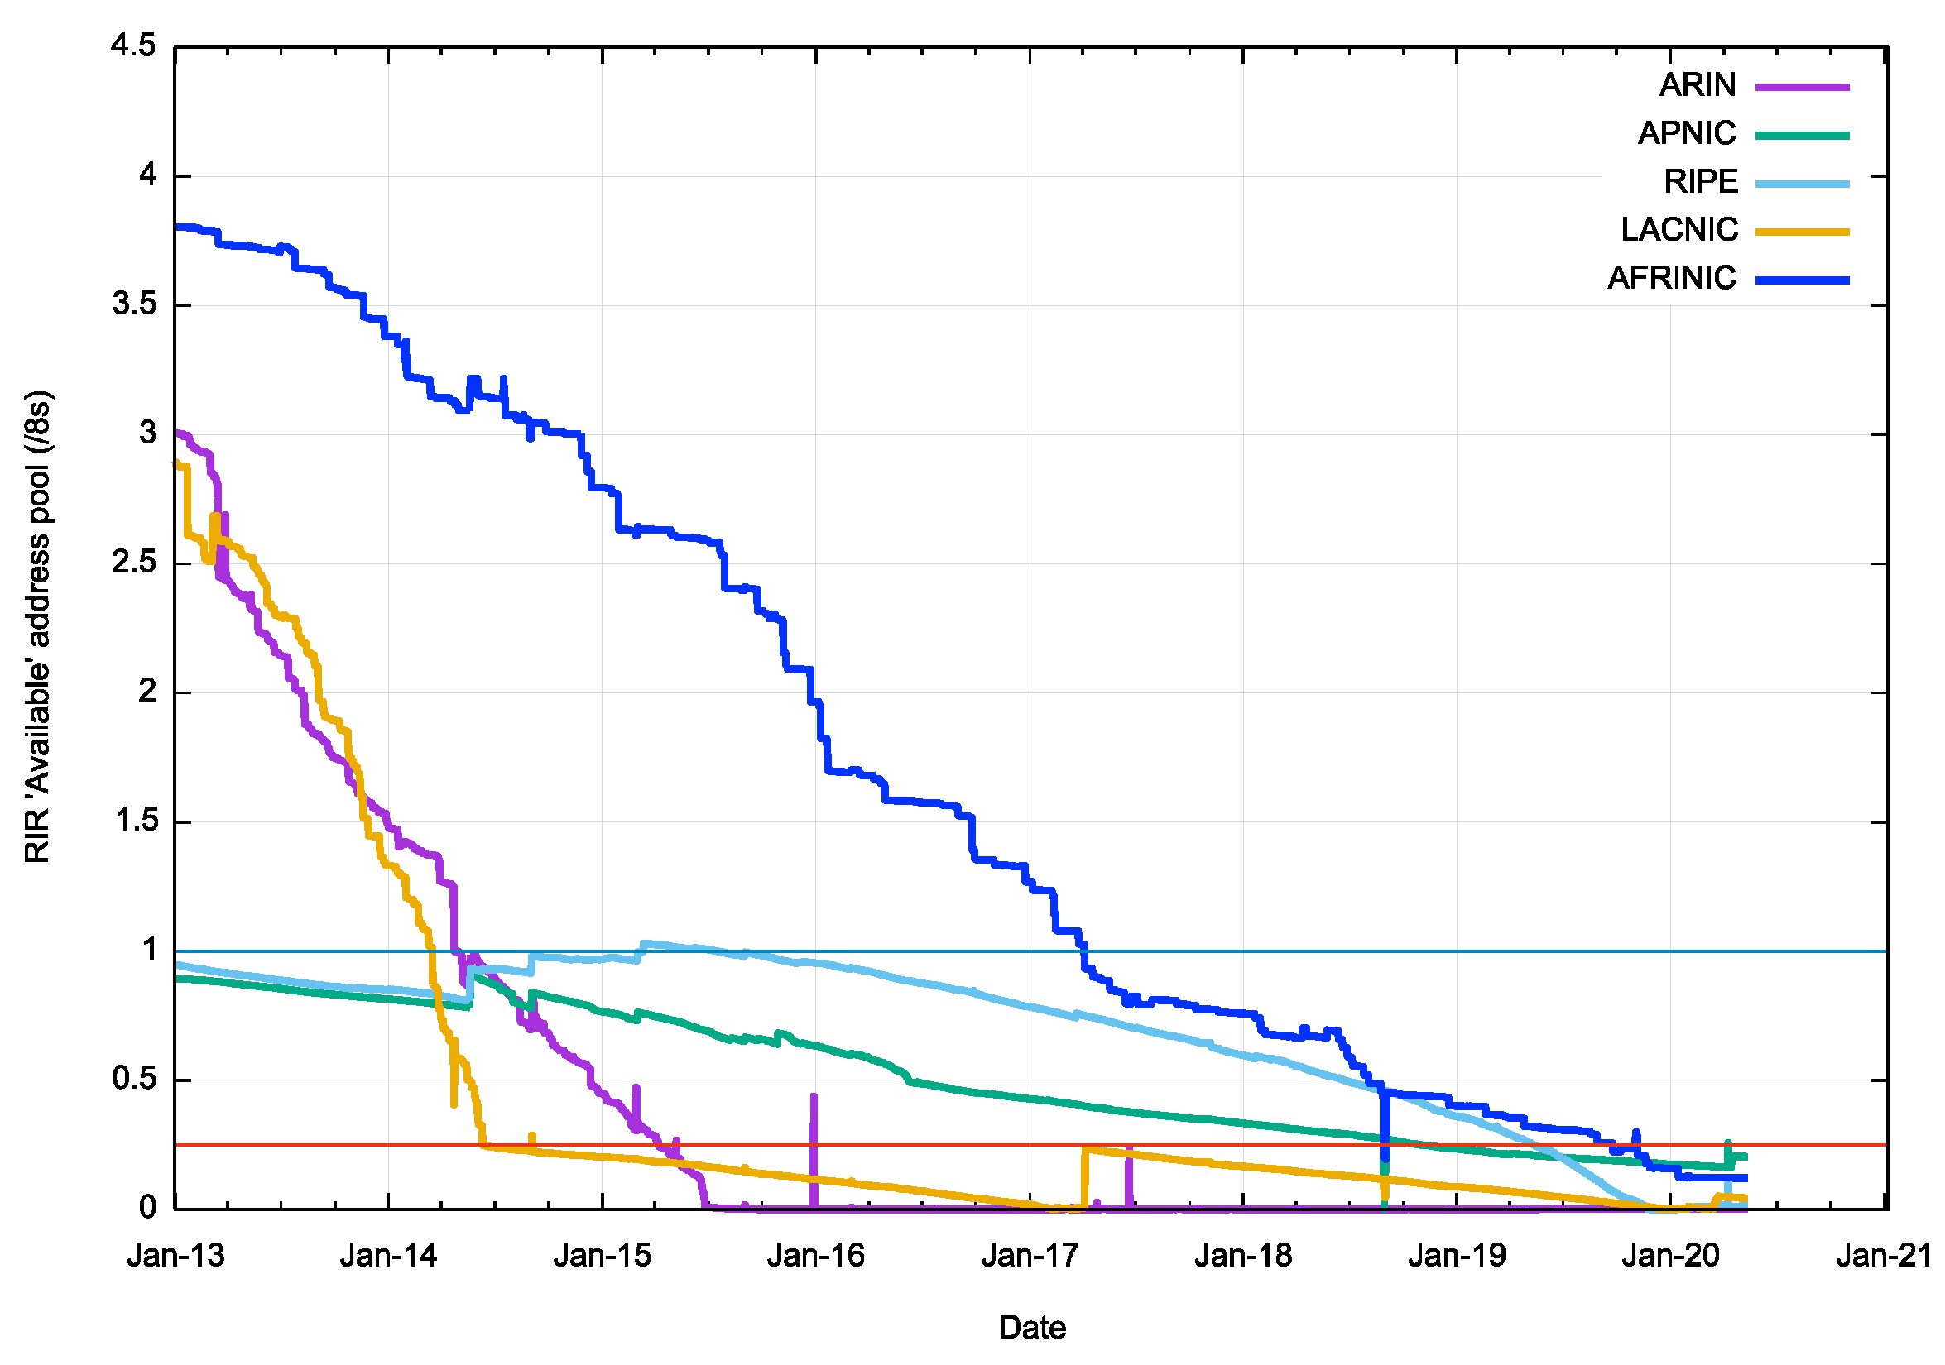
What about IPv4 Address Exhaustion?
RIR Address Pool runout projections:
ARIN – no free pool left
AFRINIC – December 2020
LACNIC – no free pool left
APNIC – January 2021
RIPE NCC – no free pool left

Slide 12
Post-Exhaustion Routing Growth
What’s driving this post-exhaustion growth?
  Transfers?
  Last /8 policies in RIPE and APNIC?
  Leasing and address recovery?

Slide 13
Advertised Address “Age”
2010
2% of all new addresses announced in 2010 were >= 20 years ‘old’ (legacy)
80% of all new addresses announced in 2010 were allocated or assigned within the past 12 months

Slide 14
Advertised Address “Age”
2019
Re-use of legacy addresses
transfers

Slide 15
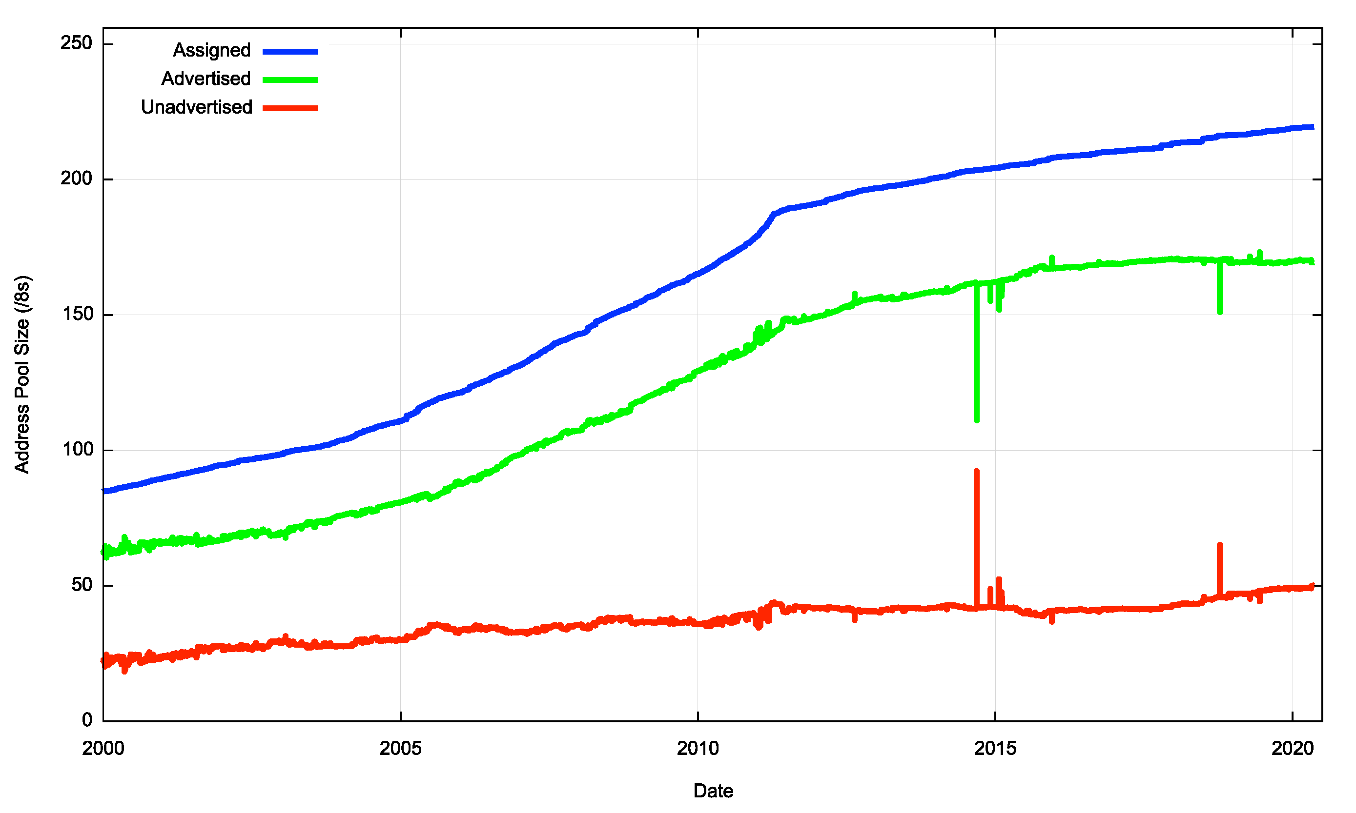
2000 – 2020: IPv4 Advertised vs Unadvertised

Slide 16
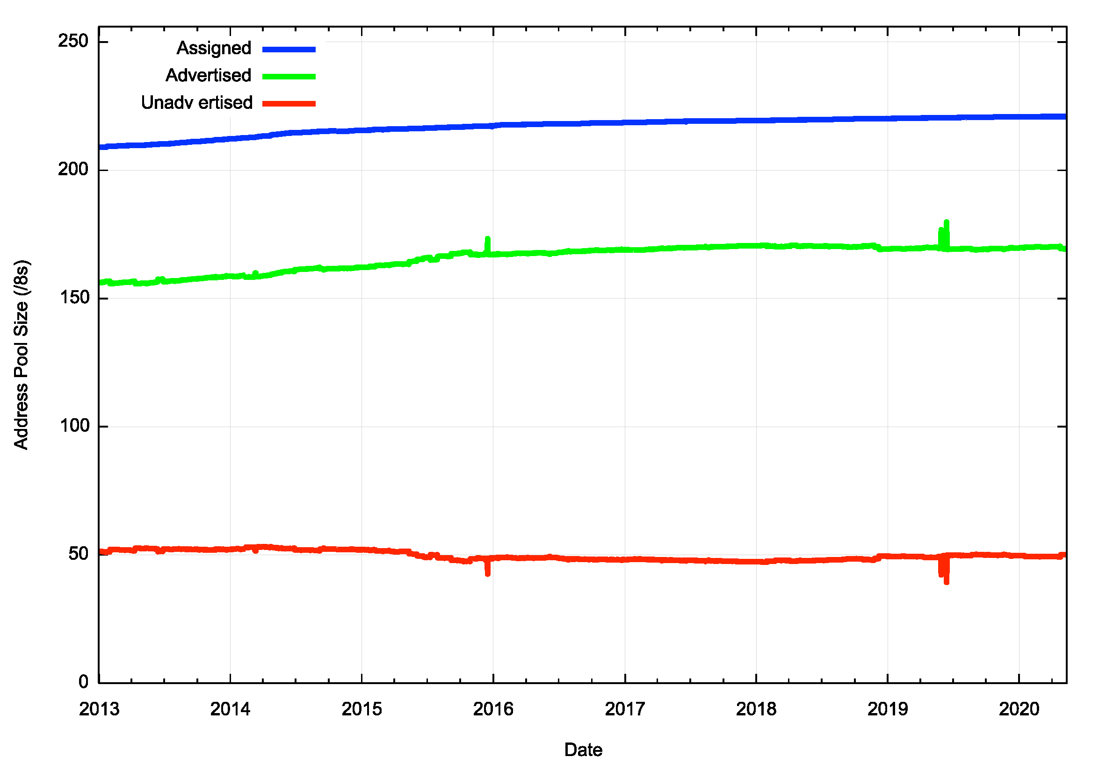
2013 – 2020: Post Free Pool Exhaustion IPv4 Advertised vs Unadvertised

Slide 17
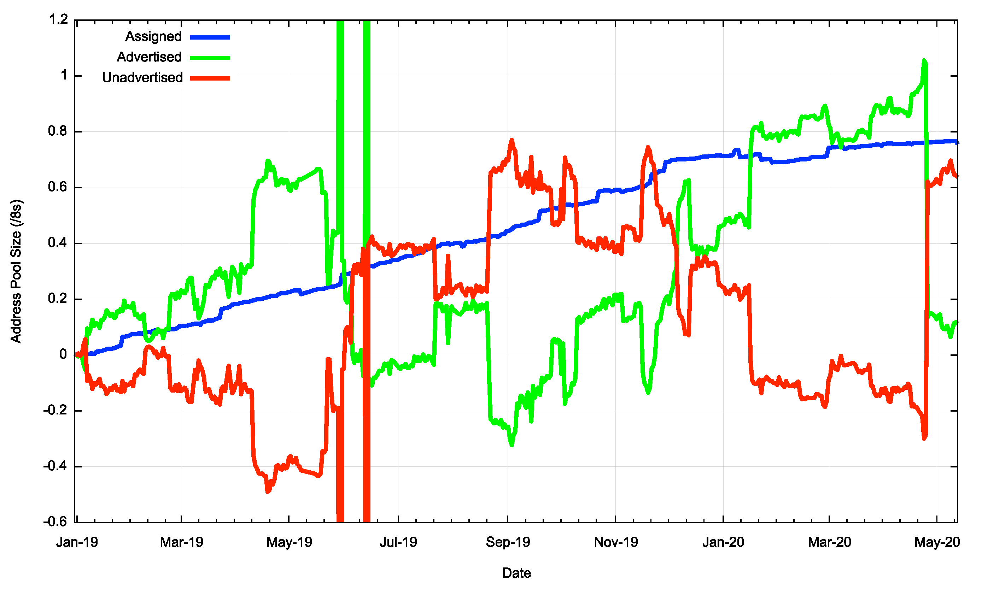
2019 - 2020: Assigned vs Unadvertised
Change in Advertised Addresses
Change in the Unadvertised Address Pool
Unadvertised growth
Advertised growth
RIR Allocations

Slide 18
V4 for the last 16 months
The equivalent of 0.1 /8s were added to the routing table
  It would’ve been 1.1 /8s but on April 25 57.0.0.0/8 (SITA) was withdrawn from the routing table
Approximately 0.8 /8s were assigned by RIRs
  0.35 /8s assigned by the RIPE NCC (last /8 allocations)
  0.24 /8’s assigned by Afrinic
  0.10 /8s were assigned by LACNIC
  0.07 /8s were assigned by APNIC (last /8 allocations)
And a net of 0.7 /8’s were added to the pool of unadvertised addresses
Over this period we saw legacy blocks transferring away from ISPs / end user sites and heading towards cloud SPs.

Slide 19
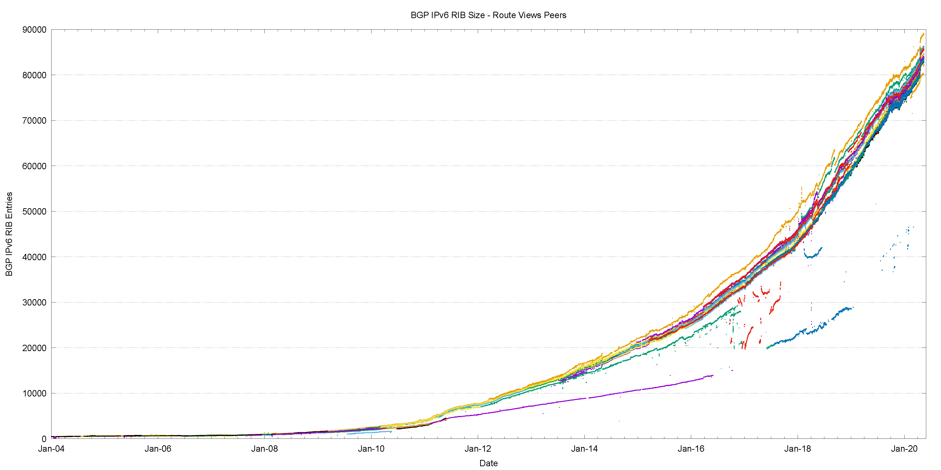
The Route-Views View of IPv6
IANA IPv4 Exhaustion

Slide 20
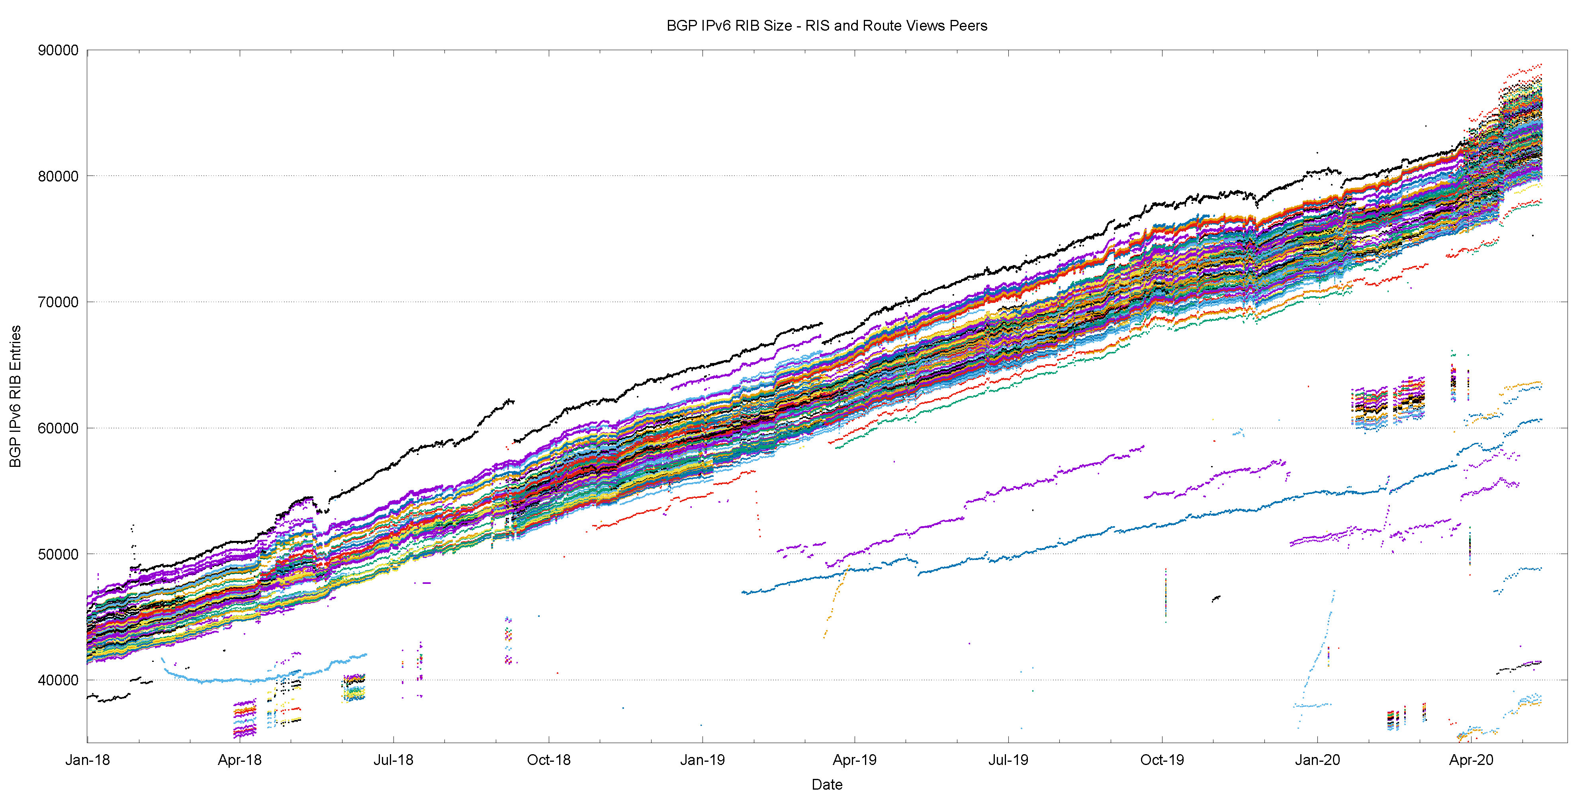
2018-2020 in Detail

Slide 21
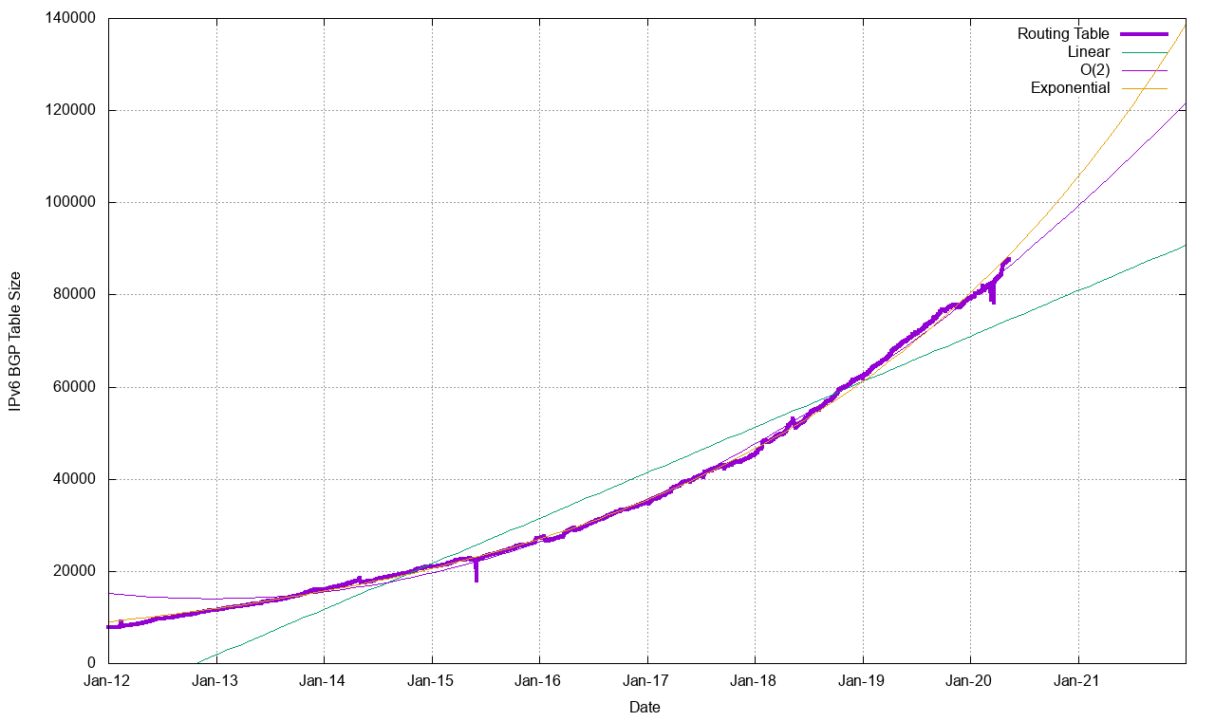
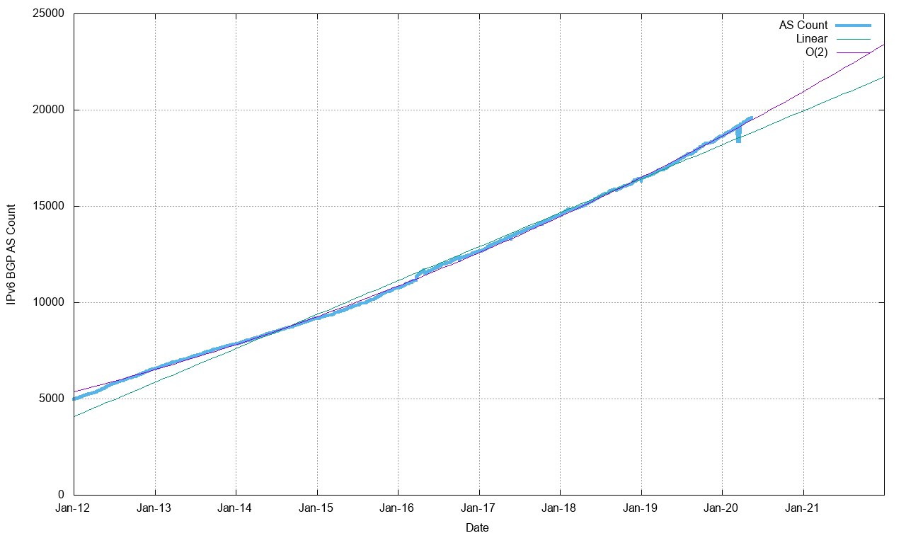
Routing Indicators for IPv6
Routing prefixes – growing by some 20,000 prefixes per year
AS Numbers– growing by some 2,000 ASNs per year (which is 60% the V4 growth)

Slide 22
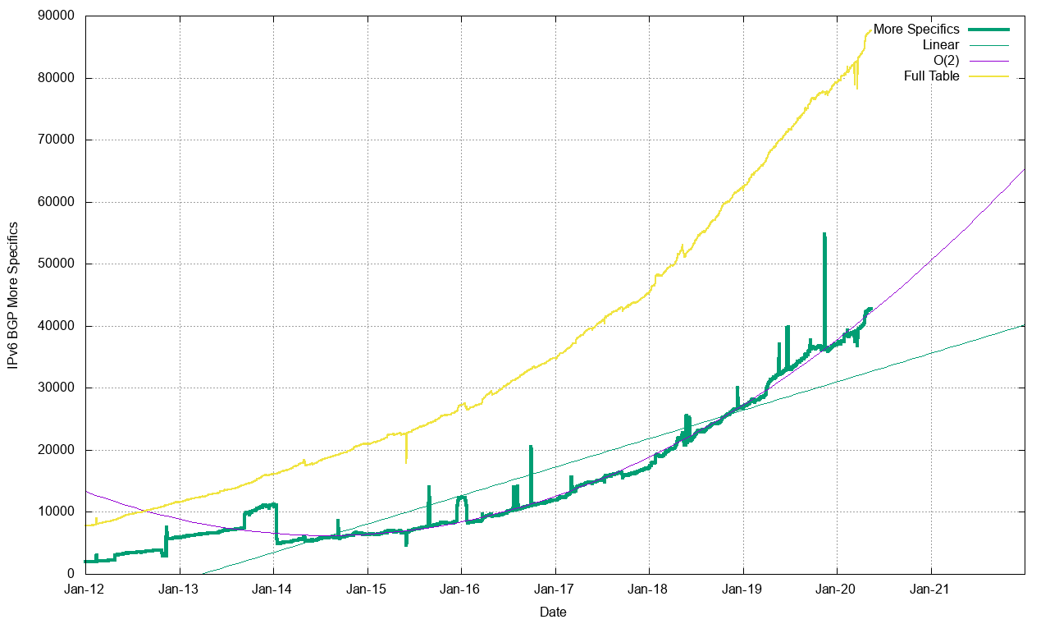
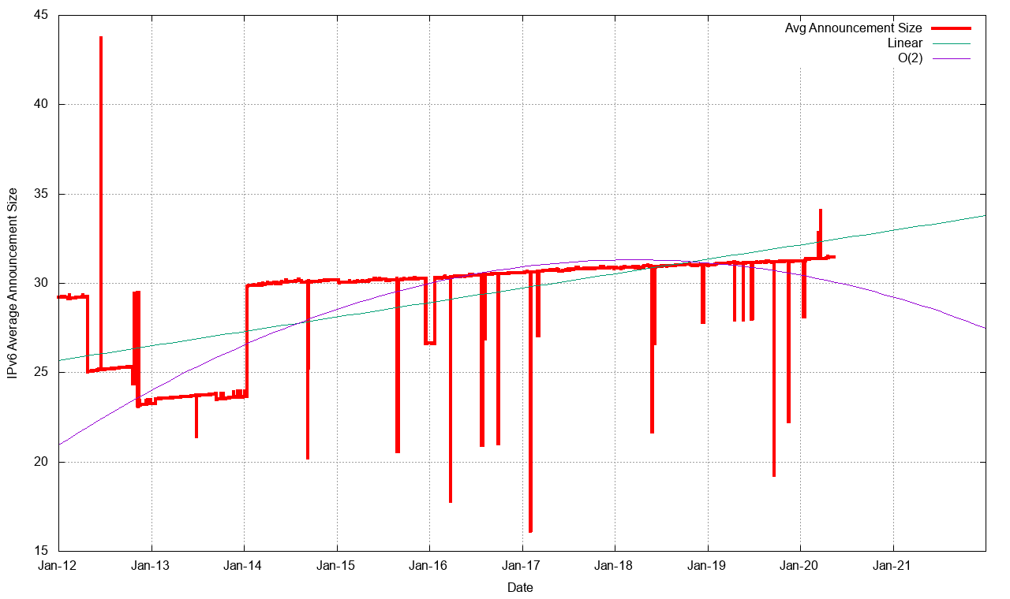
Routing Indicators for IPv6
More Specifics now take up one half of the routing table
The average size of a routing advertisement is getting smaller

Slide 23
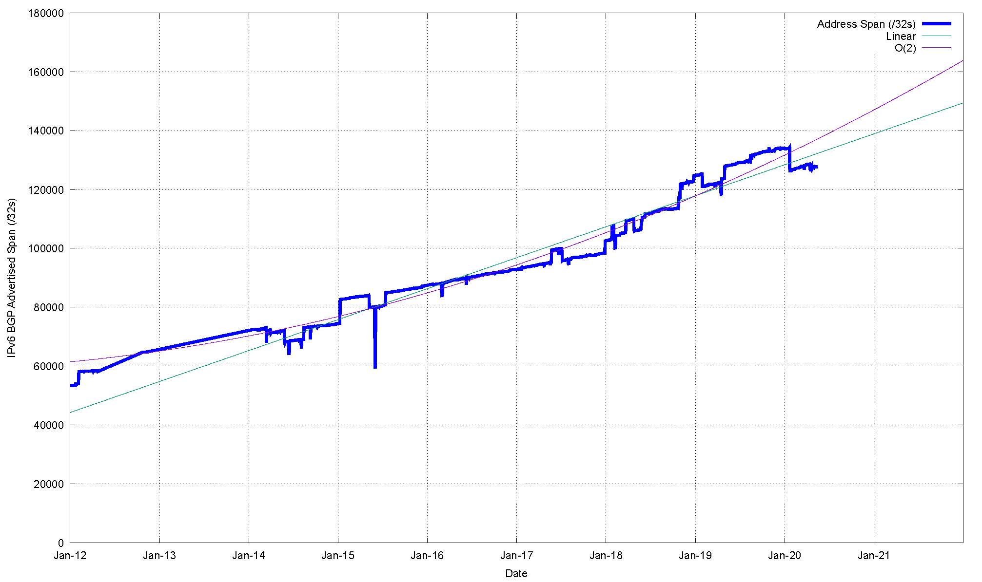
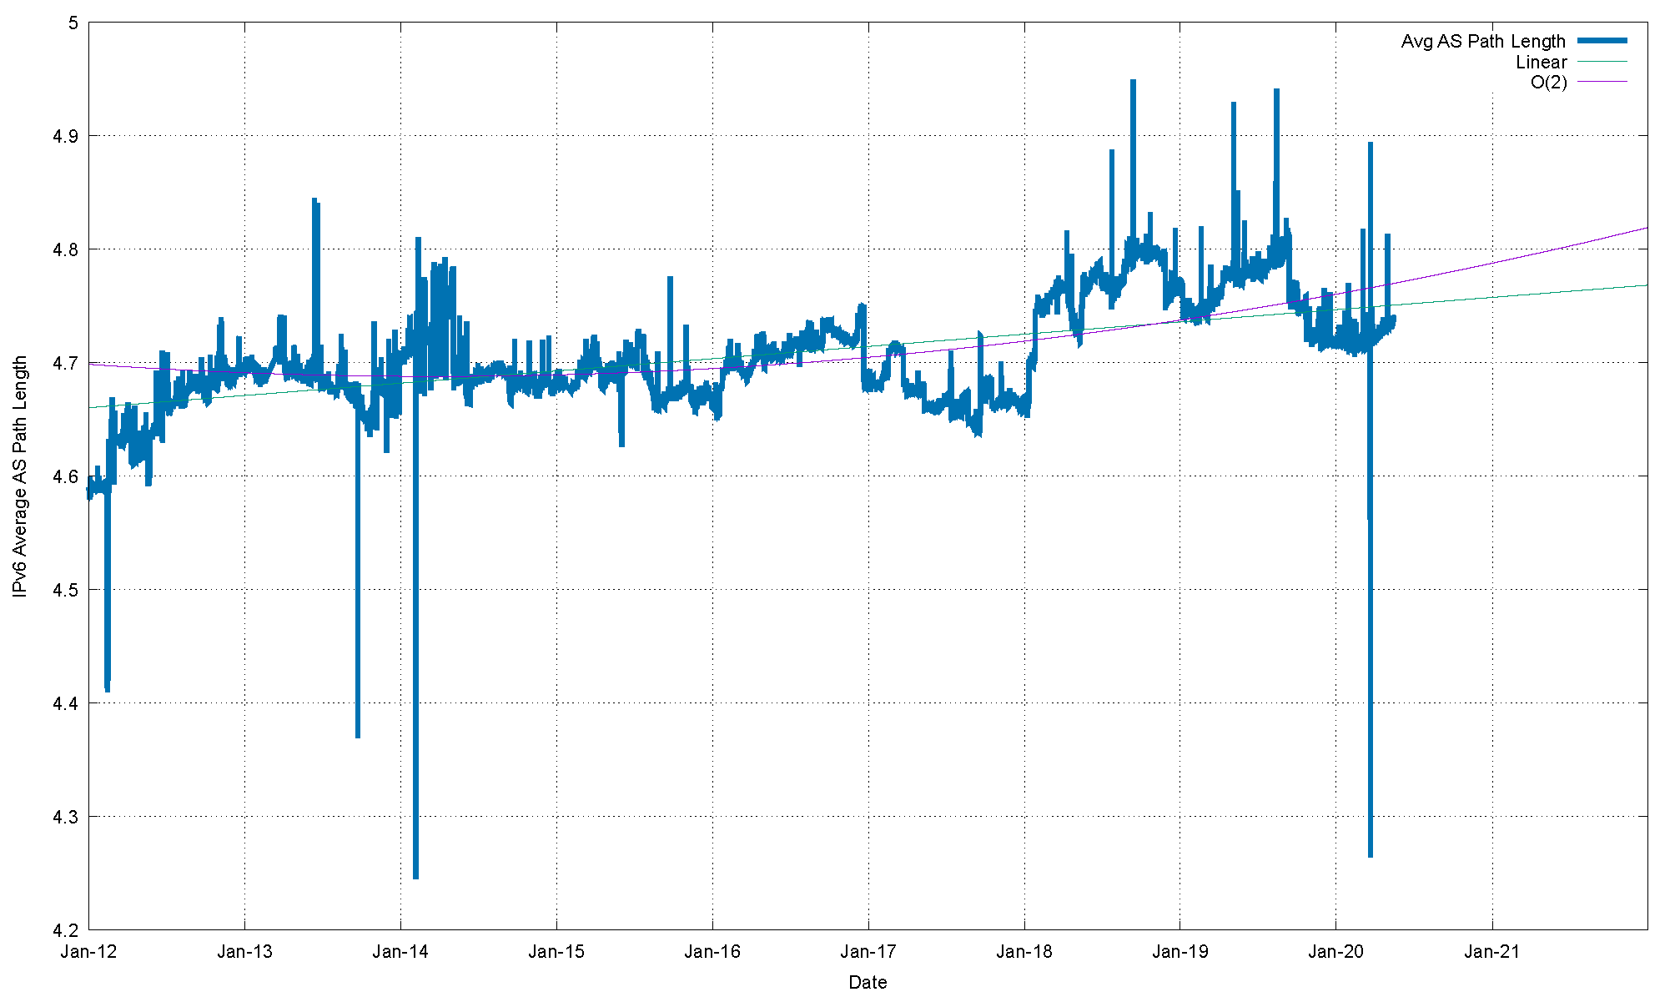
Routing Indicators for IPv6
Advertised Address span is growing at an exponential rate
The “shape” of inter-AS interconnection in IPv6 is rising slightly. Local connections appear to be replacing overlay trunk transits

Slide 24
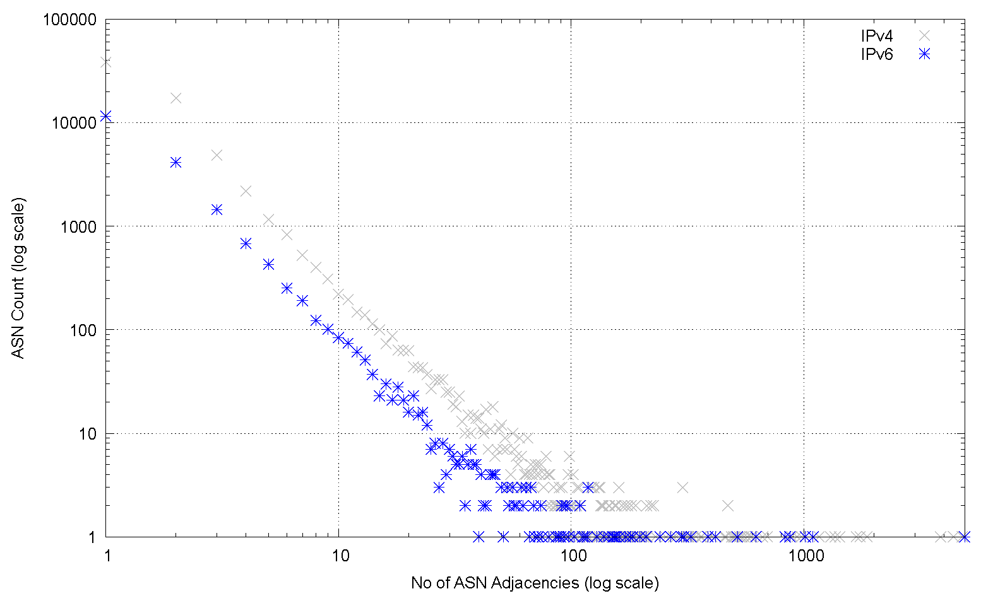
AS Adjacencies (AS131072)
15,720 out of 19,633 ASNs have 1 or 2 AS Adjacencies (80%)
698 ASNs have 10 or more adjacencies
3 ASNs have >1,000 adjacencies
4,900 AS6939 HURRICANE, US
1,093 AS3356 LEVEL3, US
1,013 AS1299 TELIANET Telia Carrier, EU
870 AS174 COGENT-174, US
830 AS2914 NTT-COMMUNICATIONS-2914, US
622 AS5539 SPACENET SpaceNET AG, DE
517 AS3257 GTT-BACKBONE GTT, DE
416 AS33891 CORE-BACKBONE GLOBAL NETWORK, DE
386 AS6461 ZAYO-6461, US
327 AS20473 AS-CHOOPA, US

Slide 25
V6 in 2020
Overall IPv6 Internet growth in terms of BGP is still increasing, and is currently at some 20,000 route entries p.a.

Slide 26
What to expect

Slide 27
BGP Size Projections
How quickly is the routing space growing?
What are the projections of future BGP FIB size?

Slide 28
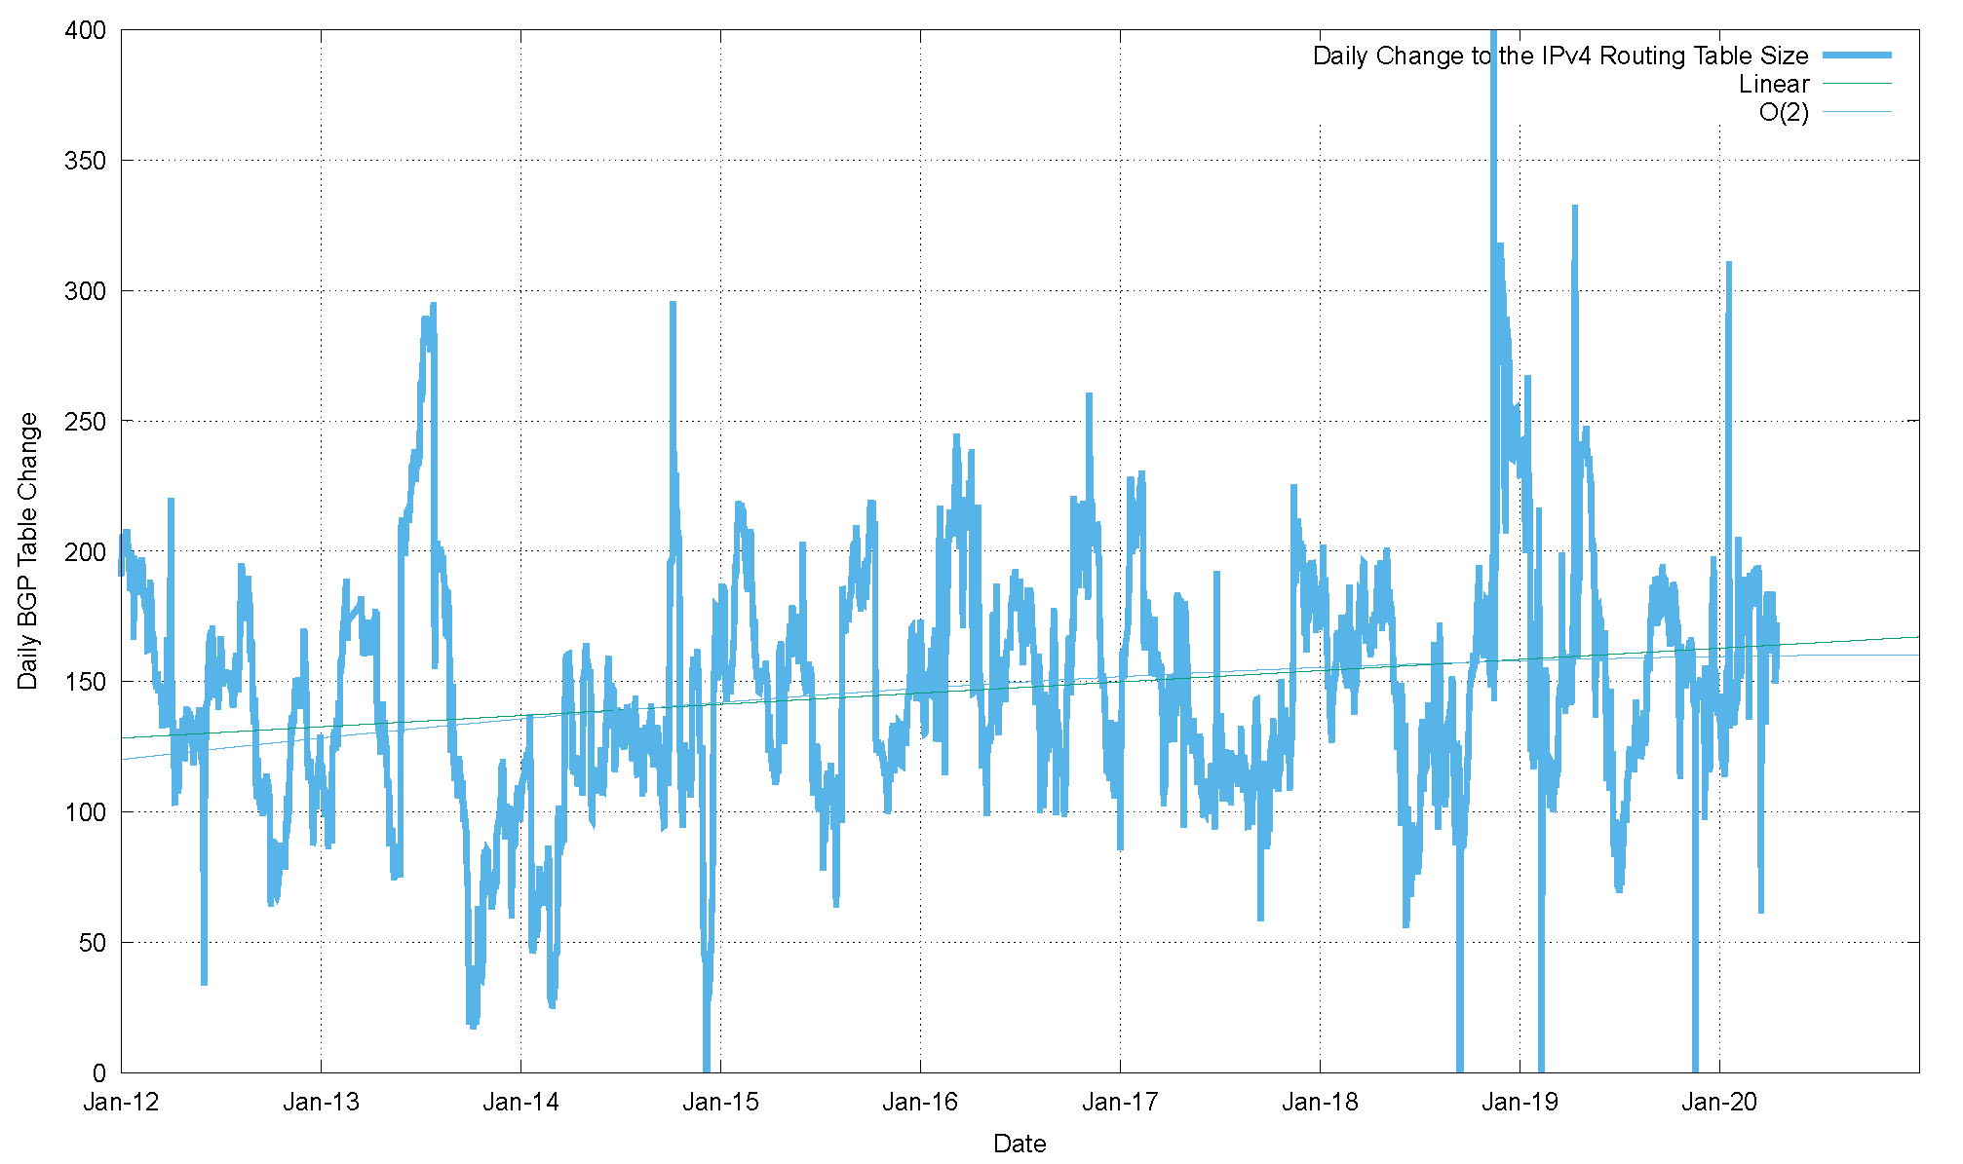
V4 - Daily Growth Rates
Growth in the V4 network appears to be consistent to a long-term average of 150 additional routes per day, or some 55,000 additional routes per year

Slide 29
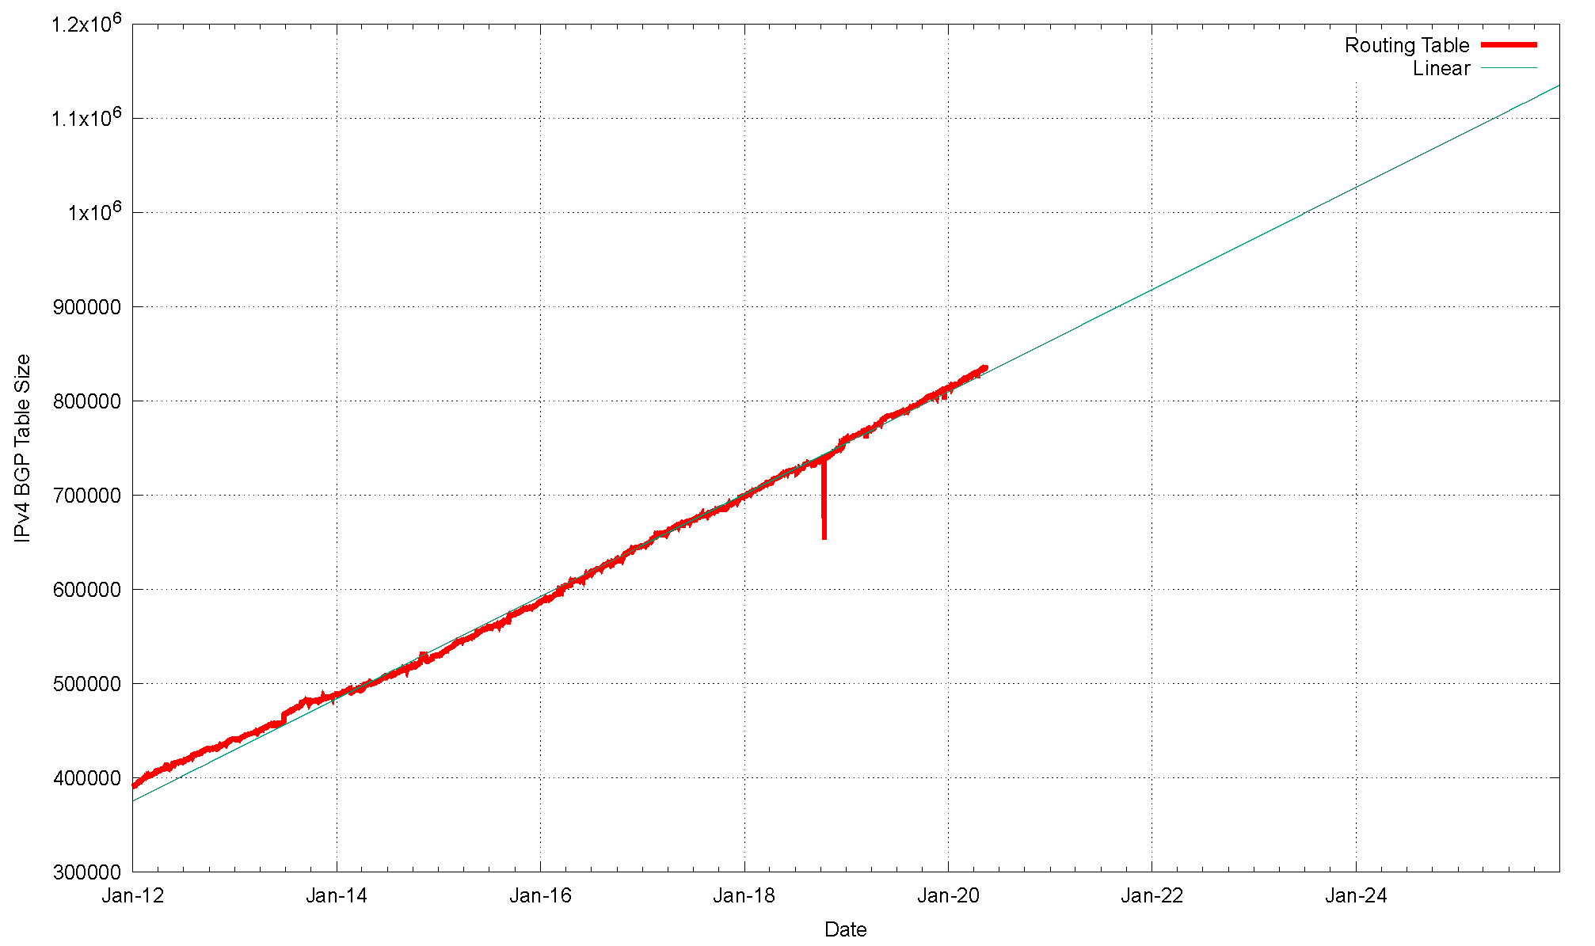
V4 BGP Table Size Predictions
Jan 2017 646,000
2018 699,000
2019 760,000
2020 814,000
2021 864,000
2022 918,000
2023 972,000
2024 1,026,000
2025 1,081,000
2026 1,135,000

Slide 30
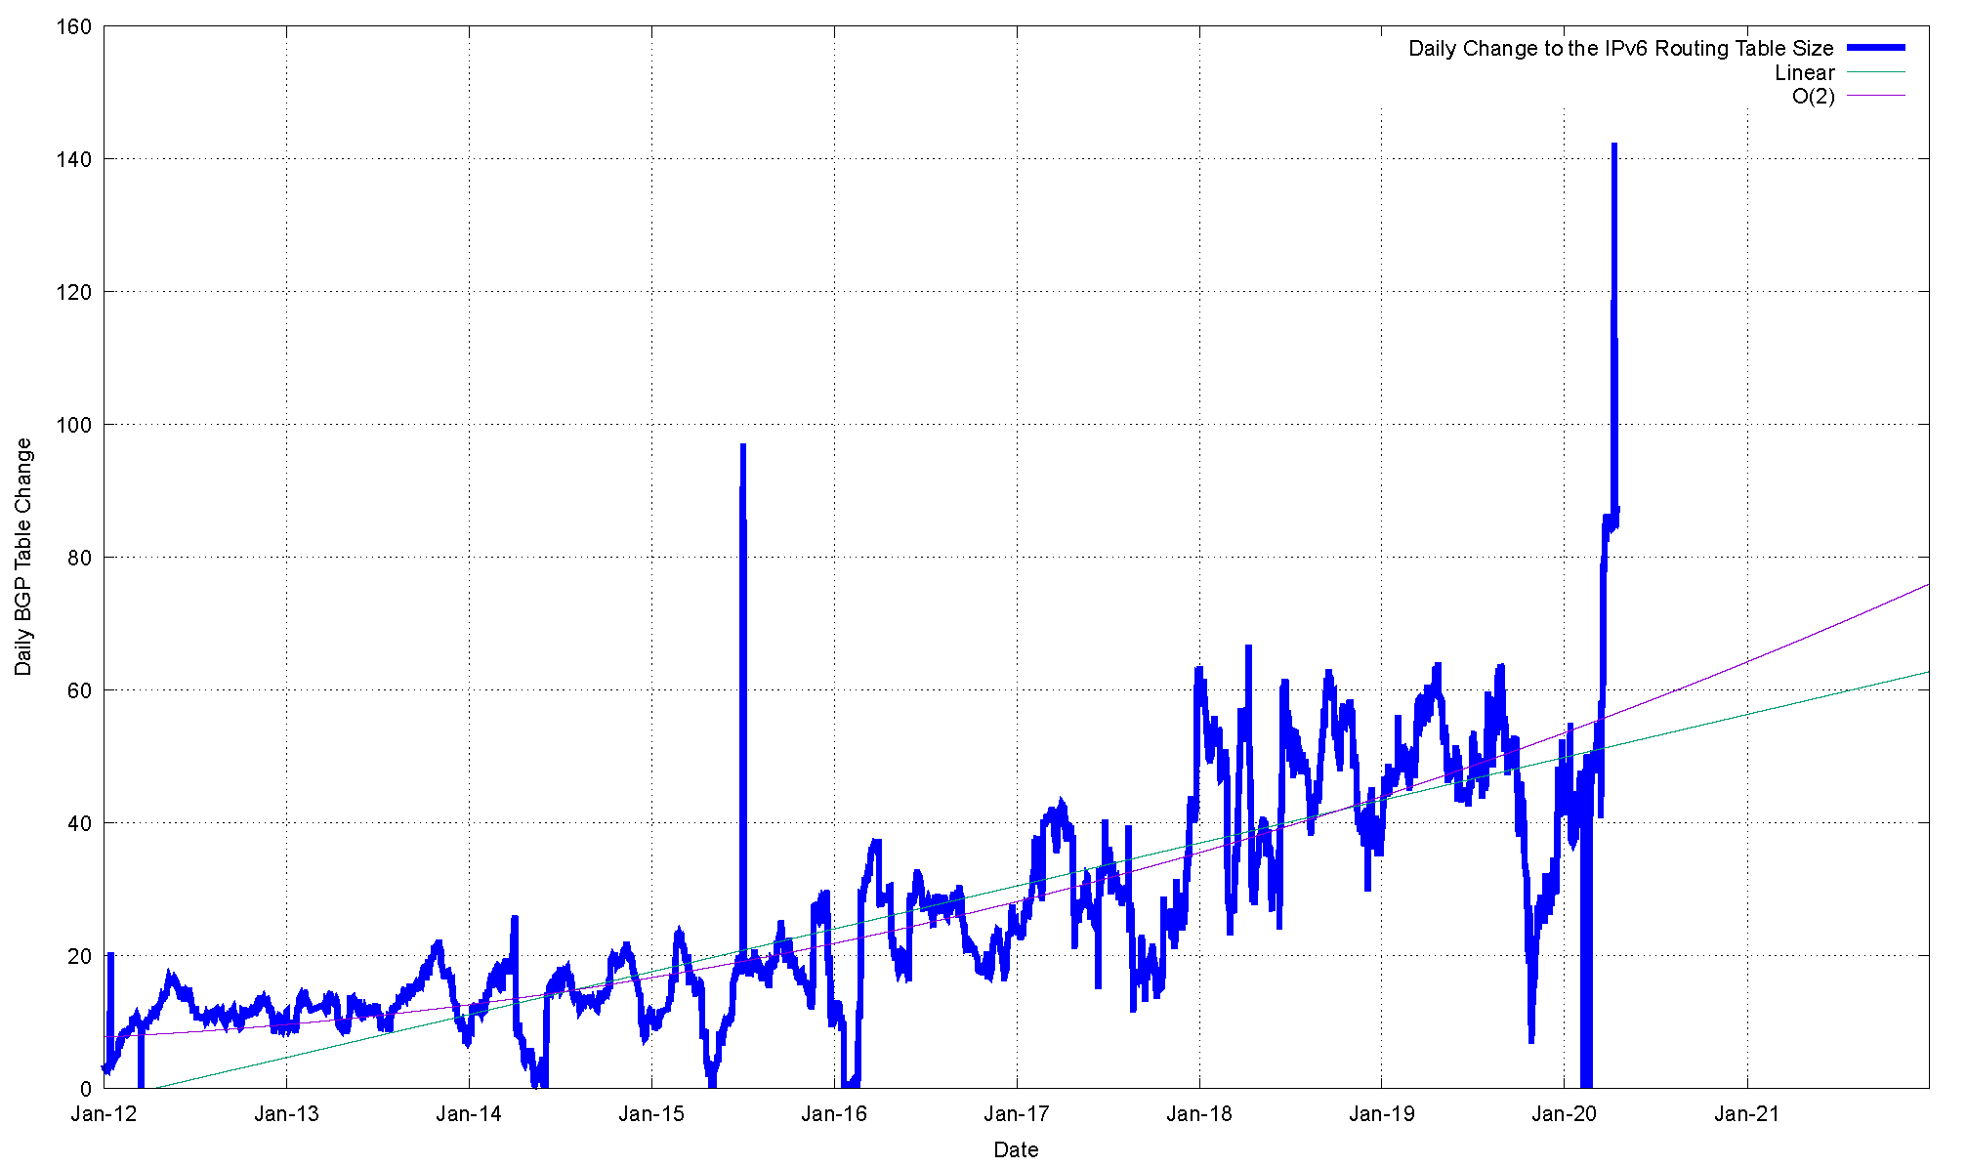
V6 - Daily Growth Rates

Slide 31
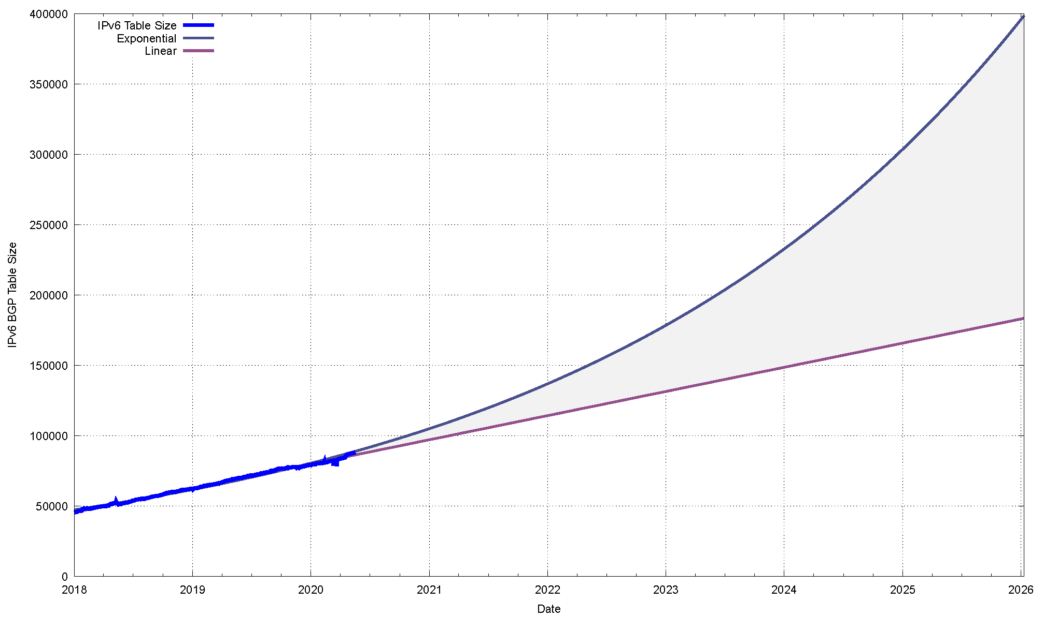
V6 BGP Table Size Predictions
Linear Exponential
Jan 2017 35,000
2018 45,000
2019 62,000
2020 80,000
2021 97,000 105,000
2022 114,000 137,000
2023 131,000 178,000
2024 148,000 233,000
2025 165,000 330,000
2026 182,000 395,000

Slide 32
BGP Table Growth
The absolute size of the IPv6 routing table is growing much faster than the IPv4 table
IPv6 will require the same memory size in around 4 years time, given that each IPv6 entry is 4 times the memory size of an IPv4 entry
But this is not that big a growth rate, and BGP can handle this scale of managed route objects with ease
As long as we are prepared to live within the technical constraints of the current routing paradigm, the Internet’s use of BGP will continue to be viable for some time yet

Slide 33
BGP Updates
What about the level of updates in BGP?

Slide 34
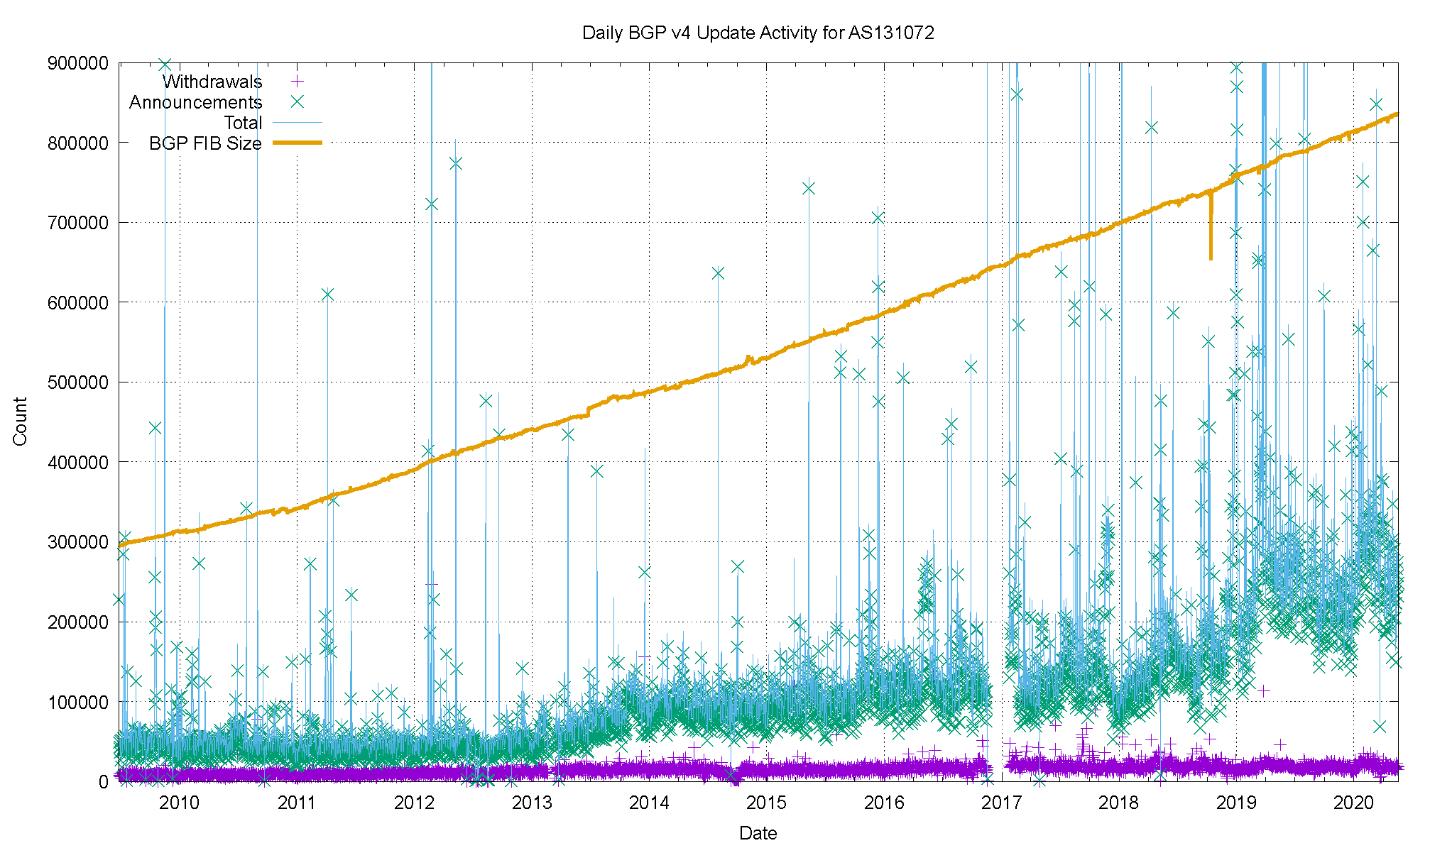
IPv4 BGP Updates

Slide 35
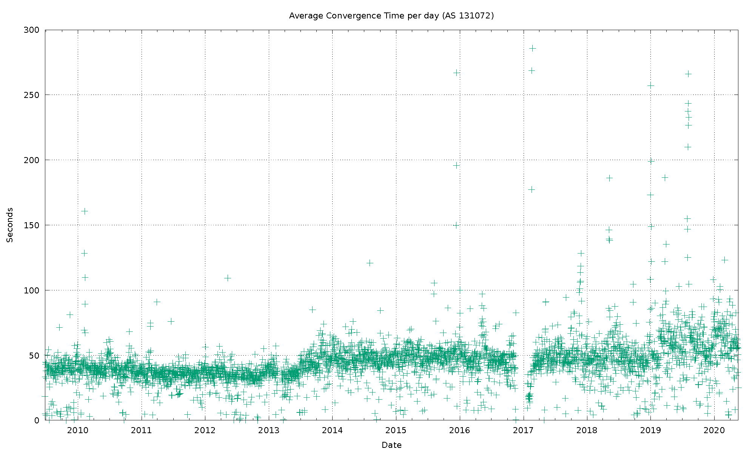
IPv4 BGP Convergence Performance

Slide 36
Updates in IPv4 BGP
Still no great level of concern …
The number of updates per instability event and the time to converge has been relatively constant
Likely contributors to this outcome are the damping effect of widespread use of the MRAI interval by eBGP speakers, and the compressed topology factor, as seen in the relatively constant AS Path Length

Slide 37
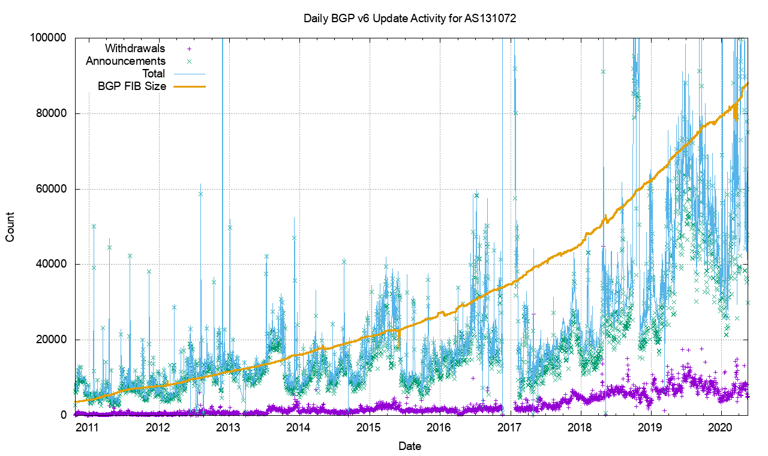
V6 BGP Updates

Slide 38
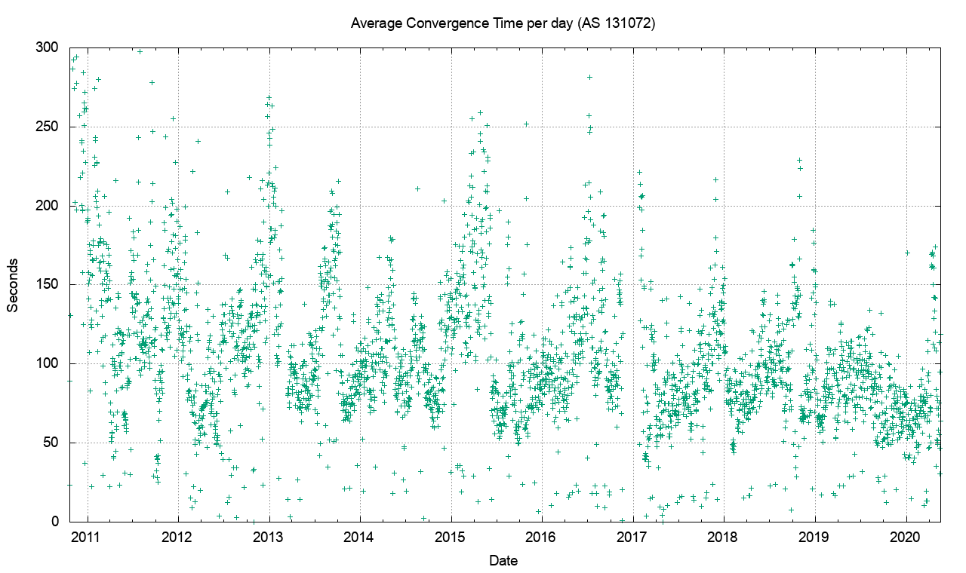
V6 Convergence Performance

Slide 39
V6 Convergence Performance

Slide 40
Routing Futures
There is little in the way of scaling pressure from BGP as a routing protocol – the relatively compressed topology and stability of the infrastructure links tend to ensure that BGP remains effective in routing the internet
The issues of FIB size, line speeds and equipment cost of line cards represent a more significant issue for hardware suppliers – we can expect cheaper line cards to to use far smaller LRU cache local FIBs in the high-speed switches and push less-used routes to a slower / cheaper lookup path. This approach may also become common in very high-capacity line cards

Slide 41
Some Practical Suggestions
Understand your hardware’s high speed FIB capacity in the default-free parts of your network
Review your IPv4 / IPv6 memory partitioning - a dual-stack eBGP router will need 920,000 IPv4 slots and 140,000 IPv6 slots for a full eBGP routing table in line cards over the coming 24 months if they are using a full FIB load
Judicious use of default routes in your internal network may allow you drop this requirement significantly
Using a hot cache for line card FIB cache would reduce the memory requirement significantly without visible performance cost

Slide 42
That’s it!

