Slide 1
DNS and IPv6
Geoff Huston
Joao Damas
APNIC Labs

Slide 2
This is not a talk about DoH and DoT
For over a year DoH is still the current hot topic in the DNS
and there is much that can be said about DoH and DoT
But let’s talk about something different but familiar at the same time
I want to get back to a much older but still not well understood issue in the DNS …

Slide 3
Dual Stack DNS
How well is IPv6 supported in the DNS?
How does the DNS handle dual-stacked authoritative servers?
Is there a “happy eyeballs” version of DNS server selection?
Or is there a reverse bias to use IPv4?
If you placed authoritative servers on an IPv6-only service how many users would be able to reach you?
And what about DNSSEC?
How well does IPv6 support large UDP packets?

Slide 4
A word or two about “how” to talk about the DNS
We really don’t understand what a “resolver” is!
It could be a single platform running an instance of DNS resolver code
It could be a collection of independent back-end systems with a load distributor front end facing clients
It could be a hybrid collection where the back ends synchronise each other to emulate a common cache
It is a stub, recursive, or forwarding resolver
A resolver may have 1 client or millions of clients or anything in between
When we talk about “resolvers” its challenging to understand exactly what we are talking about!

Slide 5
Another word, this time about “how” to talk about DNS queries
We don’t understand what a query is!
Which sounds silly, but the distributed resolution process causes a ‘fan out’ of queries as part of the resolution process when a single query may cause a number of ‘discovery’ queries to establish the identify of the authoritative server(s) for the name
Resolvers all use their own timers for retransmission
Queries have no “hop count” or “resolver path” attached
there is no context to understand the reason for a query!
Queries have a life of their own

Slide 6
APNIC’s DNS Experimental Rig
We make parts of the name unique to each experiment
That way the recursive resolvers have no cached data and are forced to query the authoritative server
We “see” the recursive to authoritative query process by instrumenting the authoritative server, and match experiment placement records to the server’s DNS logs
Authoritative Server
Dual Stack
We insert “known” DNS queries into the stub resolver
We instrument the Authoritative Server
Recursive Resolver
Stub
Resolver

Slide 7
Dual Stack DNS
How well is IPv6 supported in the DNS?
How does the DNS handle dual-stacked authoritative servers?
Is there a “happy eyeballs” version of DNS server selection?
Or is there a reverse bias to use IPv4?
If you placed authoritative servers on an IPv6-only service how many users would be able to reach you?
And what about DNSSEC?
How well does IPv6 support large UDP packets?

Slide 8
Dual Stack DNS
A “happy eyeballs*” DNS approach would be to prefer to use the IPv6 address of the authoritative server in preference to the IPv4 address
A “reverse bias” DNS approach would be to prefer to use the IPv4 address
* Why is happy eyeballs important?

Slide 9
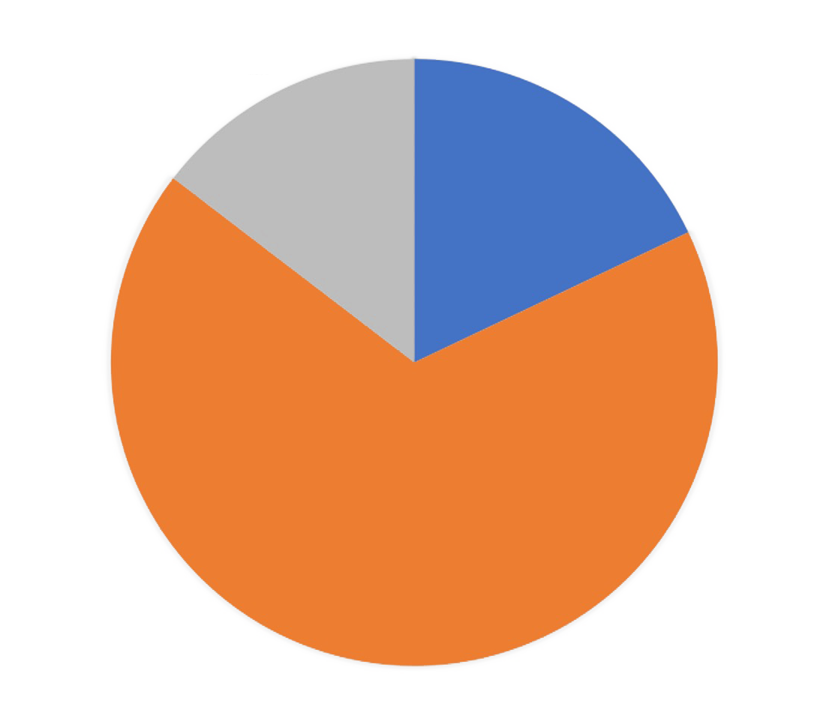
Dual Stack DNS
A “happy eyeballs*” DNS approach would be to prefer to use the IPv6 address of the authoritative server in preference to the IPv4 address
A “reverse bias” DNS approach would be to prefer to use the IPv4 address
IPv6
15%
IPv4+
IPv6
18%
IPv4 Only – 67%
* Why is happy eyeballs important?

Slide 10
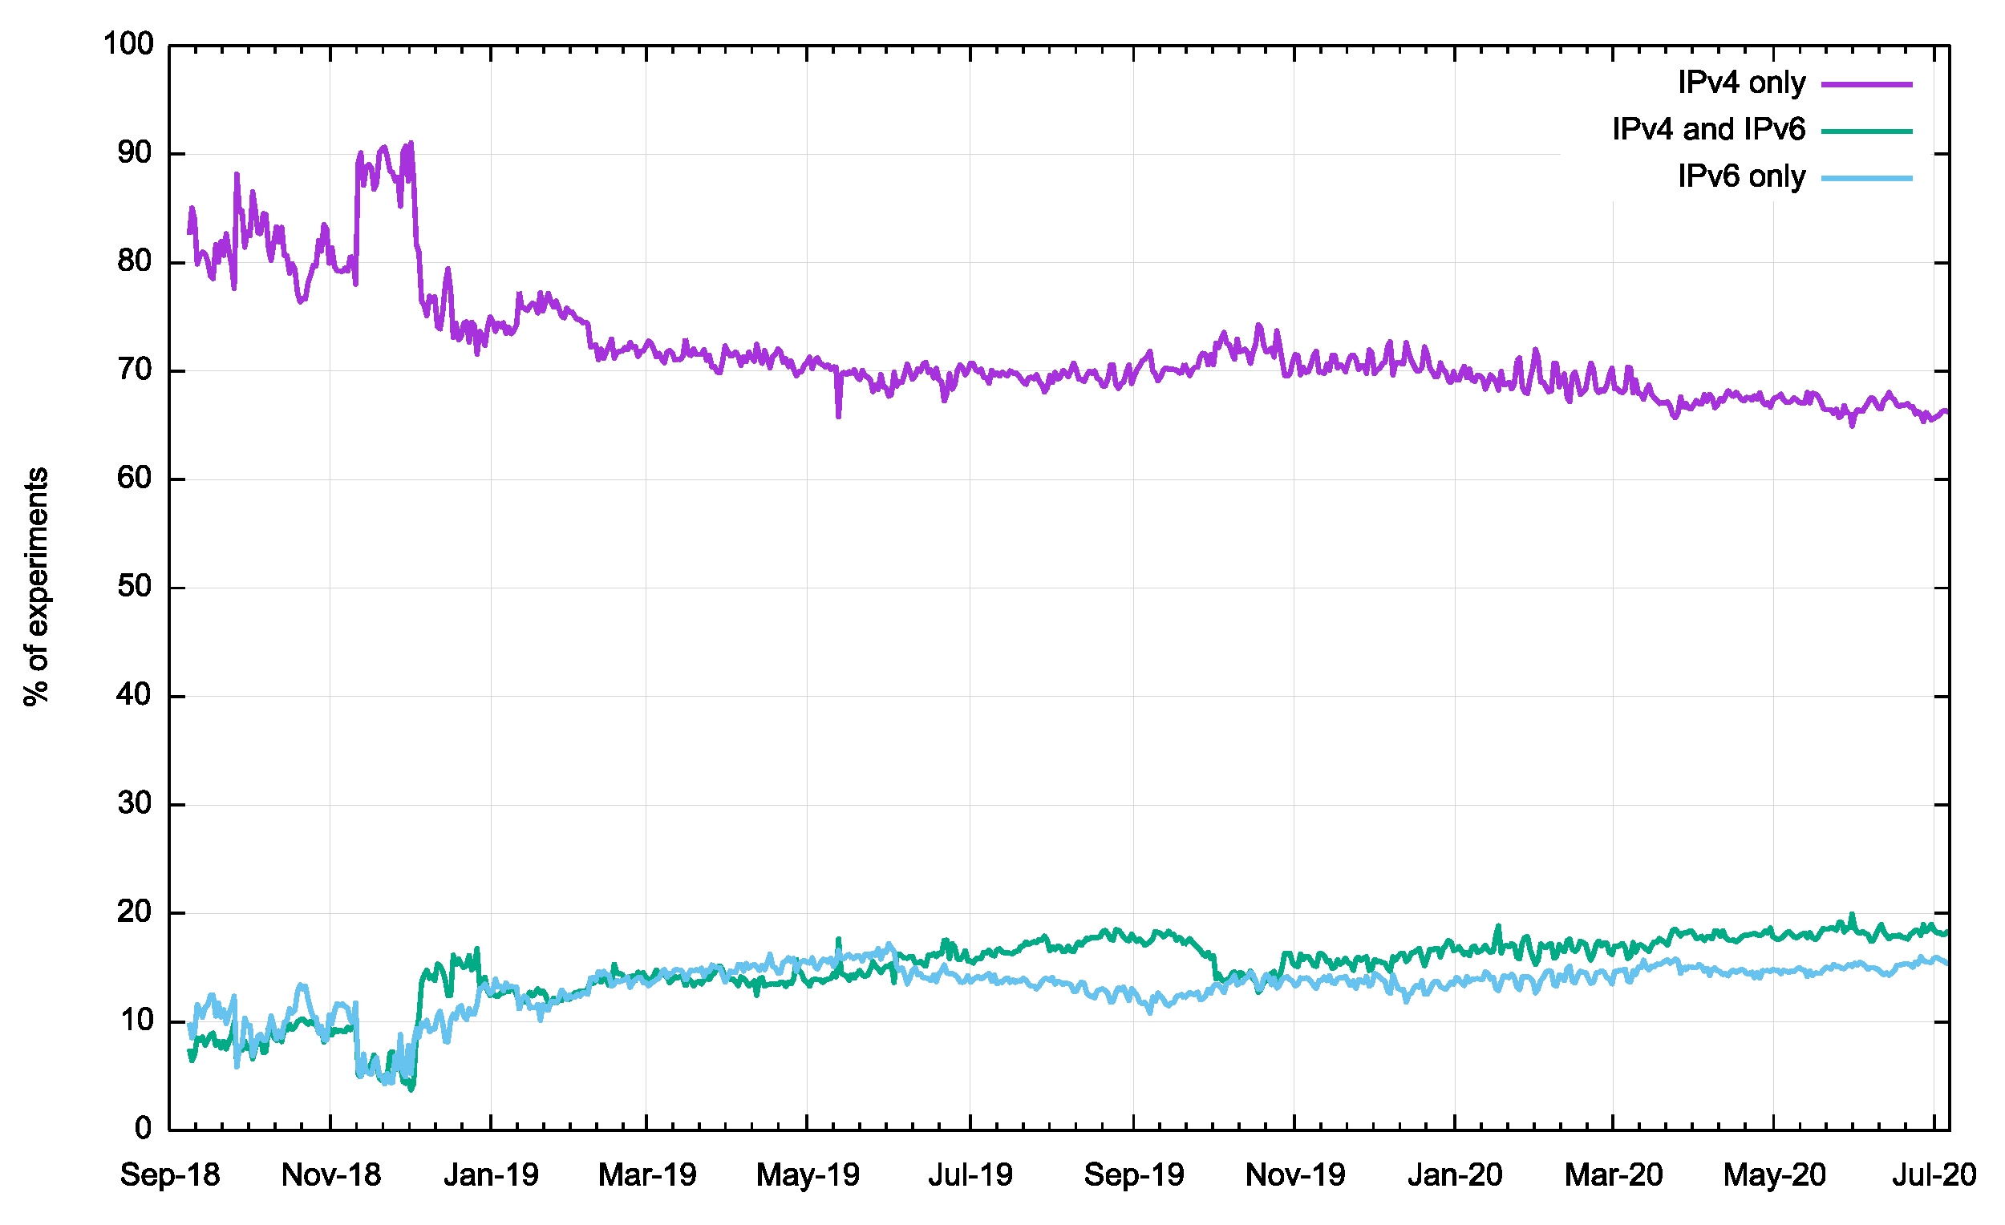
Dual Stack DNS
Time series of V4 / V6 query rates
What’s going on here?

Slide 11
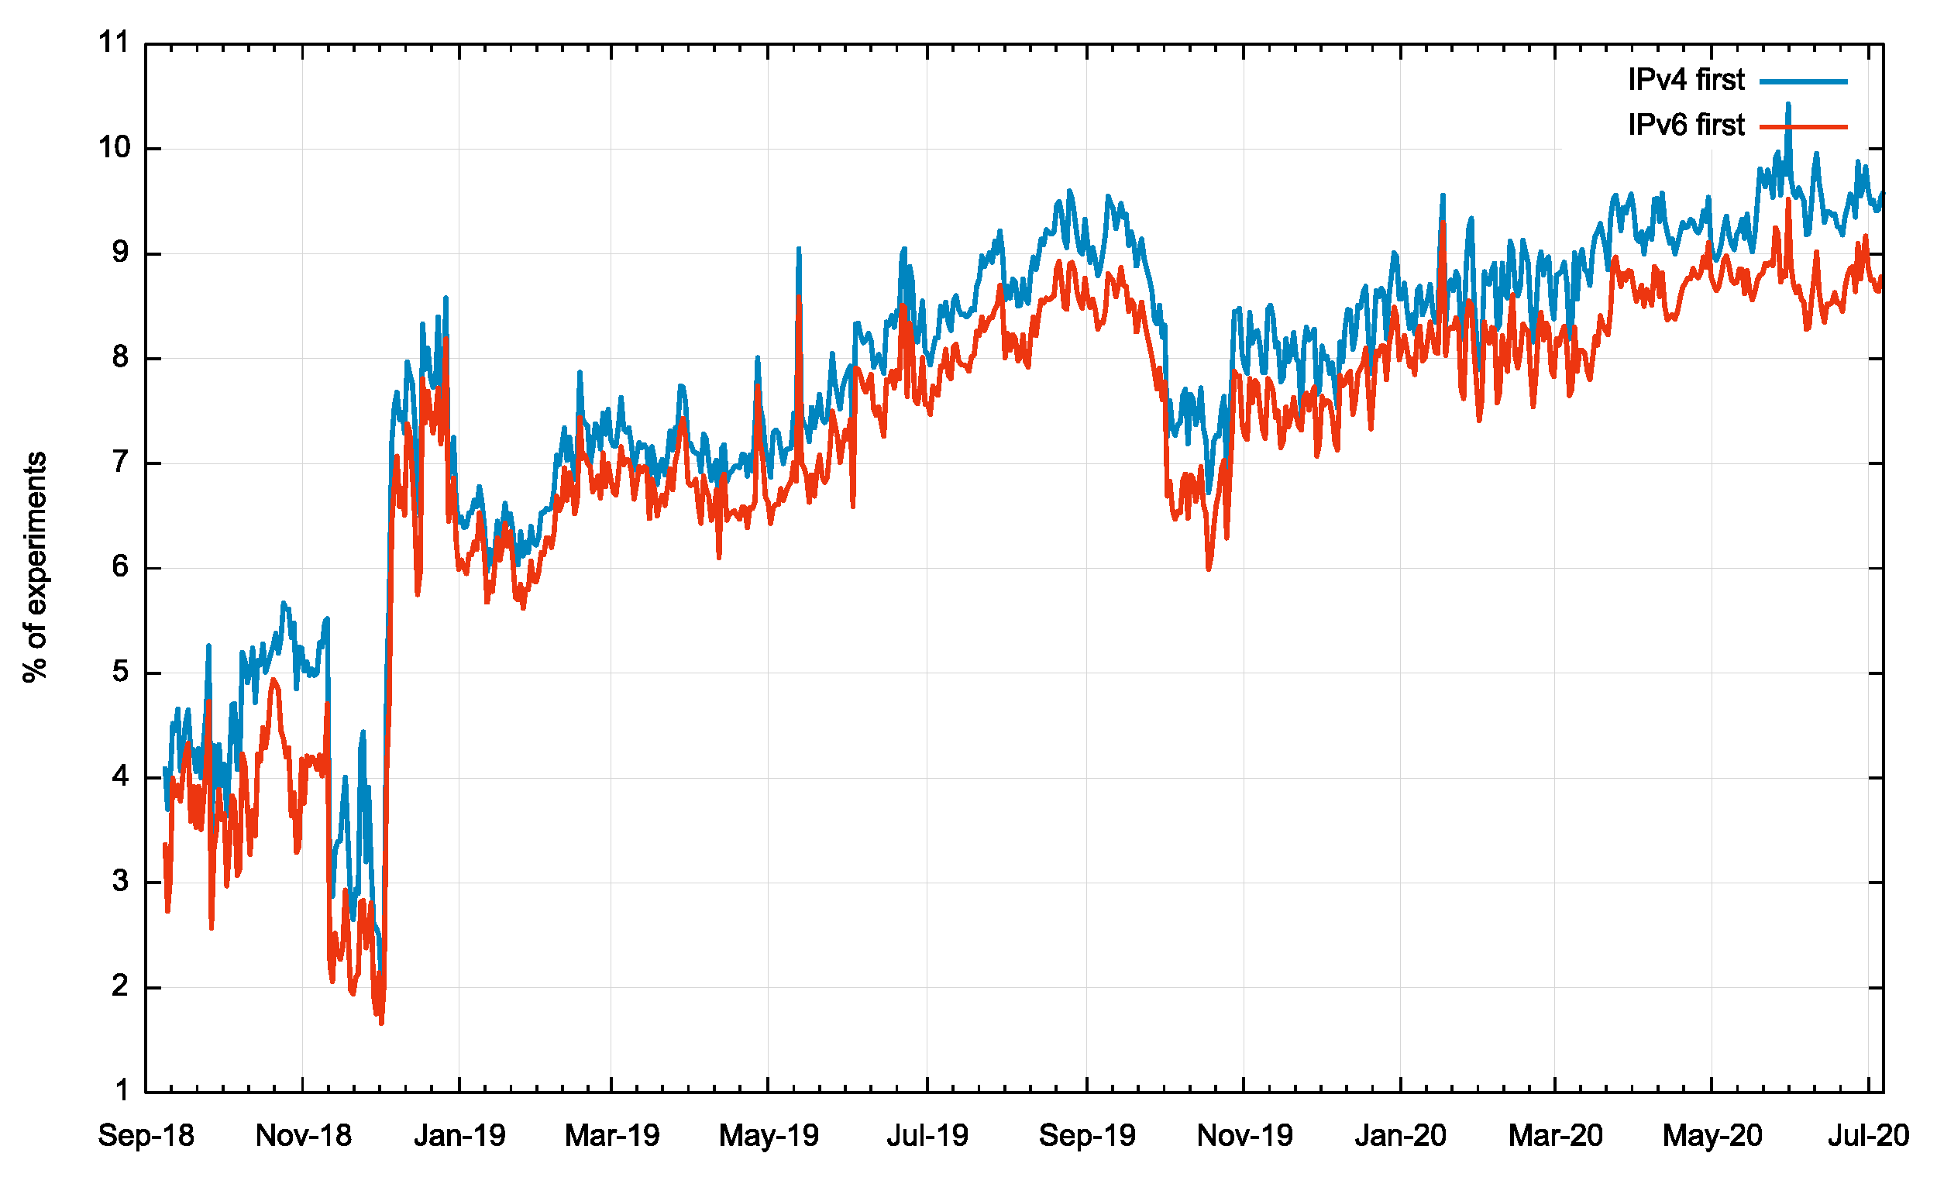
Dual Stack DNS
Time series of V4 / V6 query rates
Where we see both IPv4 and IPv6 used to query the authoritative server, there is a small bias to prefer to use IPv4 for the first query

Slide 12
Dual Stack DNS
How well is IPv6 supported in the DNS?
How does the DNS handle dual-stacked authoritative servers?
Is there a “happy eyeballs” version of DNS server selection?
Or is there a reverse bias to use IPv4?
If you placed authoritative servers on an IPv6-only service how many users would be able to reach you?
And what about DNSSEC?
How well does IPv6 support large UDP packets?
No!
Yes!

Slide 13
Dual Stack DNS
How well is IPv6 supported in the DNS?
How does the DNS handle dual-stacked authoritative servers?
Is there a “happy eyeballs” version of DNS server selection?
Or is there a reverse bias to use IPv4?
If you placed authoritative servers on an IPv6-only service how many users would be able to reach you?
And what about DNSSEC?
How well does IPv6 support large UDP packets?
No!
Yes!

Slide 14
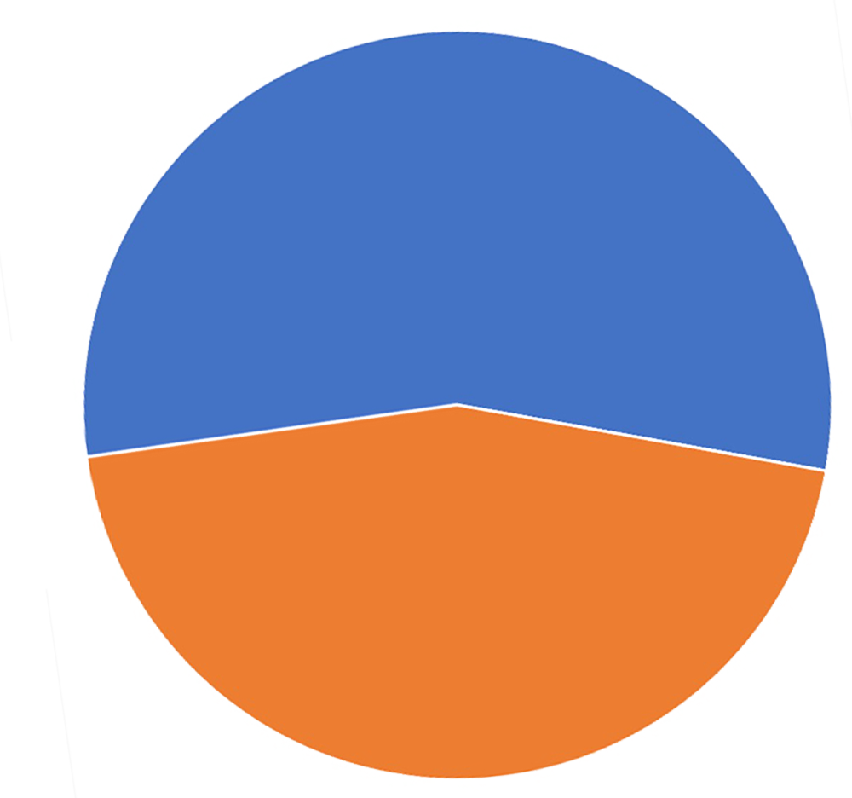
Dual Stack vs IPv6 only DNS
IPv6 Only Test
In this case the authoritative name server only has an IPv6 address
Of all the clients that are presented with an experiment (41M over 5 days) 55% of names are seen asking for the experiment name over IPv6
IPv6 – 55%
No query – 45%

Slide 15
Dual Stack vs IPv6 only DNS
Dual Stack
IPv6 Only Test
IPv6
15%
IPv4+
IPv6
18%
IPv6 – 55%
IPv4 Only – 67%
No query – 45%

Slide 16
Dual Stack DNS
How well is IPv6 supported in the DNS?
How does the DNS handle dual-stacked authoritative servers?
Is there a “happy eyeballs” version of DNS server selection?
Or is there a reverse bias to use IPv4?
If you placed authoritative servers on an IPv6-only service how many users would be able to reach you?
And what about DNSSEC?
How well does IPv6 support large UDP packets?
No!
Yes!
55%

Slide 17
Dual Stack DNS
How well is IPv6 supported in the DNS?
How does the DNS handle dual-stacked authoritative servers?
Is there a “happy eyeballs” version of DNS server selection?
Or is there a reverse bias to use IPv4?
If you placed authoritative servers on an IPv6-only service how many users would be able to reach you?
And what about DNSSEC?
How well does IPv6 support large UDP packets?
No!
Yes!
55%

Slide 18
IPv6 and Packet Fragmentation
IPv6 made two major changes to IP’s handling of packet fragmentation:
The fragmentation control header has been moved out of the IP header to become an extension header
In other words the UDP / TCP protocol header is pushed further into the packet and to find it you need to follow the header chain
The IPv4 ‘Don’t Fragment’ bit is jammed on in IPv6
In the case of path MTU issues IPv6 routers should not perform fragmentation on the fly, but are required to pass an ICMPv6 PTB message back to the packet’s sender

Slide 19
Who uses Fragmentation anyway?
Well, the DNS is a good place to start looking!

Slide 20
Who uses large DNS packets anyway?
Well, the DNS is a good place to start looking!
$ dig +dnssec DNSKEY org
; <<>> DiG 9.8.3-P1 <<>> +dnssec DNSKEY org
;; global options: +cmd
;; Got answer:
;; ->>HEADER<<- opcode: QUERY, status: NOERROR, id: 21353
;; flags: qr rd ra ad; QUERY: 1, ANSWER: 7, AUTHORITY: 0, ADDITIONAL: 1
;; OPT PSEUDOSECTION:
; EDNS: version: 0, flags: do; udp: 512;
; QUESTION SECTION:
;org. IN DNSKEY
;; ANSWER SECTION:
org. 861 IN DNSKEY 256 3 7 AwEAAXxsMmN/JgpEE9Y4uFNRJm7Q9GBwmEYUCsCxuKlg
org. 861 IN DNSKEY 256 3 7 AwEAAayiVbuM+ehlsKsuAL1CI3mA+5JM7ti3VeY8ysmo
org. 861 IN DNSKEY 257 3 7 AwEAAZTjbIO5kIpxWUtyXc8avsKyHIIZ+LjC2Dv8naO+
org. 861 IN DNSKEY 257 3 7 AwEAAcMnWBKLuvG/LwnPVykcmpvnntwxfshHlHRhlY0F
org. 861 IN RRSIG DNSKEY 7 1 900 20170815152632 20170725142632 3947
org. 861 IN RRSIG DNSKEY 7 1 900 20170815152632 20170725142632 9795
org. 861 IN RRSIG DNSKEY 7 1 900 20170815152632 20170725142632 17883
;; Query time: 134 msec
;; SERVER: 8.8.8.8#53(8.8.8.8)
;; WHEN: Mon Jul 31 12:07:16 2017
;; MSG SIZE rcvd: 1625
The response to a DNSKEY query for .org used a response of 1,625 octets!

Slide 21
Who uses large DNS packets anyway?
That was back in 2017 – what about today?
$ dig +dnssec DNSKEY org
; <<>> DiG 9.16.2 <<>> +dnssec DNSKEY org
;; global options: +cmd
;; Got answer:
…
;; WHEN: Sat May 02 13:22:02 AEST 2020
;; MSG SIZE rcvd: 1058
Well, the DNS is a good place to start looking!
$ dig +dnssec DNSKEY org
; <<>> DiG 9.8.3-P1 <<>> +dnssec DNSKEY org
;; global options: +cmd
;; Got answer:
;; ->>HEADER<<- opcode: QUERY, status: NOERROR, id: 21353
;; flags: qr rd ra ad; QUERY: 1, ANSWER: 7, AUTHORITY: 0, ADDITIONAL: 1
;; OPT PSEUDOSECTION:
; EDNS: version: 0, flags: do; udp: 512;
; QUESTION SECTION:
;org. IN DNSKEY
;; ANSWER SECTION:
org. 861 IN DNSKEY 256 3 7 AwEAAXxsMmN/JgpEE9Y4uFNRJm7Q9GBwmEYUCsCxuKlg
org. 861 IN DNSKEY 256 3 7 AwEAAayiVbuM+ehlsKsuAL1CI3mA+5JM7ti3VeY8ysmo
org. 861 IN DNSKEY 257 3 7 AwEAAZTjbIO5kIpxWUtyXc8avsKyHIIZ+LjC2Dv8naO+
org. 861 IN DNSKEY 257 3 7 AwEAAcMnWBKLuvG/LwnPVykcmpvnntwxfshHlHRhlY0F
org. 861 IN RRSIG DNSKEY 7 1 900 20170815152632 20170725142632 3947
org. 861 IN RRSIG DNSKEY 7 1 900 20170815152632 20170725142632 9795
org. 861 IN RRSIG DNSKEY 7 1 900 20170815152632 20170725142632 17883
;; Query time: 134 msec
;; SERVER: 8.8.8.8#53(8.8.8.8)
;; WHEN: Mon Jul 31 12:07:16 2017
;; MSG SIZE rcvd: 1625
The response to a DNSKEY query for .org used a response of 1,625 octets!

Slide 22
Who uses large DNS packets anyway?
That was back in 2017 – what about today?
$ dig +dnssec DNSKEY org
; <<>> DiG 9.16.2 <<>> +dnssec DNSKEY org
;; global options: +cmd
;; Got answer:
…
;; WHEN: Sat May 02 13:22:02 AEST 2020
;; MSG SIZE rcvd: 1058
Well, the DNS is a good place to start looking!
$ dig +dnssec DNSKEY org
; <<>> DiG 9.8.3-P1 <<>> +dnssec DNSKEY org
;; global options: +cmd
;; Got answer:
;; ->>HEADER<<- opcode: QUERY, status: NOERROR, id: 21353
;; flags: qr rd ra ad; QUERY: 1, ANSWER: 7, AUTHORITY: 0, ADDITIONAL: 1
;; OPT PSEUDOSECTION:
; EDNS: version: 0, flags: do; udp: 512;
; QUESTION SECTION:
;org. IN DNSKEY
;; ANSWER SECTION:
org. 861 IN DNSKEY 256 3 7 AwEAAXxsMmN/JgpEE9Y4uFNRJm7Q9GBwmEYUCsCxuKlg
org. 861 IN DNSKEY 256 3 7 AwEAAayiVbuM+ehlsKsuAL1CI3mA+5JM7ti3VeY8ysmo
org. 861 IN DNSKEY 257 3 7 AwEAAZTjbIO5kIpxWUtyXc8avsKyHIIZ+LjC2Dv8naO+
org. 861 IN DNSKEY 257 3 7 AwEAAcMnWBKLuvG/LwnPVykcmpvnntwxfshHlHRhlY0F
org. 861 IN RRSIG DNSKEY 7 1 900 20170815152632 20170725142632 3947
org. 861 IN RRSIG DNSKEY 7 1 900 20170815152632 20170725142632 9795
org. 861 IN RRSIG DNSKEY 7 1 900 20170815152632 20170725142632 17883
;; Query time: 134 msec
;; SERVER: 8.8.8.8#53(8.8.8.8)
;; WHEN: Mon Jul 31 12:07:16 2017
;; MSG SIZE rcvd: 1625
.org may have dropped its response size for DNSKEY queries
but there are still very large entries for other TLDs
The response to a DNSKEY query for .org used a response of 1,625 octets!

Slide 23
Who uses large DNS packets anyway?
.booking 2932
.winners 2932
.watches 2932
.ferrero 2932
.lincoln 2932
.chintai 2932
.citadel 2932
.oldnavy 2932
.banamex 2932
.farmers 2932
.athleta 2932
.jpmorgan 2937
.discover 2937
.homegoods 2942
.marshalls 2942
.analytics 2942
.homesense 2942
.statefarm 2942
.swiftcover 2947
.xn--kpu716f 2952
.weatherchannel 2967
.bananarepublic 2967
.americanexpress 2972
.gdn 3033
These folk do!
Size of dnssec-signed DNSKEY response for some gtlds

Slide 24
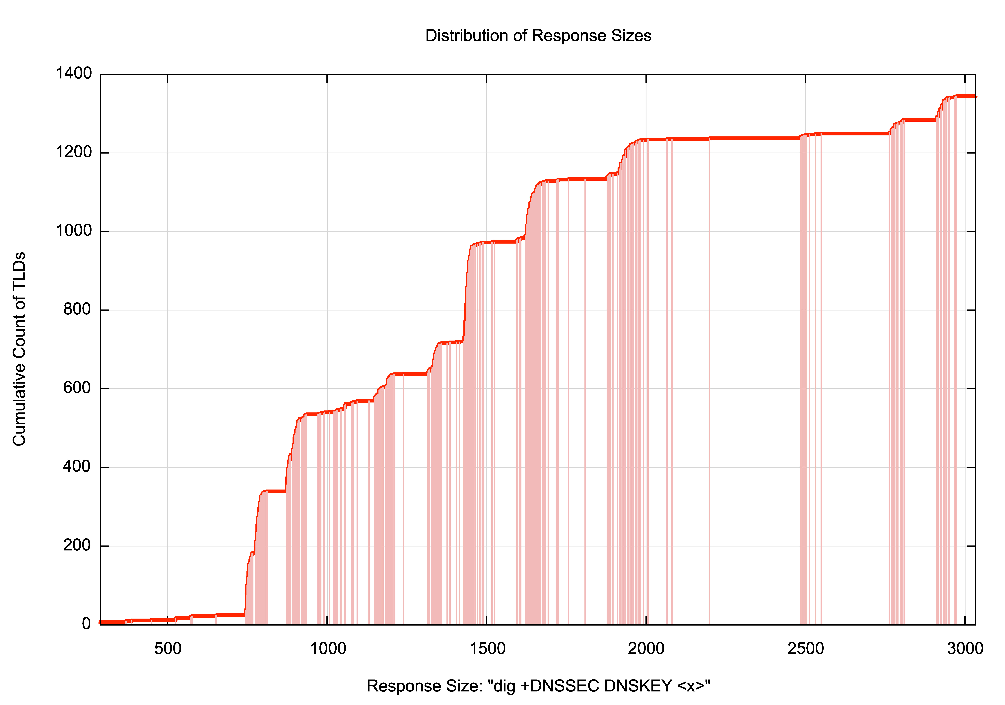
Who uses large DNS packets anyway?
Some 300 gtlds rely on fragmented UDP responses!

Slide 25
However…
UDP Fragmentation has its problems
UDP trailing fragments in IPv4 and IPv6 may encounter fragment filtering rules on firewalls in front of resolvers
Large UDP packets in IPv6 may encounter path MTU mismatch problems, and the ICMP6 Packet Too Big diagnostic message may be filtered.
Even if it is delivered, the host may not process the message due to the lack of verification of the authenticity of the ICMP6 message.
Because the protocol is UDP, receipt of an ICMP6 message will not cause retransmission of a re-framed packet.
UDP fragments in IPv6 are implemented by Extension Headers. There is some evidence of deployment of IPv6 switching equipment that unilaterally discards IPv6 packets with extension headers

Slide 26
Is this a problem for today’s IPv6 Internet?
Can we measure the extent to which users might be affected with this scenario of large DNS responses, DNS resolvers and IPv6?

Slide 27
Our Measurement Approach
We use an Online Ad platform to enroll endpoints to attempt to resolve a set of DNS names:
Each endpoint is provided with a unique name string (to eliminate the effects of DNS caching)
The DNS name is served from our authoritative servers
Resolving the DNS name requires the user’s DNS resolvers to receive a fragmented IPv6 packet

Slide 28
V6, the DNS and Fragmented UDP
Total number of tests (DNS over UDP over IPv6): 27,619,047
Failure Rate in receiving a large response: 11,232,833
IPv6 Fragmentation Failure Rate: 41%
Data gathered 26 April – 1 May 2020

Slide 29
V6, the DNS and Fragmented UDP
Total number of tests (DNS over UDP over IPv6): 27,619,047
Failure Rate in receiving a large response: 11,232,833
IPv6 Fragmentation Failure Rate: 41%
That’s awesomely bad!
Data gathered 26 April – 1 May 2020

Slide 30
What to do?
Accepting a future IPv6-only Internet means we are going to have to take the problem of IPv6 Fragmentation seriously
Because relying on IPv4 as a backup is a hack with an indeterminate future!
Which means that we need to figure out how to change the appalling drop rate for fragmented IPv6 packets both in the DNS and in end-to-end paths in the net
Should we try and fix the network problem or try to work around it?

Slide 31
What do the RFC’s say?

Slide 32
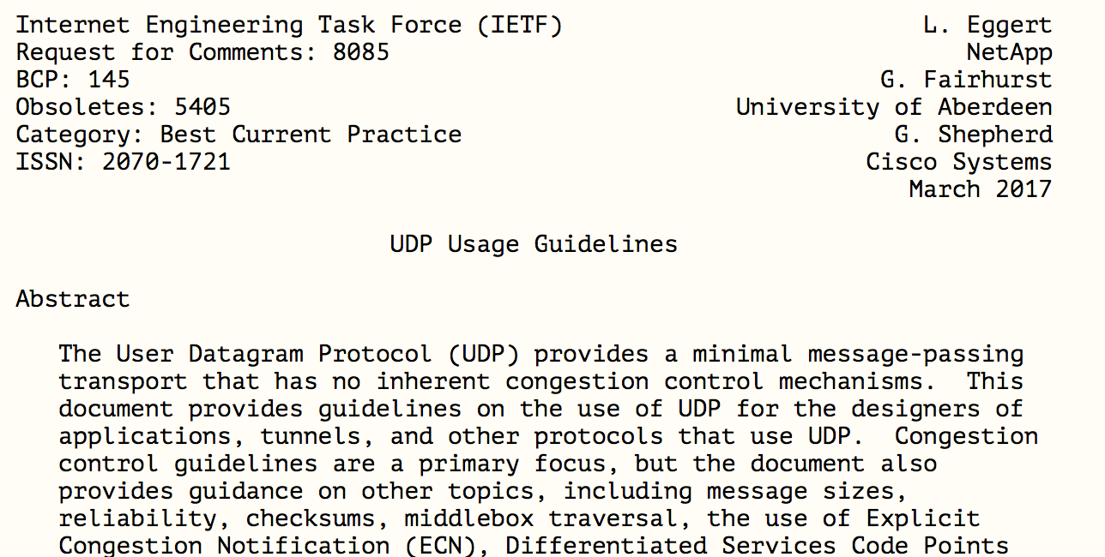
What do the RFC’s say?

Slide 33
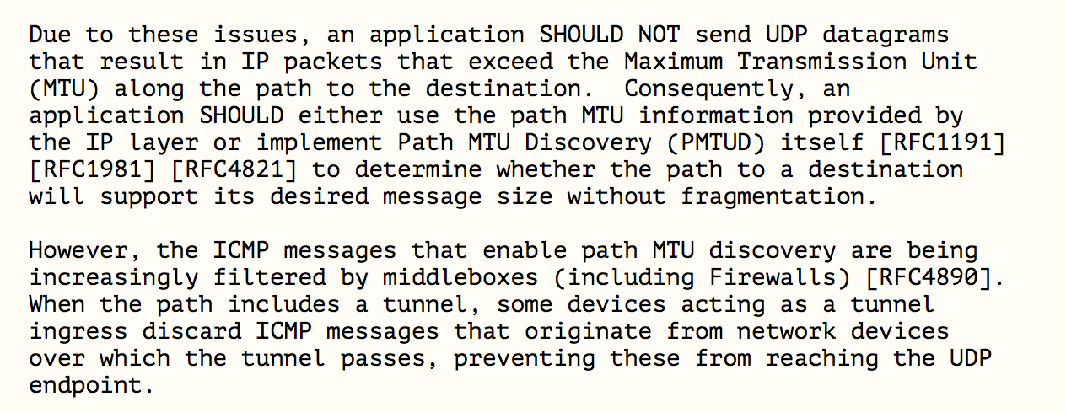
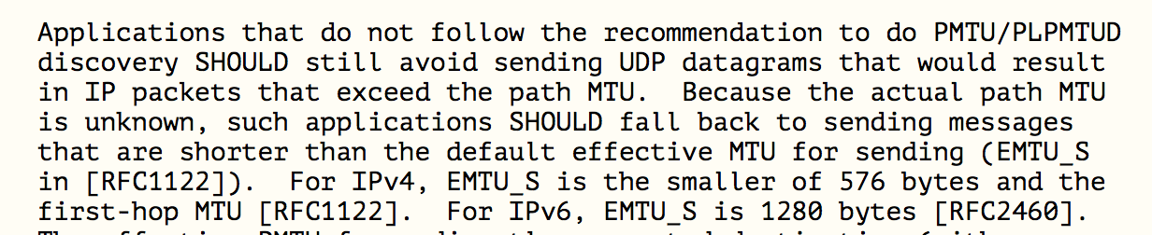
What do the RFC’s say?

Slide 34
What do the RFC’s say?
DON’T FRAGMENT!
This BCP is saying that using EDNS(0) in the DNS to signal the capability of accepting large fragmented DNS responses was unwise, and if a host/application does not know the path MTU, it should truncate at UDP at 1280 octets (and IPv4 should truncate at 512 octets!)

Slide 35
What can we do about it?
Fix it!
Get all the deployed routers, switches and firewalls and related network middleware to accept packets with IPv6 Fragmentation Headers

Slide 36

What can we do about it?
Fix it!
Get all the deployed routers, switches and firewalls and related network middleware to accept packets with IPv6 Fragmentation Headers

Slide 37
What can we do about it?
Change it!
Change the way in which IPv6 manages IP fragmentation and the use of Extension Headers as Fragmentation Control fields

Slide 38

What can we do about it?
Change it!
Change the way in which IPv6 manages IP fragmentation and the use of Extension Headers as Fragmentation Control fields

Slide 39
What can we do about it?
Avoid it!
Change application behaviour to avoid the use of packet fragmentation completely

Slide 40
What can we do about it?
Avoid it!
Change application behaviour to avoid the use of packet fragmentation completely

Slide 41
Which?
All of these options have a certain level of pain, cost and potential inconvenience
Its hard to work out what is the best course of action, but it seems like a lot of extra effort if we take on all three at once!

Slide 42
Large DNS Responses and IPv6
Change the transport protocol?
DNS over TCP by default
DNS over TLS over TCP by default
DNS over HTTP over TLS over TCP
DNS over QUIC
Devise some new DNS framing protocol that uses multiple packets with firewall-friendly packet and protocol headers instead of IP fragmentation

Slide 43
Large DNS Responses and IPv6
Change the application protocol behaviour?
Perform UDP MTU discovery using EDNS(0) UDP Buffer Size variations as a probe
Shift Additional Records into additional explicit UDP query/response transactions rather than bloating the original DNS response
Add a truncated minimal UDP response to trail a fragmented response (ATR)

Slide 44
Where now?
We have a decent idea of the problem space we need to resolve
We’d prefer a plan that allows each of us to work independently rather than a large scale orchestrated common change
We’re not sure we can clean up all the ICMPv6 filters and EH packet droppers in the IPv6 network
And it sure seems a bit late in the day to contemplate IPv6 protocol changes
Which means that we are probably looking at working around the problem by changing the behaviour of DNS and use an upper payload size of 1232 octets
See https://dnsflagday.net/2020/

Slide 45
Thanks!

Slide 46
Additional Material

Slide 47
Top 20 Tables

Slide 48
Which Resolvers?
73,354 IPv6 resolver /48 subnets seen
12,287 resolvers were consistently unable to resolve the target name (likely due to failure to receive the fragmented response)
Which is too large a list to display here
But we can show the top 20…

Slide 49
Which Resolvers can’t
All these resolvers appear to be unable to receive fragmented UDP
This is the top 20, as measured by the number of tests that used this resolver subnet
Notes:
./count-rvrs.pl | originas -d ' ' -f 1 | originas -d ' ' -f 1 -n | more

Slide 50
Which Network’s Resolvers can’t
All these networks host resolvers that appear to be unable to receive fragmented UDP
This is the Top 20, as measured by the query count per origin AS of the resolver address
Notes:
./count-rvrs.pl | originas -d ' ' -f 1 | originas -d ' ' -f 1 -n | more

Slide 51
Its not quite so simple as “can’t”
When a resolver fails to receive a UDP response it _may_ re-query with a smaller UDP buffer size
parameter
This will cause our server to respond with a truncated DNS response over UDP
This _should_ cause the resolver to re-query using TCP
1. Large fragmented UDP
resolver
server
2. Truncated unfragmented UDP
3. TCP
Notes:
./count-rvrs.pl | originas -d ' ' -f 1 | originas -d ' ' -f 1 -n | more

Slide 52
It’s not quite so simple as “can’t”
When a resolver fails to receive a UDP response it _may_ re-query with a smaller UDP buffer size
parameter
This will cause our server to respond with a truncated DNS response over UDP
This _should_ cause the resolver to re-query using TCP
There are four cases of fragmentation failure :
can’t receive fragmented UDP and won’t use a smaller UDP Buffer Size
can’t receive fragmented UDP, will use a smaller UDP Buffer Size but cannot make a TCP connection
can’t receive fragmented UDP, will use a smaller UDP Buffer Size but cannot complete a TCP connection
can’t receive fragmented UDP, will use a smaller UDP Buffer Size and make a TCP connection (fail then recovery)
Notes:
./count-rvrs.pl | originas -d ' ' -f 1 | originas -d ' ' -f 1 -n | more

Slide 53
Case 1 - Which Resolvers really can’t
These resolvers appear to be unable to receive fragmented UDP and will not re-query with a smaller UDP buffer size
This is the Top 20, as measured by the query count per resolver subnet address
Notes:
./count-rvrs.pl | originas -d ' ' -f 1 | originas -d ' ' -f 1 -n | more

Slide 54
Case 1 - Which Networks’ Resolvers really can’t
These networks host resolvers that appear to be unable to receive fragmented UDP and will not re-query with a
smaller UDP buffer size
This is the Top 20, as measured by the query count per ASN
Notes:
./count-rvrs.pl | originas -d ' ' -f 1 | originas -d ' ' -f 1 -n | more

Slide 55
Case 2 - Which Resolvers can’t TCP
These resolvers appear to be unable to receive fragmented UDP, will re-query with a smaller UDP buffer size but not open a TCP session
This is the top 20, as measured by the query count per resolver subnet address
Notes:
./count-rvrs.pl | originas -d ' ' -f 1 | originas -d ' ' -f 1 -n | more

Slide 56
Case 2 - Which Networks’ Resolvers can’t TCP
These networks host resolvers that appear to be unable to receive fragmented UDP, will re-query with a smaller UDP buffer size but not open a TCP session
This is the top 20, as measured by the query count per resolver subnet address
Notes:
./count-rvrs.pl | originas -d ' ' -f 1 | originas -d ' ' -f 1 -n | more

Slide 57
Case 3 - Which Resolvers can’t complete TCP
These resolvers appear to be unable to receive fragmented UDP, will re-query with a smaller UDP buffer size, will open a TCP session, but appear to have a TCP MTU black hole issue
This is the top 20, as measured by the query count per resolver subnet address
Notes:
./count-rvrs.pl | originas -d ' ' -f 1 | originas -d ' ' -f 1 -n | more

Slide 58
Case 3 - Which Networks’ Resolvers can’t complete TCP
These networks host resolvers that appear to be unable to receive fragmented UDP, will re-query with a smaller UDP buffer size, will open a TCP session, but appear to have a TCP MTU black hole issue
This is the top 20, as measured by the query count per resolver subnet address
Notes:
./count-rvrs.pl | originas -d ' ' -f 1 | originas -d ' ' -f 1 -n | more

Slide 59
Case 4 - Which Resolvers can’t Frag but can TCP
These resolvers appear to be unable to receive fragmented UDP, will re-query with a smaller UDP buffer size, get the truncated UDP response and successfully complete the TCP session
This is the top 20, as measured by the query count per resolver subnet address
Notes:
./count-rvrs.pl | originas -d ' ' -f 1 | originas -d ' ' -f 1 -n | more

Slide 60
Case 4 - Which Networks’ Resolvers can’t Frag but can TCP
These networks host resolvers that appear to be unable to receive fragmented UDP, will re-query with a smaller UDP buffer size, get the truncated UDP response and successfully complete the TCP session
This is the top 20, as measured by the query count per resolver subnet address
Notes:
./count-rvrs.pl | originas -d ' ' -f 1 | originas -d ' ' -f 1 -n | more

