Slide 1
Measuring RPKI Effectiveness
Geoff Huston
APNIC

Slide 2
Routing Security
That’s the objective of routing security?

Slide 3
Pick One, and only One?
If you had to pick just one objective what would you choose?
  Protect the routing system from all/some operational mishaps?
  Protect the routing system from all/some hostile attacks?
  Prevent the routing of bogus address prefixes?
  Prevent the use of bogus AS’s in the routing system?
  Prevent all forms of synthetic routes from being injected into the routing system?
  Prevent unauthorised route withdrawal?
  Protect users from being directed along bogus routing paths?

Slide 4
A Touch of Realism
Enforcing rules to ensure that the routes carried in BGP are both protocol-wise accurate and policy-wise accurate is well beyond the capabilities of BGP and viable BGP control mechanisms *
Route Origin Validation is designed to prevent BGP speakers from learning and preferring routes that are not authorised by the prefix holder
The intent of not preferring unauthorised routes is to prevent users’ traffic from being steered along these bogus routes

Slide 5
A Touch of Realism
*
BGP is not a deterministic protocol, but more of a negotiation protocol that attempts to find meta-stable solutions to matching importer/export policy preferences simultaneously.
Where the policies are not uniquely compatible the BGP “solution” is not necessarily reached deterministically and different outcomes will be seen at different times – see RFC4264 “BGP Wedgies” for an illustration of this form of indeterminism

Slide 6
My Choice…
If you had to pick just one objective what would you choose?
  Protect the routing system from all/some operational mishaps?
  Protect the routing system from all/some hostile attacks?
  Prevent the routing of bogus address prefixes?
  Prevent the use of bogus AS’s in the routing system?
  Prevent all forms of synthetic routes from being injected into the routing system?
  Prevent unauthorised route withdrawal?
  Protect users from being directed along bogus routing paths?

Slide 7
My Objective
I want to measure the “impact” of invalid route filtering on users
The question I want to answer here is user-centric:
  What proportion of users can’t reach a destination when the only available destination route is invalid according to ROV?
I’d like to position this as a long term whole-of-Internet measurement to track the increasing deployment of RoV filtering* over the coming months and years

Slide 8
RoV Filtering
*
“RoV filtering” is shorthand to “using RPKI validation of published Route Origination Attestations to detect and drop route objects that are invalid according to the conventional RoA interpretation”, which in practice means either too specific or wrong origin AS

Slide 9
Methodology
If we are looking at the effectiveness of the secure routing system in blocking the ability to direct users along bogus routing paths, then this suggests a measurement approach:
  Set up a bogus (RPKI RoV-invalid) routing path as the only route to a prefix
  Direct a very large set of users from across the Internet to try to reach a web server located at this prefix
  Use a ‘control’ of a valid routing path to the same destination
  Measure and compare

Slide 10
Methodology
1. Set up a prefix and AS in a delegated RPKI repository
  We used the Krill package to achieve this
  It Just Worked!

Slide 11
Aside: Counting RPKI Clients
Number of Unique IP addresses per day performing a fetch from our RPKI repository

Slide 12
Methodology
2. Regularly revoke and re-issue ROAs that flip the validity state between valid and invalid states, using time slicing to flip between measurement case and control case
# Flip to "good" at 00:00 on Fri/Mon/Thu
0 0 * * 1,4,5 krillc roas update --delta ./delta-in.txt > /tmp/krillc-in.log 2>&1
# Flip to "bad" at 12:00 on sat/Tue/Thu
0 12 * * 2,4,6 krillc roas update --delta ./delta-out.txt > /tmp/krillc-out.log 2>&1
These two scripts flip the ROA valid state between ‘good’ and ’bad’ origin ASNs for the prifix

Slide 13
Methodology
3. Anycast the prefix and AS pair in a number of locations across the Internet
  3 locations: US (LA), DE (FRA), SG
  3 transit providers
  The server at these locations only delivers 1x1 blots from the anycast service address
  This is IPv4-only at this point

Slide 14
Methodology
4. Load a unique URL that maps to the destination into a measurement script
  The DNS component uses HTTPS and a unique DNS label component to try and ensure that the HTTP FETCH (which is the actual RoV test) is not intercepted by caching middleware proxies
Feed a script into an advertising campaign to have this test performed on a large scale

Slide 15
Flipping ROA states
What’s a good frequency to flip states?
  How long does it take for the routing system as a whole to learn that a previously valid route is now invalid? And how long for the inverse invalid to valid transition
Validity / Invalidity is determined by what is published at the RPKI publication point
  Each transition is marked by revocation of the previous ROA’s EE certificate and the issuing of a new ROA and EE certificate
What’s the re-query interval for clients of a RPKI publication point?
  There is no standard-defined re-query interval so implementors have exercised their creativity!

Slide 16
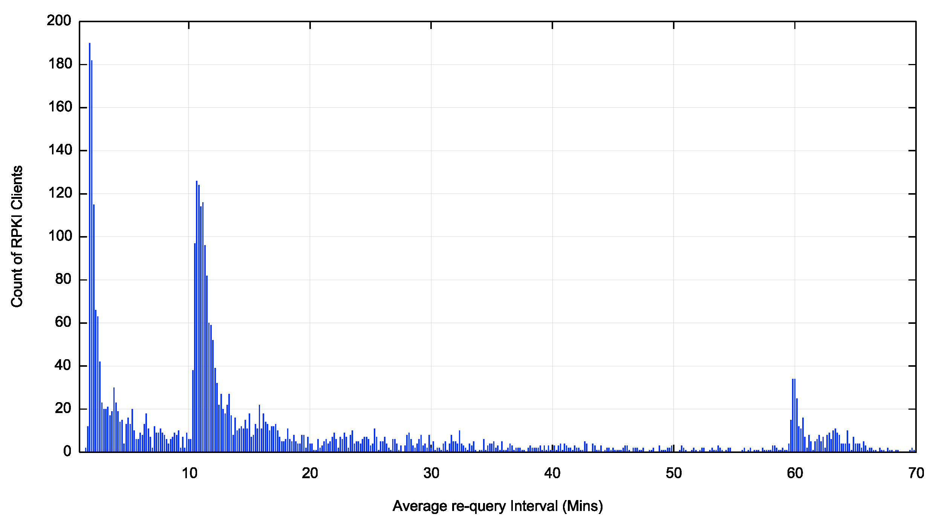
Re-Query Intervals (first hour)
120 seconds is popular
600 seconds is also well used
as is one hour
What’s this?

Slide 17
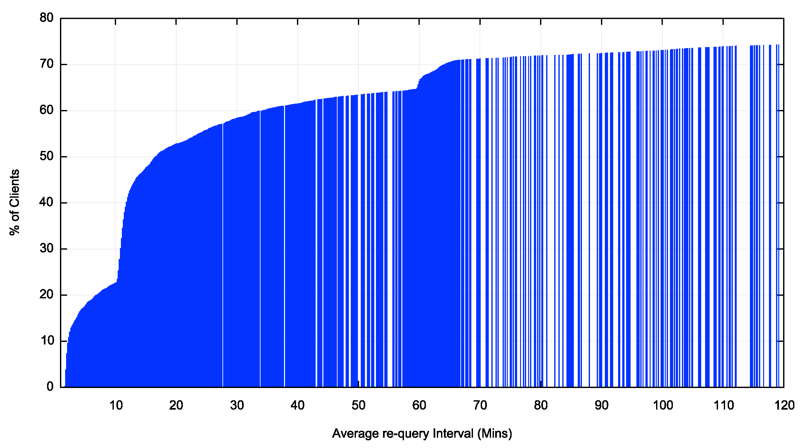
Re-Query – Cumulative Distribution
Within 2 hours we see 75% of clients perform a requery

Slide 18
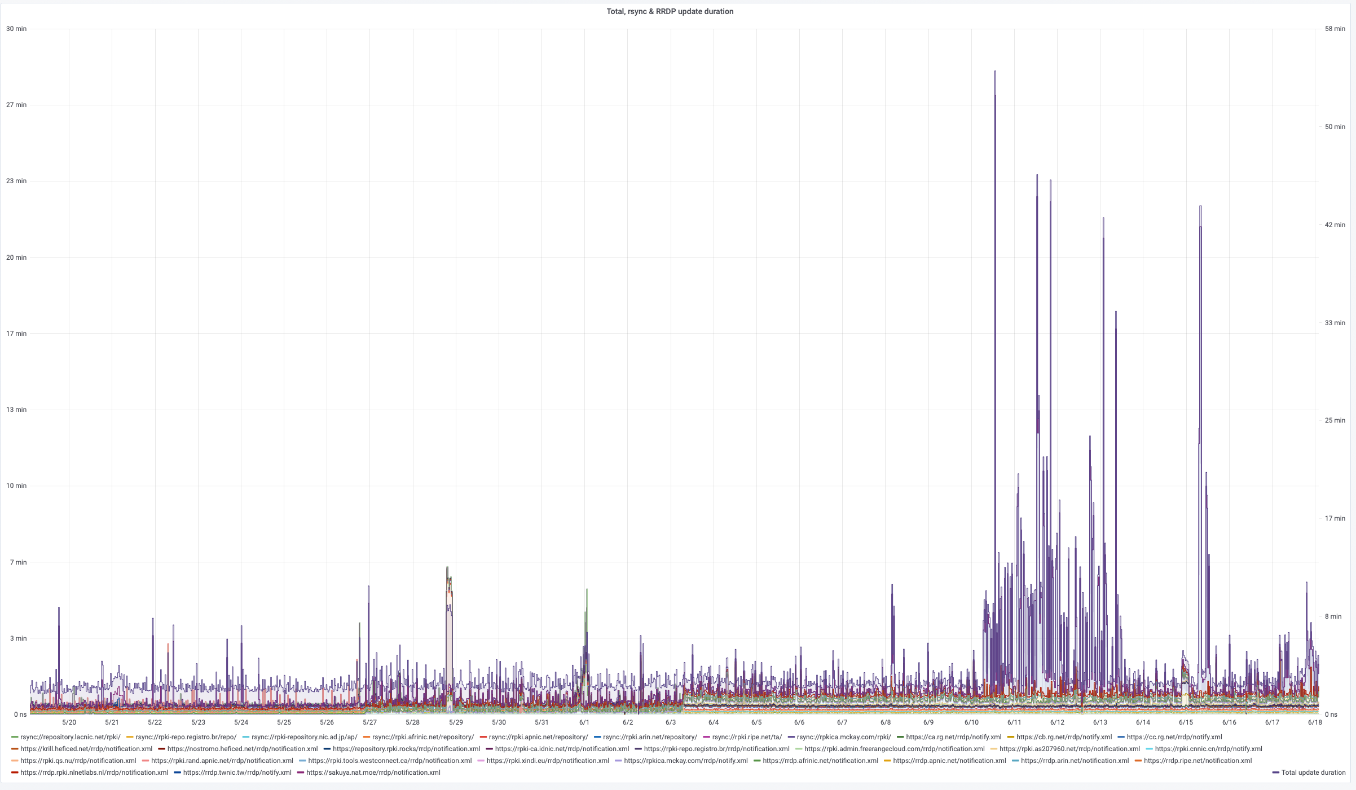
Why the tail lag?
Clients can take a significant amount of time to complete a pass through the entire RPKI distributed repository set, which makes the entire system sluggish to respond to changes
https://grafana.wikimedia.org/d/UwUa77GZk/rpki?panelId=59&fullscreen&orgId=1&from=now-30d&to=now

Slide 19
We use 12 and 36 hour held states
The route object validity state cycles over a 7 day period in a set of 12 and 36 hour intervals

Slide 20
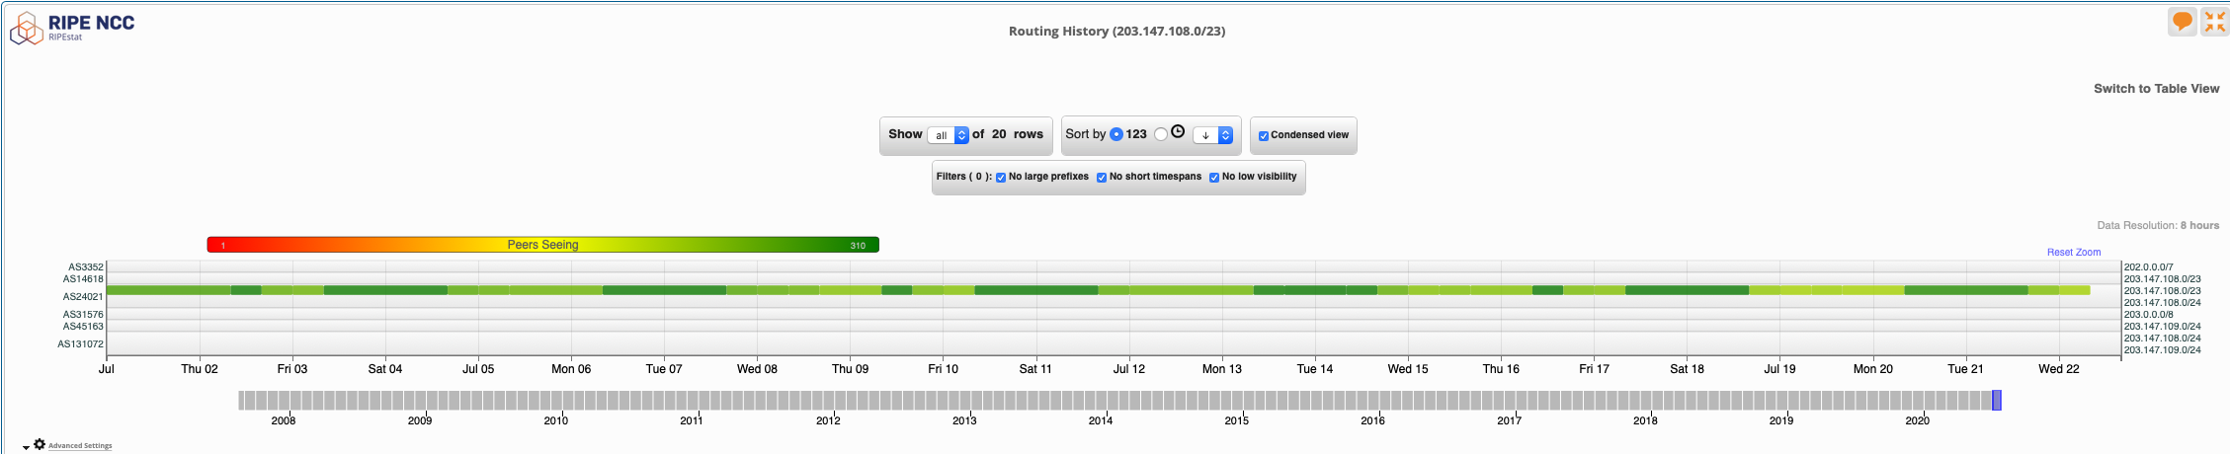
We use 12 and 36 hour held states
view from stat.ripe.net

Slide 21
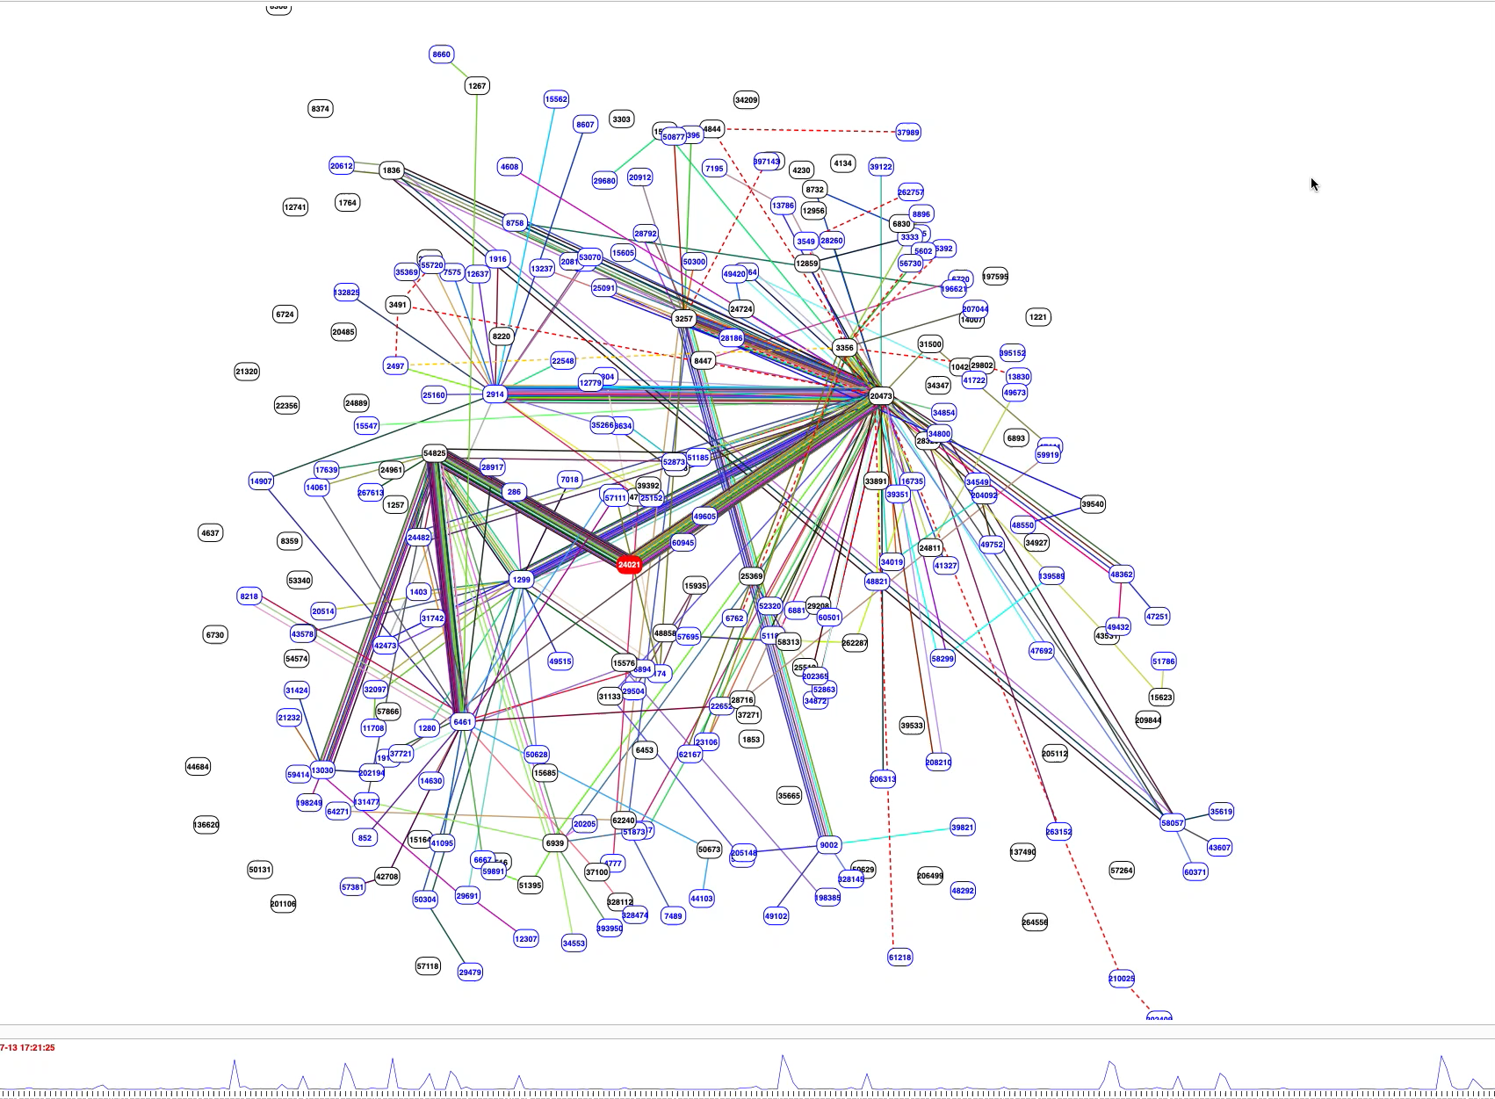
We use 12 and 36 hour held states
BGP Play view of the
routing changes

Slide 22
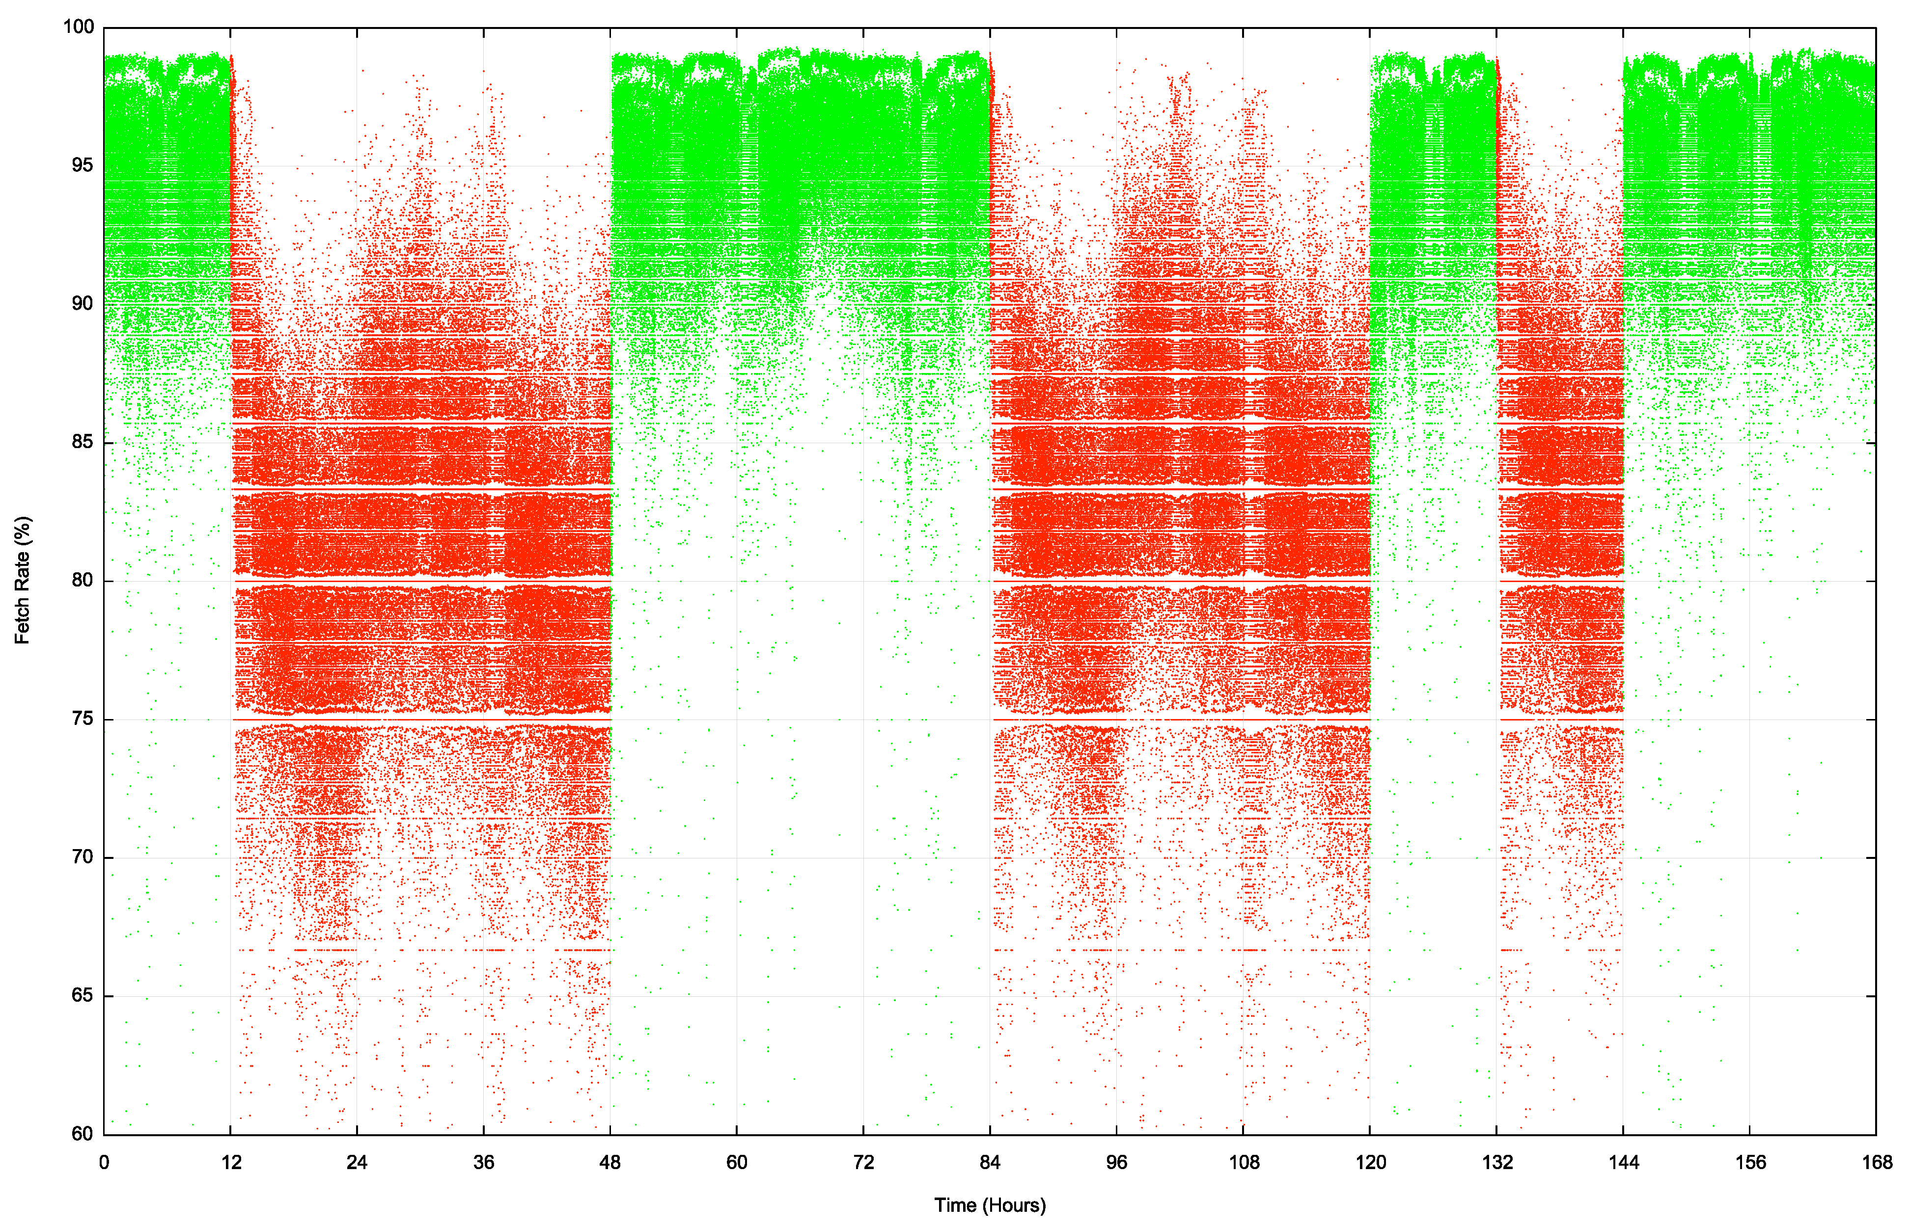
We use 12 and 36 hour held states
”valid” route state
This shows the per-second fetch rate when the route is valid (green) and invalid (red) over a 7 day window
The route validity switches are clearly visible
Weekly Measurement
”invalid” route state

Slide 23
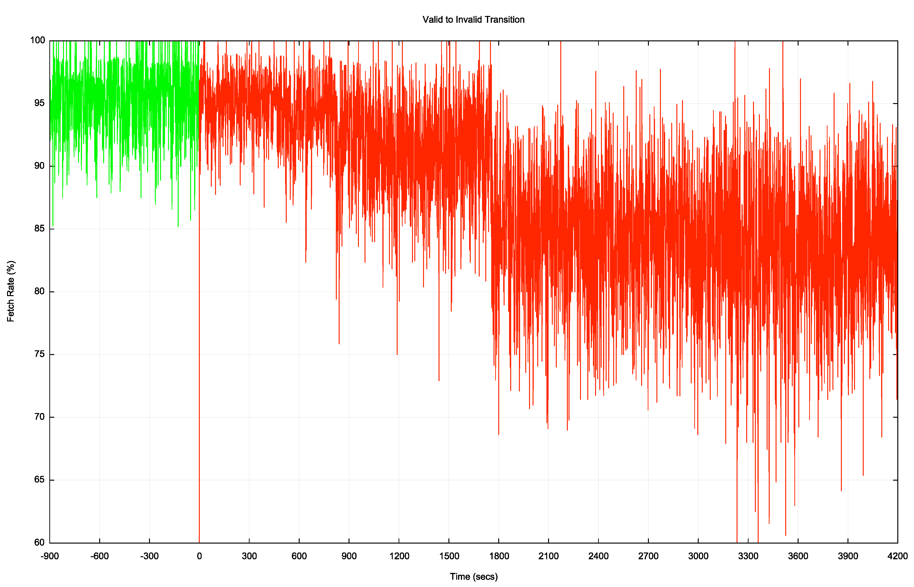
Transition – Valid to Invalid
It takes some 30 minutes for the valid to invalid transition to take effect in this measurement
It appears that this is a combination of slow re-query rates at the RPKI publication point and some delays in making changes to the filters being fed into the routers
This system is dependant on the last transit ISP to withdraw
Time of ROA change at the RPKI repository

Slide 24
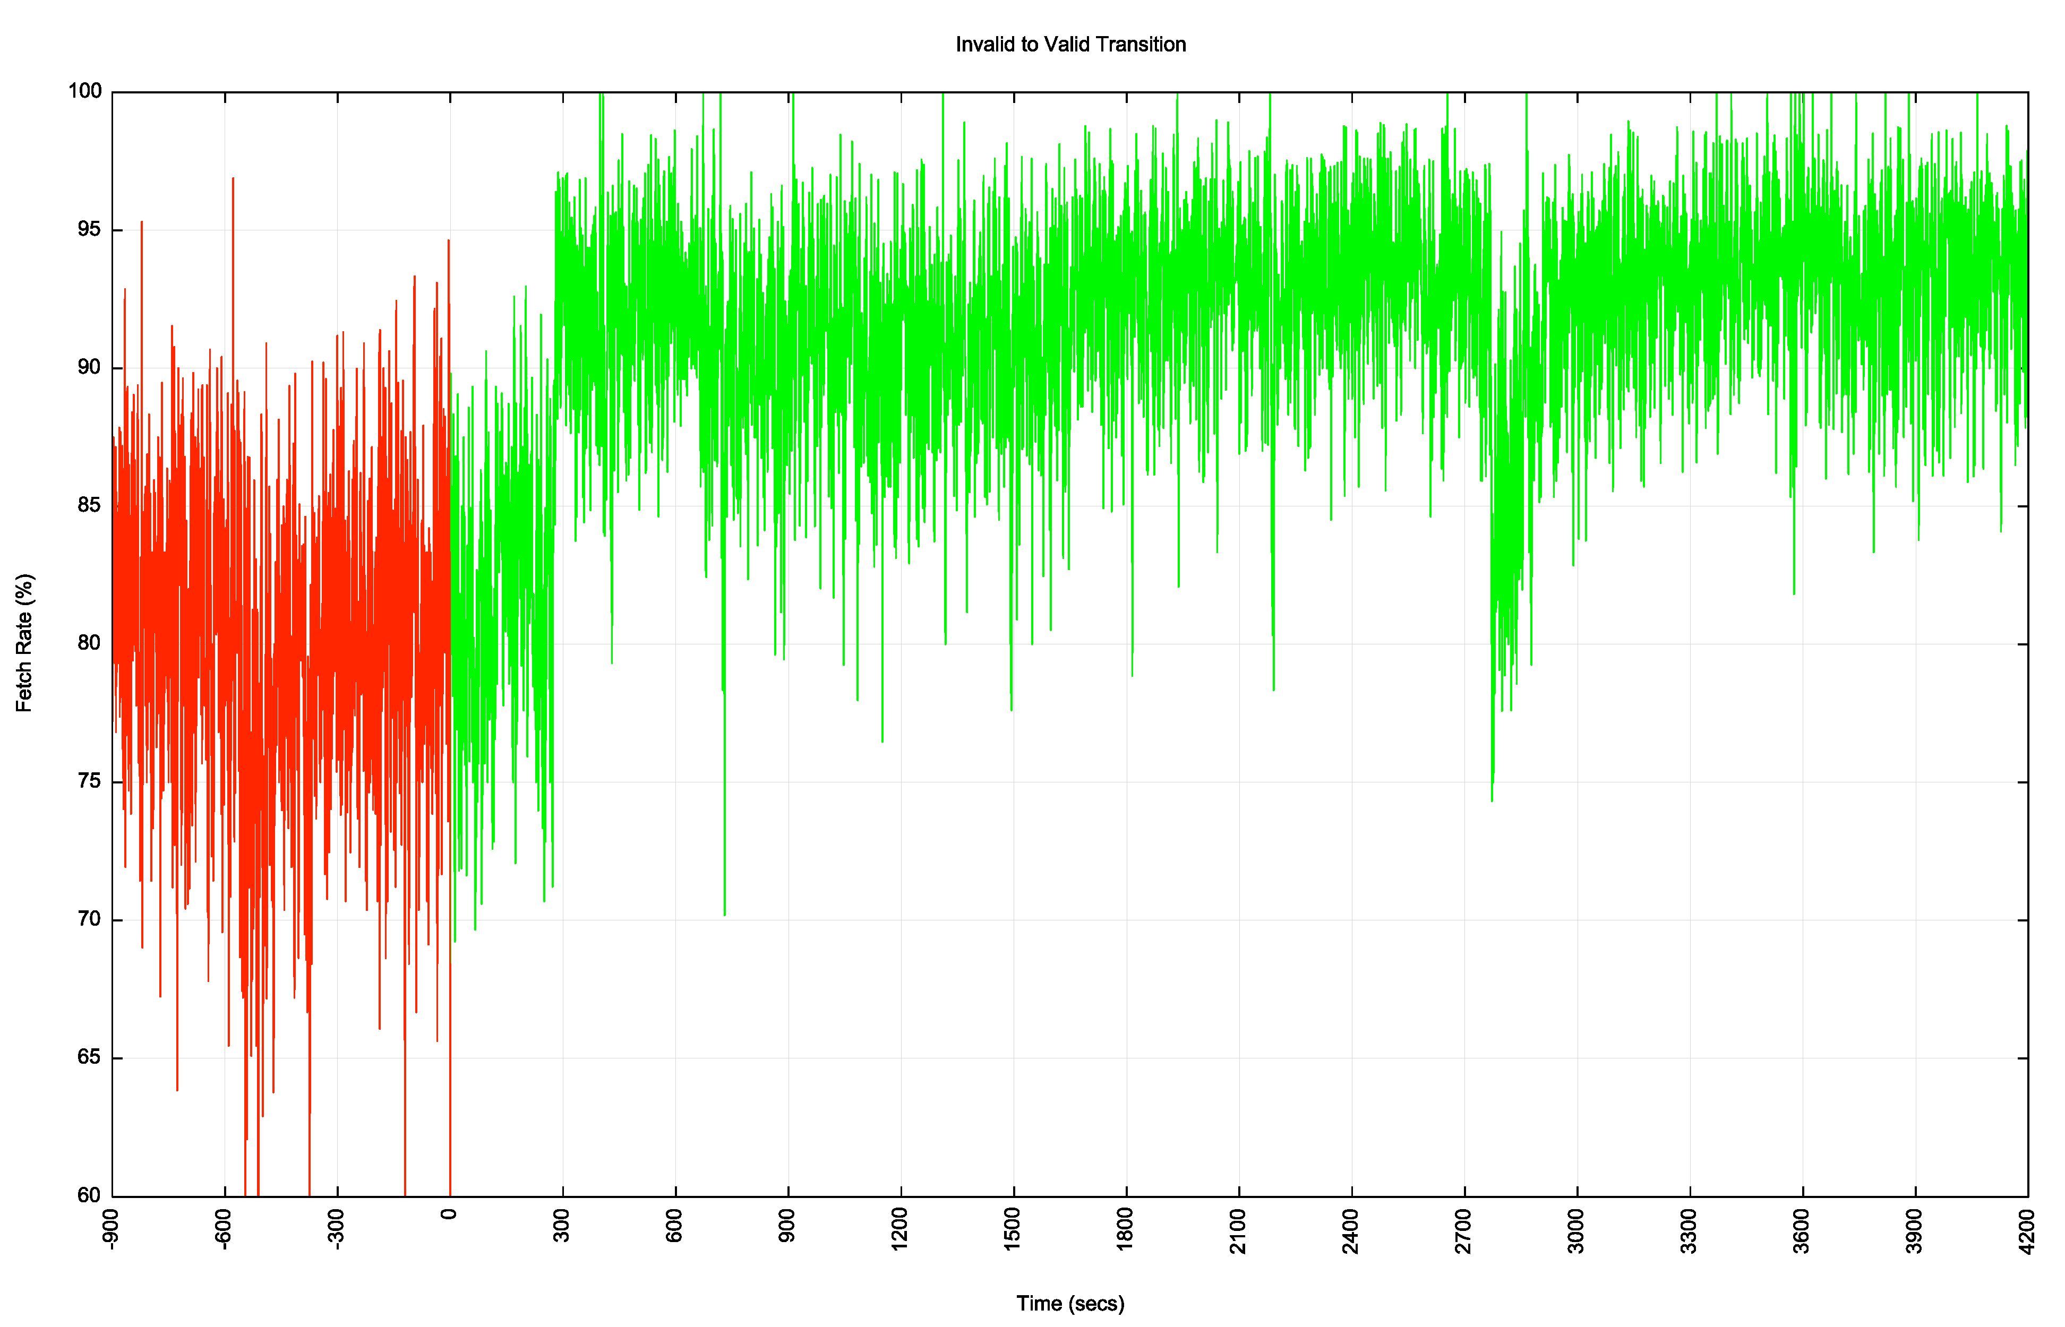
Transition – Invalid to Valid
It takes some 5 minutes for the invalid to valid transition to take effect in this measurement
This system is dependant on the first transit ISP to announce, so it tracks the fastest system to react
Time of ROA change at the RPKI repository

Slide 25
RPKI “sweep” software
There is a mix of 2, 10 and 60 minute timers being used by RPKI clients to perform a distributed repository sweep
2 minutes seems like a lot of thrashing with little in the way of outcome – the system is held back by those clients using longer re-query timers
60 minutes seems too slow
I’d suggest that we use a 10 minute query timer as a compromise here

Slide 26
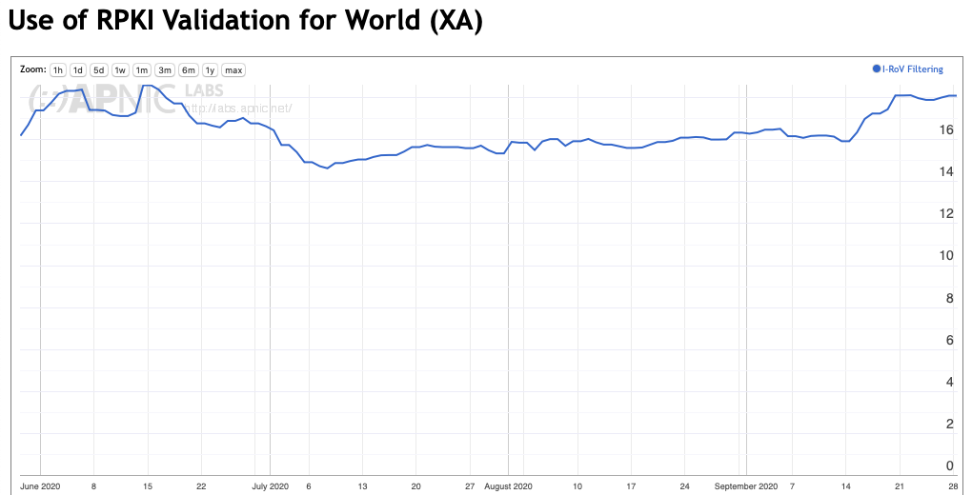
Results: User Impact of RPKI filtering
At 17% of users that’s a surprisingly large impact for a very recent technology

Slide 27
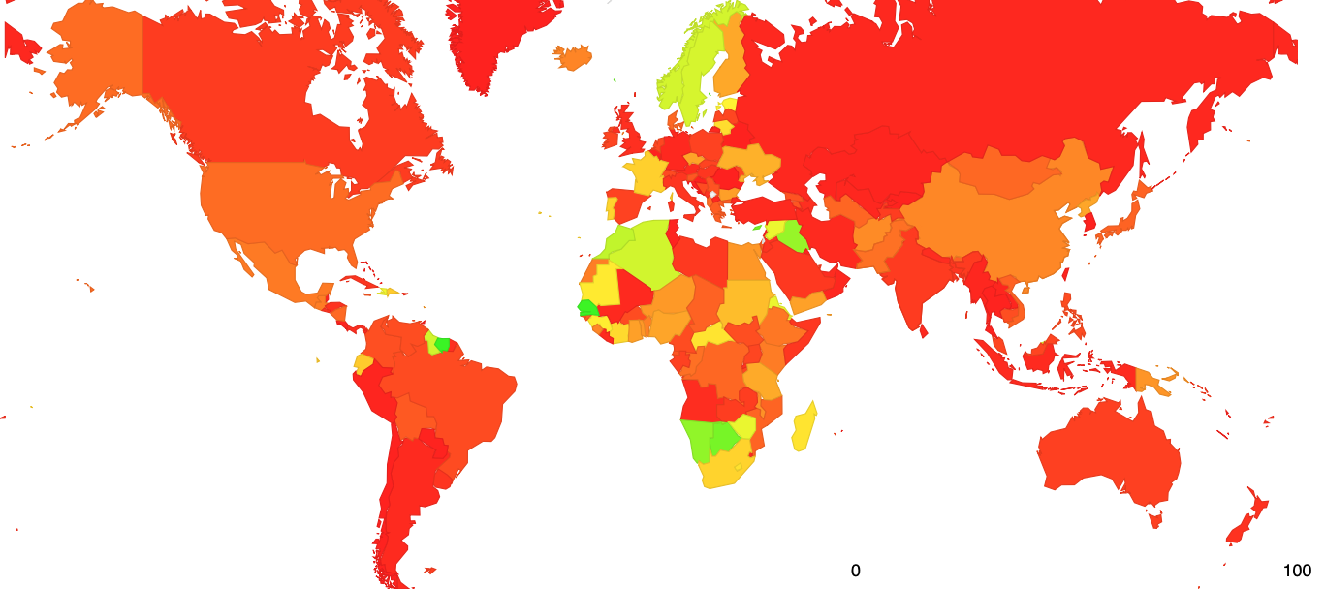
Results: User Impact of RPKI filtering – Jul 2020

Slide 28
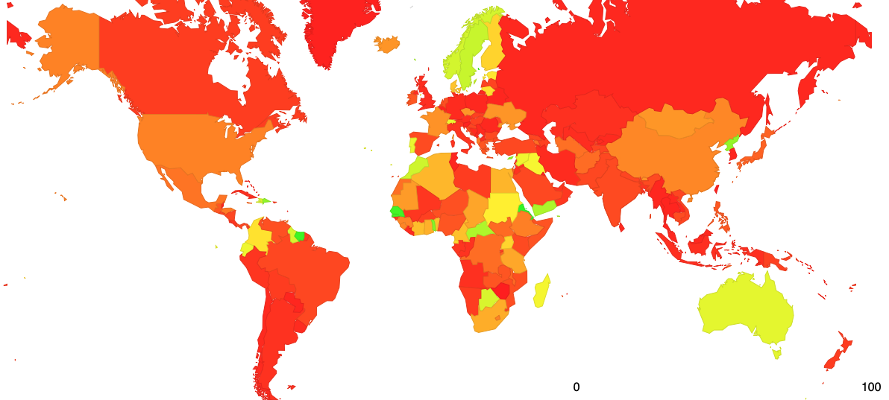
Results: User Impact of RPKI filtering – Oct 2020

Slide 29
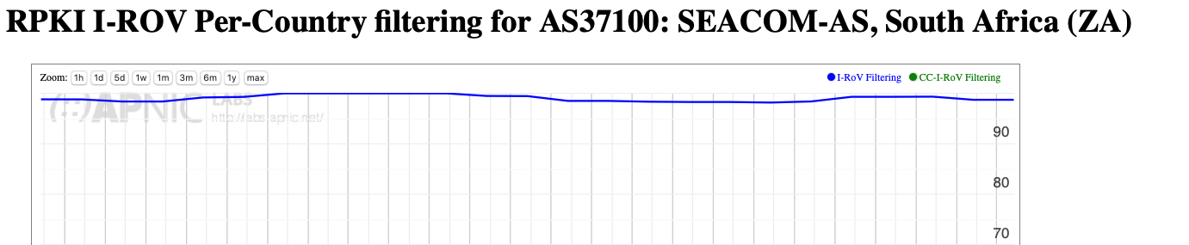
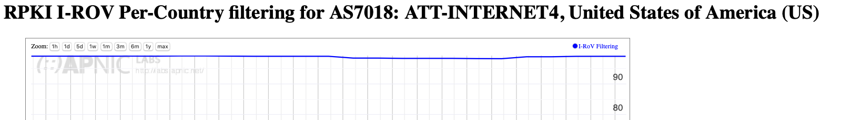
Why?
This map is a mix of two factors
  Networks that perform invalid route filtering

Slide 30
Why?
This map is a mix of two factors
  Networks that perform invalid route filtering
  and
  Network that do not filter themselves but are customers of transit providers who filter
In either case the basic RoV objective is achieved, in that end users and their networks are not exposed to invalid route objects

Slide 31
Next Steps for Measurement
This is a work in progress and would benefit from more refinement, including:
Adding more anycast servers with more transit diversity

Slide 32
Next Steps for Measurement (2)
Attempting selective traceroute from the anycast servers to identify the networks that are performing the RoV invalid filter drop?
  The measurement setup detects the user impact but not the individual networks who are performing drop invalid. Selective traceroute may allow a better way to identify the point of invalid drop

Slide 33
Next Steps for Measurement (3)
Further analysis of BGP route updates in route collectors to determine route withdrawal and announcement patterns when RPKI validity changes?
  What is the difference between the primary point of route withdrawal / announcement and the consequent propagation in eBGP to the surrounding networks

Slide 34
Questions we might want to think about
Stub vs Transit
Is it necessary for every AS to operate RPKI ROV infrastructure and filter invalid routes?
If not, what’s the minimal set of filtering networks that could provide similar levels of filtering for the Internet as a whole
What’s the marginal benefit of stub AS performing RPKI ROV filtering?

Slide 35
Questions we might want to think about (2)
Ingress vs Egress
Should a stub AS RPKI only RoV filter its own announcements?
Should every AS filter their own announcements?
What’s more important: Protecting others who DON’T RoV filter from your operational mishaps or protecting yourself from the mishaps of others?

Slide 36
Questions we might want to think about (3)
Prefix vs AS
Should an AS be able to enumerate ALL of its originations in a AS-signed attestation?

Slide 37
What are we trying to achieve here?
If this is a routing protection measure then what are you trying to protect? From whom? From what threat?
If this is a user protection measure then the issue of route filtering is potentially a more important issue for transits not stubs
  A stub should generate ROAs for its routes, but there is far less of an incentive to perform RoV invalid filtering if all of the the stub’s upstreams / IXs are already performing this filtering

Slide 38
Thanks!

