Slide 1
Future Networking Needs
Geoff Huston AM
Chief Scientist, APNIC

Slide 2
The Brief
Discuss: “the nature and requirements of computer communications networks that will be needed by society 50 years from now”

Slide 3
My thoughts on this question
What if this question had been posed in 1971?
Or even in 1921?

Slide 4
Moving back 100 years
What might we have said in 1921 about the public communications requirements for 2021?
Postage dominated the mass market and the telegram was the premium service
Radio and telephony deployment were picking up pace and entering the next phase of mass deployment
What we would’ve probably missed (or maybe dismissed) in 1921:
The rise and fall of the Fax
Television
Computers
Digital environments

Slide 5
Moving back 50 years
What might we have said in 1971 about the requirements for 2021?
What was happening
“mini-computing” was gathering momentum
Unix had been developed as a “lightweight” Multix (on a PDP-7)
What should’ve been seen as significant at the time?
Transformation of computers into a consumer product
Transformation of the role of data into information
We thought about communications through the lens of the telephone network
Packet networking was being developed, but it was unclear whether these packets were quanta of data or quanta of sessions (datagrams vs virtual circuit)

Slide 6
What’s happened since 1971?

Slide 7
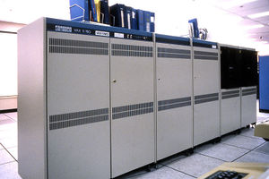
It used to be so simple…
1980’s:
The network was the transmission fabric for computers
It was just a packet transmission facility
Every other function was performed by attached mainframe computers

Slide 8
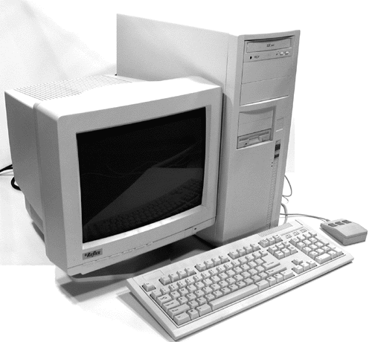
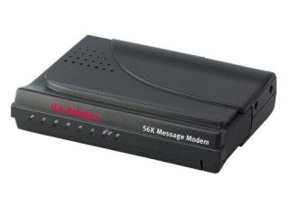
Then we went client/server
1990’s:
The rise of the Personal Computer as the “customer’s computer”
We started to make a distinction between “customers” and “network”
The naming system was pulled into the network
The routing system was pulled into the network
Messaging, content and services were pulled into the network
We created the asymmetric client/server network architecture for the Internet

Slide 9
Internet Infrastructure of 2000
Rapid expansion of infrastructure in many directions:
Exchanges, Peering Points and Gateways
Tier 1 ISPs
Transit and Traffic Engineering
Data Centres and Service “Farms”
Quality of Service Engineering
MPLS, VPNs and related network segmentation approaches
Customer Access Networks
Content Distribution Networks

Slide 10
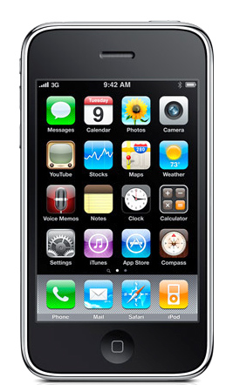
Mobility - 2007

Slide 11
Aren’t these all “different” networks?
Well, yes they are
The true genius of the Internet was to separate the service environment from the link technology
Each time we invented a new comms technology we could just “map” the Internet onto it
This preserved the value of the investment in “the Internet” across successive generations of comms technologies

Slide 12
What about the next 50 years?
The seeds of the dominant factors of the environment in 50 years from now are probably with us today
The problem is that a lot of other seeds are here as well, and sifting out the significant from the merely distracting is the challenge
So with that in mind lets work out the big drivers in today’s environment…

Slide 13
What’s driving change today?

Slide 14

Bigger
Increasing transmission capacity by using photonic amplifiers, wavelength multiplexing and phase/amplitude/polarisation modulation for fibre cables
Serving content and service transactions by distributing the load across many individual platforms through server and content aggregation
The rise of high capacity mobile edge networks and mobile platforms add massive volumes to content delivery
To manage this massive load shift we’ve stopped pushing content and transactions across the network and instead we serve from the edge

Slide 15
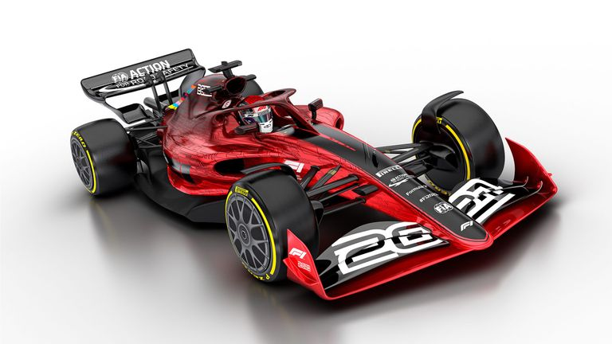
Faster
Reduce latency - stop pushing content and transactions across the network and instead serve from the edge
The rise of CDNs serve (almost) all Internet content and services from massively scaled distributed delivery systems.
The “Packet Miles” to deliver content to users has shrunk - that’s faster!
The development of high frequency cellular data systems (4G/5G) has resulted in a highly capable last mile access network with Gigabit capacity
Applications are being re-engineered to meet faster response criteria
Compressed interactions across shorter distances using higher capacity circuitry results in a faster Internet

Slide 16
Better
If “better” means “more trustworthy” and “more privacy” then we are making progress at last!
Encryption is close to ubiquitous in the world of web services
TLS 1.3 is moving to seal up the last open TLS porthole, the SNI field
Oblivious DNS and Oblivious HTTP is moving to isolate knowledge of the querier from the name being queried
The content, application, and platform sectors have all taken the privacy agenda up with enthusiasm, to the extent that whether networks are trustable or not doesn’t matter any more – all network infrastructure is uniformly treated as untrustable!

Slide 17

Cheaper
We are living in a world of abundant comms and computing capacity
And working in an industry when there are significant economies of scale
And being largely funded by capitalising a collective asset that is infeasible to capitalise individually
The result is that a former luxury service accessible to just a few has been transformed into an affordable mass-market commodity service available to all

Slide 18
So it’s all good!
Right?

Slide 19
Some issues to think about
What matters:
Addressing – IPv4 / IPv6 / IPv? Absolute? Relative?
Is universal unique end-point addressing a 1980’s concept who’s time has come and gone?
Naming and Name Spaces – DNS evolution?
Are ”names” a common attribute of the network, or an attribute of a service environment?
Referential Frameworks?
In a world of densely replicated service delivery points how does a client rendezvous with the “best” service point? Does the client work it out? Or the network? Or the service?
Nature of network transactions – Bilateral? Synchronised?

Slide 20
Longer Term Trends?
Pushing EVERYTHING out of the network and over to the edge!
Transmission infrastructure is becoming an abundant commodity
Sharing technology (multiplexing) is decreasingly relevant
We have so much network and computing that we no longer have to bring consumers to service delivery points - instead, we are shifting services towards consumers and using the network to replicate servers
With so much computing and storage the application is becoming the service, rather than just a window to a remotely operated service

Slide 21
Do Networks matter any more?
We have increasingly stripped out network-centric functionality in out search for lower cost, higher speed, and better agility
We are pushing functions out to the edge and ultimately off “the network” altogether and what is left is just dumb pipes
What defines “the Internet”?
A common network, a common protocol and a common protocol address pool?
or
A disparate collection of services that share common referential mechanisms?

Slide 22
Thanks!

