Slide 1
Future Networking Needs
Geoff Huston AM
Chief Scientist, APNIC

Slide 2
The Brief
Discuss: “the nature and requirements of computer communications networks that will be needed by society 50 years from now”

Slide 3
My thoughts on this question
What if this question had been posed in 1971?
Or even in 1921?

Slide 4
Moving back 100 years
What might we have said in 1921 about the public communications requirements for 2021?
Postage dominated the mass market and the telegram was the premium service
Radio and telephony deployment were picking up pace and entering the next phase of mass deployment
What we would’ve probably missed (or maybe dismissed) in 1921:
  The rise and fall of the fax
  Television
  Computers
  Digital environments

Slide 5
Moving back 50 years
What might we have said in 1971 about the requirements for 2021?
What was happening
  “mini-computing” was gathering momentum
  Unix had been developed as a “lightweight” Multix (on a PDP-7)
What should’ve been seen as significant at the time, but might have been missed
  Transformation of computers into a consumer product
  Transformation of the role of data into information
We thought about communications through the lens of the telephone network
  Packet networking was being developed, but it was unclear whether these packets were quanta of data or quanta of sessions (datagrams vs virtual circuit)

Slide 6
What’s happened since 1971?

Slide 7
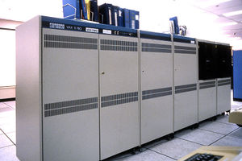
It used to be so simple…
1980’s:
The network was the transmission fabric for computers
It was just a packet transmission facility
Every other function was performed by attached mainframe computers

Slide 8
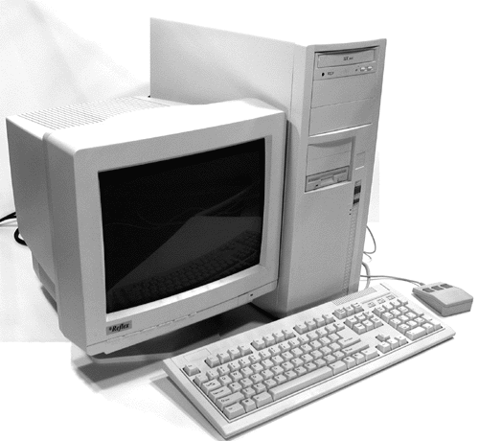
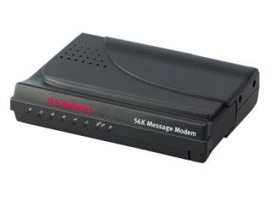
Then we went client/server
1990’s:
The rise of the Personal Computer as the “customer’s computer”
We started to make a distinction between “customers” and “network”
  The naming system was pulled into the network
  The routing system was pulled into the network
  Messaging, content and services were pulled into the network
We created the asymmetric client/server network architecture for the Internet

Slide 9
Internet Infrastructure of 2000
Rapid expansion of infrastructure in many directions:
Exchanges, Peering Points and Gateways
Tier 1 ISPs
Transit and Traffic Engineering
Data Centres and Service “Farms”
Quality of Service Engineering
MPLS, VPNs and related network segmentation approaches
Customer Access Networks
Content Distribution Networks

Slide 10
Aren’t these all “different” networks?
Well, yes they are
The true genius of the Internet was to separate the service environment from the link technology
  Each time we invented a new comms technology we could just “map” the Internet onto it
  This preserved the value of the investment in “the Internet” across successive generations of comms technologies

Slide 11
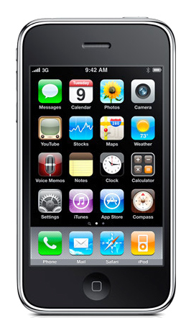
Then along came mobility in 2007
The iPhone was a breakthrough product that completely transformed the computer and communications environment and touched just about everything else!

Slide 12
The Rise and Rise of the Internet
There were few natural barriers to growth
  No labour force limitations
  No geographic limitations
  No regulatory inhibitors
  No coherent business models to follow, so investors became irrationally optimistic over future growth potential
Digital business models quickly became global in scope
  Uber, WeWork, Cisco, Microsoft, Amazon, Apple, etc
This “winner take all” environment created an environment that is dominated by a small number of giant enterprises that operate at a global scale

Slide 13
Enter the Giants
The 90’s was characterized by the triumphs of deregulation and innovation
Thousands of enterprises funded by a relatively small pool of venture capital occupying new digital real estate
Then moving on to take on the established market players

Slide 14
The Internet’s Gilded Age
At some point in the past decade or so the dominant position across the entire Internet has been occupied by a very small number of players who are moving far faster than the regulatory measures that were intended to curb the worst excesses of market dominance by a small clique of actors.

Slide 15
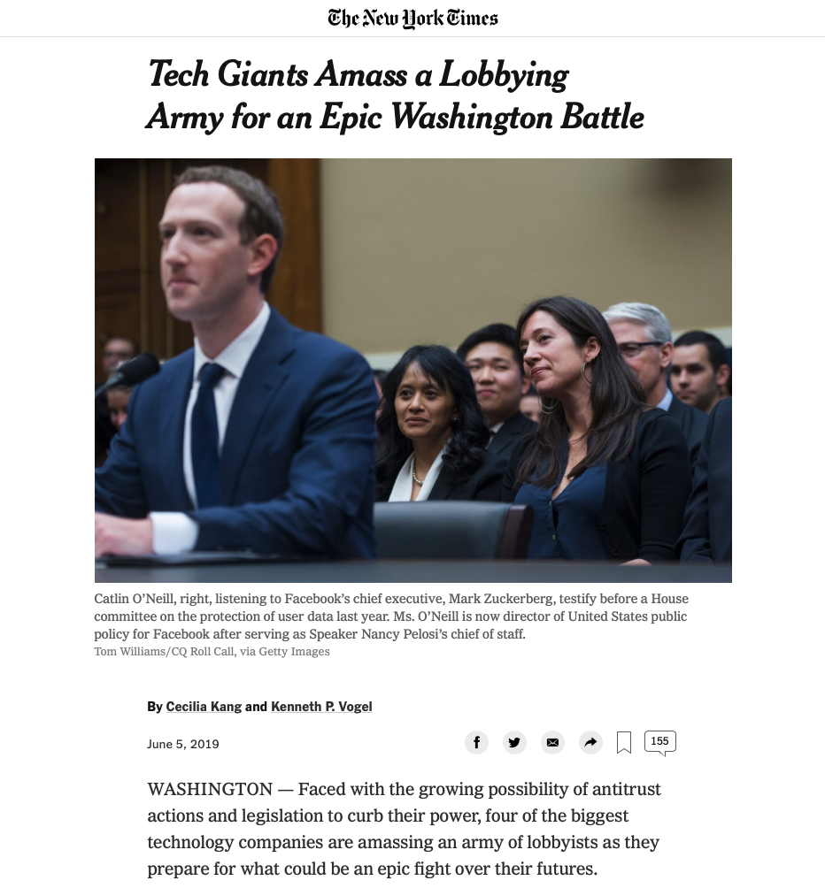
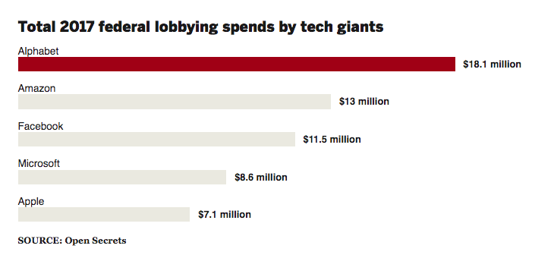
The Internet’s Gilded Age
At some point in the past decade or so the dominant position across the entire Internet has been occupied by a very small number of players who are moving far faster than the regulatory measures that were intended to curb the worst excesses of market dominance by a small clique of actors.
15

Slide 16
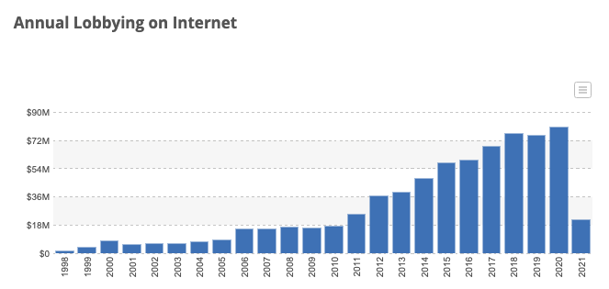
The Internet’s Gilded Age
At some point in the past decade or so the dominant position across the entire Internet has been occupied by a very small number of players who are moving far faster than the regulatory measures that were intended to curb the worst excesses of market dominance by a small clique of actors.
Source: Open Secrets

Slide 17
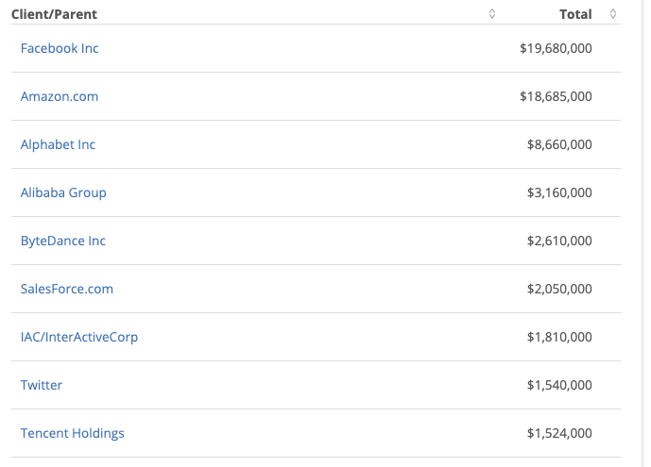
The Internet’s Gilded Age
2020 Lobbying Sources - US
At some point in the past decade or so the dominant position across the entire Internet has been occupied by a very small number of players who are moving far faster than the regulatory measures that were intended to curb the worst excesses of market dominance by a small clique of actors.
Source: Open Secrets

Slide 18
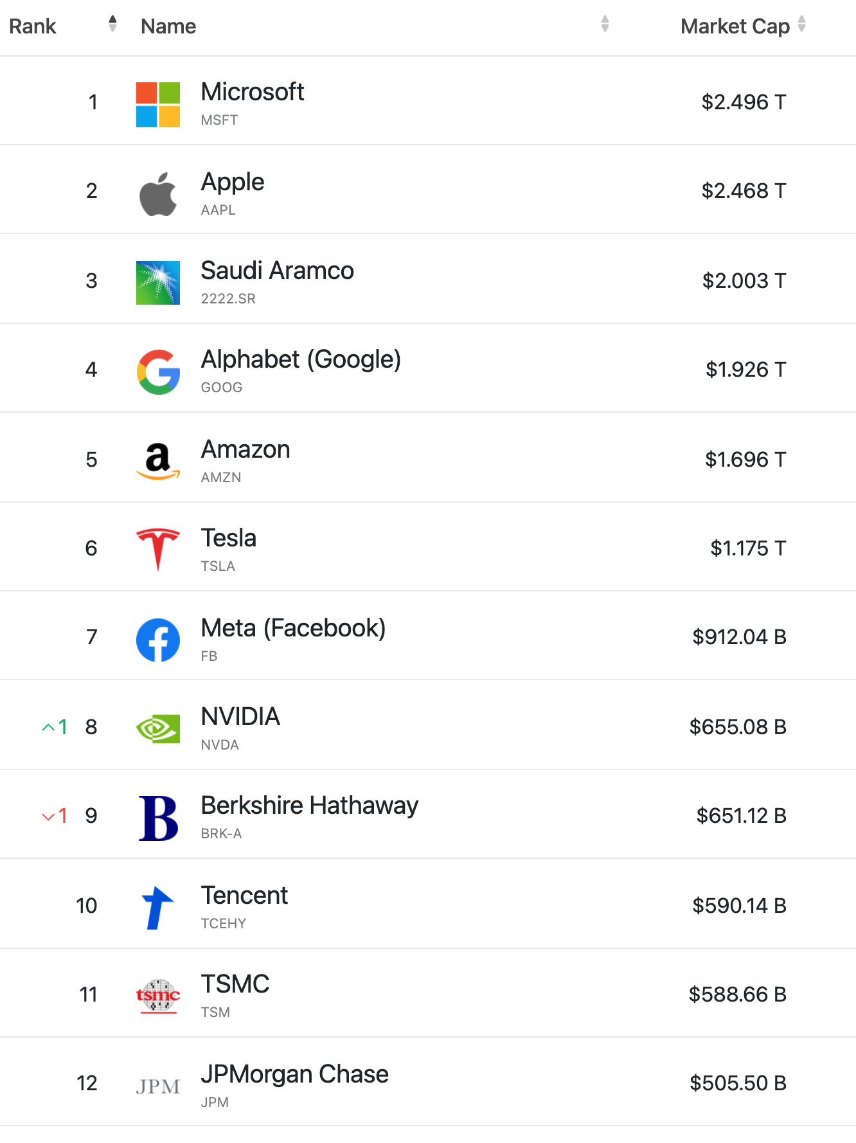
Today’s Giants
One fossil fuel extractor, one investment fund and a legacy carryover from the last guilded age – and all the rest are technology enterprises
And only 1 is Chinese.

Slide 19
The Internet’s Gilded Age
These actors have enough market influence to set their own rules of engagement with:
  Users,
  Each other,
  Third party suppliers,
  Regulators and Governments
By taking a leading position with these emergent technologies, these players can amass vast fortunes, with little in the way of accountability to a broader common public good

Slide 20
There are side-effects
In order to understand what each consumer wants, the service provider needs to understand the consumer
Which brings us to…

Slide 21

Surveillance Capitalism
Much of the wealth and impact of these activities is built upon a foundation of aggregation of individual user behaviour and construction of personal profiles
It also has benefitted from a cavalier attitude towards data security and privacy concerns and the absence of regulatory imposts that attempt to safeguard some basic common aspects of personal privacy

Slide 22
Change and Monopolies
We are now communicating with a computer-mediated environment rather than with each other
The network itself is largely incidental to this evolving story, and this is not really about the Internet any more
It’s about a set of revolutionary social changes on a par with the industrial revolution that have been triggered by abundant computing, storage and comms
And it’s dominated by a very small cartel of monopolists

Slide 23
Change and Monopolies
We are now communicating with a computer-mediated environment rather than with each other
The network itself is largely incidental to this evolving story, and this is not really about the Internet any more
It’s about a set of revolutionary social changes on a par with the industrial revolution that have been triggered by abundant computing, storage and comms
And it’s dominated by a very small cartel of monopolists
“Every monopoly and all exclusive privileges are granted only at the expense of the public interest”
Andrew Jackson, 1830

Slide 24

Incumbency Rewards
Gittes: How much are you worth?
Cross: I've no idea. How much do you want?
Gittes: I just want to know what you're worth. Over ten million?
Cross: Oh my, yes!
Gittes: Why are you doing it? How much better can
you eat? What can you buy that you
can't already afford?
Cross: The future, Mr. Gittes - the future!
Chinatown (1974)

Slide 25
What about the next 50 years?
The seeds of the dominant factors of the environment in 50 years from now are probably with us today
The problem is that a lot of other seeds are here as well, and sifting out the significant from the merely distracting is the challenge
So with that in mind lets work out the big drivers in today’s environment…

Slide 26
What’s driving change today?

Slide 27
Scale
“The only real problem is scaling. All others inherit from this.”
  Attributed to Mike O’Dell

Slide 28

Bigger
Increasing transmission capacity by using photonic amplifiers, wavelength multiplexing and phase/amplitude/polarisation modulation for fibre cables
Serving content and service transactions by distributing the load across many individual platforms through server and content aggregation
The rise of high capacity mobile edge networks and mobile platforms add massive volumes to content delivery
To manage this massive load shift we’ve stopped pushing content and transactions across the network and instead we serve from the edge

Slide 29
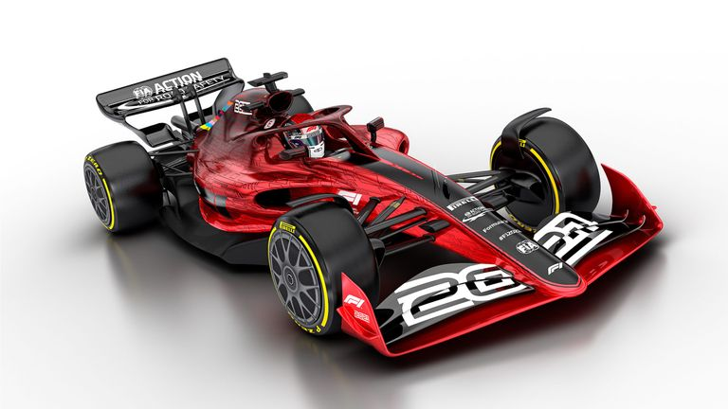
Faster
Reduce latency - stop pushing content and transactions across the network and instead serve from the edge
The rise of CDNs serve (almost) all Internet content and services from massively scaled distributed delivery systems.
The “Packet Miles” to deliver content to users has shrunk - that’s faster!
The development of high frequency cellular data systems (4G/5G) has resulted in a highly capable last mile access network with Gigabit capacity
Applications are being re-engineered to meet faster response criteria
Compressed interactions across shorter distances using higher capacity circuitry results in a faster Internet

Slide 30
Better
If “better” means “more trustworthy” and “more privacy” then we are making progress at last!
  Encryption is close to ubiquitous in the world of web services
  TLS 1.3 is moving to seal up the last open TLS porthole, the SNI field
  Oblivious DNS and Oblivious HTTP is moving to isolate knowledge of the querier from the name being queried
  The content, application, and platform sectors have all taken the privacy agenda up with enthusiasm, to the extent that whether networks are trustable or not doesn’t matter any more – all network infrastructure is uniformly treated as untrustable!

Slide 31

Cheaper
We are living in a world of abundant comms and computing capacity
And working in an industry when there are significant economies of scale
And being largely funded by capitalising a collective asset that is infeasible to capitalise individually
The result is that a former luxury service accessible to just a few has been transformed into an affordable mass-market commodity service available to all
  but provided by a small clique of providers!

Slide 32
So it’s all good!
Right?

Slide 33
So it’s all good?
Or maybe not.

Slide 34
Some issues to think about
What matters in such a network?
  Addressing – IPv4 / IPv6 / IPv? Absolute? Relative?
    Is universal unique end-point addressing a 1980’s concept who’s time has come and gone?
  Naming and Name Spaces – DNS evolution?
    Are ”names” a common attribute of the network, or an attribute of a service environment?
  Referential Frameworks?
    In a world of densely replicated service delivery points how does a client rendezvous with the “best” service point? Does the client work it out? Or the network? Or the service?

Slide 35
Some issues to think about
What matters in such a network?
  If we don’t try to share our transactions across a common network then what are we asking from common infrastructure?
  If anything!

Slide 36
Longer Term Trends?
Pushing EVERYTHING out of the network and over to the edge!
Transmission infrastructure is becoming an abundant commodity
  Sharing technology (multiplexing) is decreasingly relevant
We have so much network and computing that we no longer have to bring consumers to service delivery points - instead, we are shifting services towards consumers and using the network to replicate servers
With so much computing and storage the application is becoming the service, rather than just a window to a remotely operated service

Slide 37
Do Networks matter any more?
We have increasingly stripped out network-centric functionality in out search for lower cost, higher speed, and better agility
We are pushing functions out to the edge and ultimately off “the network” altogether and what is left is just dumb pipes
What defines “the Internet”?
  A common network, a common protocol and a common protocol address pool?
  or
  A disparate collection of services that share common referential mechanisms?

Slide 38
What will ”Internet Governance” mean anyway?
There has been no governance at all in the Internet’s 50 year old history so far
  Its just been the relentless pressure of deregulated markets
The only discernible trend has been the progressive shift in value up the protocol “stack”
  From networks to platforms to applications
  As value moves up commodity economics comes in its wake
    Networks are cheap utilities, platforms are now valueless

Slide 39
Maybe it’s just User Preference
Dismantling the telco monopoly ripped apart the command and control economy of communications
  And when governments stopped investing they lost their seat at the table
What’s left is a market where user preferences rule
  Forecasting user preferences is good
  Shaping user preferences is better
  And monetising user preferences is better still!

Slide 40
Wherever we’re heading…
It’s not the Internet any more
That has already died and gone to silicon heaven!

Slide 41

Sic transit gloria mundi
In 1776 English historian Edward Gibbon published a mighty 6 volume work tracing the Roman Empire (and Western Civilisation) from the height of Empire to the fall of Byzantium
The seeds of of the empire’s eventual decline and fall were sown early in its rise

Slide 42
Thanks!

