Slide 1
A Quick look at QUIC
Geoff Huston, Joao Damas,
APNIC Labs

Slide 2
QUIC is…
QUIC
HTTP/3
HTTP/2
HTTP
Multi-stream
HTTP
TLS
Session Encryption
QUIC
Multi-stream
Encryption
Data stream integrity
Congestion Control
e2e encrypted
TCP
Data stream integrity
Congestion Control
e2e encrypted
UDP
IP

Slide 3
TCP is..
A transport protocol that constructs a reliable full duplex adaptive streaming service constructed on top of an unreliable IP datagram service
  Uses a coordinated state between the two end systems without any network intervention or mediation
  Uses a sliding window to allow lost data to be resent
  Uses ACK-clocking to regulate the sending behaviour to match network path capacity estimate
  Has been tweaked to support (*to some degree) multi-stream and RPC transport models

Slide 4
TCP isn’t…
Fully independent of the underlying platform’s transport services
Fully multi-stream (it has head of line blocking)
Free from on-the-wire network intervention (TCP control parameters are sent in the clear)
Has e2e encryption as a second step / afterthought
Everything for everyone – it relies on the application to perform data framing and in-band control

Slide 5
QUIC is…
Constructed upon a transport level framing protocol that offers applications access to the basic IP datagram services offered by IP through the use of UDP
  All other transport services (data integrity, session control, congestion control, encryption) are shifted towards the application. A platform may provide a QUIC API, but the application can also provide its own service
So much more than just “encrypted TCP over UDP”:
  Support for multi-stream multiplexing that avoids head-of-line blocking and exploits a shared congestion and encryption state
  Faster - Combines transport and encryption setup exchange in a single 3-way exchange
  Customisable - QUIC implementations can use individual flow controllers per flow
  QUIC places it’s transport control fields inside the encryption envelope, so QUIC has minimal exposure to the network
  Supports record and RPC service models as well as streaming and datagram

Slide 6
QUIC is address agile
NATs are potentially hostile to QUIC because of the outer UDP wrapper
  A NAT may rebind (shift the externally visible address/port of a host during a session), as NATs are not generally aware of UDP streaming states
QUIC uses a persistent “connection ID”
  If a host receives a QUIC frame with the same connection ID and a new IP address / port it will send a challenge by way of a random value that should be echoed back. This is all performed within the e2e encryption envelope. That way a QUIC e2e session can map into new address/port associations on the fly

Slide 7
QUIC also…
Is IP fragmentation intolerant – QUIC uses PMTUD, or defaults to 1,200 octet UDP payloads
Never retransmits a QUIC packet – retransmitted data is sent in the next QUIC packet number – this avoids ambiguity about packet retransmission
Extends TCP SACK to 256 packet number ranges (up from 3)
Separately encrypts each QUIC packet
May load multiple QUIC packets in a single UDP frame

Slide 8
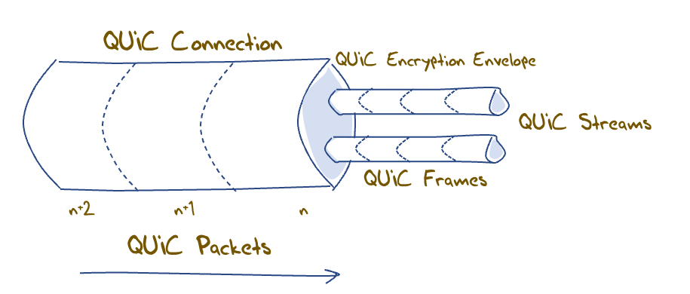
QUIC flow structuring
A QUIC connection is broken into “streams” which are reliable data flows – each stream performs stream-based loss recovery, congestion control, and relative stream scheduling for bandwidth allocation
QUIC also supports unreliable encrypted datagram delivery

Slide 9
QUIC and RPC
By associating each RPC request/reply with a new stream, QUIC can support asynchronous RPC transactions using reliable messaging
  This can handle lost, mis-ordered and duplicated RPC messages without common blocking or throttling

Slide 10
QUIC and Load Balancing
This assumes that a front-end load balancer is capable of performing load balancing on UDP flows using the UDP connection 5-tuple
If the remote end performs NAT rebinding the load balancer will be thrown by this shift, and it has no direct visibility into the e2e session to uncover the connection ID
Using UDP to carry sustained high-volume streams may not match the internal optimisations used in server content delivery networks
If we really want large scale QUIC with front end load balancing and if we still need to tolerate NATs then we will need to think about how the end point can share the connection ID state with its front end load balancer, or how to terminate the QUIC session in the front end and use a second session to a selected server

Slide 11
QUIC and DOS
Very little lies outside the encryption envelope in QUIC
Which means all incoming packets addressed to the QUIC port need to be decrypted
But the session uses symmetric crypto so the packet decode overhead is far smaller than the asymmetric load
Its not the best answer, but its not disastrous either!

Slide 12
Looking for QUIC
At APNIC we use Ads to perform large scale measurements of network service capabilities as seen by users
  IPv6 deployment
  DNSSEC validation
  Fragmentation
Can we use this measurement platform to see the level of use of QUIC in today’s network?

Slide 13
Setting up QUIC
Server:
  nginx v1.21.7 with QUIC functions included
DNS:
  Set up an HTTPS record for each URL with value: alpn=“h3”
Content:
  Alt-Svc: h3=“:443”
  (This second method requires a subsequent query to allow the client to use the Alt-Svc capability. We perform a delayed second query for this URL in the measurement experiment)

Slide 14
Setting up QUIC
Server:
  nginx v1.21.7 with QUIC functions included
DNS:
  Set up an HTTPS record for each URL with value: alpn=“h3”
Content:
  Alt-Svc: h3=“:443”
First Fetch
Second Fetch

Slide 15
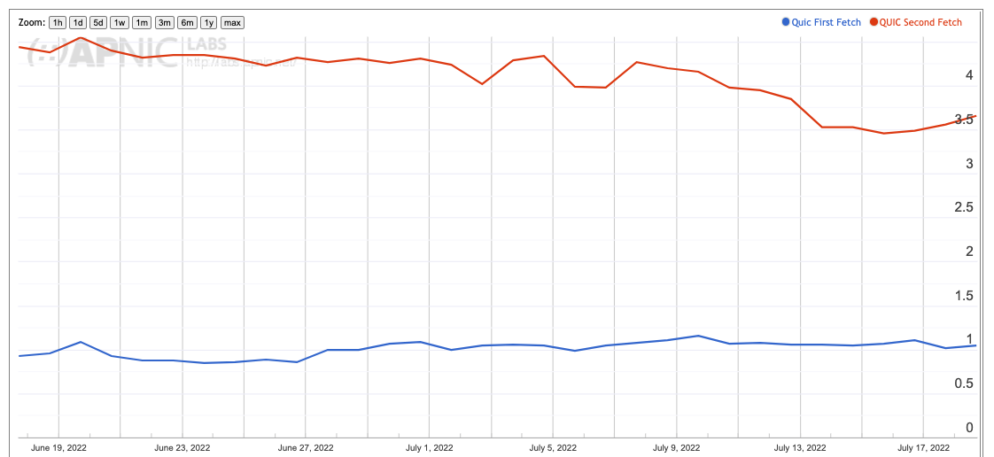
QUIC Use – June/July 2022
About 3.5% of users use HTTP/3 for the second fetch
About 1% of users are seen to use HTTP/3 on first fetch

Slide 16
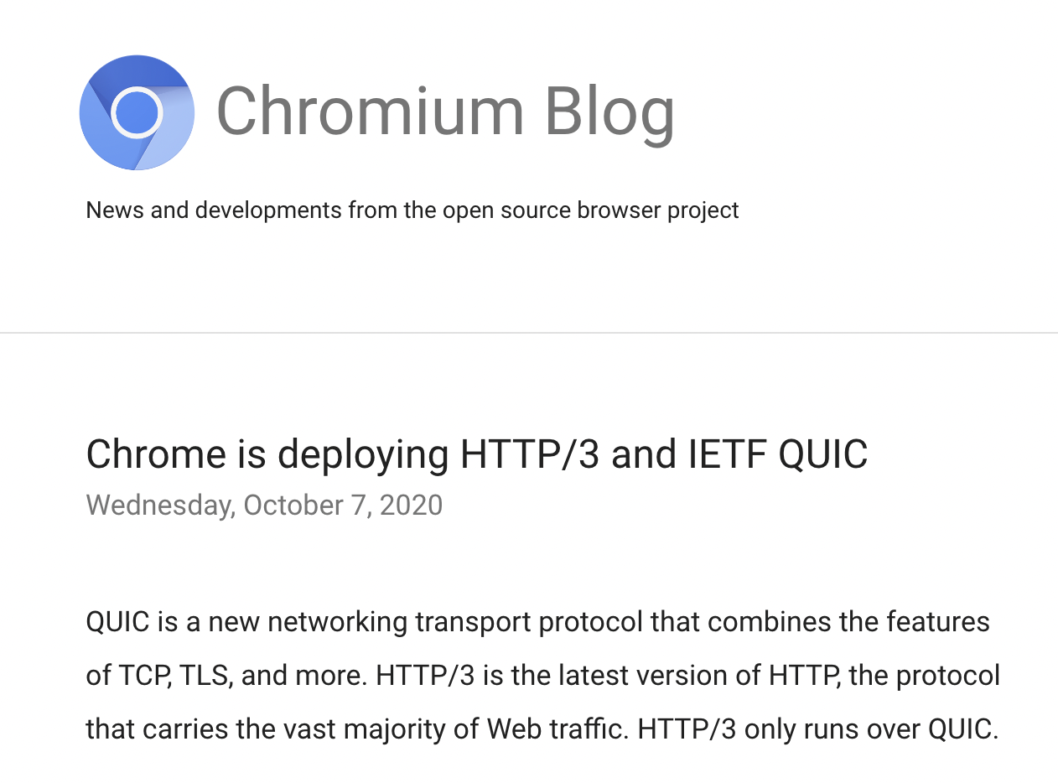
This result looks wrong!
Some 90% of the browsers we “see” via the ad campaign identify themselves as Chrome
And Chrome has been supporting a switch to QUIC via the Alt-Svc directive since 2020

Slide 17
This result looks wrong!
Some 90% of the browsers we “see” via the ad campaign identify themselves as Chrome
And Chrome has been supporting a switch to QUIC via the Alt-Svc directive since 2020
So we should be seeing a far higher level of QUIC use than 3.5%
Hmm
What do others see?

Slide 18

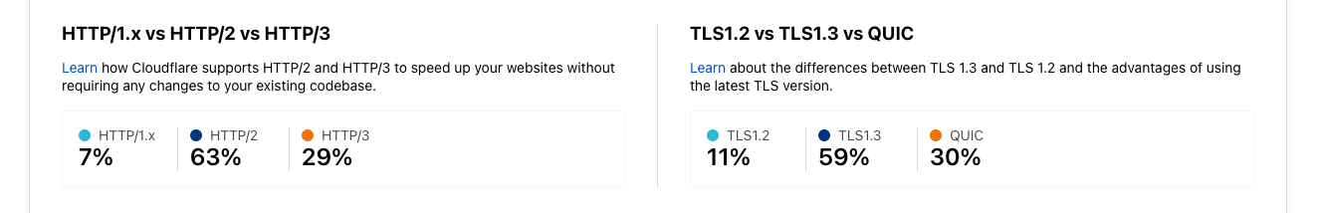
Cloudflare’s Numbers
Our QUIC use numbers are far lower than other published measures

Slide 19
Maybe 2 fetches is not enough?
So we changed the experiment to fetch the same URL 7 times with a 2 second pause between each fetch
Surely this would flush out QUIC use!

Slide 20
Nope!
No change!
The problem appears to be related to HTTP/2 and persistent connections
When the browser performs the followup fetch the connection is likely still open and then the browser will prefer to use the open connection over opening up a new QUIC connect
So on the NGINX server let’s set the keepalive session parameter to 0 seconds
Yes?

Slide 21
Still Nope!
That was worse!
We didn’t see any use of QUIC at all
Nothing. Nada. Not even a little bit.
Seems that if you set keepalive to zero then NGINX disables QUIC completely!
So we then set the session keepalive parameter to 1 second
Better?

Slide 22
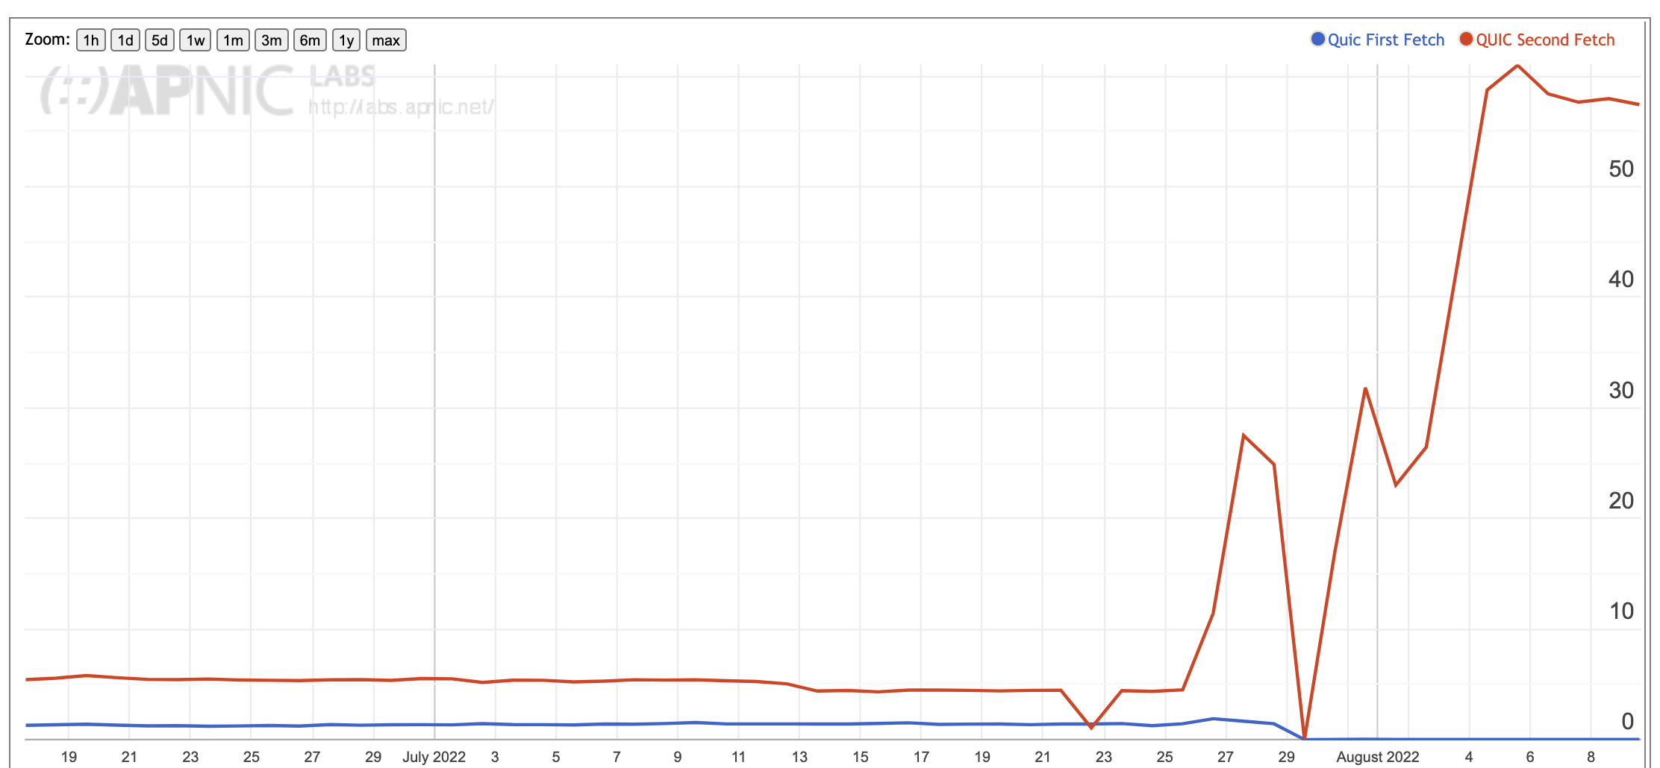
QUIC Use – June - August 2022
Change from 1 to 7 repeat fetches
keepalive=0
keepalive=1

Slide 23
Yes!
We are seeing a 57% QUIC on the repeat fetches, corresponding to a rate of 63% QUIC use of Chrome clients

Slide 24
Yes, and No
We are seeing a 57% QUIC on the repeat fetches, corresponding to a rate of 63% QUIC use of Chrome clients
But at the same time the first fetch use dropped from 1% to minimal levels
Which appears to be an issue with Safari, and iOS (and MAC OS)
And we were seeing Chrome clients revert from QUIC to HTTP/2 across the 7 fetches on a semi-random basis

Slide 25
Its all about Keepalive Timers
After much searching under many rocks we are advised (many thanks to Ryan Hamilton, Martin Thompson and Tommy Pauly for various clues at this stage) that a server keepalive timer value of 1 second is also a Really Bad setting!
The server is dropping the QUIC connection too aggressively and the browser client drops back to HTTP/2
The default value of 65 seconds for the server keepalive interval seems to be too long
And 1 second is too short
So now let’s try a value of 20 seconds…

Slide 26
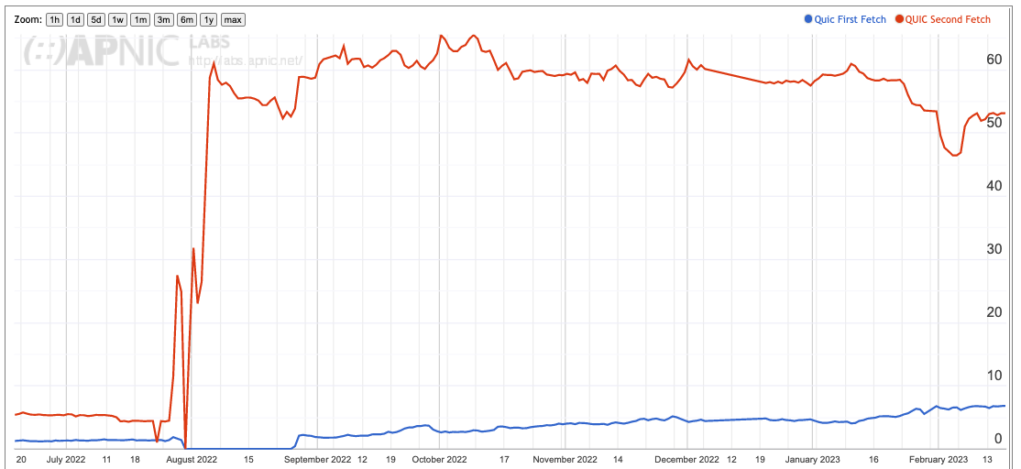
Quic Use
Change from 1 to 7 repeat fetches
keepalive=0
keepalive=20
keepalive=1

Slide 27
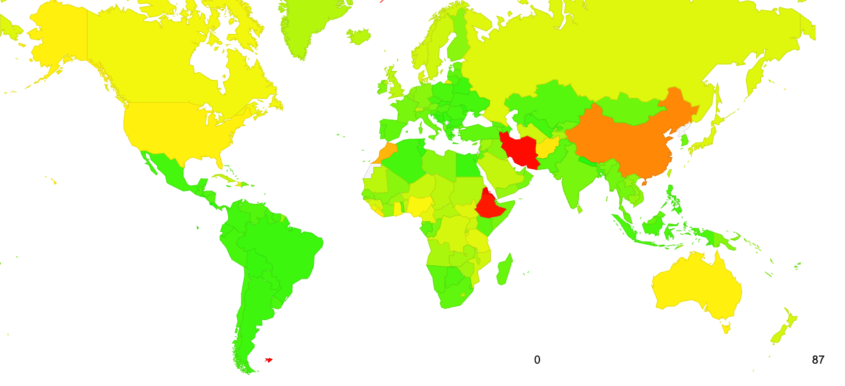
Quic Use – February 2023

Slide 28
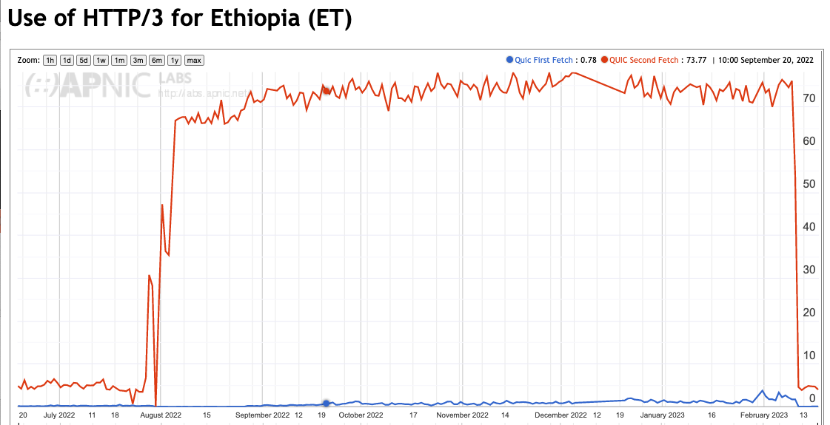
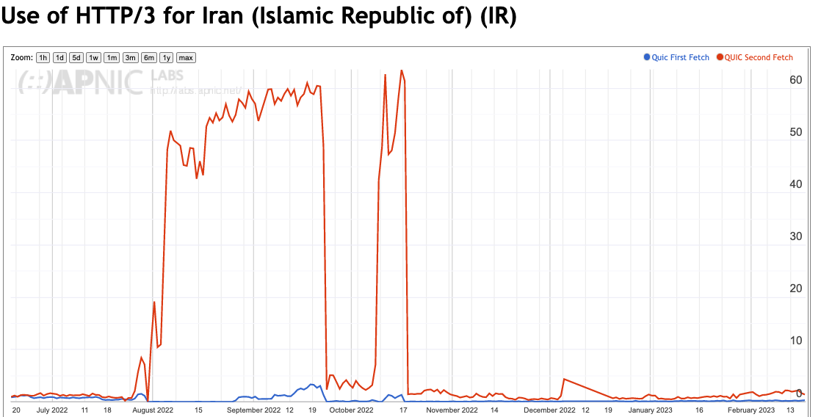
National Filtering of QUIC?

Slide 29
Some Questions:
Which clients are performing QUIC and why?
What are the QUIC MSS values?
What is the QUIC connection failure rate?
Is QUIC faster than HTTP/2 + TLS?

Slide 30
1. OS Clients* performing QUIC
TCP/TLS QUIC on First Fetch QUIC on Second Fetch
iOS 5.5% 93.3% 16.1%
Mac OS 1.0% 2.8% 0.6%
Android 84.5% 1.7% 77.9%
Win 5.5% 1.4% 4.3%
Linux 0.4% 0.2% 0.2%
Others 3.1% 0.6% 0.9%
100.0% 100.0% 100.0%
* Based on reported browser string

Slide 31
1. Browser Clients* performing QUIC
TCP/TLS QUIC on First Fetch QUIC on Second Fetch
Chrome 91.8% 4.1% 81.7%
Safari 4.3% 93.3% 16.1%
Firefox 0.8% 2.4% 1.0%
Edge 0.7% 0.0% 0.5%
Opera 0.2% 0.1% 0.6%
Others 2.2% 0.1% 0.1%
100.0% 100.0% 100.0%
* Based on reported browser string

Slide 32
1. Who does QUIC and why?
Apple Safari clients use a DNS HTTPS query and some of these clients then follow up with a fetch over QUIC. The observed DNS HTTPS query to QUIC fetch conversion rate was relatively small.
Chrome clients use the Alt-Svc field as a QUIC trigger for most clients. The observed QUIC conversion rate was high, but not universal.
* Based on reported browser string

Slide 33
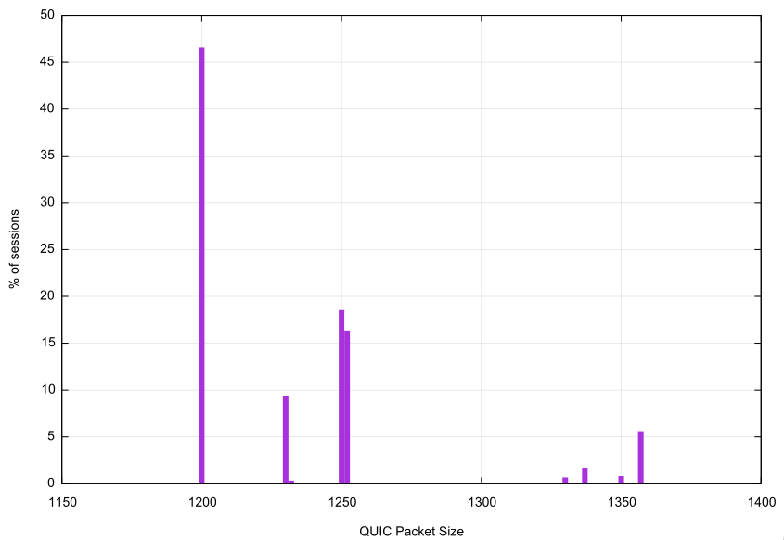
2. QUIC Packet Size distribution
QUIC clients take a very conservative approach to maximum packet sizes to avoid packet fragmentation complications
Maximum Packet Sizes used in QUIC sessions:
1,200 octets – 46.6%
1,250 octets – 18.5%
1,252 octets – 16.4%

Slide 34
3. QUIC Connection Loss
In this measurement framework we cannot measure client -> server loss, but we can measure server-> client loss by looking for incomplete QUIC initial connections that do not complete
  (this form of connection loss could be due to the client filtering incoming UDP port 443 packets)
Initial QUIC Connections: 19,211,357
Failed Connections: 46,645
Failure Rate: 0.24%

Slide 35
4. Is QUIC Faster?
Let’s compare the user-measured time to load an object using HTTP/2 and the same user’s measured time to load the same object using HTTP/3
  There are a number of variables in the user time measurement, including varying time penalties relating to the internal task scheduling within the browser, but these individual factors should be cancelled out over a large enough sample set

Slide 36
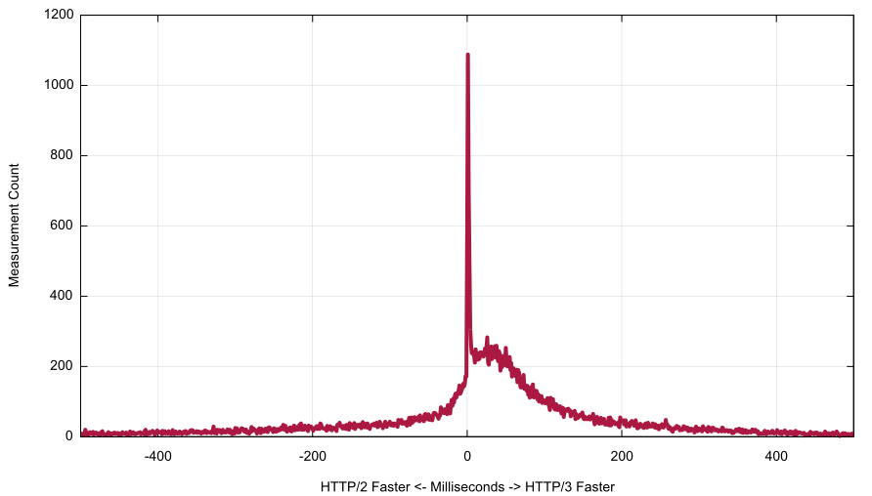
4. TCP/TLS vs QUIC speed difference
Area where QUIC is faster
Non-QUIC Faster
ms
QUIC Faster

Slide 37
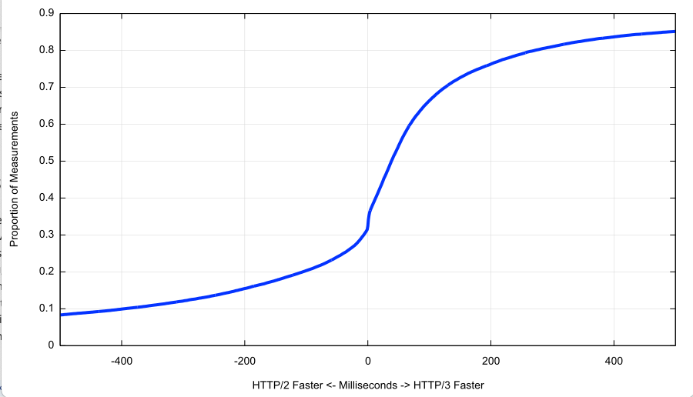
4. Cumulative Distribution
HTTP/3 is faster to perform object retrieval in 2/3 of the observed cases
Non-QUIC Faster
ms
QUIC Faster

Slide 38
Thanks!
Ongoing HTTP/3 Measurement Report at APNIC Labs:
https://stats.labs.apnic.net/quic

