Slide 1
On GEOs, LEOs and Starlink
Geoff Huston
APNIC

Slide 2
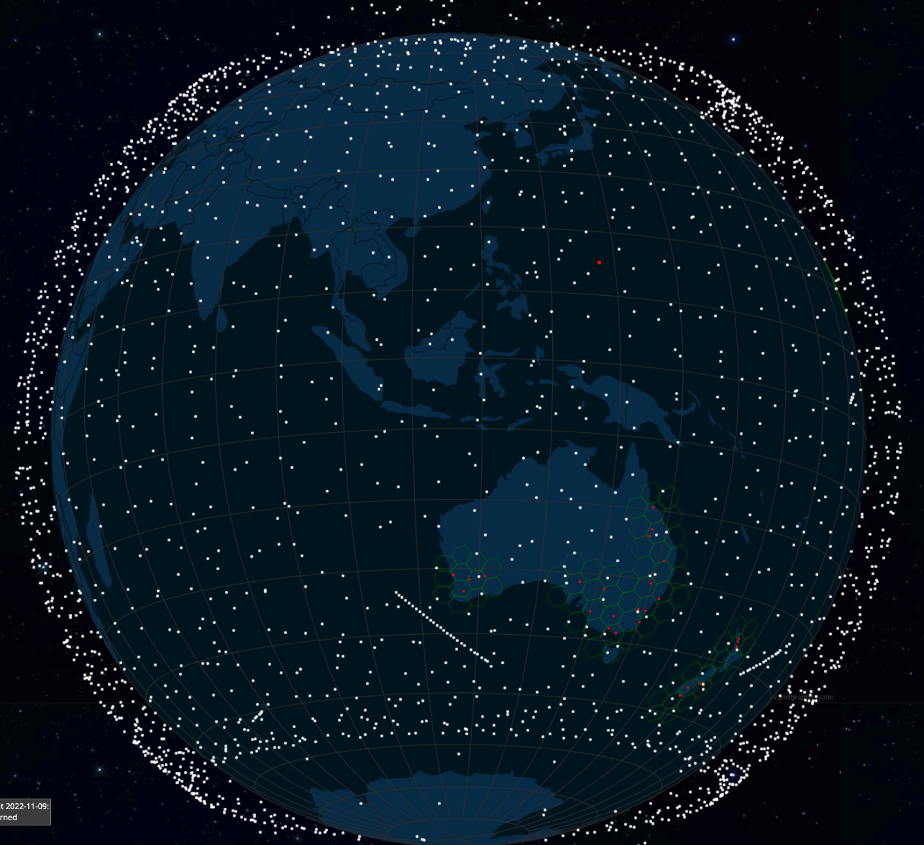
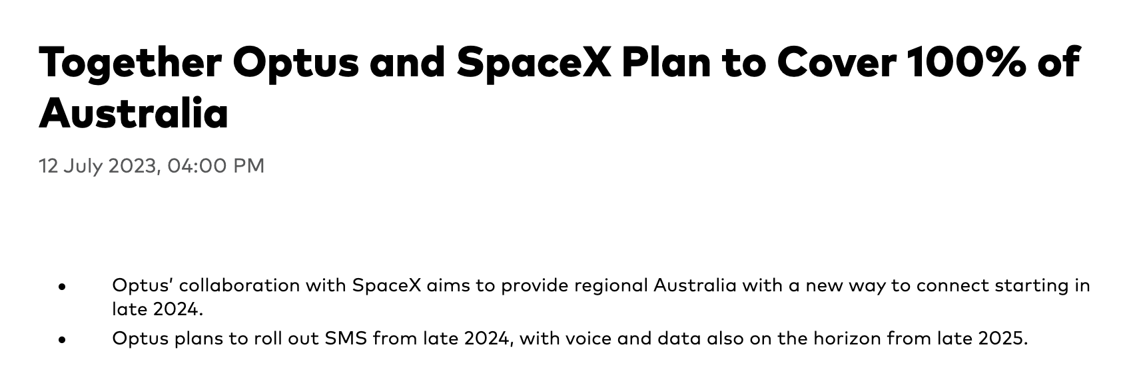
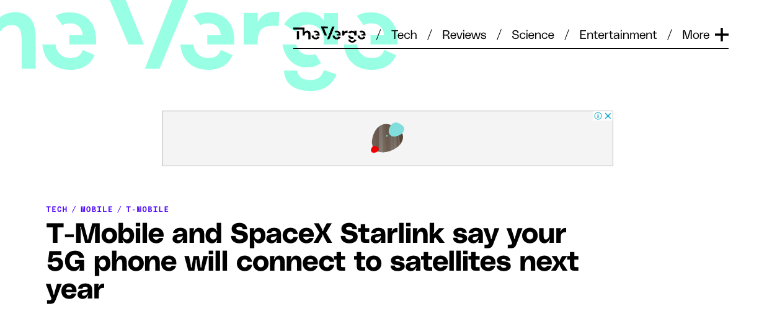
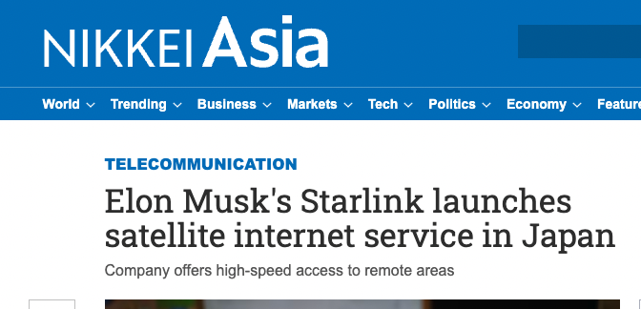
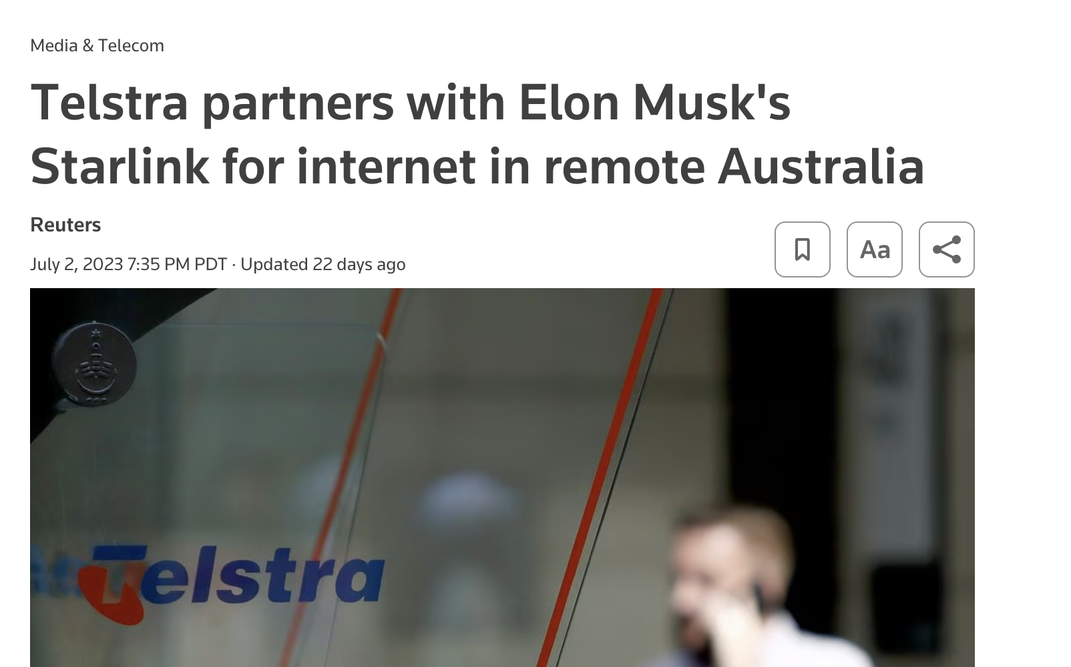
LEOs in the News
screenshot from starwatch app
Screenshot - https://www.theverge.com/2022/8/25/23320722/spacex-starlink-t-mobile-satellite-internet-mobile-messaging
Screenshot: https://asia.nikkei.com/Business/Telecommunication/Elon-Musk-s-Starlink-launches-satellite-internet-service-in-Japan

Slide 3
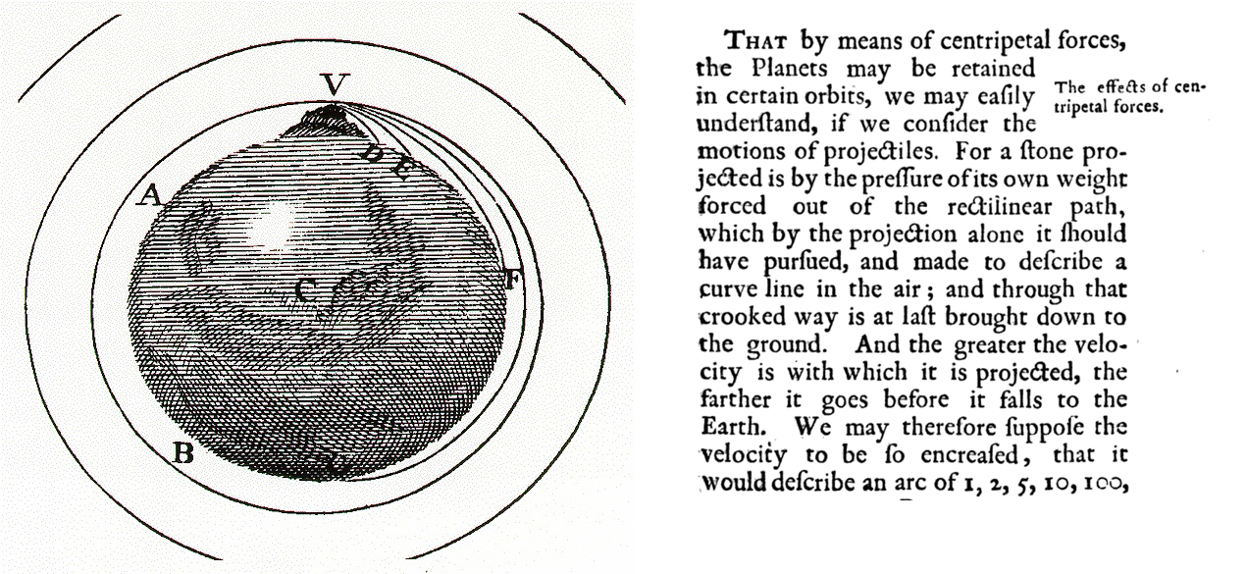
Newtonian Physics
If you fire a projectile with a speed greater than 11.2Km/sec it will not fall back to earth, and instead head away from earth never to return
On the other hand, if you incline the aiming trajectory and fire it at a critical speed it will settle into an orbit around the earth
The higher the altitude, the lower the orbital speed required to maintain orbit

Slide 4
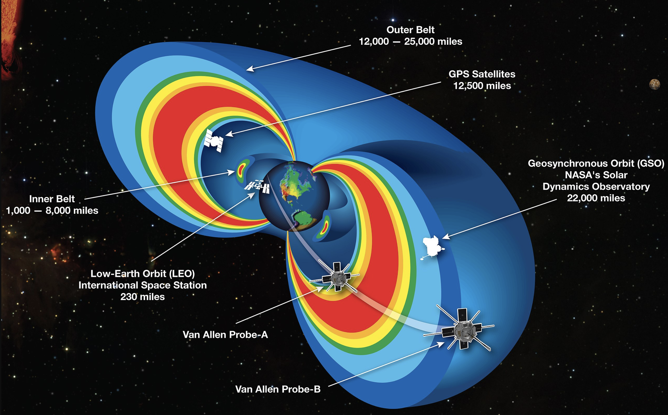
Solar Radiation Physics
The rotating iron core of the Earth produces a strong magnetic field
This magnetic deflects solar radiation – the Van Allen Belt
Sheltering below the Van Allen Belt protects the spacecraft from the worst effects of solar radiation, allowing advanced electronics to be used in the spacecraft

Slide 5
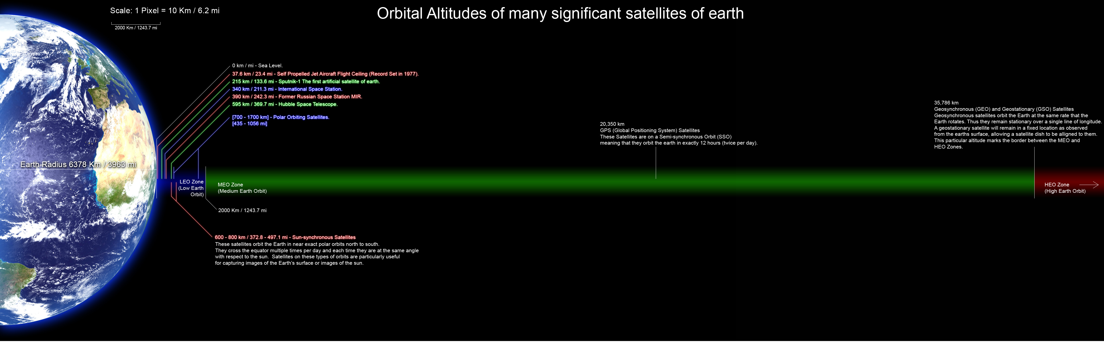
Leos
Geos
https://commons.wikimedia.org/wiki/File:Orbitalaltitudes.jpg GNU Free Documentation License

Slide 6
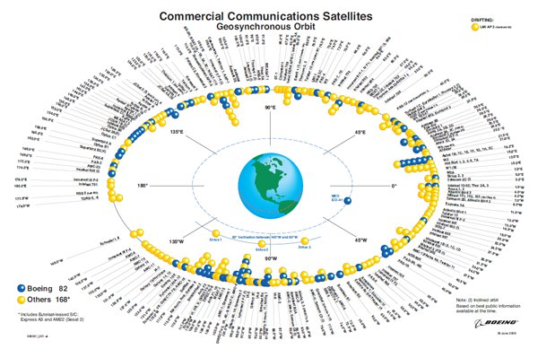
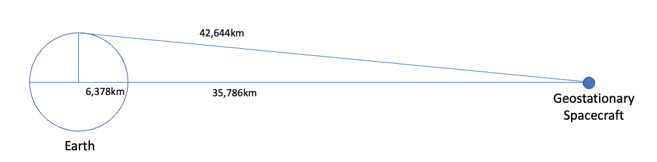
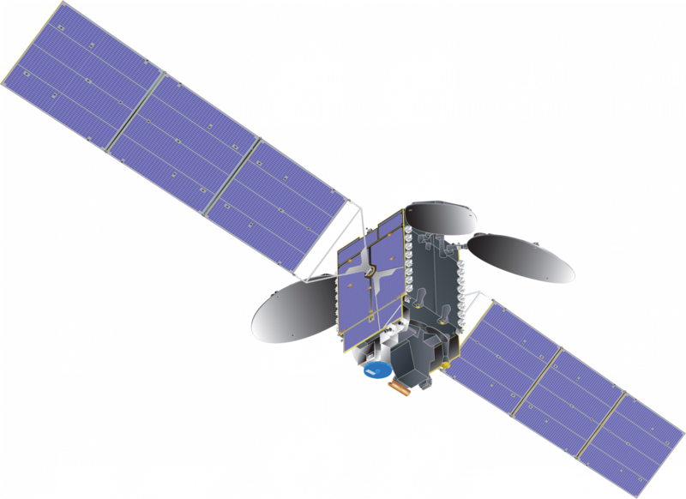
Geostationary Earth Orbit
At an altitude of 35,786km a satellite will orbit the earth with the same period as the earth’s rotation – from the earth it will appear to be stationary in the sky
https://commons.wikimedia.org/wiki/File:Communications_satellite_with_TEMPO_spacecraft_model.png – public domain
https://secure.boeingimages.com/archive/Commercial-Communications-Satellites-Orbit-2F3XC5KQCM9.html

Slide 7
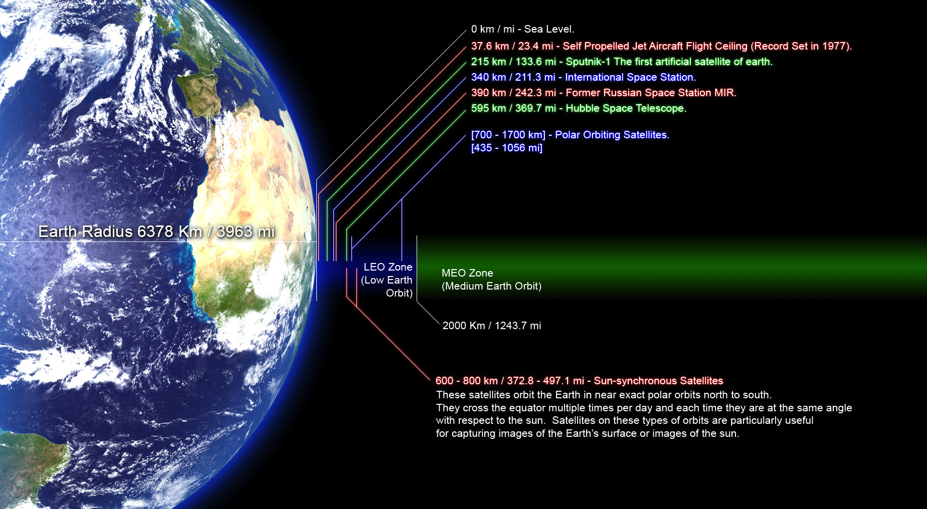
Low Earth Orbit
https://commons.wikimedia.org/wiki/File:Orbitalaltitudes.jpg GNU Free Documentation License

Slide 8
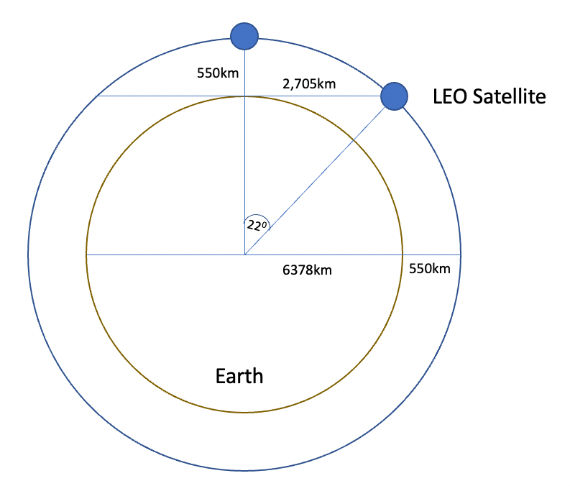
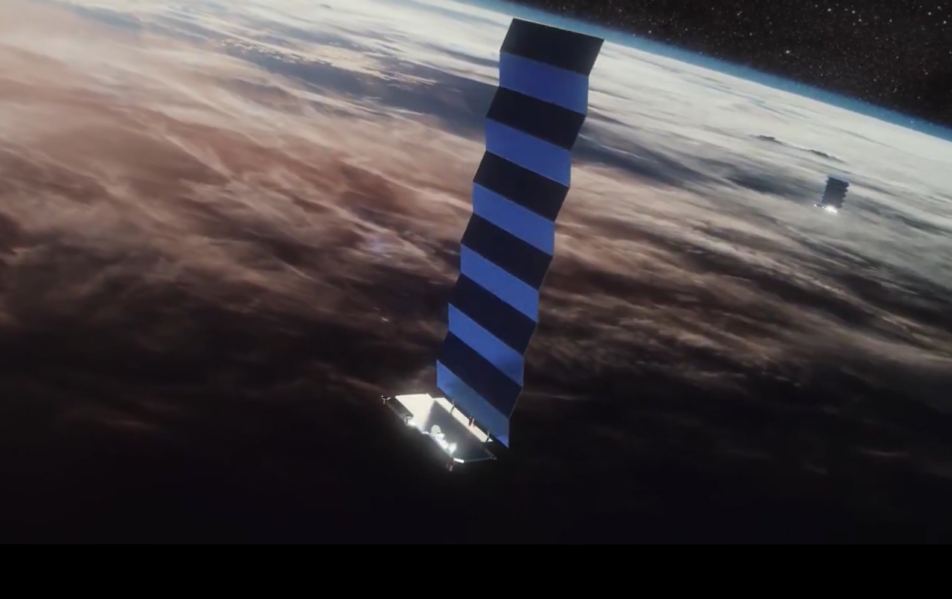
Low Earth Orbit
LEO satellites are stations between 160km and 2,000km in altitude.
High enough to stop it slowing down by “grazing” the denser parts of the earth’s ionosphere
Not so high that it loses the radiation protection afforded by the Inner Van Allen belt.
At a height of 550km, the minimum signal propagation delay to reach the satellite and back is 3.7ms.
Image - spacex
screenshot from starwatch app

Slide 9
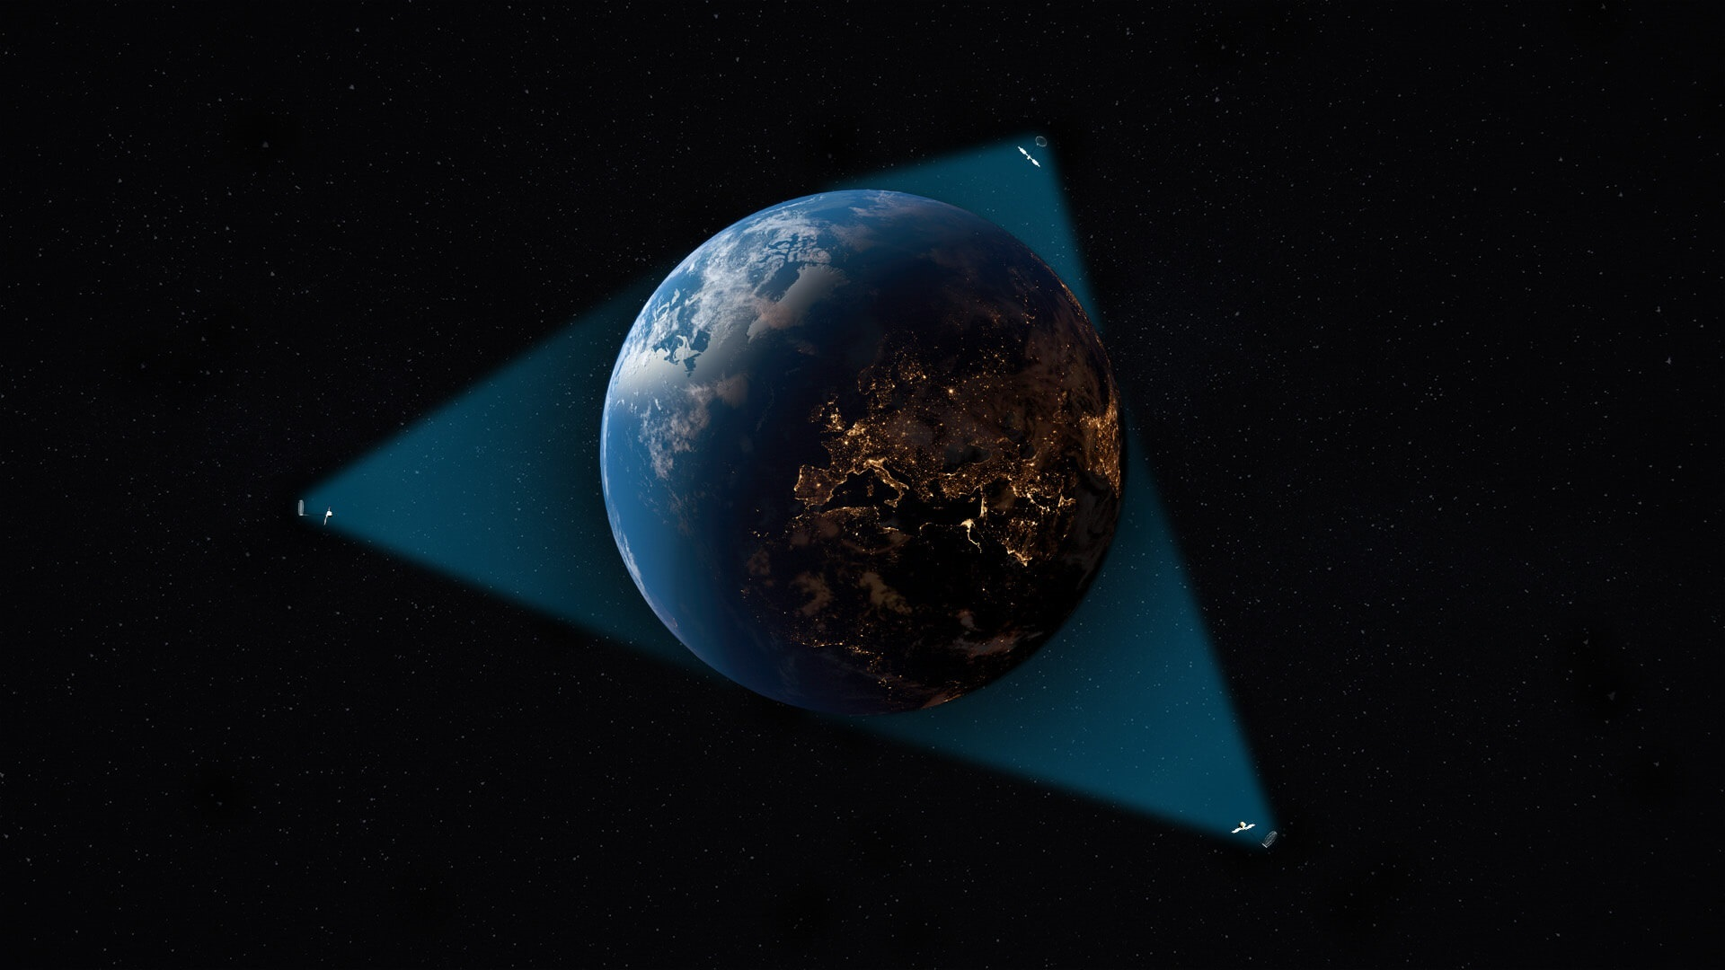
Geo Coverage
It needs just 3 GEO satellites to provide global continuous coverage everywhere (except polar)
Source: Viasat

Slide 10
LEO coverage
It needs a minimum of some 500 LEO satellites to provide global continuous coverage everywhere (at 550km altitude)
Depending on the quality of coverage you are after, you may need some thousands of LEO spacecraft!

Slide 11
So LEOs are “interesting”!
They are very close to the Earth – which means:
  They don’t need specialised high-power equipment to send and receive signals
    Even hand-held mobile devices can send and receive signals with a LEO!
  They can achieve very high signal speeds
    It’s a highly focussed signal beam
But you need a large number of them to provide a continuous service
  Each satellite spans footprint of no more than ~900Km radius, or 2M K²
  At a minimum you’ll need 500 satellites to provide continuous coverage
  But if you want high quality coverage you are going to need 6x-20x that number (or more)
The extremely host cost of launching a large constellation of LEO spacecraft has been the major problem with LEO service
  Which is why Motorola’s Iridium service went bankrupt soon after launch

Slide 12
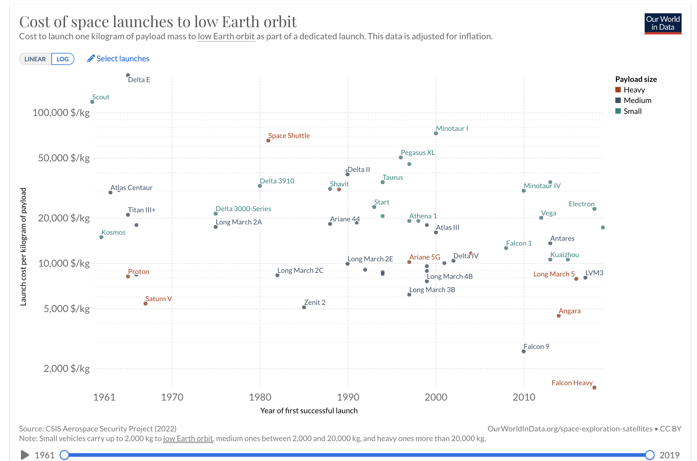
What’s changed recently?
SpaceX’s reusable rocket technology has slashed the cost of lifting spacecraft into low earth orbit
Cost/Kg (log scale)
SpaceX
Time
https://ourworldindata.org/grapher/cost-space-launches-low-earth-orbit

Slide 13
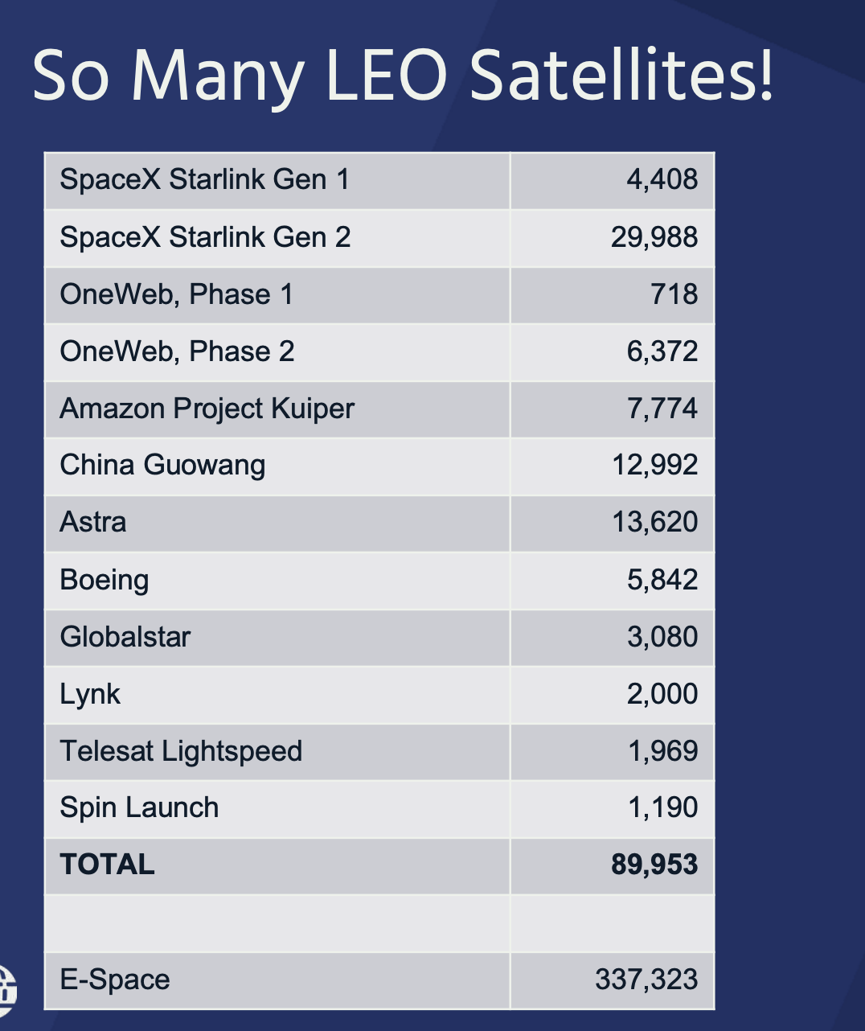
Current and Planned satellite constellations

Slide 14
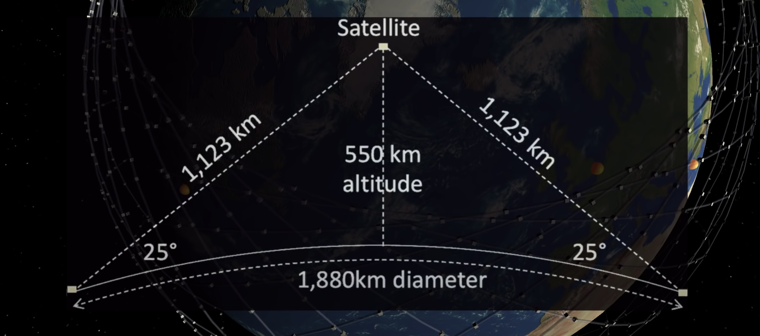
Low altitude: smaller footprint

Slide 15
Tracking a LEO satellite
Satellite
27,000 km/h
horizon to horizon: ~5 minutes
550km

Slide 16
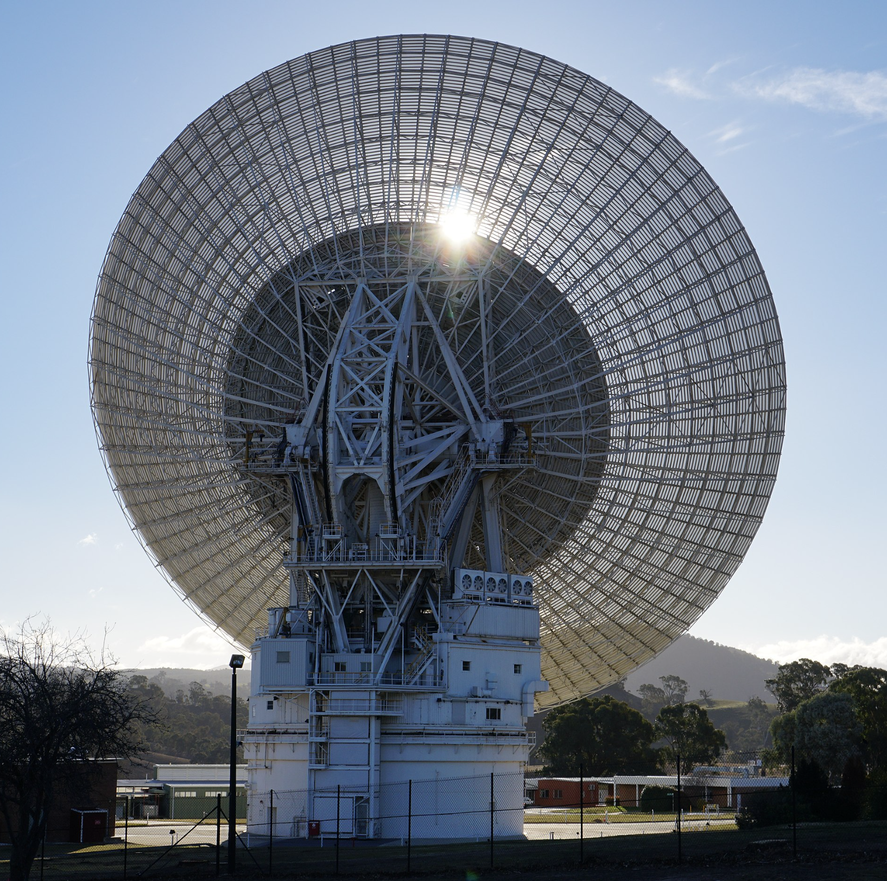
Earth Dishes for LEOs
Just overkill!
(in every possible way!)

Slide 17
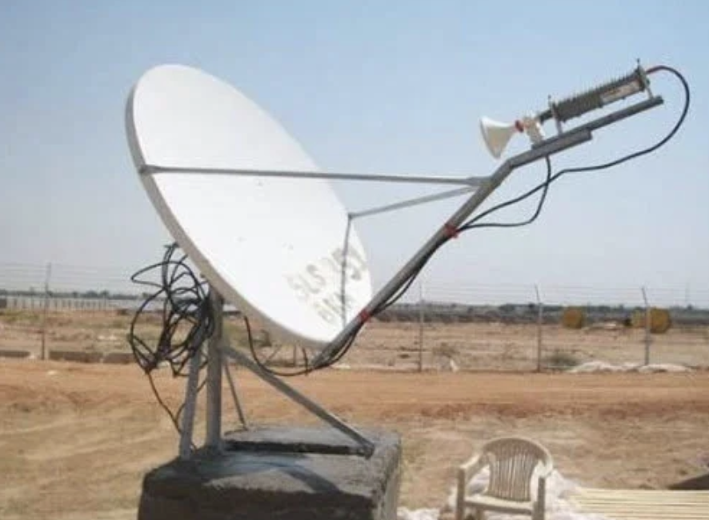
Earth Dishes for LEOs
Still too big
And it needs to be steered

Slide 18

Earth Dishes for LEOs
Phased array antennae
An array of smaller antenna with software-controlled phase alignment means that the dish can steer its focal angle in two dimensions with minimal lag
This is ideal for LEO systems which use low power but high traversal speed
Small, light, cheap, self-aligning!

Slide 19
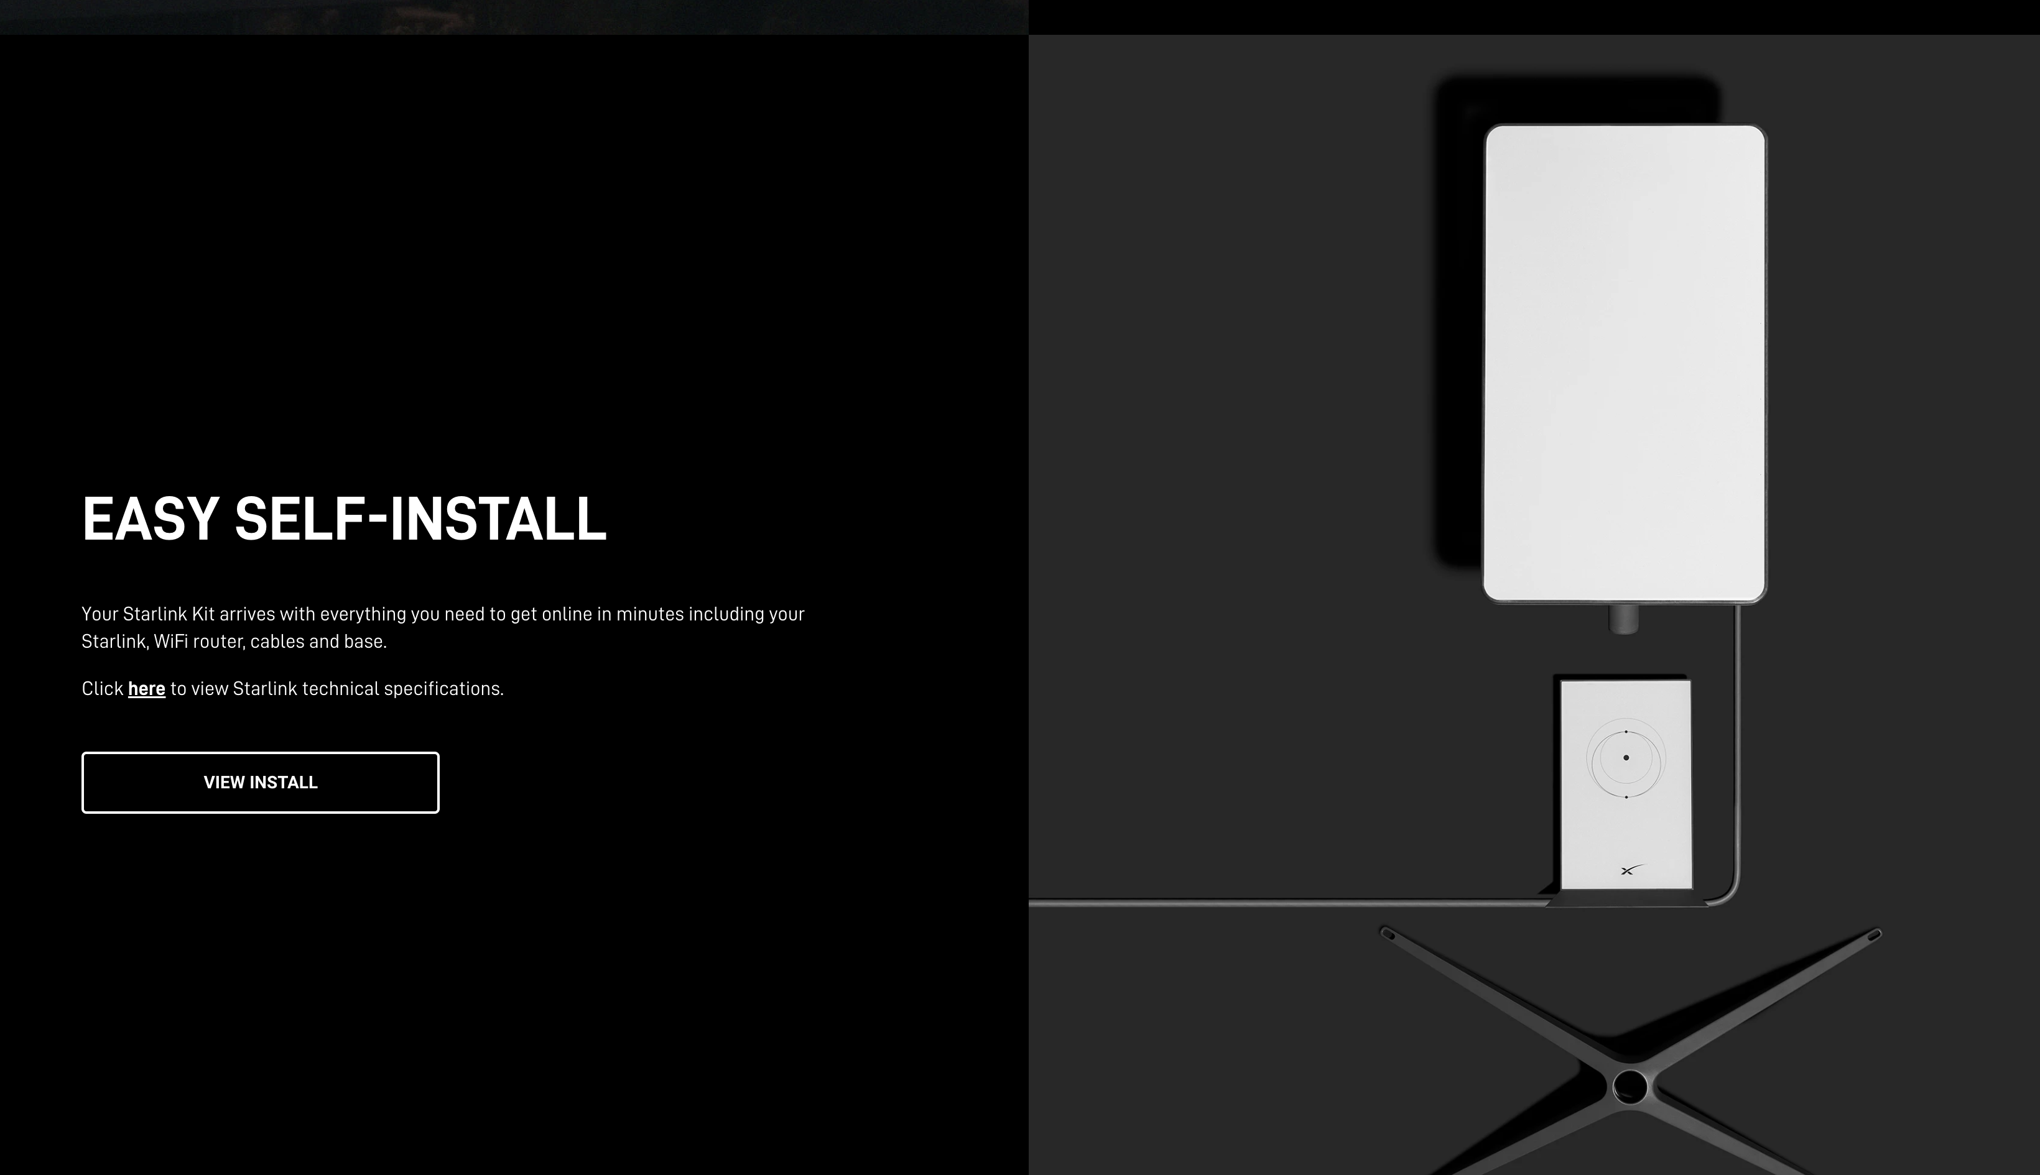
Self Installed!

Slide 20
Gen1 vs Gen2
GEN 1 – “mirror in the sky”
This approach is limited by the number and location of earth stations. Earth stations need to be located within 900km of the clients
This approach cannot span large ocean spaces
Earth station
client

Slide 21
Gen1 vs Gen2
GEN 2 – Inter-Satellite laser Links
This approach equips the satellites with laser transmitters and receivers
Signals can be relayed to adjacent satellites in the ”train” to hop across spaces where there is no coverage by earth stations
Earth station
client

Slide 22
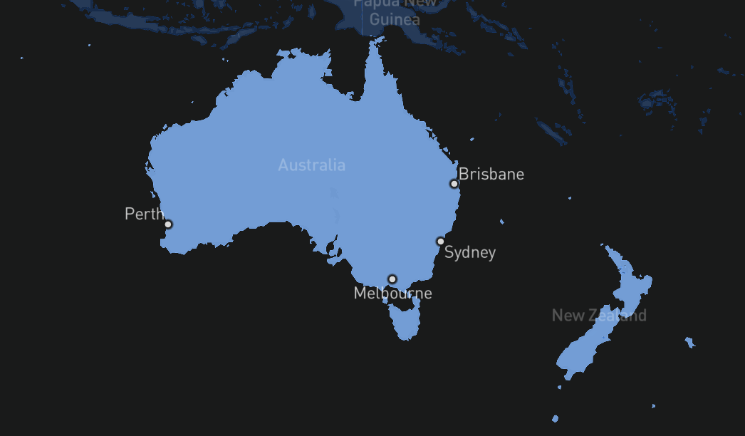
ISL in action
The introduction of ISL has allowed Starlink to extend its coverage area to the entirety of the Australian continent, and it manages this by relaying the signal between spacecraft to one that is within range of an earth station

Slide 23
How well does all this work?
Let’s measure it!
We use three services between the same endpoints:
  Terrestrial fibre connection (control)
  GEO satellite service
  Starlink service
We also use three TCP flow control algorithms to compare their performance

Slide 24
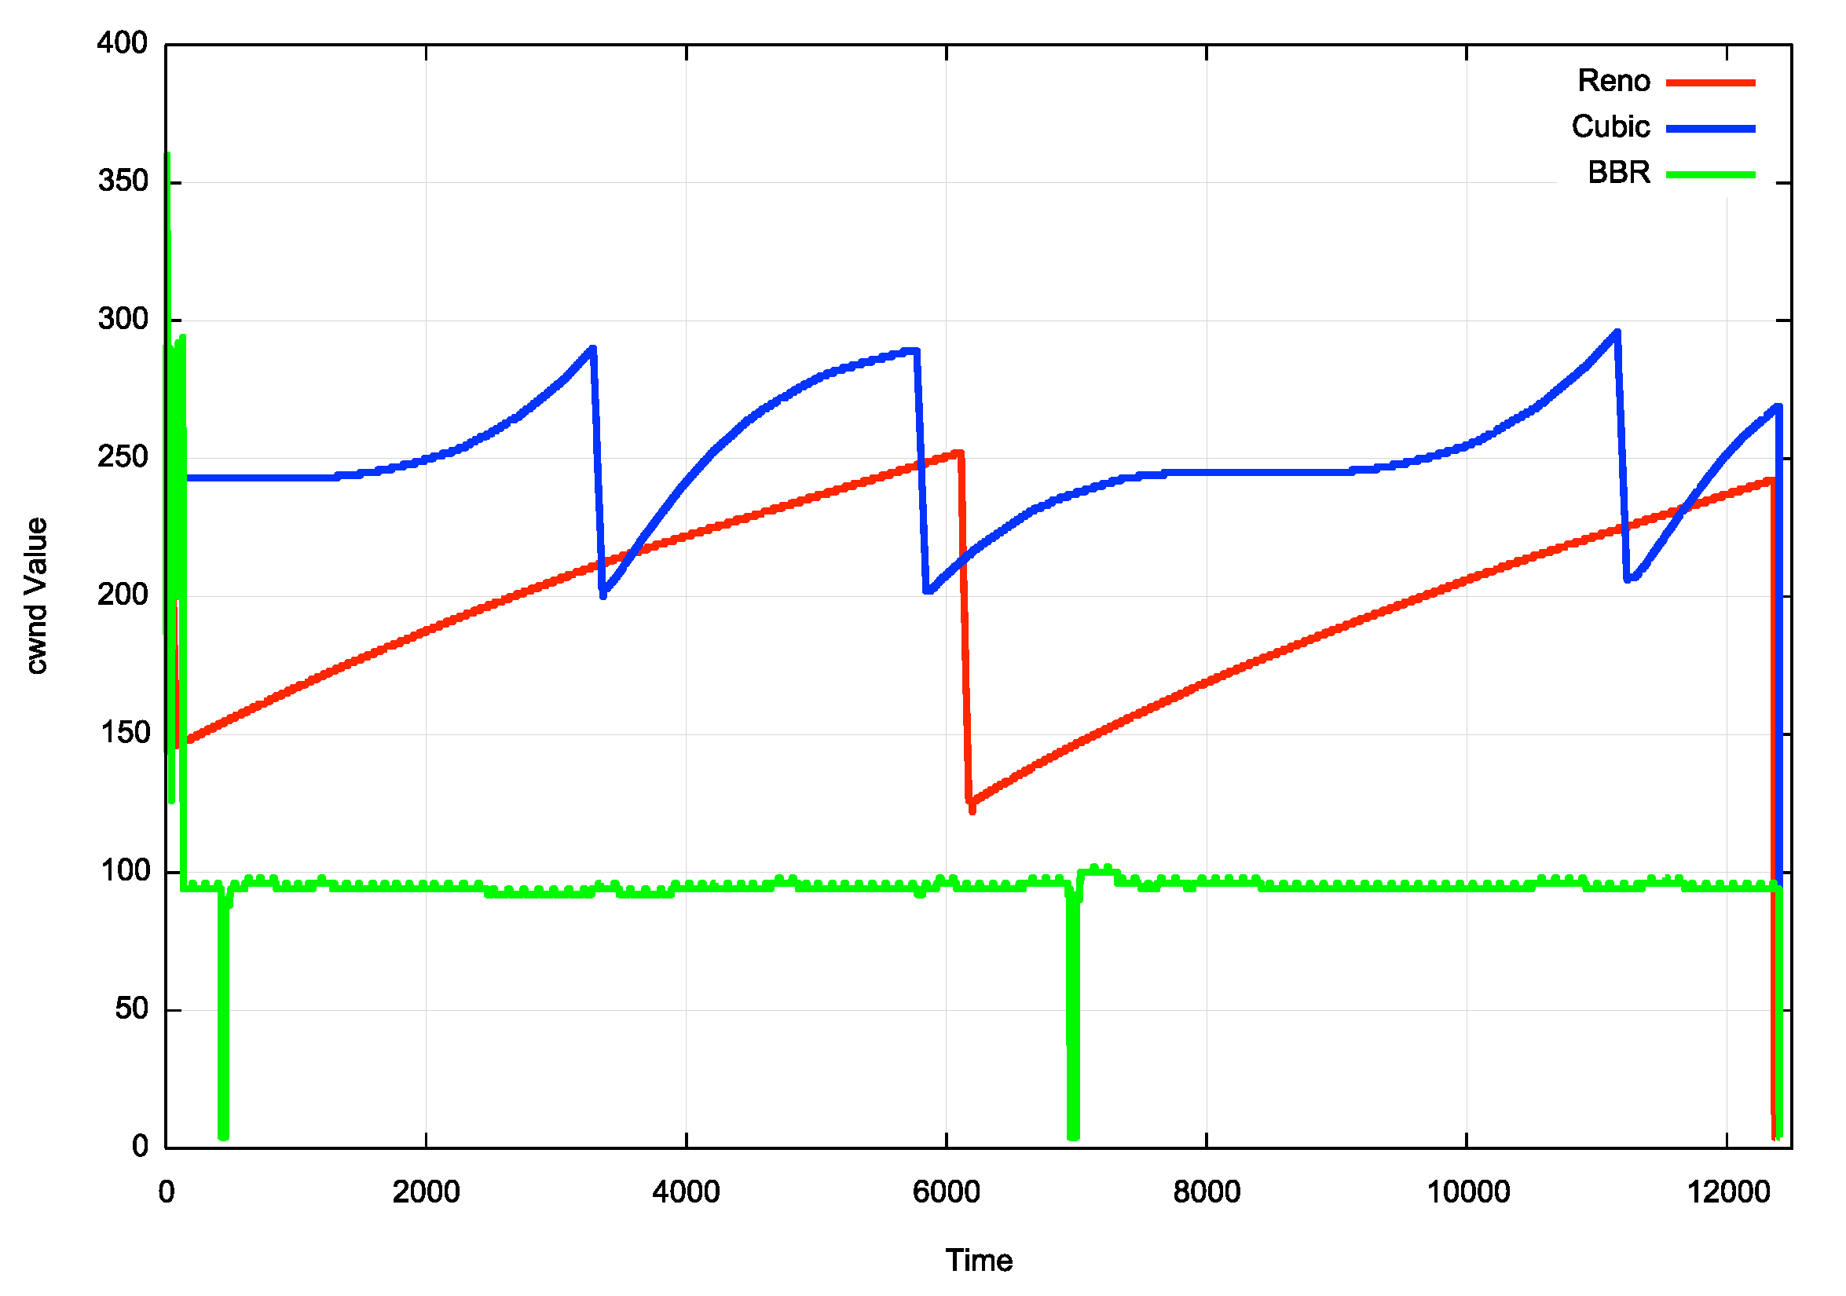
TCP Flow Control Algorithms
“Ideal” Flow behaviour for each protocol

Slide 25
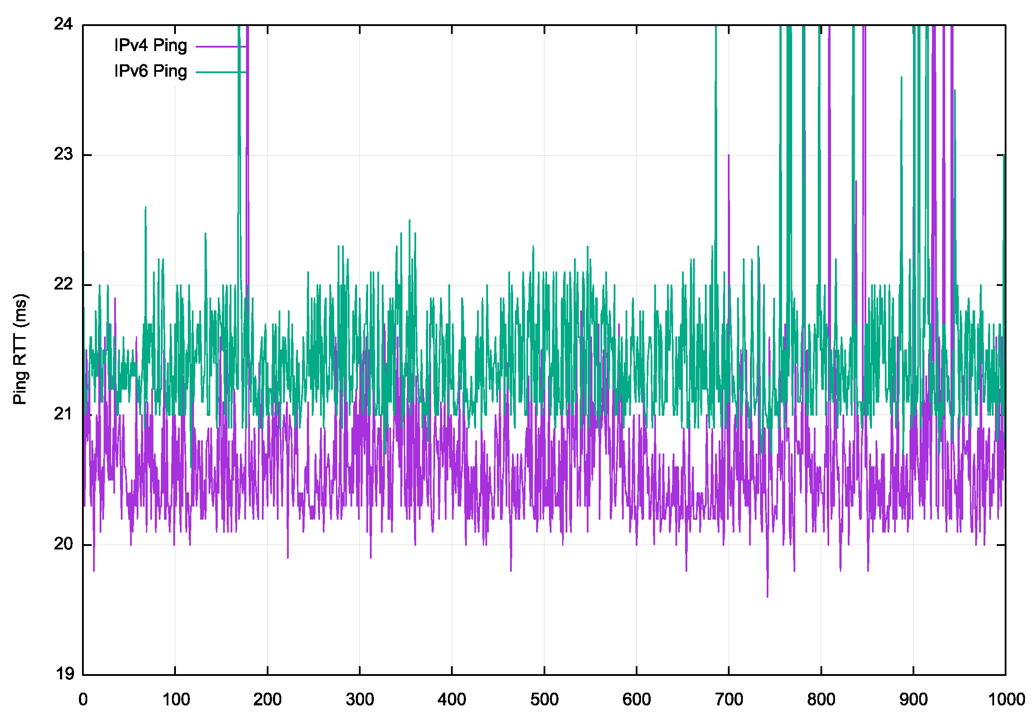
Terrestrial Fibre
Australian NBN FTTP service with a 275/25 Mbps access rate
Server and client are some 1,000km apart
Ping test:
IPv6 average 21.5ms
IPv4 average 20.5ms

Slide 26
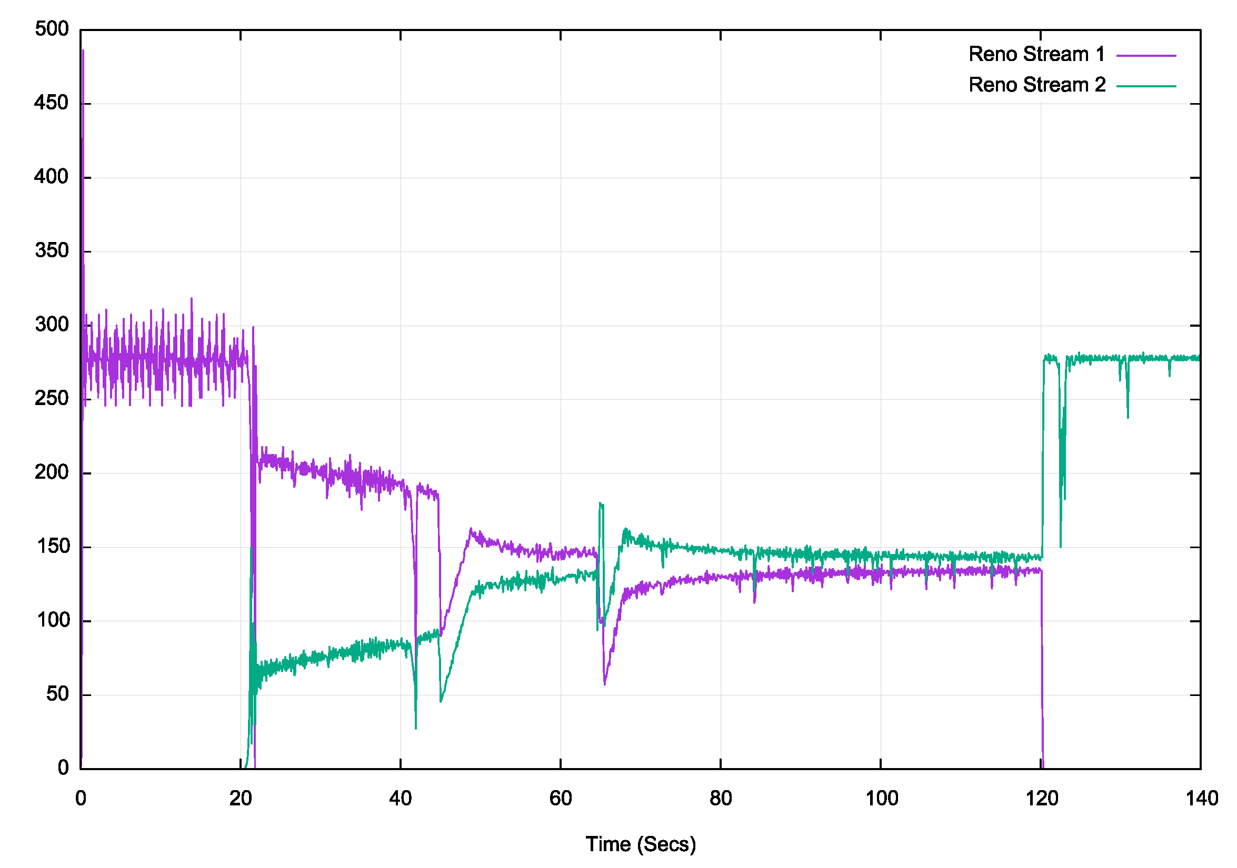
Fibre – 2 Stream Reno
Data Rate (MBPS)

Slide 27
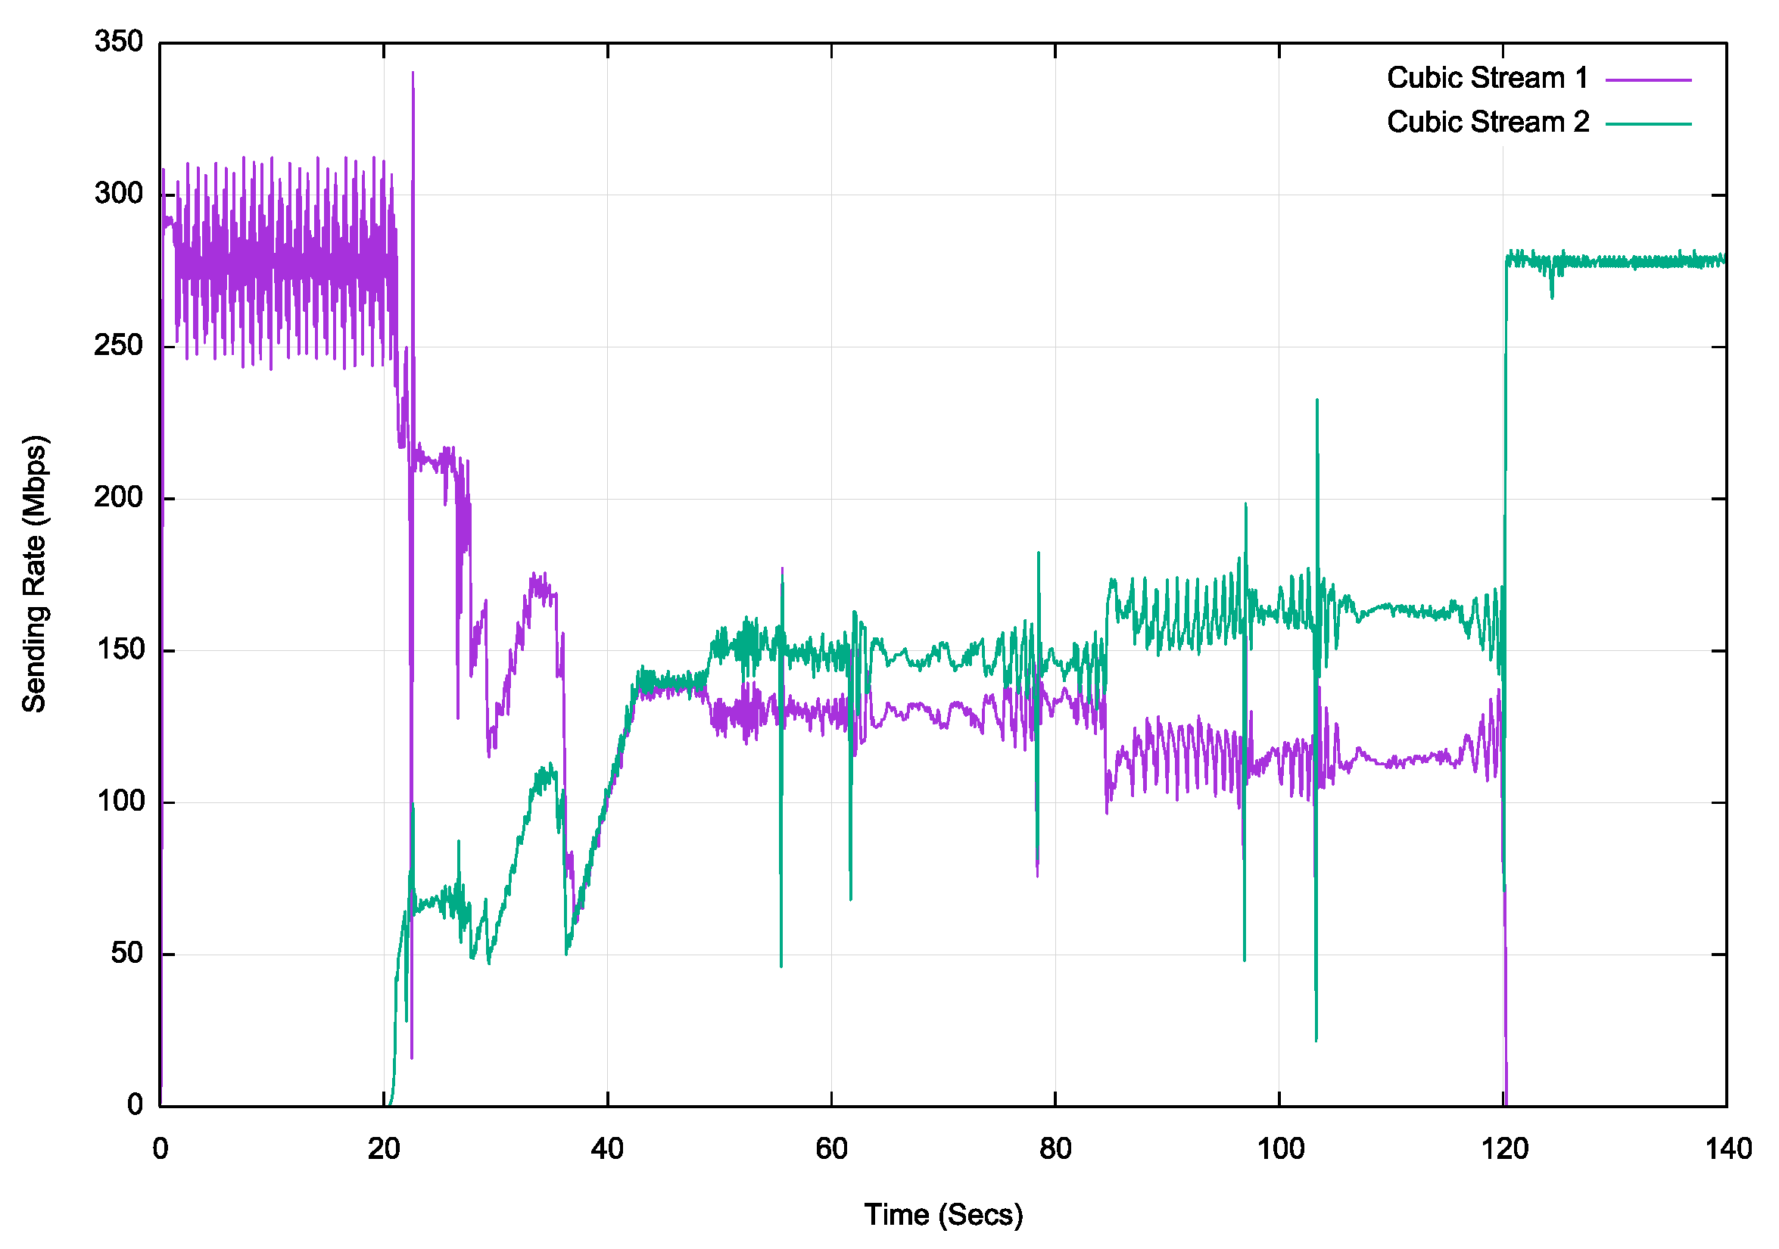
Fibre – 2 Stream Cubic

Slide 28
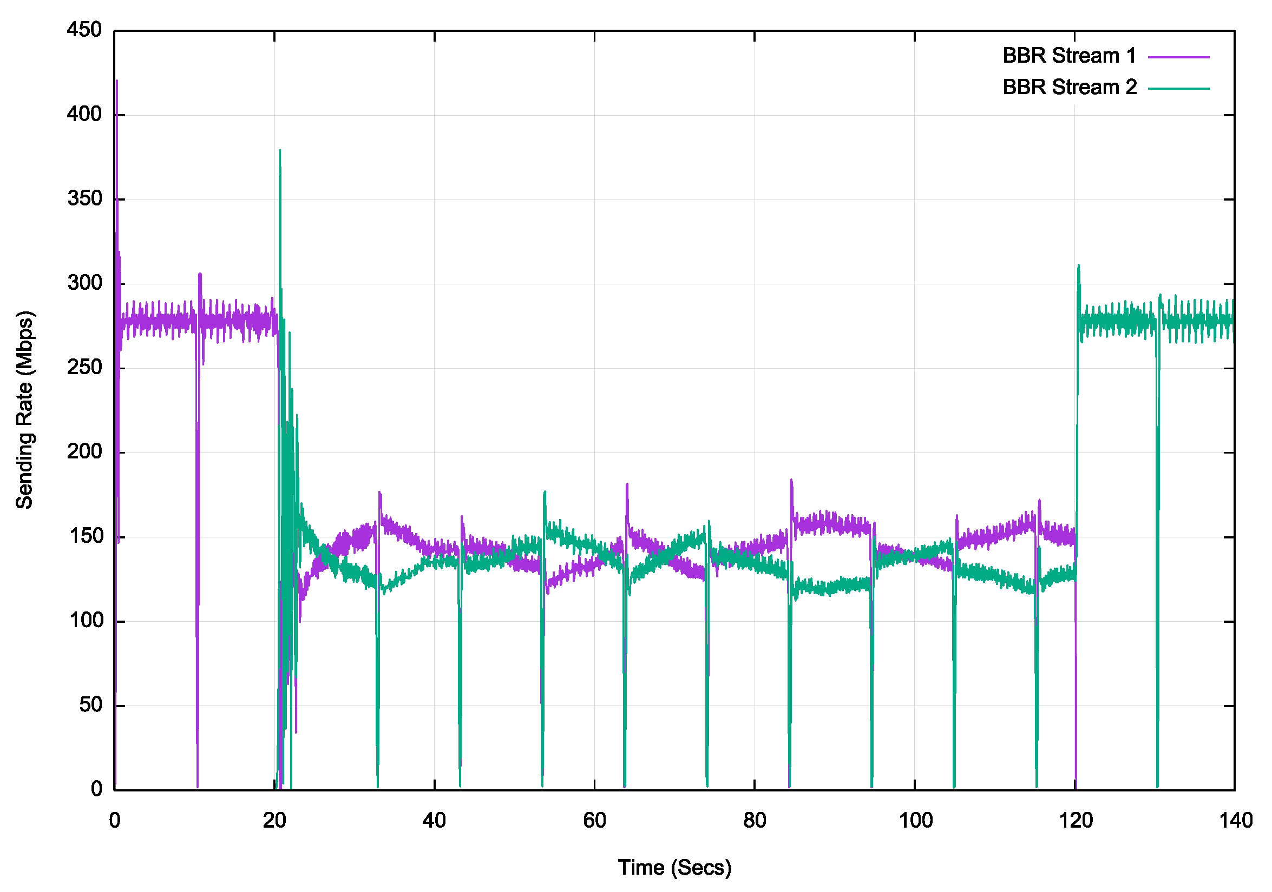
Fibre – 2 Stream BBR

Slide 29
Protocol Performance over Fibre
All three congestion control algorithms are “well behaved” in this simple test
Reno and BBR equilibrate to a 50/50 share when 2 sessions are active, while Cubic stabilises at a 60/40 split
BBR operates with very small queue pressure, and stabilises at wire speed very quickly

Slide 30
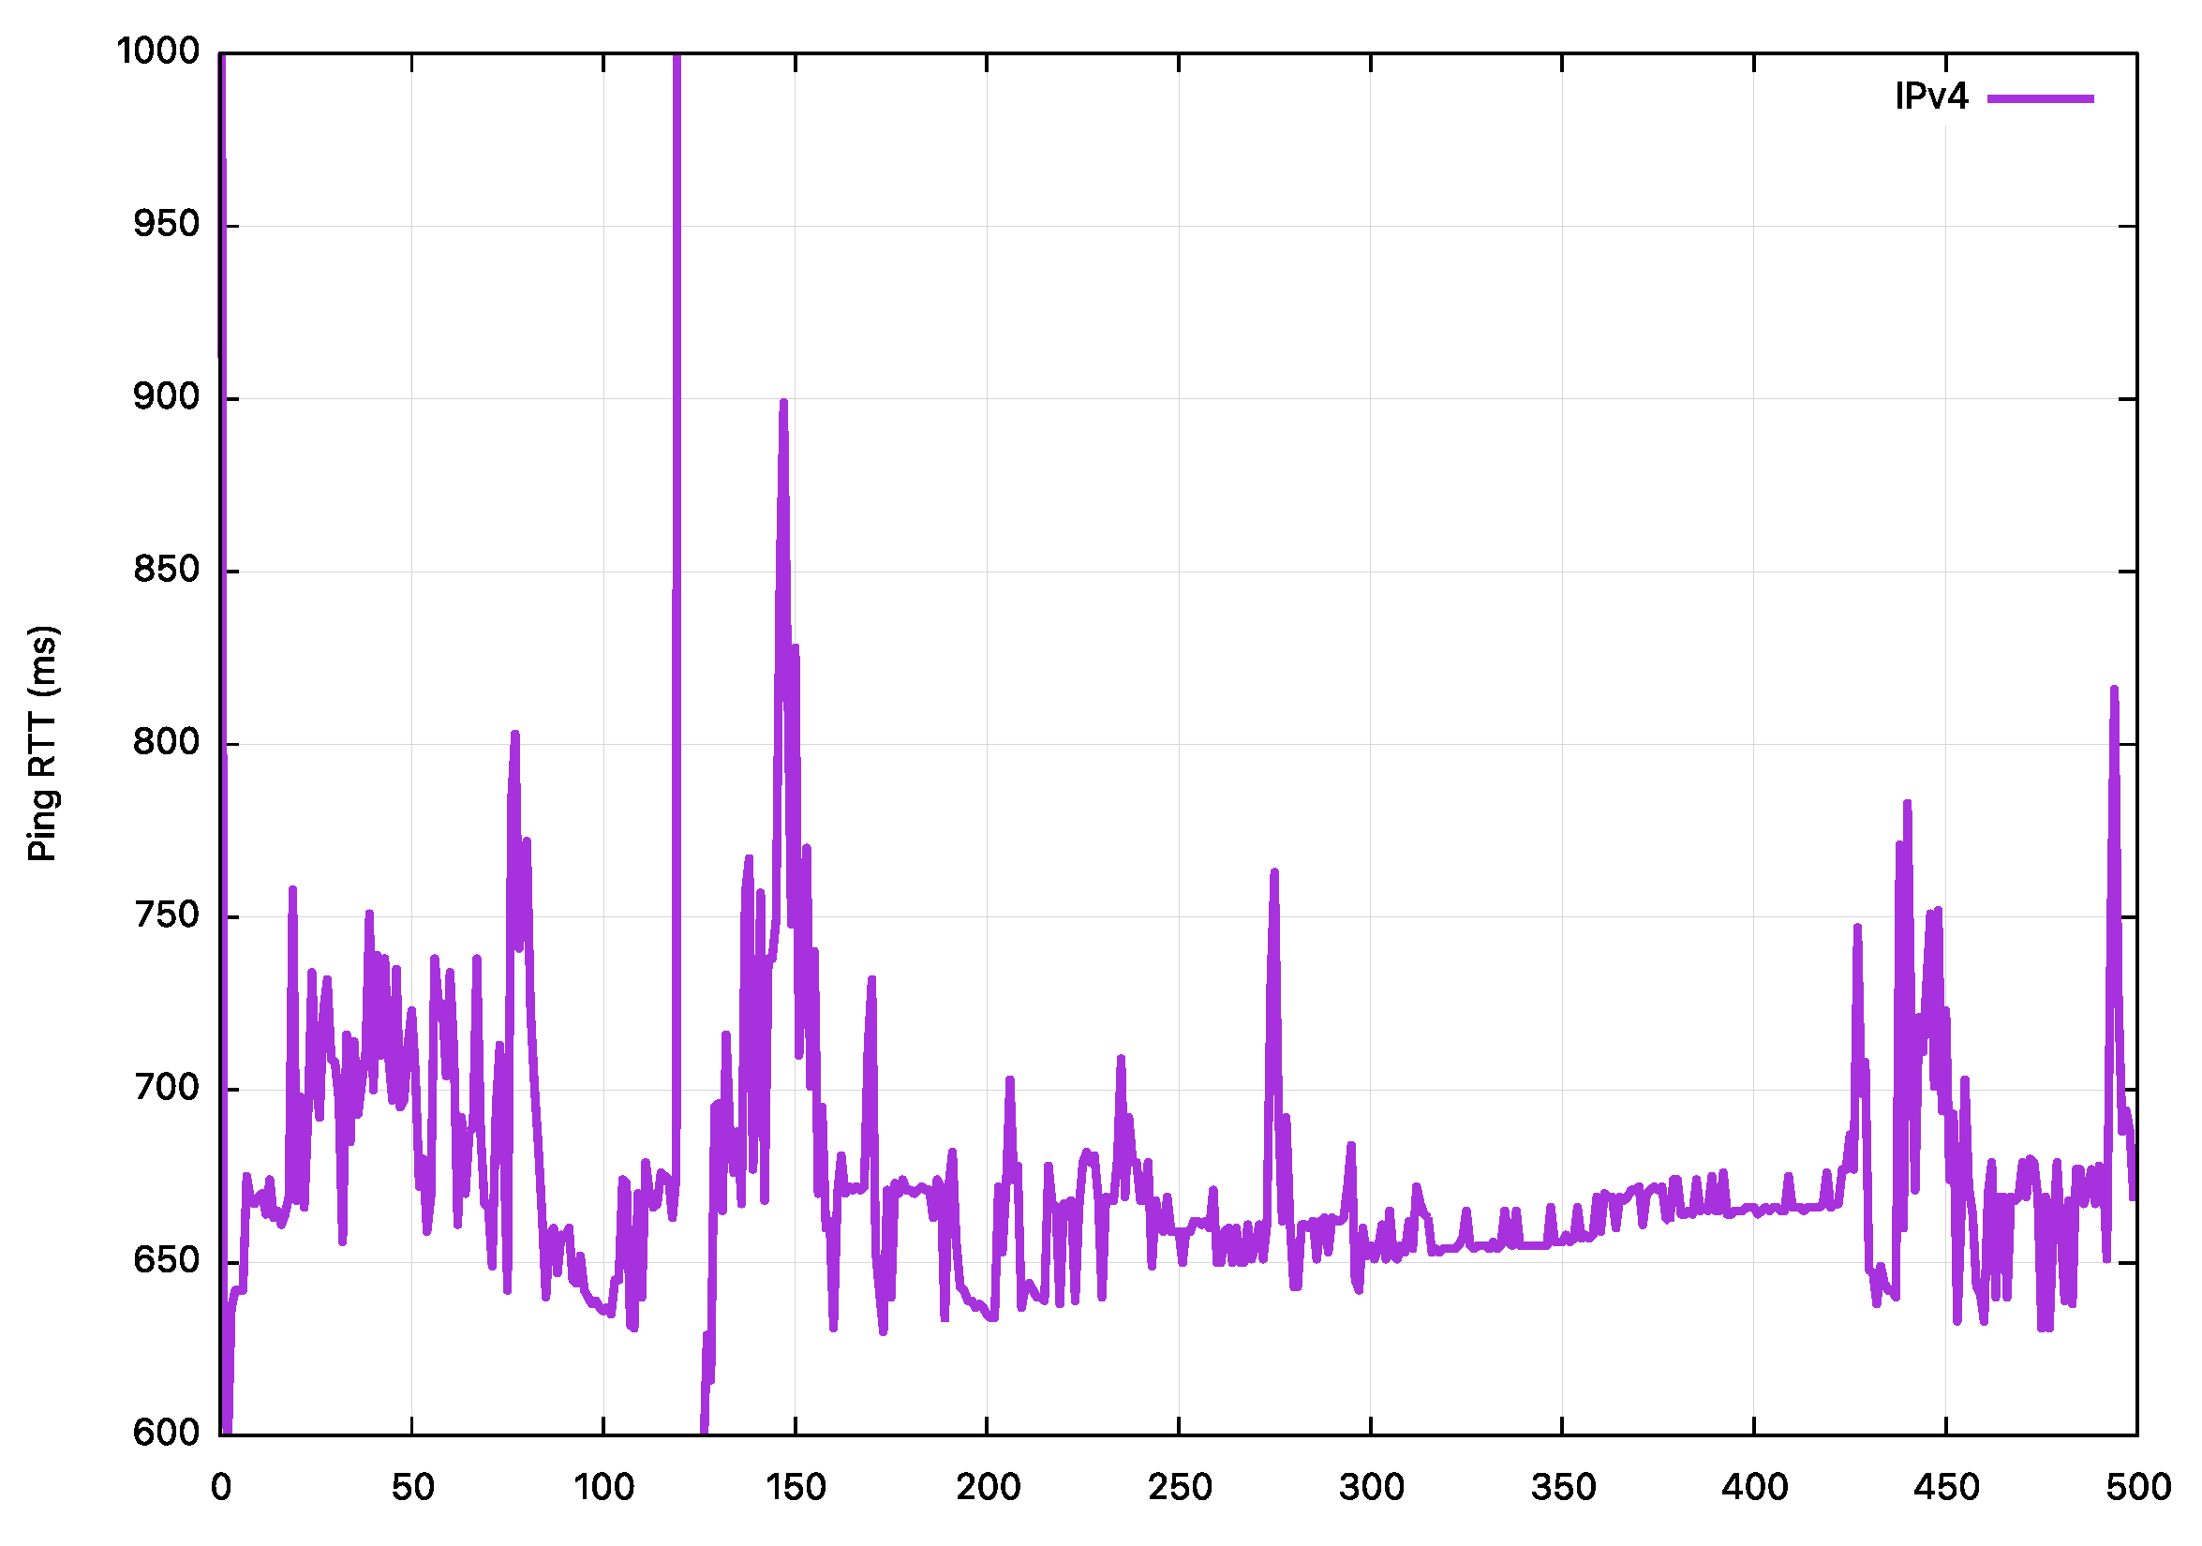
GEO Service – (45Mbps service)
Ping profile

Slide 31
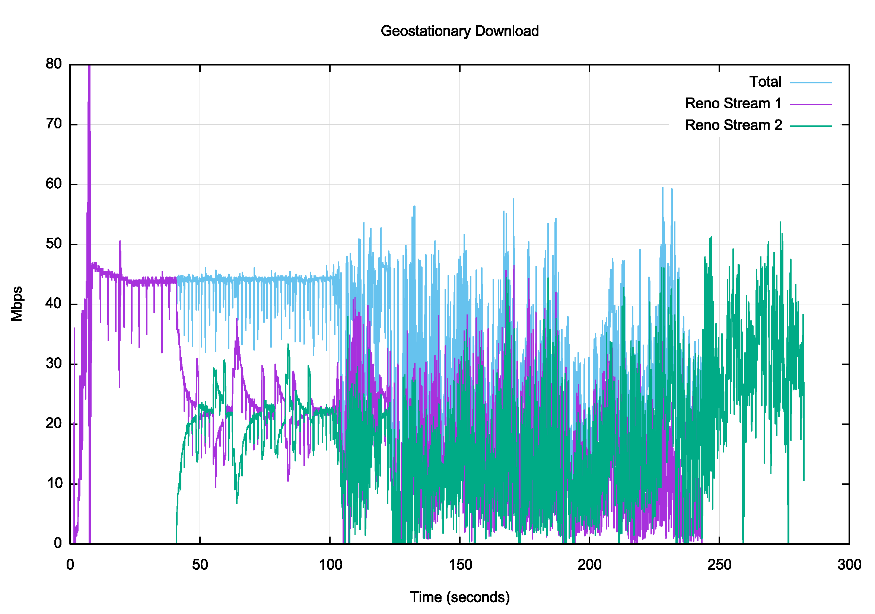
GEO – 2 Stream Reno

Slide 32
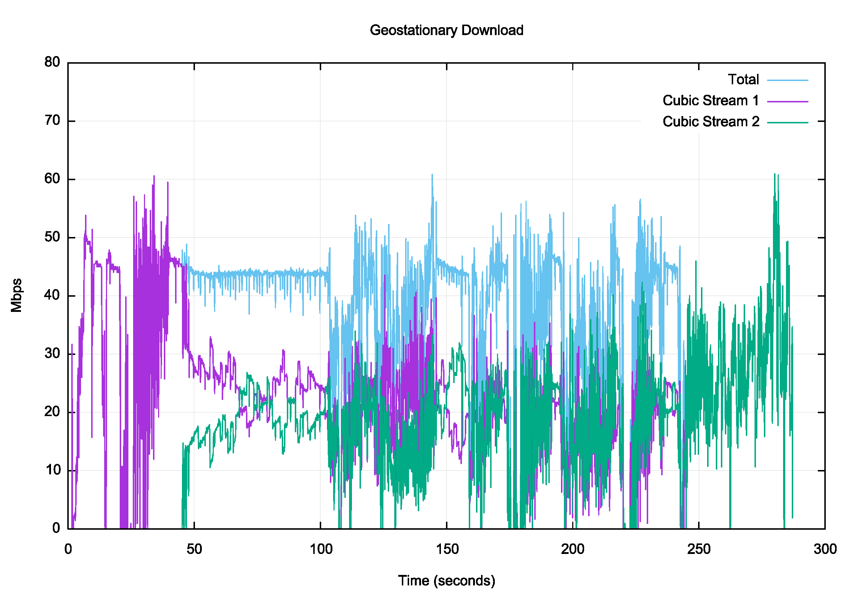
GEO – 2 Stream Cubic

Slide 33
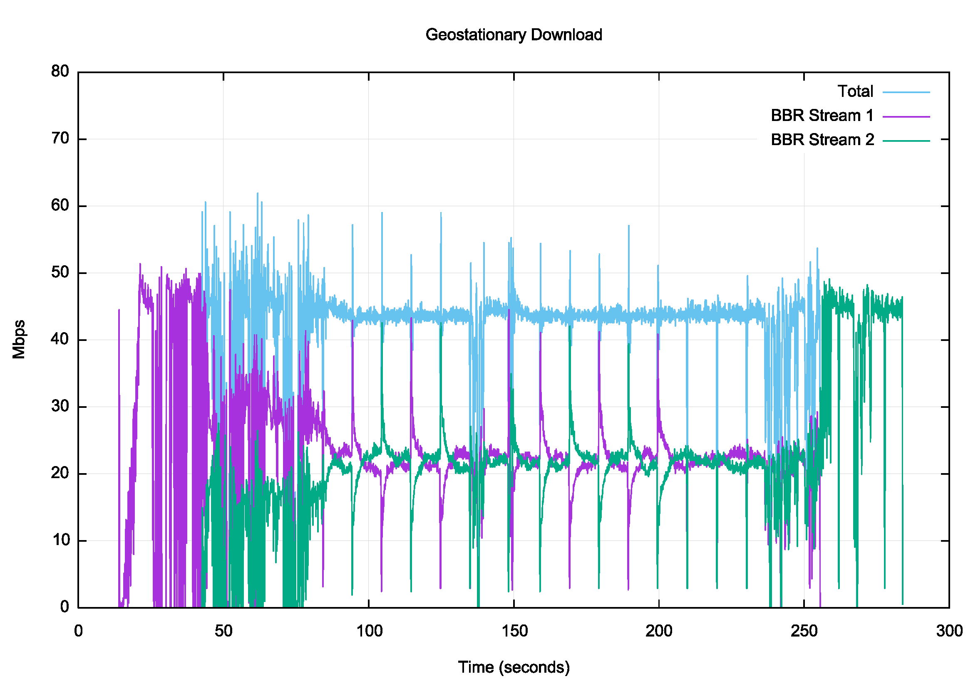
GEO – 2 Stream BBR

Slide 34
Protocol Performance over a GEO circuit
While the ping times are relatively stable, the extended RTT time pushes the congestion protocol into areas of instability – this is likely due to the presence of deep queues in this product, in conjunction with the high delay of the path
Both Reno and Cubic drop into instability after some 60 seconds. It is unclear whether this is protocol breakdown, or the impact of cross traffic on the tested flows within the GEO system
BBR operates remarkably efficiently across this system, driving the link to the delivered capacity without the build up of a standing queue - clearly BBR out-performs Reno and Cubic in this context

Slide 35
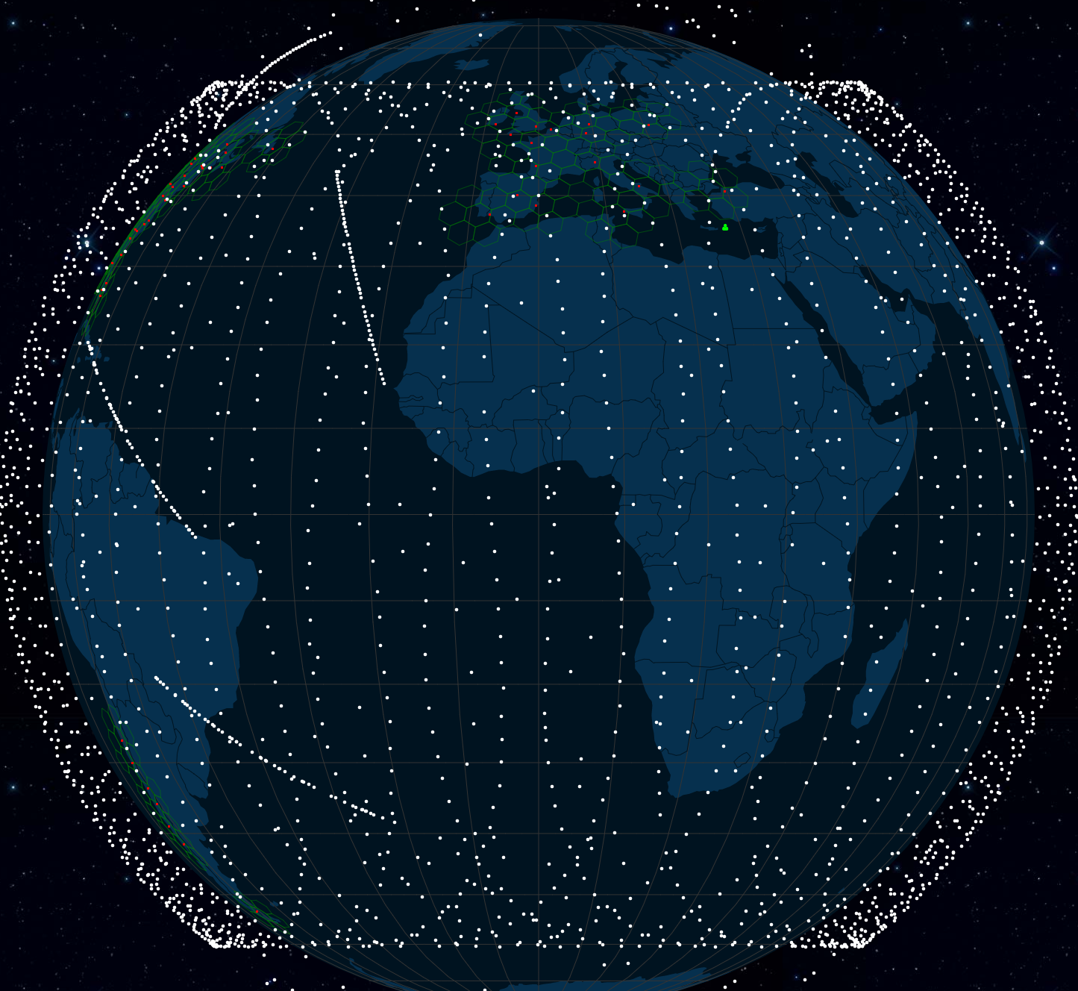
Starlink service
https://satellitemap.space/

Slide 36
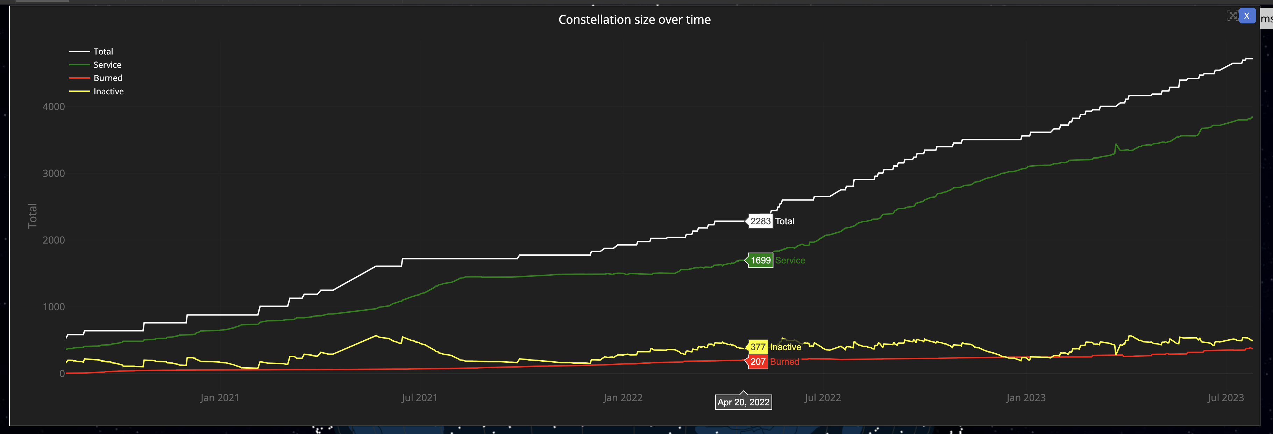
Starlink service
3,840 in-service operational spacecraft, operating at an altitude of 550km
https://satellitemap.space/

Slide 37
Starlink service
3,840 operational spacecraft, operating at an altitude of 550km
One-way signal propagation time to reach the spacecraft varies between 1.8ms and 3.6ms (equivalent RTT of 7.3ms to 14.6ms)
But that’s not what we see:
2000 packets transmitted, 1991 received, 0.45% packet loss, time 2009903ms
rtt min/avg/max/mdev = 37.284/60.560/214.301/13.549 ms

Slide 38
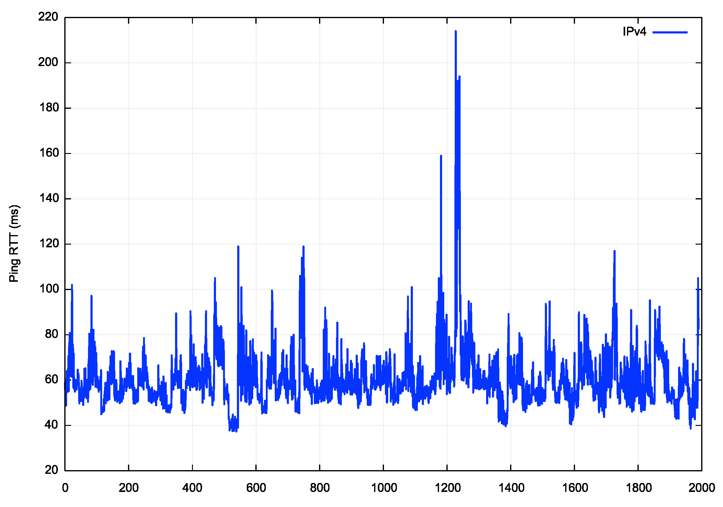
Starlink RTT Ping Times
We are seeing:
12ms terrestrial component,
7ms/14ms propagation component,
30ms for codec/fec/switching?

Slide 39
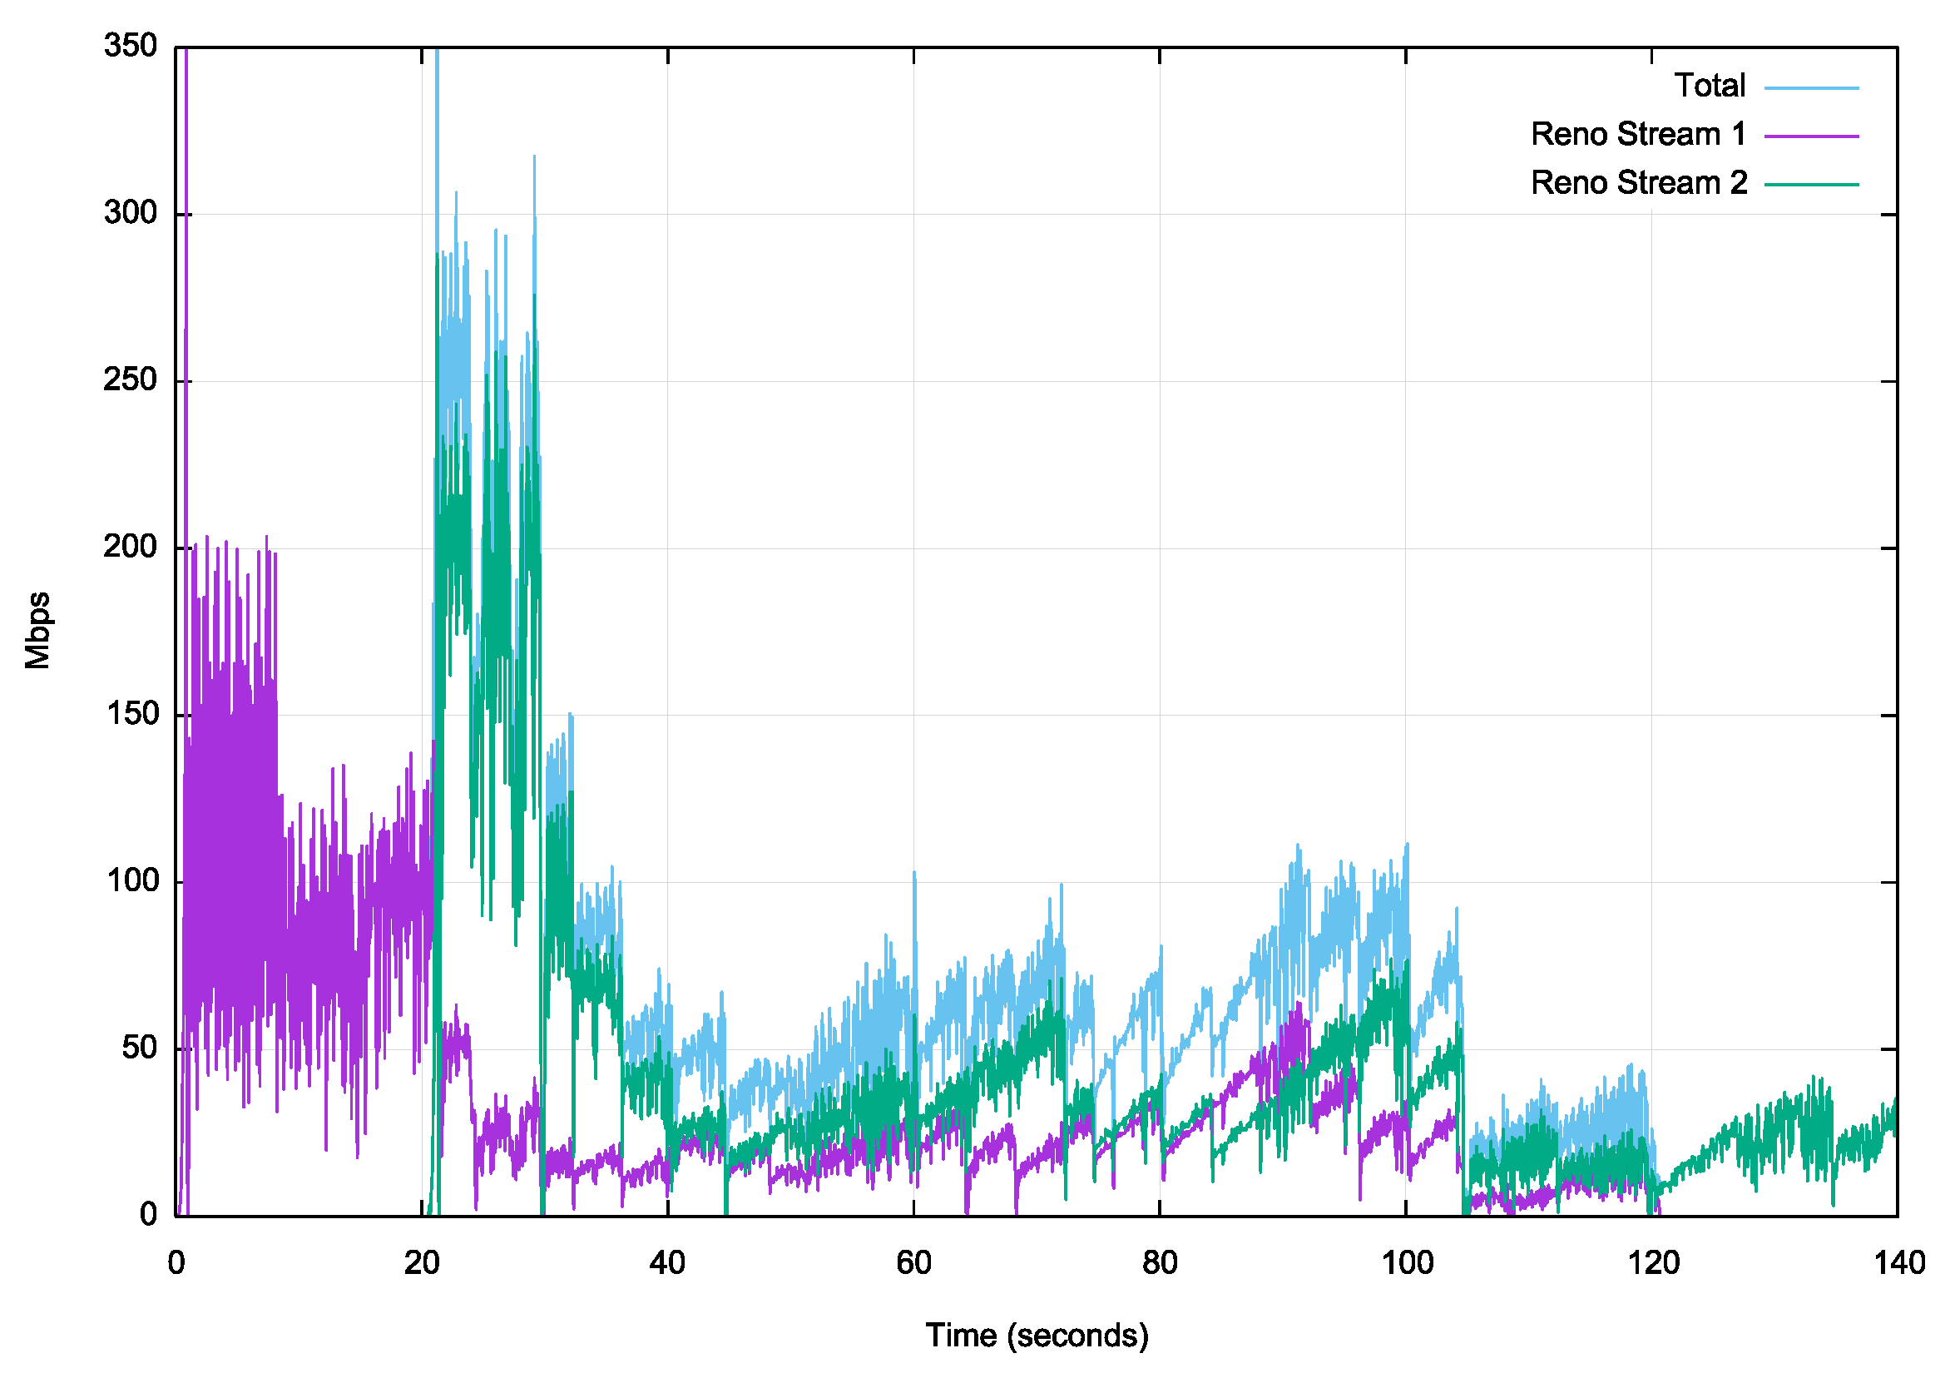
Starlink – 2 Stream Reno
Relatively unimpressive performance.
There appears to be imposed packet loss events that hampers Reno inflating the sending rate

Slide 40
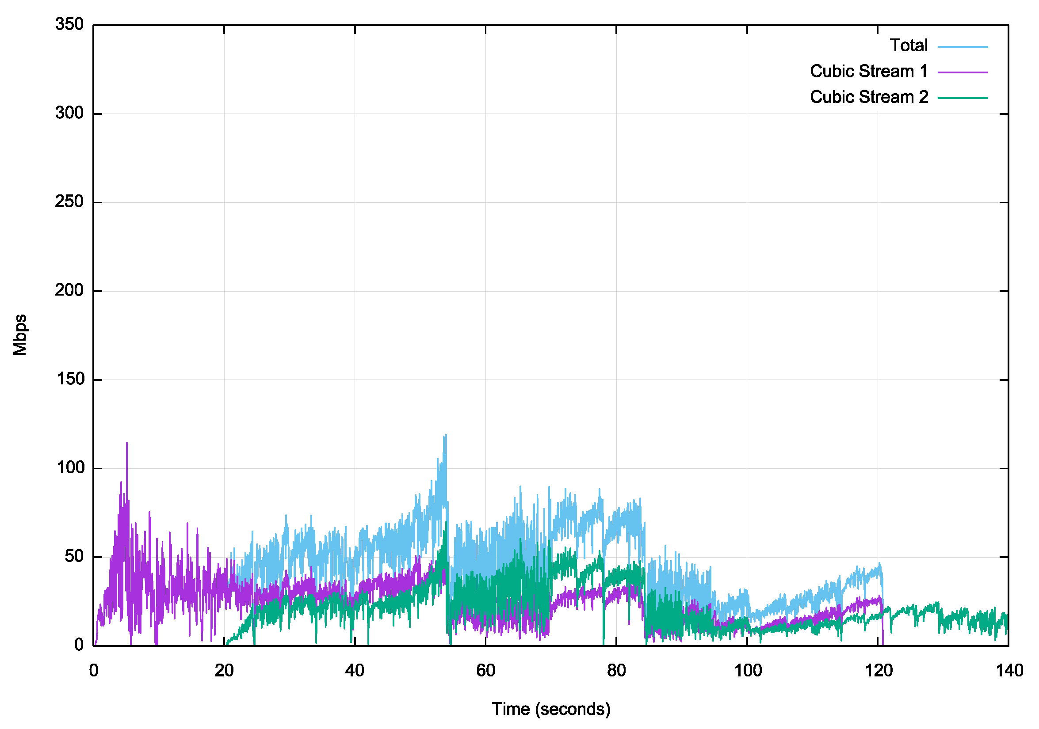
Starlink – 2 Stream Cubic
Also unimpressive performance.
Cubic appears to be more stable than Reno, but still fails to open up its sending rate over time, so the higher stability is achieved at a cost of lower overall throughput

Slide 41
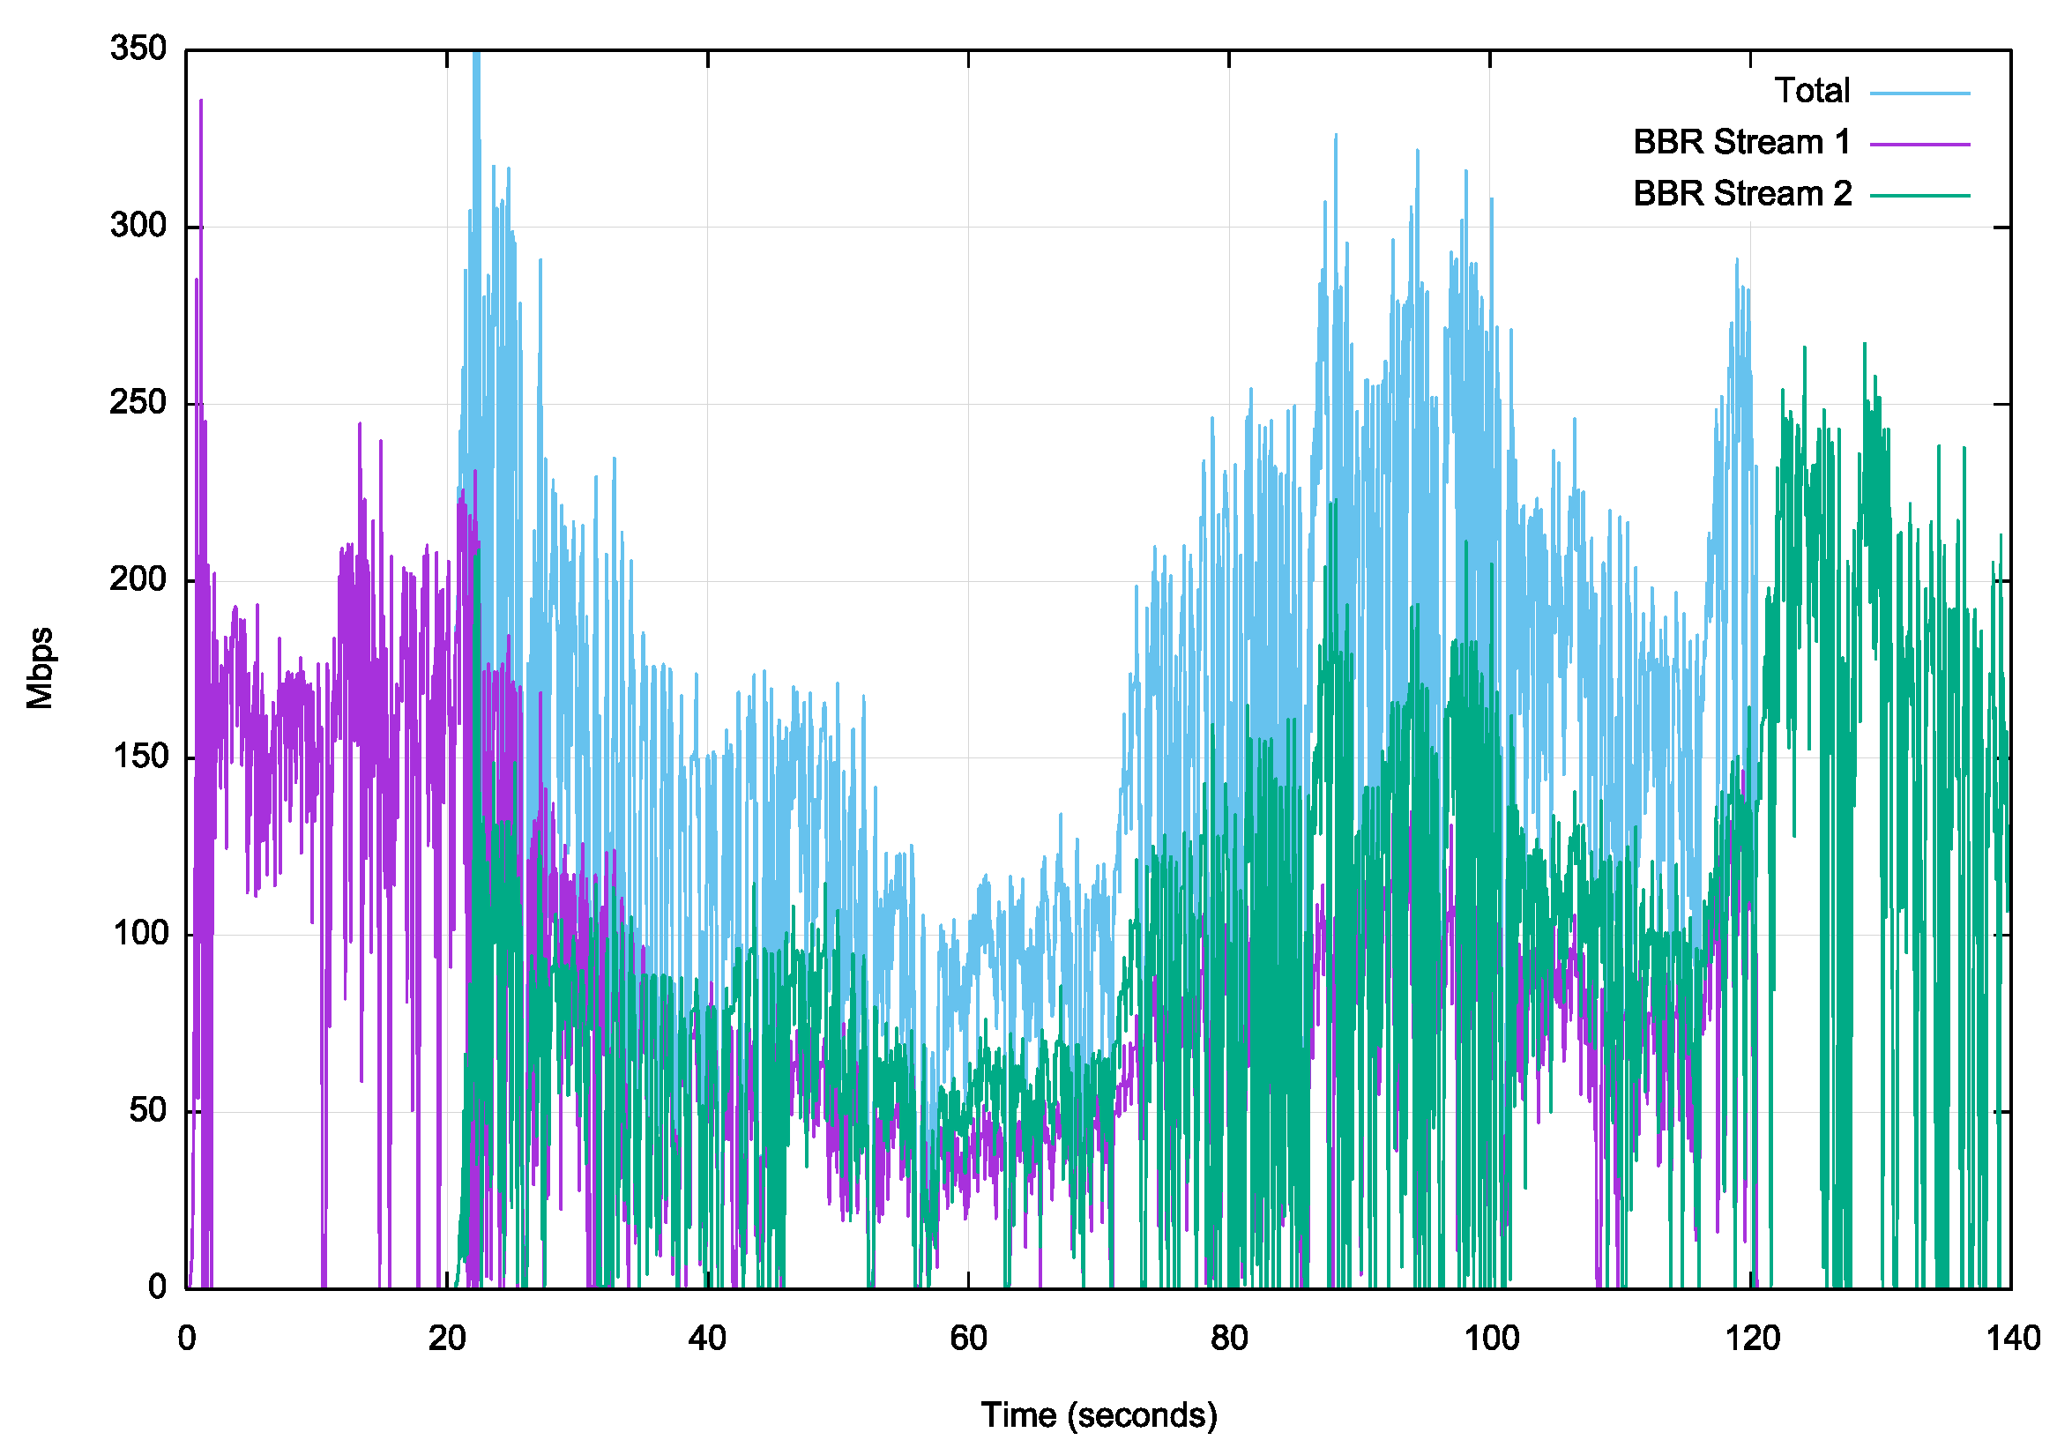
Starlink – 2 Stream BBR
BBR seems to be better positioned to extract performance from a variable platform in loss and jitter terms- it is able to operate 3 – 5 times the speed of Cubic or Reno between the same endpoints
The packet loss rate is higher than expected, and this may be an outcome of the combination of using phase array antennae that are tracking satellites that are moving through the sky at a relative speed of 1 degree of elevation every 15 seconds, together with the need to perform satellite handover at regular intervals.

Slide 42
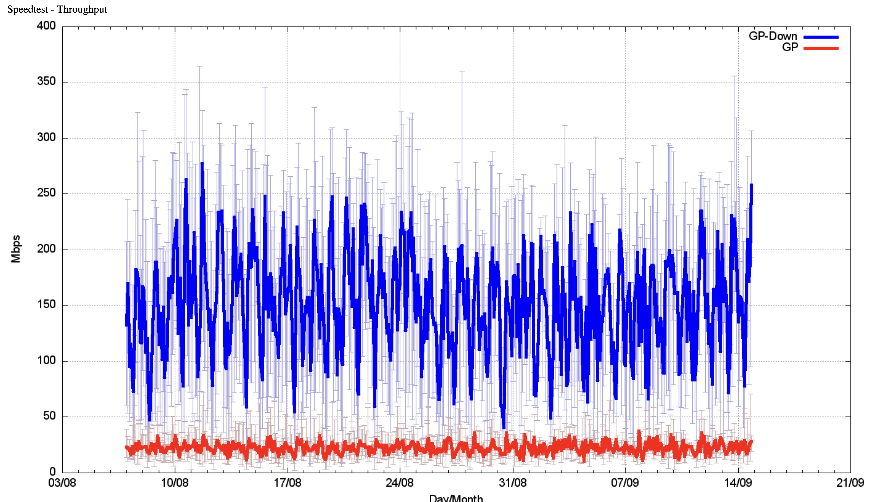
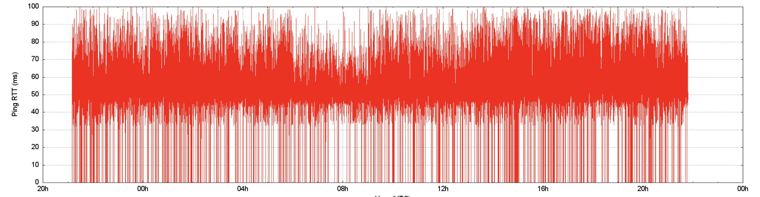
Performance
Speedtest-measuremed capacity
1 second ping
Micro-drops

Slide 43
Protocol Considerations
Starlink services have two issues:
  Very high jitter rates
  High levels of micro-loss
Loss-based flow control algorithms will over-react and pull back the sending rate
  Short transactions work well
  Paced connections (voice, zoom) tend to work well most of the time
  Bulk data transfer not so mucj
You need to move to less sensitive flow control algorithms, such as BBR to get good performance out of these services

Slide 44
Measuring QUIC Performance
In this test (between the same endpoints) over a Starlink circuit, TCP CUBIC underperforms badly, while TCP BBR and QUIC both perform reasonably well

Slide 45
More measurements needed …
Is iperf3 on Linux the right measurement tool?
Can we bypass the Linux kernel baggage and measure the ‘raw’ TCP protocol performance?
Would using QUIC provide a different view of protocol performance?
How do LEO services compare to 5G?
Speed vs stability?
  Should a LEO service expose the underlying jitter and loss to the application, or should it integrate smoothing, and even basic retransmission into the service at the cost of a higher delay overhead?

Slide 46
What about Starlink Gen2?
These satellites are larger, heavier and operate at a higher power level
More bandwidth available, and high achievable data speeds
Multiple orbital plans at a collection of discrete altitudes
Incorporates 5G cellular services
Will use inter-satellite laser connectors to support packet routing across satellites – details sparse so far, and it’s not clear how flexible this will be in terms of routing in the mesh

Slide 47
Does it scale?
Fibre – well yes, just bury more cable!
GEO – no, not really
  Geostationary spacecraft are normally separated by 2 – 3 degrees or arc, so there are some 120 – 180 viable slots. The radio frequencies are also limited to the C, Ku and Ka bands. The on-craft transponders are not steerable so the capacity is provided to a pre-designed footprint
LEO – unclear, but probably not
  LEO constellations use low altitude eccentric orbits so the number of space craft in a constellation is determined by the inter-craft distance, horizontally and vertically.
  Starlink plan for 12,000 craft, Kuiper (Amazon) place for 3,200, Telesat 188, ITU-R filings indicate China is planning a constellation with 13,000 craft
  There is an issue with space junk at LEO orbits. Any collision will generate more junk, and the risk of a runaway effect is high if the altitude slots are densely packed

Slide 48
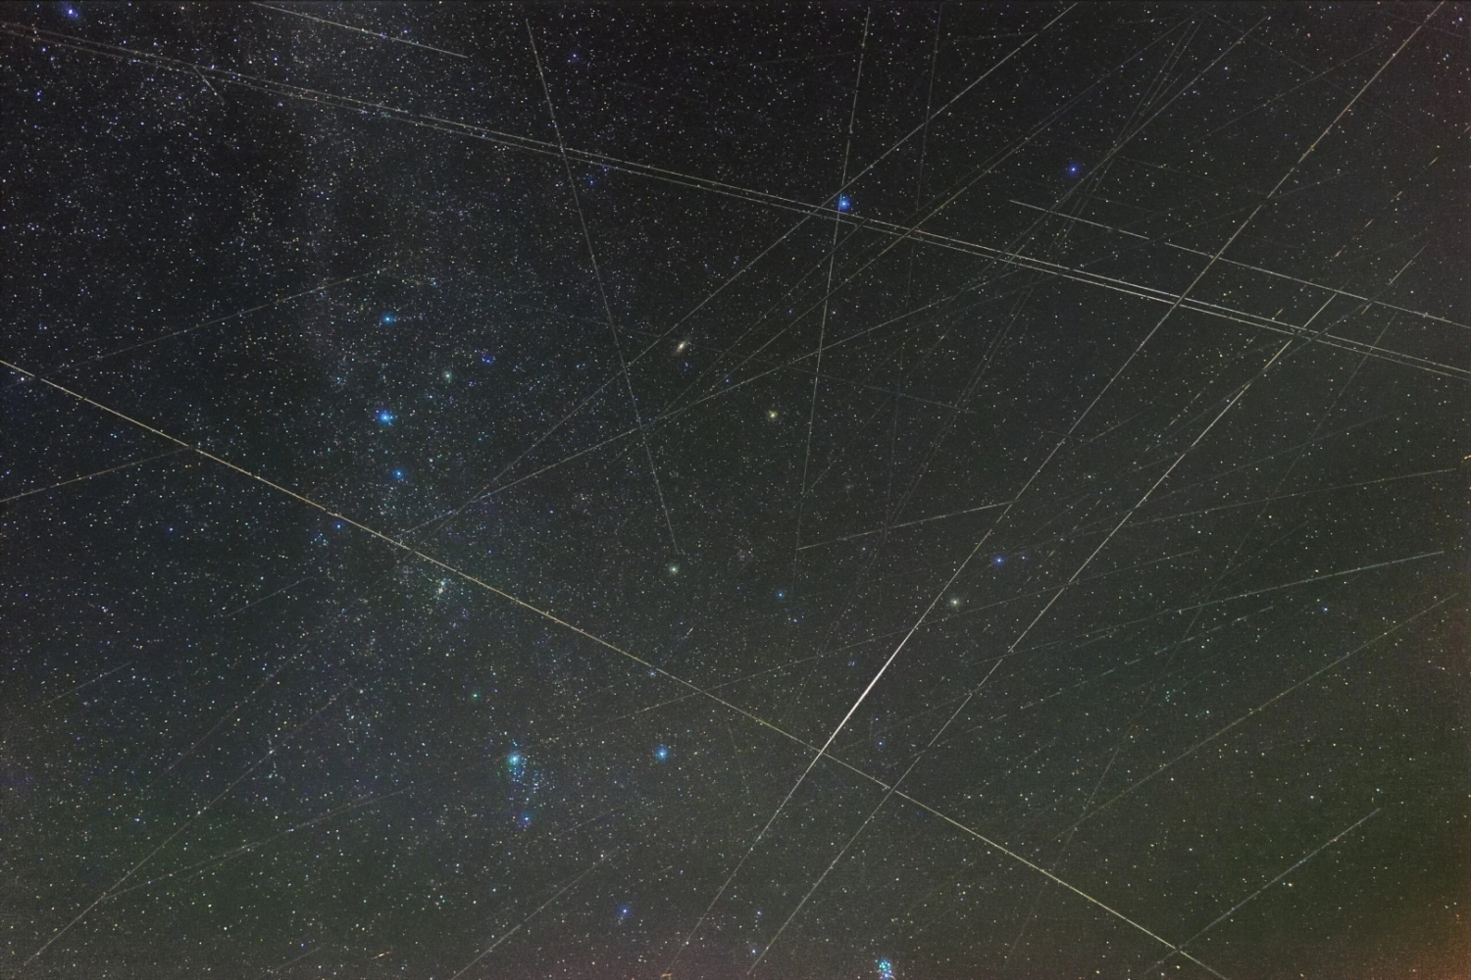
Questions?

Slide 49
Questions?

