Slide 1
On LEOs and Starlink
Geoff Huston AM
APNIC
November 2023

Slide 2
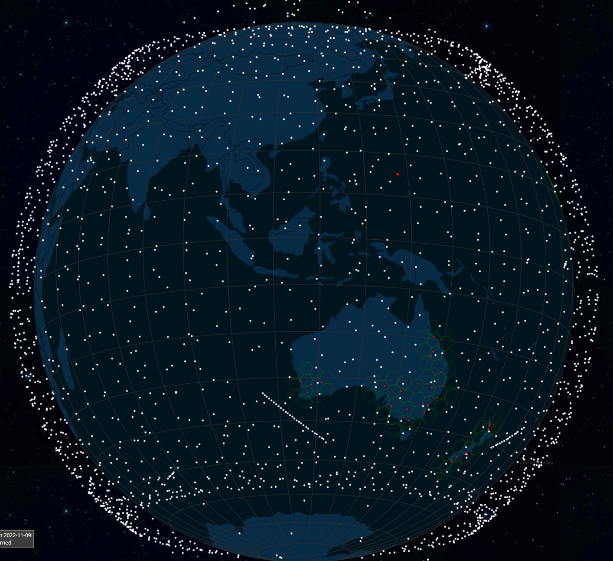
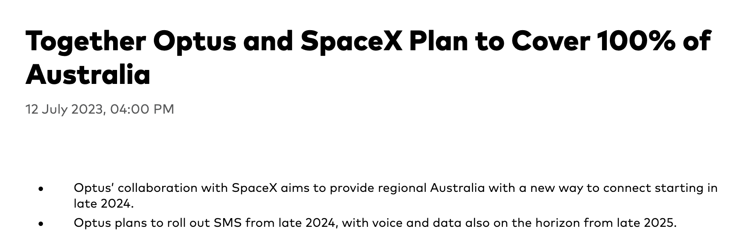
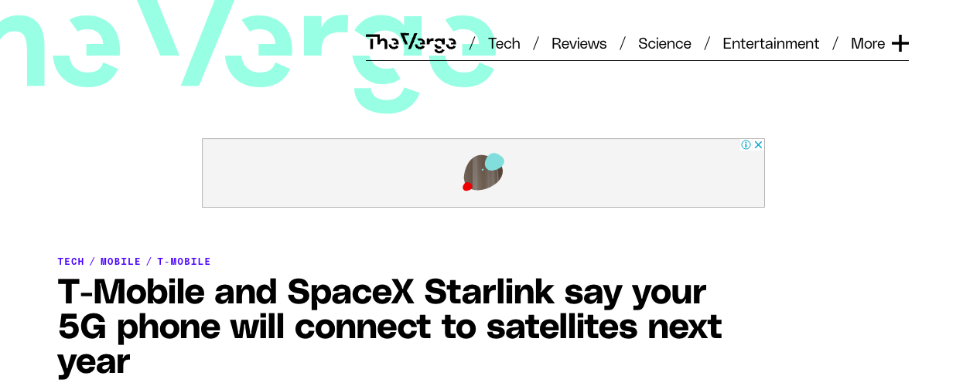
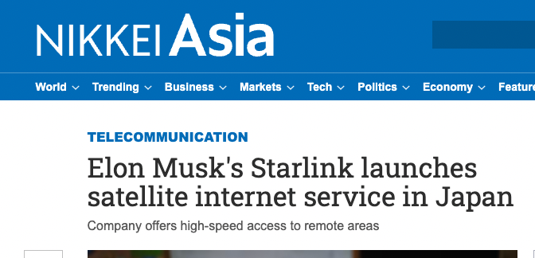
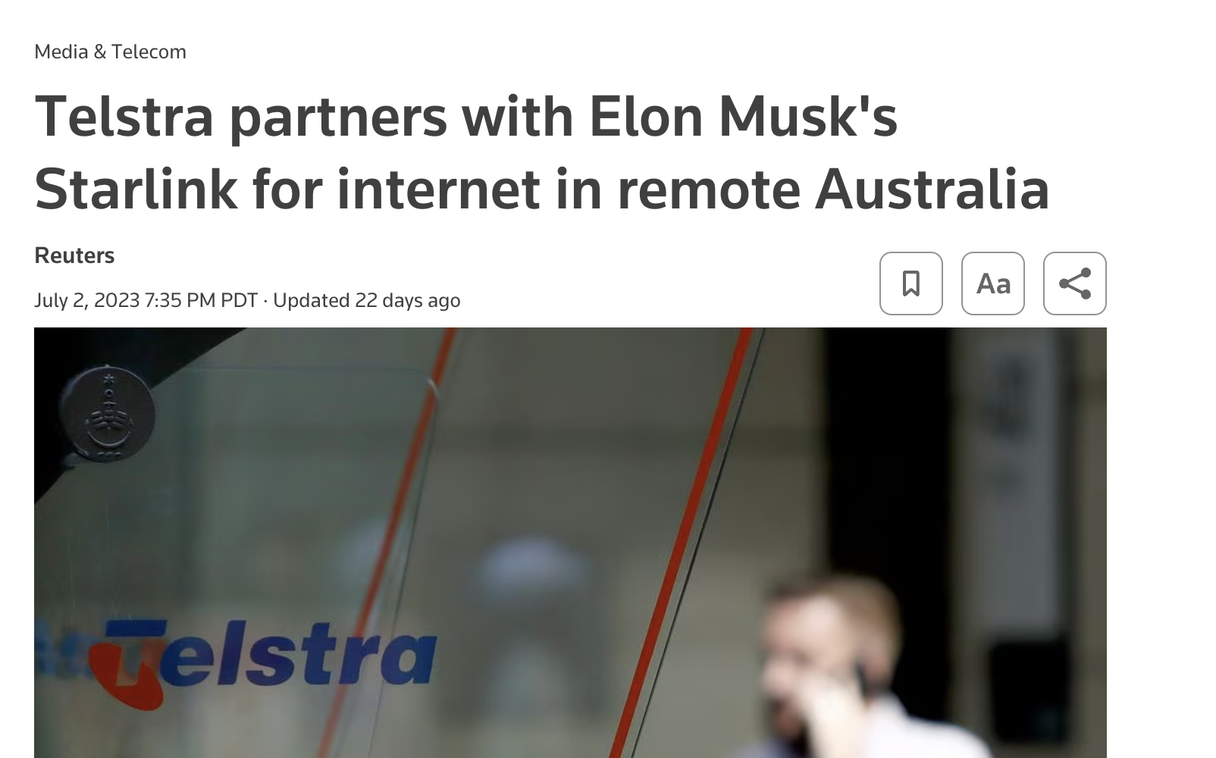
LEOs in the News
screenshot from starwatch app
Screenshot - https://www.theverge.com/2022/8/25/23320722/spacex-starlink-t-mobile-satellite-internet-mobile-messaging
Screenshot: https://asia.nikkei.com/Business/Telecommunication/Elon-Musk-s-Starlink-launches-satellite-internet-service-in-Japan

Slide 3
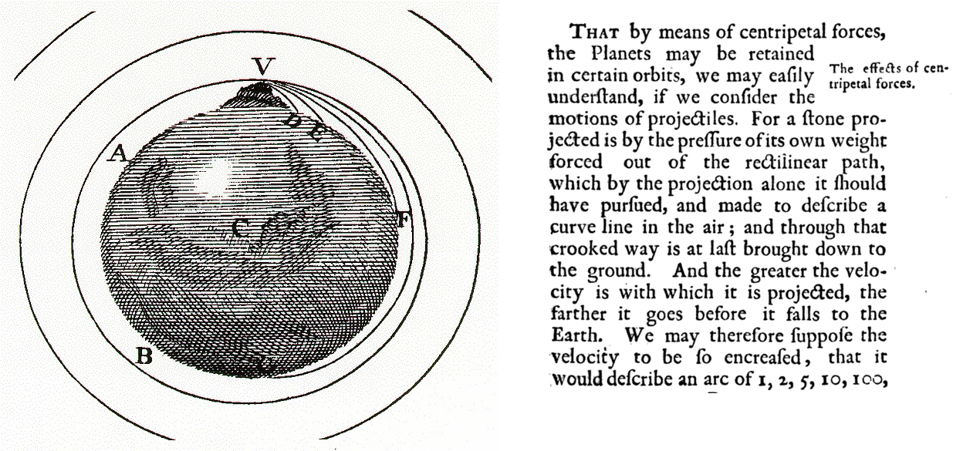
Newtonian Physics
If you fire a projectile with a speed greater than 11.2Km/sec it will not fall back to earth, and instead head away from earth never to return
On the other hand, if you incline the aiming trajectory and fire it at a critical speed it will settle into an orbit around the earth
The higher the altitude, the lower the orbital speed required to maintain orbit

Slide 4
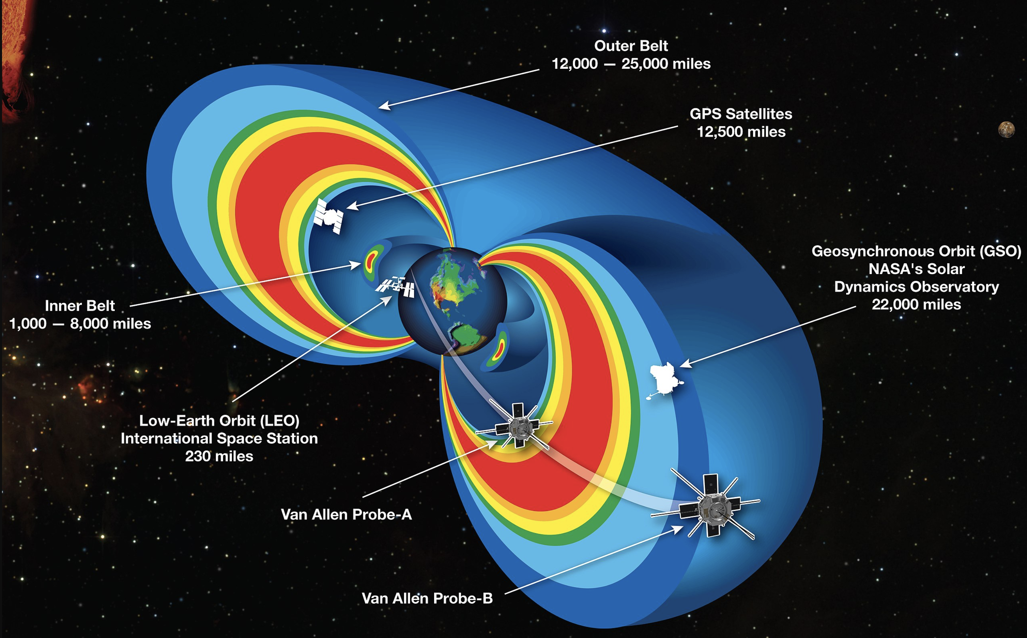
Solar Radiation Physics
The rotating iron core of the Earth produces a strong magnetic field
This magnetic deflects solar radiation – the Van Allen Belt
Sheltering below the Van Allen Belt protects the spacecraft from the worst effects of solar radiation, allowing advanced electronics to be used in the spacecraft

Slide 5
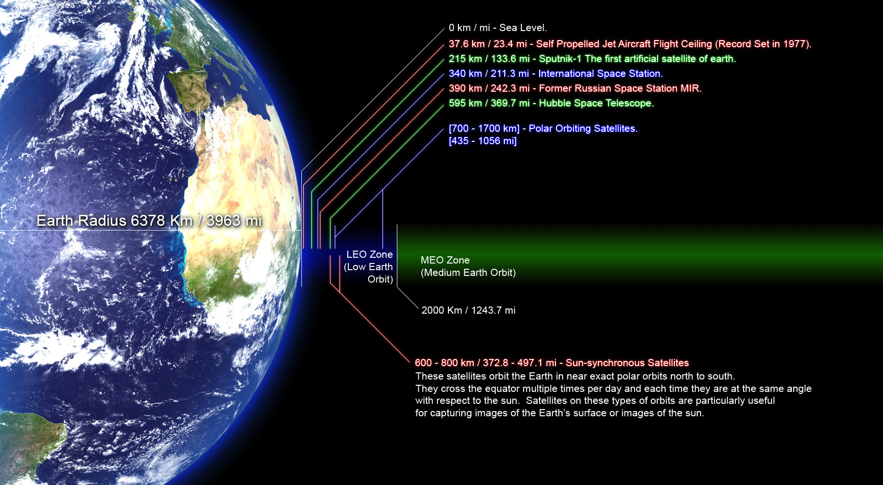
Low Earth Orbit
550 km – Starlink Constellation
https://commons.wikimedia.org/wiki/File:Orbitalaltitudes.jpg GNU Free Documentation License

Slide 6
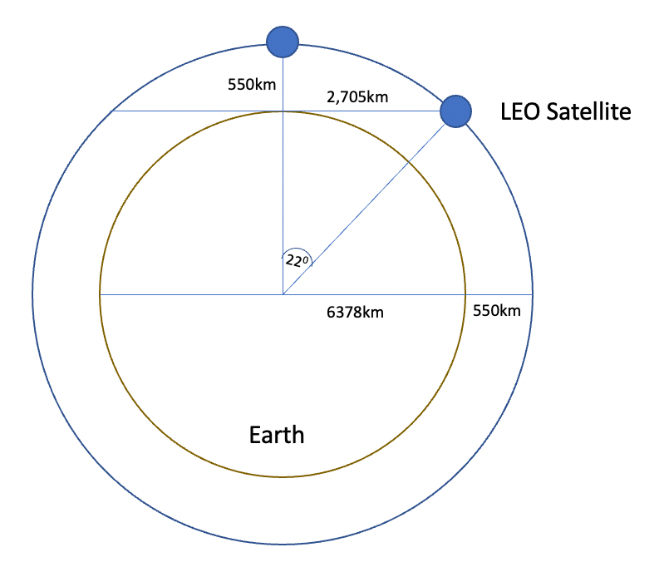
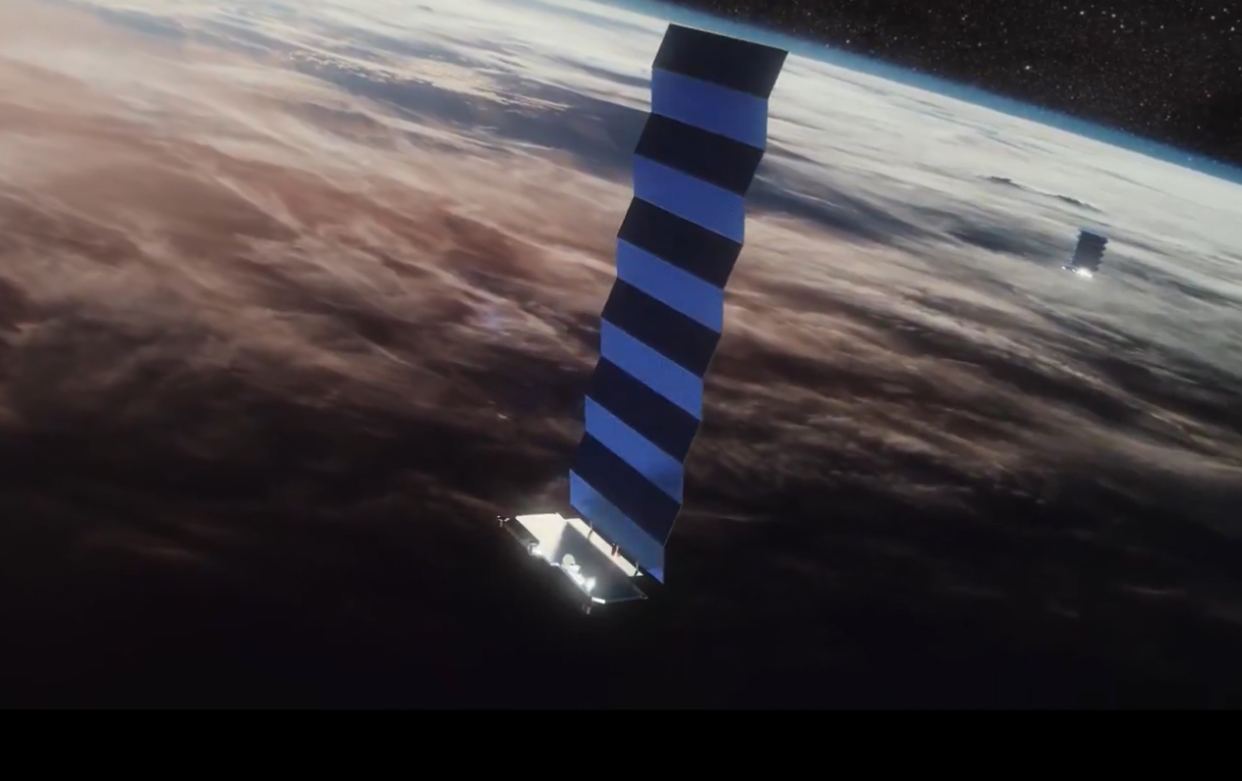
Low Earth Orbit
LEO satellites are stations between 160km and 2,000km in altitude.
High enough to stop it slowing down by “grazing” the denser parts of the earth’s ionosphere
Not so high that it loses the radiation protection afforded by the Inner Van Allen belt.
At a height of 550km, the minimum signal propagation delay to reach the satellite and back is 3.7ms, at 25º it’s 7.5ms.
Image - spacex
screenshot from starwatch app

Slide 7
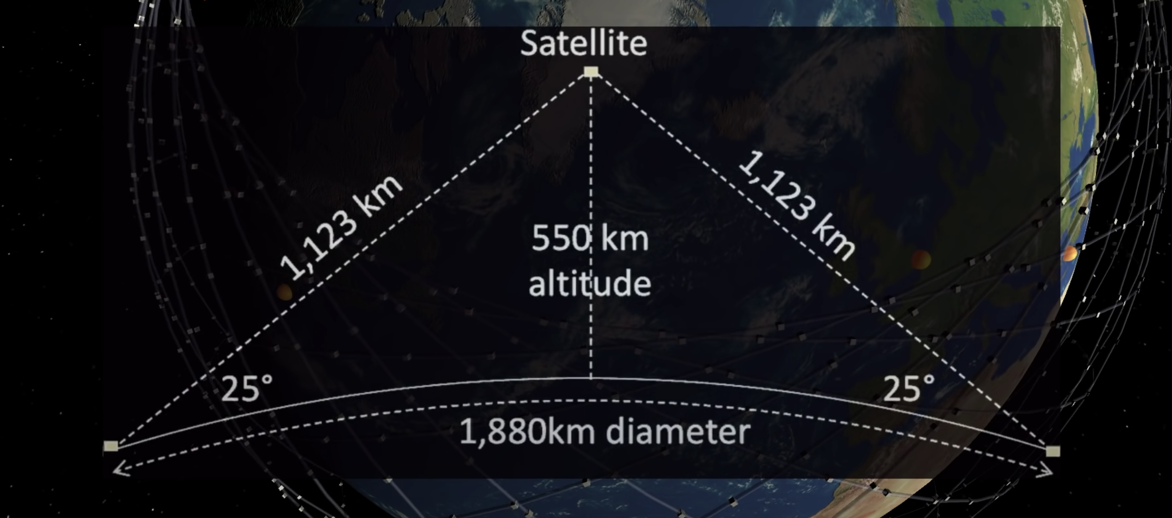
Starlink Constellation
If you use a minimum angle of elevation of 25º then at an altitude of 550km each satellite spans a terrestrial footprint of no more than ~900Km radius, or 2M K²
At a minimum, a LEO satellite constellation needs 500 satellites to provide coverage of all parts of the earth’s surface
For high quality coverage the constellation will need 6x-20x that number (or more!)

Slide 8
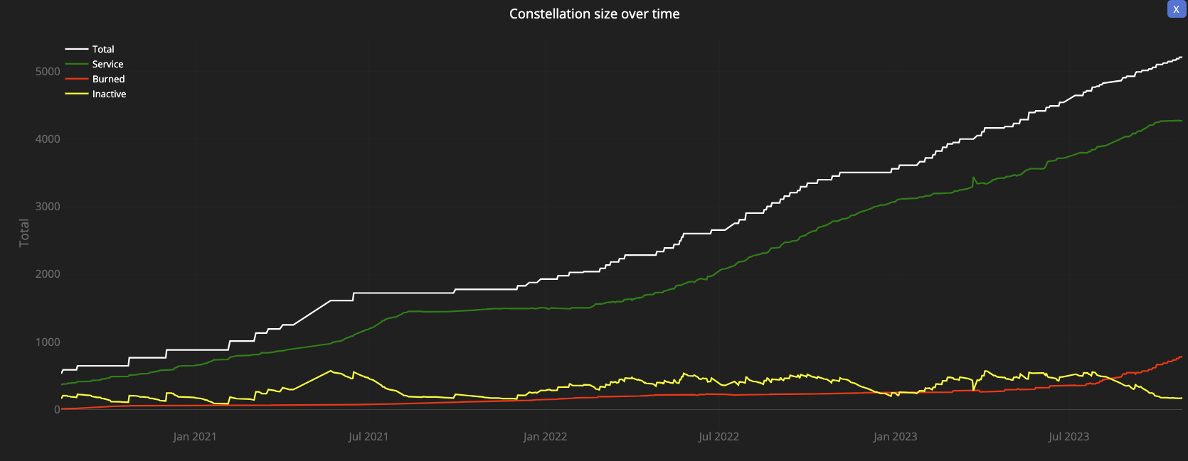
Starlink Constellation
4,276 in-service operational spacecraft, operating at an altitude of 550km
https://satellitemap.space/

Slide 9
So LEOs are “interesting”!
They are very close to the Earth – which means:
  They don’t need specialised high-power equipment to send and receive signals
    Even hand-held mobile devices can send and receive signals with a LEO!
  They can achieve very high signal speeds
    It’s a highly focussed signal beam
  They are harder to disrupt by external interference
But you need a large number of them to provide a continuous service
The extremely host cost of launching a large constellation of LEO spacecraft has been the major problem with LEO service until recently
  Which is why Motorola’s Iridium service went bankrupt soon after launch

Slide 10
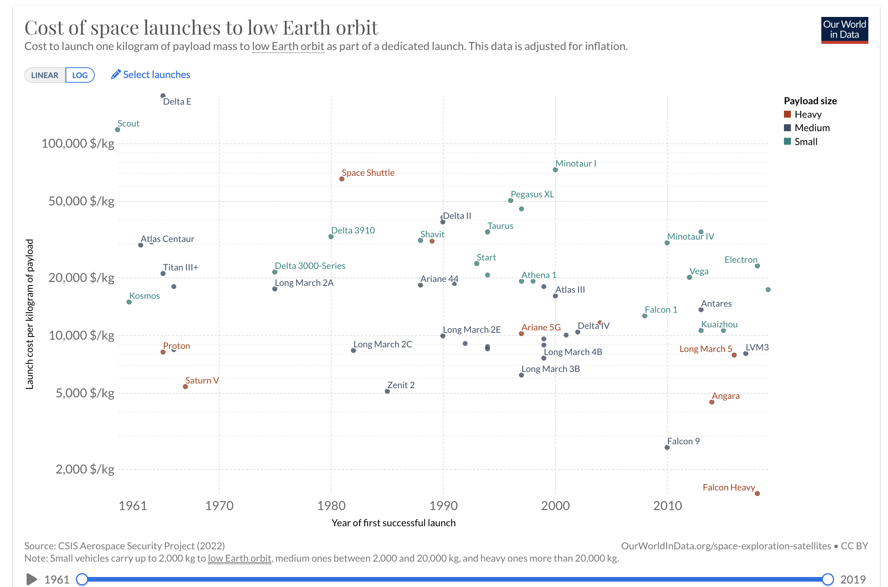
What’s changed recently?
SpaceX’s reusable rocket technology has slashed the cost of lifting spacecraft into low earth orbit
Cost/Kg (log scale)
SpaceX
Time
https://ourworldindata.org/grapher/cost-space-launches-low-earth-orbit

Slide 11
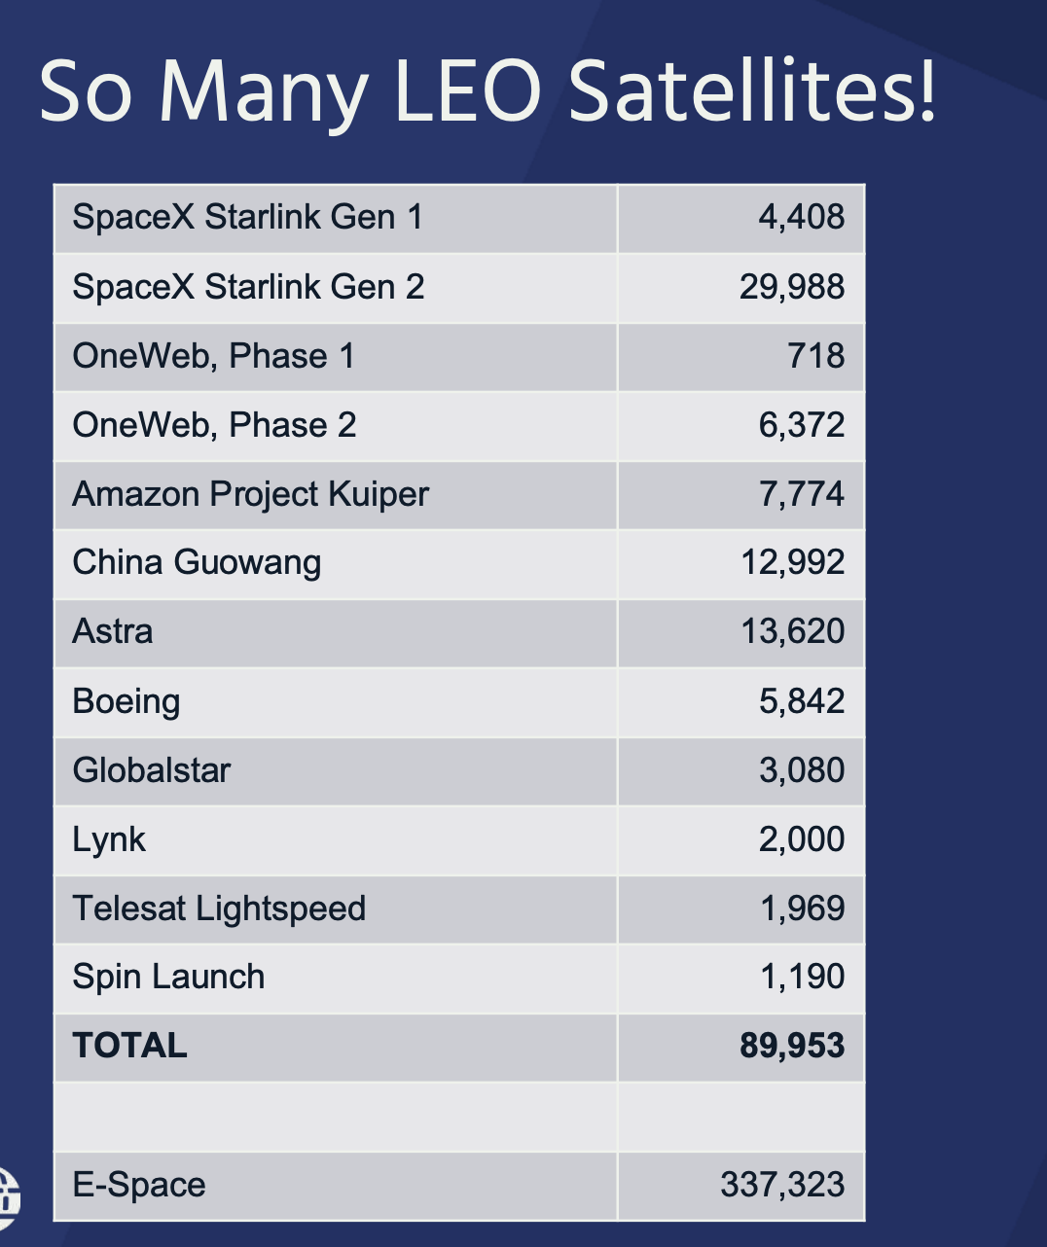
Current and Planned satellite constellations

Slide 12
What about Starlink Gen2?
These satellites are larger, heavier and operate at a higher power level
More bandwidth available, and high achievable data speeds
Multiple orbital plans at a collection of discrete altitudes
Incorporates 5G cellular services
Will use inter-satellite laser connectors to support packet routing across satellites – details sparse so far, and it’s not clear how flexible this will be in terms of routing in the mesh

Slide 13
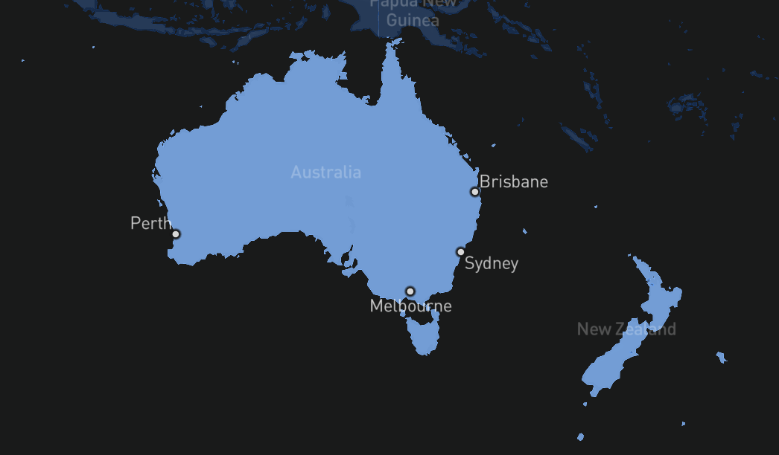
ISL in action
The introduction of ISL has allowed Starlink to extend its coverage area to the entirety of the Australian continent, and it manages this by relaying the signal between spacecraft to one that is within range of an earth station

Slide 14
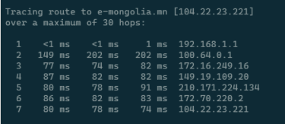
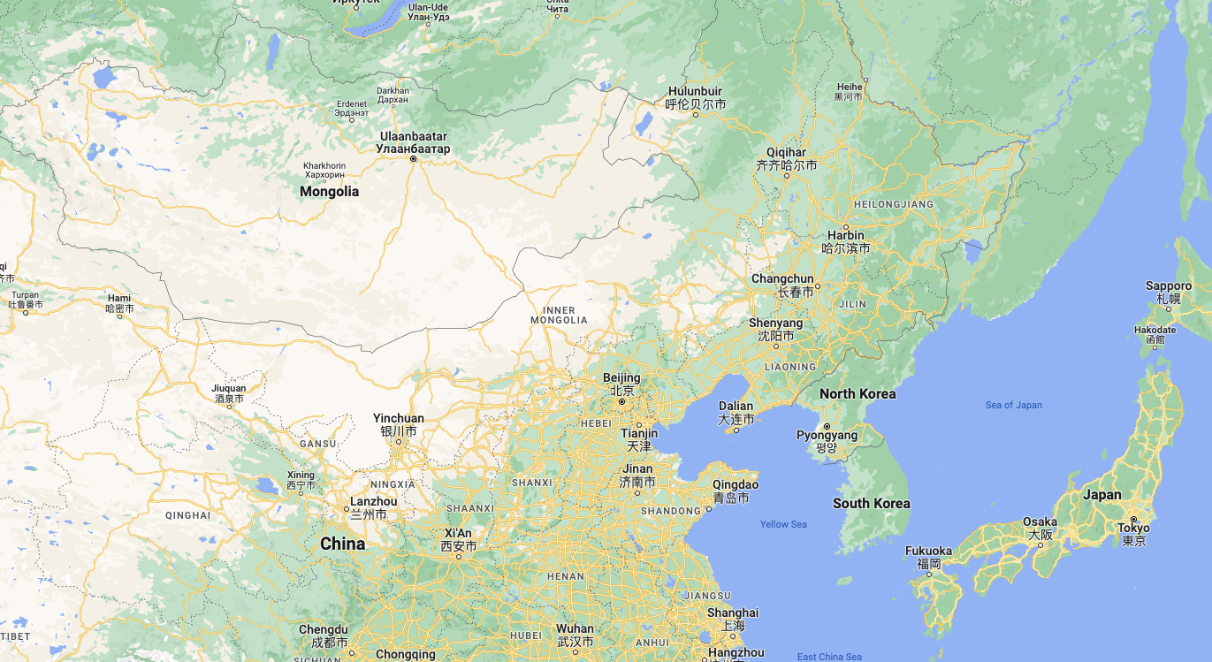
ISL in Mongolia
Use of ISL appears to add no more than ~20ms to the RTT in this case
JPIX (Japan)
Cloud Flare server (Japan)

Slide 15
Tracking a LEO satellite
Satellite
27,000 km/h
horizon to horizon: ~5 minutes
550km

Slide 16
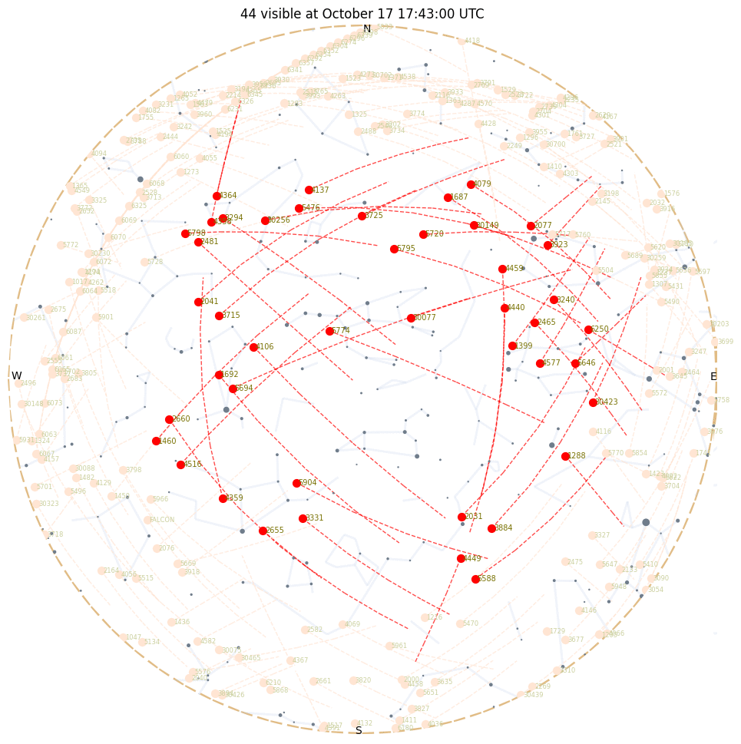
Looking Up
Starlink tracks satellites with a minimum elevation of 25º.
There are between 30 – 50 visible Starlink satellites at any point on the surface between latitudes 56º North and South
Each satellite traverses the visible aperture for a maximum of ~3 minutes

Slide 17
Starlink Scheduling
A satellite is assigned to a user terminal in 15 second time slots
Tracking of a satellite (by phased array focussing) works across 11 degrees of arc per satellite in each 15 second slot
15 seconds
11º
client

Slide 18
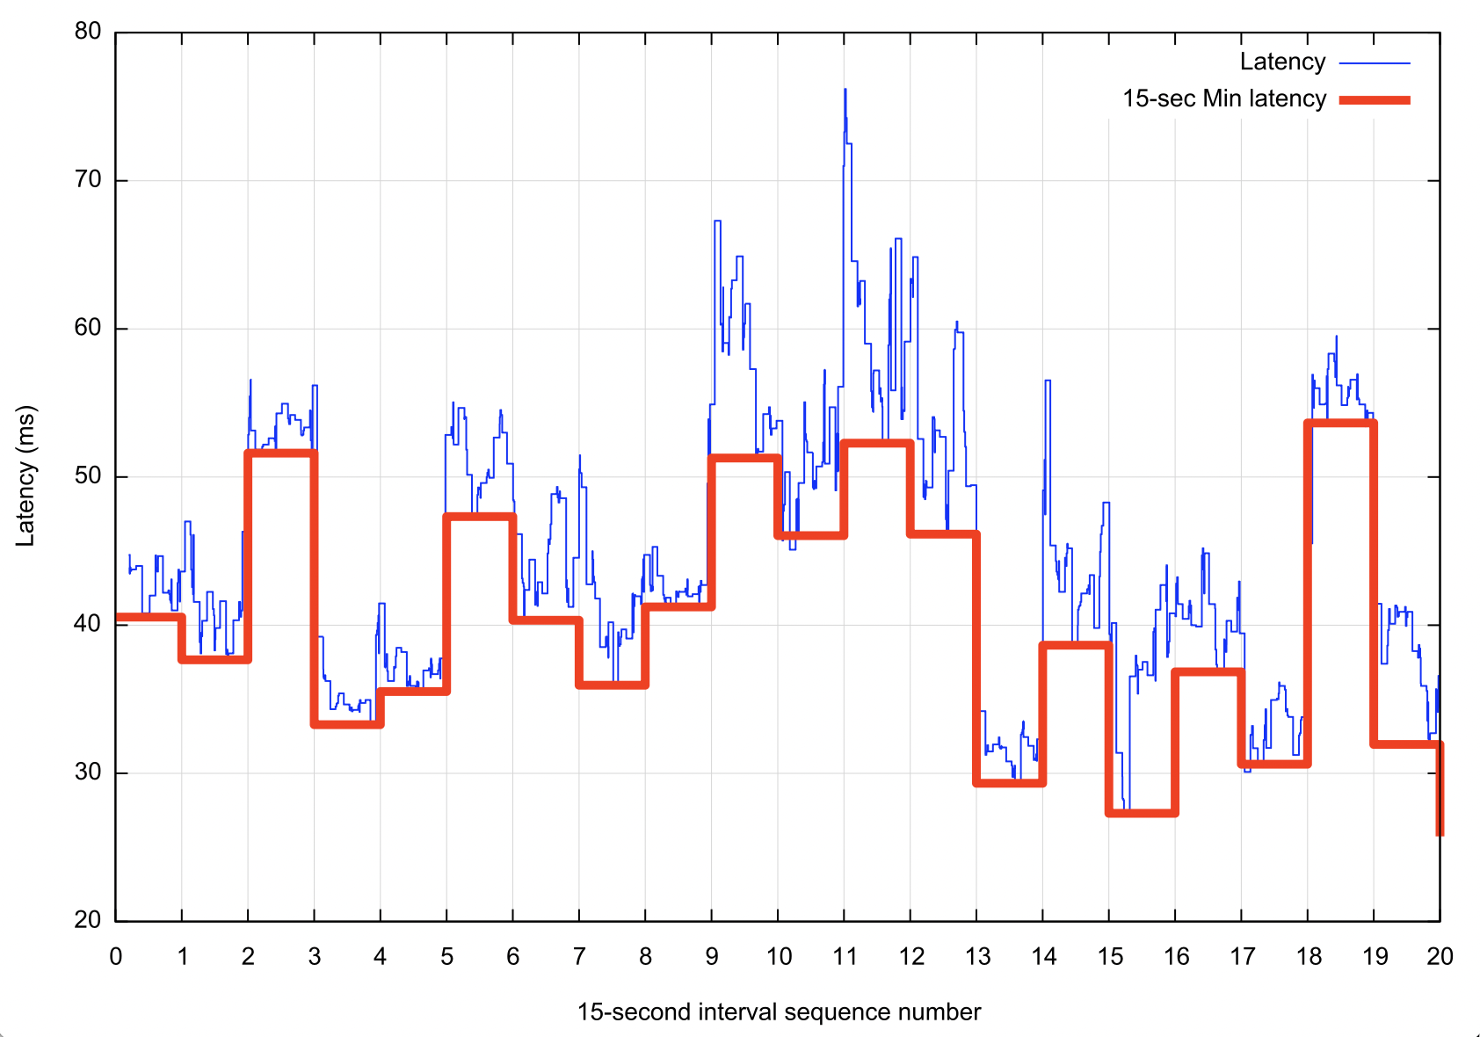
Starlink Scheduling
Latency changes on each satellite switch
If we take the minimum latency on each 15 second scheduling interval, we can expose the effects of the switching interval on latency
Across the 15 second interval there will be a drift in latency according to the satellite’s track and the distance relative to the two earth points
Other user traffic will also impact on latency, and also the effects of a large buffer in the user modem

Slide 19
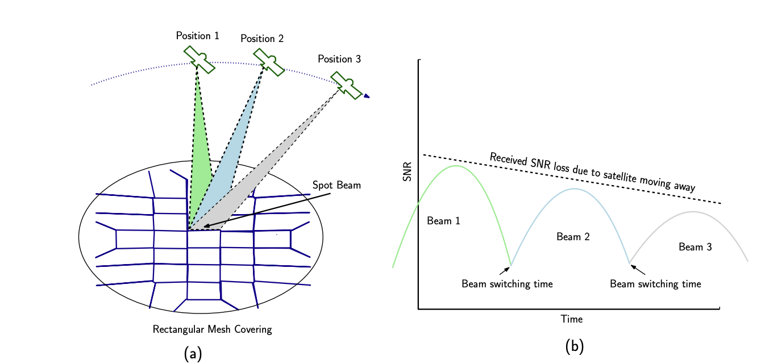
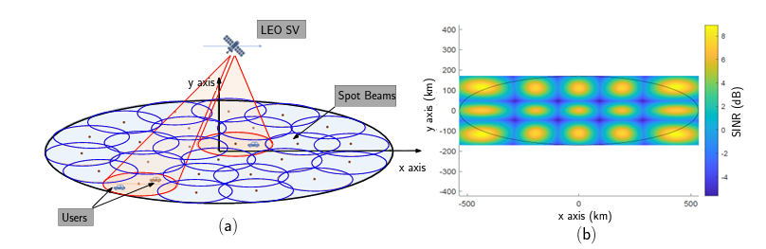
Starlink Spot Beams
Each spacecraft 2,000 MHz of spectrum for user downlink and splits it into 8x channels of 250 MHz each
Each satellite has 3 downlink antennas and 1 uplink antennas, and each can do 8 beams x 2 polarizations, for a total of 48 beams down and 16 up.
“Unveiling Beamforming Strategies of Starlink LEO Satellites”
https://people.engineering.osu.edu/sites/default/files/2022-10/Kassas_Unveiling_Beamforming_Strategies_of_Starlink_LEO_Satellites.pdf

Slide 20
Starlink’s reports
$ starlink-grpc-tools/dish_grpc_text.py -v status
id: ut01000000-00000000-005dd555
hardware_version: rev3_proto2
software_version: 5a923943-5acb-4d05-ac58-dd93e72b7862.uterm.release
state: CONNECTED
uptime: 481674
snr:
seconds_to_first_nonempty_slot: 0.0
pop_ping_drop_rate: 0.0
downlink_throughput_bps: 16693.330078125
uplink_throughput_bps: 109127.3984375
pop_ping_latency_ms: 49.5
Alerts bit field: 0
fraction_obstructed: 0.04149007424712181
currently_obstructed: False
seconds_obstructed:
obstruction_duration: 1.9579976797103882
obstruction_interval: 540.0
direction_azimuth: -42.67951583862305
direction_elevation: 64.61225128173828
is_snr_above_noise_floor: True

Slide 21
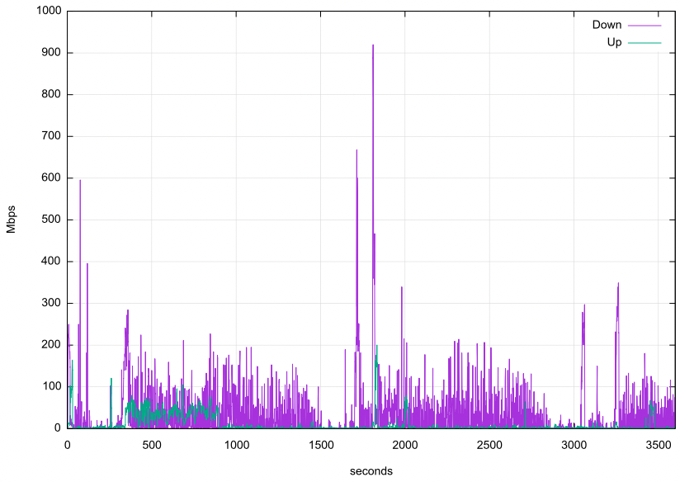
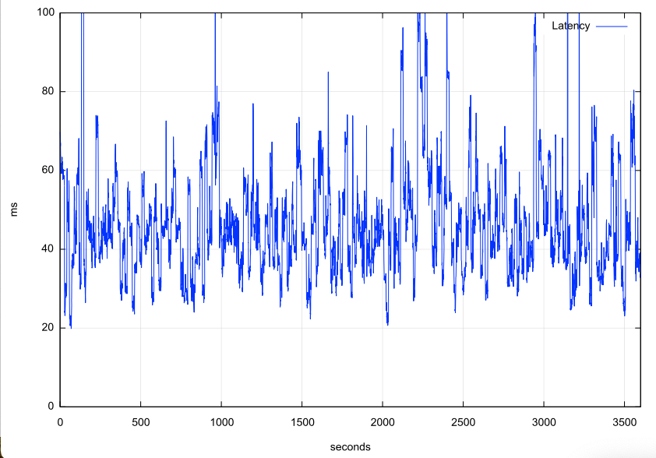
Reported Capacity & Latency

Slide 22
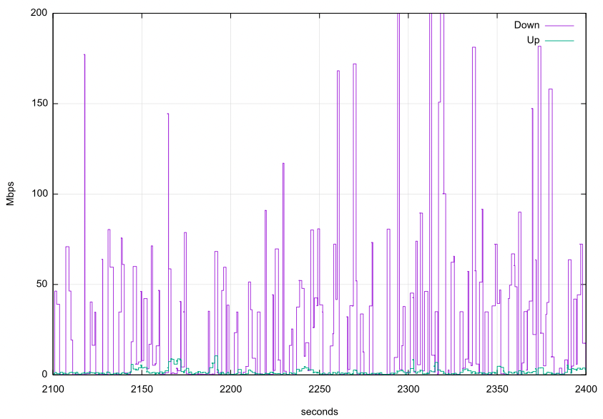
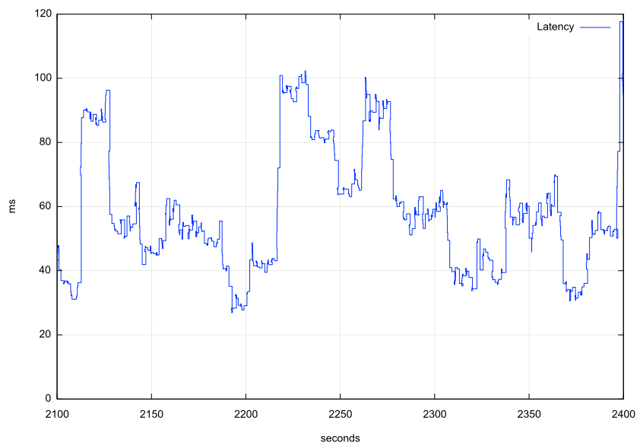
Reported Capacity & Latency
This is going to present some interesting issues for conventional TCP
TCP uses ACK pacing which means it attempts to optimize its sending rate over multiple RTT intervals
The variation in latency and capacity occurs at high frequency, which means that TCP control is going to struggle to optimize itself against a shifting target

Slide 23
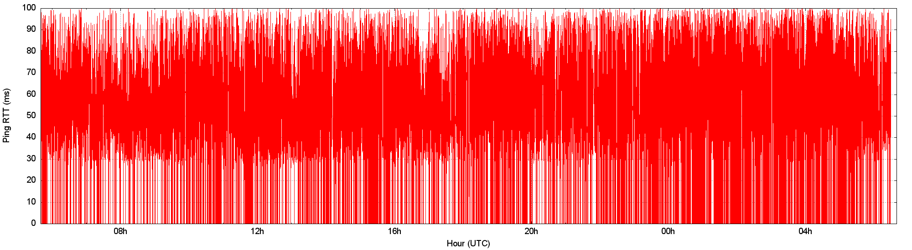
Link Characteristics
1-second ping
Highly unstable jitter
Micro-drops
24 Hours

Slide 24
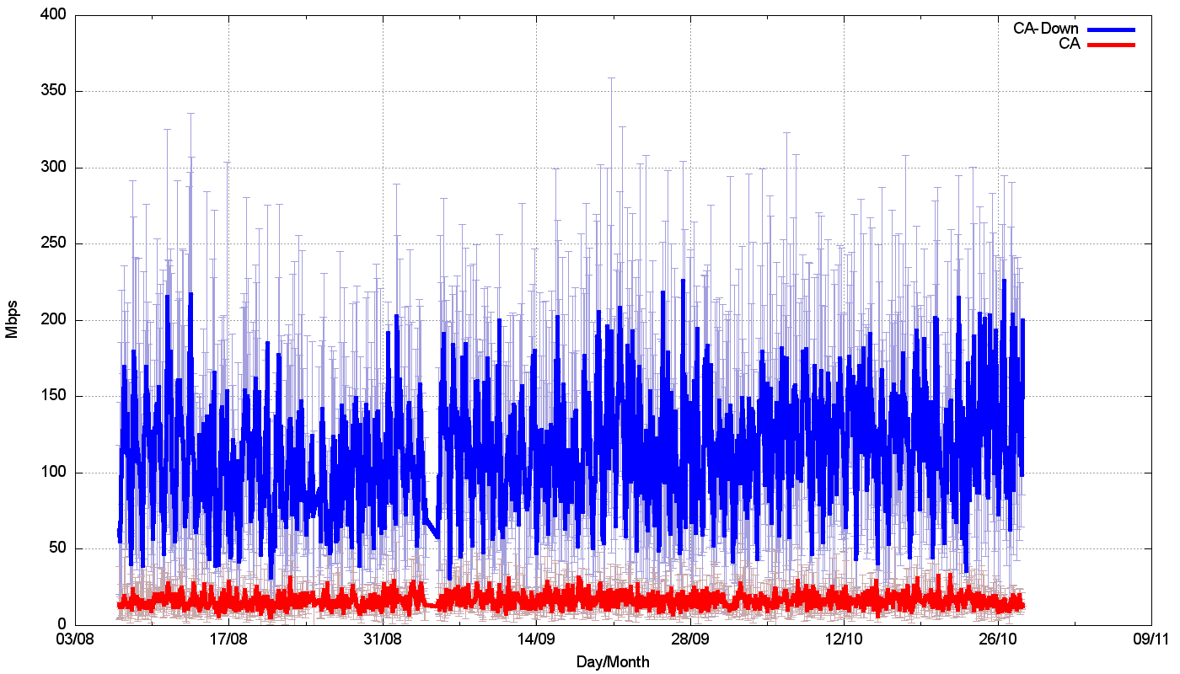
How well does all this work?
Speedtest measurements:
We should be able to get ~120Mbps out of a starlink connection. Right?

Slide 25
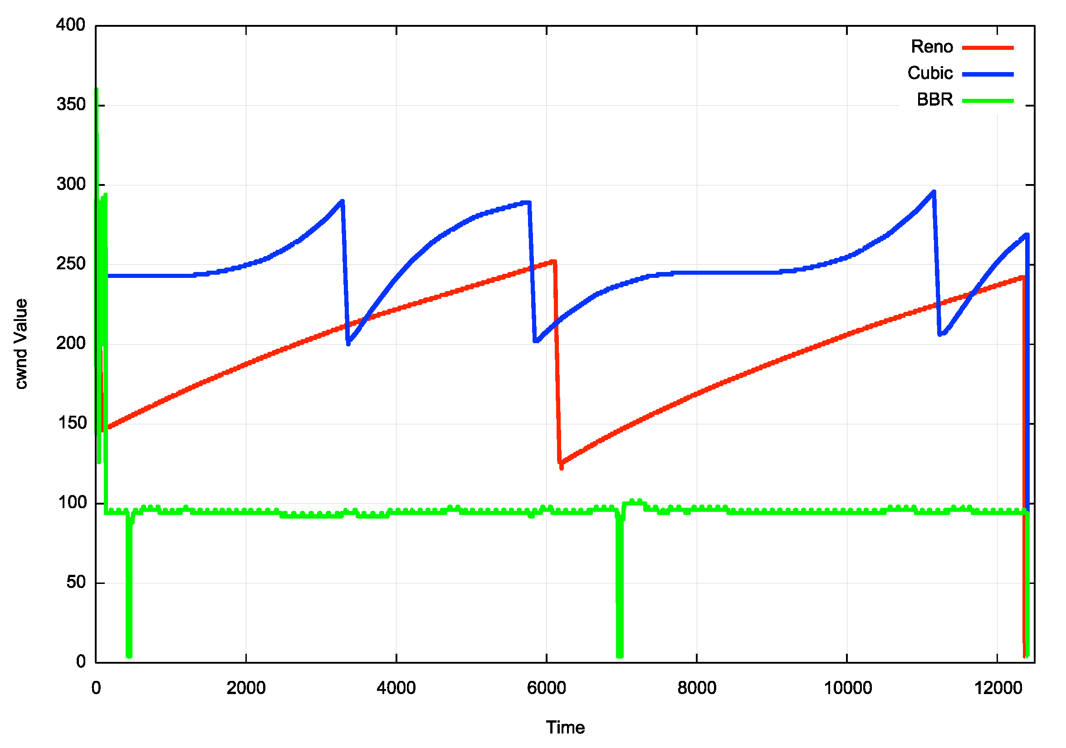
TCP Flow Control Algorithms
“Ideal” Flow behaviour for each protocol

Slide 26
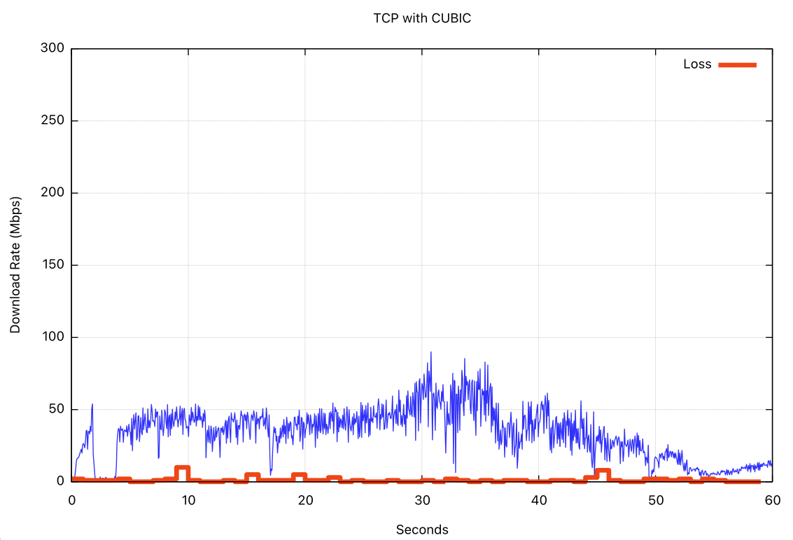
iperf3 – cubic, 60 seconds
CUBIC
Loss

Slide 27
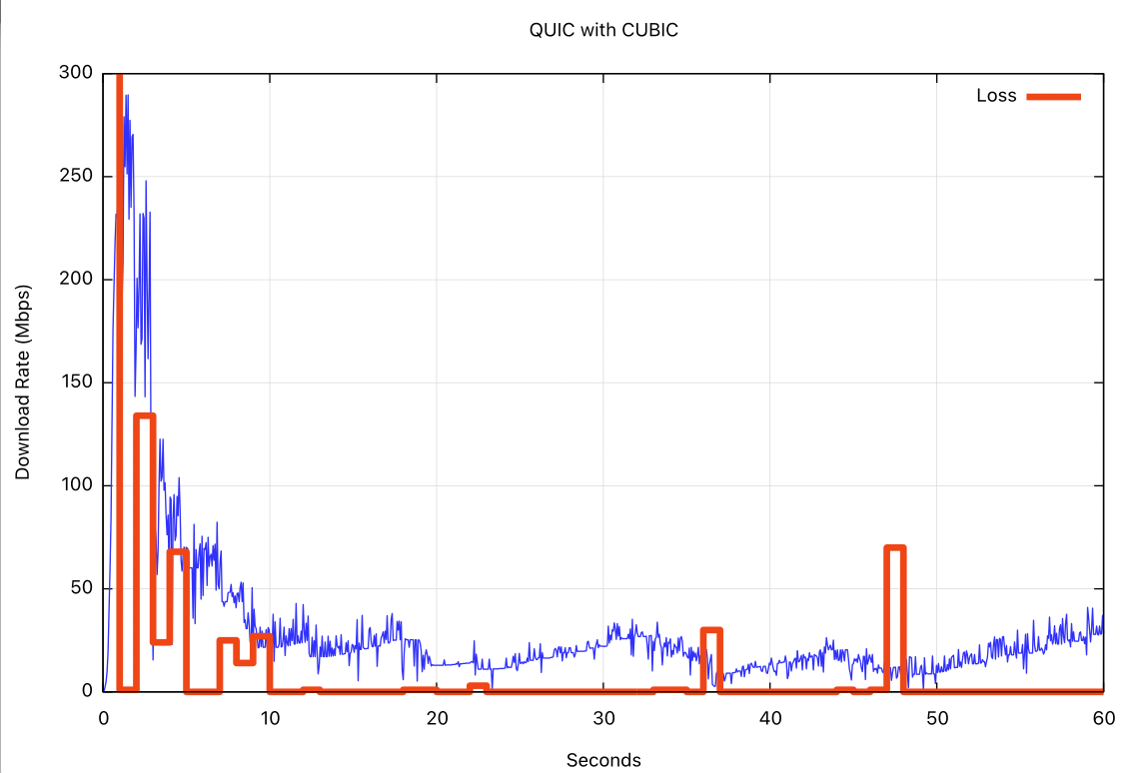
Qperf – quic (with cubic)
QUIC/CUBIC
Loss

Slide 28
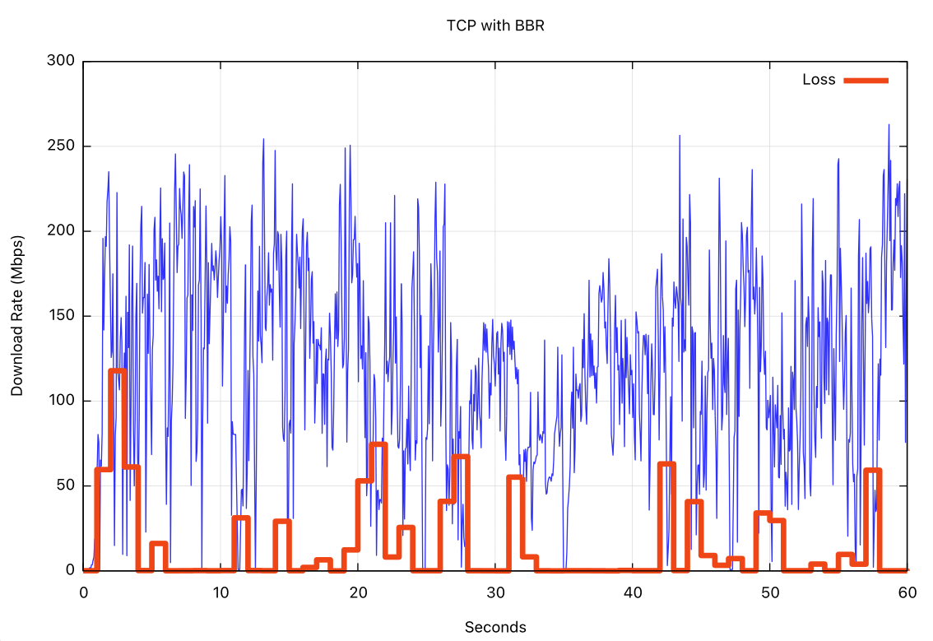
iperf3 - bbr
BBR
Loss

Slide 29
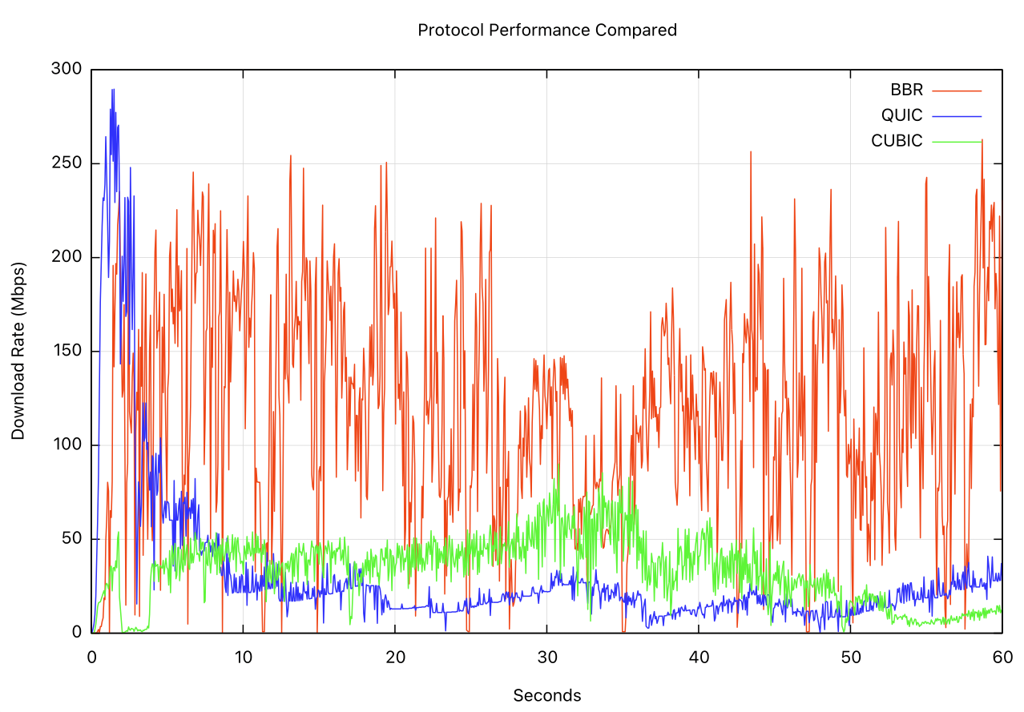
Cubic, Quic/Cubic, BBR

Slide 30
Protocol Considerations
Starlink services have two issues:
  Very high jitter rates
  High levels of micro-loss
Loss-based flow control algorithms will over-react and pull back the sending rate over time
  Short transactions work very well
  Paced connections (voice, zoom, video streaming) tend to work well most of the time
  Bulk data transfer, not so much
You need to move to less loss-sensitive flow control algorithms, such as BBR to get good performance out of these services

Slide 31
I don’t want to leave you with the wrong impression of Starlink
Starlink is perfectly acceptable for:
  short transactions
  video streaming
  conferencing
The service can sustain 10 – 20Mbps delivery for long-held sessions
  The isolated drop events generally do not intrude into the session state
And it can be used in all kinds of places where existing wire and mobile radio systems either under-perform or aren’t there at all!
Its probably not the best trunk infrastructure service medium, but it’s a really good high speed last mile direct retail access service, particularly for remote locations!
Its also very challenging to jam!

Slide 32
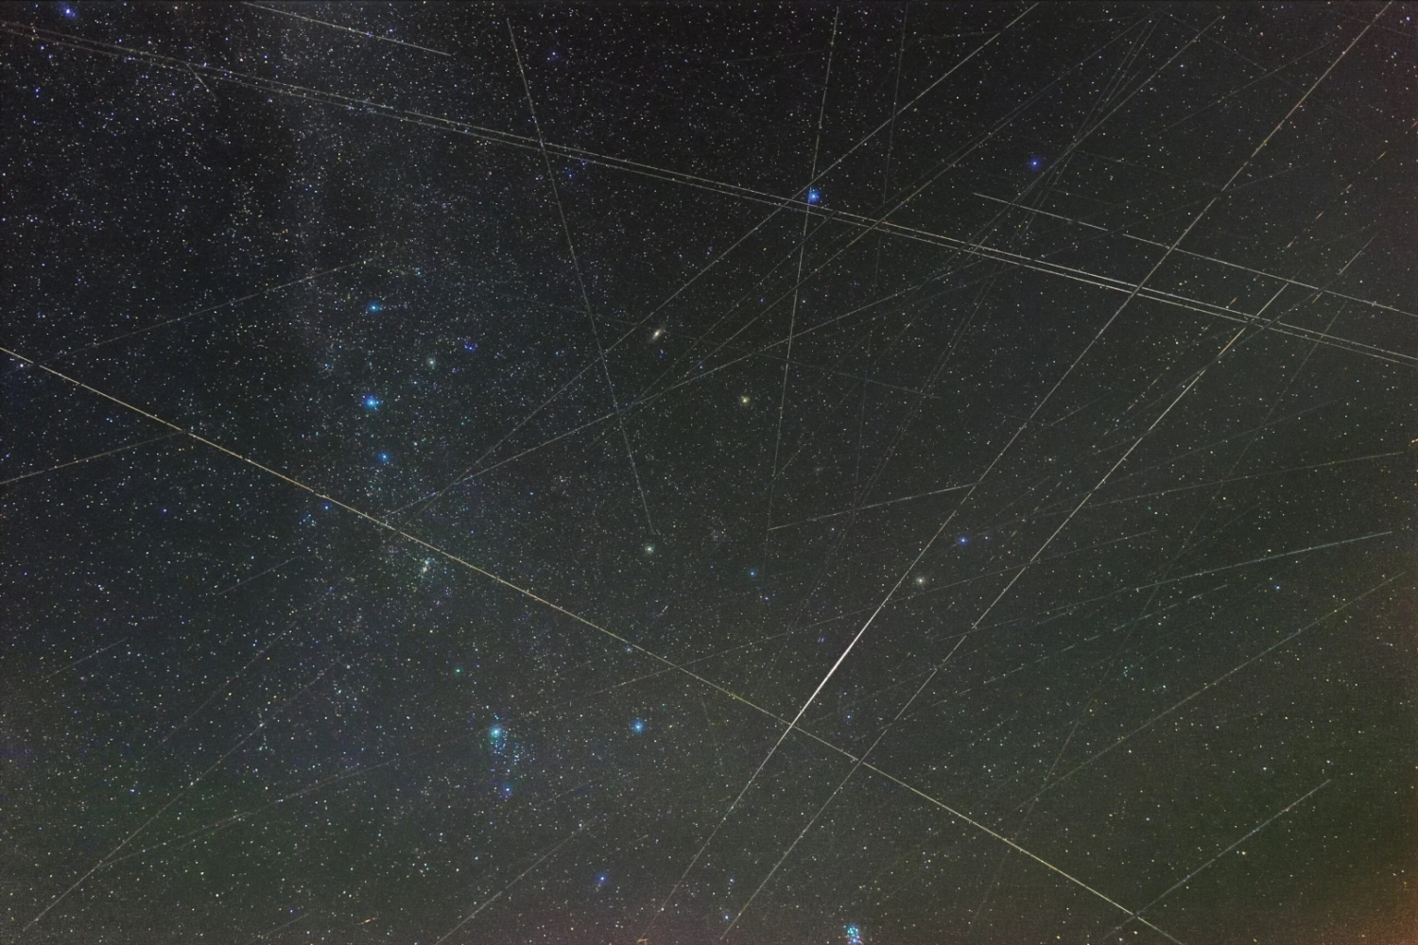
Questions?

