Slide 1

BGP in 2023
Geoff Huston AM
APNIC Labs

Slide 2
The Highlights
IPv4 Summary
IPv6 Summary
FIB Projections
Churn
Conclusions

Slide 3
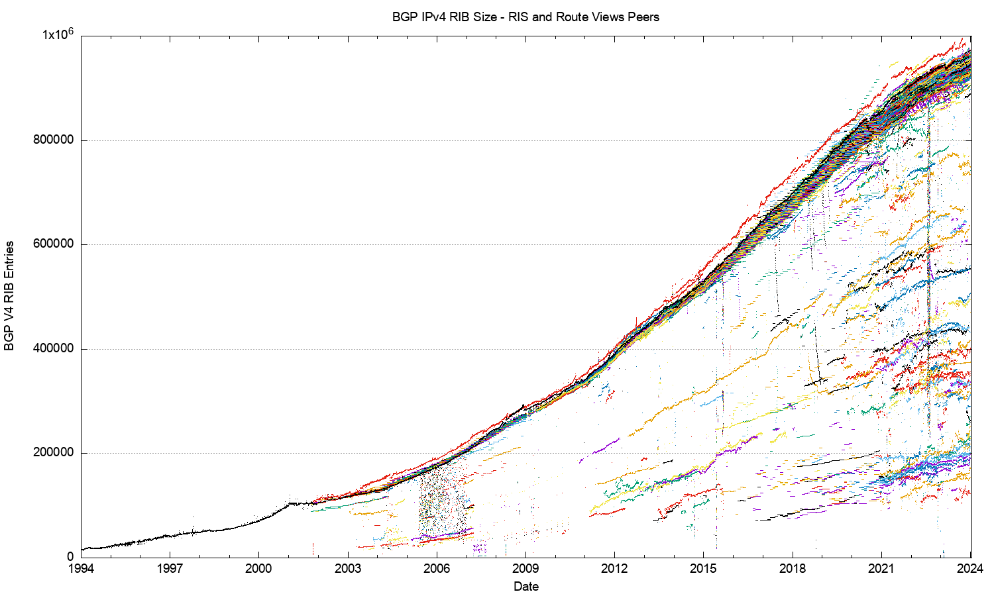
30 Years of Routing the IPv4 Internet
This is a view pulled together from each of the routing peers of Route-Views and RIPE RIS
2011: Onset of Address Exhaustion
2005: Consumer Market
2001: The Great Internet
Boom and Bust
1994: Introduction of CIDR

Slide 4
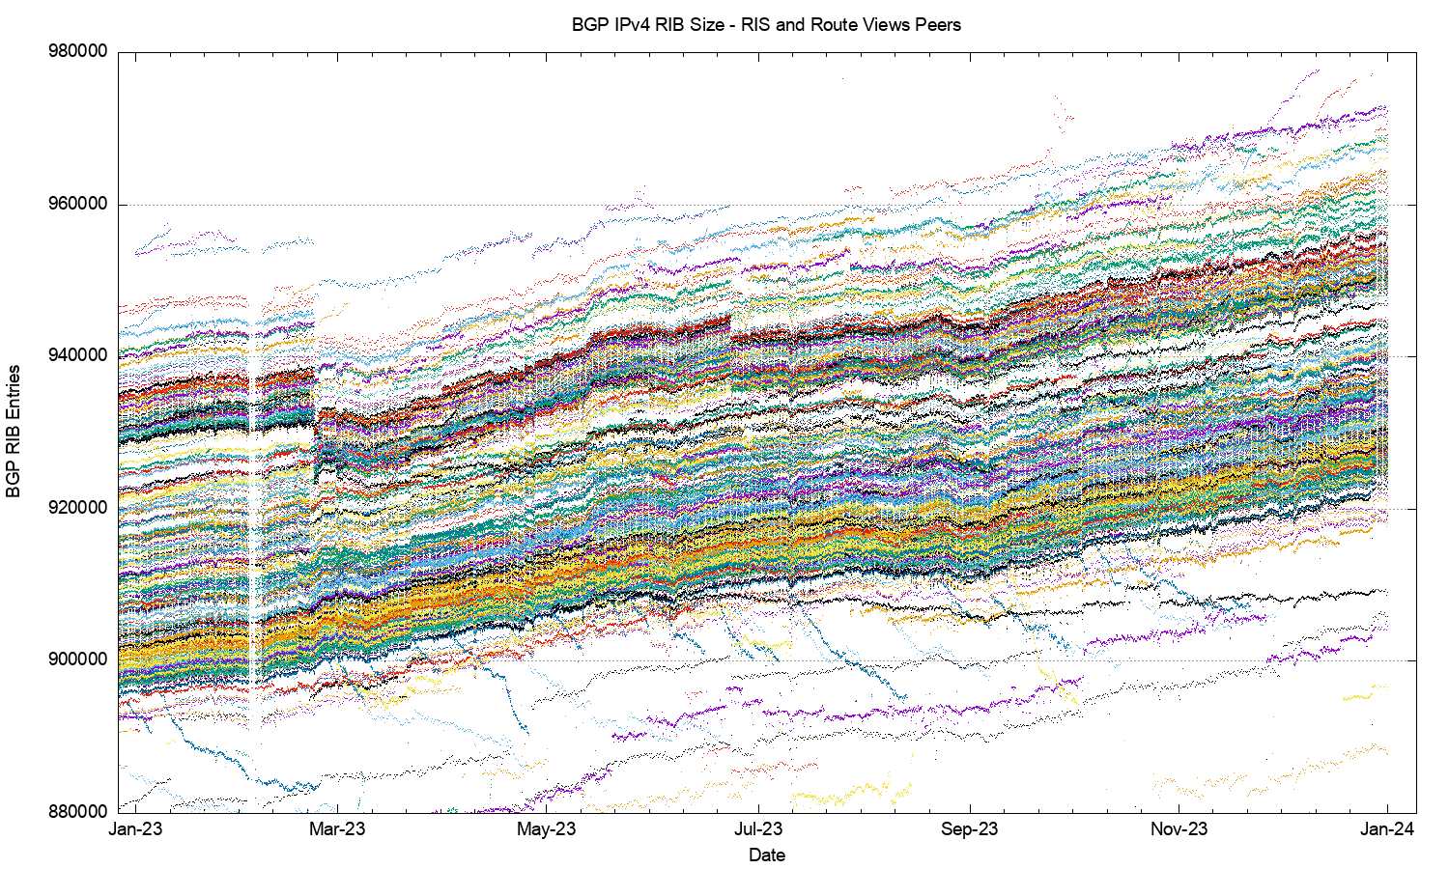
IPv4 in 2023

Slide 5
IPv4 in 2023
Large Withdrawal
60K entry variation
22 Feb
TTNET – Turkey
AS9121 -5,279 prefixes
AS47331 -2,427 prefixes

Slide 6
Aside: What happened to TTNET?
These are all withdrawals of more specific prefixes

Slide 7
AS Prefix Count over 2023
Dropped Prefixes
Added Prefixes

Slide 8
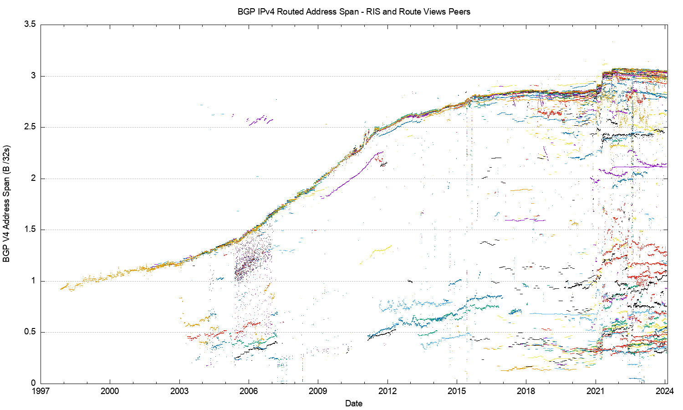
30 Years of IPv4 Advertised Address Span
2021: Advertised DoD blocks
This is a view pulled together from each of the routing peers of Route-Views and RIPE RIS
2011: Onset of Address Exhaustion
2005: Consumer Market
2001: The Great Internet
Boom and Bust

Slide 9
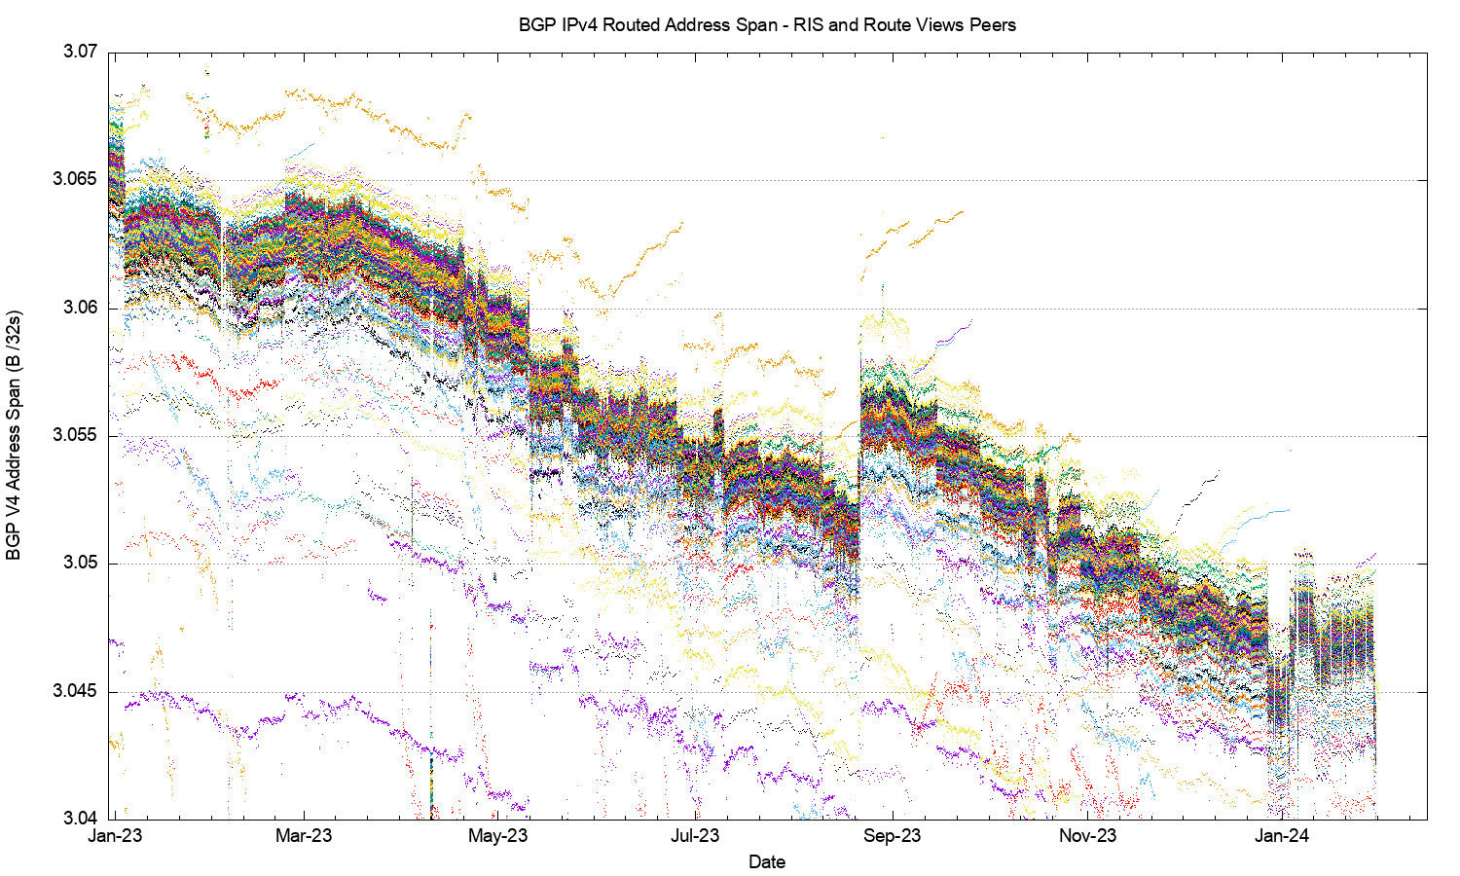
2023 in Detail
Amazon O2 – 22 Aug

Slide 10
2023: Assigned vs Recovered Addresses
Change in UnAdvertised Addresses
640M unadvertised
+18M delta
RIR Allocations
3.6B allocated
-0.02M delta
Change in the Advertised Address Pool
3.0B advertised
-18M delta

Slide 11
2023: Assigned vs Recovered Addresses
Change in UnAdvertised Addresses
No net “address recovery” occurred across 2023 in IPv4
A total of 18M addresses were withdrawn from the advertised network, and shifted to the unadvertised pool
The net change in the unadvertised pool was an increase of 18M addresses
640M unadvertised
+18M delta
RIR Allocations
3.7B allocated
+0,5M delta
Change in the Advertised Address Pool
3.0 advertised
-18M delta

Slide 12
2018-2023: 6 Year Assigned vs Recovered Addresses
DoD block Advertisments
Advertised IPv4 span
starts to decline
Residual RIR Address pools are exhausted

Slide 13
Advertised Span per Origin AS over 2023
Reduced Advertised Address Span
Increased Advertised Address Span

Slide 14
What happened in 2023 in V4?
  From the look of the routing growth plots, the growth of the size of the IPv4 network is slowing down
  The number of entries in the IPv4 default-free zone reached 920K – 960K by the end of 2023
  The pace of growth of the routing table was slightly lower than the rolling 5-year average, with 20,000 new entries in 2023 (was 36,000 in 2022)
  The AS position was slightly lower with 1,100 new AS’s advertised in 2023 (was 1,400 in 2021)
  Transit relationships have not changed materially over 2022 for most networks
  The address range spanned by the advertised route set declined in 2023 by the equivalent of 1 /8
  The overall IPv4 routing growth trends slowed down or even reversed through 2023

Slide 15
What happened in 2023 in V4?
  From the look of the routing growth plots, the growth of the size of the IPv4 network is slowing down
  The number of entries in the IPv4 default-free zone reached 920K – 960K by the end of 2023
  The pace of growth of the routing table was slightly lower than the rolling 5-year average, with 20,000 new entries in 2023 (was 36,000 in 2021)
  The AS position was slightly lower with 1,100 new AS’s advertised in 2023 (was 1,400 in 2021)
  Transit relationships have not changed materially over 2022 for most networks
  The address range spanned by the advertised route set declined in 2023 by the equivalent of 1 /8
  The overall IPv4 routing growth trends slowed down or even reversed through 2023
Have we reached Peak IPv4?

Slide 16
The Highlights
IPv4 Summary
IPv6 Summary
FIB Projections
Churn
Conclusions

Slide 17
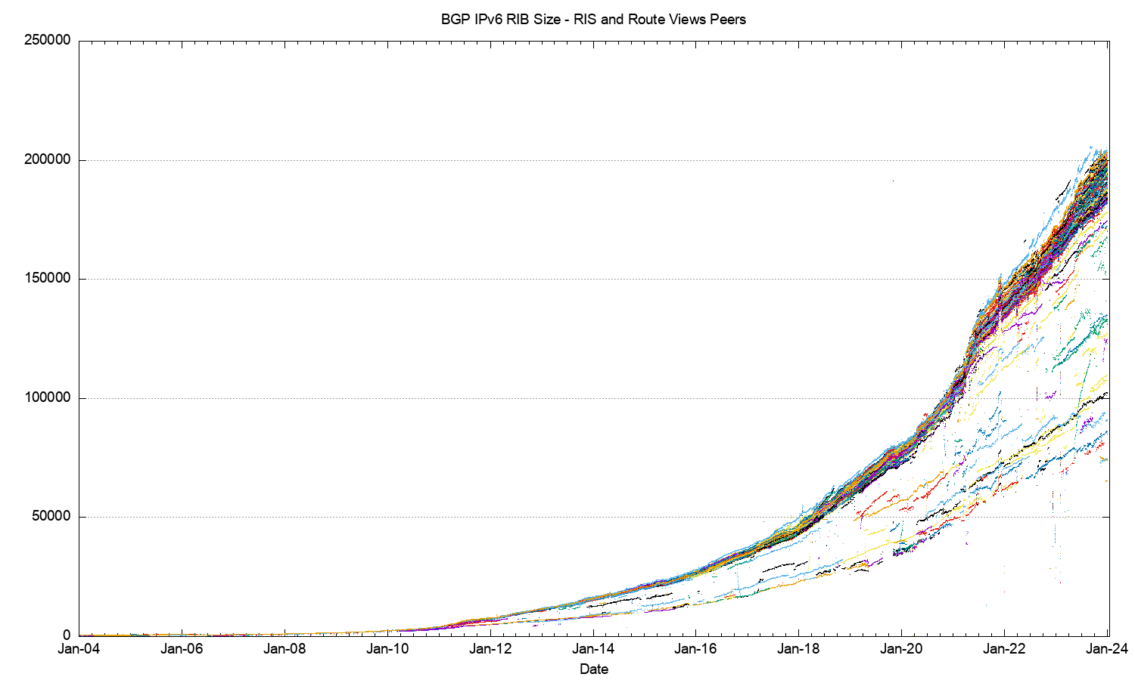
The 20-Year View of IPv6
IANA IPv4 Exhaustion

Slide 18
2023 IPv6 FIB in Detail

Slide 19
2023 IPv6 FIB in Detail
AS60539 + 2,049 prefixes – HUICAST_TELECOM, HK
AS18403 + 3,292 prefixes – FPT, VN

Slide 20
More Specifics in IPv6
IPv6
IPv4
45% of all IPv6 prefixes are /48’s

Slide 21
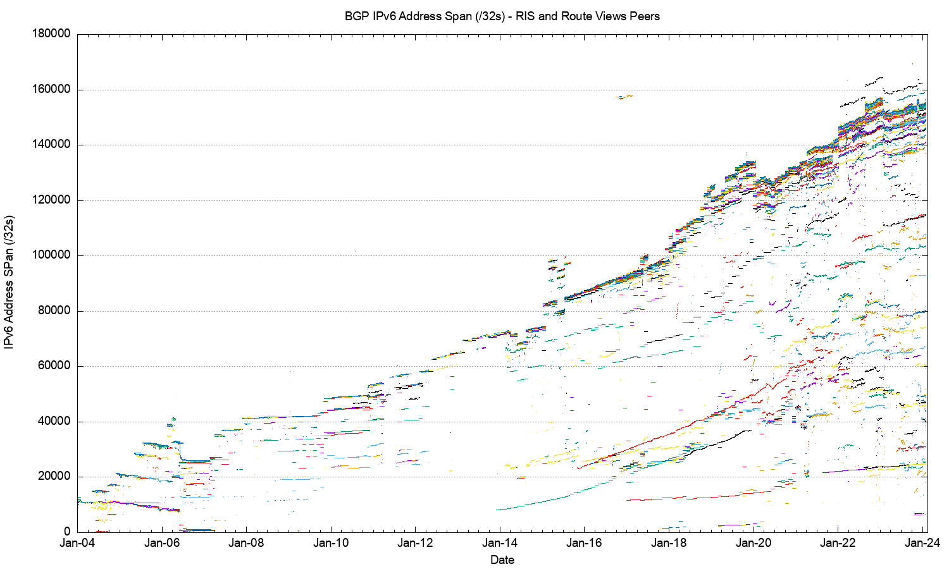
20-Year IPv6 Advertised Address Span

Slide 22
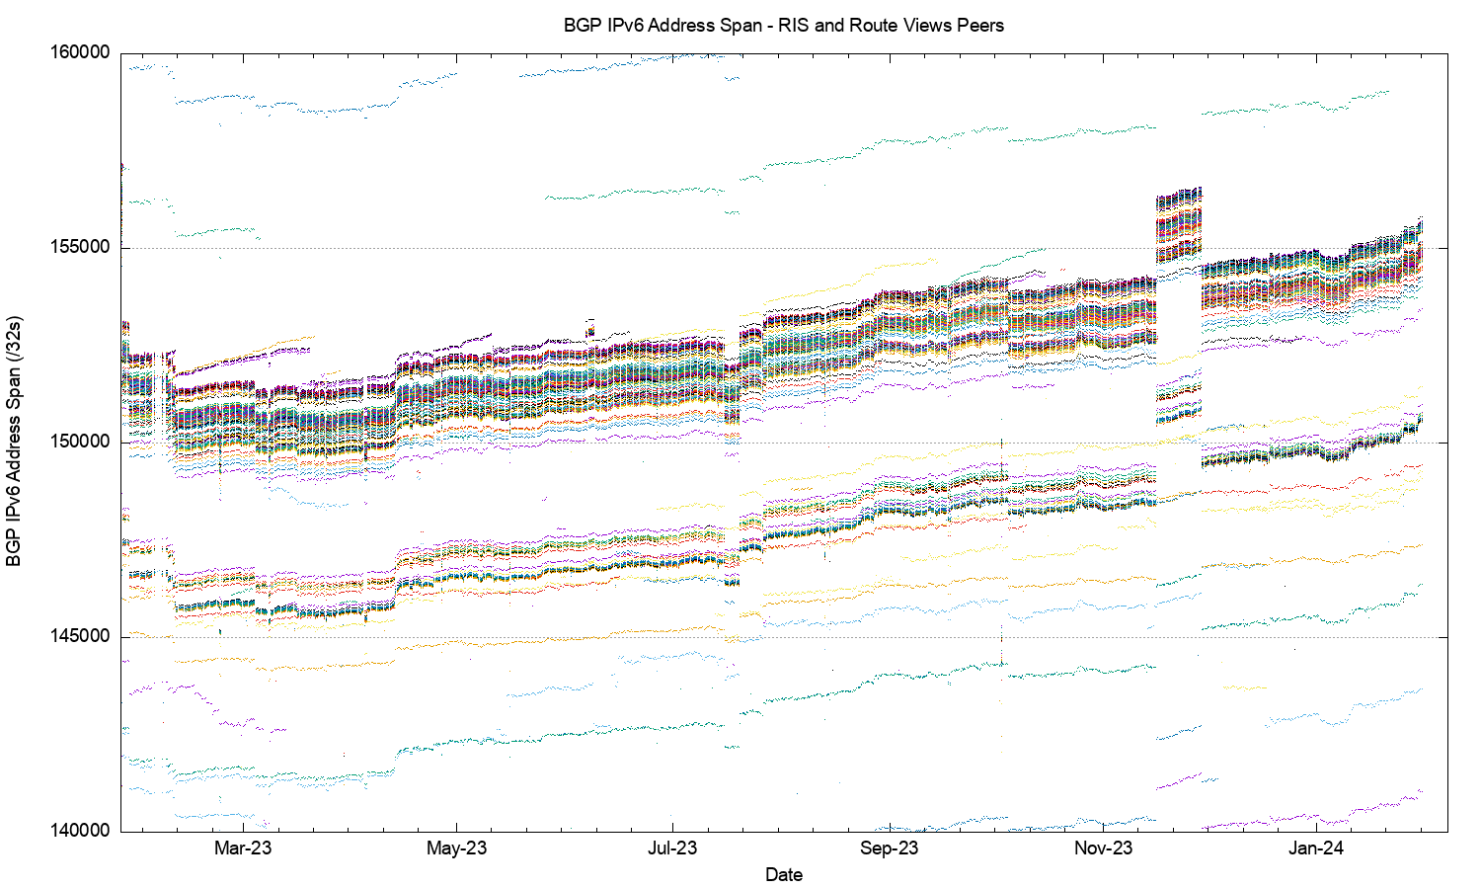
IPv6 Advertised Address Span in 2023

Slide 23
V6 in 2023
Overall IPv6 Internet growth in terms of BGP is still increasing, and is currently at some 30,000 route entries p.a. (17%)
  Predominate use of /48 more specifics
  2,000 more AS’s advertising IPv6 prefixes
  Growth of 2,500 /32 equivalents in the advertised address span ( 1.6%)
  Growth rates across 2023 are lower than 2018 – 2020 annual rates

Slide 24
The Highlights
IPv4 Summary
IPv6 Summary
FIB Projections
Churn
Conclusions

Slide 25
V4 BGP Table Size Predictions
Date RIB Size Prediction
Jan 2019 760,000
2020 814,000
2021 856,000
2022 906,000
2023 942,000
2024 944,0000 949,000
2025 958,000
2026 958,000
2027 947,000
2028 928,000
2029 898,000

Slide 26
V4 BGP Table Size Predictions
Date RIB Size Prediction
Jan 2019 760,000
2020 814,000
2021 856,000
2022 906,000
2023 942,000
2024 944,0000 949,000
2025 958,000
2026 958,000
2027 947,000
2028 928,000
2029 898,000
The best fit projection model to the past 4 years of FIB data is a polynomial function that peaks in 2024 at just under 1M entries

Slide 27
V6 BGP Table Size Predictions
Linear Exponential
Jan 2019 62,000
2020 79,000
2021 106,000
2022 147,000
2023 172,000
2024 201,000 198,000 227,000
2025 226,000 293,000
2026 254,000 380,000
2027 282,000 491,000
2028 310,000 635,000
2029 337,000 822,000
Note that the IPv6 tables are 128bits wide – i.e. 4x the size of the IPv4 tables!

Slide 28
V6 BGP Table Size Predictions
Linear Exponential
Jan 2019 62,000
2020 79,000
2021 106,000
2022 147,000
2023 172,000
2024 201,000 198,000 227,000
2025 226,000 293,000
2026 254,000 380,000
2027 282,000 491,000
2028 310,000 635,000
2029 337,000 822,000
The growth model for IPv6 is highly uncertain today – It looks like a linear growth model matches the most recent 24 months of data
The underlying network growth is lower, and over half of the growth in this model is due to the continued intensive use of /48 more specifics
Note that the IPv6 tables are 128bits wide – i.e. 4x the size of the IPv4 tables!

Slide 29
BGP Table Growth
The absolute size of the IPv6 routing table is growing much faster than the IPv4 table
  These two tables will require the same storage/lookup size in around 1 year from now, given that each IPv6 entry is 4 times the bit size of an IPv4 entry
The good news …
  As long as we are prepared to live within the technical constraints of the current routing paradigm, the Internet’s use of BGP will continue to be viable for some time yet

Slide 30
The Highlights
IPv4 FIB Summary
IPv6 FIB Summary
FIB Projections
Churn
Conclusions

Slide 31
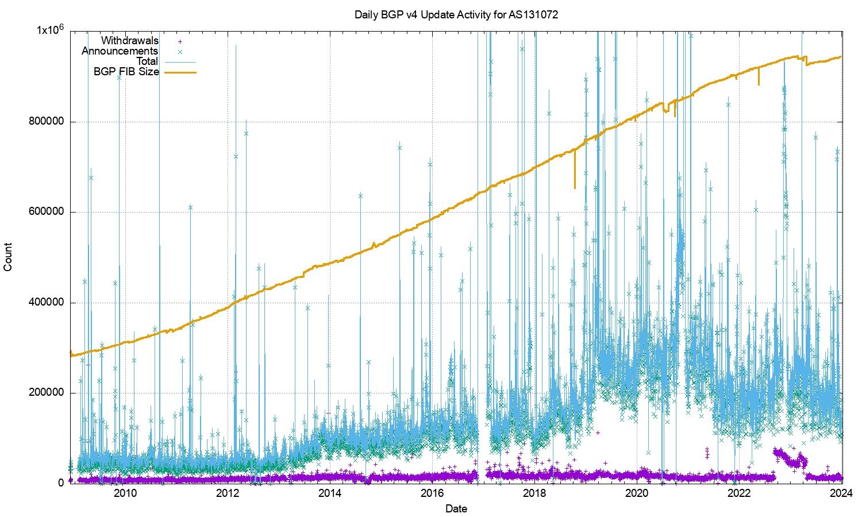
IPv4 BGP Updates – Daily Updates

Slide 32
IPv4 BGP Updates – Daily Updates
The IPv4 network is surprisingly stable
The number of withdrawals per day has been relatively steady for some 15 years (aside from some increases in 2022/3)
The number of updates per day has been declining through 2023

Slide 33
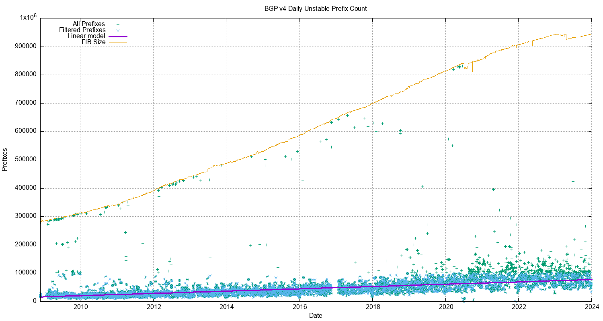
IPv4 Unstable Prefixes per Day

Slide 34
IPv4 Unstable Prefixes per Day
The number of prefixes that are the subject of updates has been slowly increasing over this 15-year period
The rate of increase of unstable prefixes is far lower than the number of advertised prefixes

Slide 35
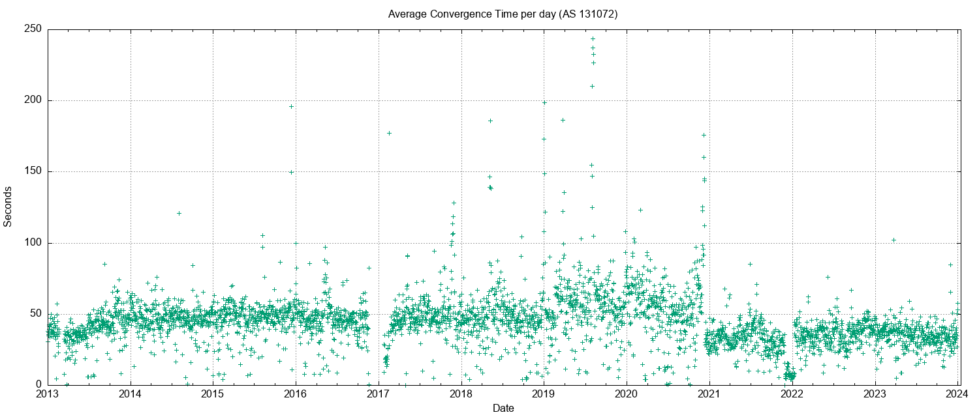
IPv4 BGP Convergence Performance

Slide 36
IPv4 BGP Convergence Performance
Convergence performance has been steady for 15 years, despite the massive growth in the network
The network topology continues to increase in density, keeping critical AS Paths short as the network itself increases in size

Slide 37
Updates in IPv4 BGP
The IPv4 inter-domain routing system is still highly stable …
The number of updates per instability event and the time to converge to a stable forwarding state has been relatively constant for many years - it rose in 2019 - 2020 and has declined again in 2021, and stabilized in 2022
20% of prefixes generate 80% of all updates. Less than 5% of all origin networks are linked to 80% of all updates. Routing instability is concentrated in a small number of highly unstable cases.

Slide 38
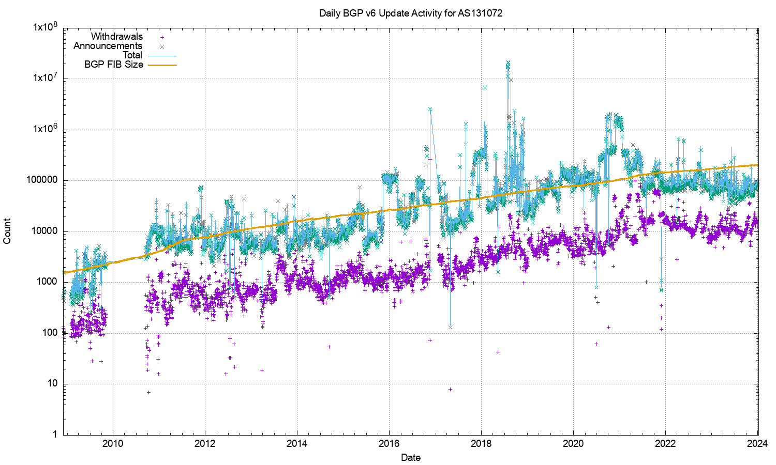
V6 BGP Updates
LOG Scale!

Slide 39
V6 BGP Updates
LOG Scale!
The growth trajectory of IPv6 has slackened off, and the daily total of updates and withdrawals has been steady across 2023

Slide 40
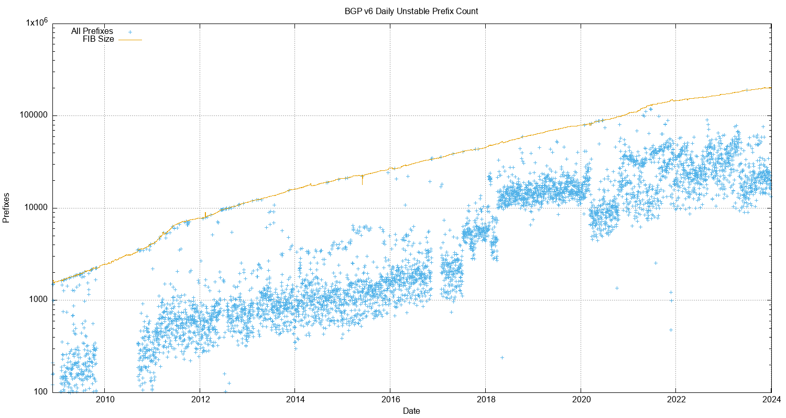
V6 Unstable Prefixes
LOG Scale!

Slide 41
V6 Unstable Prefixes
The number of unstable address prefixes stabilised across 2023
Proportionally, IPv6 prefixes are ~2x more likely to be updated as compared to the IPv4 BGP network
LOG Scale!

Slide 42
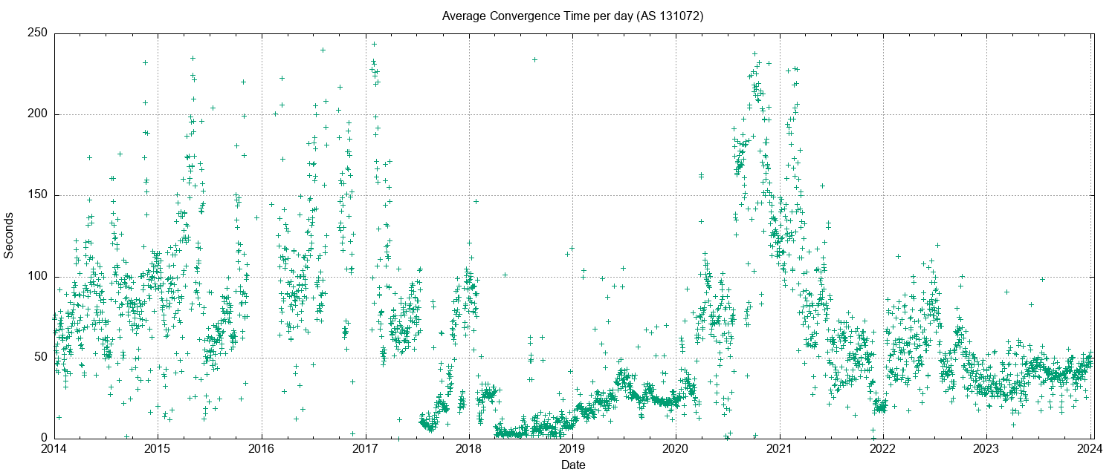
V6 Convergence Performance

Slide 43
V6 Convergence Performance
Time to converge has been very unstable for years in IPv6
This is now stabilising to a level that is on a par with the IPv4 network

Slide 44
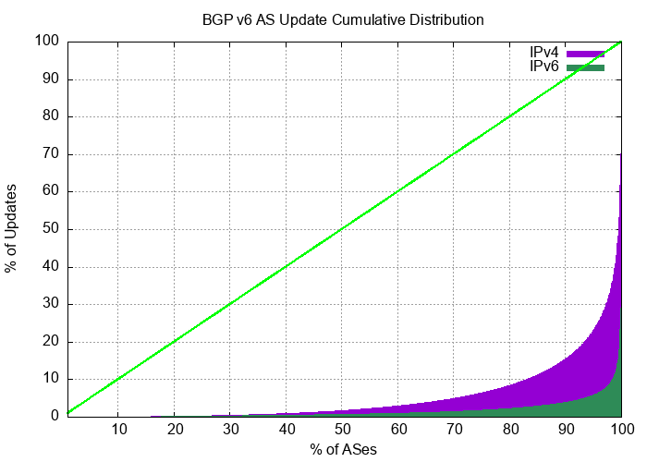
Updates in IPv6 BGP
It’s improving …
Compared to IPv4, the IPv6 network has exhibited a high level of skew of routing instability, where a small number of networks contribute disproportionately to the overall level of BGP updates in IPv6.
Just 2 AS’s generated 50% of the BGP IPv6 update load in the last 2 weeks of 2023. IPv6 routing instability is still concentrated in a small number of pathologically unstable cases.

Slide 45
The Highlights
IPv4 FIB Summary
IPv6 FIB Summary
FIB Projections
Churn
Conclusions

Slide 46
Routing Futures
There is still little in the way of scaling pressure from BGP as a routing protocol – the relatively compressed inter-AS topology and stability of the infrastructure links tend to ensure that BGP remains effective in routing the internet.
Instability levels are rising, generally driven by a small set of highly unstable “super generators”

Slide 47
Routing Futures
The frenetic pace of expansion in the routing infrastructure of the Internet has slowed down across 2023. The IPv4 BGP network shrank slightly in 2023, and the pace of growth the IPv6 network also slackened off across the year.
The drivers for growth were the product of the population of networks with discrete routing policies and the need to balance incoming traffic across multiple paths (traffic engineering) – the rapid increase in the use of CDN platforms has reduced the dependence on transit routes to provide content and services to end users.
Much of the overall volume of content traffic has shifted across into privately operated platforms, and the demands on the public routed common infrastructure have started to decline

Slide 48
Some Practical Suggestions
For those network operators whose service needs are dependent on the BGP network to some extent (which is mostly everyone)
Know your network’s limits:
Understand your routing FIB capacity in the default-free parts of your network
There may be some default max prefix setting of ~1M FIB entries which will cause a BGP session shutdown when tripped
  AS 4804 (Optus) in Australia appeared to encounter this situation in October 2023
Use a max prefix exceeded switch which avoids sessions shutdown where possible

Slide 49
Some Practical Suggestions
Know your network’s limits
Review your routers’ settings
Review your IPv4 / IPv6 portioning in the FIB tables - a dual-stack eBGP router will conservatively need a 1.2 M 32-bit IPv4 slots and 320K 128-bit IPv6 slots for a full eBGP routing table in line cards by 2026 if they are using a full eBGP FIB load (plus internal routes of course). That’s roughly the same memory footprint for IPv4 and IPv6!

Slide 50
Some Practical Suggestions
Know your network’s limits
Review your routers’ settings
Default routes can be helpful
Judicious use of default routes in your internal network may allow you drop this high speed line card memory requirement significantly

Slide 51
Some Practical Suggestions
Know your network’s limits
Review your routers’ settings
Default routes can be helpful
Time for hot caching in line card FIBs?
Using a hot cache for line card FIB cache would reduce the high-speed TCAM memory requirement significantly without visible performance cost

Slide 52
Some Practical Suggestions
Know your network’s limits
Review your routers’ settings
Default routes can be helpful
Time for hot caching in line card FIBs?

Slide 53
That’s it!
Questions?

