Slide 1
Operating the Internet’s Largest Measurement System
Geoff Huston AM
APNIC Labs

Slide 2
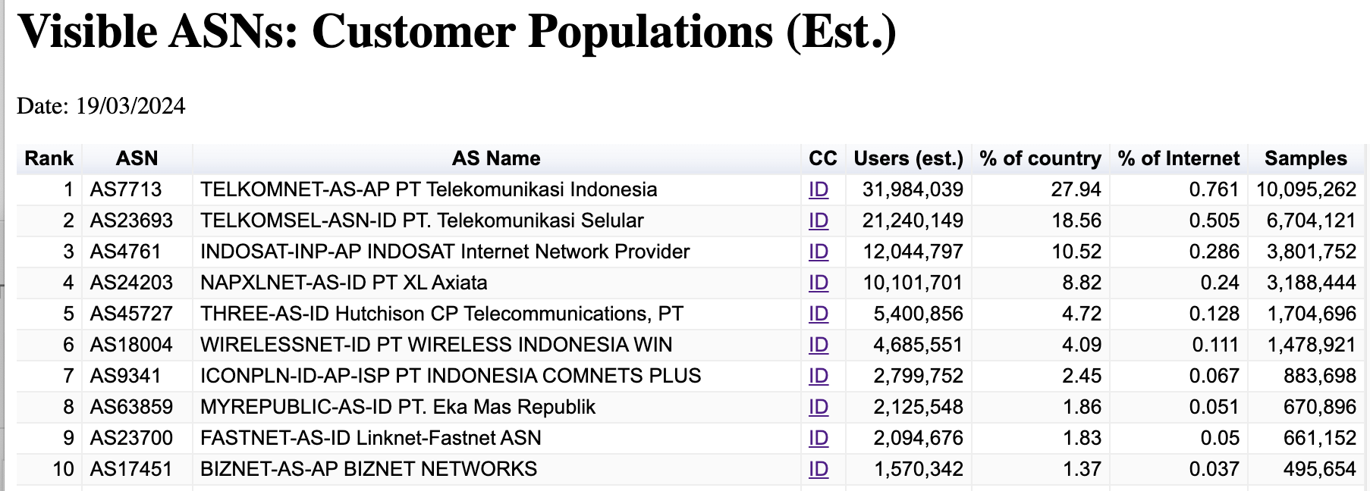
Indonesian ISPs

Slide 3
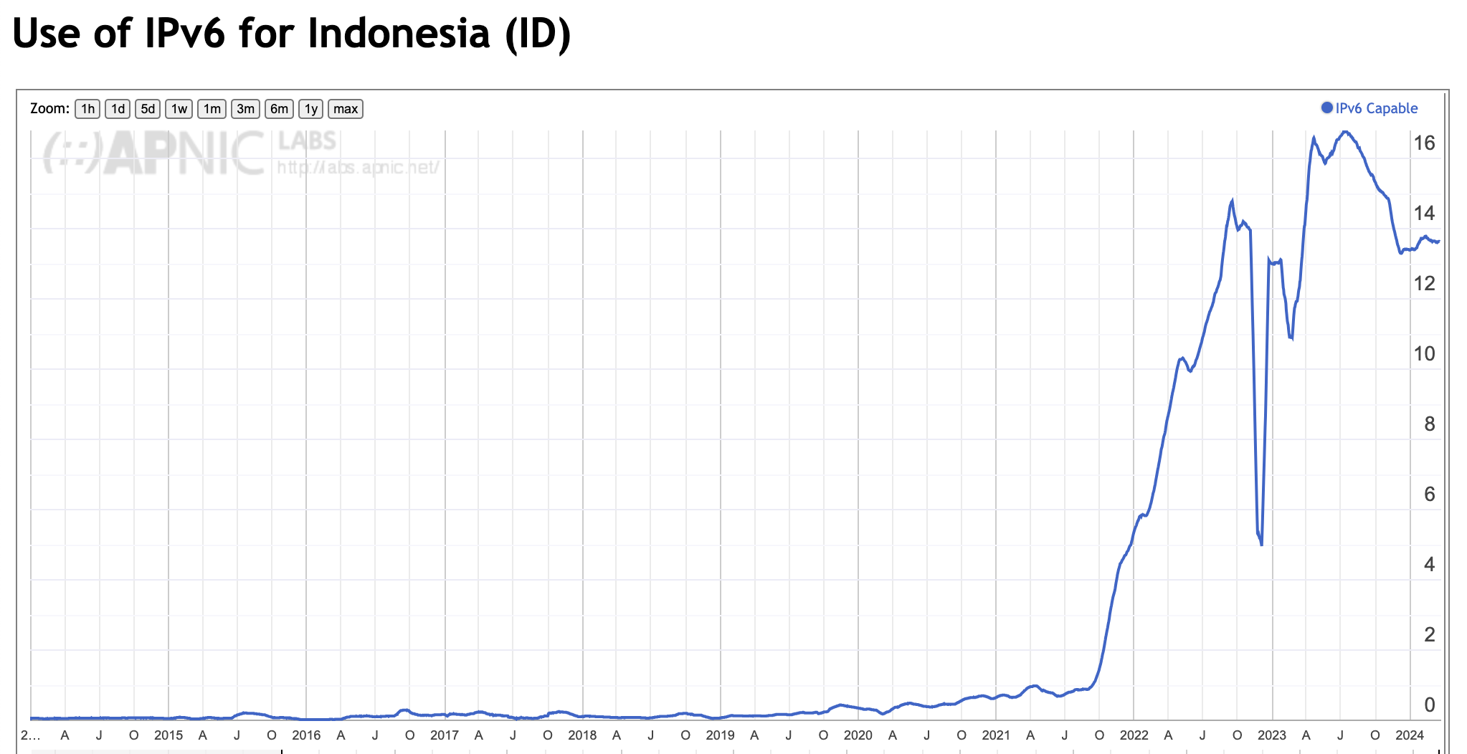
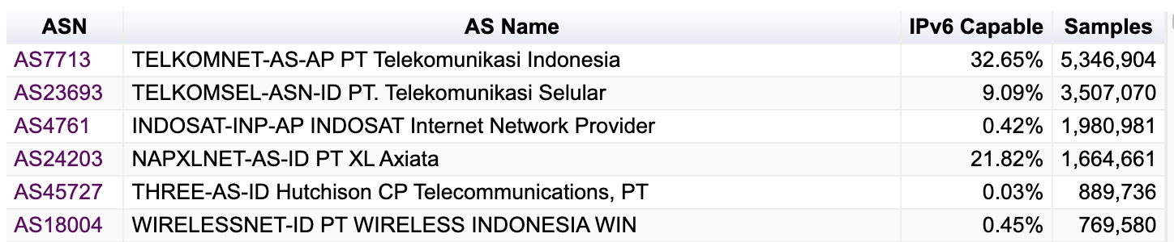
Use of IPv6 in Indonesia

Slide 4
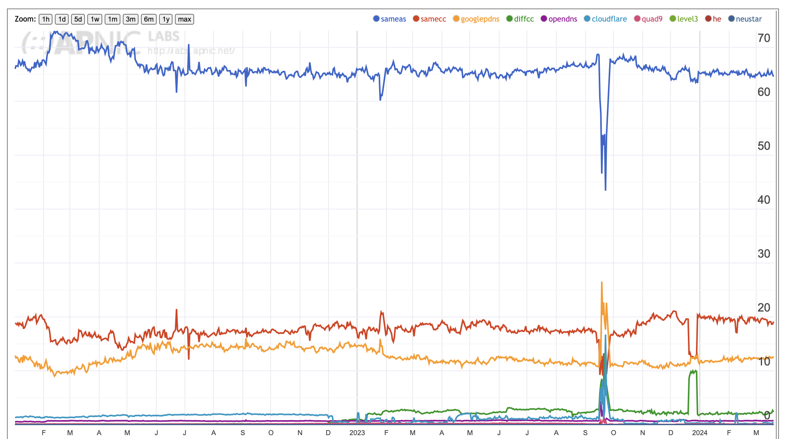
DNS Resolver use in Indonesia
ISP resolver – 60%
Google’s resolver – 10%

Slide 5
So much to measure…
so little time!

Slide 6
Measurement at Scale
We could measure the network using embedded measurement scripts in a web site – but we would really need to use a massively popular web service to conduct this experiment
But “massively popular web services” worry constantly about service resiliency and privacy of their data regarding users
They tend to be extremely suspicious of adding script elements to their service that performs third party dual stack tests with their clients (and I can’t blame them!)
So, we need to rethink this approach…

Slide 7

How to conduct measurements at scale
Use Google!

Slide 8
How to conduct measurements at scale
How?

Slide 9

Online Ads

Slide 10
Ads use scripts
Each time an ad is loaded the ad server loads creative content and scripts on to the client’s browser
The script can include action items to fetch ‘network assets’
Typically used to load alternate images, sequences
Its not a generalized network stack, subject to constraints such as limited to certain object loads, reduced run-time library
There are on-Load, on-Hover and on-Click actions
We want to minimise interactions, so we use on-Load scripting

Slide 11

Our Ad
Thank you for helping us measure the Internet

Slide 12
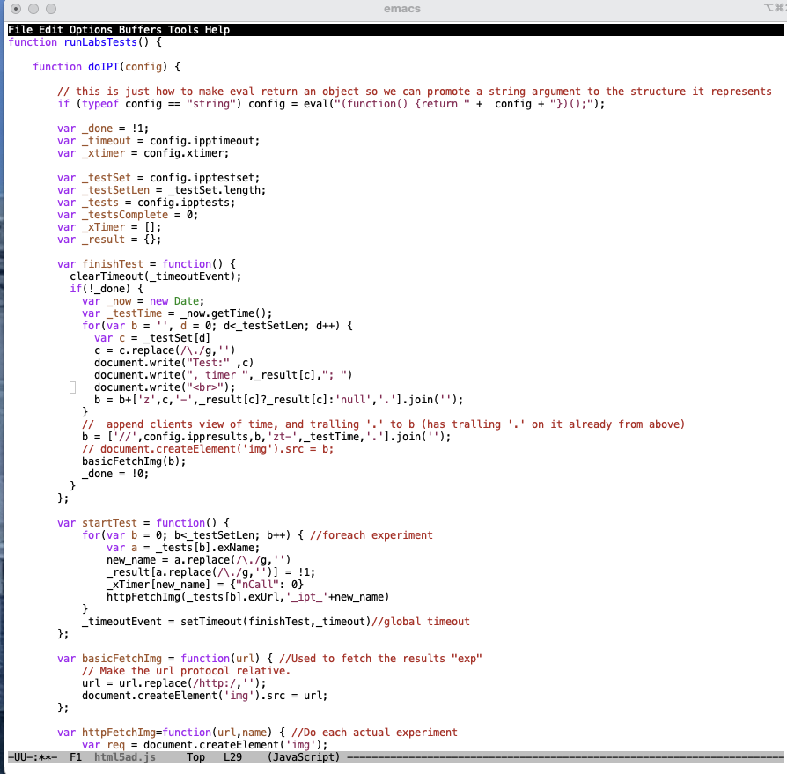
Our Ad Script
Thank you for helping us measure the Internet

Slide 13
This can work
We can instrument the target host via an ad script
we can constrain the ad script to talk only to our server(s)
And if we instrument these servers, then we can infer the host’s properties
Ads try to deliver to new users all of the time
We want to measure new sample points all of the time to avoid implicit repeat bias in the measurement set
Ads are biased towards ‘clicks’
We are not interested in clicks
We just want impressions
Impressions are far cheaper than clicks!

Slide 14
Advertising placement logic
Fresh Eyeballs == Unique endpoints
We have good evidence the advertising channel is able to sustain a constant supply of unique endpoints
Pay by click, or pay by impression
If you select a preference for impressions, then the channel tries hard to present your ad to as many unique endpoints as possible
Time/Location/Context tuned
Can select for time of day, physical location or keyword contexts (for search-related ads)
But if you don’t select, then placement is generalized
Aim to fill budget
If you request $100 of ad placements per day, then inside 24h the algorithm tries hard to even placement but in the end the ad placement algorithm will ramp up your ad to achieve enough views, to bill you $100

Slide 15
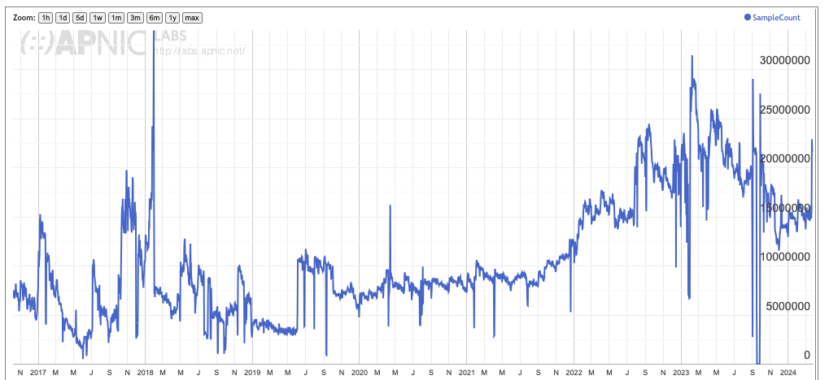
Daily Ad Impression Count

Slide 16
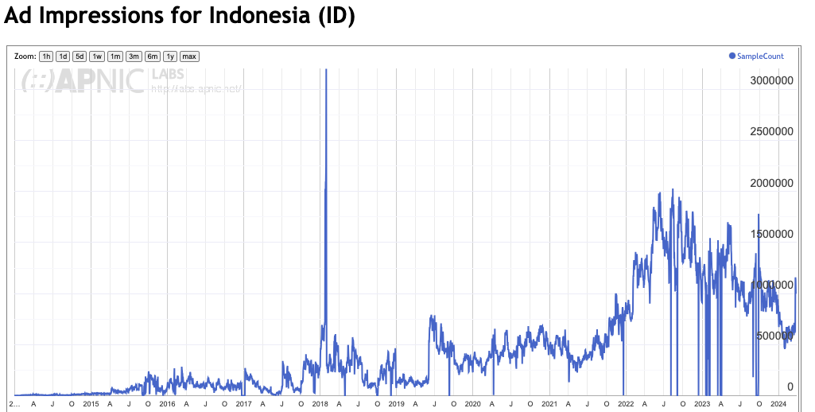
Daily Ad Impression Count for Indonesia

Slide 17
Measuring IPv6 via Ads
Use HTML5 code that is executed on ad impression
Client retrieves set of “tests” from an ad-controller
Client is given 10 URLs to load, including:
Dual Stack object
V4-only object
V6-only object
Result reporting URL (10 second timer)
All DNS is dual stack
All URLs use a unique DNS label

Slide 18
Experiment Server config
There are five server sets, identically configured in VMs in DCs (Frankfurt, Singapore, Dallas, Sao Paulo, Mumbai)
The experiment script directs the client to the “closest” server set (based on geolocation of the client IP address)
Server set has dedicated DNS and web content server VMs

Slide 19
Collected Data
Per Server, Per Day:
HTTP access log
(successfully completed fetches)
DNS query log
(incoming DNS queries)
Packet capture
All packets!

Slide 20
Data Analysis
For example – IPv6 measurement
IPv6 “capable” means that the client successfully fetched the URL target that is only accessible using IPv6
IPv6 “preferred” means that the client used IPv6 to fetch the dual stack URL target
Aggregate data by origin AS and by geolocation CC
“Normalise” the country data against estimates of national user populations (to compensate for aD placement bias at a national level)
Generate IPv6 daily report and data to data set

Slide 21
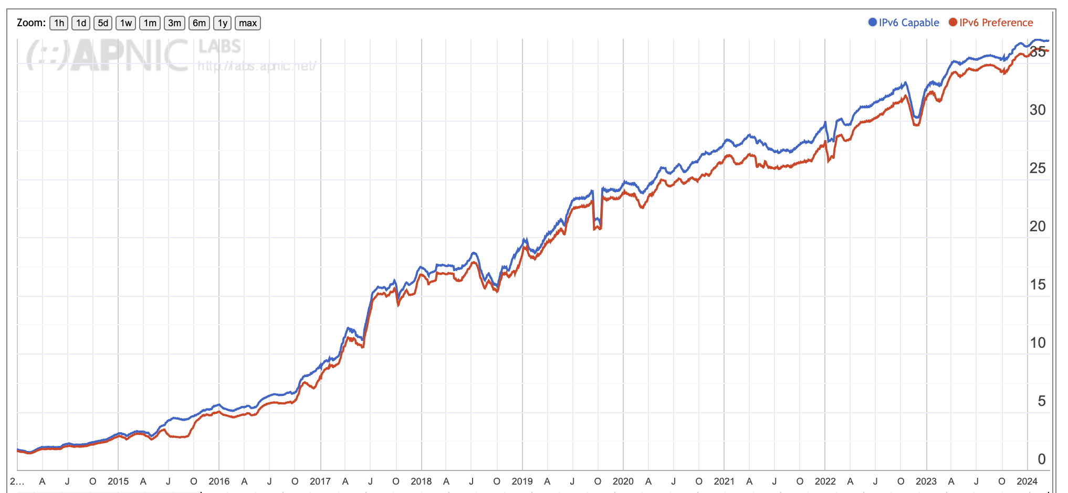
V6 Time Series for the entire Internet

Slide 22
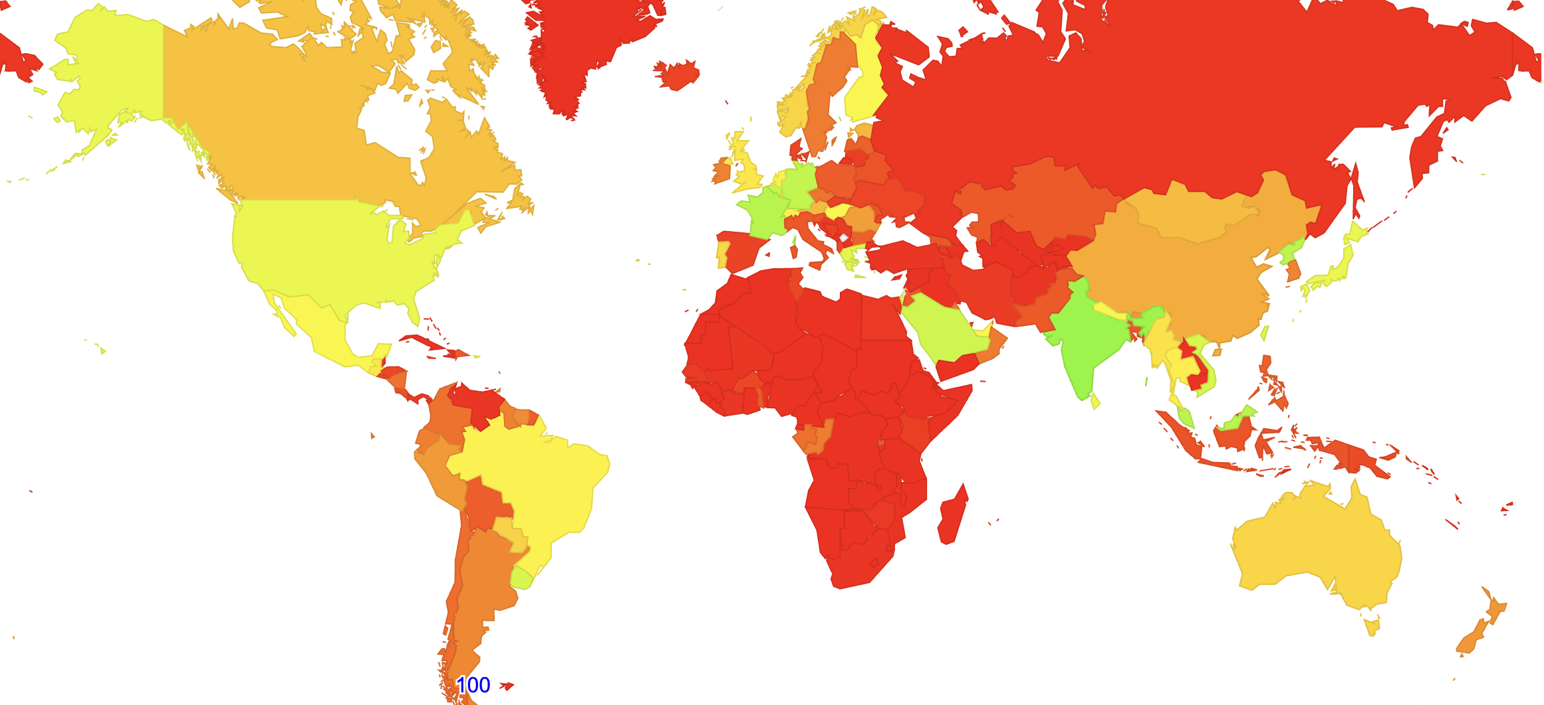
IPv6 Report
https://stats.labs.apnic.net/ipv6

Slide 23
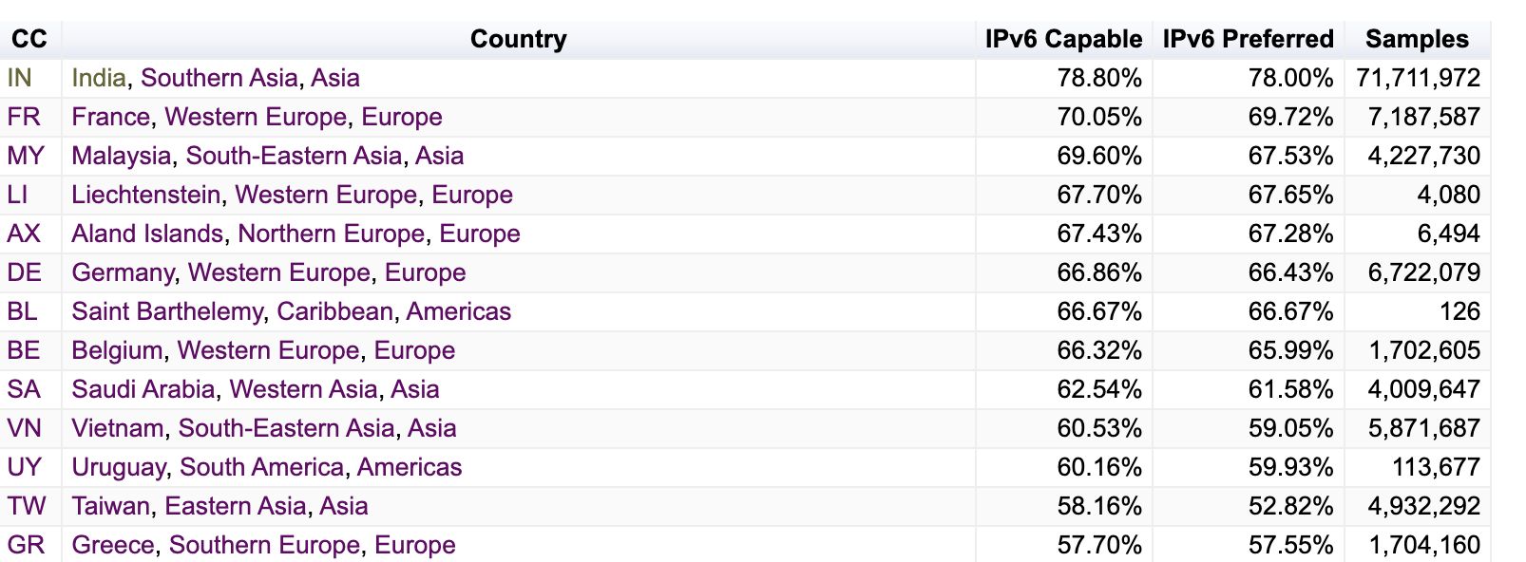
IPv6 Report
https://stats.labs.apnic.net/ipv6

Slide 24
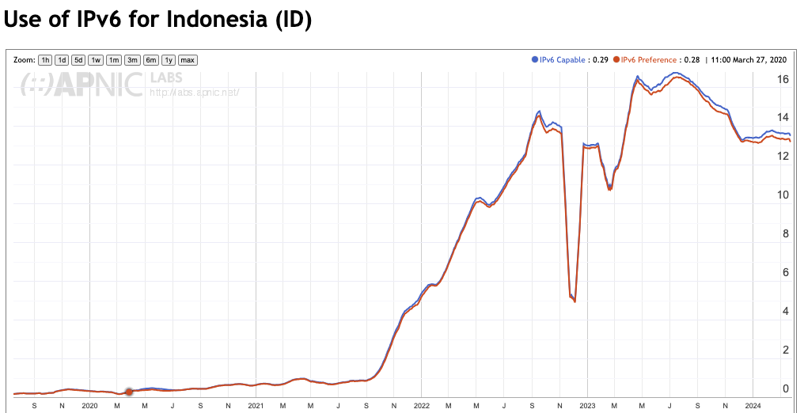
IPv6 - Indonesia

Slide 25
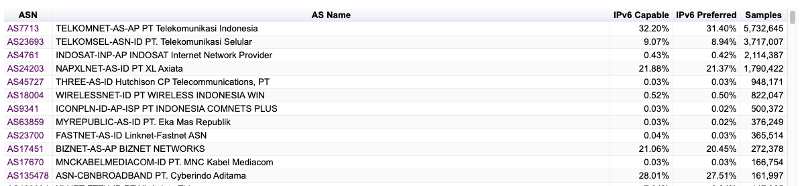
IPv6 - Indonesia

Slide 26
What about DNSSEC Use?
Can we use the same platform to measure the proportion of users who sit behind DNS resolvers that perform DNSSEC validation?

Slide 27
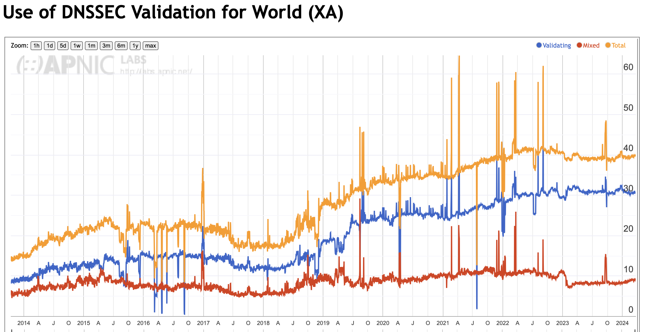
DNSSEC Results
https://stats.labs.apnic.net/dnssec/XA

Slide 28
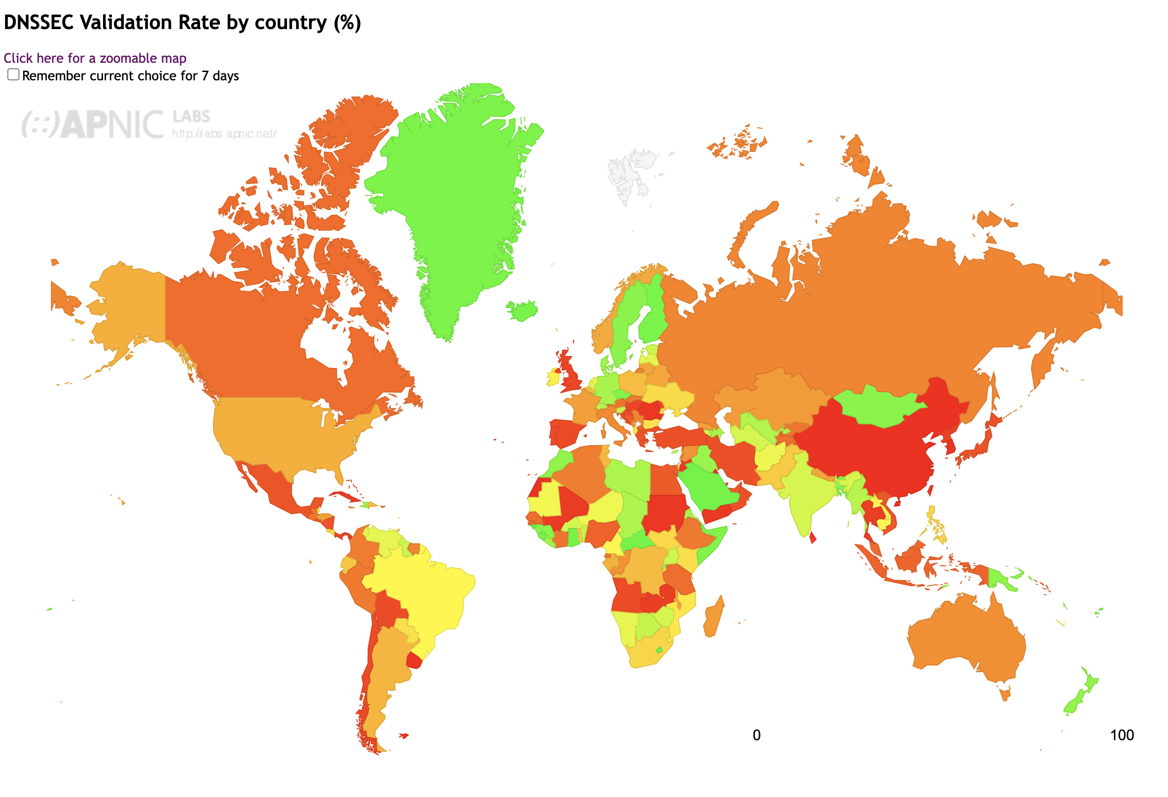
DNSSEC Results
https://stats.labs.apnic.net/dnssec

Slide 29
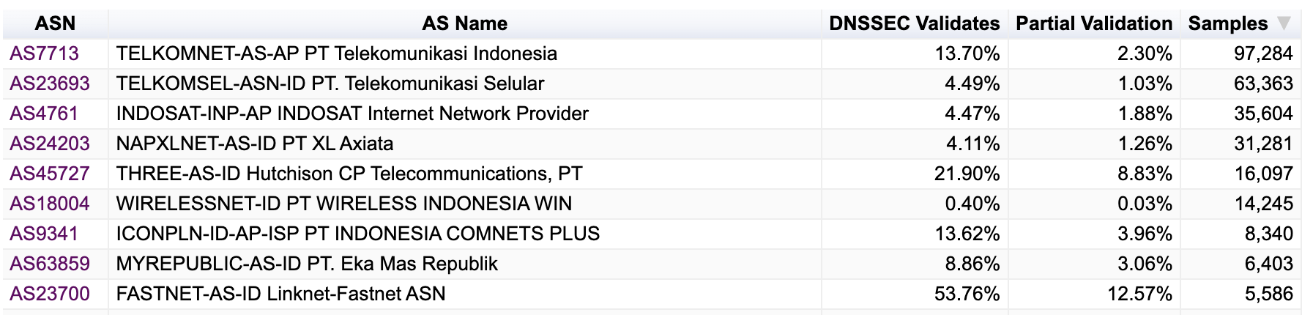
DNSSEC Validation in Indonesia
https://stats.labs.apnic.net/dnssec/ID

Slide 30
Measurement Projects
IPv6 Performance (connection reliability and relative speed)
IPv6 Fragmentation
IPv6 Extension Header loss Rates (HBH and DST)
DNS: Use of ECDSA and EDDI DNSSEC signing algorithms
DNS: Fragmentation Drop (and TCP support)
DNS resolver use profile (use of open DNS resolvers)
DNS KSK roll probes (RFC8509)
Support for QUIC use (HTTP/3)
Support for Route Origination Validation
Zombies and tracking
https://stats.labs.apnic.net

Slide 31
Server Side Measurement
This approach complements client side measurements (CAIDA’s ARK, RIPE NCC’s Atlas) and network-level internal measurements by using a large scale server side measurement platform
In this form of server-side measurement the client does what clients always do - fetch URLs
We can test particular client behaviours and network behaviours by deliberately altering the server-side behaviour and triggering the behaviour in a measured behaviour
The benefit of this approach is that rather than measuring the effect and inferring the cause, in this approach we trigger a cause and then correlate the observed outcomes against the known cause.

Slide 32
Thanks!
Measurement Reports at APNIC Labs:
https://stats.labs.apnic.net

