Slide 1
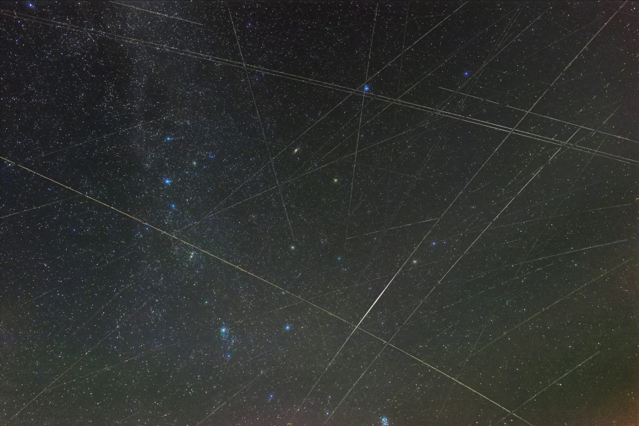
Measuring Starlink
Geoff Huston AM
APNIC
AUSNOG 2024

Slide 2
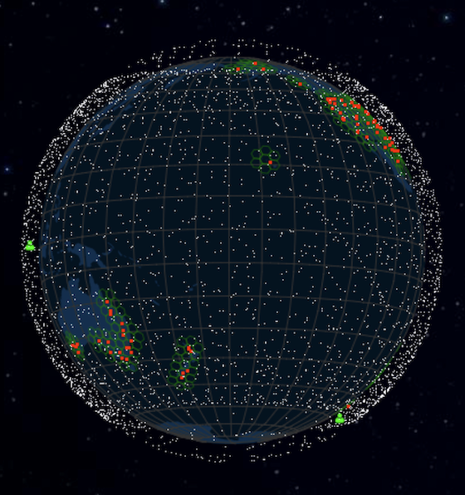
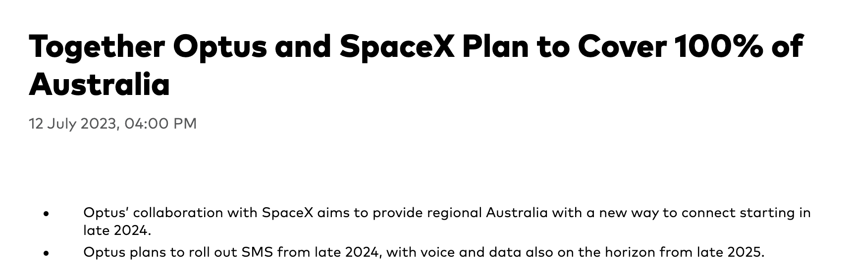
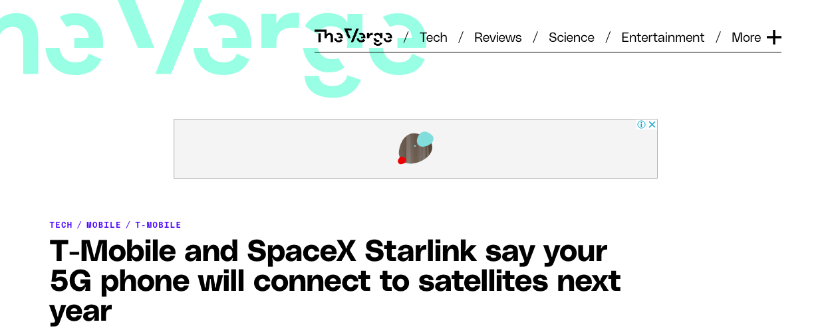
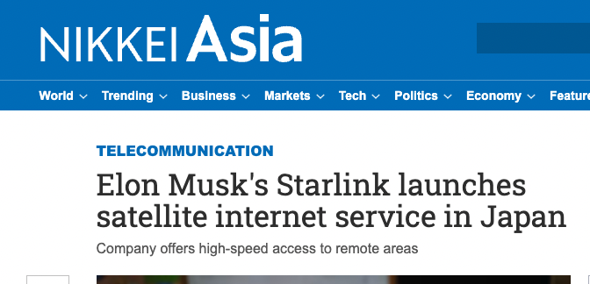
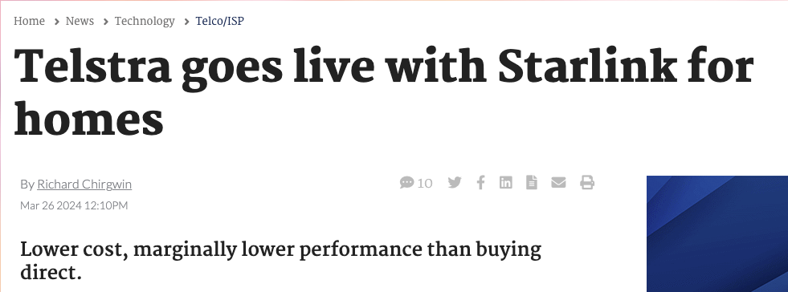
LEOs in the News
screenshot from starwatch app
Screenshot - https://www.theverge.com/2022/8/25/23320722/spacex-starlink-t-mobile-satellite-internet-mobile-messaging
Screenshot: https://asia.nikkei.com/Business/Telecommunication/Elon-Musk-s-Starlink-launches-satellite-internet-service-in-Japan
https://www.itnews.com.au/news/telstra-goes-live-with-starlink-for-homes-606423#:~:text=Telstra%20has%20kicked%20off%20its,the%20end%20of%20the%20year.

Slide 3
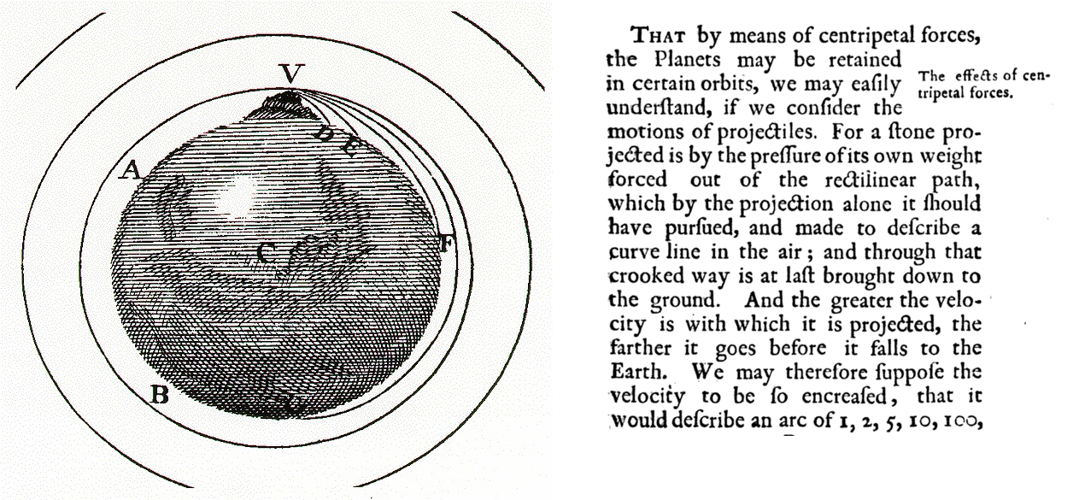

Newtonian Physics
If you fire a projectile with a speed greater than 11.2Km/sec it will not fall back to earth, and instead head away from earth never to return
On the other hand, if you incline the aiming trajectory and fire it at a critical speed it will settle into an orbit around the earth
The higher the altitude, the lower the orbital speed required to maintain orbit

Slide 4
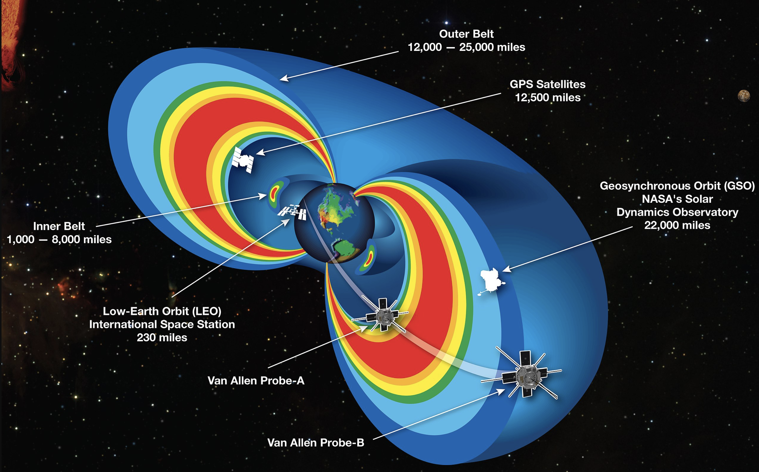
Solar Radiation Physics
The rotating iron core of the Earth produces a strong magnetic field
This magnetic field deflects solar radiation – the Van Allen Belt
Sheltering below the Van Allen Belt protects the spacecraft from the worst effects of solar radiation, allowing advanced electronics to be used in the spacecraft

Slide 5
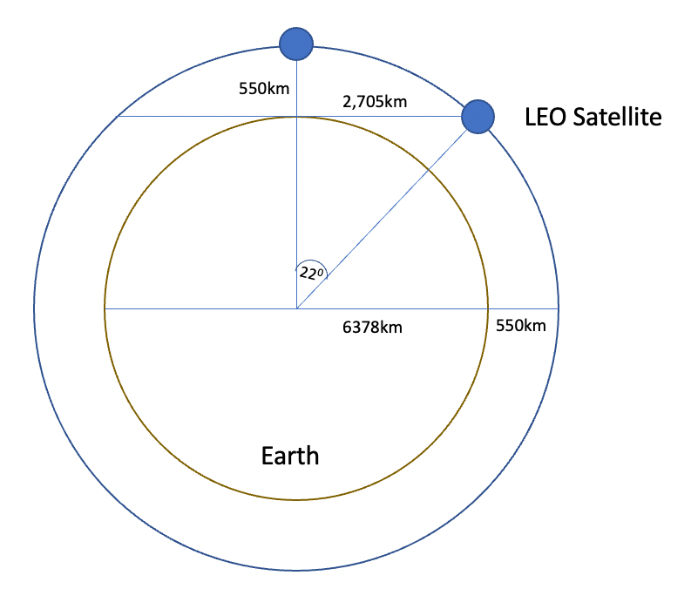
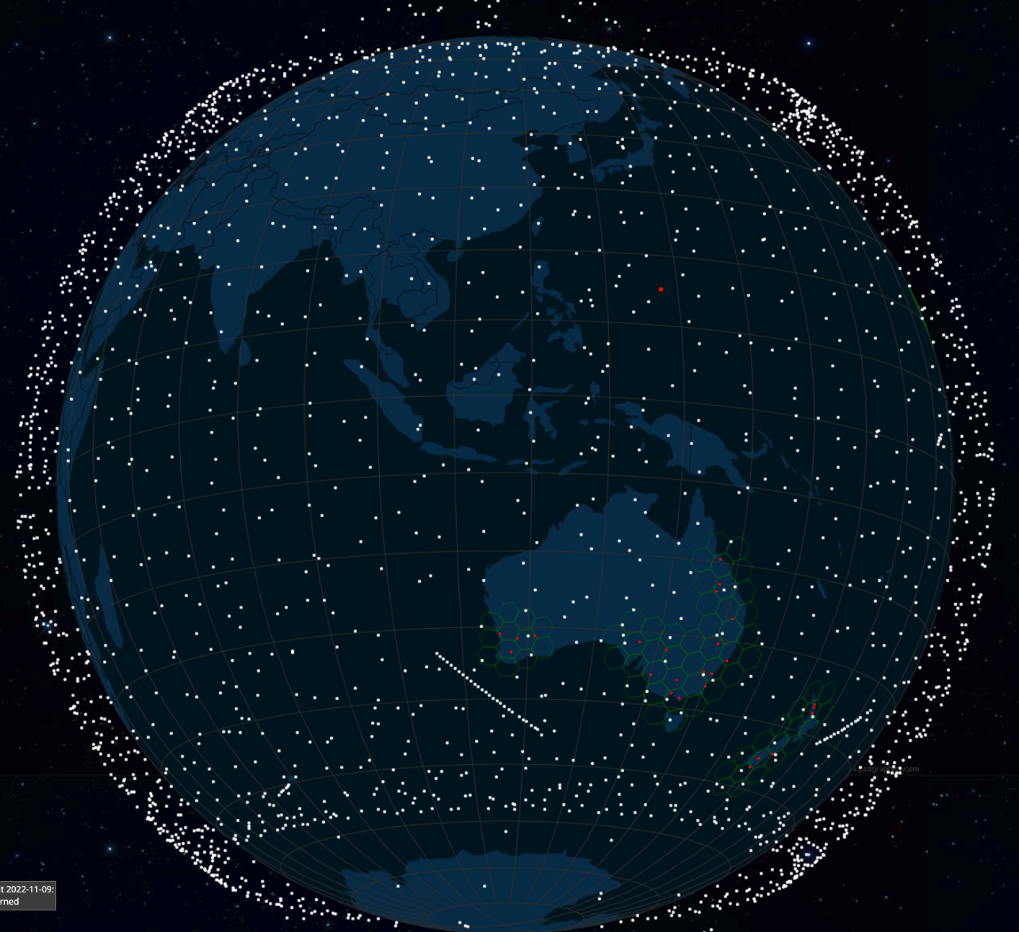
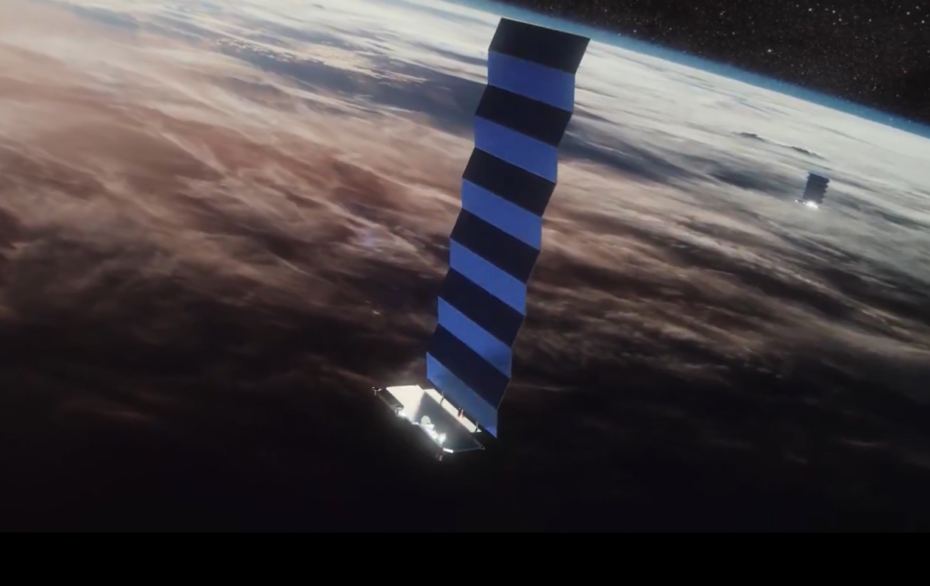
Low Earth Orbit
LEO satellites are stations between 160km and 2,000km in altitude.
High enough to stop it slowing down by “grazing” the denser parts of the earth’s ionosphere
Not so high that it loses the radiation protection afforded by the Inner Van Allen belt.
At a height of 550km, the minimum signal propagation delay to reach the satellite and back is 3.7ms, at 25º it’s 7.5ms.
Image - spacex
screenshot from starwatch app

Slide 6
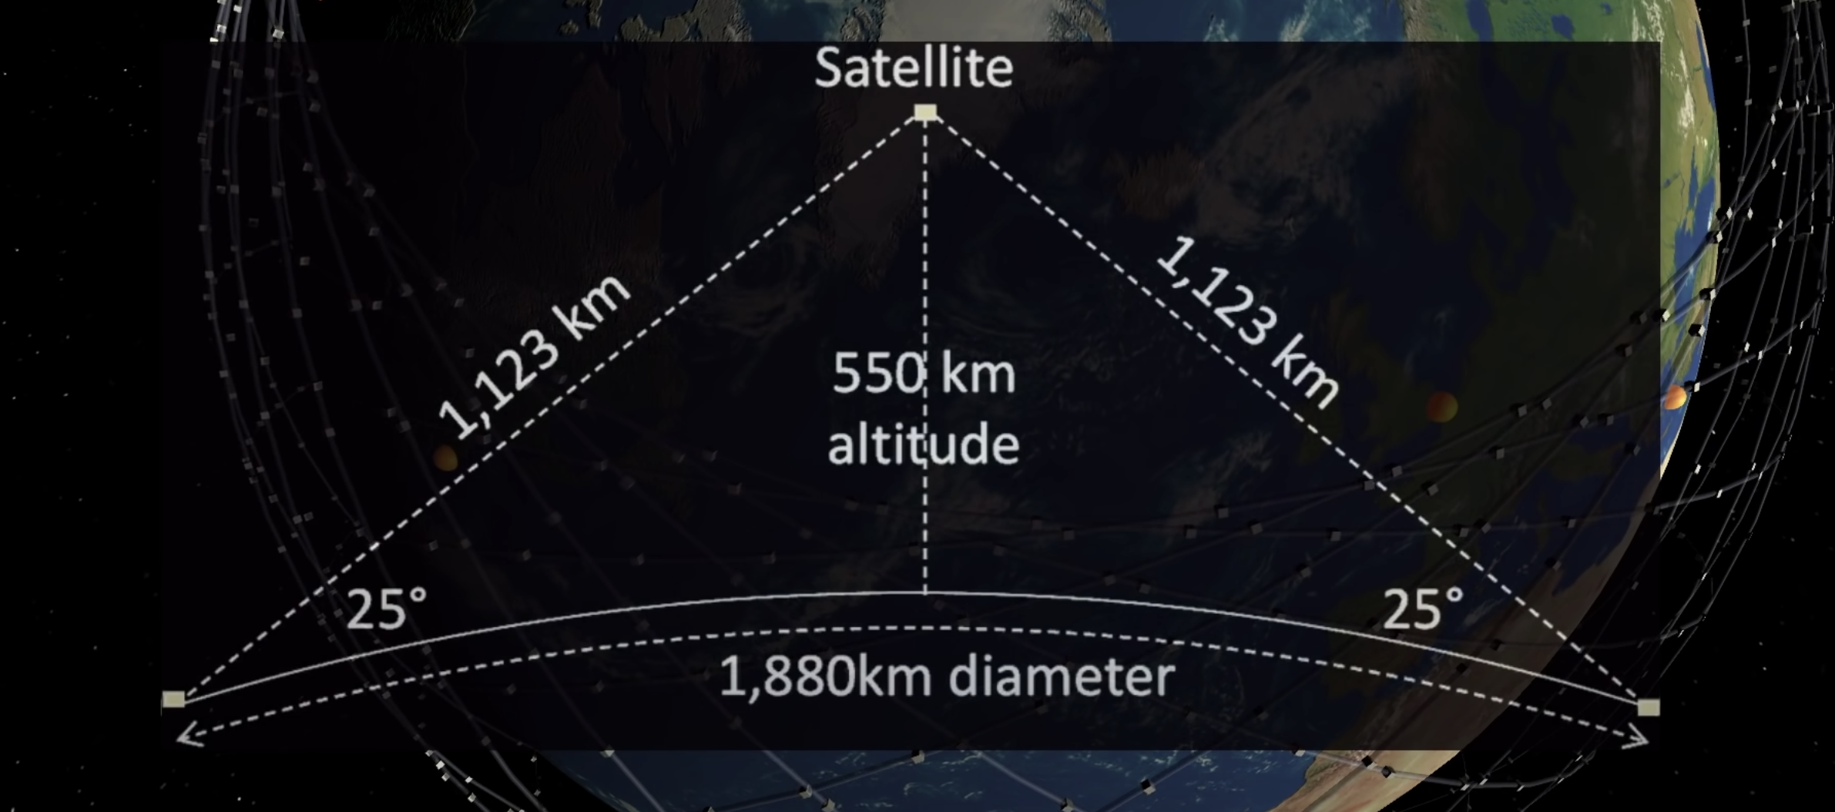
Starlink Constellation
If you use a minimum angle of elevation of 25º then at an altitude of 550km each satellite spans a terrestrial footprint of no more than ~950Km radius, or 2M K²
At a minimum, a LEO satellite constellation needs 500 satellites to provide coverage of all parts of the earth’s surface
For high quality coverage the constellation will need 6x-20x that number (or more!)

Slide 7
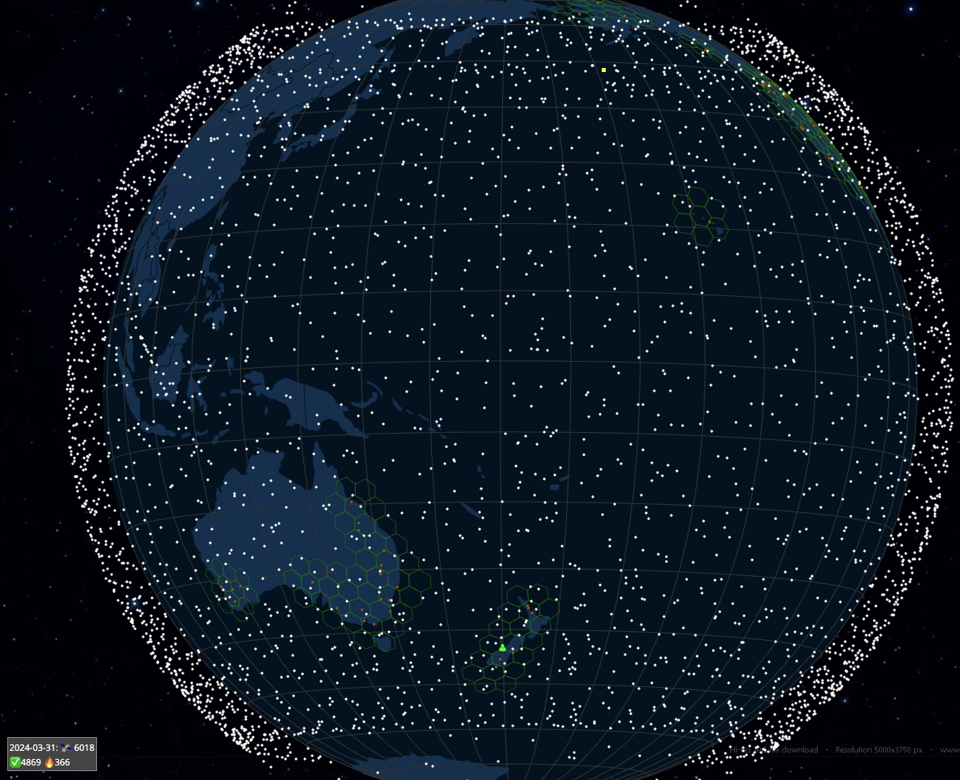
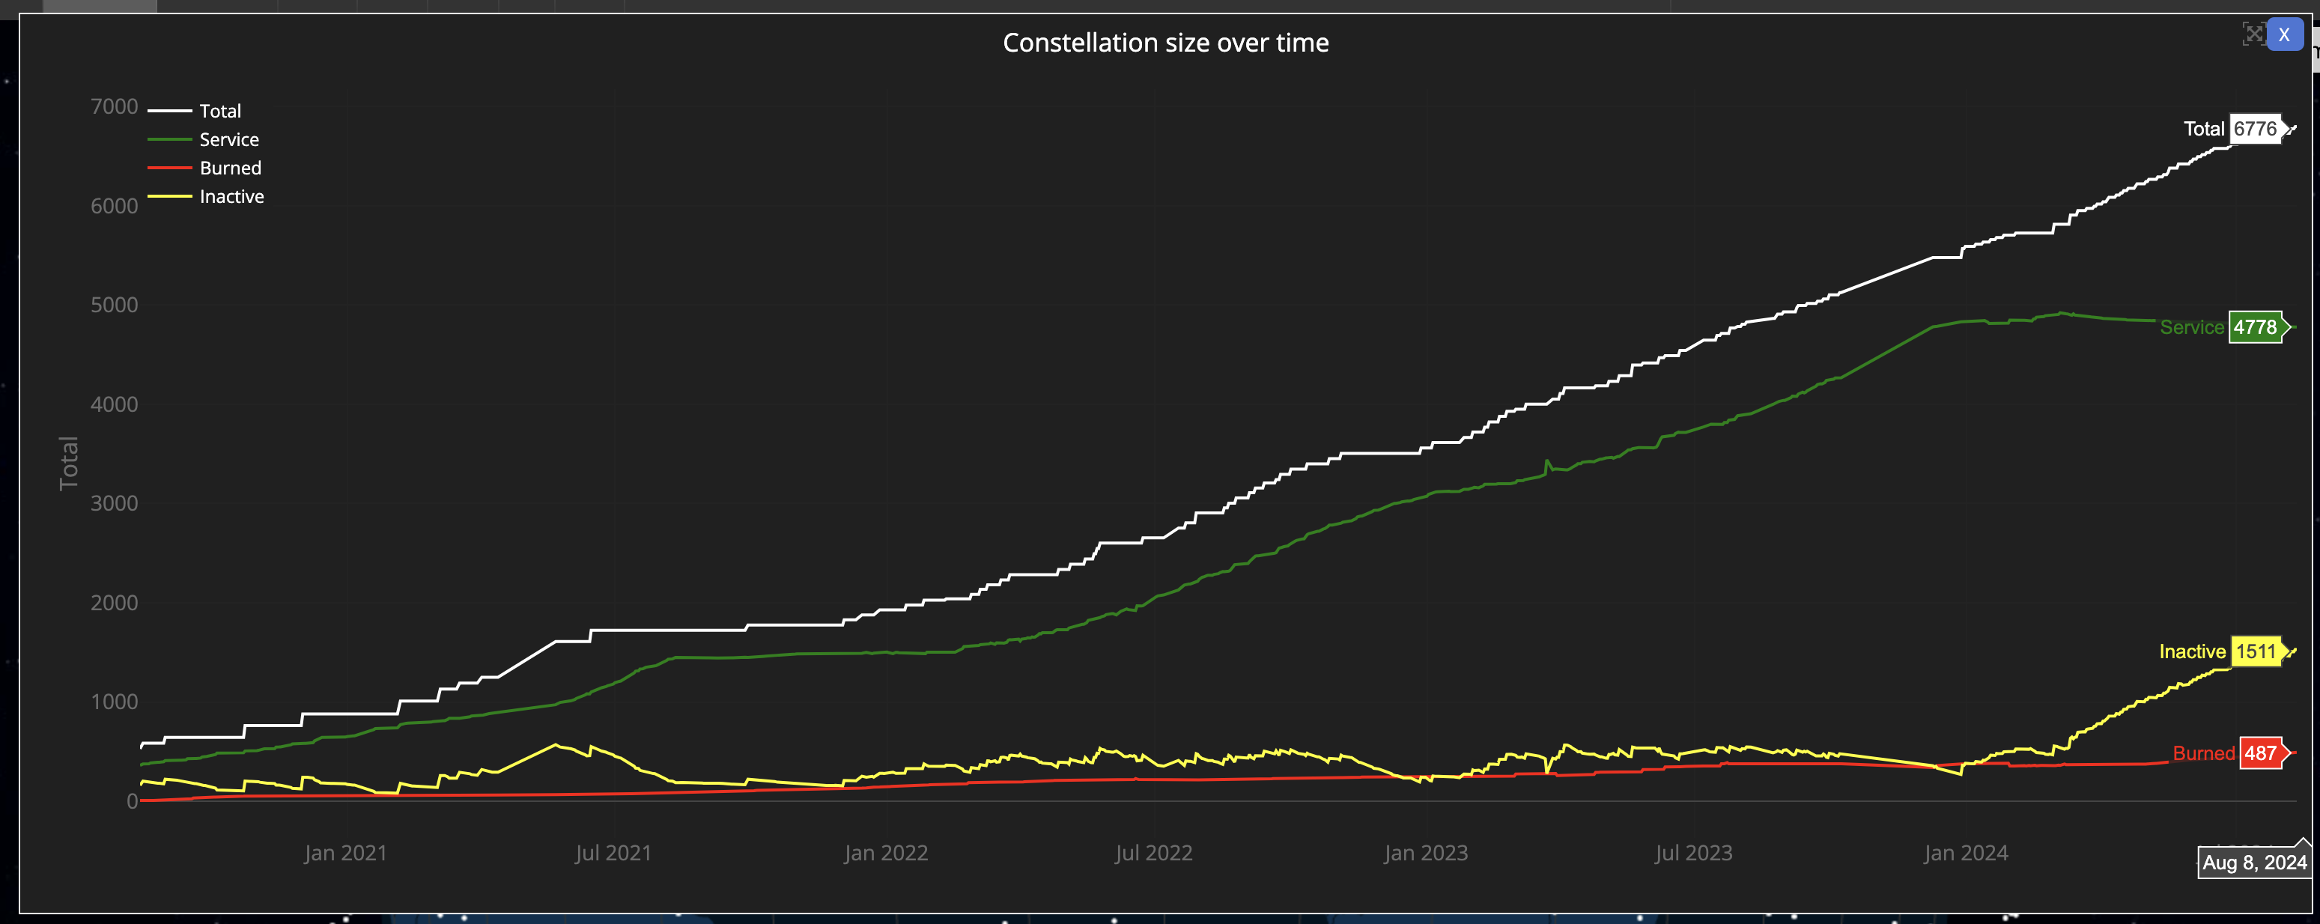
Starlink Constellation
4,778 in-service operational spacecraft, operating at an altitude of 550km
https://satellitemap.space/

Slide 8
So LEOs are “interesting”!
They are very close to the Earth – which means:
They don’t need specialised high-power equipment to send and receive signals
Even hand-held mobile devices can send and receive signals with a LEO!
They can achieve very high signal speeds
It’s a highly focussed signal beam
They are harder to disrupt by external interference
But you need a large number of them to provide a continuous service
The extremely host cost of launching a large constellation of LEO spacecraft has been the major problem with LEO service until recently
Which is why Motorola’s Iridium service went bankrupt soon after launch

Slide 9
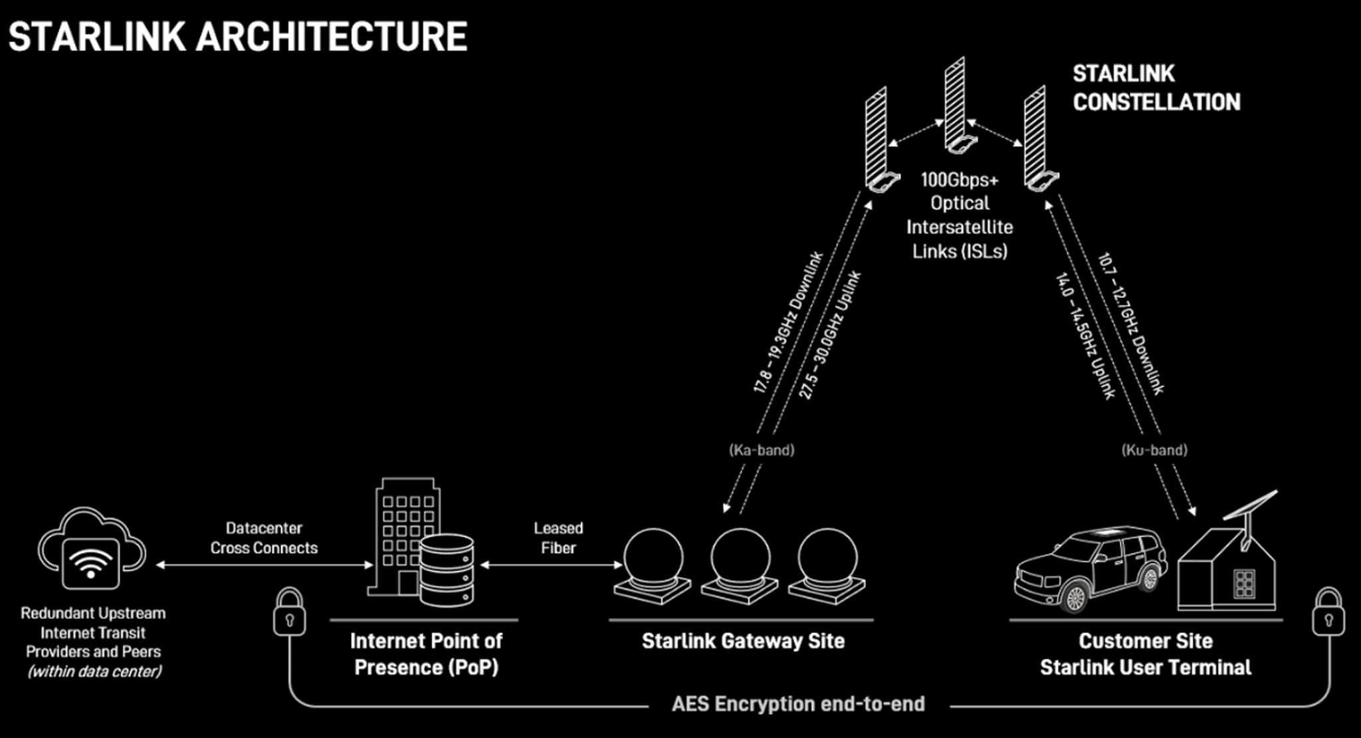
Starlink Architecture

Slide 10
Tracking a LEO satellite
Satellite
27,000 km/h
horizon to horizon: ~5 minutes
550km

Slide 11
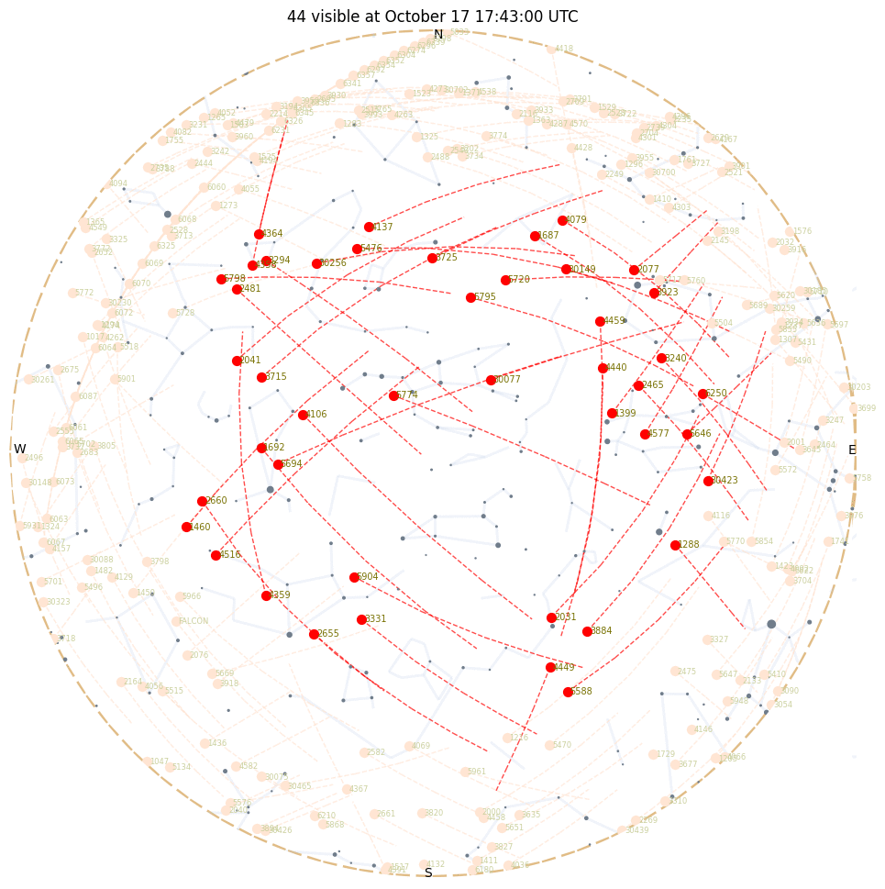
Looking Up
Starlink tracks satellites with a minimum elevation of 25º.
There are between 30 – 50 visible Starlink satellites at any point on the surface between latitudes 56º North and South
Each satellite traverses the visible aperture for a maximum of ~3 minutes

Slide 12
Starlink Scheduling
A satellite is assigned to a user terminal in 15 second time slots
Tracking of a satellite (by phased array focussing) works across 11 degrees of arc per satellite in each 15 second slot
15 seconds
11º
client

Slide 13
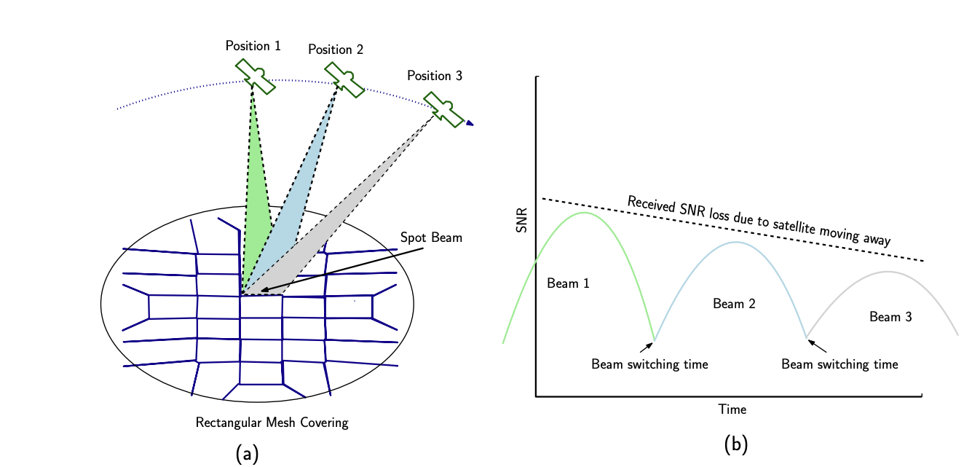
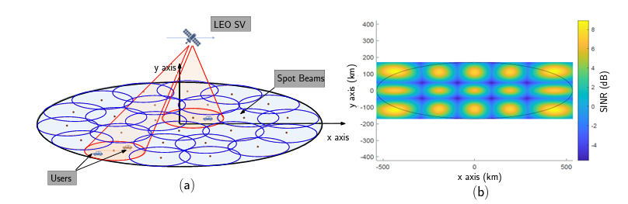
Starlink Spot Beams
Each spacecraft uses 2,000 MHz of spectrum for user downlink and splits it into 8x channels of 250 MHz each
Each satellite has 3 downlink antennas and 1 uplink antennas, and each can do 8 beams x 2 polarizations, for a total of 48 beams down and 16 up.
“Unveiling Beamforming Strategies of Starlink LEO Satellites”
https://people.engineering.osu.edu/sites/default/files/2022-10/Kassas_Unveiling_Beamforming_Strategies_of_Starlink_LEO_Satellites.pdf

Slide 14
Starlink’s Reports
$ starlink-grpc-tools/dish_grpc_text.py -v status
id: ut01000000-00000000-005dd555
hardware_version: rev3_proto2
software_version: 5a923943-5acb-4d05-ac58-dd93e72b7862.uterm.release
state: CONNECTED
uptime: 481674
snr:
seconds_to_first_nonempty_slot: 0.0
pop_ping_drop_rate: 0.0
downlink_throughput_bps: 16693.330078125
uplink_throughput_bps: 109127.3984375
pop_ping_latency_ms: 49.5
Alerts bit field: 0
fraction_obstructed: 0.04149007424712181
currently_obstructed: False
seconds_obstructed:
obstruction_duration: 1.9579976797103882
obstruction_interval: 540.0
direction_azimuth: -42.67951583862305
direction_elevation: 64.61225128173828
is_snr_above_noise_floor: True

Slide 15
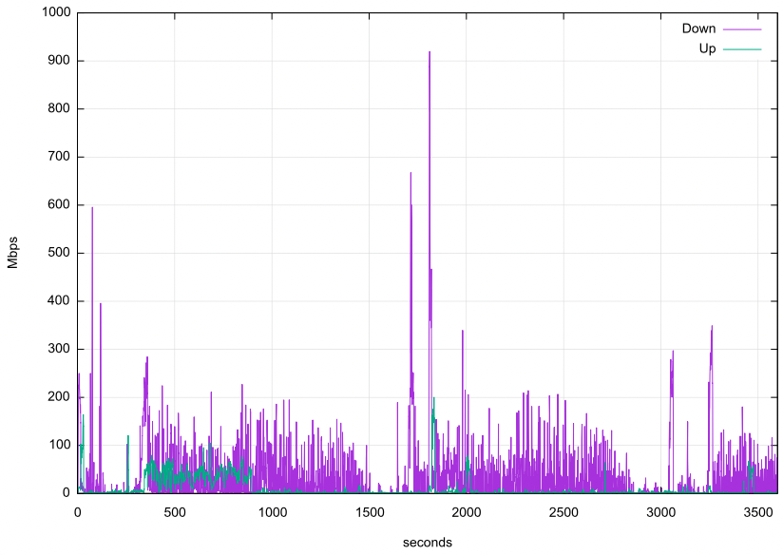
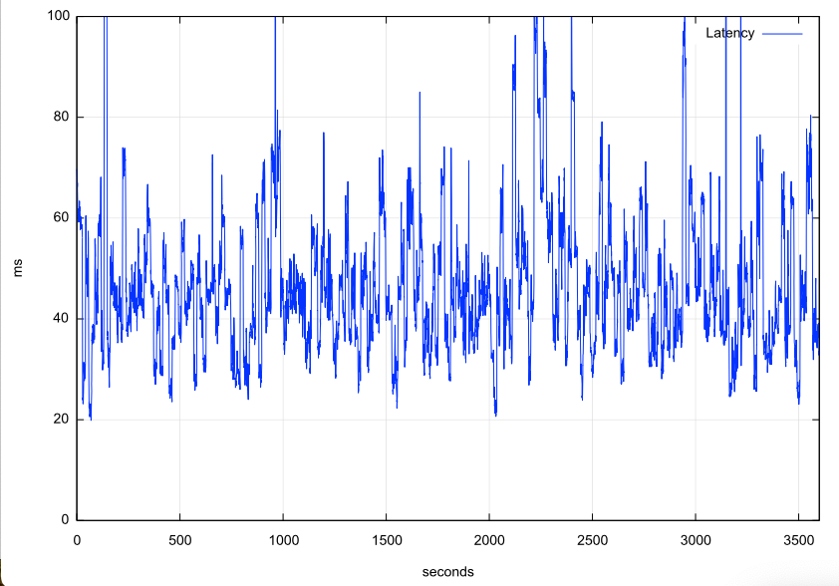
Reported Capacity & Latency
Capacity
Latency (Jitter)

Slide 16
Why is this service so “noisy”?

Slide 17
Frames
Starlink does NOT provide each user with a dedicated frequency band
The system uses Multiplexing to divide a channel into frames and sends 750 frames per second. Each frame is divided into 302 intervals.
Each frame carries a header that carrier satellite, channel and modulation information

Slide 18
Varying SNR
Starlink likely uses IEEE 802.11ac dynamic channel rate control, adjusting the signal modulation to match the current SNR
This continual adjustment causes continual shift in the available capacity and imposes a varying latency on the round-trip time

Slide 19
Why?
The variation in latency and capacity occurs at high frequency, which means that TCP control is going to struggle to optimize itself against a shifting target
TCP uses ACK pacing which means it attempts to optimize its sending rate over multiple RTT intervals

Slide 20
Starlink Scheduling
Latency and Loss
Latency changes on each satellite switch
If we take the minimum latency on each 15 second scheduling interval, we can expose the effects of the switching interval on latency
Across the 15 second interval there will be a drift in latency according to the satellite’s track and the distance relative to the two earth points
Other user traffic will also impact on latency, and also the effects of a large buffer in the user modem
Latency
Loss
Time (Seconds)

Slide 21
Satellite Handover
Latency and Loss Spikes

Slide 22
Satellite Handover
Packet loss occurs most frequently during handover events, and loss is confined to small numbers of packets
This is NOT congestion-based tail-drop loss – which implies that the packet loss can be generally repaired by a TCP SACK mechanism without needing a TCP session restart
Latency
Loss

Slide 23
Starlink Characteristics
Varying SNR produces varying modulation, which is expressed as varying capacity and delay
Relative motions of earth and spacecraft add to varying latency
15 second handovers generate regular loss and latency spikes
Contention by many users for access to intervals in multiplexed frames in a common transmission leads to queuing delays

Slide 24
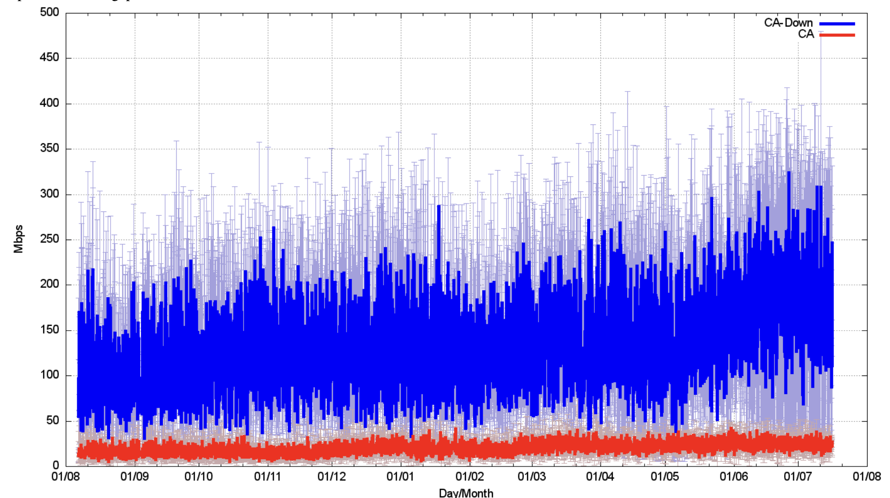
How well does all this work?
Speedtest measurements:
We should be able to get ~160Mbps out of a Starlink connection.

Slide 25
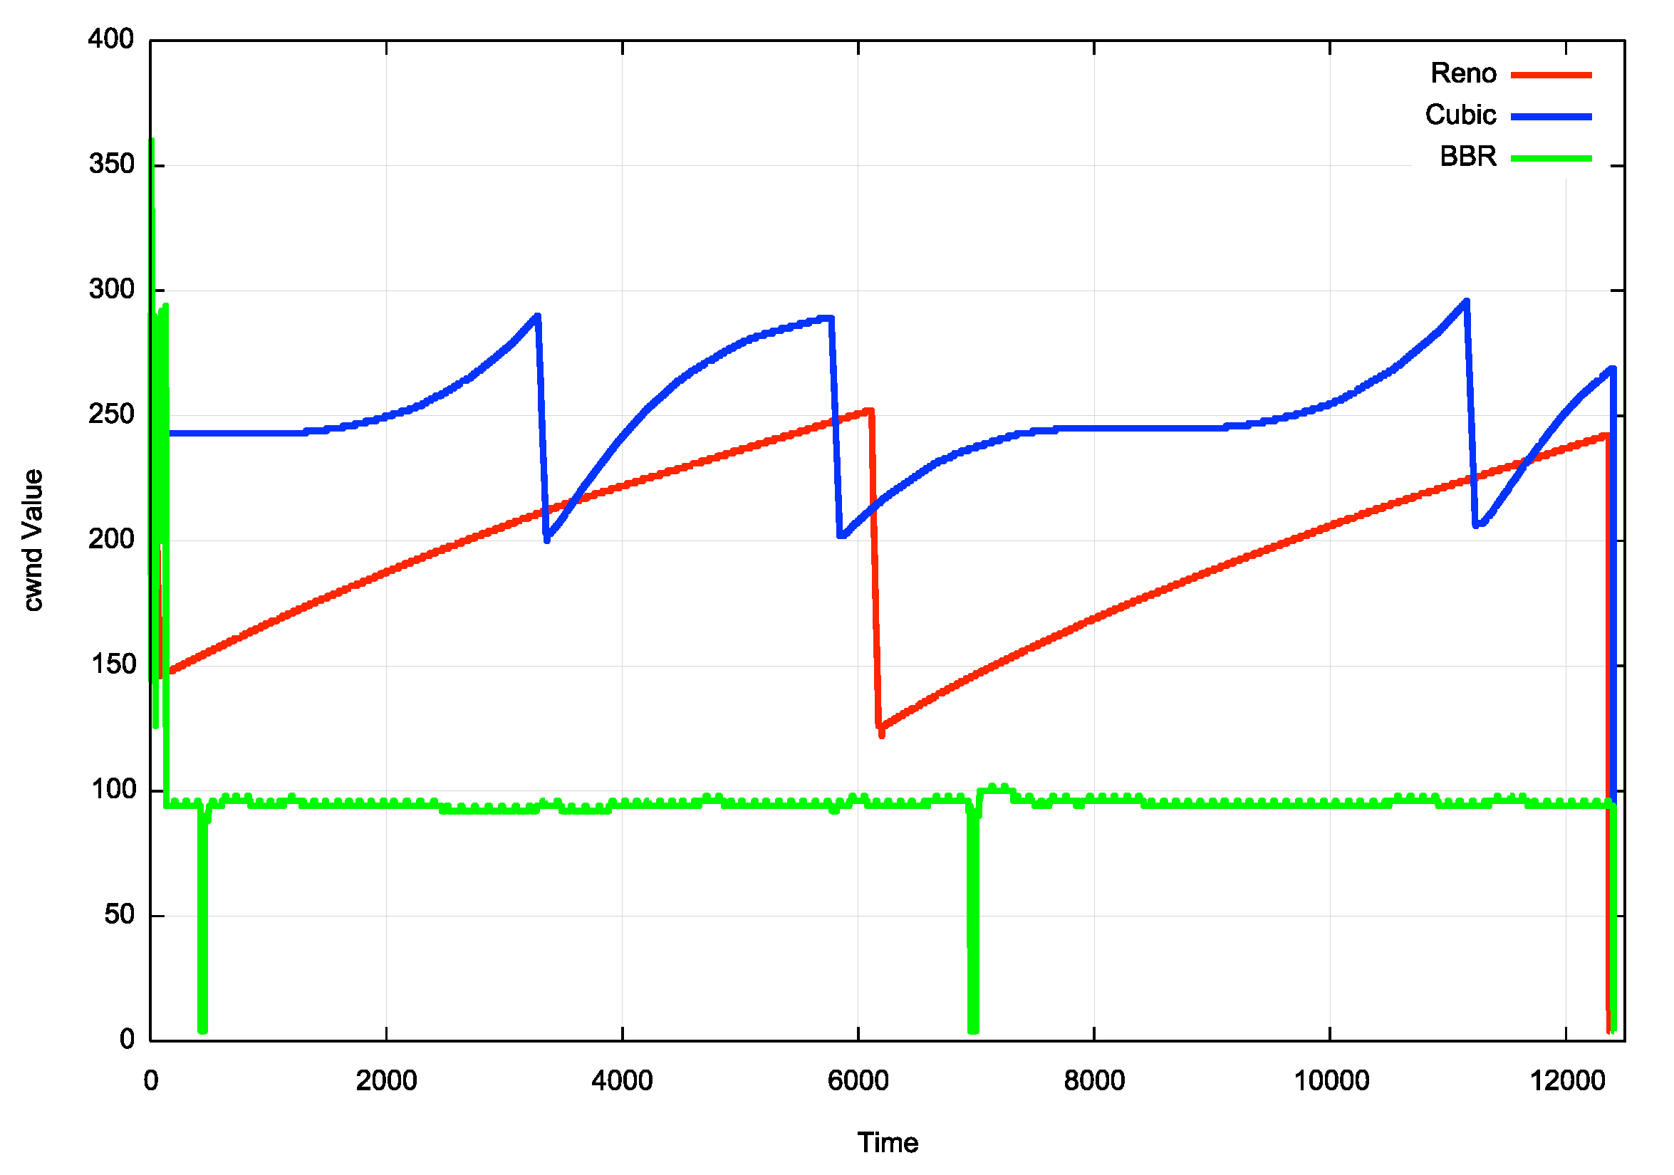
TCP Flow Control Algorithms
“Ideal” Flow behaviour for each protocol

Slide 26
iperf3 – cubic, 40 seconds

Slide 27
iperf3 – cubic, 40 seconds
Slow Start
Queue Drain
Congestion Avoidance

Slide 28
iperf3 - bbr
BBR’s Link Capacity Reassessment

Slide 29
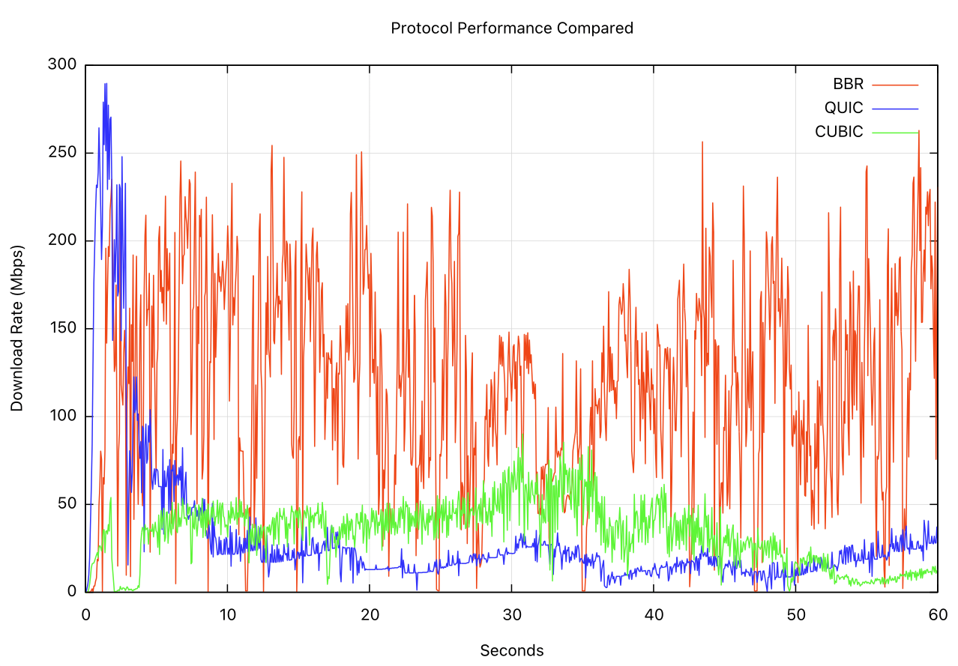
Cubic, Quic/Cubic, BBR

Slide 30
Protocol Considerations
Starlink services have three issues:
Very high jitter rates – varying signal modulation
High levels of micro-loss (1.4%) – largely due to loss on satellite handover events (every 15 seconds)
Common bearer contention between users
Loss-based flow control algorithms will over-react and pull back the sending rate over time
Short transactions work very well
Paced connections (voice, zoom, video streaming) tend to work well most of the time
To obtain better performance you need to move to flow control algorithms that are not loss-sensitive, such as BBR

Slide 31
Other Considerations
Senders should use fair queuing to pace sending rates and avoid bursting and tail drop behaviours
SACK (selective acknowledgement) for TCP can help in rapid repair to multiple lost packets
Its possible that ECN would also be helpful to disambiguate latency changes due to satellite behaviours and network queue buildup

Slide 32
Starlink Performance
Starlink is perfectly acceptable for:
short transactions
video streaming
conferencing
The service can sustain 40 – 50Mbps delivery for long-held sessions during local peak use times in high density use scenarios
The isolated drop events generally do not intrude into the session state
In off-peak and/or low-density contexts it can deliver 200-300Mbps
Or, if the server uses BBR then far higher throughput is possible!
It can be used in all kinds of places where existing wire and mobile radio systems either under-perform or aren’t there at all!
Its probably not the best trunk infrastructure service medium, but it’s a really good high speed last mile direct retail access service, particularly for remote locations!

Slide 33
Questions?

