Slide 1
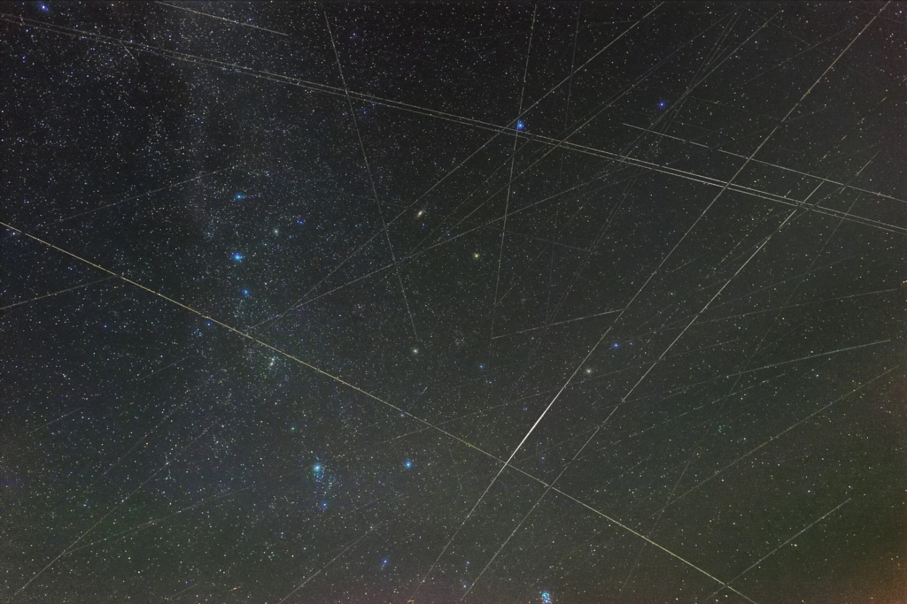
Measuring Starlink Protocol Performance
Geoff Huston
APNIC

Slide 2
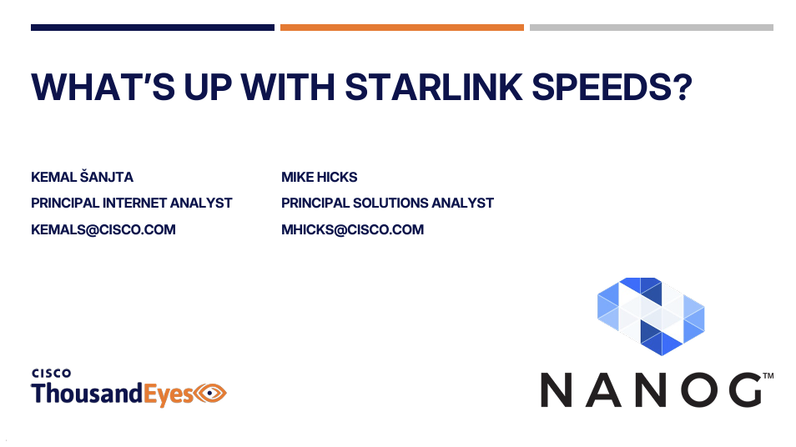
From NANOG 92…

Slide 3
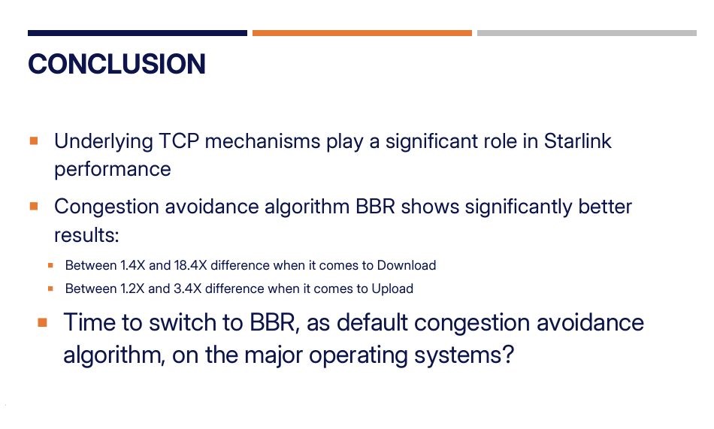
From NANOG 92…

Slide 4
From NANOG 92…
WHY does BBR outperform CUBIC on Starlink systems?

Slide 5
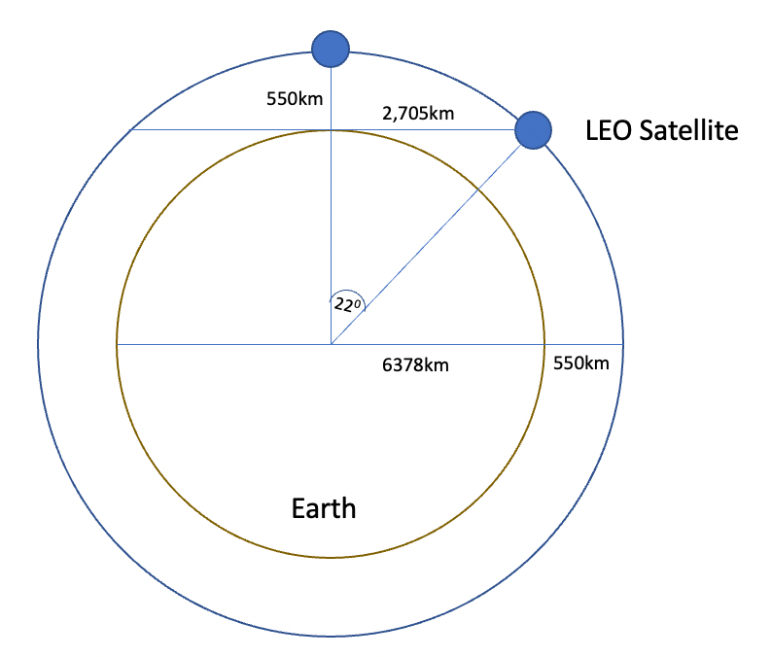
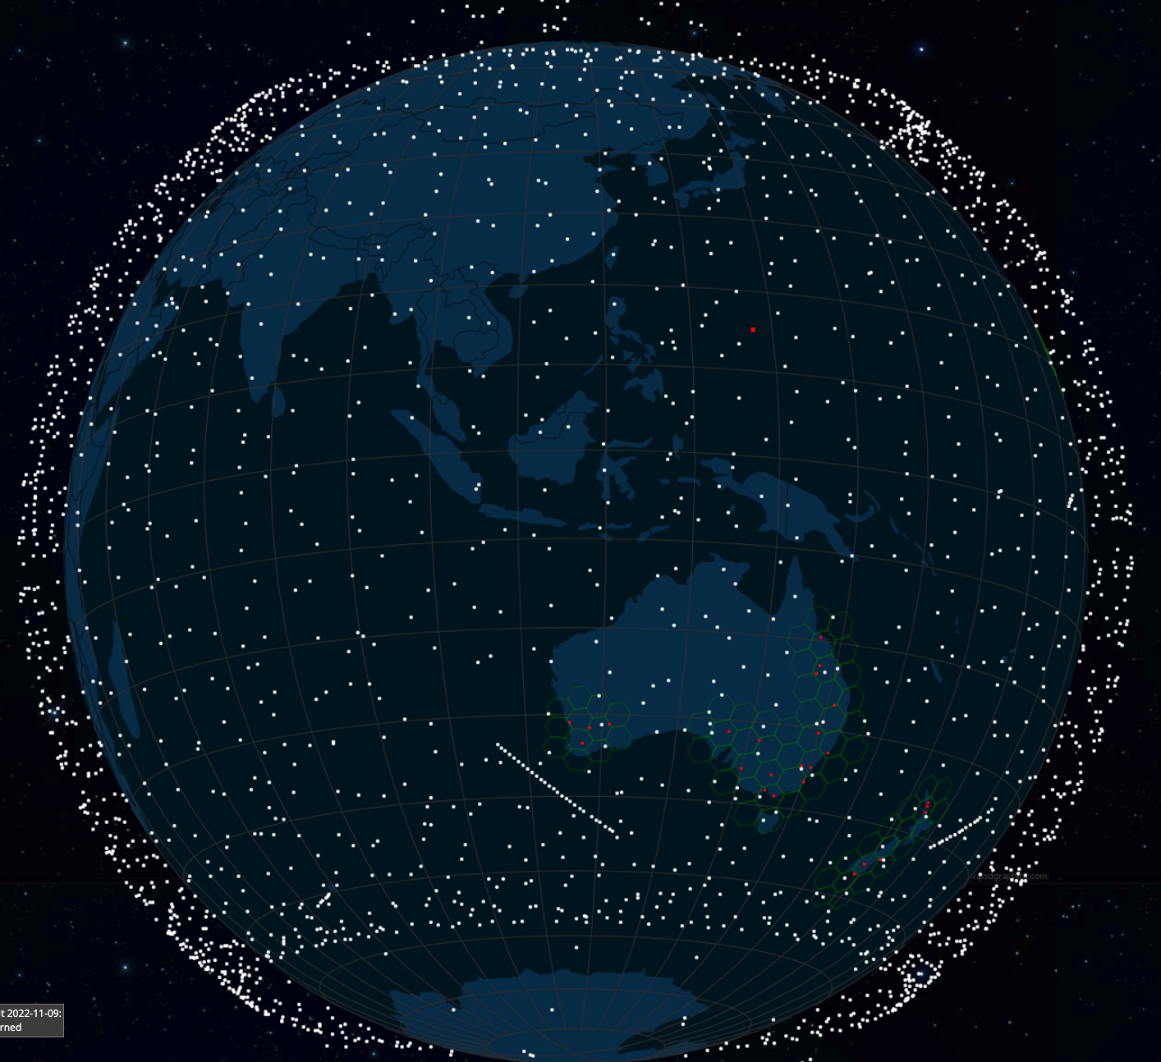
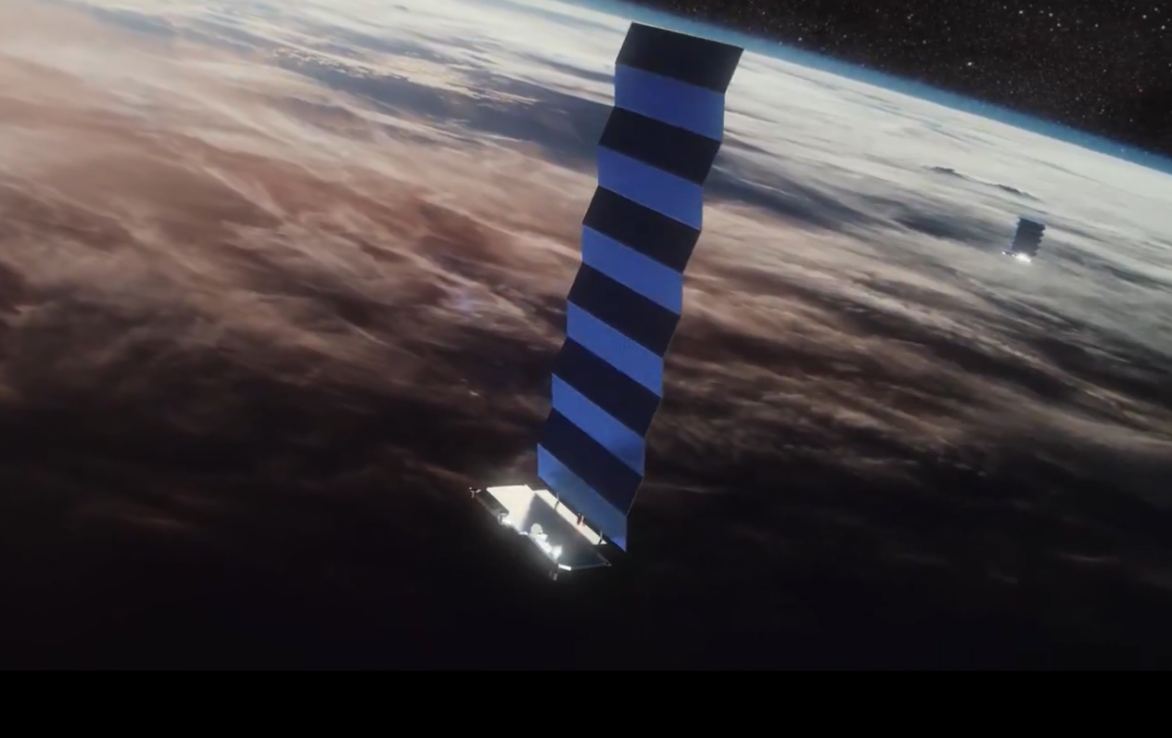
Low Earth Orbit
LEO satellites are stations between 160km and 2,000km in altitude. Starlink operates at 550km (V2 includes additional orbital shells at 525km, 530km and 535km)
High enough to stop it slowing down by “grazing” the denser parts of the earth’s ionosphere
Not so high that it loses the radiation protection afforded by the Inner Van Allen belt.
At a height of 550km, the minimum signal propagation delay to reach the satellite and back is 3.7ms, at 25º elevation it’s 7.5ms.
Image - spacex
screenshot from starwatch app

Slide 6
Starlink is “interesting”!
The spacecraft are very close to the Earth – which means:
They don’t need specialised high-power equipment to send and receive signals
Even hand-held mobile devices can send and receive signals with a LEO!
They can achieve very high signal speeds
It’s an array of highly focussed signal beams
But you need a large number of them to provide a continuous service
The extremely high cost of launching a large constellation of LEO spacecraft has been the major problem with LEO service until recently
(Which was a major reason why Motorola’s Iridium service went bankrupt soon after launch)

Slide 7
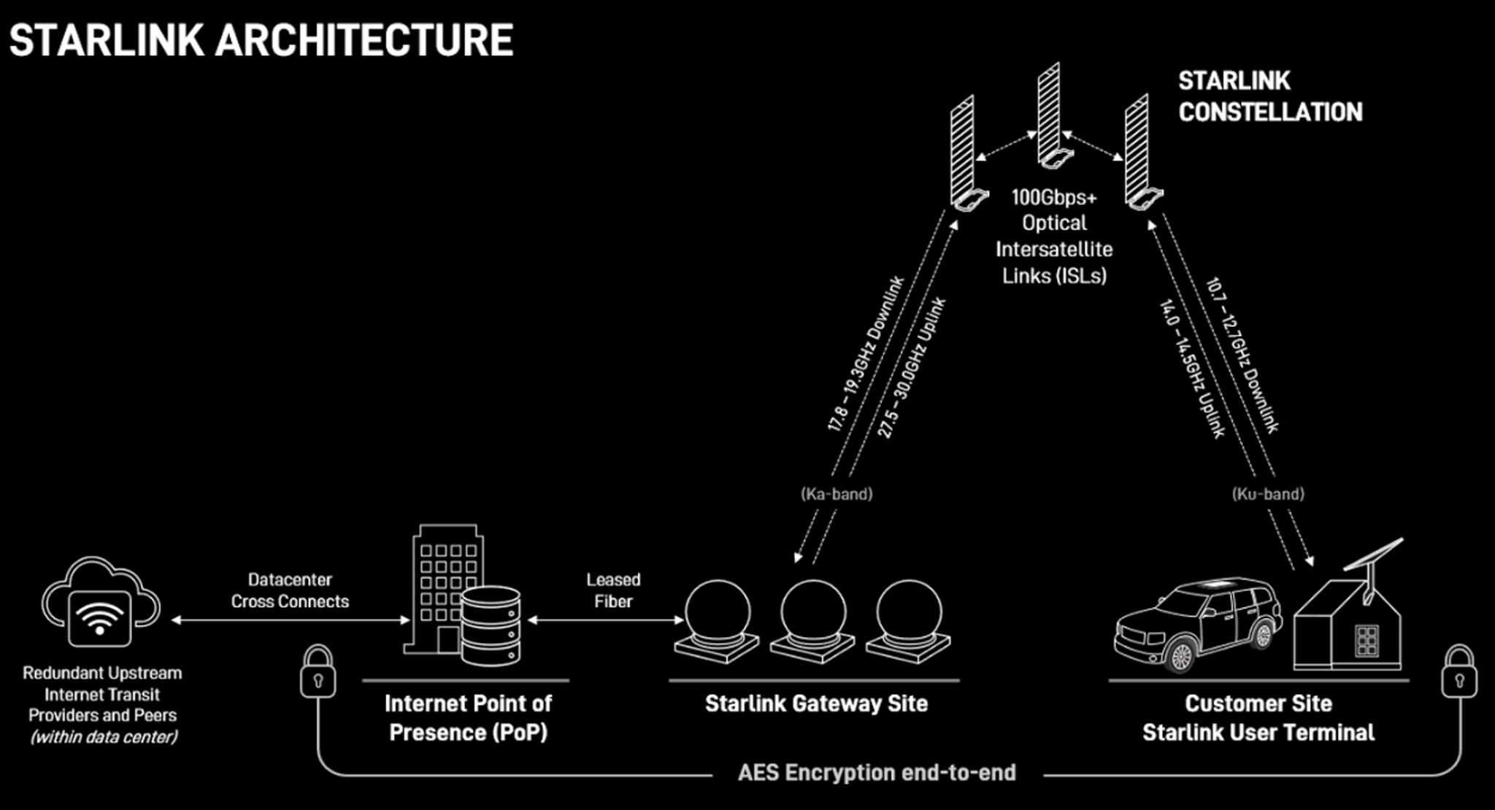
Starlink Architecture

Slide 8
Tracking a LEO satellite
Satellite
27,000 km/h
horizon to horizon: ~5 minutes
370km - 550km

Slide 9
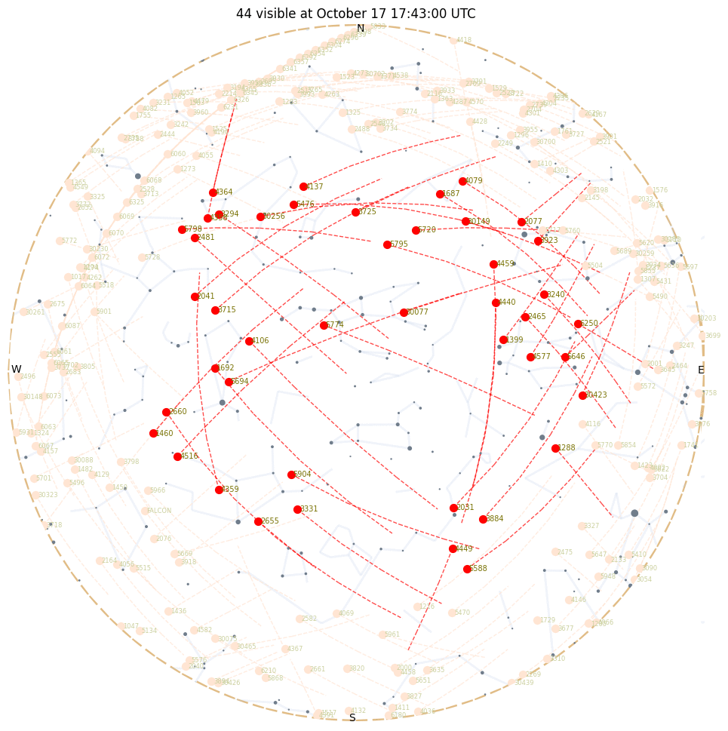
Looking Up
Starlink tracks satellites with a minimum elevation of 25º.
There are between 30 – 50 visible Starlink satellites at any point on the surface between latitudes 56º North and South
Each satellite traverses the visible aperture for a maximum of ~3 minutes

Slide 10
Starlink Scheduling
A satellite is assigned to a user terminal in 15 second time slots
Tracking of a satellite (by phased array focussing) works across 11 degrees of arc per satellite in each 15 second slot
15 seconds
11º
client

Slide 11
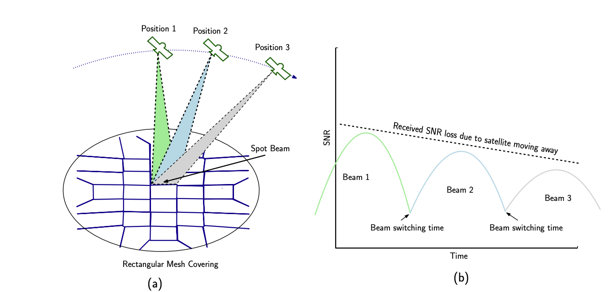
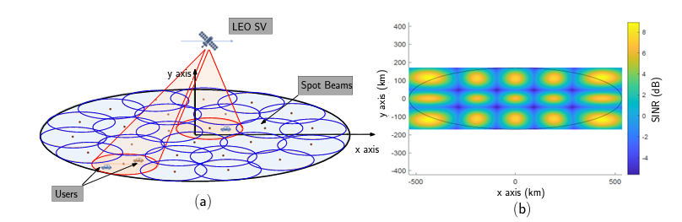
Starlink Spot Beams
Each spacecraft uses 2,000 MHz of spectrum for user downlink and splits it into 8x channels of 250 MHz each
Each satellite has 3 downlink antennas and 1 uplink antennas, and each can do 8 beams x 2 polarizations, for a total of 48 beams down and 16 up.
“Unveiling Beamforming Strategies of Starlink LEO Satellites”
https://people.engineering.osu.edu/sites/default/files/2022-10/Kassas_Unveiling_Beamforming_Strategies_of_Starlink_LEO_Satellites.pdf

Slide 12
Starlink’s Reports
$ starlink-grpc-tools/dish_grpc_text.py -v status
id: ut01000000-00000000-005dd555
hardware_version: rev3_proto2
software_version: 5a923943-5acb-4d05-ac58-dd93e72b7862.uterm.release
state: CONNECTED
uptime: 481674
snr:
seconds_to_first_nonempty_slot: 0.0
pop_ping_drop_rate: 0.0
downlink_throughput_bps: 16693.330078125
uplink_throughput_bps: 109127.3984375
pop_ping_latency_ms: 49.5
Alerts bit field: 0
fraction_obstructed: 0.04149007424712181
currently_obstructed: False
seconds_obstructed:
obstruction_duration: 1.9579976797103882
obstruction_interval: 540.0
direction_azimuth: -42.67951583862305
direction_elevation: 64.61225128173828
is_snr_above_noise_floor: True

Slide 13
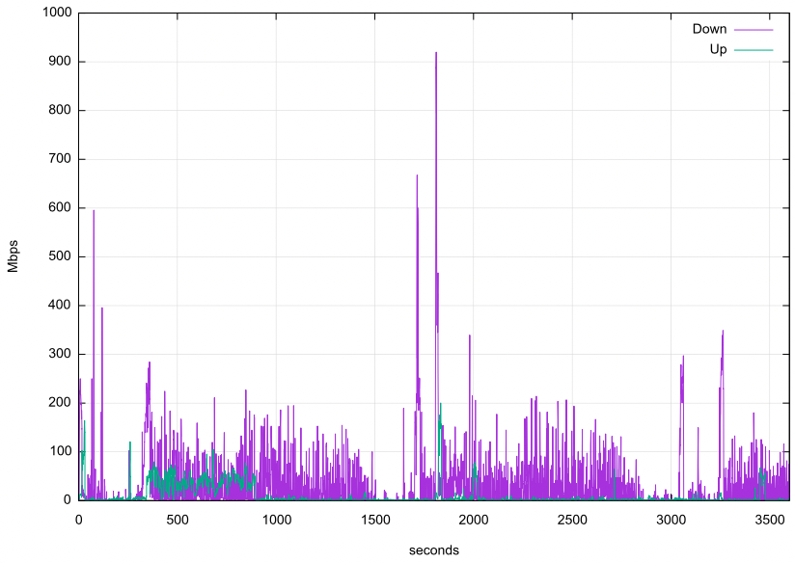
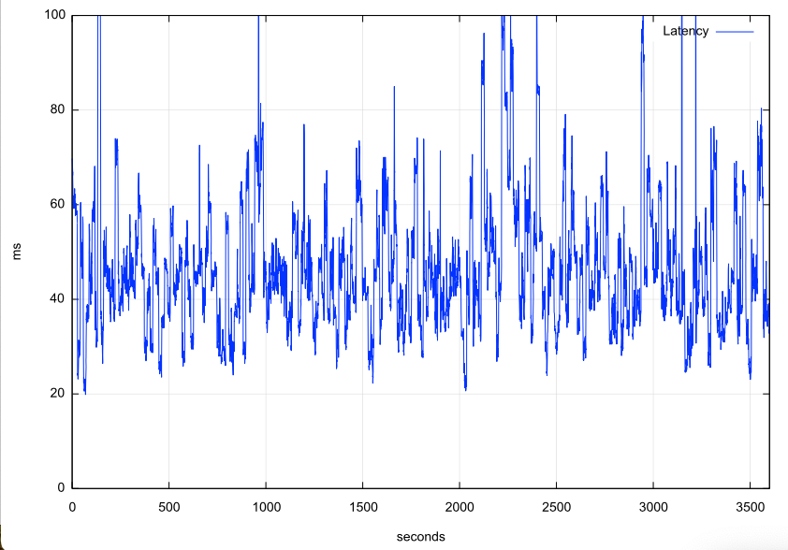
Reported Capacity & Latency

Slide 14
Reported Capacity & Latency
Why is this service so unstable?

Slide 15
Starlink Scheduling
Latency changes on each satellite switch
If we take the minimum latency on each 15 second scheduling interval, we can expose the effects of the switching interval on latency
Across the 15 second interval there will be a drift in latency according to the satellite’s track and the distance relative to the two earth points
Other user traffic will also impact on latency, and also the effects of a large buffer in the user modem

Slide 16
Satellite handover
Each handover sees a spike in latency and a higher probability of loss

Slide 17
Satellite handover
Packet loss occurs most frequently during handover events, and if confined to small set of packets
This is NOT congestion-based tail-drop loss - so the packet loss can be generally repaired by a TCP SACK mechanism without needing a TCP session restart
Latency
Loss

Slide 18
Latency
The signal propagation latency to push a signal up and back to a Starlink spacecraft varies between 3.7ms and 7.5ms – which is an RTT of 7.4ms to 15ms
But the minimum RTTs we see are 20ms!
And the jitter is at an extremely high frequency (as is the change in channel capacity)

Slide 19
Varying SNR means varying signal modulation
Starlink likely uses IEEE 802.11ac dynamic channel rate control, adjusting the signal modulation to match the current SNR
This continual adjustment causes continual shift in the available capacity and imposes a varying latency on the round-trip time
It also adds a few ms to the RTT times

Slide 20
So What?
The variation in latency and capacity occurs at high frequency, which means that TCP control is going to struggle to optimize itself against a shifting target
TCP uses ACK pacing which means it attempts to optimize its sending rate over multiple RTT intervals

Slide 21
Frames
Starlink does NOT provide each user with a dedicated frequency band
The system uses multiplexing to divide a channel into frames and sends 750 frames per second. Each frame is divided into 302 intervals.
Each frame carries a header that contains satellite, channel and modulation information

Slide 22
Starlink Characteristics
Varying SNR produces varying modulation, which is expressed as varying capacity and delay
Relative motions of earth and spacecraft add to varying latency
15 second satellite handover generates regular loss and latency extension
Contention for common transmission medium leads to queuing delays

Slide 23
In Summary…
The profile of a Starlink connection is governed by:
Regular handovers at precise 15 second intervals when the connection will experience:
a change in base latency
very short-term additional queuing latency of ~80 – 100ms
a high probability of non-congestion packet loss
Adaptive dynamic rate control by constantly changing signal modulation
High frequency jitter
No consistent upper bound to channel capacity
Common channel contention with other users

Slide 24
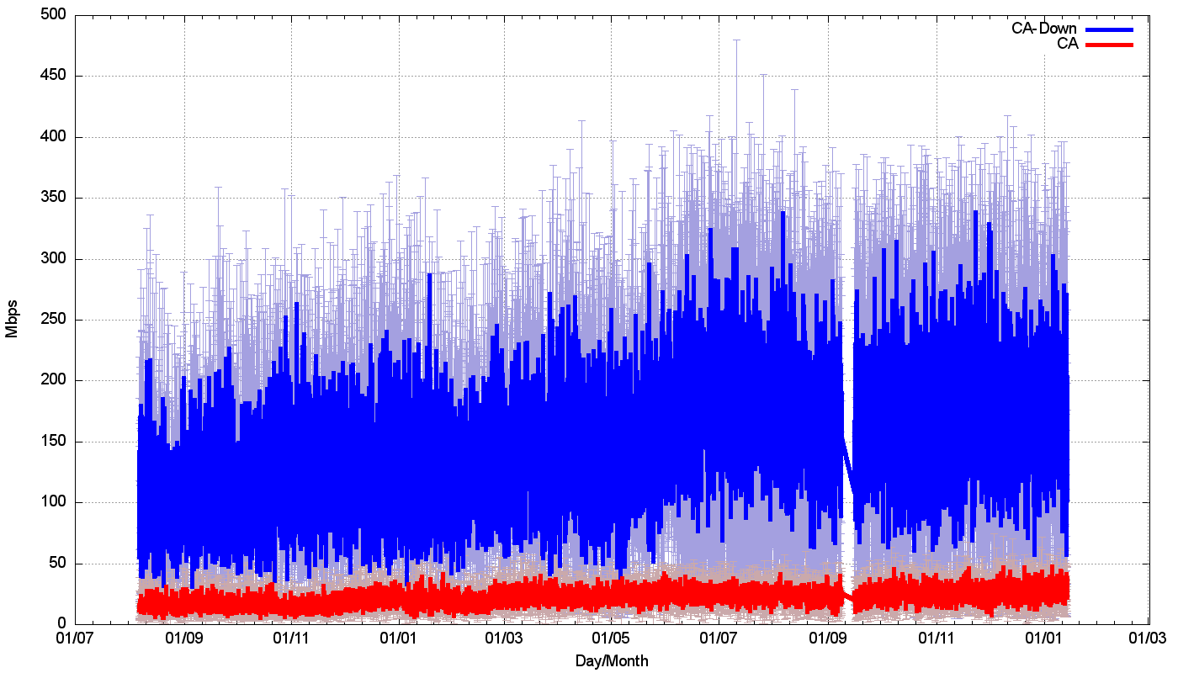
How well does all this work?
Speedtest measurements:
We should be able to get ~160Mbps out of a Starlink connection.

Slide 25
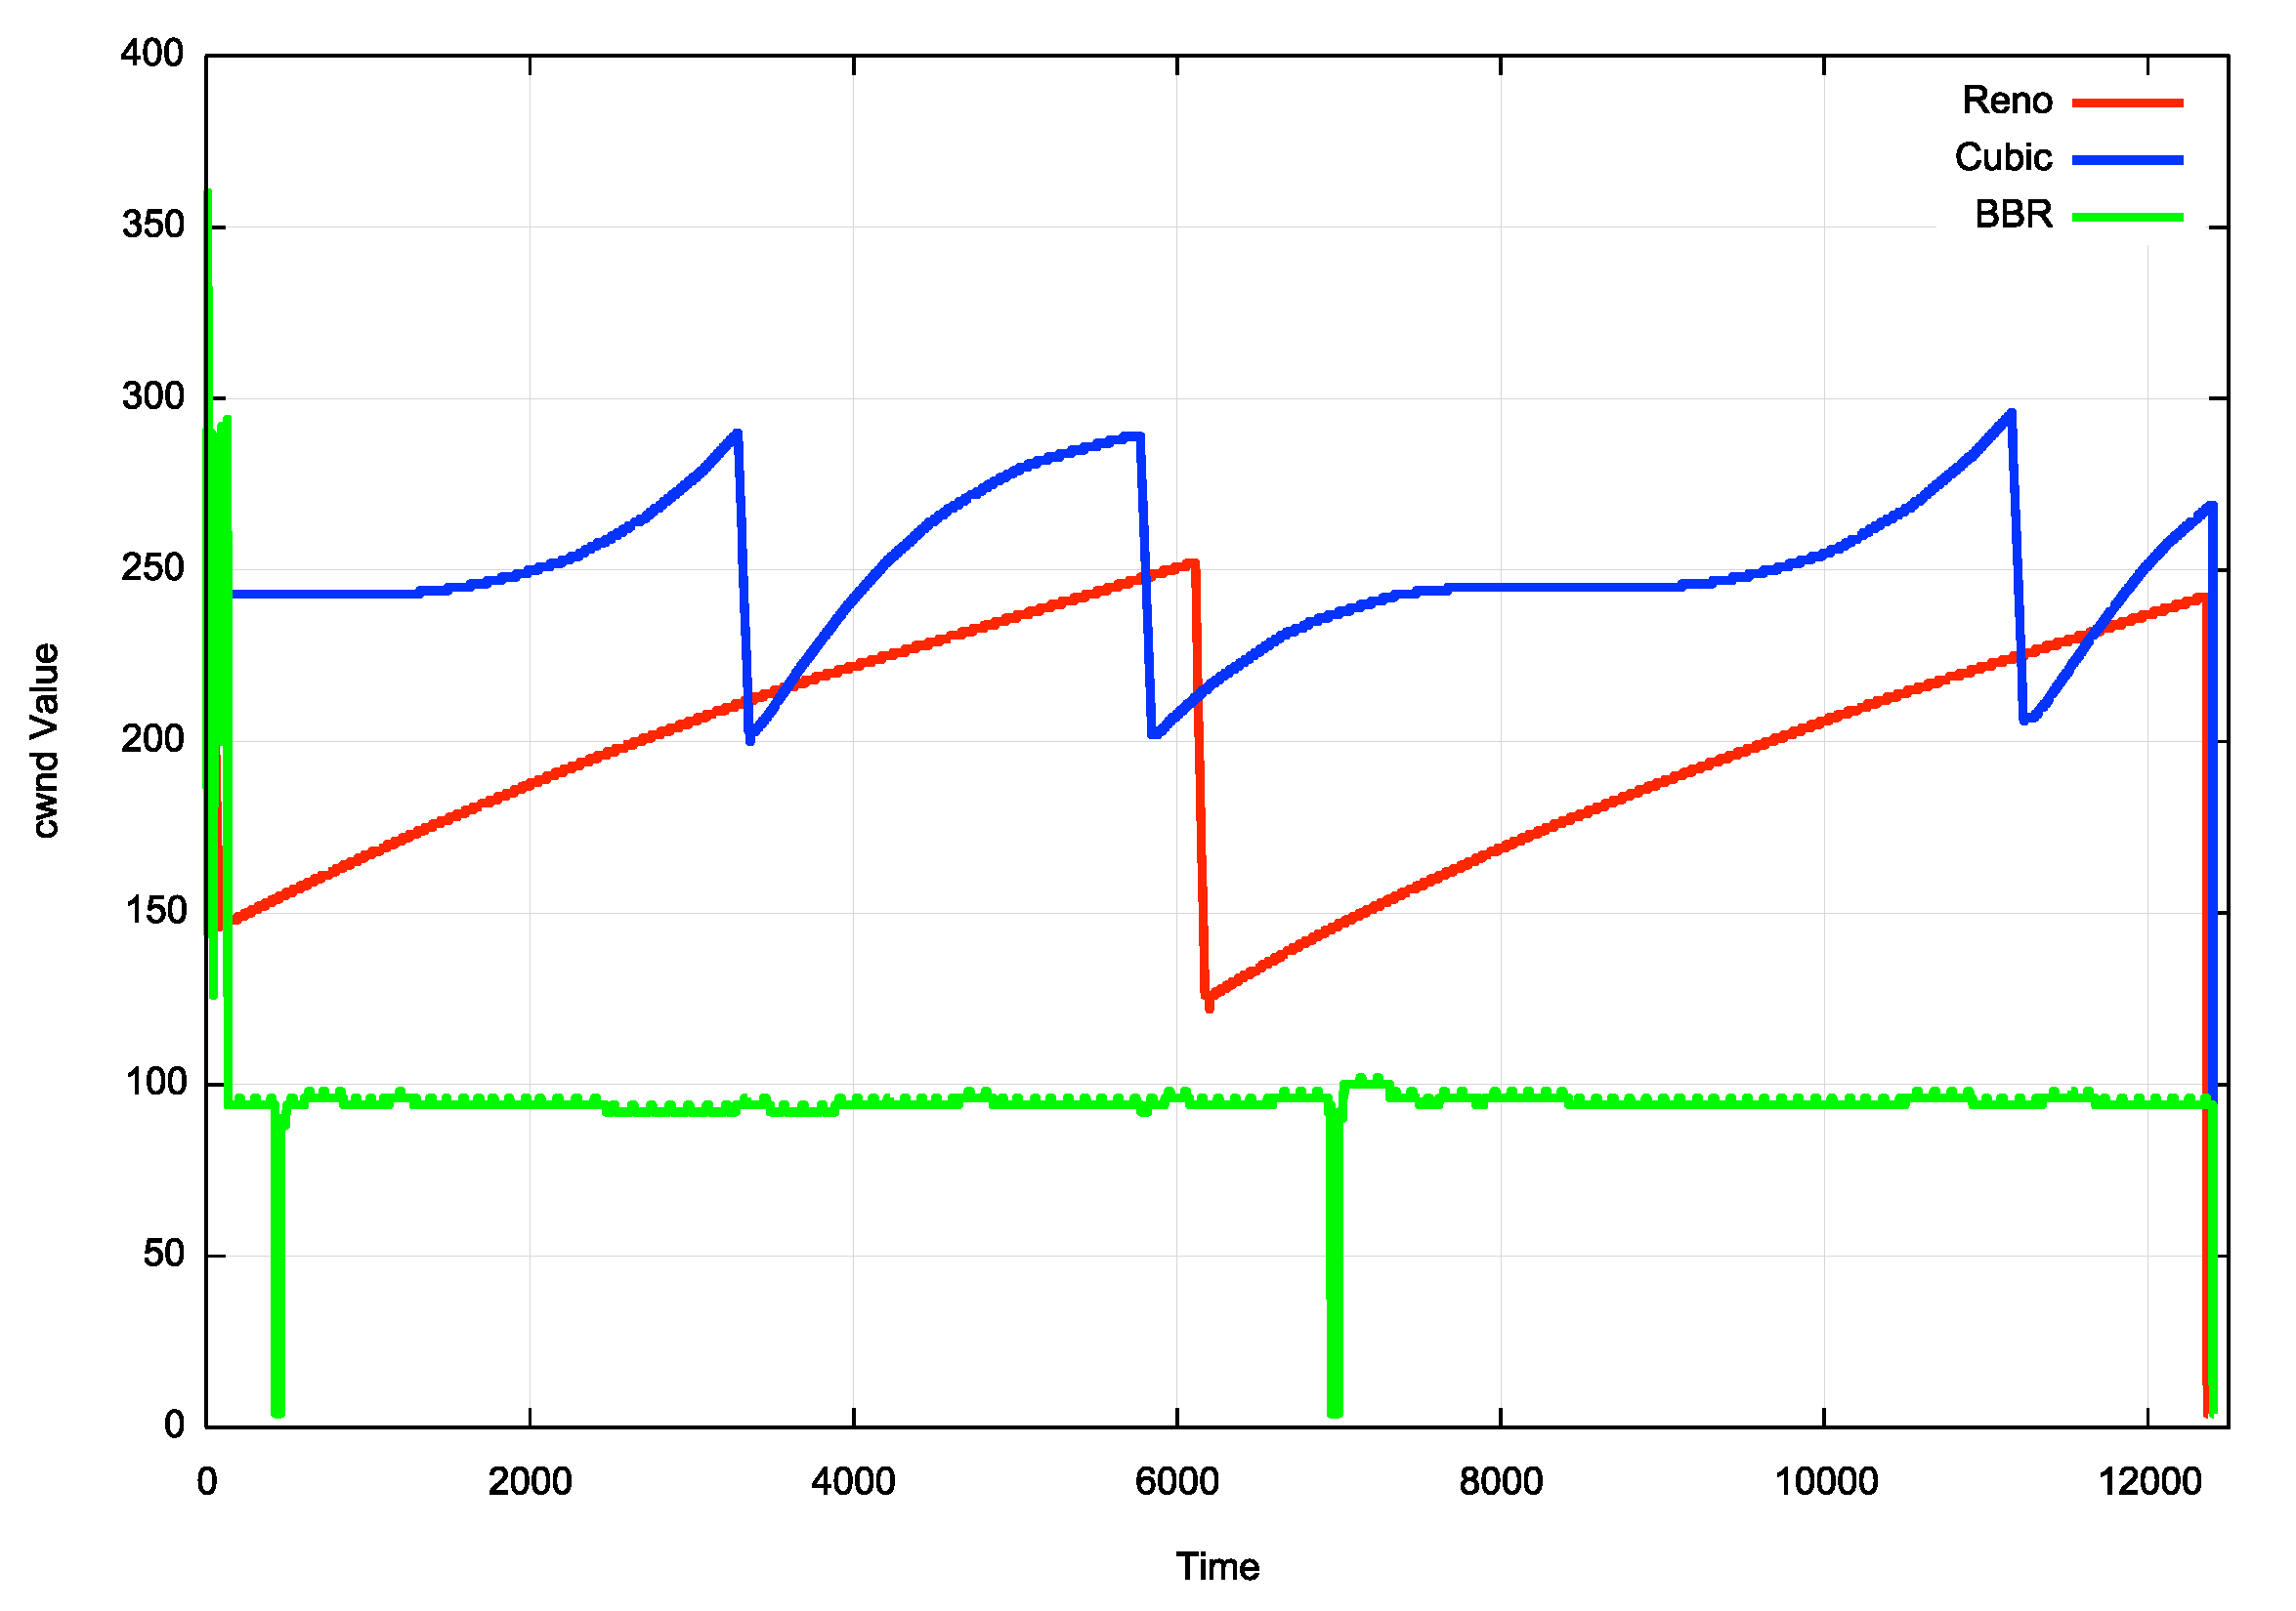
TCP Flow Control Algorithms
“Ideal” Flow behaviour for each protocol

Slide 26
iperf3 – cubic, 40 seconds

Slide 27
iperf3 – cubic, 40 seconds
Slow Start
Queue Drain
Congestion Avoidance

Slide 28
iperf3 - bbr
Satellite handover

Slide 29
Transport Protocol Considerations
Starlink services have three issues:
Very high jitter rates – varying signal modulation
High levels of micro-loss (1.4%) – largely due to loss on satellite handover events (every 15 seconds)
Common bearer contention between users
Loss-based flow control algorithms will over-react and pull back the sending rate over time
Short transactions work very well
Paced connections (voice, zoom, video streaming) tend to work well most of the time
To obtain better performance you need to move to flow control algorithms that are not as loss-sensitive, such as BBR

Slide 30
Other considerations
Senders should use fair queuing to pace sending rates and avoid bursting and tail drop behaviours
SACK (selective acknowledgement) for TCP can help in rapid repair to multiple lost packets
It’s likely that ECN would also be really helpful to the protocol to disambiguate latency changes due to satellite behaviours and network queue buildup - i.e. only shrink the congestion window in response to ECN signals, not packet loss!

Slide 31
Starlink Performance
Starlink is perfectly acceptable for:
short transactions
video streaming
conferencing
The service can sustain 40 – 50Mbps delivery for long-held sessions during local peak use times in high density use scenarios
The isolated drop events generally do not intrude into the session state
In off-peak and/or low-density contexts it can deliver 200-300Mbps
Or, if the server uses BBR, then higher throughput is possible!
It can be used in all kinds of places where existing wire and mobile radio systems either under-perform or aren’t there at all!
Its probably not the best trunk infrastructure service medium, but it’s a really good high speed last mile direct retail access service, particularly for remote locations!

Slide 32
Making Starlink Faster
Increase antennae transmitter power
Use higher gain antennae with narrower beams
Drop the orbital altitude to 340Km
Drop the minimum elevation angle from 25º to 20º
Use more bands (Ka-, V-, and E- bands)
(Proposed measures described in an October 2024 FCC application by Starlink)

Slide 33
Questions?

