Slide 1
The Evolution of Internet Markets
Geoff Huston AM
Chief Scientist, APNIC

Slide 2
Conversations change
In the Internet infrastructure world we used to talk about “Tier 1” transit providers, peering, paid peering, and customers
Then we talked about Exchange Points, Data Centres and Peering
Then autonomous content distribution networks and embedding content in access networks
Today, the only topic we appear to talk about is AI!
Why is this such a rapidly changing environment?

Slide 3
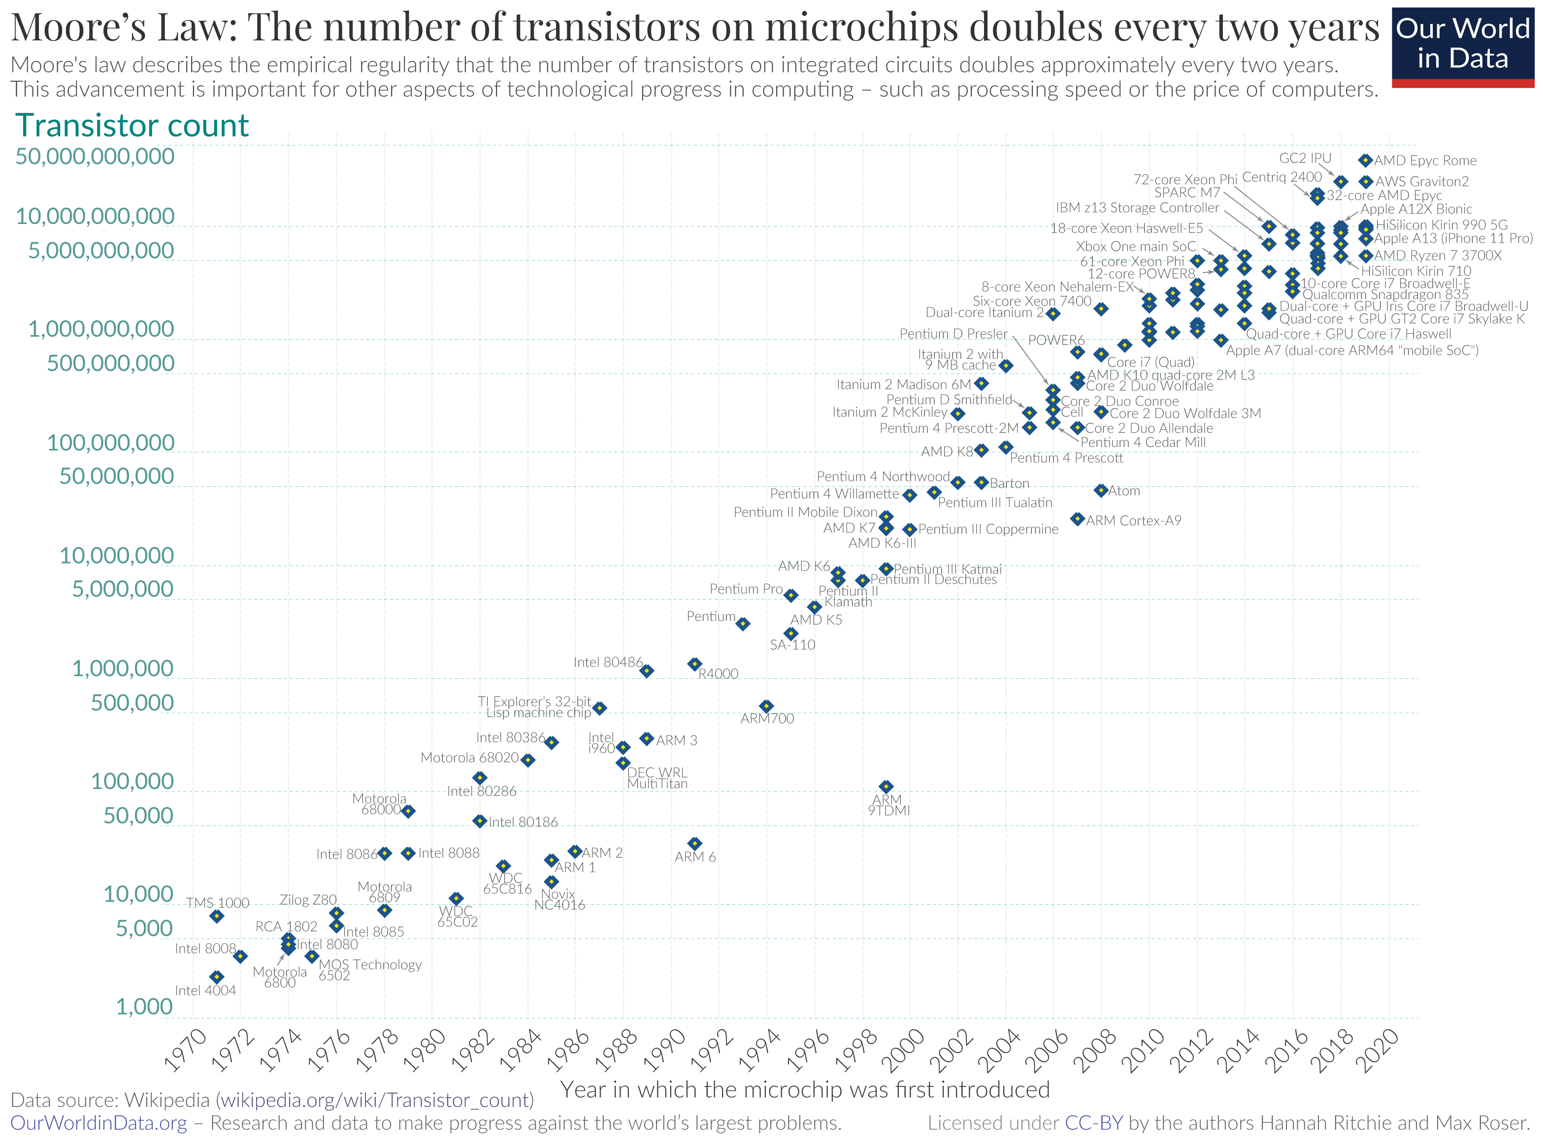
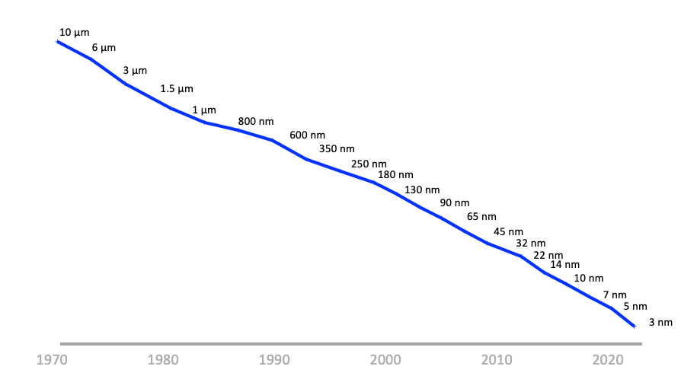
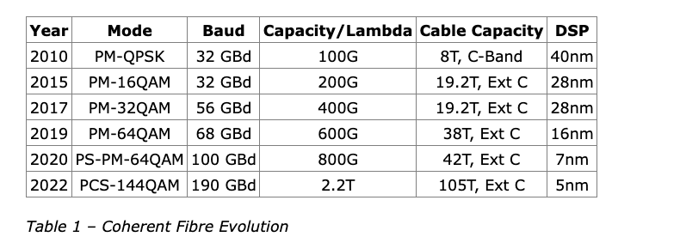
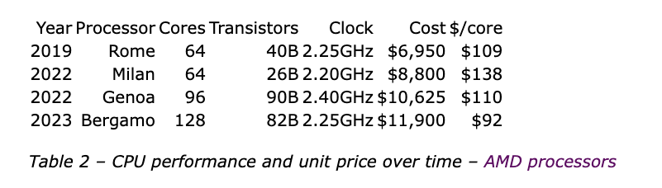
The Driver of Change: Moore’s Law
Silicon Chip Track Width over time
Silicon Chip transistor counts

Slide 4
What does this mean?
The economics of silicon chip evolution have a profound impact on the computing space - few technologies has been able to survive more than 5 years in this sector!
  What was too expensive, too slow, or just impossible to scale up becomes quickly viable when the currency of computation and storage changes so quickly
The result is that no business plan has been able to survive more than 5 years in the computing/communications marketplace!
From planning, to debut, to consolidation, maturity, and then to obsolescence, a market service offering has at best just 5 years to do it all!

Slide 5

Moore’s Law is BRUTAL!
This is a BRUTAL market environment:
  Smaller entities almost always fail
  Some larger entities may get sucked up by being acquired by yet larger entities
  And only the very largest of entities can afford to buy a future
Gittes: How much are you worth?
Cross: I've no idea. How much do you want?
Gittes: I just want to know what you're worth. Over
ten million?
Cross: Oh my, yes!
Gittes: Why are you doing it? How much better can you
eat? What can you buy that you can't already
afford?
Cross: The future, Mr. Gittes - the future!
Chinatown (1974)

Slide 6
Moore’s Law is BRUTAL!
Consolidation and Centrality of goods and service provision is not a surprising outcome in this space – its INEVITABLE
  What would be far more surprising would be if consolidation and centrality was NOT the outcome!

Slide 7
The 1990’s Internet
Interconnection Friction

Slide 8
Change
Abundance and scale have driven radical changes across the Internet’s basic architecture
  Networks are no longer shared transit services that connect users to services
    (“sharing” is so yesterday!)
  Content distributors are using abundance of computing, storage and communications capacity to bring content and service replicants to each user in advance of actual use

Slide 9
Today’s Internet Architecture

Slide 10
Change
Greater capacity in edge networks has enabled…
Greater use of high-volume streaming content, which has lead to …
Adoption of higher capacity technologies in edge networks, which generates economies of scale that enables …
Reductions in the unit cost of carriage in edge networks
“Bigger” induces “faster” and “cheaper”!

Slide 11
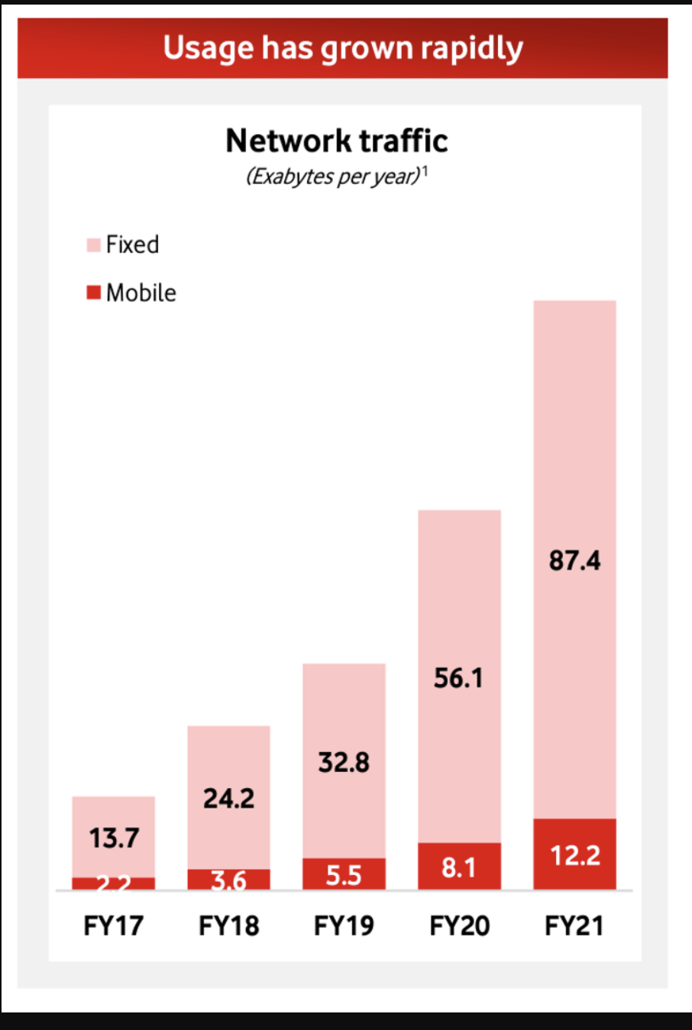
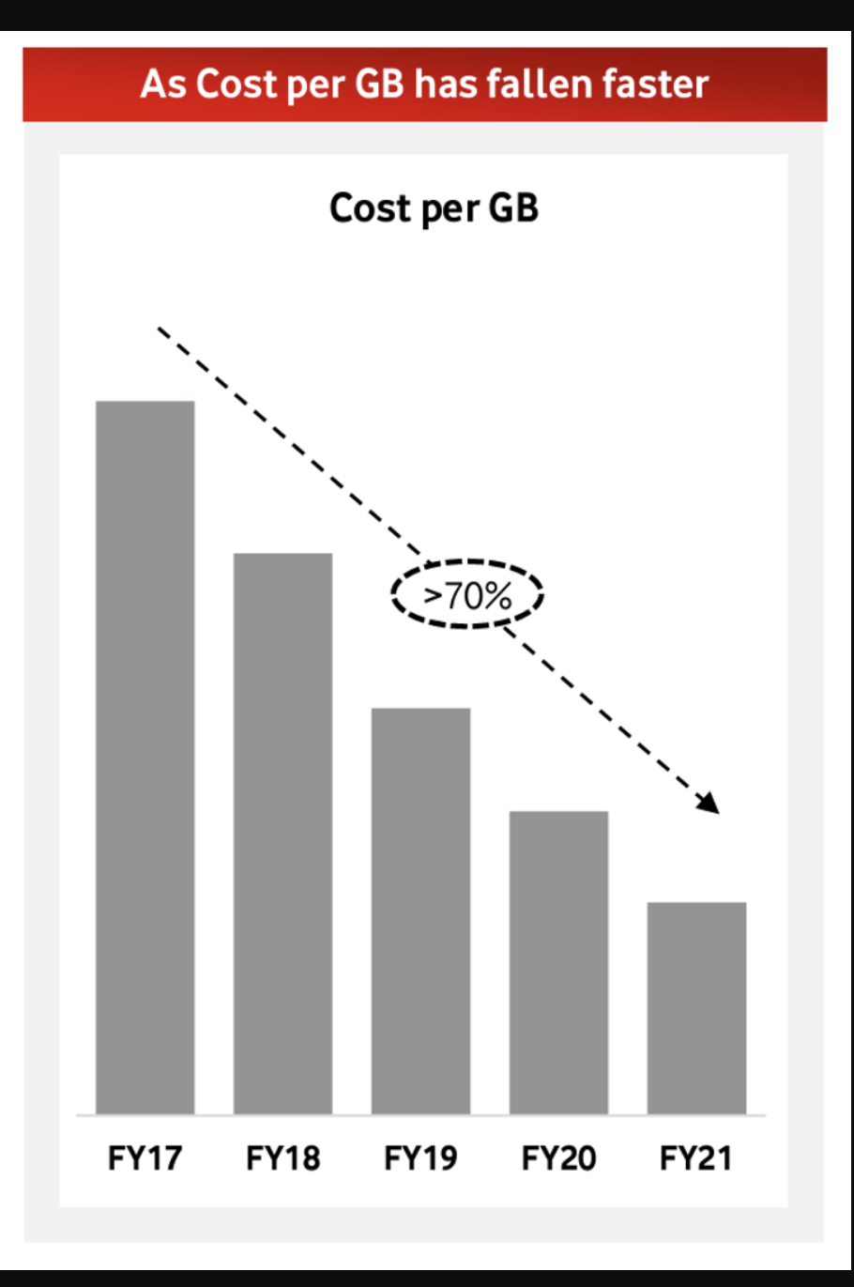
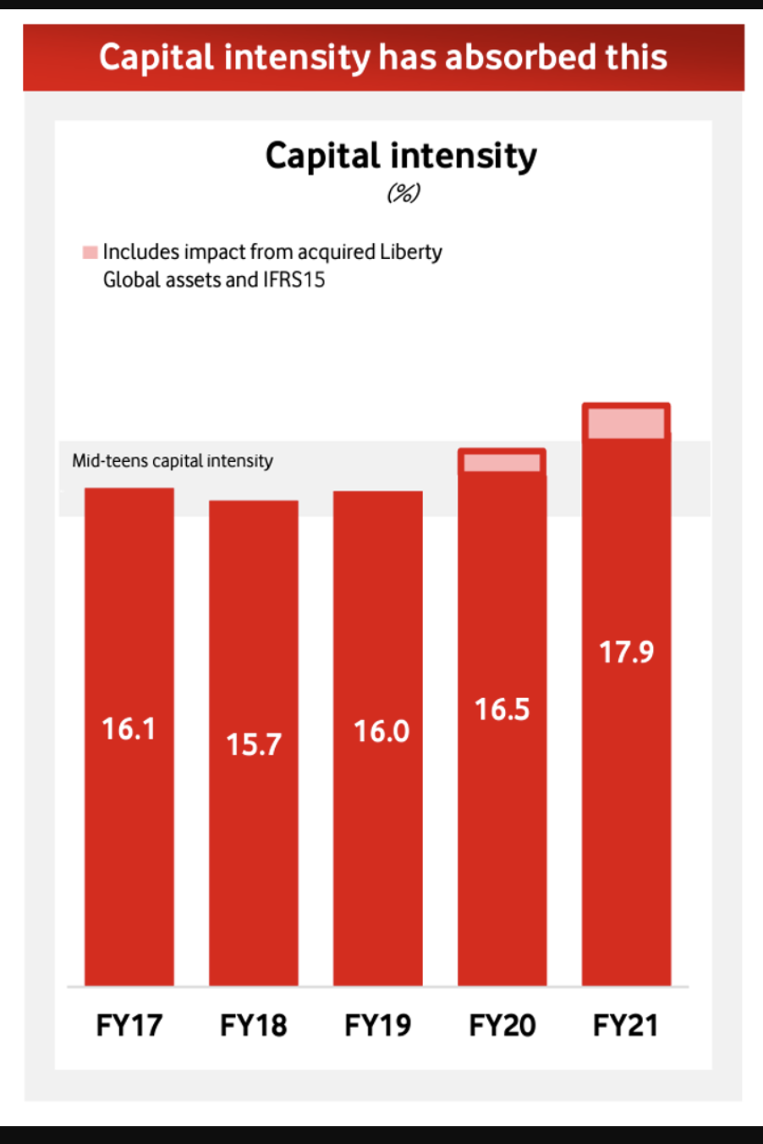
Change
Source: Vodaphone 2021 Investor Briefing

Slide 12
Change
Refreshing edge network technologies allows for significant capacity increases
  3G -> 4G -> 5G mobile access
  DSL -> VDSL -> Fibre in wired access
Failure to reinvest in edge access places the operator in a disadvantaged competitive position

Slide 13
Changing Internal Arrangements
The comprehensive domination of over-the-top service provision
  The carriers’ case that increases in carried traffic volumes should be funded by content streamers is based on a desire by the carriage sector to cling to outdated technology and financial models for carriage that are well and truly over their Use By dates!

Slide 14
Regulatory Responses?
Regulate the interconnection regime?
  Poor outcomes that distort the interconnection market when regulators have attempted this
Regulate inter-provider pricing?
  Allows the less efficient operators to be cross-subsidised by more efficient operators
  Inhibits technology refresh in carriage networks

Slide 15
How to deal with termination monopolies?
Neutralise the capital investment infrastructure as a competitive level and facilitate competition at the retail level
  Australian NBN-style of common access network, or New Zealand’s Crown Infrastructure Partners program
  Allow seamless consumer switching between retail providers
  Encourage MVNO operators in the mobile space

Slide 16
What are we learning?
At no time in the past 70 years has the pace and impact of technology-induced change slackened off
  Moore’s Law has, remarkably, just kept on delivering outcomes!
Conventional responses to market distortions have little leverage in markets already dominated by small cliques of massively scaled providers
For these providers, speed to market is far more important than quality and resilience of the offering
  So, we are in crisis-mode attempting to resource the public sector to react to the frightening level of malicious and disruptive attacks which exploit the weaknesses of immature and poorly understood infrastructure platforms and service offerings that come from an overly exploitative private sector
And we just can’t seem to be able to change this situation!

Slide 17
How can we measure this?
By measuring the money!
As a general metric, market capitalization if market actors appears to be one of the few useful metrics that describe the extent of market centralization and consolidation
  And the enthusiasm of capital markets to support further consolidation by these entities!

Slide 18
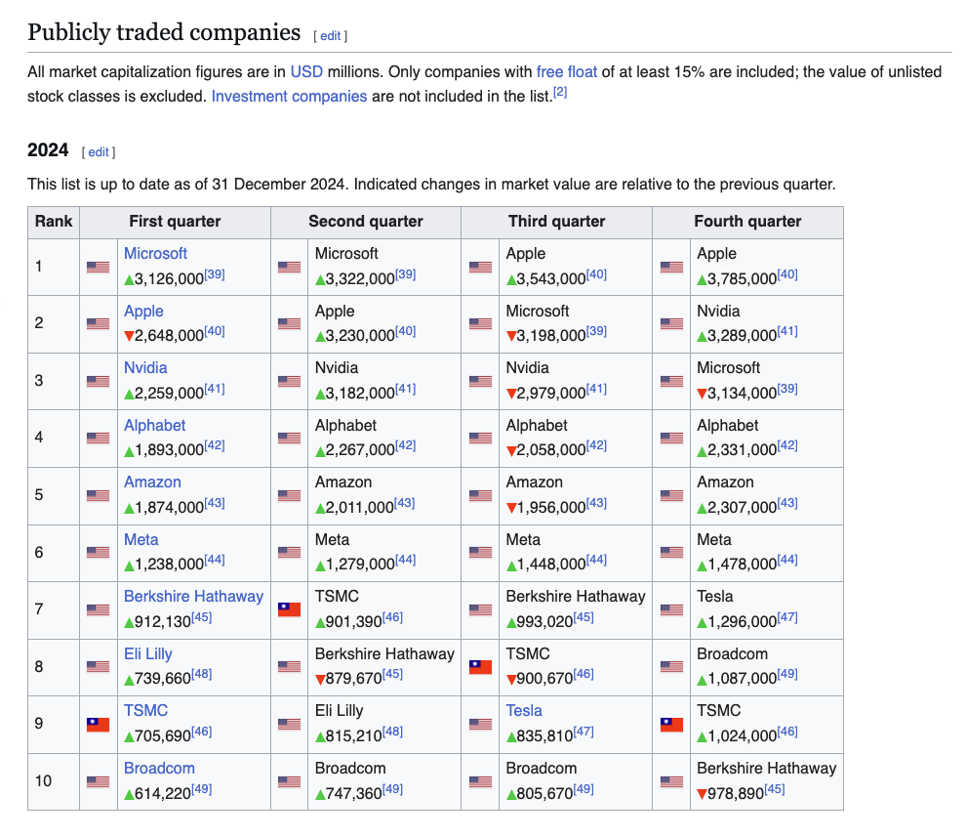
How can we measure this?
https://en.wikipedia.org/wiki/List_of_public_corporations_by_market_capitalization

Slide 19
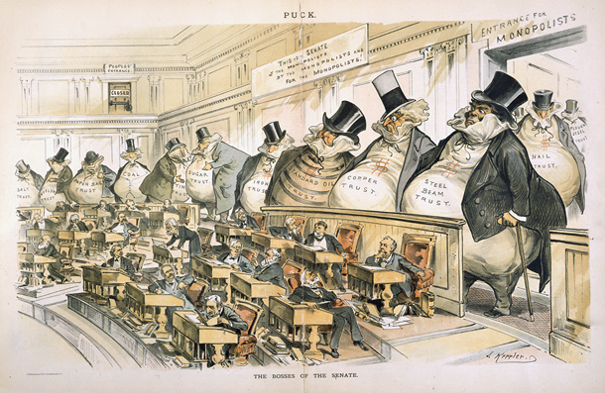
How can we measure this?
By measuring the money!
There’s the reported sums spent by market actors on political lobbying
In the US in 2024 the communications and electronics sector spent some $585M on political lobbying
https://www.opensecrets.org/federal-lobbying/ranked-sectors

Slide 20
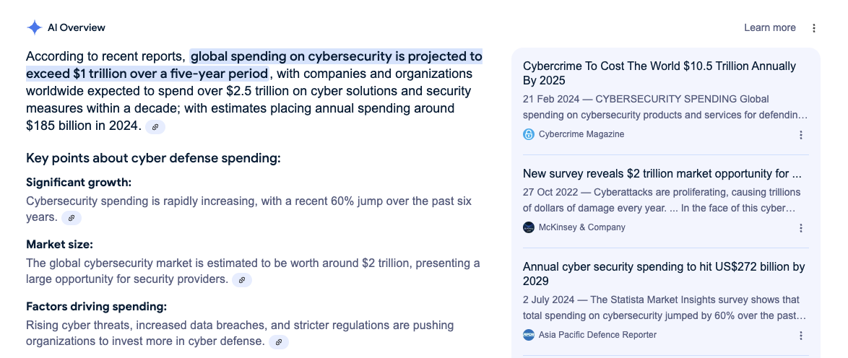
How can we measure this?
By measuring the money!
And the sums spent by the public sector in cyber response and resilience measures

Slide 21
This is probably not “evolution”
We are playing on the edge of a number of tipping points….

Slide 22
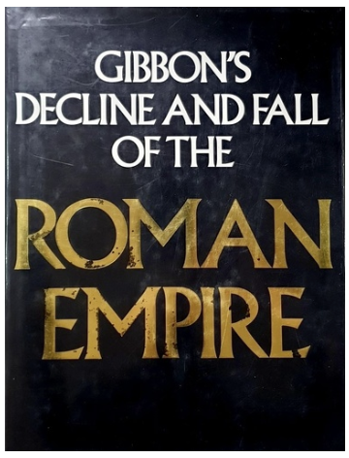
This is probably not “evolution”
We are playing on the edge of a number of tipping points….

Slide 23
Thanks!

