Slide 1
QUIC
Geoff Huston AM
Chief Scientist, APNIC

Slide 2
TCP is..
The workhorse of the Internet!
A transport protocol that constructs a reliable full duplex adaptive streaming service on top of an unreliable IP datagram service
Uses a coordinated state between the two end systems without any network intervention or mediation
Uses a sliding window to allow lost data to be resent
Uses ACK-clocking to regulate the sending behaviour to match network path capacity estimate

Slide 3
TCP is NOT…
Fully independent of the underlying platform Operating System’s transport services
Fully multi-stream (it has head-of-line blocking)
Fully multi-path (yes, MP-TCP exists, but there are some outstanding issues here!)
Address-agile
Free from on-the-wire network intervention (TCP control parameters are sent in the clear)
Has e2e encryption as a second step / afterthought (TLS)
Everything for everyone – it relies on the application to perform data framing and in-band control

Slide 4
Can we fix this in TCP?
We’ve been trying to fix this for about 40 years
Without much success!
TCP does have a capabilities exchange in the opening handshake, but it has only been used for Max Segment Size, Window Scaling and Selective Acknowledgement
A large part of the issue is the proliferation of TCP-aware middleware embedded within networks, which prevents significant modification of TCP behaviours
So how about an entirely new protocol?

Slide 5
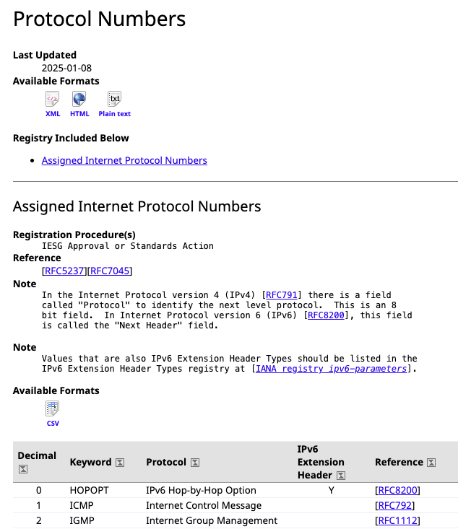
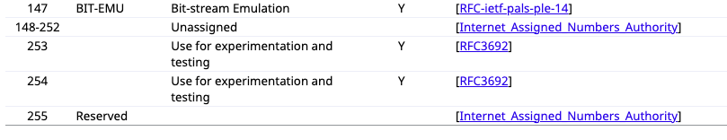
A New Protocol?
We could define a new IP protocol
We still have 105 available protocol number slots in the IANA Protocol Number registry!
…

Slide 6
Unlikely!
It’s the same problem .. every host and every piece of active middleware needs to be aware of this new protocol
Widespread adoption of a new transport protocol in the public Internet is just not a realistic option
Just look at the protracted adoption saga for IPv6 to understand the issues around the dynamics of technology adoption in a highly decentralized environment

Slide 7
Borrowing from the Past
The Internet was conceived as an Inter-net, an overlay network that provided an end-to-end model of connectivity layered above a disparate collection of networks
Why not place a new transport protocol ABOVE an end-to-end UDP service as an overlay transport?
And why not scramble the fields with end-to-end encryption to deter network middleware from intruding (and ossifying) the protocol?
Which gives us QUIC!

Slide 8
QUIC is a mashup of TCP and TLS
QUIC
HTTP/3
HTTP/2
HTTP
Multi-stream
HTTP
TLS
Session Encryption
QUIC
Multi-stream
Encryption
Data stream integrity
Congestion Control
e2e encrypted
TCP
Data stream integrity
Congestion Control
e2e encrypted
UDP
IP

Slide 9
QUIC is…
Constructed upon a basic UDP datagram service
All other transport services (data integrity, session control, congestion control, encryption) are shifted upwards in the protocol stack towards the application. A host platform may provide a QUIC API as part of the host library, but the application can also provide its own QUIC service independent of the host

Slide 10
QUIC is…
So much more than just “encrypted TCP over UDP”
Support for multi-stream multiplexing that avoids head-of-line blocking and exploits a shared congestion and encryption state
Faster - Combines transport and encryption setup exchange in a single 3-way exchange at session start, and supports fast reopen
Customisable - QUIC implementations can use individual flow controllers
QUIC places its transport control fields inside the encryption envelope using TLS 1.3, so QUIC features minimal exposure to the network
Supports Remote Procedure Call service models as well as bit-streaming and datagram services

Slide 11
QUIC is address agile
NATs are potentially hostile to QUIC because of the outer UDP wrapper
A NAT may rebind a QUIC session (shift the externally visible address/port of a host during a session), as NATs are not generally aware of UDP streaming states
QUIC uses a persistent “connection ID”
If a host receives a QUIC frame with the same connection ID and a new source IP address / port it will send a challenge by way of a random value that should be echoed back. This is all performed within the e2e encryption envelope. That way a QUIC e2e session can map into new address/port associations on the fly

Slide 12
QUIC also…
Is IP fragmentation intolerant – QUIC uses PMTUD, or defaults to 1,200 octet UDP payloads
Never retransmits a QUIC packet – retransmitted data is sent in the next QUIC packet number – this avoids ambiguity about packet retransmission
Extends TCP SACK to 256 packet number ranges (up from 3 in TCP SACK)
Separately encrypts each QUIC packet – no inter-packet dependencies on decryption
May load multiple QUIC packets in a single UDP frame

Slide 13
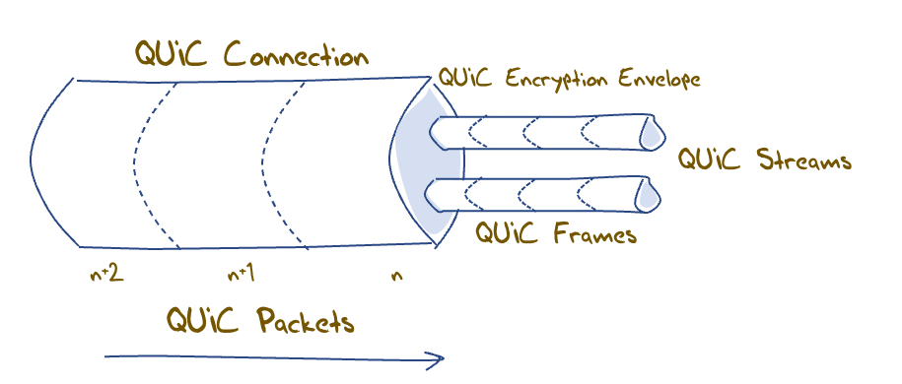
QUIC flow structuring
A QUIC connection is broken into “streams” which are reliable data flows – each stream performs stream-based loss recovery, congestion control, and relative stream scheduling for bandwidth allocation
QUIC also supports unreliable encrypted datagram delivery

Slide 14
QUIC is:
A logical evolutionary step for transport services, providing more flexibility, faster connection setup, and a larger set of transport services
It’s what we should expect from a capable modern transport protocol!

Slide 15
But…

Slide 16
QUIC and Network Load Balancing
Front-end load balances performing load balancing on UDP flows using the UDP connection 5-tuple
If the remote end performs NAT rebinding the load balancer will be thrown by this shift, and it has no direct visibility into the e2e session to uncover the connection ID
QUIC session
Source Address A
Server A
NAT re-binding
Load Balancer
NAT
Server B
Source Address B

Slide 17
QUIC and Network Load Balancing
Front-end load balances performing load balancing on UDP flows using the UDP connection 5-tuple
If the remote end performs NAT rebinding the load balancer will be thrown by this shift, and it has no direct visibility into the e2e session to uncover the connection ID
If we really want large scale QUIC with front-end load balancing and if we still need to tolerate NATs then we will need to think about how the end point can share the connection ID state with its front-end load balancer, or how to terminate the QUIC session in the front-end and use a second session to a selected server

Slide 18
QUIC and NIC Offloading
Many (most?) NICs these days offer ”TCP Offloading”
Platform sends a large data buffer to the NIC, and the processor in the NIC performs TCP segmentation
The NIC reassembles smaller received data units to a larger unit before raising an interrupt to the host processor
Relieves the CPU from TCP processing overheads, improving server capacity
Offloading QUIC to NICs is work-in-progress
But its looking good – QUIC is well suited to device offload
There is a need for mods to kernel and network drives, as well as QUIC libraries
It’s not here just yet, but it is looking promising!

Slide 19
Measuring QUIC

Slide 20
Triggering QUIC in HTTP
1 - Use the DNS to trigger QUIC:
Set up an HTTPS record for each server name, with value: alpn=“h3”

Slide 21
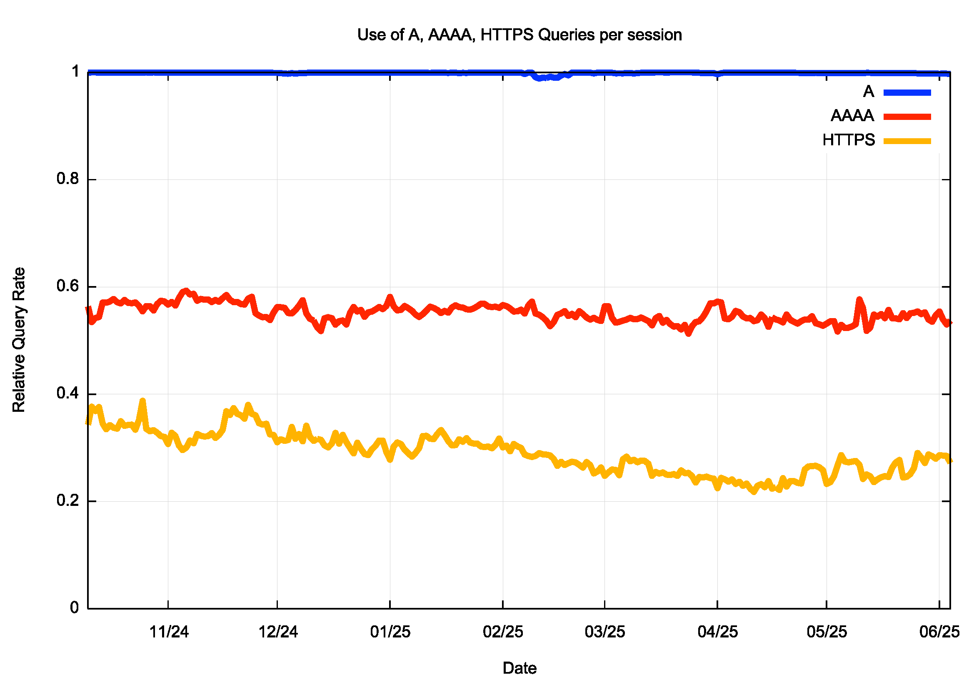
DNS HTTPS Query Rate
The query volume for DNS names now includes a query for the HTTPS record in addition to the A and AAAA queries
This has increased the total query volume by some 33%

Slide 22
Triggering QUIC in HTTP
1 - Use the DNS to trigger QUIC:
Set up an HTTPS record for each server name, with value: alpn=“h3”
2 - Use content-level controls to trigger QUIC:
Add Alt-Svc: h3=“:443” to the HTML headers
(This second method requires a subsequent query in a distinct HTTP session to allow the client to use the Alt-Svc capability.)

Slide 23
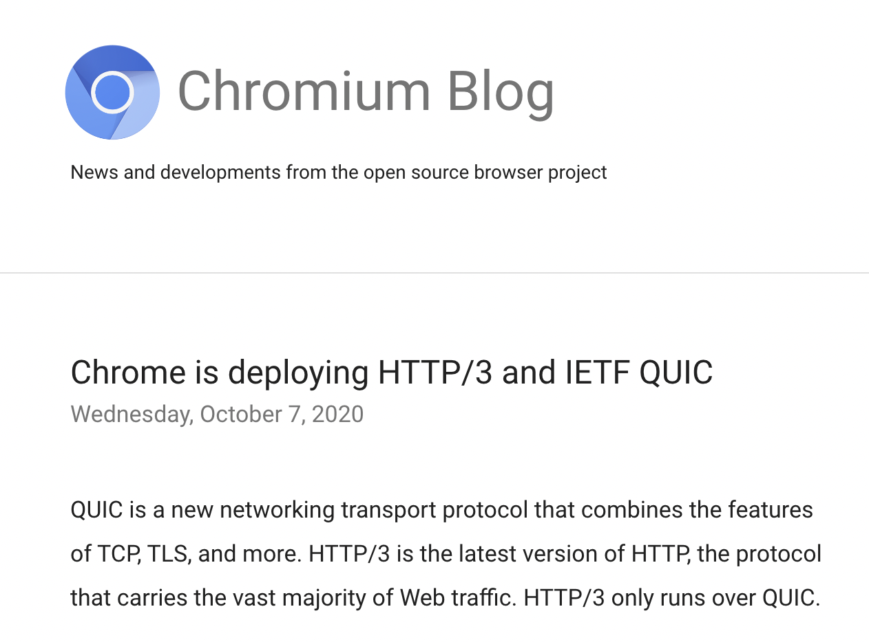
Setting Expectations
Chrome has a dominant share of browser instances - roughly, some 65%*
And Chrome has been supporting a switch to QUIC via the Alt-Svc directive since 2020
* Oberlo.com

Slide 24
Setting Expectations
Chrome has a dominant share of browser instances - roughly, some 65%*
And Chrome has been supporting a switch to QUIC via the Alt-Svc directive since 2020
Apple Safari is now supporting QUIC, using the DNS apln directive
So a QUIC-aware server platform should be seeing up to 85% of its sessions using QUIC
This figure is probably not achievable as the content level control requires some precise conditions for the “second” visit:
long enough between visits for the session keepalive timer to expire
Short enough such that the local cache of server capabilities has not expired
* https://gs.statcounter.com/browser-market-share

Slide 25
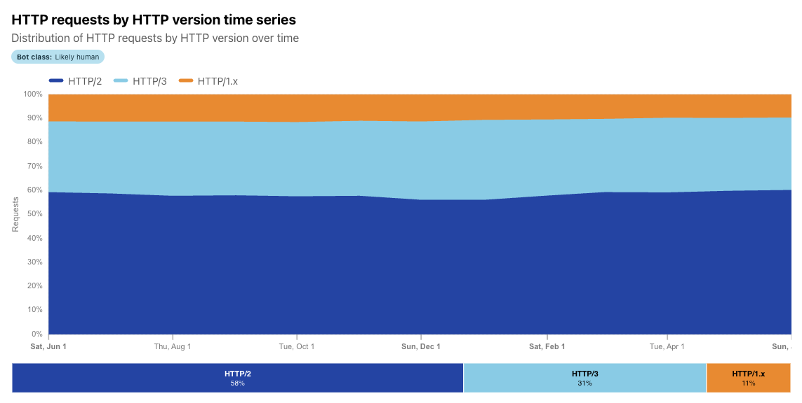

Cloudflare’s Numbers – 31%
12 Month Time Series

Slide 26
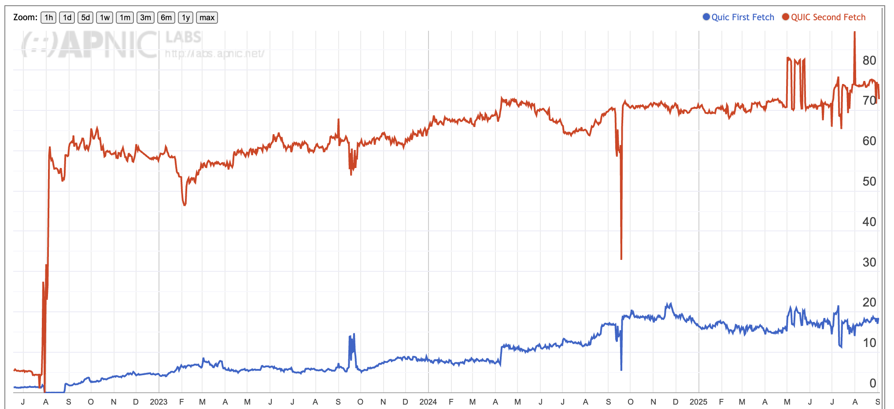
APNIC’s Numbers – 75%
Second and Subsequent Fetches – mainly Chrome clients are added here
First Fetch – mainly Safari clients

Slide 27
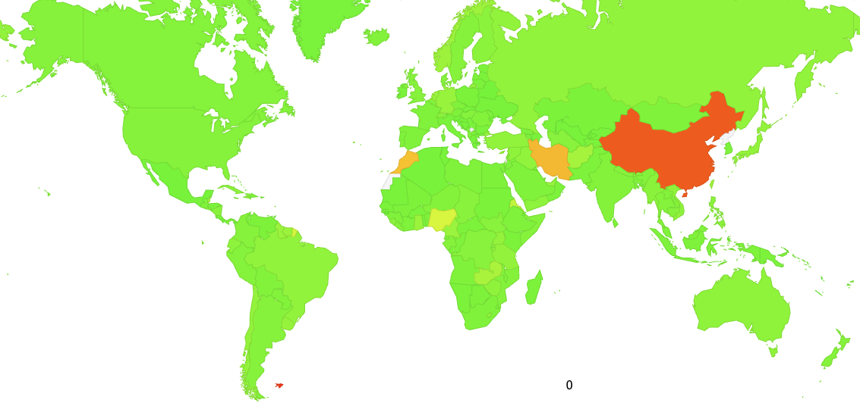
APNIC Measured QUIC Use – June 2025
100%

Slide 28
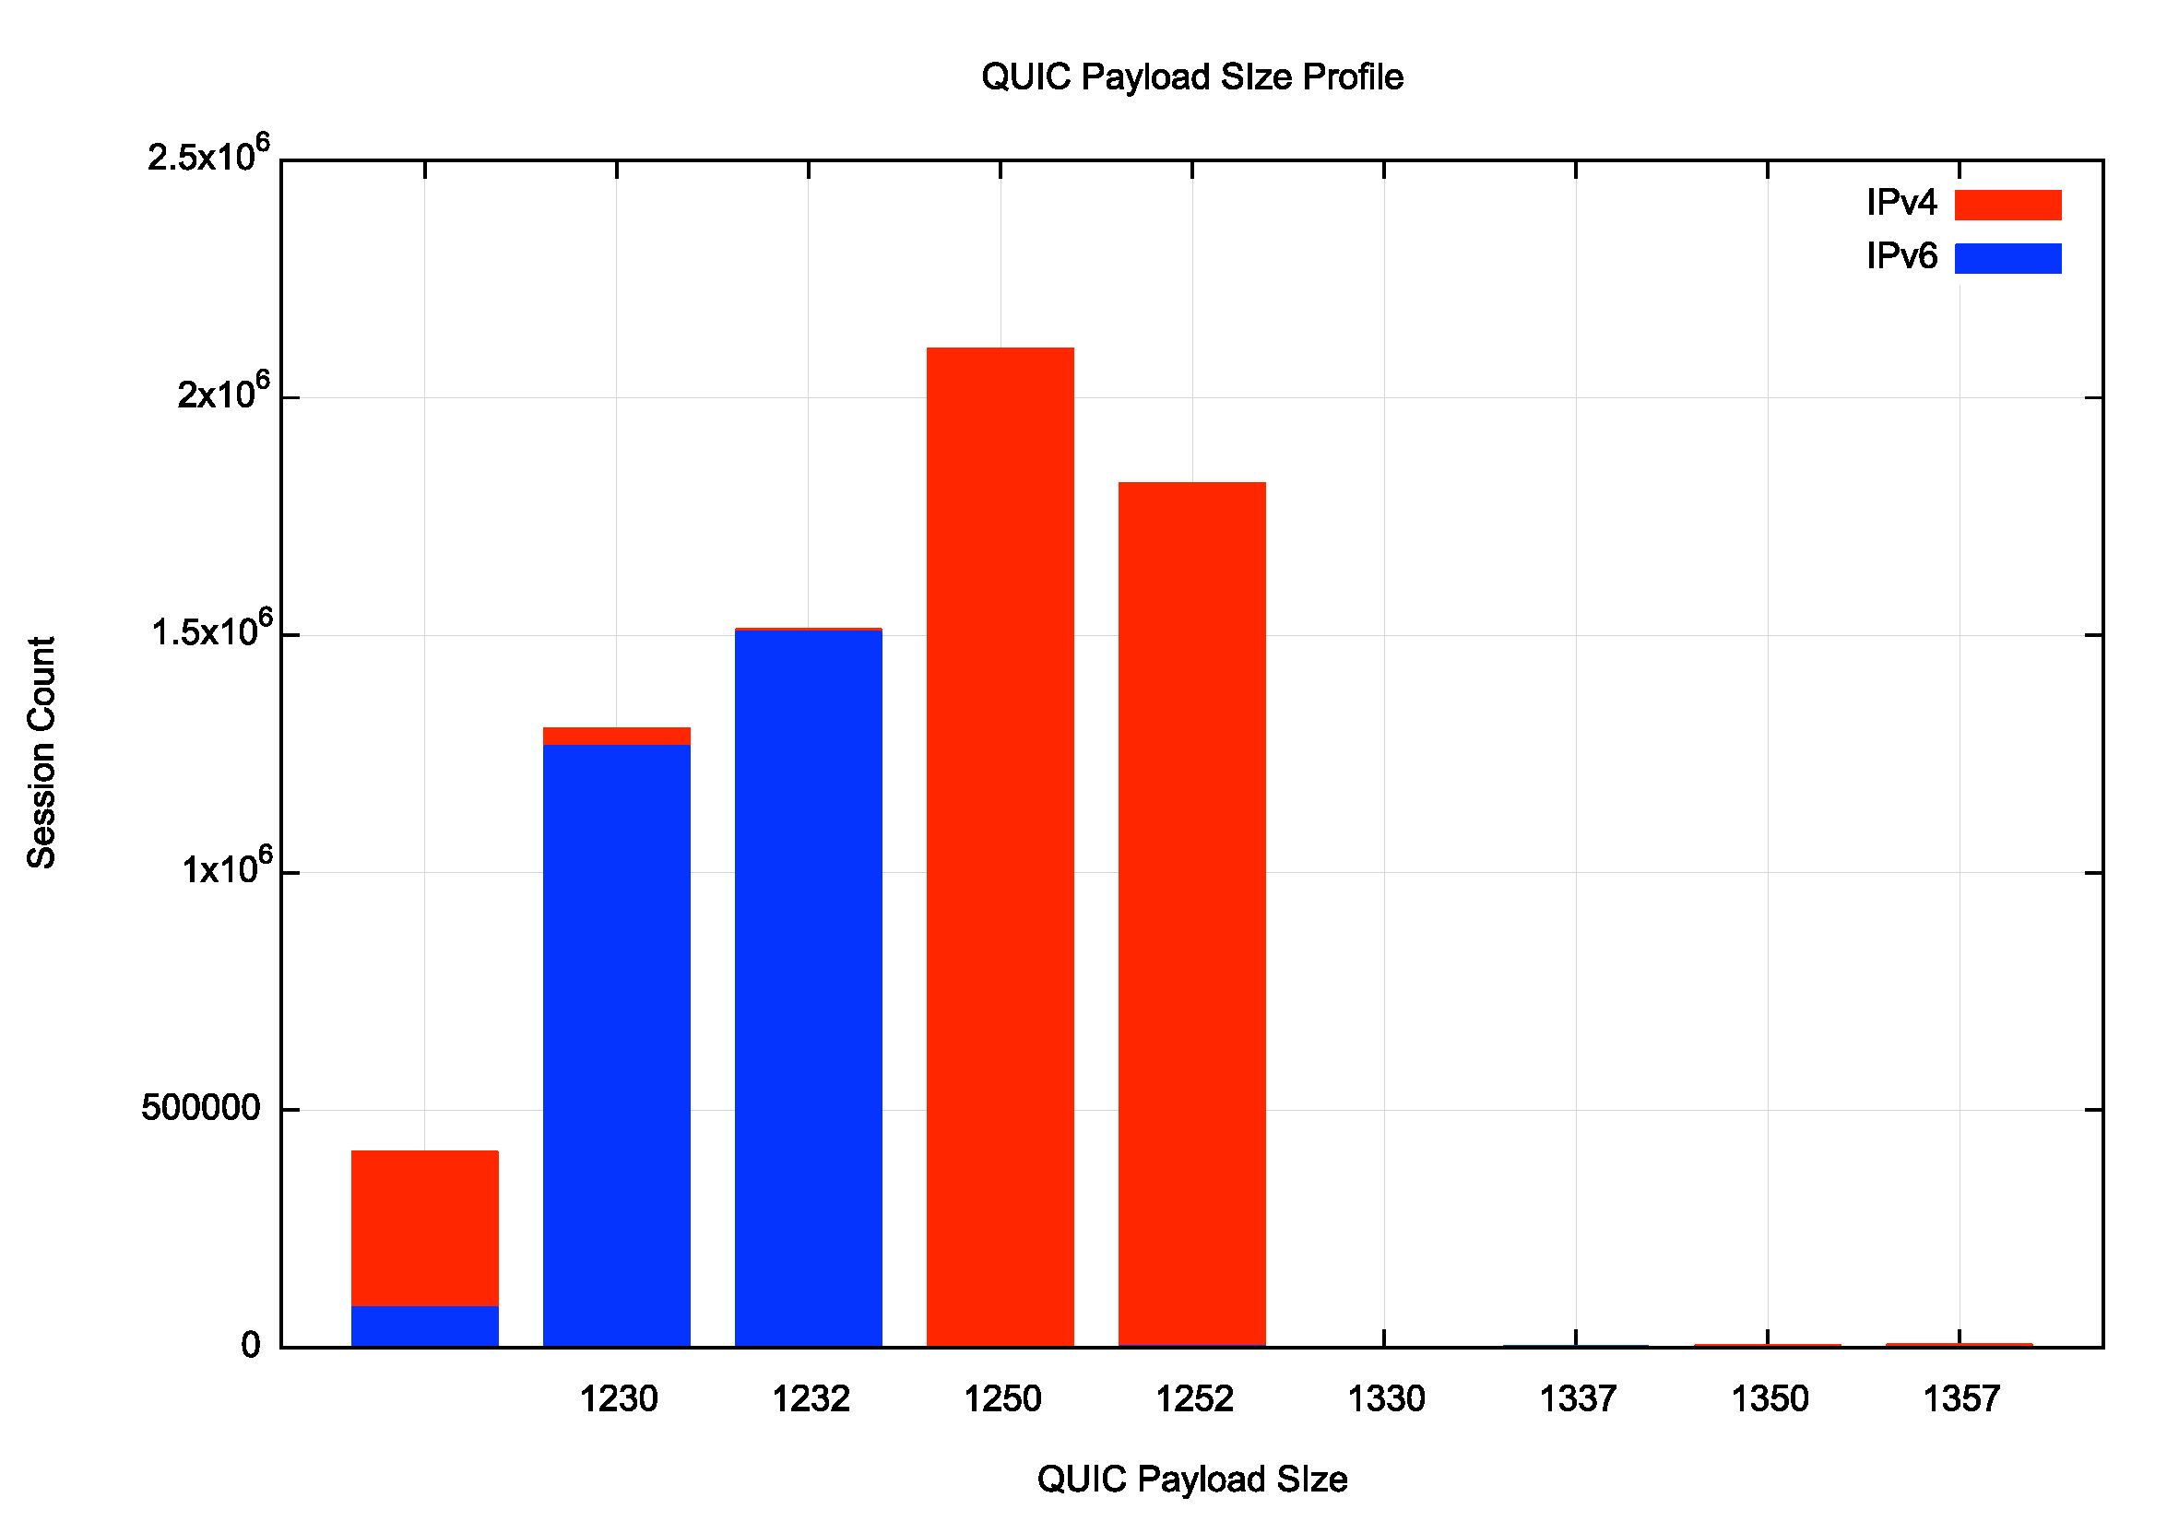
QUIC Payload Sizes
This data has been collected from a single day of measurement (4/6/25)
This disparity between V4 and V6 appears to reflect a popular implementation’s design choice to aim at an IP MTU of 1,280 bytes

Slide 29
Browsers and QUIC Use

Slide 30
Browsers and QUIC Use

Slide 31
QUIC Use
If QUIC access is supported by the current releases by both the major browsers then we should see a high QUIC use rate when the ability to use QUIC is signaled by both methods (alt-svc and DNS HTTPS)
What do we see?
In most locales the alt-svc method of triggering QUIC is supported by browsers and network infrastructure
What about the DNS HTTPS method of triggering QUIC?
Who uses a DNS HTTPS query?
Are HTTPS responses being filtered by DNS infrastructure in some cases?

Slide 32
The DNS HTTPS record
The HTTPS record can also contain ipv4hint and ipv6hint attributes
Any A and AAAA records for a name will be used by a client in preference to these hint attributes
But if there is no A and no AAAA record in the zone, then a HTTPS-aware client will be forced to use these address hint attributes
Let’s try that, and allow the client to use either HTTP/2 OR HTTP/3:
test_name IN HTTPS 1 . alpn="h2,h3" ipv4hint=192.0.2.1 ipv6hint=2001:db8::1

Slide 33
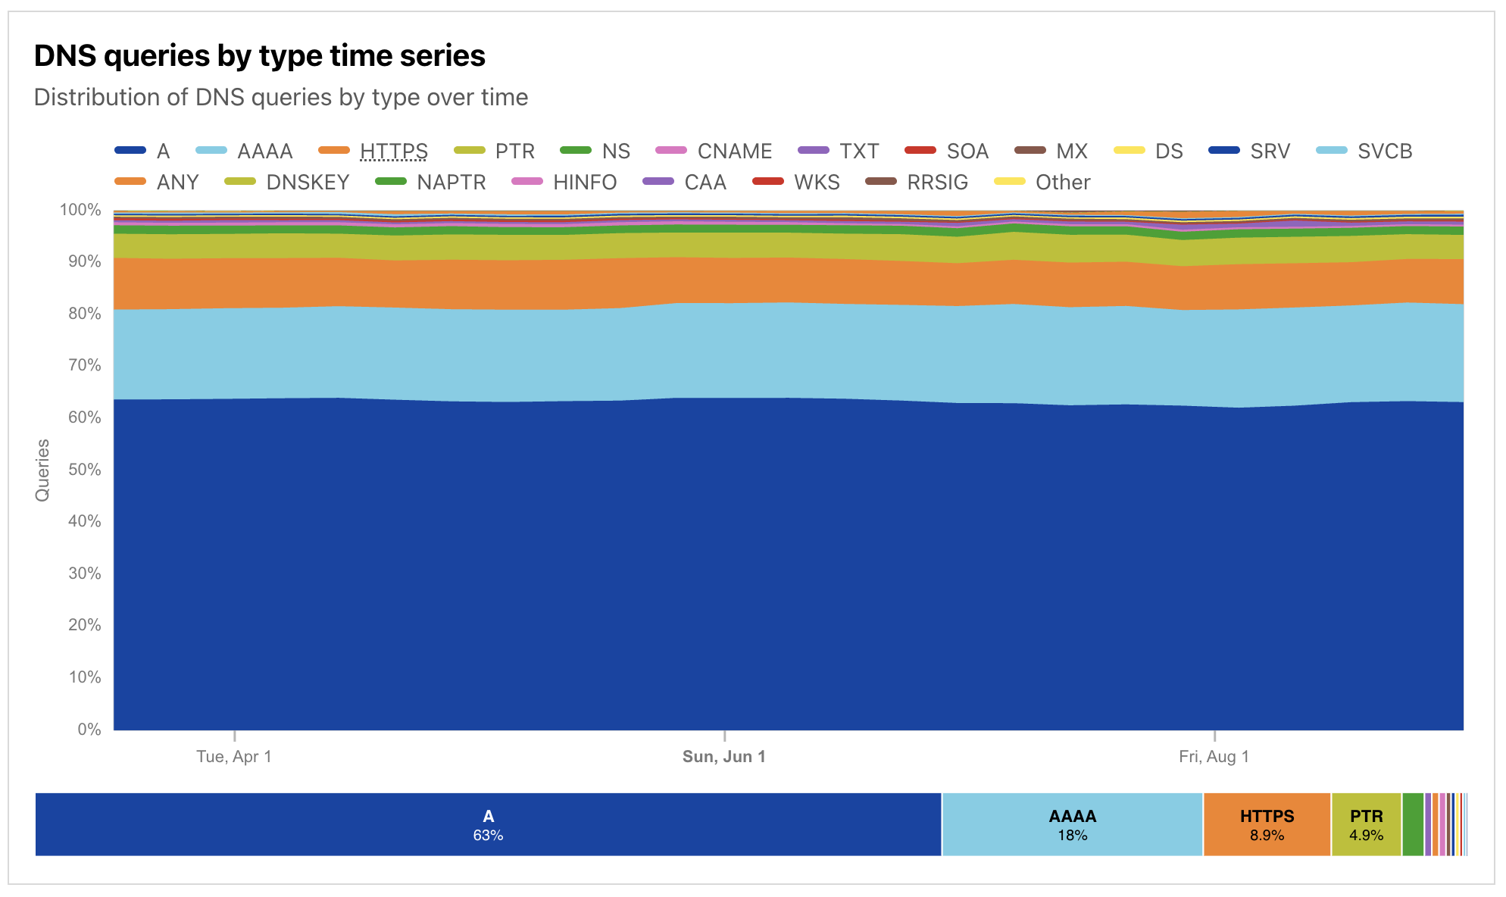
DNS HTTPS Use Rate
How many users query HTTPS records?
DNS Query Data from
Cloudflare Radar
A – 63%
AAAA – 18%
HTTPS – 8.9%

Slide 34
DNS HTTPS Use Rate
How many users can use DNS HTTPS responses?
Data collected over a 24-hour period (7/7/2025)
Few Chrome users (1.7%) perform an HTTPS query, and even fewer (0.1%) followup with a fetch of the web object.
Most Safari users (97.3%) perform an HTTPS query, and most (96.3%) followup with a fetch of the web object. Fewer users (75%) prefer to use QUIC to perform web object retrieval when given the choice.

Slide 35
DNS HTTPS Use Rate
How many users can use DNS HTTPS responses?
Data collected over a 24-hour period (7/7/2025)
Why is Safari not using QUIC in 25% of cases?
Few Chrome users (1.7%) perform an HTTPS query, and even fewer (0.1%) followup with a fetch of the web object.
Most Safari users (97.3%) perform an HTTPS query, and most (96.3%) followup with a fetch of the web object. Fewer users (75%) prefer to use QUIC to perform web object retrieval when given the choice.

Slide 36
DNS HTTPS Use Rate
How many users can use DNS HTTPS responses?
Data collected over a 24-hour period (7/7/2025)
Chrome uses alt-svc and not DNS HTTPS
Safari uses DNS HTTPS
Few Chrome users (1.7%) perform an HTTPS query, and even fewer (0.1%) followup with a fetch of the web object.
Most Safari users (97.3%) perform an HTTPS query, and most (96.3%) followup with a fetch of the web object. Fewer users (75%) prefer to use QUIC to perform web object retrieval when given the choice.

Slide 37
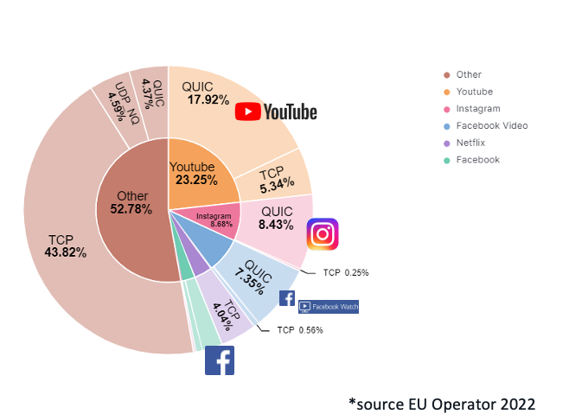
Network Traffic Volume
Presentation to RIPE 86: The New Encrypted Protocol Stack and How to Deal with it – Bart van de Velde, Cisco

Slide 38
Why is QUIC important?
Because QUIC is fast
Because QUIC encrypts everything
No visible transport control settings
No visible Server Name Indication in the crypto-setup
No visible traffic profile other than inter-packet timing
And if you use a MASQUE-based VPN then there no residual visibility!

Slide 39
What does this mean for TCP?
It’s not looking all that good for TCP’s prospects
QUIC not only does faster start up, but it supports multi-channel in a frictionless manner
QUIC resists network operator efforts to perform traffic shaping through direct manipulation of TCP control parameters
QUIC allows the application service provider to control the congestion behaviour of its sessions

Slide 40
What does this mean for TCP?
Normally you would expect any transition from TCP to QUIC to take forever
BUT:
QUIC gives benefit to adopters through more responsive web services
QUIC does a better job of hiding content, which is a benefit to the service operator
QUIC has fewer external dependencies
QUIC can be deployed on a piecemeal basis
So it all may be over for TCP in a very small number of years!

Slide 41
What does this mean for the Internet?
IP was a network protocol that provided services to attached devices
The network service model used by IP was minimal
Packets may be dropped, fragmented, duplicated, corrupted and/or reordered on their path through the network
It’s left to the edge systems to recover from this network behaviour.
Efforts to expand the network’s role have foundered
QoS has just got nowhere!
Various forms of source-directed forwarding are resisted by network operators who want control over traffic engineering
apps
TCP Transport
$$$
network
media

Slide 42
The new Networking Space
And this is why QUIC is so interesting – it is pushing both network carriage and host platform into commodity roles in networking and allowing applications to effectively customize the way in which they want to deliver services and dominating the entire networked environment
QUIC is the application’s view of what Transport should be!
apps
$$$
apps
TCP Transport
Internal
Transport +
session security
QUIC and value transform
in the network stack
network
UDP Transport
network
media
media

Slide 43
What does this mean for the Internet?
The relationship between applications, hosts and networks has soured into mutual distrust and suspicion
The application now defends its integrity by wrapping up as much of the service transaction with encryption and indirection
QUIC (and MASQUE) is an intrinsic part of this process of wrapping up traffic in encryption and redirection
For the network operator there is little left to see
And I suspect that there is no coming back from here!

Slide 44
What can a Network Operator Do?
When all customer traffic is completely obscured and encrypted?
Traffic Shaping?
Regulatory Requirements for traffic interception?
Load Balancing / ECMP

Slide 45
The new Internet Space
“What you can’t dominate, you commoditise*”
Vertically integrated service providers have faded away into history - the deregulated competitive service industry continues to specialize rather than generalize at every level
Carriage is no longer an inescapable monopoly - massively replicated content can be used as a substitute for many carriage service elements
Control over the platform is no longer control over the user. Operating systems have been pushed back into a basic task scheduling role, while functions are being absorbed into the application space
* A related quote is Peter Thiel’s “Competition is for losers!”

Slide 46
Thanks!

