Slide 1
Internet Evolution (and IPv6)
Geoff Huston AM
Chief Scientist, APNIC

Slide 2
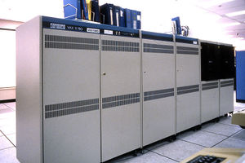
The Internet used to be simple…
1980’s:
The network was the transmission fabric for computers
It was just a packet transmission facility
Every other function was performed by attached mainframe computers
“dumb” network, “smart” devices

Slide 3
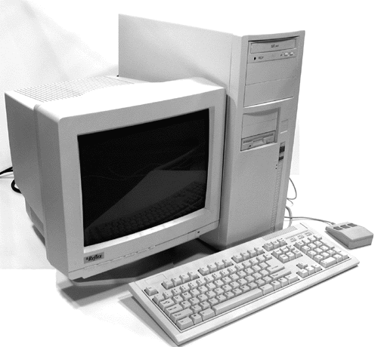

Then we went client/server
1990’s:
The rise of the Personal Computer as the “customer’s computer”
We started to make a distinction between “customers” and “network”
  The naming system was pulled into the network
  The routing system was pulled into the network
  Messaging, content and services were pulled into the network
We created the asymmetric client/server network architecture for the Internet

Slide 4
Internet Infrastructure of 2000
Rapid expansion of network infrastructure in many directions:
Exchanges, Peering Points and Gateways
Transit and Traffic Engineering
Data Centres and Service “Farms”
Quality of Service Engineering
MPLS, VPNs and related network segmentation approaches
Mobility Support – Mobile Networks
Customer Access Networks
Content Distribution Networks

Slide 5
Aren’t these all “different” networks?
Well, yes they are
The true genius of the Internet was to separate the service environment from the transmission technology
  Each time we invented a new comms technology we could just “map” the Internet onto it
  This preserved the value of the investment in “the Internet” across successive generations of comms technologies

Slide 6
What about the coming decades?
The seeds of the dominant factors of the future environment are probably with us today
The problem is that a lot of other seeds are here as well, and sifting out the significant from the merely distracting is the challenge
So with that in mind lets work out the big drivers in today’s environment…

Slide 7
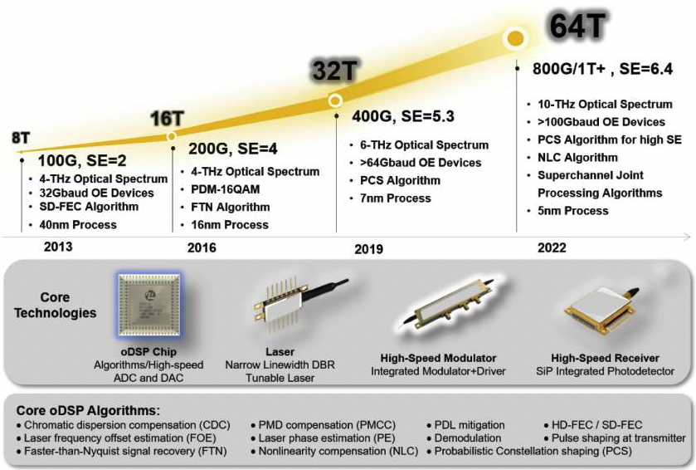
Abundant Capacity
Fibre cables continue to deliver massive capacity increases within relatively constant unit cost of deployment
https://www.ncbi.nlm.nih.gov/
(That 2022 number is probably low – at the end of 2022 we can pull 2.2T per lambda with a 190Gbd signal rate, giving a fibre capacity of 105T)

Slide 8
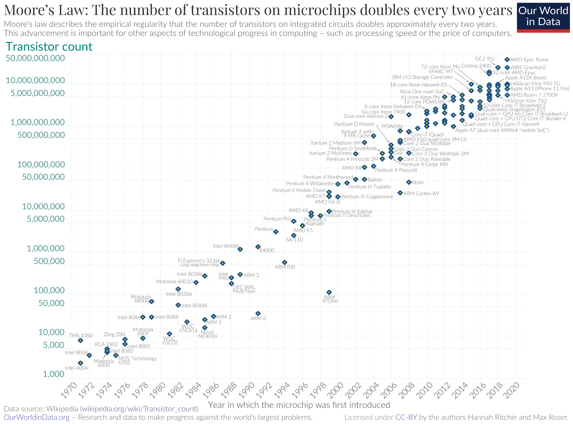
Abundant Compute Power
By Max Roser, Hannah Ritchie - https://ourworldindata.org/uploads/2020/11/Transistor-Count-over-time.png, CC BY 4.0, https://commons.wikimedia.org/w/index.php?curid=98219918

Slide 9
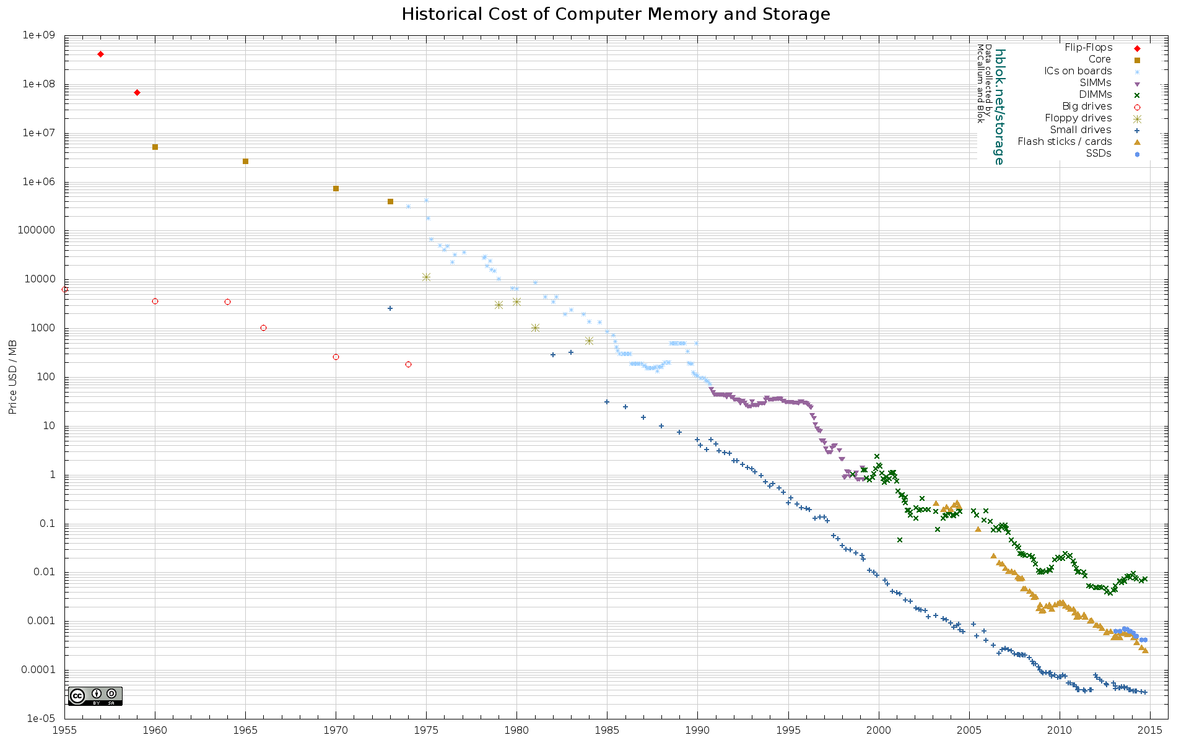
Abundant Storage
http://aiimpacts.org/wp-content/uploads/2015/07/storage_memory_prices_large-_hblok.net_.png

Slide 10
What’s driving change today?
From scarcity to abundance!
For many years the demand for communications services outstripped available capacity
We used price as distribution function to moderate demand to match available capacity
But this is no longer the case – available capacity in today’s communications domain far outpaces demand

Slide 11
How can we use this abundance?
By changing the communications provisioning model from on demand to just in case
Instead of using the network to respond to users by delivering services on demand we’ve changed the service model to provision services close to the edge just in case the user requests the service
With this change we’ve been able to eliminate the factors of distance from the network and most network transactions occur over shorter network spans
What does a shorter network enable?

Slide 12

Bigger
Increasing transmission capacity by using photonic amplifiers, wavelength multiplexing and phase/amplitude/polarisation modulation for fibre cables
Serving content and service transactions by distributing the load across many individual platforms through server and content aggregation
The rise of high capacity mobile edge networks and mobile platforms add massive volumes to content delivery
To manage this massive load shift we’ve stopped pushing content and transactions across the network and instead we serve from the edge

Slide 13

Faster
Reduce latency - stop pushing content and transactions across the network and instead serve from the edge
The rise of CDNs serve (almost) all Internet content and services from massively scaled distributed delivery systems.
The “Packet Miles” to deliver content to users has shrunk - that’s faster!
The development of high frequency cellular data systems (4G/5G) has resulted in a highly capable last mile access network with Gigabit capacity
Applications are being re-engineered to meet faster response criteria
Compressed interactions across shorter distances using higher capacity circuitry results in a much faster Internet

Slide 14

Cheaper
We are living in a world of abundant comms and computing capacity
And working in an industry when there are significant economies of scale
And being largely funded by capitalising a collective asset that is infeasible to capitalise individually – the advertisement market
The result is that a former luxury service accessible to just a few has been transformed into an affordable mass-market commodity service available to all

Slide 15
So it’s all good!
Right?

Slide 16
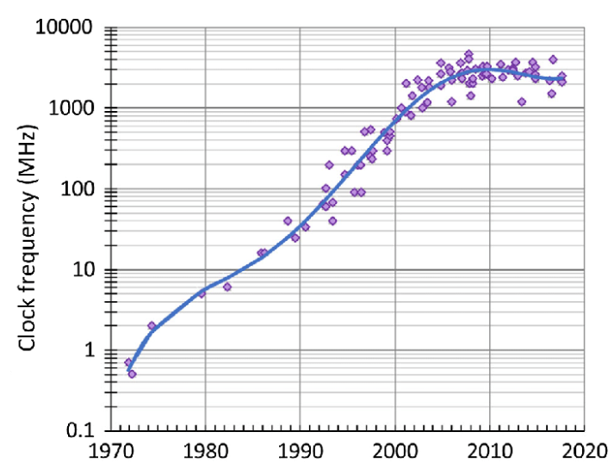
Not Quite
Processor clock speeds have topped out over the past decade
While the network growth trends continue to scale at an exponential rate, silicon-based processing capacity is now growing at a linear capacity at best
Why should we be concerned about this?
Processor Clock Frequency Trend Data

Slide 17
Internet Scaling
To make up the shortfall in IPv4 addressing we’ve adding greater processing capability into the network’s infrastructure
  Network Address Translation, dynamic naming and content steerage
  Replacing static data with on-demand processing
This approach is viable in the long term only if we can scale processing efficiency in line with demand growth
But if processing capability is not scaling then we have a problem …

Slide 18
Internet Scaling
Device Population
Infrastructure
Complexity
Size
IPv4 Pool
Time

Slide 19
Internet Scaling
Device Population
Size
Embedded network processing
IPv4 Pool
Time

Slide 20
Internet Scaling
If we cannot scale network complexity, then we need to reduce the complexity burden within the network
But IPv4 exhaustion gives us little leeway to reduce network complexity
Which means that if you want to:
  Deploy digital services at scale
  Contain cost escalation to keep the service affordable
  Improve network robustness and security
Then you have few choices left other than to reduce the network complexity burden
Deploying IPv6 is one obvious response

Slide 21
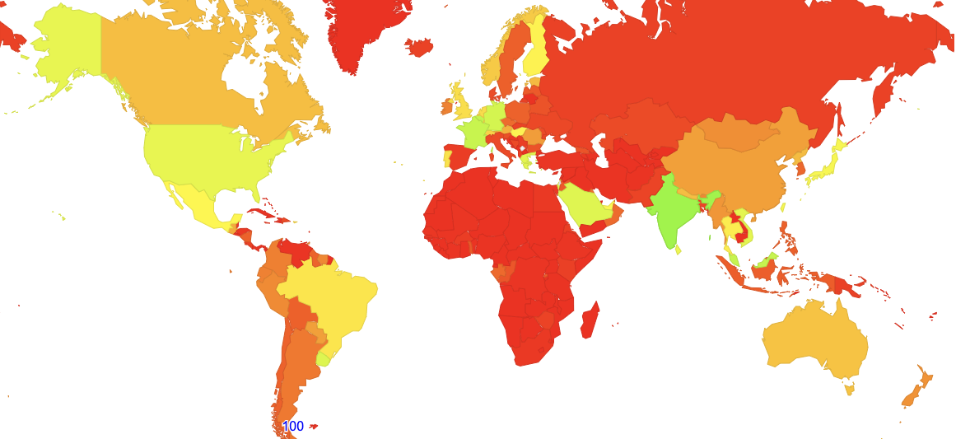
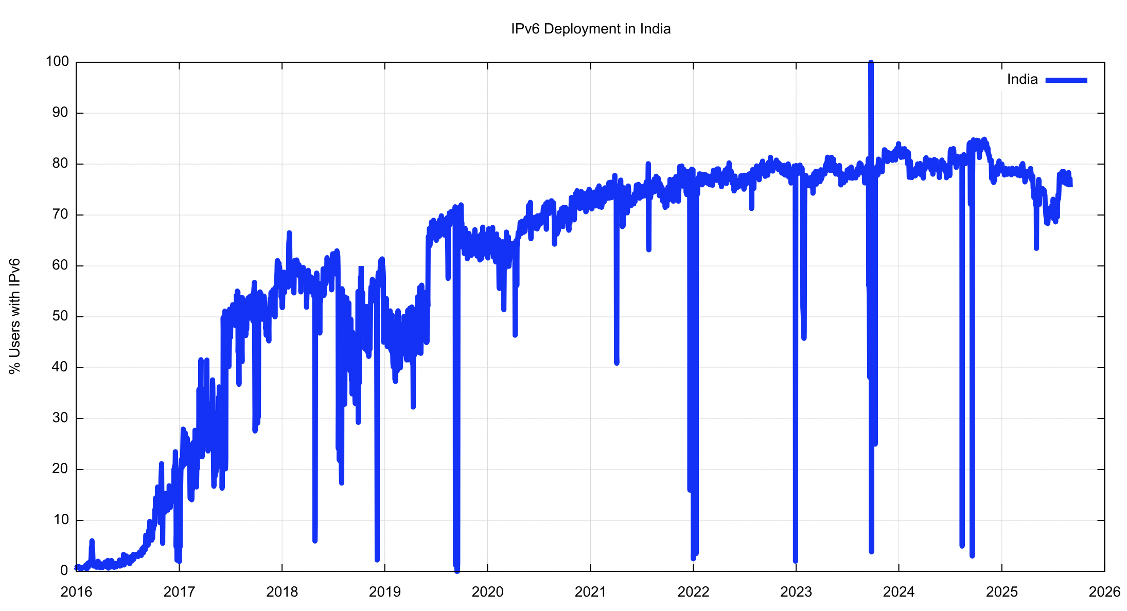
Which might help to explain India’s dramatic move to IPv6
IPv6 Capable Rate by country (%)
80%
2017
2020
2023

Slide 22
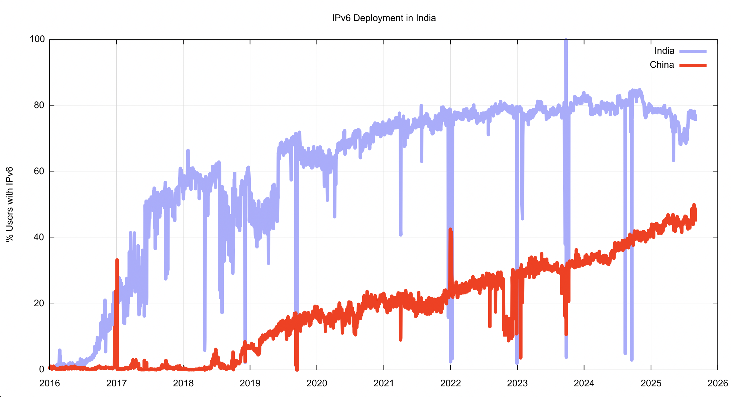
And China’s IPv6 efforts
IPv6 Capable Rate by country (%)

Slide 23
Longer Term Evolution
Pushing EVERYTHING out of the network and over to applications
Leave the network’s role to simple end-to-end transmission at scale
Push service mediation roles out of the network and bring services towards consumers, using content distribution frameworks to distribute replicated servers and services
The application is becoming the service, rather than just a window to a remotely operated service

Slide 24
Evolutionary Shifts
The key innovation of the Internet in the 1980’s was to push functionality out of the networks and into the connected hosts at the edge
  A simpler network allowed the network to scale at lower cost
  And scaling at the edge was a case of replication
We tied this together with a coherent address architecture

Slide 25
Evolutionary Shifts
Today we are moving away from host-centric services to application-centric services, pushing services and functions away from hosts and platforms into distributed shared state at the application level
  Services are defined by reference in a common name space
  Addresses are just tokens used to guide packets through the underlying connectivity mesh
We tie this together with a coherent name space – the DNS

Slide 26
Longer Term Evolution
The infrastructure for applications and security is transitioning into the name space
  The identity space and associated authenticity credentials are now associated with service names, not IP addresses
  DNS services now underpin and define the Internet environment
  IP addresses are still topology tokens used to for packet forwarding – but the association between a service and an IP address token is dynamically dcefined by the DNS.
  This has removed the pressure from the transition to IPv6, as the DNS masks over the dual stack nature of the underlying forwarding network

Slide 27
Where does IPv6 fit?
IPv6 allows us to move on from the issues of scaling the underlying connectivity fabric of the network with an inadequate pool of IPv4 address tokens
Today’s need is to scale the service environment so that we can meet the scale and capacity of service delivery requirements that exceed individual platform capabilities
This service level scaling challenge is what should absorb our attention in the coming decade or more

Slide 28
Thanks!

