Slide 1
The Evolution of TCP Transport Protocols
Geoff Huston AM
APNIC Labs

Slide 2
November 1859
Charles Darwin published a monumental work that described a theory of the origins of the diversity of life through a process of natural selection, a finding initially jointly authored in a paper by Alfred Wallace and Charles Darwin
It described a natural process that is commonly corrupted as “survival of the fittest”
It’s not just the living world where we observe these evolutionary pressures

Slide 3
The Evolution of Speed
1980’s
TCP rates of Kilobits per second
1990’s
TCP rates of Megabits per second
2000’s
TCP rates of Gigabits per second
2010’s
TCP rates of tens of Gigabits per second
2020’s
TCP rates of tens of Gigabits per second
G
M
K
80’s
90’s
00’s
10’s
20’s

Slide 4
The Evolution of Speed
1980’s
TCP rates of Kilobits per second
1990’s
TCP rates of Megabits per second
2000’s
TCP rates of Gigabits per second
2010’s
TCP rates of tens of Gigabits per second
2020’s
TCP rates of tens of Gigabits per second
G
M
K
?
80’s
90’s
00’s
10’s
20’s

Slide 5
Today
Optical transmission speeds are now edging into multi-Terabit capacity
But peak TCP session speeds across the network are not keeping up
Why not?
optical transport
T
TCP speed
G
M
K
80’s
90’s
00’s
10’s
20’s

Slide 6
TCP is the Internet
The Transmission Control Protocol is an end-to-end protocol that creates a reliable stream protocol from the underlying IP datagram device
This single protocol is the “beating heart” at the core of the Internet
TCP operates as an adaptive rate control protocol that attempts to operate efficiently and fairly

Slide 7
TCP Performance Objectives
To maintain an average flow which is both Efficient and Fair
Efficient:
Minimise packet loss
Minimise packet re-ordering
Do not leave unused path bandwidth on the table!
Fair:
Do not crowd out other TCP sessions
Over time, take an average 1/N of the path capacity when there are N other TCP sessions sharing the same path

Slide 8
It’s a Flow Control process
Think of this as a multi-flow fluid dynamics problem
Each flow has to gently exert pressure on the other flows to signal them to provide a fair share of the network, and be responsive to the pressure from all other flows

Slide 9
TCP Control
TCP is an ACK Pacing protocol
If the sender sends one packet each time it receives an ACK, then the sender will maintain a steady number of packets in flight within the network
Data sending rate is matched to the ACK arrival rate

Slide 10
TCP Control
Ideally TCP would send packets at a fair share of available network capacity. But the TCP sender has no idea what “available network capacity” means.
So, TCP uses ‘rate adaptation’ to probe into network, increasing the sending rate until it receives a signal that the sending rate is ‘too fast’
We’ve been experimenting with various forms of TCP rate adaptation for decades!

Slide 11
“Classic TCP” – TCP Reno
Additive Increase Multiplicative Decrease (AIMD)
While there is no packet loss, increase the sending rate by one segment (MSS) each RTT interval
If there is packet loss (detected by duplicate ACKs) pause for 1xRTT and decrease the sending rate by 50% over the next RTT Interval by halving the sender’s send window
Start Up
Each RTT interval, double the sending rate
We call this “slow start” – probably because its anything but slow!!!

Slide 12
The Classic TCP Picture
Queue formation
Queue drain

Slide 13
Changing TCP’s control algorithm
The TCP packet format is invariant
But the control algorithm can vary
What defines a “fitter” control algorithm?
Be no less ‘aggressive’ than everyone else
Try to exploit opportunities that others do not
But don’t destroy the environment (network)

Slide 14
Carriage Service Challenges
Radio system with non-congestion loss behaviours
LEO satellite services with very high jitter elements
Very high bandwidth services pose a challenge to linear rate increase
How to take advantage of equal-cost multi path frameworks
Session “pulsing” used by streaming services

Slide 15
CUBIC
CUBIC is designed to be useful for high-speed sessions while still being ‘fair’ to other sessions and also be efficient even at lower speeds
Rather than probe in a linear manner for the sending rate that triggers packet loss, CUBIC uses a non-linear (cubic) search algorithm

Slide 16
CUBIC and Queue formation
Total Queue Capacity
(Onset of Packet Loss)
Network Buffers Fill
Link Capacity Capacity
(Onset of Queuing)
Network Buffers Drain

Slide 17
CUBIC assessment
Can react quickly to available capacity in the network
Tends to sit for extended periods in the phase of queue formation
Can react efficiently to long fat pipes and rapidly scale up the sending rate
Operates in a manner that tends to exacerbate ‘buffer bloat’ conditions

Slide 18
And there’s a whole lot more…

Slide 19
TCP and Buffers – the Theory
When a sender receives a loss signal it repairs the loss and halves it’s sending window
This will cause the sender to pause for the amount of time to drain half the outstanding data in the network (1xRTT interval)
Ideally, this exactly matches the amount of time taken for the queue to drain
At the time the queue is drained the sender resumes its sending (at half the rate) and the buffer has fully drained
For this to work efficiently, the queue size for a link should equal the delay bandwidth product of the link it drives

Slide 20
TCP and Buffers
Buffer Too Big: The queue never drains, so part of the buffer just adds delay to the connection
Queue too big
Packet Loss
Added delay, or “buffer bloat”
Congestion Avoidance
Congestion Avoidance
Sending Rate / Sender Window
Link Capacity
Sender’s window recovery interval
(1xRTT)
Standing Queue
Time

Slide 21
TCP and Buffers
Buffer Too Small: The queue drains, and the sender operates below bottleneck speed – so the link is under-used
Queue too small
Packet Loss
Idle capacity
Link Capacity
Congestion Avoidance
Congestion Avoidance
Sending Rate / Sender Window
Sender’s window recovery interval
(1xRTT)
Time
Link Idle

Slide 22
TCP and Buffer Size
The “general” rule of thumb for configuring the buffer size in a router is:
Size = (BW ∙ RTT)
Using the bandwidth and the roundtrip delay of the link being driven

Slide 23
TCP and Buffer Size
The “general” rule of thumb for configuring the buffer size in a router is:
Size = (BW ∙ RTT)
Using the bandwidth and the roundtrip delay of the link being driven
All this works with an assumption of a single queue and a single flow

Slide 24
From 1 to N – Scaling Switching
This finding of buffer size relates to a single flow through a single bottleneck resource
What happens to buffers with more simultaneous flows and faster transmission systems?

Slide 25
Flow Mixing
If 2 flows use a single buffer and they resonate precisely then the buffer still needs to be delay-bandwidth size
If they are precisely out of phase the common buffer requirement is reduced by 25%

Slide 26
Smaller Buffers?
What about the case of N de-synchronised flows?
Size = (BW ∙ RTT) / √N
Assuming that the component flows manage to achieve a fair outcome of obtaining 1/N of the resource in a non-synchronised manner, then the peak buffer resource is inversely proportionate to the square root of N
(“Sizing Router Buffers”, Appenzeller, McKeown, Keslassy, SIGCOM’04)

Slide 27
The Role of Buffers
Buffers in a network serve two essential roles:
smooth sender burstiness
Multiplexing N inputs to 1 output

Slide 28
Sender Pacing (Fair Queuing)
Distribute cwnd data across the entire RTT interval
Removes burst adaptation pressure on network buffers
net.core.default_qdisc=fq
This is important –
EVERY sender should have pacing enabled!

Slide 29
Tiny Buffers?
If all senders ‘paced’ their sending to avoid bursting, and were sensitive to the formation of standing queues then we would likely have a residual multiplexing requirement for buffers where:
B >= O(log W)
where W is the average flow window size

Slide 30
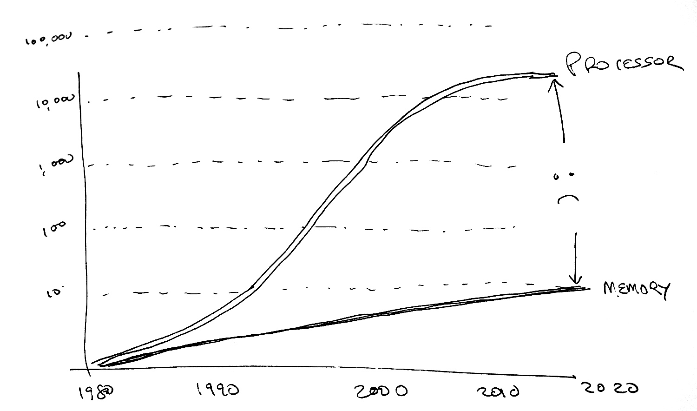
Why is this important?
Because memory speed is not scaling at the same rate as transmission or switching
Further capacity and speed improvements in the network mandate reduced memory demands within the switch

Slide 31
Switching Chip Design TradeOffs
On-Chip memory is faster, but limited to between ~16M to ~64M
A chip design can include an interface to external memory banks but the memory interface/controller also takes up chip space and the external memory is slower
Between 20% to 60% of switch chip real estate is devoted to memory / memory control
Small memory buffers in switch design allows for larger switch fabric implementations on the chip

Slide 32
Optimising Flow State
There are three ‘states’ of flow management:
Under-Utilised – where the flow rate is below the link capacity and no queues form
Over-Utilised – where the flow rate is greater that the link capacity and queues form
Saturated – where the queue is filled and packet loss occurs
Loss-based control systems probe upward to the Saturated point, and back off quickly to what they guess is the Under-Utilised state in order to the let the queues drain
But the optimal operational point for any flow is at the point of state change from Under to Over-utilised, not at the Saturated point

Slide 33
RTT and Delivery Rate with Queuing
Under-Utilised
Over-Utilised
Saturated

Slide 34
How to detect the onset of queuing?
By getting the network’s routers to report when queues are forming!
TCP
IP

Slide 35
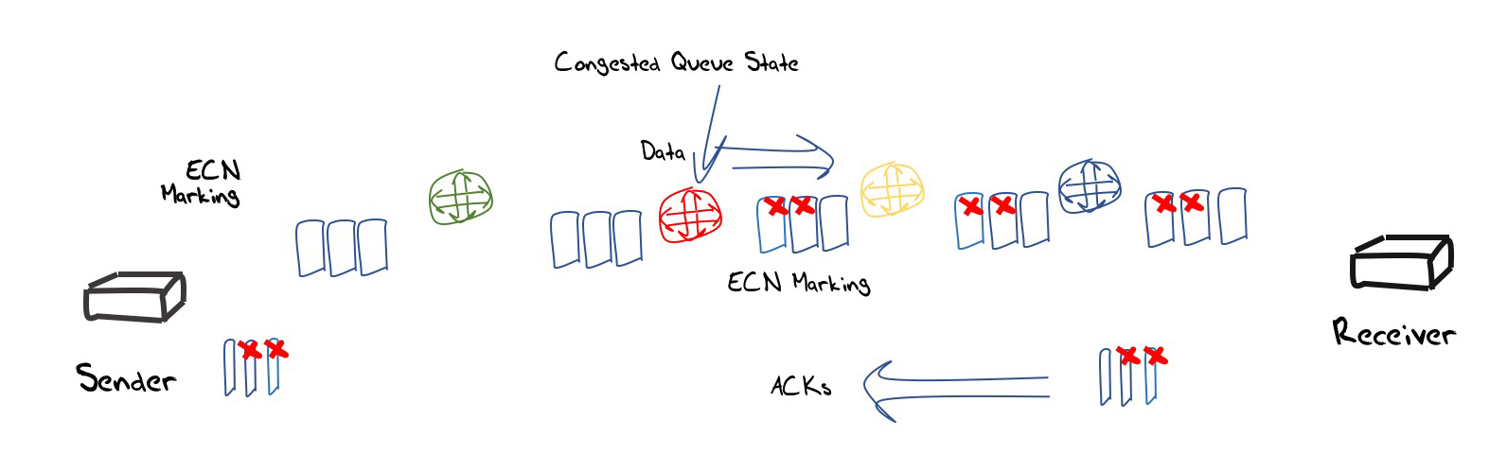
ECN Control Loop
IP
TCP
A router “marks” IP packets at the onset of queue formation with a bit signal
The Receiver echoes this bit up into the transport protocol reverse flow
The sender reduces its sending window size (and notifies the receiver that it was performed this window reduction)

Slide 36
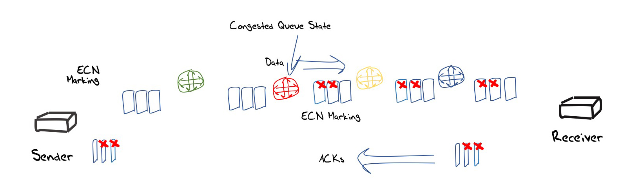
Explicit Congestion Notification

Slide 37
Explicit Congestion Notification
Sparse signal (single bit)
Both hosts and routers need to be ECN aware
IP level marking requires end host protocol surgery at both ends:
Receivers need to reflect ECN bits
Senders need to pass IP CE up to the TCP session to signal a need to reduce the sending rate

Slide 38
ECN Issues
It would be good if everyone did it!
That probably means every router and every end host running TCP (and QUIC)
How are we doing in deploying ECN?

Slide 39
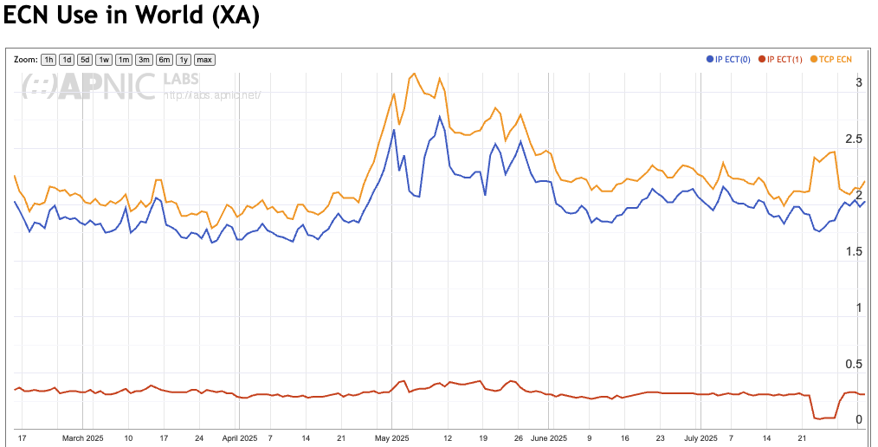
ECN Issues
2%!!!!

Slide 40
How to detect the onset of queuing?
By getting the network’s routers to report when queues are forming!
OR
By detecting the onset of queue-based delays in the measured RTT

Slide 41
Flow Control Evolution
Current flow control systems make small continual adjustments every RTT interval and a massive adjustment at irregular intervals
As the flow rate increases the CA adjustments of 1 segment per RTT become too small
Rate halving is a massive response
OR
We could use a system that only made periodic adjustments every n RTT intervals based on delay probing
And set the adjustment to be proportionate to the current flow rate

Slide 42
BBR Design Principles
Pace the sending packets to avoid the need for network buffer rate adaptation
Probe the path capacity only intermittently (every 8th RTT)
Probe the path capacity by increasing the sending rate by 25% for an RTT interval and then drop the rate to drain the queue:
If the RTT of the probe interval equals the RTT of the previous state, then there is available path bandwidth that could be utilised
If the RTT of the probe rises, then the path is likely to be at the onset of queuing and no further path bandwidth is available
Do not alter the path bandwidth estimate in response to packet loss!

Slide 43
Idealised BBR profile
sending rate
network queues

Slide 44
BBR Politeness?
BBR will probably not constantly pull back when simultaneous loss-based protocols exert pressure on the path’s queues
BBR tries to make minimal demands on the queue size, and does not rely on a large dynamic range of queue occupancy during a flow

Slide 45
Our Environment…
It’s a pretty comprehensive mess:
A diverse mix of e-2-e TCP control protocols
CUBIC, NewRENO, LEDBAT, Fast, BBR, Compound
A mix of traffic models
Buffer-filling streamers, flash bursts, bulk data
A mix of active queue management disciplines
RED, WRED, CODEL, FQ, none
A mix of media
Wire line, mobile, WiFi
A mix of buffer size deployments
Sporadic ECN marking

Slide 46
Protocol Darwinism?
What “wins” in this diverse environment?
Efficiency is perhaps more critical than fairness as a “survival fitness” strategy
I suspect that protocols that make minimal assumptions about the network will be more robust than those that require certain network characteristics to operate efficiently
Protocols that operate with regular feedback mechanisms appear to be more robust than irregular “shock” treatment protocols

Slide 47
What is all this telling us?
We actually don’t know all that much about fine-grained behaviour of large-scale high capacity switching systems.
Some of our cherished assumptions about network design may be mistaken
Moving large data sets over very high-speed networks requires an entirely different approach to what we are doing today
The Internet still contains a large set of important unsolved problems!

Slide 48
That’s it!
Questions?

