Slide 1
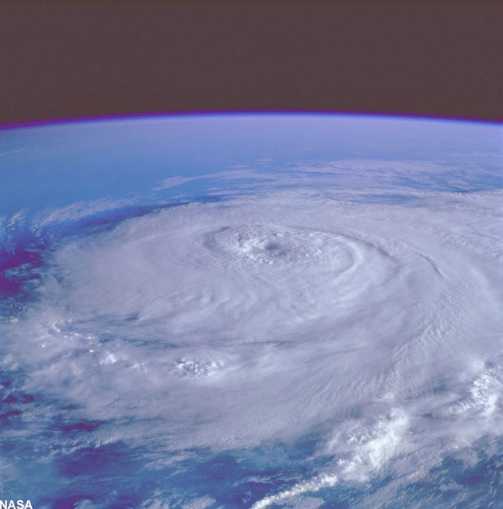
The View from Above: Geolocation and Starlink
Geoff Huston, APNIC

Slide 2
Where are you?
“Where” depends what you are trying to achieve:
Lat/Long coords are overkill if you just want to place an IP address into a country, but are great if you want to dispatch emergency services to a precise physical location
Political coordinates are used for enforcing national regulatory controls, but may not be so good if you want to make the “best” server selection in a CDN context
Network topology coordinates (origin AS, adjacent AS) are sometimes useful if you want to optimize service performance
And of course there are mobility issues
If you change location, do you change IP addresses?

Slide 3
Where are you?
“you” is also variable:
Is it the human end user of a service?
Is it a device? Even if it’s a shared device?
Can “you” have multiple devices? In multiple locations? It is still a single “you” or multiple instances of “you”?
Is it a service subscription?
And of course there are mobility issues
Is “you” relative to a network provider, and when you change providers do you change identity?

Slide 4
For me, it started as a simple question
Can I calculate the market share of retail Internet Service Providers in every economy?
And by ”market share” I mean “user population”

Slide 5
The tools of the trade
For country- level geolocation I use the ISO 3166 list of recognized countries and their two-letter alpha code
And I’m trying to map every IPv4 and IPv6 address to a CC code corresponding to the assumed geo location of the device that has this IP address
I use a mix of Maxmind and IPinfo to assemble a database of IP address prefix to CC code

Slide 6
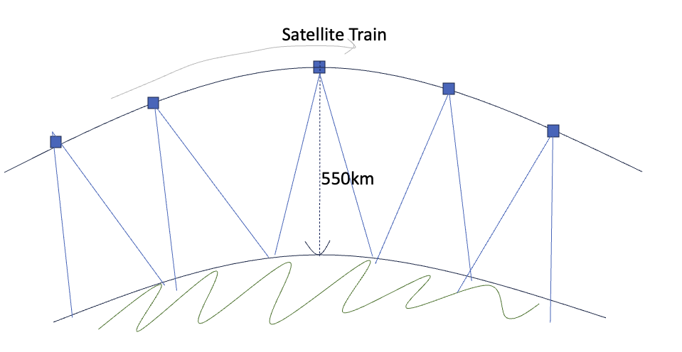


And then there is Starlink
Conventionally with “bent-pipe” LEO systems the end user and the ground station are typically closely located (within ~600km or so)
Starlink may use inter-satellite 100Gbps laser connections to relay packets across satellites, when the Dishy user and the associated ground station are distant from each other

Slide 7
What is ”location” for a satellite service?
Where the user is located?
Where the gateway earth station is located?
Where the satellite operator is registered or licensed?

Slide 8
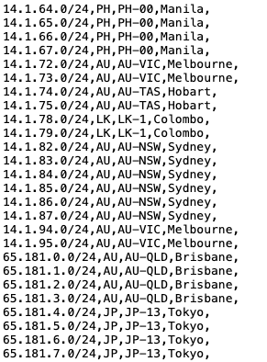
Starlink Geolocation
https://geoip.starlinkisp.net/
These are notional “user” locations
But the city code is confusing/unclear

Slide 9
What does this map mean?
It’s NOT the location of the ground station
It’s not the terminating point of the terrestrial path to the user
It looks like its the notional location of the Starlink subscriber
But the city code is pretty misleading, as in many cases Starlink is a rural/remote solution
If you buy a roaming package does this map apply to where you purchased the package or where you are right now?
If it’s the latter how does Starlink handle IP address reassignment?
And what happens for aircraft and/or ships?

Slide 10
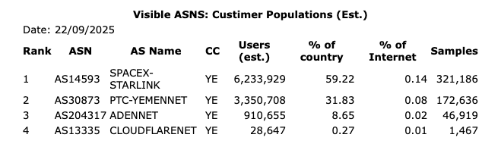
Is this list ”accurate”?
That’s hard to tell!
But when I plug this into my “market share” data I get some results that are challenging to accept

Slide 11
Really?
Over a 60 day interval, 60% of the ad placements that are geolocated to the country of Yemen are from IP addresses that geo-locate to Yemen!
Starlink is a globally priced service, and the GDP per capita in Yemen is USD 752, which would suggest that a service that costs ~USD 50 per month is simply unaffordable for many Yemenis

Slide 12
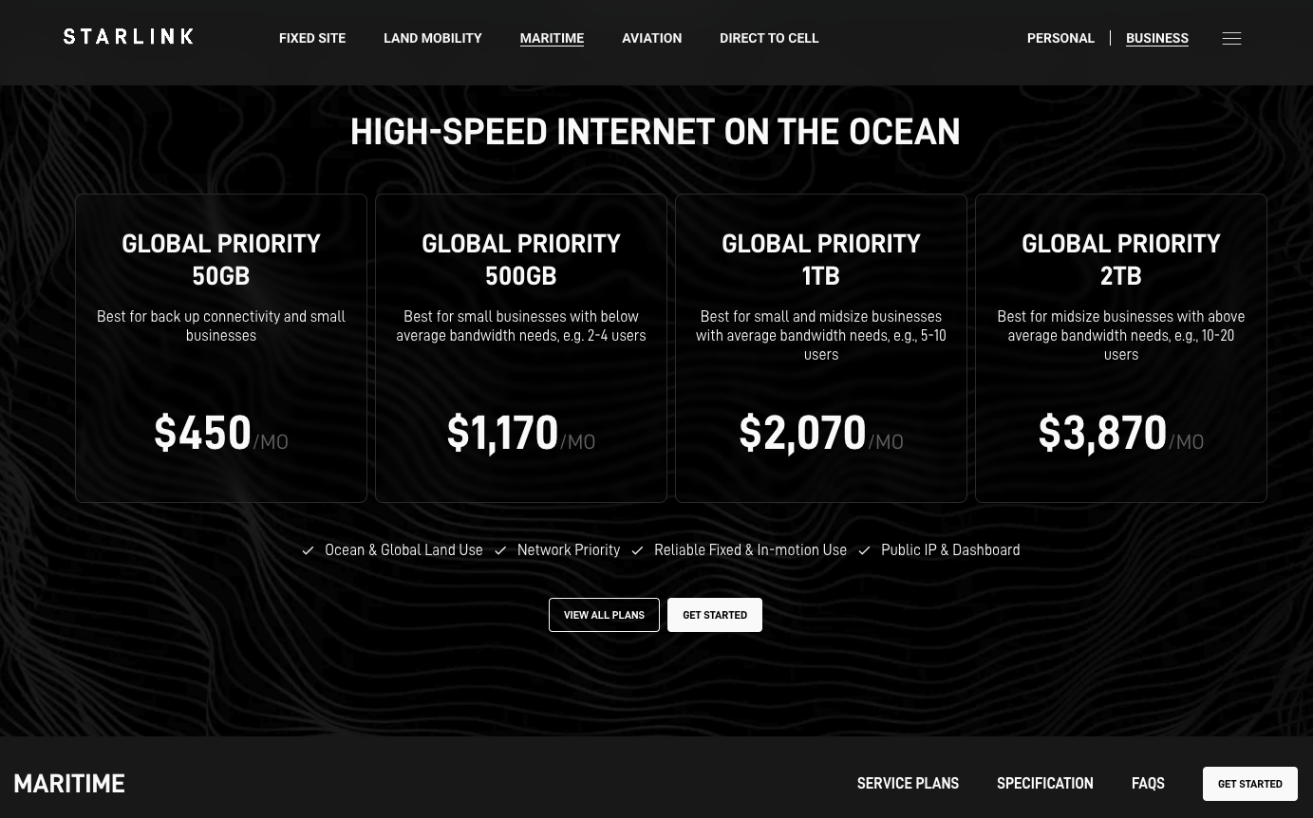
Starlink Issues
How do Starlink treat ships at sea in terms of geolocation?
There are no maritime geolocation codes in the Starlink geo files, and all of our ad placements into AS14593 locate into (land) countries
It’s possible that shipping in the Red Sea could account for a part of the anomaly, BUT there are only 60 - vessels a day going through the Suez Canal, which is just nowhere near enough

Slide 13
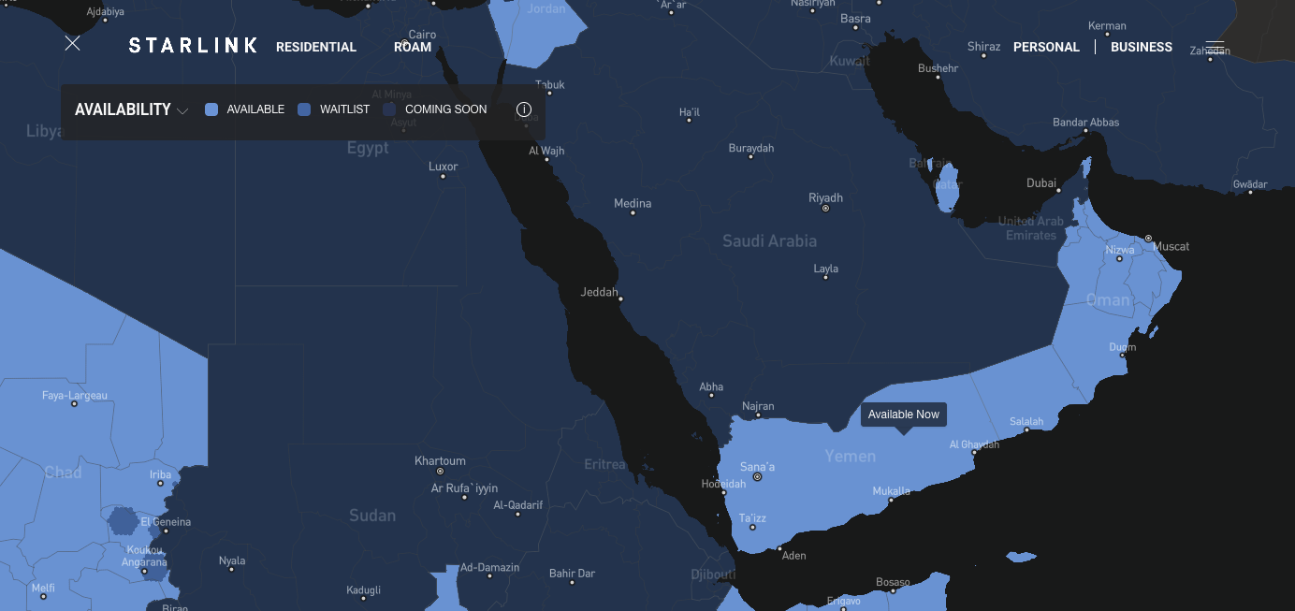
Starlink Roaming “Leakage”

Slide 14
Starlink Roaming “Leakage”
Starlink is not authorized for use in Saudi Arabia, Egypt or Ethopia, including roaming use
The Starlink service can work, but Starlink may block the service for Dishy units located in these places
Is the high use level in Yemen due to users in neighbouring countries purchasing a roaming service in Yemen (which geolocates to Yemen) and using the Dishy back home?
Yes, Starlink assert that they may cut off the service when the unit roams to locations where its use is unauthorized, but what they say they will do, and what they actually do may differ
At the same time, there are reports of Starlink performing geo-blocking when ships enter territorial waters.

Slide 15
Starlink ”reselling”
There are Starlink Community Gateways , but the cost is high
You CAN resell access to Starlink in the form of a community Wi-Fi local hotspot
Is the extremely high Yemen use level a result of widespread community “pooling” of Starlink services?

Slide 16
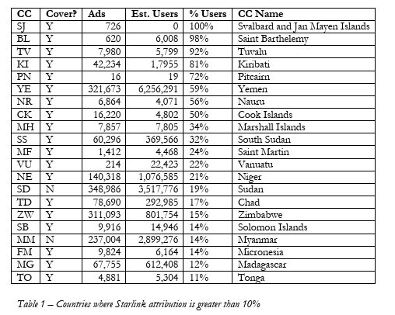
It’s not just Yemen
There are 21 countries where the use of Starlink services appears to be more than 10% of the domestic population
Including two countries where Starlink claims that the service is unavailable in that country, yet the Starlink Geo map lists these countries, and ads are presented to users on these IP addresses

Slide 17
What about ships and aircraft?
The Tokyo Convention for aircraft says that once an international flight is airborne, the laws of the country of registration of the aircraft apply to the aircraft
This is the similar for ships at sea, with the UN Convention of the Law of the Sea (UNCLOS), but UNCLOS applies only in international waters
Does this imply that geo country attribution for either ships or aircraft should revert to the country of registration once the craft is out of any national territory?

Slide 18
Thanks!

