Slide 1
BGP in 2025
Geoff Huston
APNIC

Slide 2
This presentation
IPv4 Routing Table
IPv6 Routing Table
FIB Projections
Updates and Churn
Conclusions

Slide 3
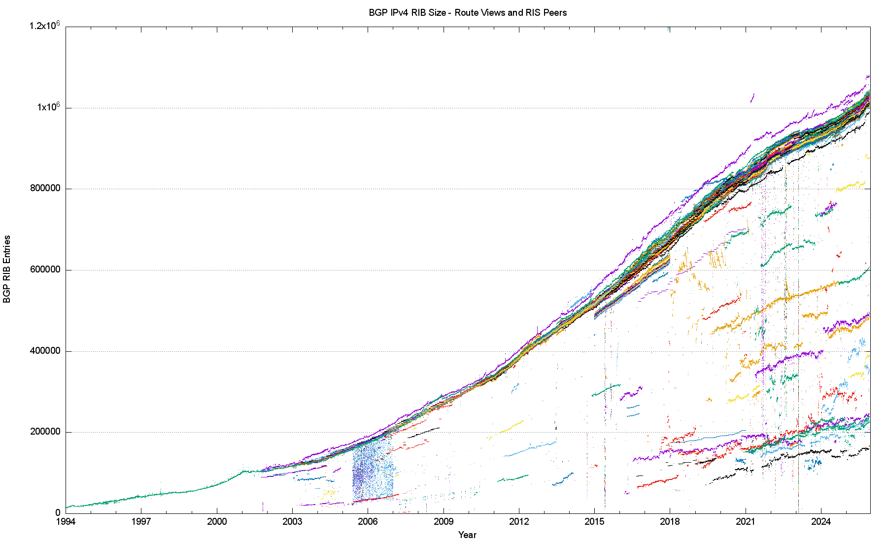
32 Years of Routing the IPv4 Internet – FIB Count
This is a view pulled together from each of the routing peers of Route-Views and RIPE RIS
2020: The COVID Years
2011: Onset of Address Exhaustion
2005: Consumer Market
2001: The Great Internet
Boom and Bust
1994: Introduction of CIDR

Slide 4
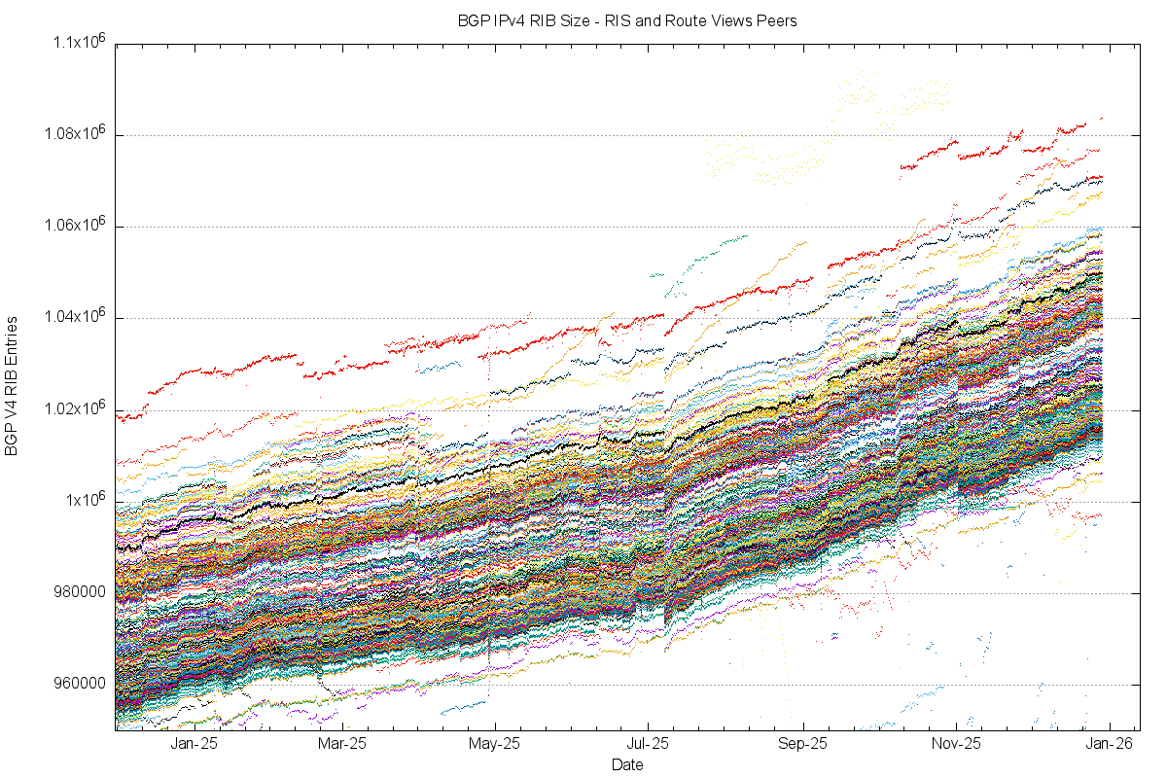
IPv4 in 2025
45K entry variation
The DFZ now exceeds 1M entries for ALL BGP peers

Slide 5
IPv4 in 2025
AS4155 – USDA
WDL 3,122 pfxs on 1-Nov

Slide 6
IPv4 in 2025
?

Slide 7
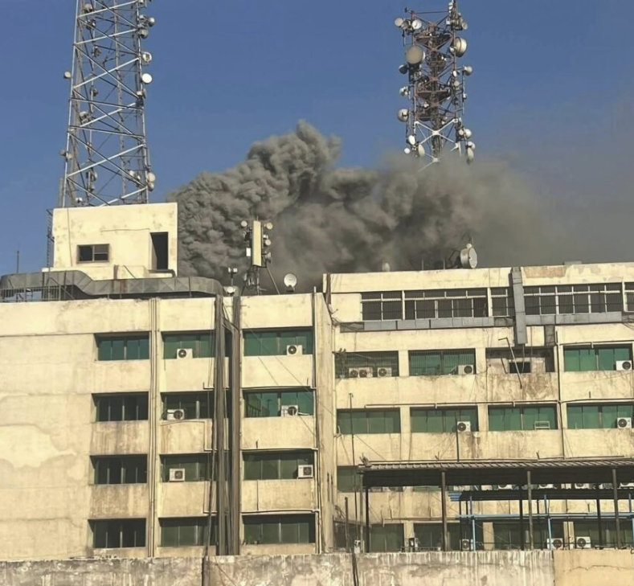
7 July 2025 - Egypt
On July 7, 2025, a major fire broke out at the Ramses Central building in Cairo, a critical telecommunications hub. The fire resulted in four deaths, dozens of injuries, and significant disruptions to Egypt's internet and telecommunications services. The incident also led to a temporary suspension of trading on the Cairo stock exchange and caused severe traffic congestion due to street closures.
Daily News Egypt

Slide 8
Announced Prefix Changes in 2025

Slide 9
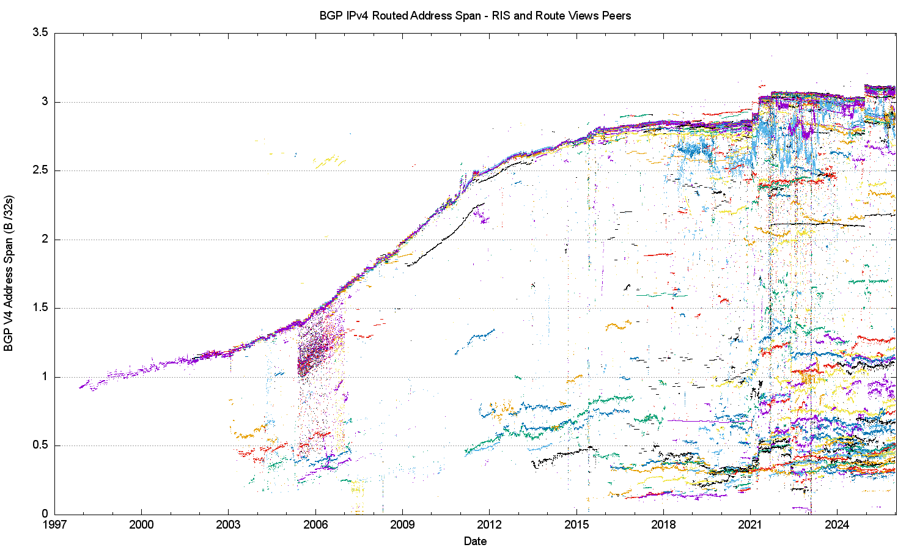
32 Years of Routing the IPv4 Internet – Address Span
2021: Advertised DoD blocks
This is a view pulled together from each of the routing peers of Route-Views and RIPE RIS
2011: Onset of Address Exhaustion
2005: Consumer Market
2001: The Great Internet
Boom and Bust

Slide 10
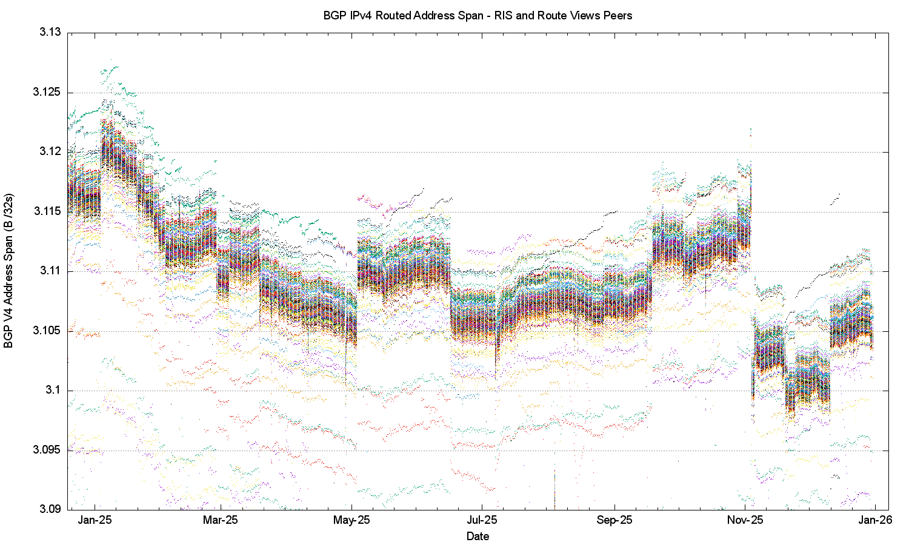
2025 in Detail

Slide 11
2025 in Detail
16 Jun, AS7738, V Tal, Brazil, -2.6M
4-Jan AS16509, Amazon, +4.3M
16 Jun, AS6389, Bell South, -0.5M
28-Feb AS37963, Alibaba Advertising, -3.5M
4-Nov AS16509, Amazon, -15.8M
5-Mar AS16509, Amazon, +1.9M
28-Feb AS17676, Softbank GigInfra, -1.9M
18-Sep AS396982, Google Cloud, +3.2M
28-Feb AS8100, Quadranet, -1.9M
10-Dec AS16509, Amazon, +15.1M
4-May AS16509, Amazon, +4.6M

Slide 12
AS16509 – Amazon in 2025

Slide 13
2025: Assigned vs Recovered Addresses
Change in UnAdvertised Addresses
580M unadvertised
+10M delta
RIR Allocations
3.7B assigned
-0.25M
3.1B advertised
-11M delta
Change in the Advertised Address Pool

Slide 14
Announced Address Span Changes in 2025
The advertised table shrunk by 11M /32’s over 2025

Slide 15
Announced Address Span Changes in 2025
The advertised table shrunk by 11M /32’s over 2025

Slide 16
What Happened in 2025 in V4
The size of the FIB table is growing, but the span of advertised addresses is declining
V4 Address use in access networks is declining in some markets, notably the US
V4 address use in Cloud infrastructure is still increasing
Use of more specific entries in IPv4 fell from 52.9% of all advertised V4 prefixes to 51.8%

Slide 17
This presentation
IPv4 Routing Table
IPv6 Routing Table
FIB Projections
Updates and Churn
Conclusions

Slide 18
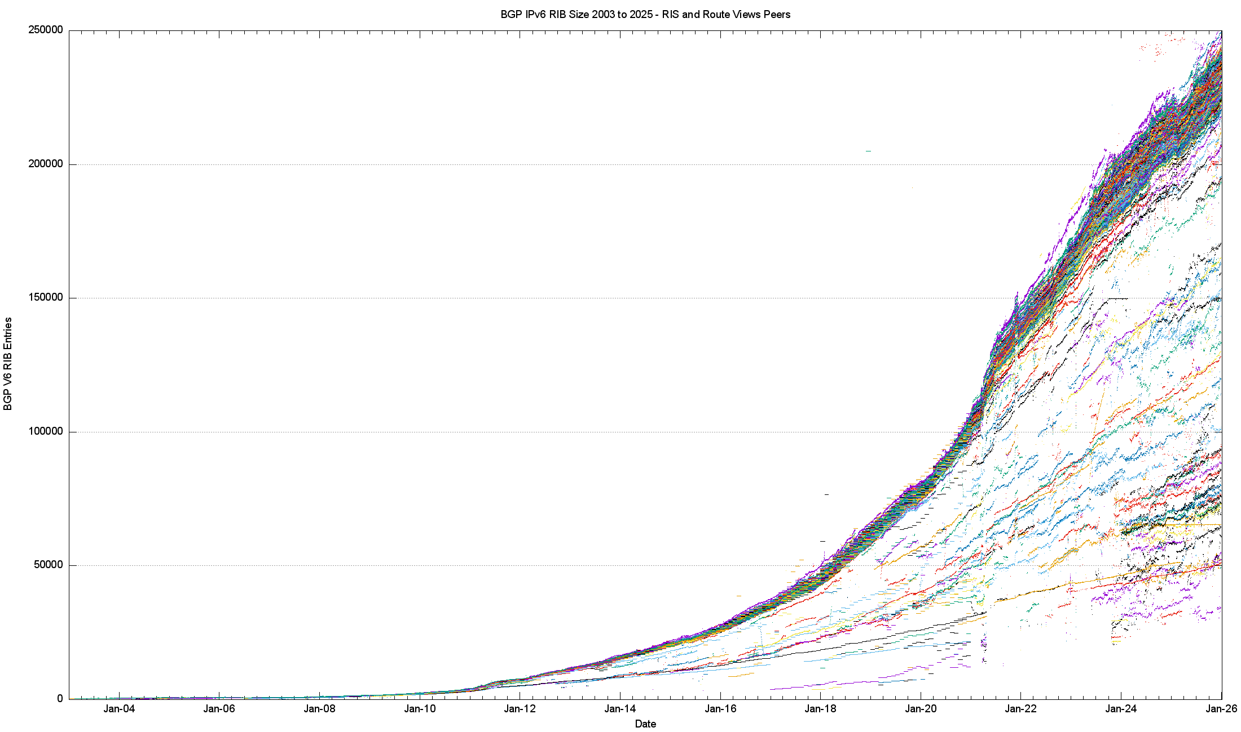
The 20-Year View of IPv6

Slide 19
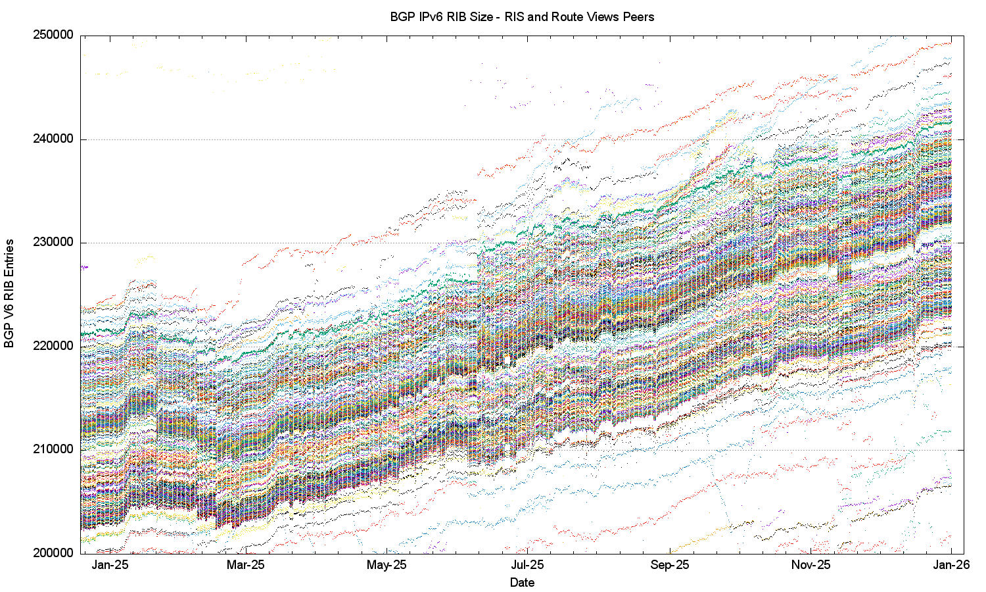
IPv6 in 2025

Slide 20
IPv6 in 2025
AS60539, Huicast Telecom, HK

Slide 21
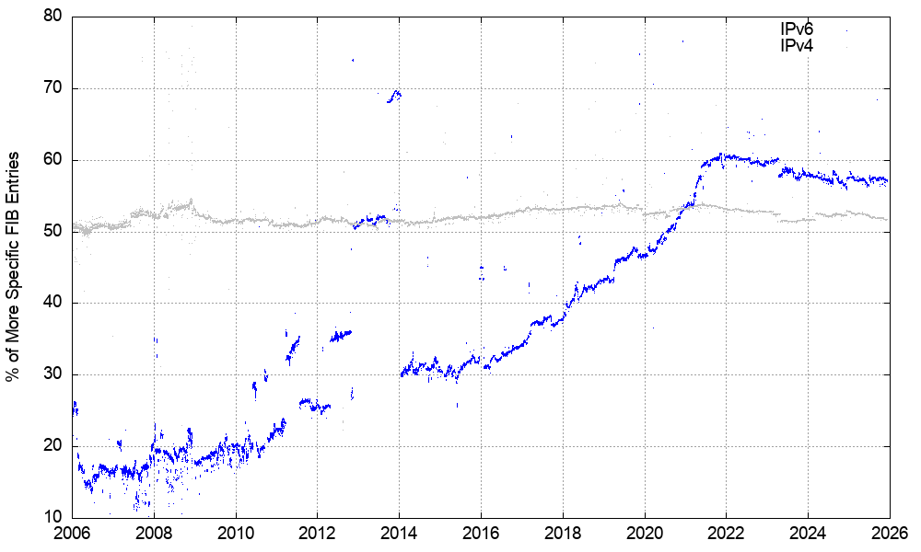
More Specifics in IPv6
IPv6
IPv4
45% of all IPv6 prefixes are /48’s

Slide 22
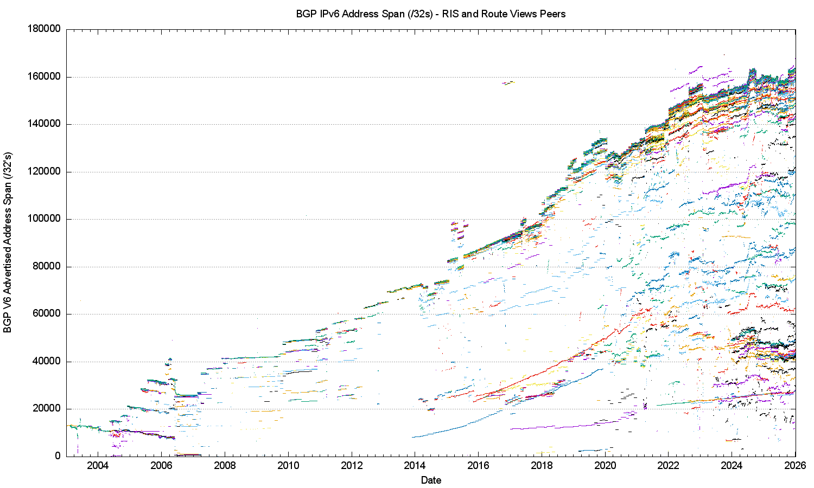
20-Year IPv6 Advertised Address Span

Slide 23
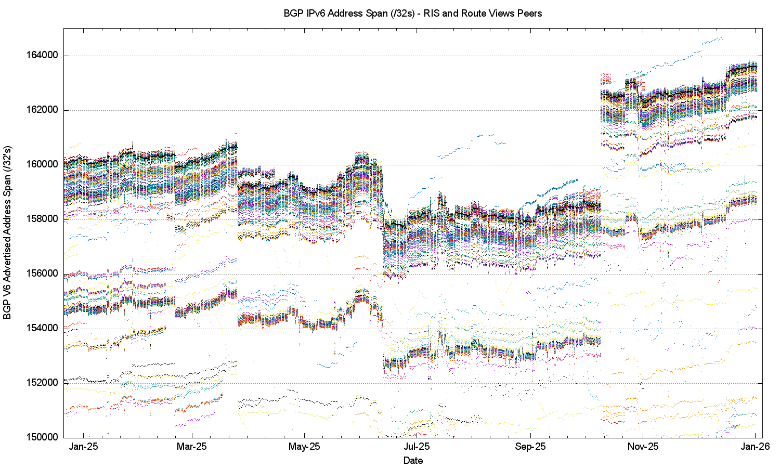
IPv6 Advertised Address Span in 2025

Slide 24
IPv6 Advertised Address Span in 2025
10-Oct AS11492, Cable One, US, +4K
26-Mar AS3462, HiNet, TW, -2K
13-Jun AS60262, PANQ, NL, -784
AS3969, MTL, MW, -356
AS204790, FLOCCUS, NL -200

Slide 25
IPv6 in 2025
Overall IPv6 Internet growth in terms of BGP FIB size is still increasing, and is currently at some 20,000 route entries p.a. (10%)
The advertised address span grew by just 4K /32s (thanks to Cable One!)
There were 2096 new AS’s advertising IPv6 prefixes through 2025, and 956 AS’s ceased advertising IPv6 prefixes
IPv6 is still expanding – slowly!

Slide 26
This presentation
IPv4 Routing Table
IPv6 Routing Table
FIB Projections
Updates and Churn
Conclusions

Slide 27
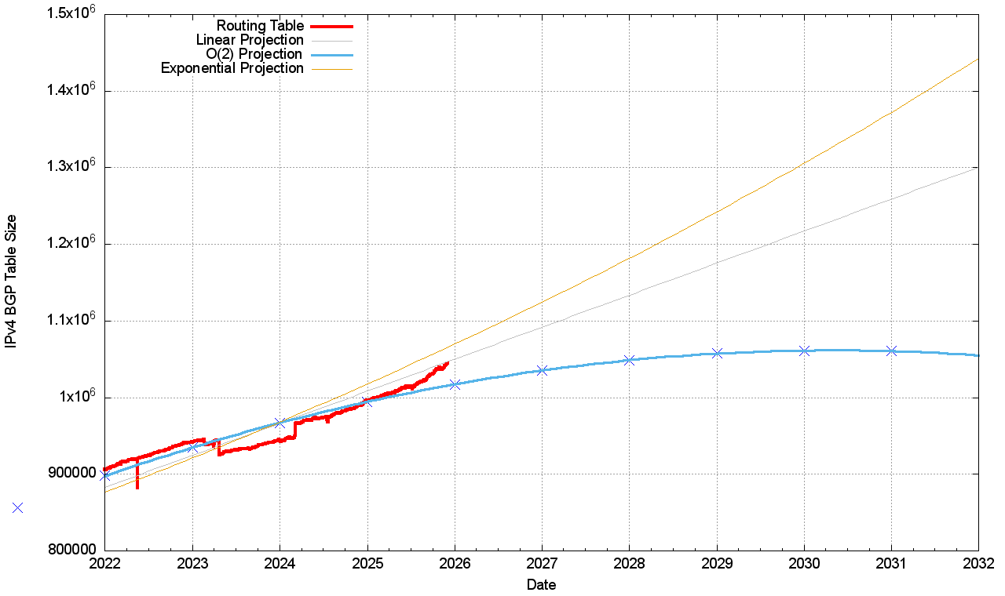
V4 BGP Table Size Predictions
Year RIB Size Prediction
2019 760,000
2020 814,000
2021 856,000
2022 906,000
2023 942,000
2024 944,000
2025 996,000 994,000
2026 1,040,000 1,101,000
2027 1,035,000
2028 1,048,000
2029 1,057,000
2030 1,060,000
Predictive uncertainty

Slide 28
V4 BGP Table Size Predictions
Year RIB Size Prediction
2019 760,000
2020 814,000
2021 856,000
2022 906,000
2023 942,000
2024 944,000
2025 996,000 994,000
2026 1,040,000 1,101,000
2027 1,035,000
2028 1,048,000
2029 1,057,000
2030 1,060,000
Predictive uncertainty
2025 saw a higher growth than a polynomial model would predict
The best fit over the past 5 years is still a polynomial model, but the best fit over the past 3 years is a linear model

Slide 29
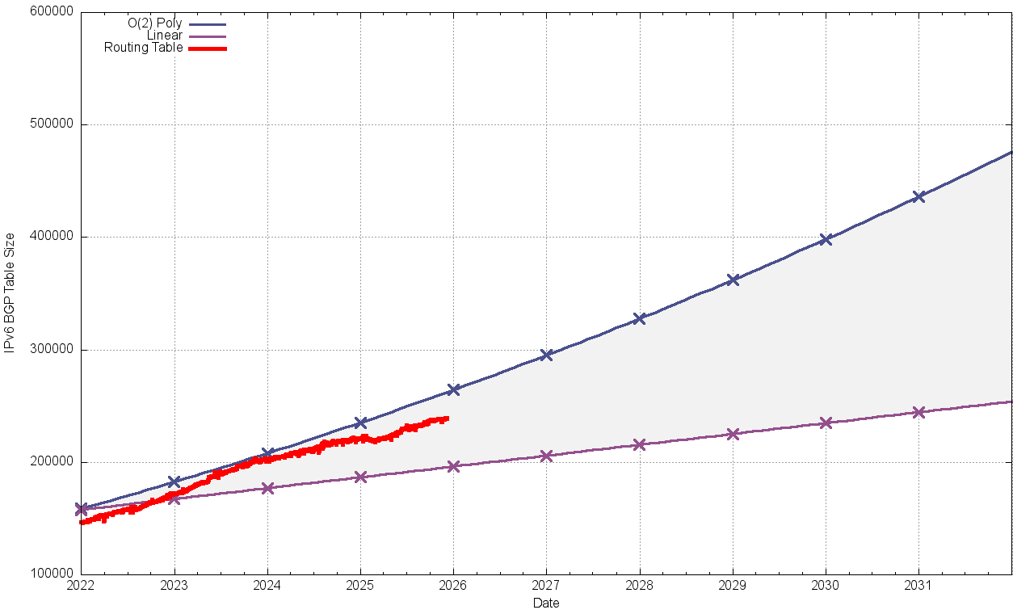
V6 BGP Table Size Predictions
Linear O(2) Poly
Year RIB Size
2019 62,000
2020 79,000
2021 106,000
2022 147,000
2023 172,000
2024 201,000
2025 222,000
2026 250,000 245,000 254,000
2027 271,000 286,000
2028 296,000 319,000
2029 322,000 353,000
2030 348,000 388,000
Note that the IPv6 tables are 128bits wide – i.e. 4x the size of the IPv4 tables!

Slide 30
V6 BGP Table Size Predictions
Linear O(2) Poly
Year RIB Size
2019 62,000
2020 79,000
2021 106,000
2022 147,000
2023 172,000
2024 201,000
2025 222,000
2026 250,000 245,000 254,000
2027 271,000 286,000
2028 296,000 319,000
2029 322,000 353,000
2030 348,000 388,000
The growth model for IPv6 is highly uncertain today – It looks like a linear growth model matches the most recent 24 months of data
The underlying network growth is lower, and over half of the growth in this model is due to the continued intensive use of /48 more specifics
Note that the IPv6 tables are 128bits wide – i.e. 4x the size of the IPv4 tables!

Slide 31
BGP Table Growth
The good news …
As long as we are prepared to live within the technical constraints of the current routing paradigm, the Internet’s use of BGP will continue to be viable for some time yet

Slide 32
The Highlights
IPv4 FIB Summary
IPv6 FIB Summary
FIB Projections
Churn
Conclusions

Slide 33
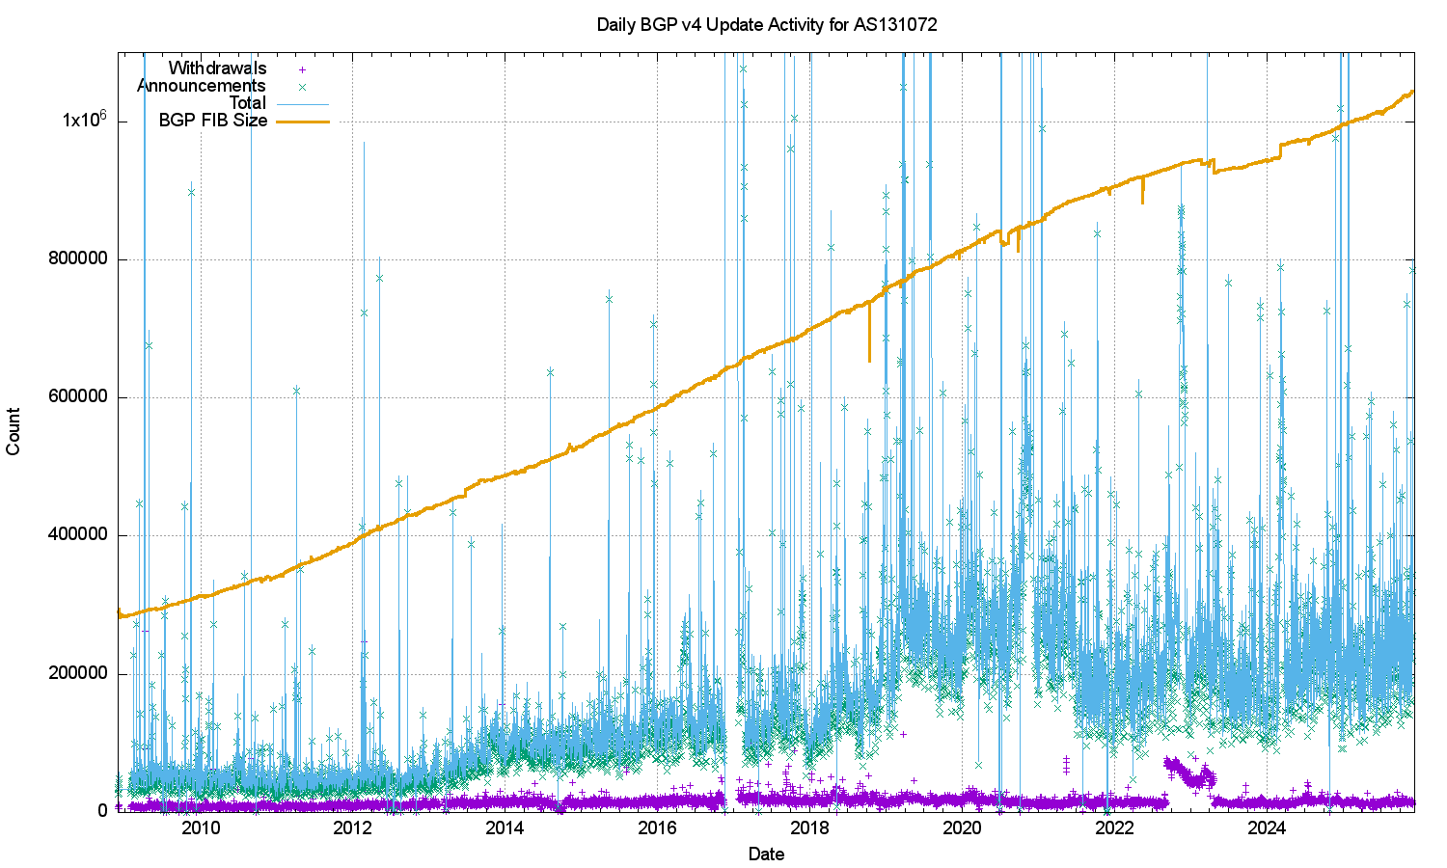
IPv4 BGP Updates – Daily Updates

Slide 34
IPv4 BGP Updates – Daily Updates
The IPv4 network is surprisingly stable
The number of withdrawals per day has been relatively steady for some 15 years (aside from some increases in 2022/3)
The number of updates per day has been steady through 2025

Slide 35
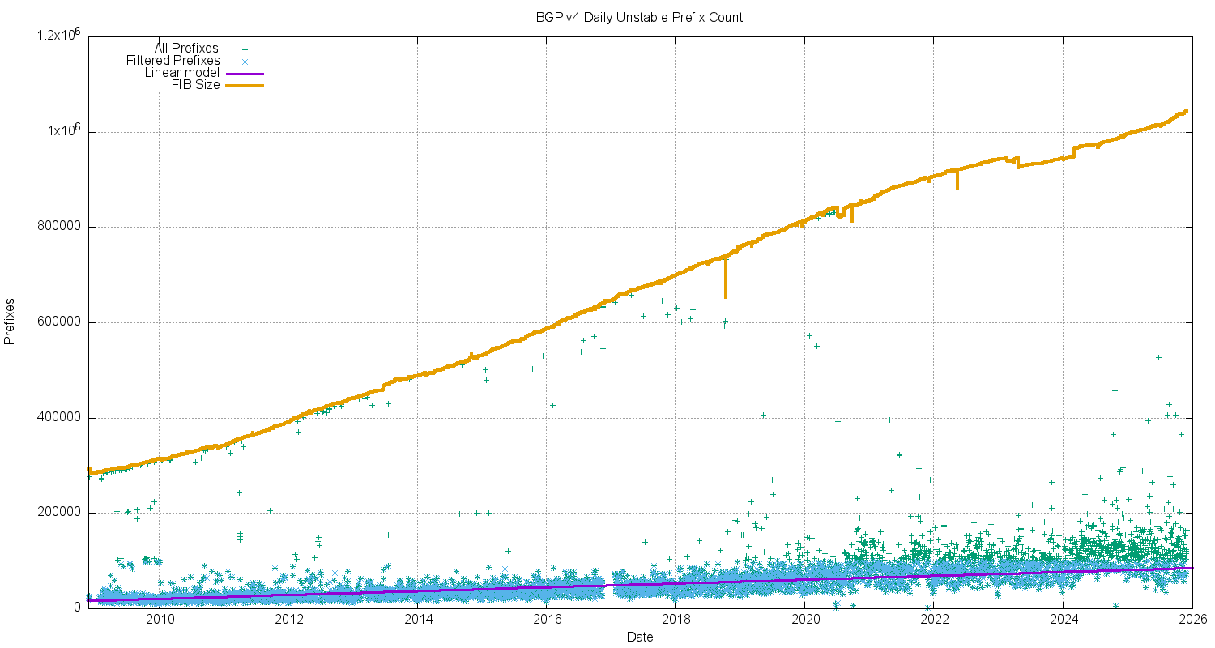
IPv4 Unstable Prefixes per Day

Slide 36
IPv4 Unstable Prefixes per Day
The number of prefixes that are the subject of updates has been slowly increasing over this 15-year period
The rate of increase of unstable prefixes is far lower than the number of advertised prefixes

Slide 37
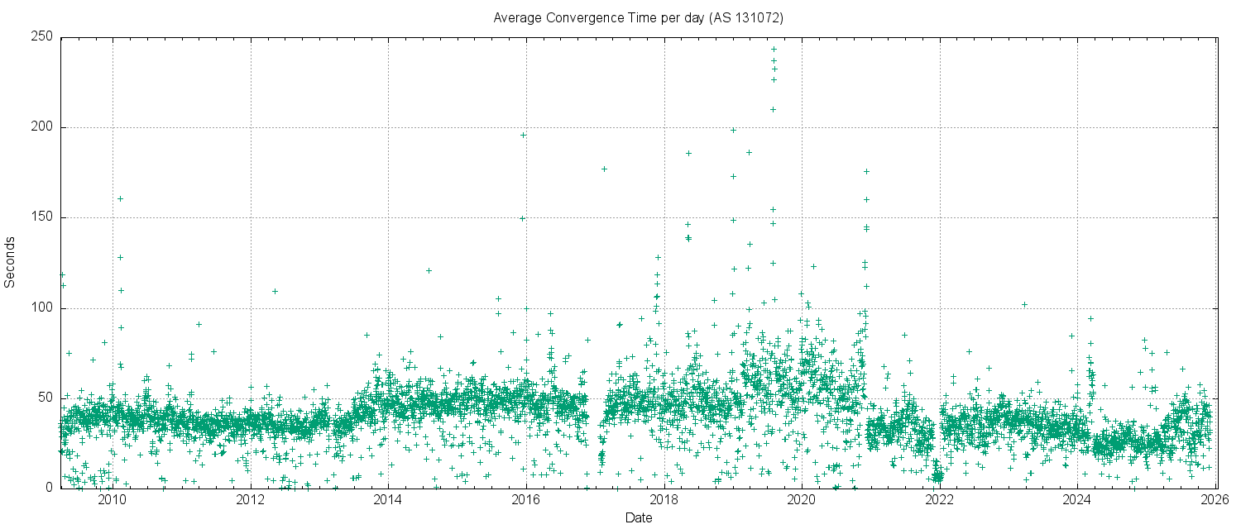
IPv4 BGP Convergence Performance

Slide 38
IPv4 BGP Convergence Performance
Convergence performance has been steady for 15 years, despite the massive growth in the network
The IPv4 network topology continues to increase in density, keeping critical AS Paths short as the network itself increases in size

Slide 39
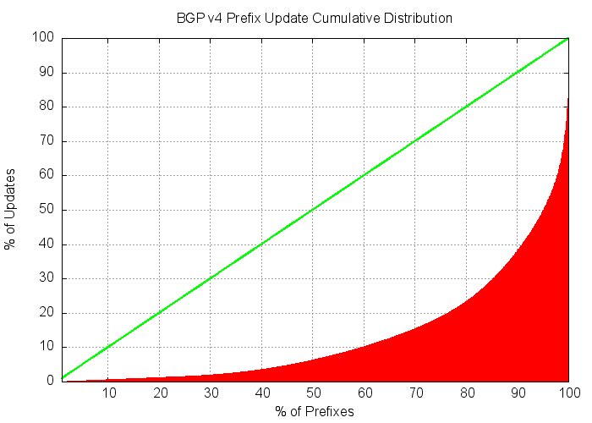
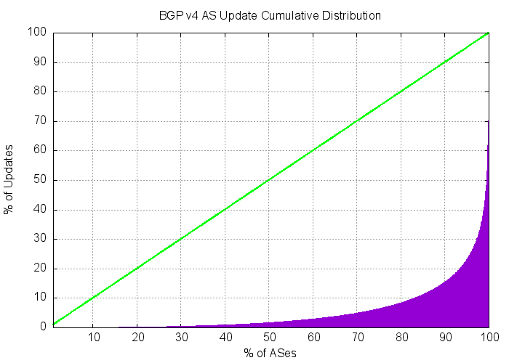
Updates in IPv4 BGP
The IPv4 inter-domain routing system is still highly stable …
The number of updates per instability event and the time to converge to a stable forwarding state has been relatively constant for many years
20% of prefixes generate 77% of all updates. Less than 5% of all origin networks are linked to 78% of all updates. Routing instability is concentrated in a small number of highly unstable cases.

Slide 40
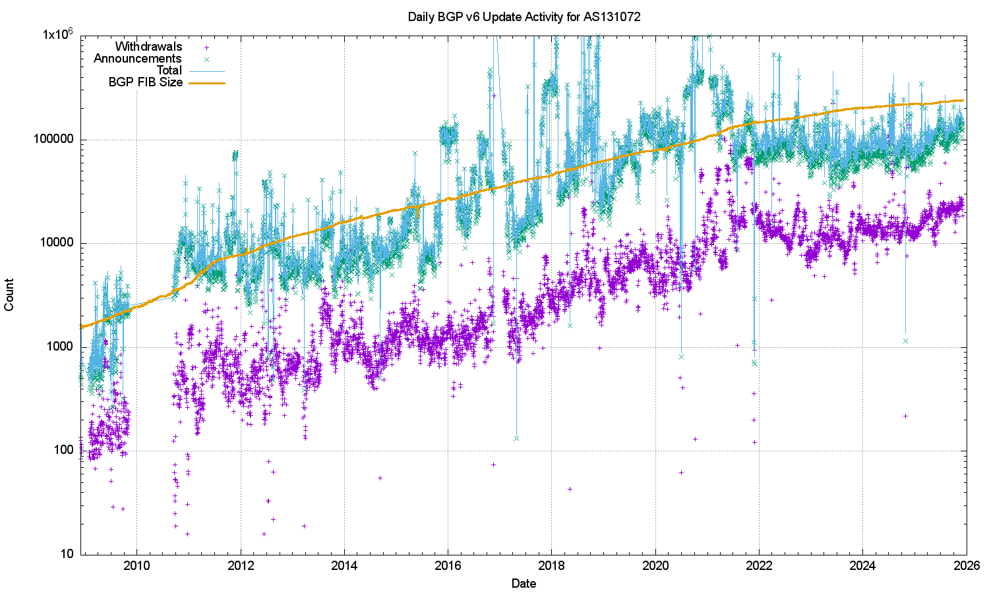
V6 BGP Updates
LOG Scale!

Slide 41
V6 BGP Updates
LOG Scale!
The growth trajectory of IPv6 updates has stopped, and the daily total of updates and withdrawals has been steady across 2025

Slide 42
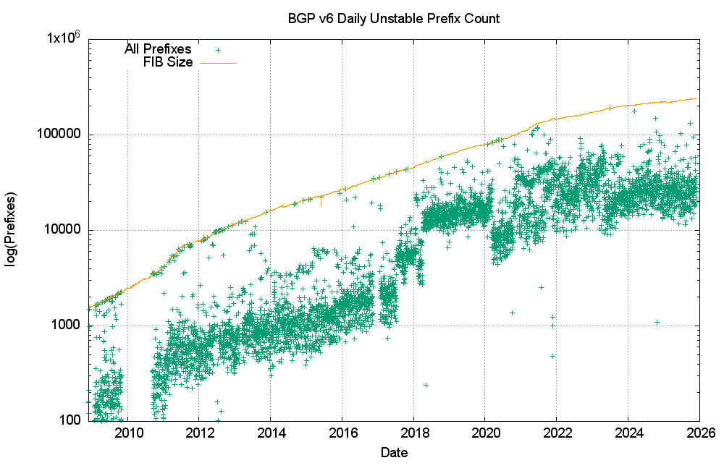
V6 Unstable Prefixes
LOG Scale!

Slide 43
V6 Unstable Prefixes
The number of unstable address prefixes has stabilised since 2023
Proportionally, IPv6 prefixes are ~2x more likely to be updated as compared to IPv4 prefixes
LOG Scale!

Slide 44
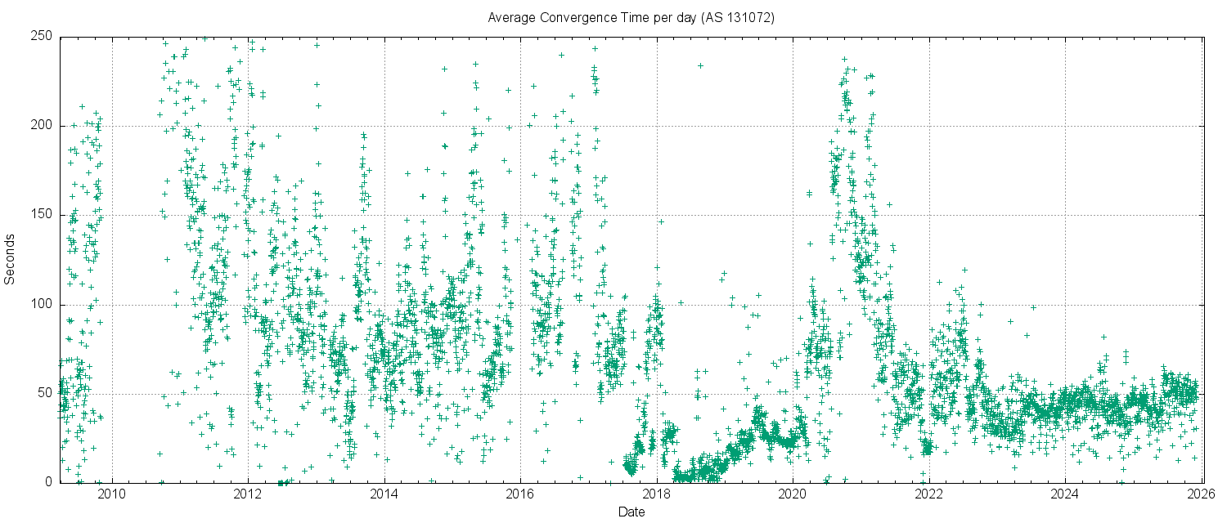
V6 Convergence Performance

Slide 45
V6 Convergence Performance
Time to converge has been very unstable for years in IPv6
This is now stabilising to a level that is on a par with the IPv4 network

Slide 46
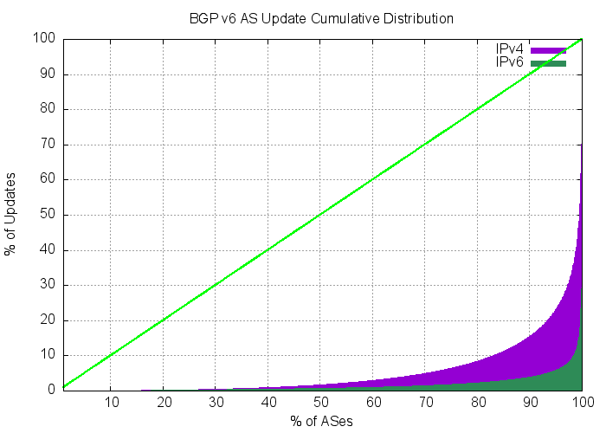
Updates in IPv6 BGP
Compared to IPv4, the IPv6 network has exhibited a high level of skew of routing instability, where a small number of networks contribute disproportionately to the overall level of BGP updates in IPv6.
Just 3 AS’s generated 20% of the BGP IPv6 update load in early December 2025. IPv6 routing instability is still concentrated in a small number of pathologically unstable cases.
https://www.potaroo.net/bgpupds/reports/v6-bgpupd.html

Slide 47
The Highlights
IPv4 FIB Summary
IPv6 FIB Summary
FIB Projections
Churn
Conclusions

Slide 48
Routing Futures
There is no further acute scaling pressure from BGP as a routing protocol – the relatively compressed inter-AS topology and stability of the infrastructure links tend to ensure that BGP remains effective in routing the internet.
Instability levels are high, generally driven by a small set of highly unstable “super update generators”

Slide 49
Routing Futures
The frenetic pace of expansion in the routing infrastructure of the Internet has slowed down in recent years. The IPv4 BGP network grew slightly in 2025, while IPv6 FIB size growth has slackened off
The drivers for growth were the product of the population of networks with discrete routing policies and the need to balance incoming traffic across multiple paths (traffic engineering) – the rapid increase in the use of CDN platforms has reduced the dependence on transit routes to provide content and services to end users.
Much of the overall volume of long-haul traffic has shifted to privately operated cloud platforms, and the demands on the public routed common infrastructure are in relative decline

Slide 50
Some Practical Suggestions
For those network operators whose service needs are dependent on the BGP network to some extent (which is mostly everyone)
Know your network’s limits:
Understand your routing FIB capacity in the default-free parts of your network
There may be some default max prefix setting of ~1M FIB entries which will cause a BGP session shutdown when tripped
AS 4804 (Optus) in Australia appeared to encounter this situation in October 2023
Use a max prefix exceeded setting which avoids session shutdown where possible

Slide 51
Some Practical Suggestions
Know your network’s limits
Review your routers’ settings
Review your IPv4 / IPv6 portioning in the FIB tables - a dual-stack eBGP router will conservatively need a 1.2 M 32-bit IPv4 slots and 350K 128-bit IPv6 slots for a full eBGP routing table in line cards by 2026 if they are using a complete uncompressed eBGP FIB load (plus internal routes of course). That’s roughly the same memory footprint for IPv4 and IPv6!

Slide 52
Some Practical Suggestions
Know your network’s limits
Review your routers’ settings
Default routes can be helpful
Judicious use of default routes in your internal network may allow you drop this high-speed line card memory requirement significantly

Slide 53
Some Practical Suggestions
Know your network’s limits
Review your routers’ settings
Default routes can be helpful
Time for hot caching in line card FIBs?
Using a hot cache for line card FIB cache would reduce the high-speed TCAM memory requirement significantly without visible performance cost

Slide 54
That’s it!
Questions?

