Slide 1
DNS Resolvers and Nameservers (and Indonesia)
Geoff Huston AM
APNIC Labs
Notes:
The selection of which authoritative DNS server to use by a user's DNS resolver of choice greatly determines the user experience when accessing the Internet. In the past some studies have looked at the behaviour of a set of implementations describing how they perform authoritative server selection and how they re-evaluate their choices in time [1]. Other studies have leveraged the RIPE Atlas infrastructure to observe DNS resolution of a researcher-owned domain name from various points on the Internet [2] We extend and complement these studies by using APNIC's distributed ad system to recruit several million end-users throughout the global Internet to observer the resolution selection process as well as its time evolution through a several day period. References [1] Secure Nameserver Selection Algorithm for DNS Resolvers. https://datatracker.ietf.org/doc/draft-zhang-dnsop-ns-selection/ [2] Recursives in the Wild: Engineering Authoritative DNS Servers https://ant.isi.edu/~johnh/PAPERS/Mueller17b.pdf

Slide 2
DNS Infrastructure Questions
When presented with multiple authoritative nameservers / multiple IP addresses how do recursive resolvers behave?
How do we maximize performance and resilience in authoritative nameserver configurations?
How well do Indonesian DNS Recursive Resolvers and nameservers compare against the larger DNS picture?

Slide 3
Recent(ish) work
“Recursives in the Wild: Engineering Authoritative DNS Servers” Muller, Moura, Schmidt, Heidemann, 2017
https://ant.isi.edu/~johnh/PAPERS/Mueller17b.pdf
“To meet their goals of minimizing latency and balancing load across NSes and anycast, operators need to know how recursive resolvers select an NS, and how that interacts with their NS deployments.”
“… all name servers in a DNS service for a zone need to be consistently provisioned (with reasonable anycast) to provide consistent low latency to users.”

Slide 4
Recent(ish) work
“Secure Nameserver Selection Algorithm for DNS Resolvers” Zhang, Liu, Song, Huque, October 2024
https://datatracker.ietf.org/doc/draft-zhang-dnsop-ns-selection/
“Nameserver selection algorithms employed by DNS resolvers are not currently standardized in the DNS protocol”
The document contains an informal description of the selection algorithms used in a number of commonly used recursive resolvers (Bind 9, Unbound, Knot, PowerDNS, Microsoft DNS)

Slide 5
And the RFC’s say:
RFC1034: “The sorting [of nameservers]… may involve statistics from past events, such as previous response times and batting averages.”
Batting averages????

Slide 6
Our Measurement
Use a domain with four unicast authoritative nameservers
Direct client systems to resolve unique DNS names using these nameservers
Track queries to each nameserver from each visible recursive resolver

Slide 7
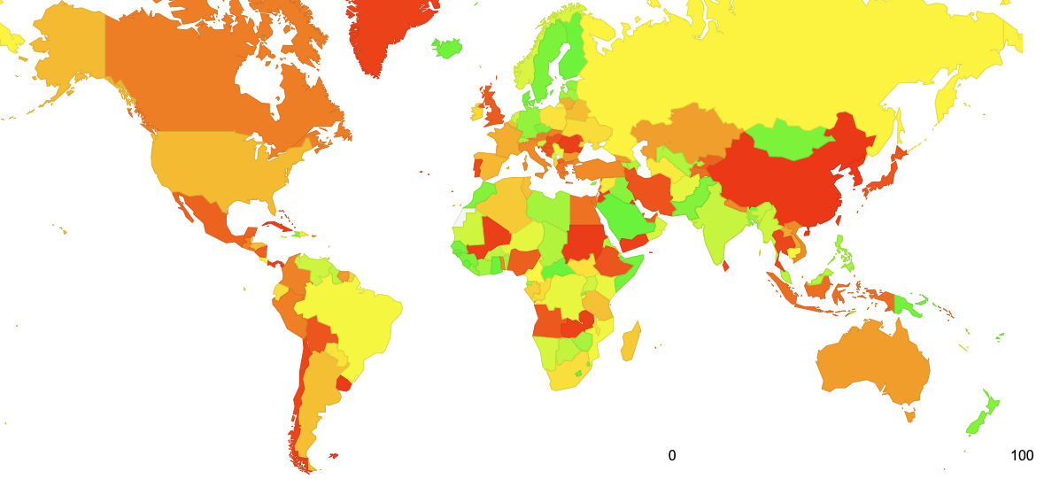
Our Measurement
Use a domain with four dual-stack unicast authoritative nameservers
Frankfurt
Atlanta
Mumbai
Singapore
170ms
290ms
170ms
Measurement origin
180ms

Slide 8
What are we expecting to see?
We anticipate seeing a “strong” preference to query the authoritative server with the lowest response time, and a regular querying of all other authoritative servers to see if their response times have changed.

Slide 9
Some Lab Tests: Bind 9
Observing Bind 9 against the four nameservers using 1 query per second (test resolver is located in au)
The resolver tests the other authoritative servers to ensure that its is “attached” to the fastest server.
This ‘other server’ test appears to be irregular, with a slight bias towards the second-closest server

Slide 10
Some Lab Tests: Unbound
Observing Unbound against the four nameservers using 1 query per second (test resolver located in au)
Unbound is not so clearly attached to the closest server (ap) and also queries Mumbai and Atlanta consistently.
The non-selected resolver (Frankfurt) is queried irregularly

Slide 11
Some Lab Tests: Google 8.8.8.8
Observing Google 8.8.8.8 against the four nameservers using 1 query per second (stub resolver located in au)
The Google resolver appears to query all instances regularly.
There appears to be a slight preference to use the Singapore (ap) server

Slide 12
Some Lab Tests: Cloudflare 1.1.1.1
Observing Cloudflare’s 1.1.1.1 resolver against the four nameservers using 1 query per second (stub resolver located in au)
There is a visible preference to use the servers located in Singapore (ap) and Mumbai (in)

Slide 13
There is no common behaviour
In this small sample set we are not seeing a common behaviour across recursive resolvers
To optimize resolution performance the recursive resolver would prefer to direct all its queries to the authoritative server that responds in the shortest time
However, the resolver would also like to track all other servers to ensure that its preferred choice of server is still optimal
It is not clear what units of time are used compare servers’ response performance, as some resolvers appear to treat a subset of servers with diverse query/response times as equivalent

Slide 14
Let’s scale up the measurements
We’ll use an ad-based measurement platform to enrol some 25M stub resolvers per day and observe the interaction between the various recursive resolvers used by these stub resolvers and their behaviour against these four unicast authoritative servers

Slide 15
Our Measurement
Use a domain with four dual-stack unicast authoritative nameservers
Frankfurt
112ms
208ms
154ms
Atlanta
267ms
Mumbai
205ms
60ms
Singapore

Slide 16
What we see – 1 Hour Profile
This is a resolver operated by Bharti Airtel in India:
It appears to spread its query load roughly equally across the servers in Mumbai, Frankfurt and Singapore
But none to Atlanta!

Slide 17
What we see – 12 Hour Profile
This resolver passed 2 queries to the server located in Atlanta just 2 times in this 12-hour period
From this graph. it is not evident if there is any preference between the other three nameservers – but maybe summary numbers can be more informative

Slide 18
A one-week profile of this resolver
How many seconds did the resolver “latch” onto this server?
What was the longest period spent asking ONLY this server
Server | Queries | Attachment Time (secs) | Longest attached Interval (secs)
Atlanta | 87 | 1 | 0
Singapore | 611,992 | 202,012 | 725
Frankfurt | 581,799 | 183,051 | 637
Mumbai | 300,751 | 32,153 | 580
A large recursive resolver, located in India, appears to prefer distant servers that are located in Singapore and Frankfurt over a server located in Mumbai

Slide 19
8 Day Profile of 100 Resolvers
Most queries
Fewer queries
The 100 recursive resolvers that processed the largest number of queries in an 8-day period
The size of the point indicates the relative amount of time the resolver appears to “latch” onto an individual server

Slide 20
What proportion of Resolvers show “Attachment Preference”?
Use the most active 1,000 recursive resolvers
Define an “attachment preference” as maintaining an authoritative server selection for more than 60% of the time
616 out of these 1,000 recursive resolvers show a strong attachment preference
Define “NO attachment preference” as having the major attachment for no more than 40% of the time
53 out of the 1,000 recursive resolvers show a no attachment preference

Slide 21
How “good” is this attachment preference?
Do recursive resolvers who have a strong attachment end up attaching to the server that is “nearest” to them?
Let’s combine ping RTT measurements with these resolver / server measurements

Slide 22
For example:
2a01:e00:ffff:53:2::13 is a recursive resolver operated by free.fr in France
RTT Measurements for this resolver. The ping measurements for this resolver are:
Atlanta – 95.3ms
Singapore - 307.5ms
Frankfurt – 9.8ms
Mumbai – 241.6 ms
This resolver (located in Paris, France) was observed to query the Atlanta server 70% of the time, a resolver that was 85ms further “away” than the closest resolver (located in Frankfurt)

Slide 23
Results
Of the 661 recursive resolvers that showed strong “attachment” for a single resolver (queried one server more than 60% of the time)
498 recursive resolvers responded to ping requests
Of these 498 resolvers:
199 resolvers chose the server that had the lowest ping time
The other 299 chose a more distant server
The average additional RTT between the chosen server and the closest server for these 299 resolvers was 142.3ms

Slide 24
Distribution of “Mismatch Times”
There is a strong signal of a time mismatch of <= 150ms
Is this indicative of some form of rounding of the resolvers’ internal recursive-to-authoritative delay timers of to a unit of 150 ms increments?

Slide 25
What is this data telling us?
You can’t rely on the preference algorithm used by today’s recursive resolvers to make an optimal selection across a dispersed set of unicast servers that will select the fastest authoritative server
i.e. even if you do a great job of deploying diverse unicast nameservers, recursive resolvers will likely muck it up and make sub-optimal selections of their “preferred” nameserver!

Slide 26
Observation
DNS recursive resolvers do not always make an accurate selection of the “fastest” nameserver
Which negates any potential performance benefits of a nameserver deployment approach of a geographically diverse collection of unicast nameservers
Many recursive resolvers appear to use a timer with a granularity of around 150ms to select the “fastest” nameserver

Slide 27
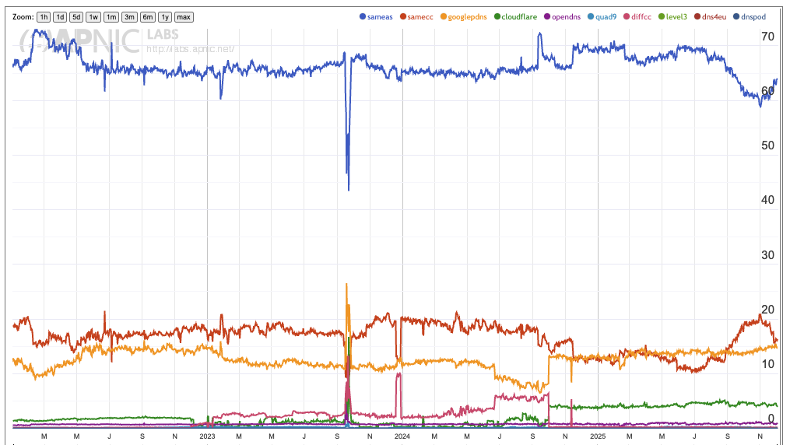
What about Indonesian Rercursive Resolvers?
75% of ID users use the ISP’s resolver
There is also growing use of Google (associated with privacy / VPN services?)
Google use is around 15% of users
Google
Cloudflare
OpenDNS
Quad9
https://stats.labs.apnic.net/rvrs/ID

Slide 28
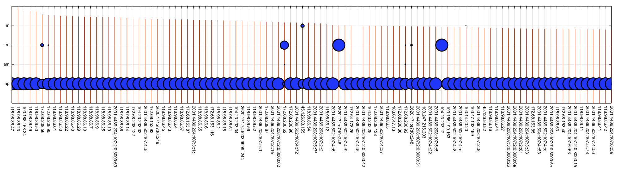
Indonesian Resolver Behaviour Top 100 Resolvers

Slide 29
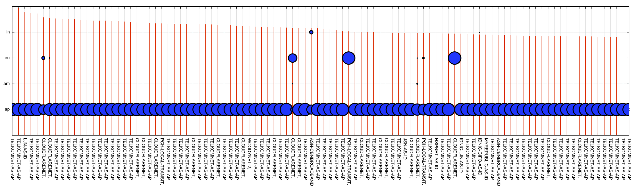
Indonesian Resolver Behaviour Top 100 Resolvers – AS Name

Slide 30
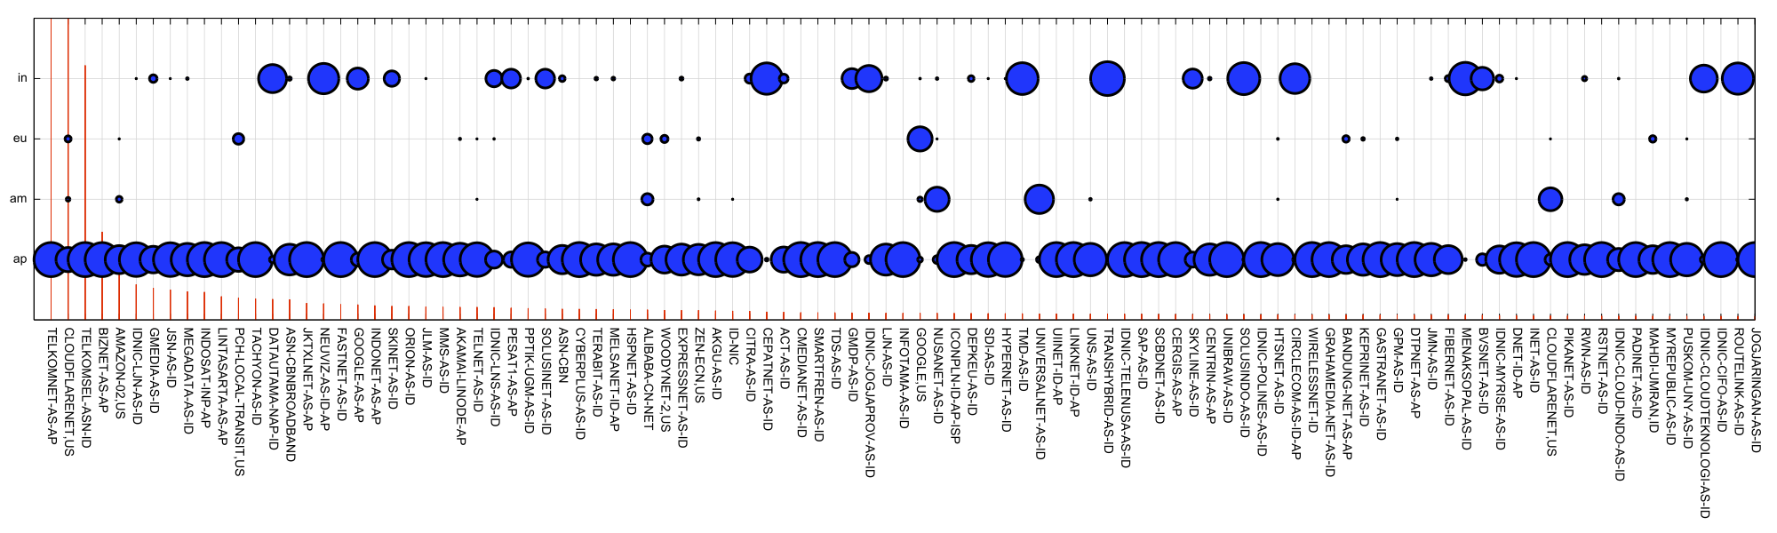
Indonesian Resolver Behaviour Top 100 per-AS Resolvers

Slide 31
Observation
DNS recursive resolvers do not always make an accurate selection of the “fastest” nameserver
Which negates any potential performance benefits of a nameserver deployment approach of a geographically diverse collection of unicast nameservers
Many recursive resolvers appear to use a timer with a granularity of around 150ms to select the “fastest” nameserver
Recursive Resolvers used in Indonesia do a much better job of forwarding queries to nearby authoritative nameservers

Slide 32
How SHOULD you deploy a set of nameservers?
Assuming that you want to optimize both performance and availability…
A distributed collection of unicast nameservers is not going to give the best possible result
Many recursive resolvers are not only poor at latching on to the fastest nameserver, but they latch onto a more distant nameserver, giving a worse resolution performance for non-cached name resolution
Perhaps a better approach is to use anycast nameservers
What do other domains do for their nameserver configuration?

Slide 33
Let’s look the Root Zone
A small set of relatively intensely used domains whose performance and reliability is (supposedly) critical

Slide 34
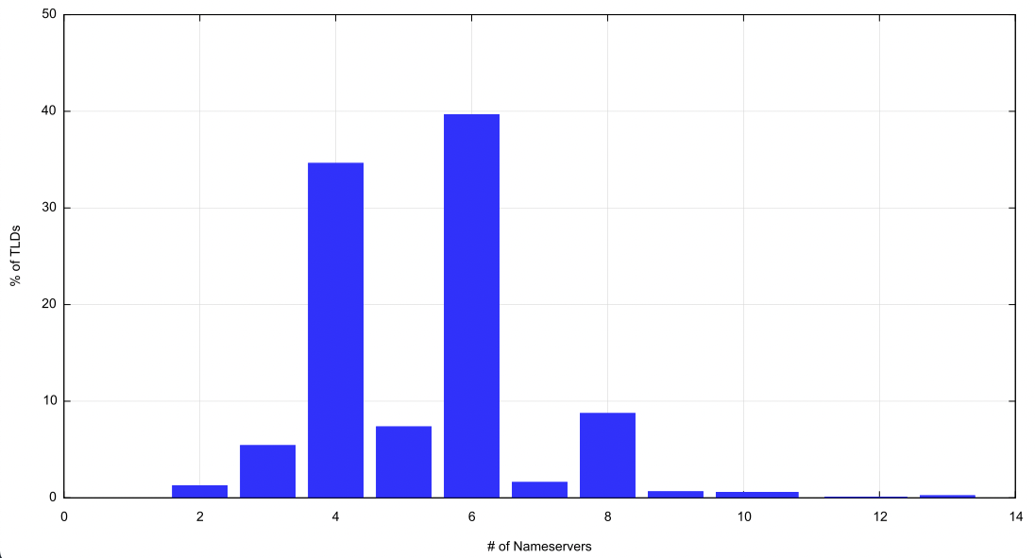
Profile of the Use of Nameservers
Root Zone:
TLDs: 1,445
Authoritative Nameservers: 5,998
Average Nameservers per TLD: 4.2
Distribution of Nameservers per TLD show strong preference for 4 or 6 nameserver names
Dual Stack Nameservers: 5,687
IPv4-only Nameservers: 321
IPv6-only Nameservers: 3

Slide 35
Unicast vs Anycast – Root TLD Nameservers
How many of these IP addresses are carried in an anycast cloud?

Slide 36
Unicast vs Anycast
How many of these IP addresses are carried in an anycast cloud?
Query the IP address from a diverse set of locations(Atlanta, Frankfurt, Sao Paulo, Singapore, Australia)
If the Name Server ID (NSID) is constant when queried from a diverse set of queries, then it’s reasonable to assume that the server’s IP address is not part of an anycast cloud (as we anticipate that different anycast instances will give a different NSID response)
If the variance of DNS query times is not sufficiently large, then it’s reasonable to assume that the server’s IP address is part of an anycast service cloud.

Slide 37
Unicast vs Anycast – Root TLD Nameservers
Unique IP addresses of nameservers: 9,014
Unicast IP addresses: 587
“Limited” Anycast addresses: 5,868 (rtt variance > 150ms)
“Diverse” Anycast IP addresses: 2,559 (rtt variance < 150ms

Slide 38
Unicast vs Anycast
TLDs served by only unicast nameservers: 8
TLDs served by a mix of unicast and anycast servers: 378
TLDs served by anycast servers only: 1,067
TLDs served only by diverse anycast: 289
TLDs served only by limited anycast: 202
TLDs served by limited and diverse anycast: 576

Slide 39
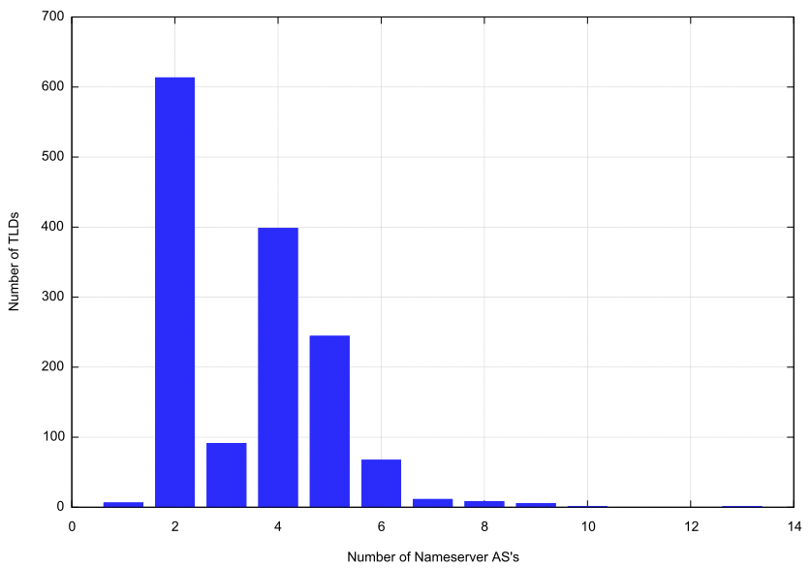
AS Diversity
In the root zone there are just 6 TLDs where all the zone’s nameservers are held in a single AS (and only 1 in a diverse anycast configuration)
On average each TLD has 10.1 distinct IP addresses of nameservers
On average each TLD has nameservers located in 3.4 origin ASes

Slide 40
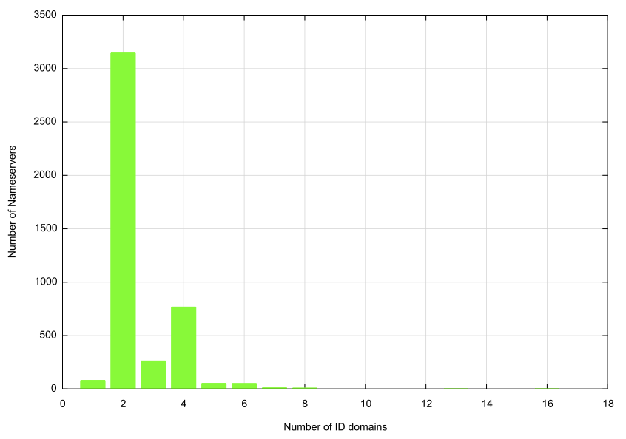
What about .ID domain names?
Using the .id domain names in the Tranco Top 1M data set:
4,698 .id domain names
4,236 unique nameservers
9501 unique nameserver IP addresses
Average Nameservers per Domain: 2.3
Strong preference for 2 nameservers, then 4
With sampangkab.go.id at 16 nameservers!
Avg IP addresses per domain: 2.35
Avg IP addresses per nameserver: 2.36
Dual Stack Nameservers: 2,157
IPv4-only Nameservers: 1,993
IPv6-only Nameservers: 4
Unresolvable Nameservers: 82
2 Nameserver names have 11 IP addresses

Slide 41
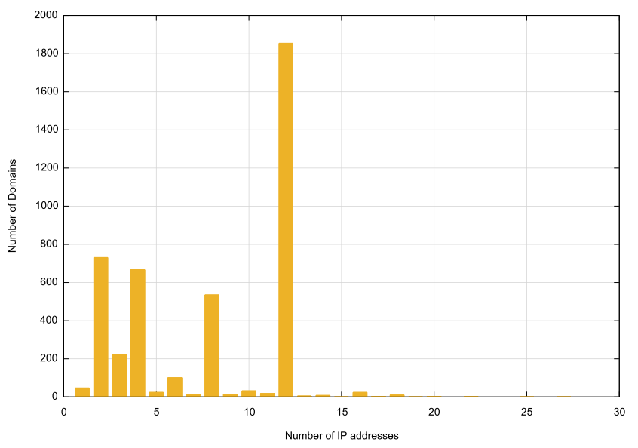
.ID domain names
Let’s now look at the mapping between each of these 4,698 .id domains and the collection of IP addresses used to serve this domain
1,434 domains are served by IPv4 only
2,882 domains are served by dual stack nameservers
382 domains are served by unresolvable nameservers
47 domains are served by a single nameserver

Slide 42
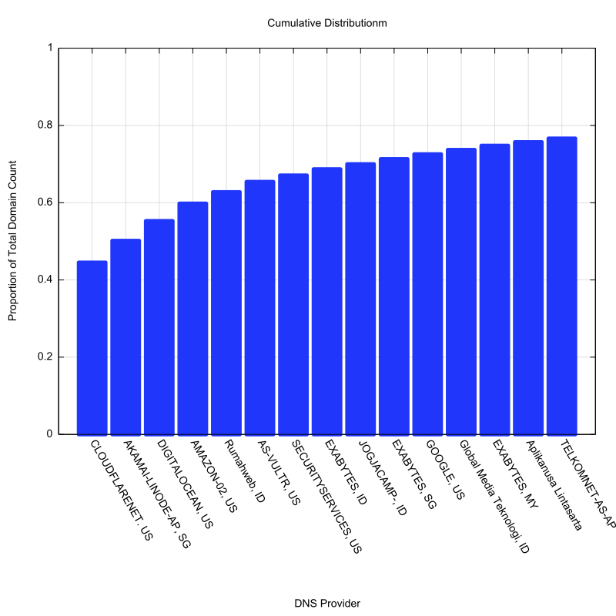
.ID domain nameservers

Slide 43
Observations (1/3)
DNS recursive resolvers do not, on average, make an accurate selection of the “fastest” nameserver
Which negates any potential performance benefits of a nameserver deployment approach of a geographically diverse collection of unicast nameservers
Many recursive resolvers appear to use a timer with a granularity of around 150ms to select the “fastest” nameserver

Slide 44
Observations (2/3)
Anycast nameserver deployments can produce better outcomes, but the effectiveness of this approach depends on the density of the anycast constellation
Limited density anycast constellations may produce sub-optimal outcomes for some clients

Slide 45
Observations (3/3)
Resilience can be provided through the use of multiple anycast service platforms
How many such platforms is “optimal” is an open question
More is not necessarily incrementally better, which leads to a suggestion of the use of 2 or 3 diverse anycast platforms, depending on the level of failover resilience you are after

Slide 46
Questions?

